Slide 2










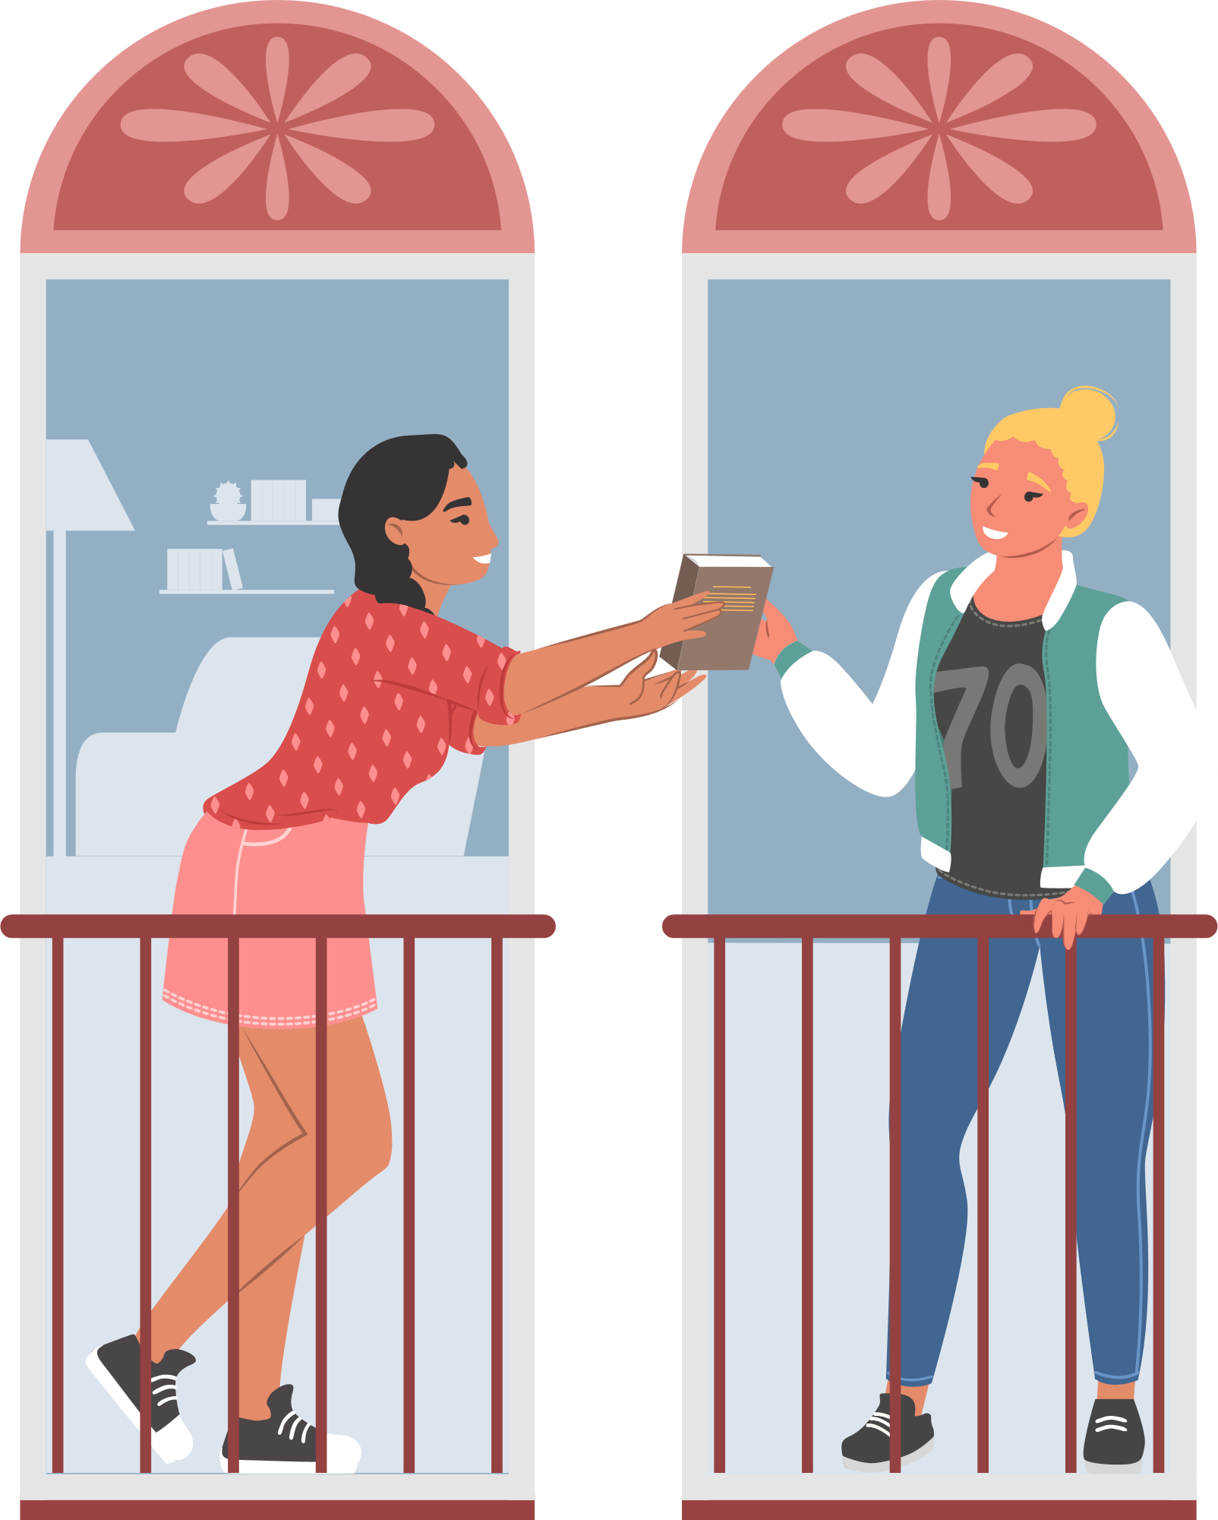
Unit 8
Let’s buy presents!
Lesson 2 – Grammar – Period 1

Slide 3
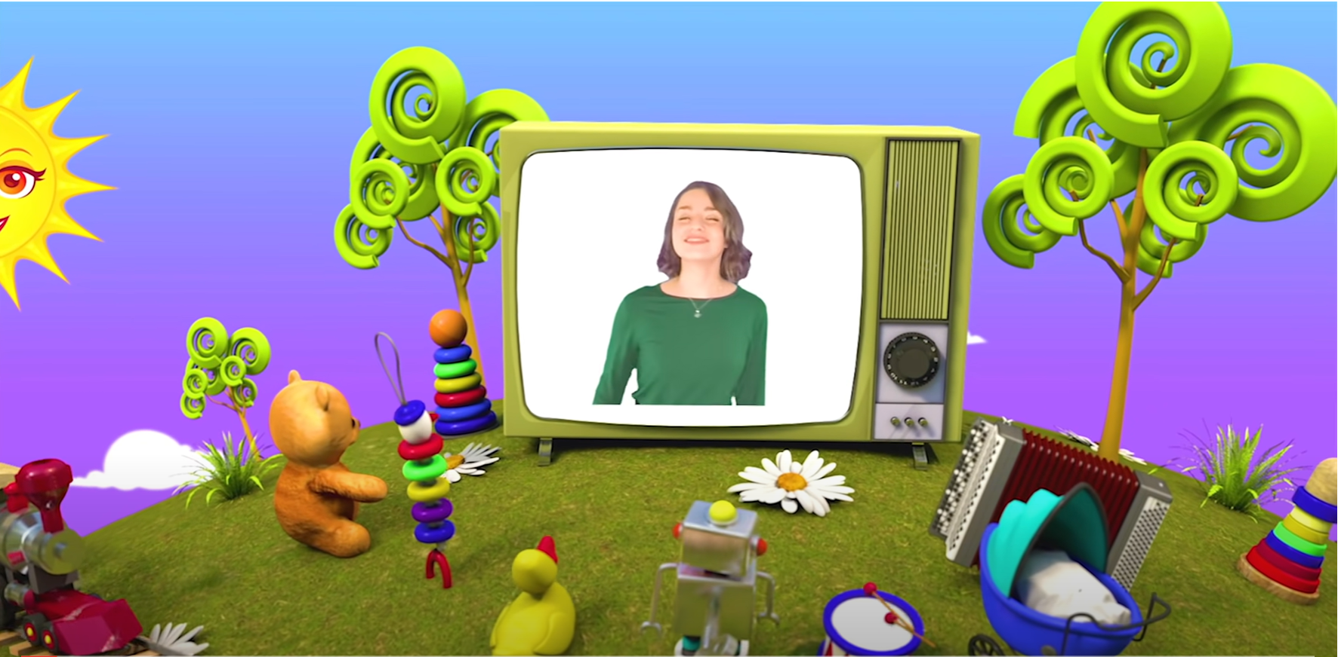
HELLO SONG
Notes:
https://www.youtube.com/watch?v=pqDEwPi7vxg

Slide 4






Slide 5




Game: WHAT’S MISSING?
Notes:
Put the flashcards on the board in a sequence, e.g. balloon, candle, present, candy for the children to say the words in order.

Slide 6
Game: WHAT’S MISSING?
Notes:
Remove one flashcard. The class repeats the sequence, including the missing word. Remove one more flashcard each time, until children are saying the whole sequence from memory.

Slide 7
Game: WHAT’S MISSING?
Notes:
Remove one flashcard. The class repeats the sequence, including the missing word. Remove one more flashcard each time, until children are saying the whole sequence from memory.

Slide 8
Game: WHAT’S MISSING?
Notes:
Remove one flashcard. The class repeats the sequence, including the missing word. Remove one more flashcard each time, until children are saying the whole sequence from memory.

Slide 9
Game: WHAT’S MISSING?
Notes:
Remove one flashcard. The class repeats the sequence, including the missing word. Remove one more flashcard each time, until children are saying the whole sequence from memory.

Slide 10
Game: WHAT’S MISSING?
Notes:
Remove one flashcard. The class repeats the sequence, including the missing word. Remove one more flashcard each time, until children are saying the whole sequence from memory.

Slide 11
Game: WHAT’S MISSING?
Notes:
Remove one flashcard. The class repeats the sequence, including the missing word. Remove one more flashcard each time, until children are saying the whole sequence from memory.

Slide 12


Good job!

Slide 13
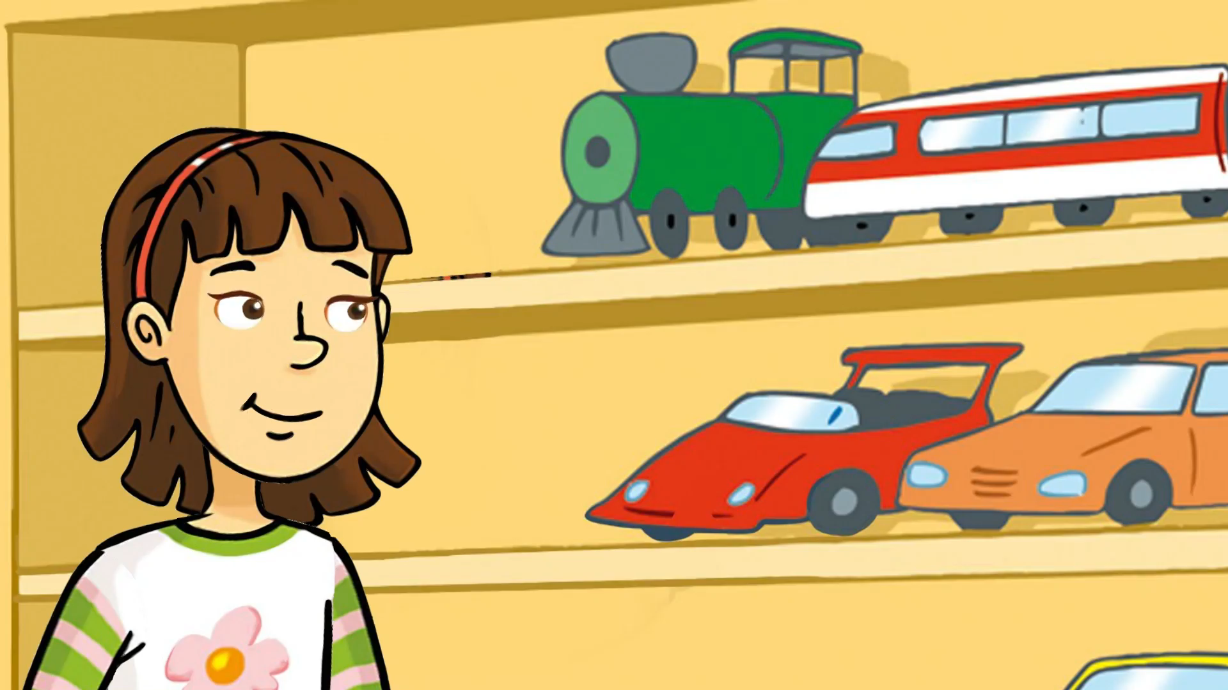
Let’s watch the video.
Notes:
*Lead-in:
Retell the story. Ask children which party objects were mentioned in the story.

Slide 14

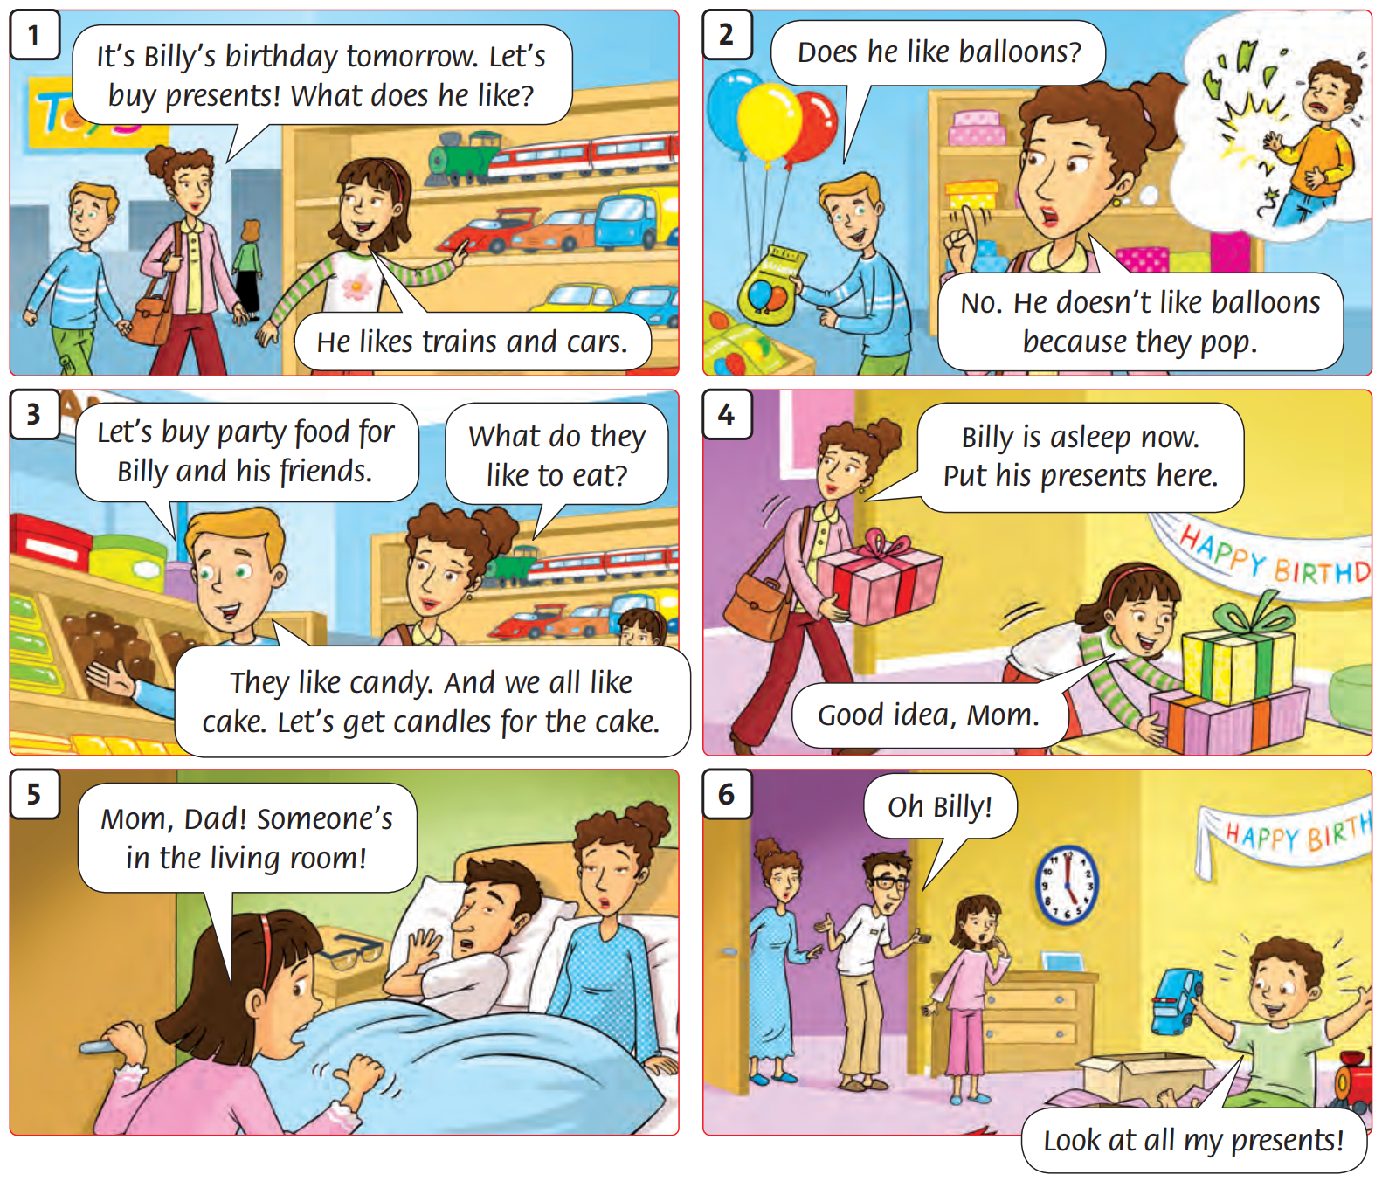

Listen and
Repeat.
60
Notes:
Ask students to open their books. Listen and repeat.

Slide 15
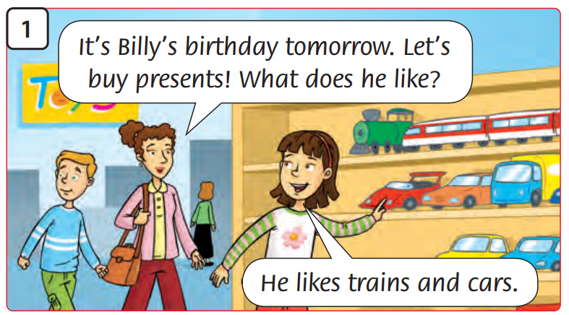
Look and
Say.
Notes:
As a class, decide on the story actions (see ideas below).
Picture 1: Mom and Tim look around the toy store. Rosy points to the toys on the shelf.

Slide 16
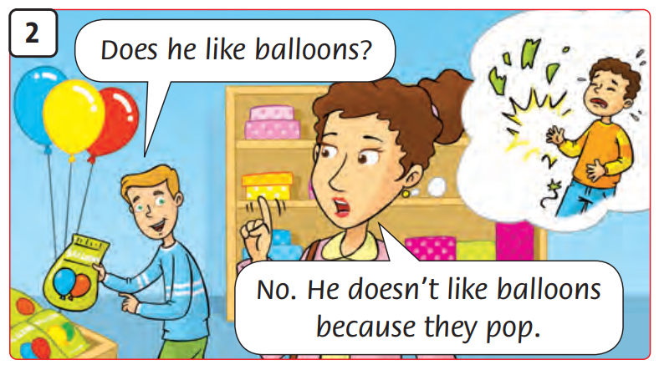
Look and
Say.
Notes:
As a class, decide on the story actions (see ideas below).
Picture 2: Tim picks up a bag of balloons. Mom waves her finger to say no. Billy mimes crying when a balloon bursts.

Slide 17
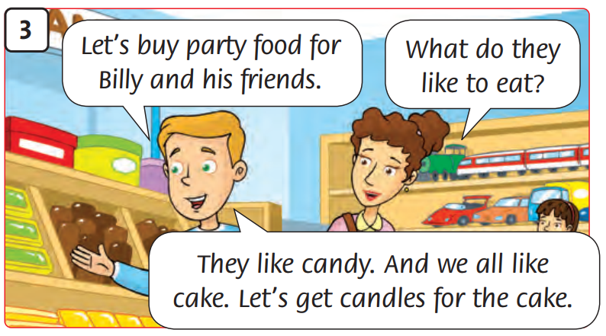
Look and
Say.
Notes:
As a class, decide on the story actions (see ideas below).
Picture 3: Tim points to the candy. Mom and Rosy smile and nod.

Slide 18
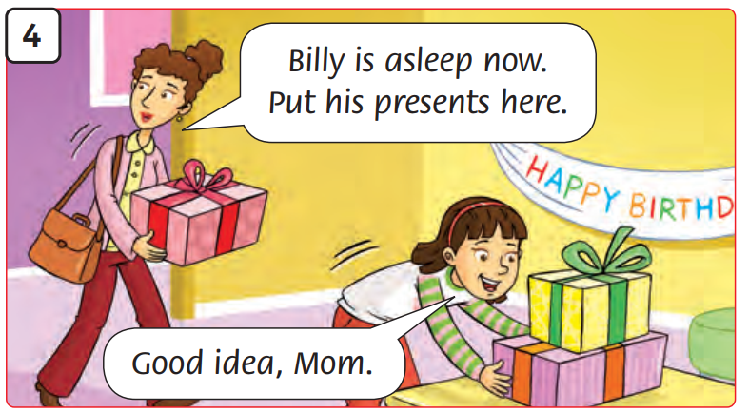
Look and
Say.
Notes:
As a class, decide on the story actions (see ideas below).
Picture 4: Rosy and Mom put the presents on the table.

Slide 19
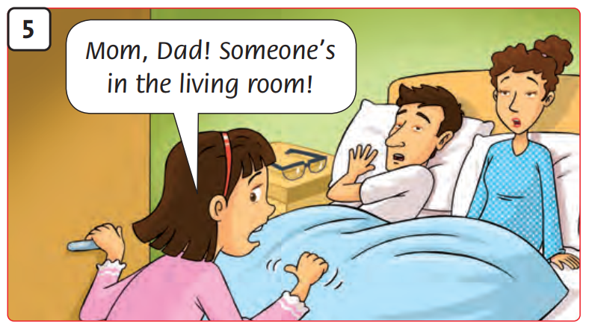
Look and
Say.
Notes:
As a class, decide on the story actions (see ideas below).
Picture 5: Rosy shakes Mom and Dad to wake them up.

Slide 20
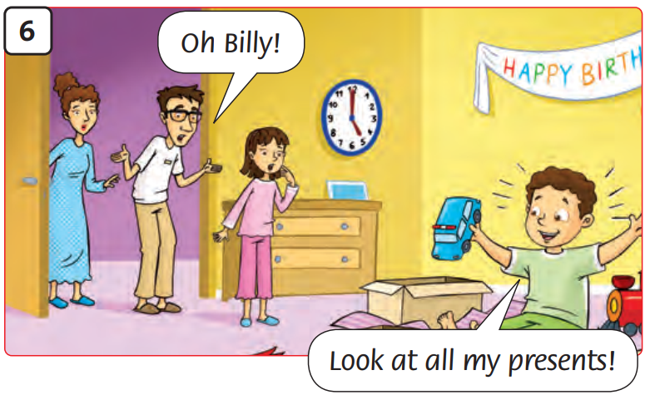
Look and
Say.
Notes:
As a class, decide on the story actions (see ideas below).
Picture 6: Billy unwraps his presents. The family is shocked.

Slide 21
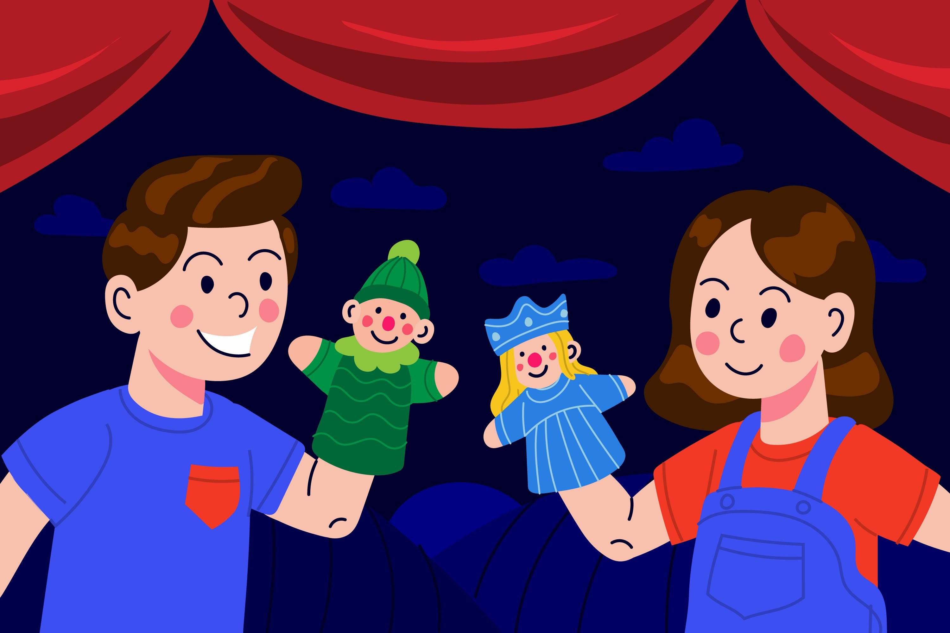
Story Actions
Notes:
Children practice acting out the story in their groups.
Ask a few groups to act out the story at the front.

Slide 22
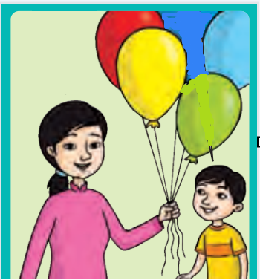
Look and Answer.
We like balloons.
They like balloons.
Notes:
Focus on Let’s learn! box. Ask What can you see?
Do a click to play the audio.
Write the question and sentence on the board.

Slide 23
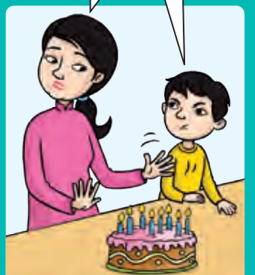
Look and Answer.
We don’t like birthday cake.
They don’t like
birthday cake.
Notes:
Focus on Let’s learn! box. Ask What can you see?
Do a click to play the audio.
Write the question and sentence on the board.

Slide 24


Look and Say.
We like candy.
They like candy.
Notes:
Write the target patterns on the board. Replace the word in each sentence with flashcards to elicit new sentences.
Children repeat.
Children work in pairs to take turns talking about the pictures.

Slide 25


Look and Say.
We don’t like candles.
They don’t like candles.
Notes:
Write the target patterns on the board. Replace the word in each sentence with flashcards to elicit new sentences.
Children work in pairs to take turns talking about the pictures.

Slide 26
Look and Say.
We like presents.
They like presents.
Notes:
Write the target patterns on the board. Replace the word in each sentence with flashcards to elicit new sentences.
Children work in pairs to take turns talking about the pictures.

Slide 27
Look and Say.
We don’t like balloons.
They don’t like balloons.
Notes:
Write the target patterns on the board. Replace the word in each sentence with flashcards to elicit new sentences.
Children work in pairs to take turns talking about the pictures.

Slide 28
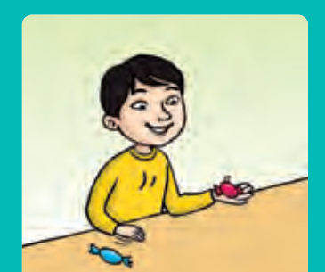
Look and Answer.
He likes this candy
because it’s red.
He doesn’t like blue candy.
Notes:
Focus on Let’s learn! box. Ask What can you see?
Do a click to play the audio.
Write the question and sentence on the board.

Slide 29

Look and Say.
He likes candy because it’s delicious.
Notes:
In pairs, children take turns making sentences about the picture. Then raise hands to talk to the teacher and the whole class.

Slide 30

Look and Say.
He doesn’t like balloons because they pop.
Notes:
In pairs, children take turns making sentences about the picture. Then raise hands to talk to the teacher and the whole class.

Slide 31

Look and Say.
She likes the present because it’s a new toy.
Notes:
In pairs, children take turns making sentences about the picture. Then raise hands to talk to the teacher and the whole class.

Slide 32


Look and Say.
She doesn’t like the cake because there is jelly inside.
Notes:
In pairs, children take turns making sentences about the picture. Then raise hands to talk to the teacher and the whole class.

Slide 33
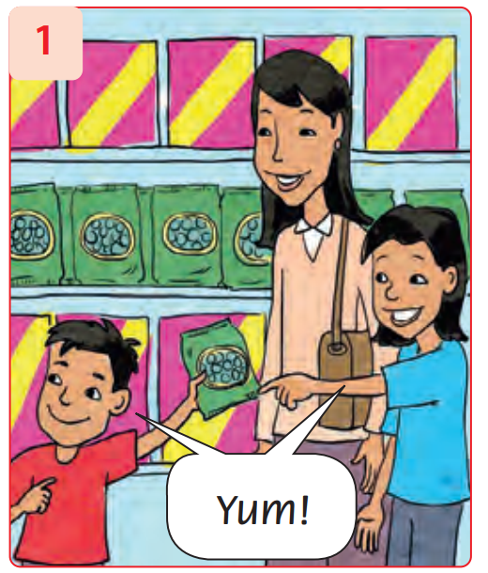
Look and Say.
They like candy because they are sweet.
Notes:
* Look and Say.
- Show the pattern in the speech bubbles and the first item.
- Explain that Yum! shows that we like something very much, and Yuck! shows that we really dislike something.
- In pairs, children talk about the other pictures.

Slide 34
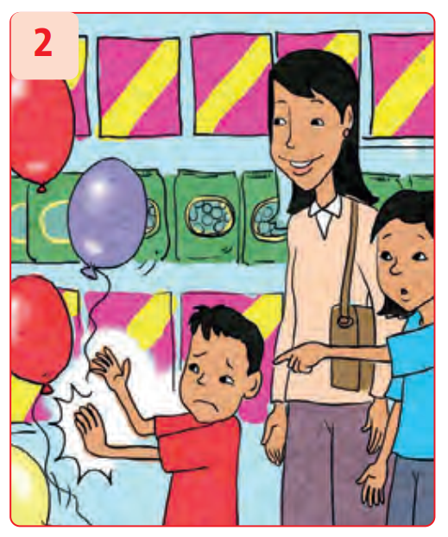
Look and Say.
They don’t like balloons because they pop.
Notes:
* Look and Say.
- Show the pattern in the speech bubbles and the first item.
- Explain that Yum! shows that we like something very much, and Yuck! shows that we really dislike something.
- In pairs, children talk about the other pictures.

Slide 35
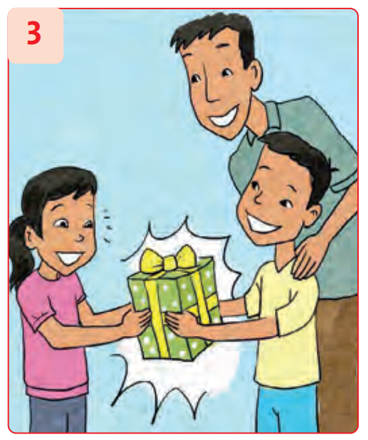
Look and Say.
They like the present because it’s new.
Notes:
* Look and Say.
- Show the pattern in the speech bubbles and the first item.
- Explain that Yum! shows that we like something very much, and Yuck! shows that we really dislike something.
- In pairs, children talk about the other pictures.

Slide 36
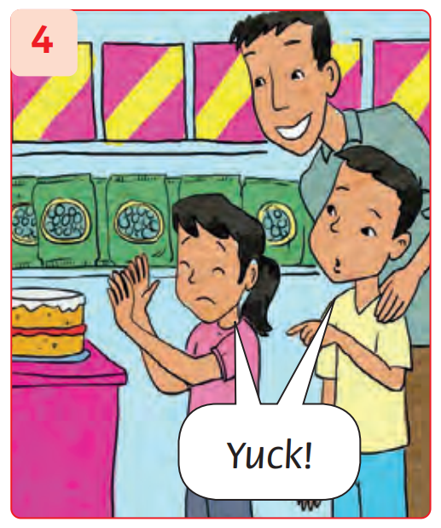
Look and Say.
They don’t like the cake
because there is not chocolate inside.
Notes:
* Look and Say.
- Show the pattern in the speech bubbles and the first item.
- Explain that Yum! shows that we like something very much, and Yuck! shows that we really dislike something.
- In pairs, children talk about the other pictures.

Slide 37
Look, Read and Write.
doesn’t like
don’t like
it’s delicious
it’s a new toy
They like candy because ____________ .
Notes:
* Look again and write.
Ask individual children to read the incomplete sentences.
Show the first picture in Exercise 3. Establish that the missing words are it’s delicious.
The children write the full sentences in their notebooks.

Slide 38
Look, Read and Write.
doesn’t like
don’t like
it’s delicious
it’s a new toy
He ___________ balloons because they pop.
Notes:
* Look again and write.
Ask individual children to read the incomplete sentences.
Show the first picture in Exercise 3. Establish that the missing words are it’s delicious.
The children write the full sentences in their notebooks.

Slide 39
Look, Read and Write.
doesn’t like
don’t like
it’s delicious
it’s a new toy
She likes the present because _____________.
Notes:
* Look again and write.
Ask individual children to read the incomplete sentences.
Show the first picture in Exercise 3. Establish that the missing words are it’s delicious.
The children write the full sentences in their notebooks.

Slide 40
Look, Read and Write.
doesn’t like
don’t like
it’s delicious
it’s a new toy
They ____________ the cake
because there is jelly inside.
Notes:
* Look again and write.
Ask individual children to read the incomplete sentences.
Show the first picture in Exercise 3. Establish that the missing words are it’s delicious.
The children write the full sentences in their notebooks.

Slide 41
Good job!

Slide 42
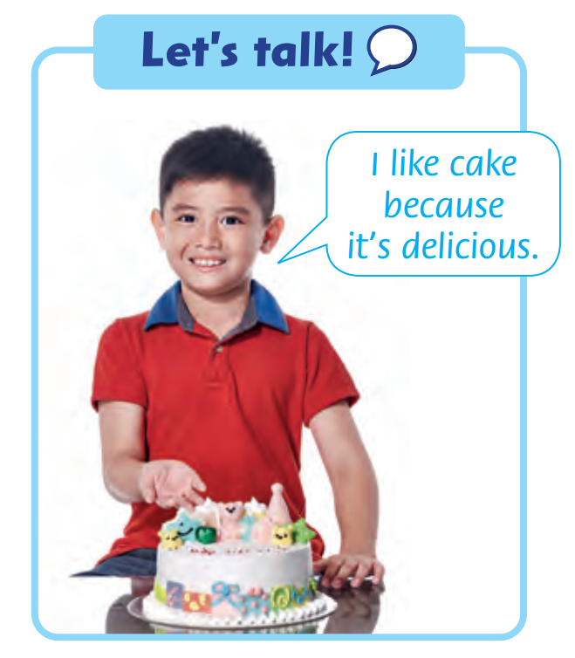
Look and Say.
I like cake
because it’s delicious.
Notes:
* Let’s talk!
Focus on the speech bubble. Ask a child to read the sentence and elicit other reasons, e.g. … because it’s pretty / yummy!
In pairs, children take turns saying the sentence using other vocabulary words on the page.

Slide 43

In the Racing Game of Knowledge
Who will finish first?
Click Here to Start
Notes:
Chia lớp thành các nhóm. Mỗi nhóm là 1 màu xe.
Các HS trong nhóm luân phiên đặt 1 câu về bản than mình. Nếu đúng, click vào xe để di chuyển (tính điểm).
5 câu miêu tả đúng sẽ cán đích.

Slide 44
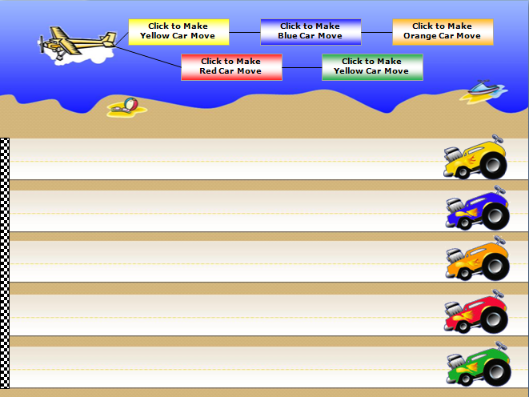
2
The Beach Rally
3
PLAY
Notes:
Chia lớp thành các nhóm. Mỗi nhóm là 1 màu xe.
Các HS trong nhóm luân phiên đặt 1 câu về bản than mình. Nếu đúng, click vào xe để di chuyển (tính điểm).
5 câu miêu tả đúng sẽ cán đích.
Có thể kết hợp hyperlink sang các slide sau để làm câu hỏi trên slide luôn.

Slide 45
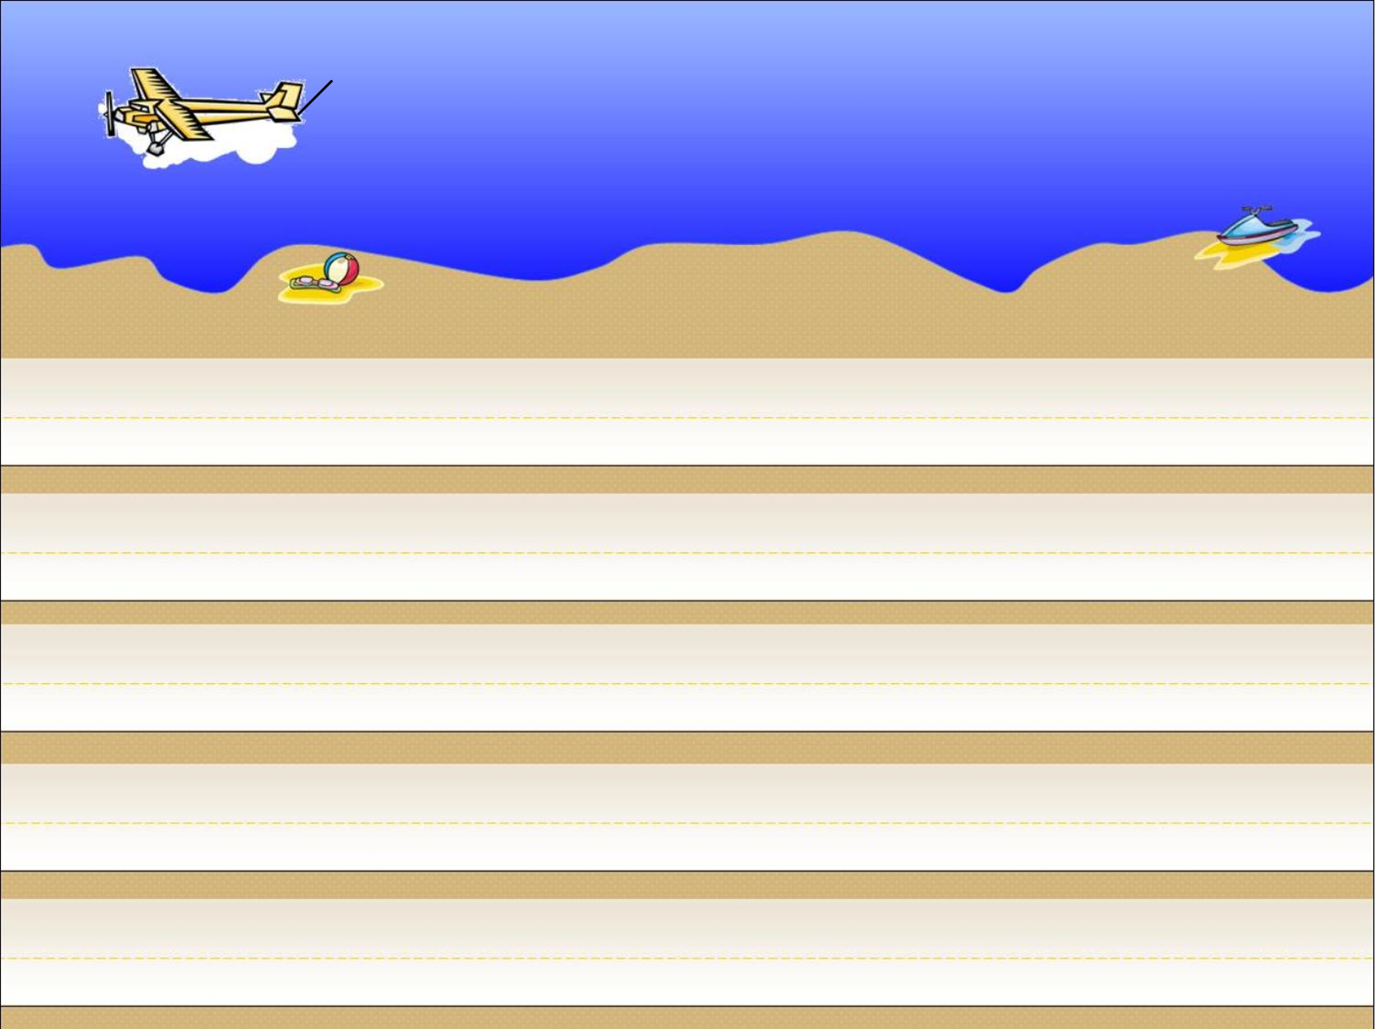





Click to Make Yellow Car Move
Click to Make Blue Car Move
Click to Make Orange Car Move
Click to Make Red Car Move
Click to Make Green Car Move
Notes:
Make the car move to score their team’s correct sentences.

Slide 46



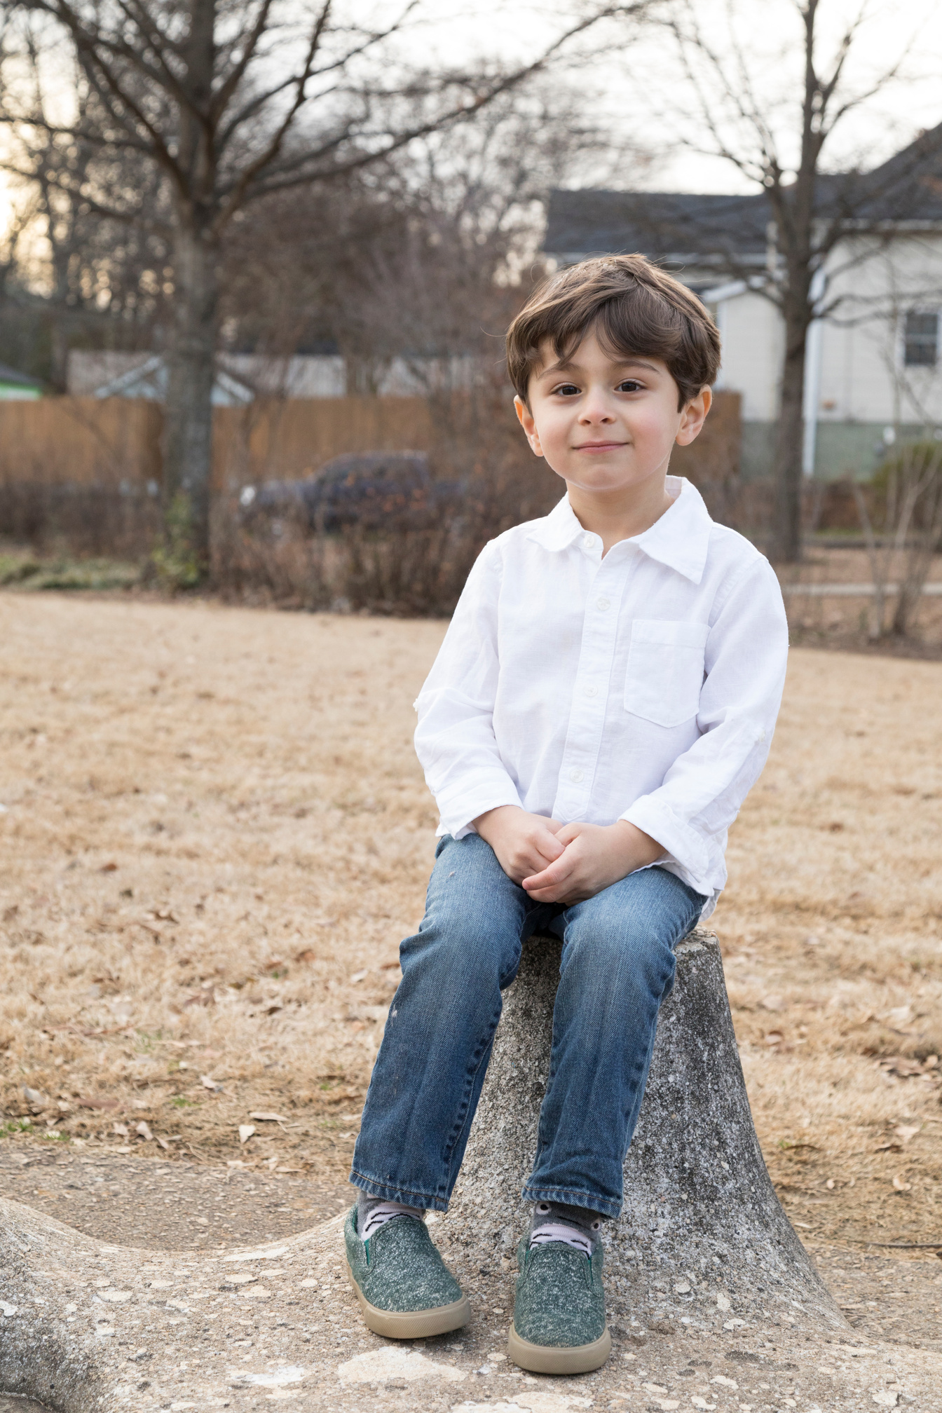
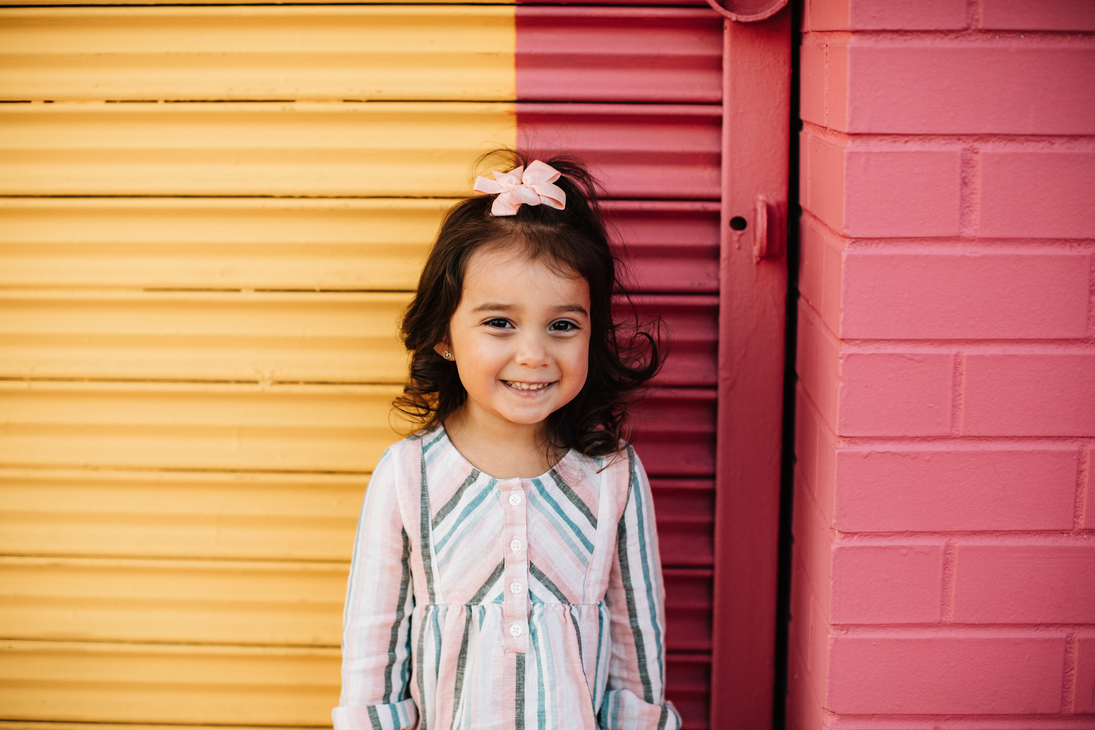
Our Winners!
Peter
Eric
Julie
Notes:
Replace photos and names with your students’ information.

Slide 47








Thank You!
See You Next Time!
Notes:
https://www.youtube.com/watch?v=SRyFiVeNjWs

