Slide 2








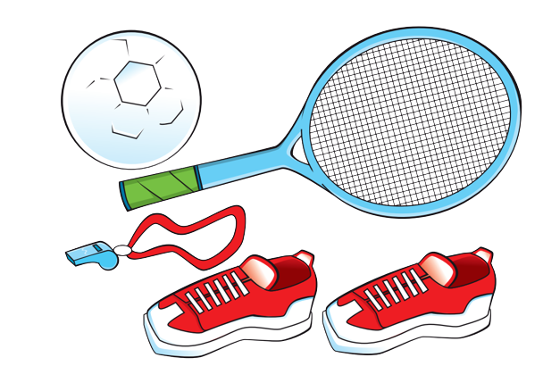
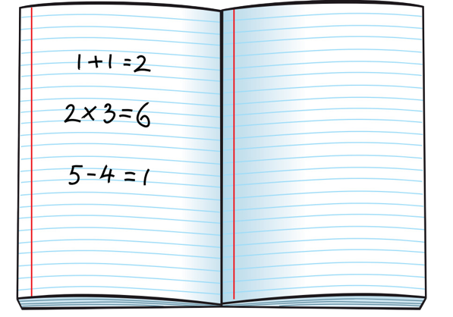

Unit 4
We have English!
Lesson 6 – Skills Time! – Period 2

Slide 3






Slide 4

HELLO SONG
Notes:
https://www.youtube.com/watch?v=pqDEwPi7vxg

Slide 5

Talk about your week!
I have Vietnamese and English on Tuesdays.
Notes:
* Talk about your week.
Read aloud the example speech bubble and elicit sentences from the children.

Slide 6

Good job!

Slide 7
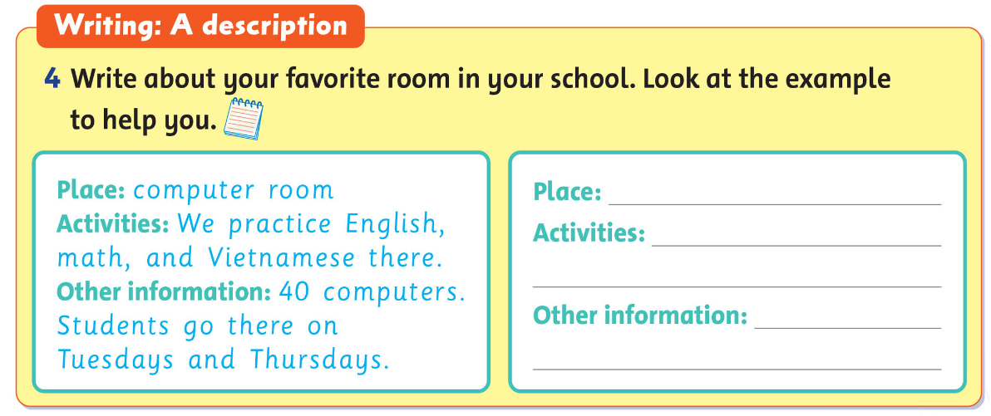
Look and Answer.
Notes:
* Write about your favorite room in your school. Look at the example to help you.
Focus on the example form. Ask the children to read it, and elicit what type of information can be included in a description like this (name of the room, what activities they do in that room, what’s in the room, when students go there).

Slide 8

Look and Write.
Notes:
Write about your favorite room in your school. Look at the example to help you.
Help with any other ideas about additional information that they may want to include.
Ask the children to copy the form in their notebooks and to fill it out so that it’s true for them.
When they have finished, they should compare their form with a partner’s.

Slide 9

Work in Pairs.
Notes:
When they have finished, they should compare their form with a partner’s.

Slide 10
Talk about YOUR ROOM!
Notes:
Invite some volunteers to talk in the front.

Slide 11
Good job!

Slide 12
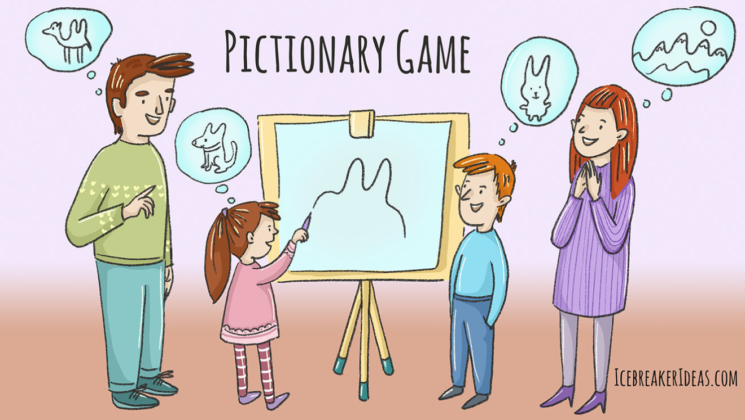
Game: PICTIONARY
Notes:
* Game: “Pictionary”
Ask children to use their favorite school room writing.
Ask them to work in pairs and read their descriptions to each other and draw pictures based on the information from the descriptions.

Slide 13
Good job!

Slide 14

HOMEWORK
Revise the words and the patterns.
Do the exercises in Workbook page 37.
Prepare for the next lesson
(Unit 5 - Lesson 1).

Slide 15



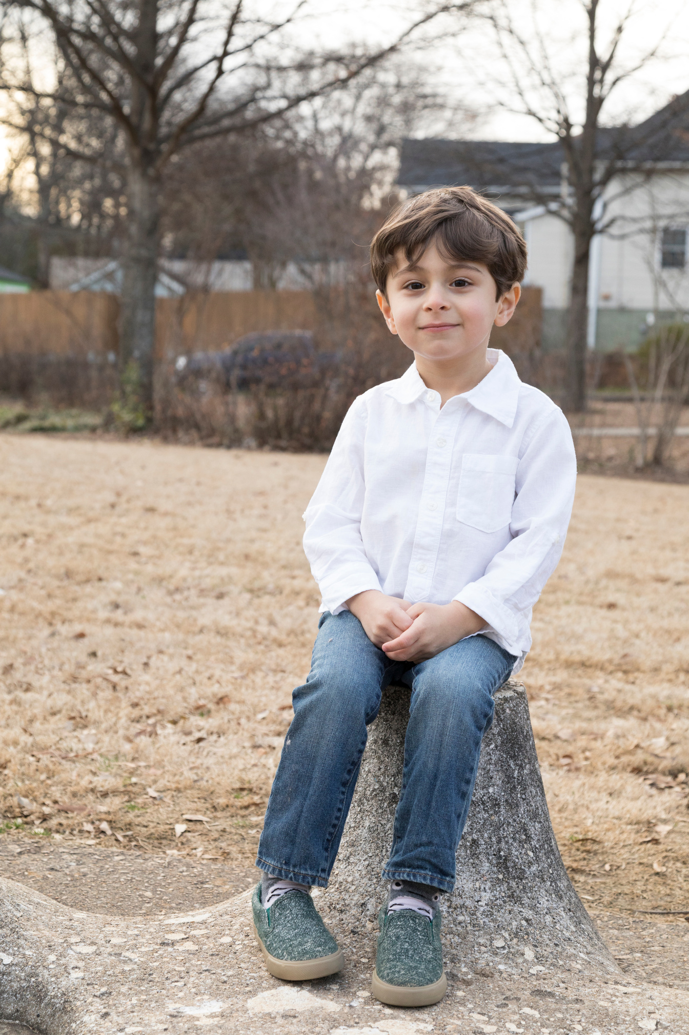

Our Winners!
Peter
Eric
Julie
Notes:
Replace photos and names with your students’ information.

Slide 16










Thank You!
See You Next Time.
Notes:
https://www.youtube.com/watch?v=SRyFiVeNjWs

