Slide 2








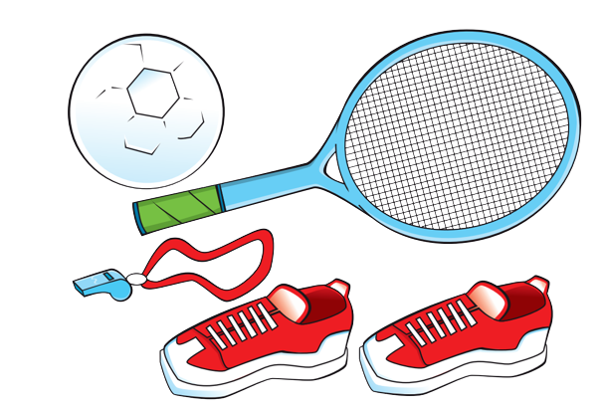
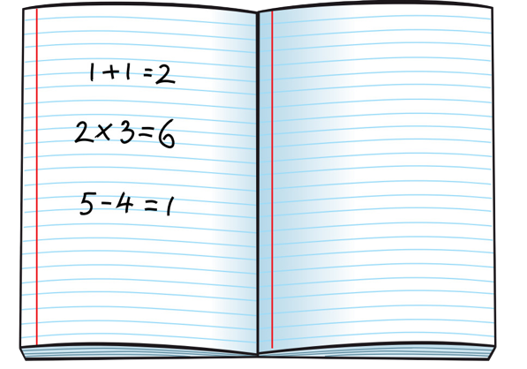

Unit 4
We have English!
Lesson 6 – Skills Time! – Period 1

Slide 3






Slide 4

HELLO SONG
Notes:
https://www.youtube.com/watch?v=pqDEwPi7vxg

Slide 5
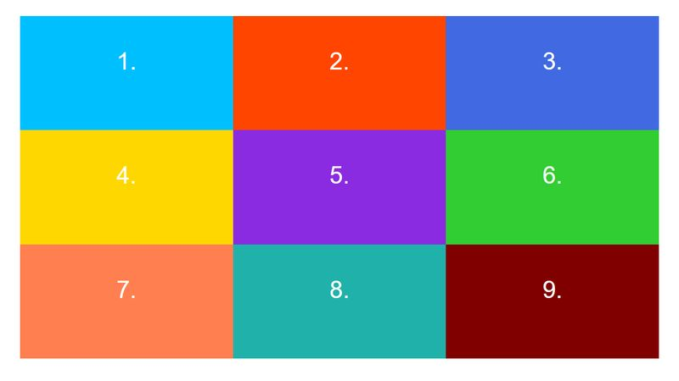
Game: BINGO GAME
Notes:
Game: Play Bingo
- Give the children a three-by-three grid. In each of the squares, they write a different word from the vocabulary they have studied in the unit.
Call out words from the vocabulary in any order. Keep a record of the words as you say them, so that you don’t say the same word twice.
The children cross off the words in their grids as they hear them. The first child to complete a line of three, shouts Bingo

Slide 6



Slide 7
Listen and Answer.
What’s the room in the picture?
How many computers are there in the room?
Notes:
Ask children what they can remember about the web page from the previous lesson.
Ask: What’s the room in the picture? How many computers are there in the room?
Allow children to check the web page on page 36 of their books to see how much they remembered correctly.

Slide 8
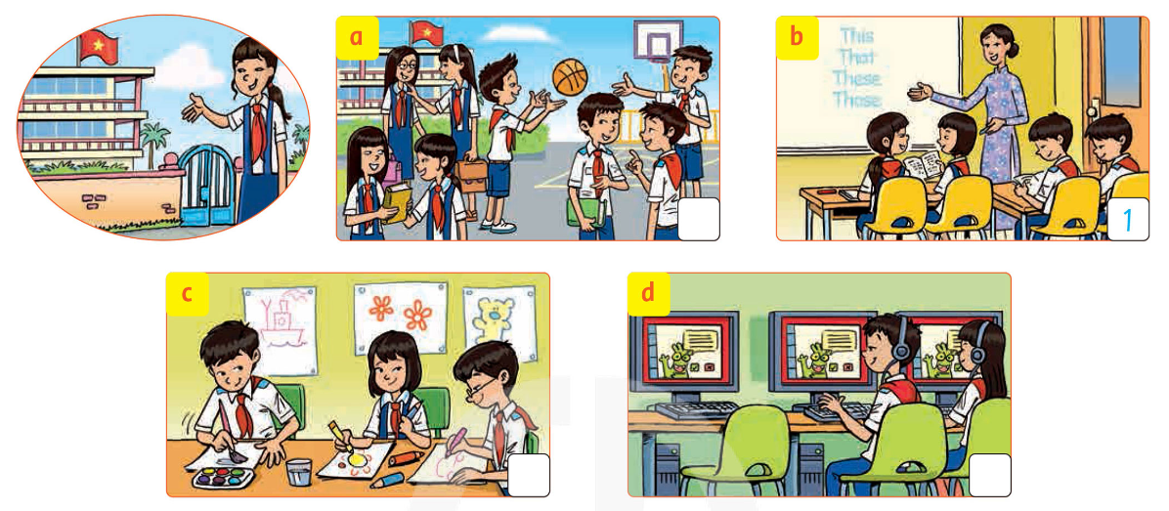
Look and Say.
Notes:
Look and say:
Where are they?
Look at the picture a, b, c, d (one by one). Then ask some questions.

Slide 9

Listen and Write the numbers.
1
Notes:
Listen and write the numbers.
Tell children that they are going to hear a girl talking about the places in her school.
They have to listen and write the number when they hear the word mentioned.
Play the recording and do number 1 as an example with the whole class.

Slide 10
Listen and Write the numbers.
1
Notes:
Play the recording a second time, stopping after each item for children to write the number onto the corresponding picture.

Slide 11
Listen and Check the answers.
2
3
4
Notes:
Play the recording again for children to complete or check their answers.
ANSWERS: 0 b 1 a 2 c 3 d 4

Slide 12

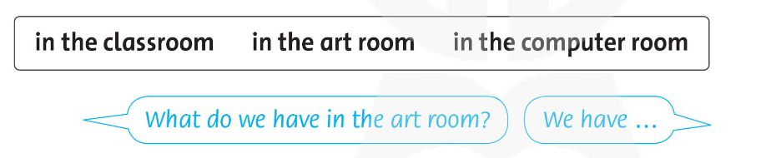
Point, Ask and Answer.
Notes:
Point, ask, and answer about your school.
• Ask children to read the words and phrases in the word box aloud.
• Focus attention on the speech bubbles. Ask a child to stand up and model the question and answer with you. Children repeat the question and answer chorally.
• In pairs, children take turns pointing, asking, and answering questions about what is in the different places. • Ask some of the pairs to ask and answer questions for the class.

Slide 13

Talk about your week!
I have Vietnamese and English on Tuesdays.
Notes:
Read aloud the example speech bubble and elicit sentences from the children

Slide 14

Good job!

Slide 15

HOMEWORK
Revise the words and the patterns.
Do the exercises in Workbook page 37.
Prepare for the next lesson
(Unit 4 - Lesson 6/Part 2).

Slide 16



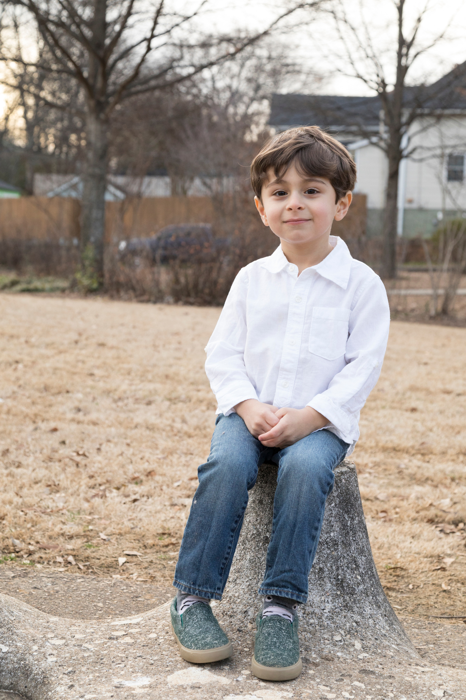
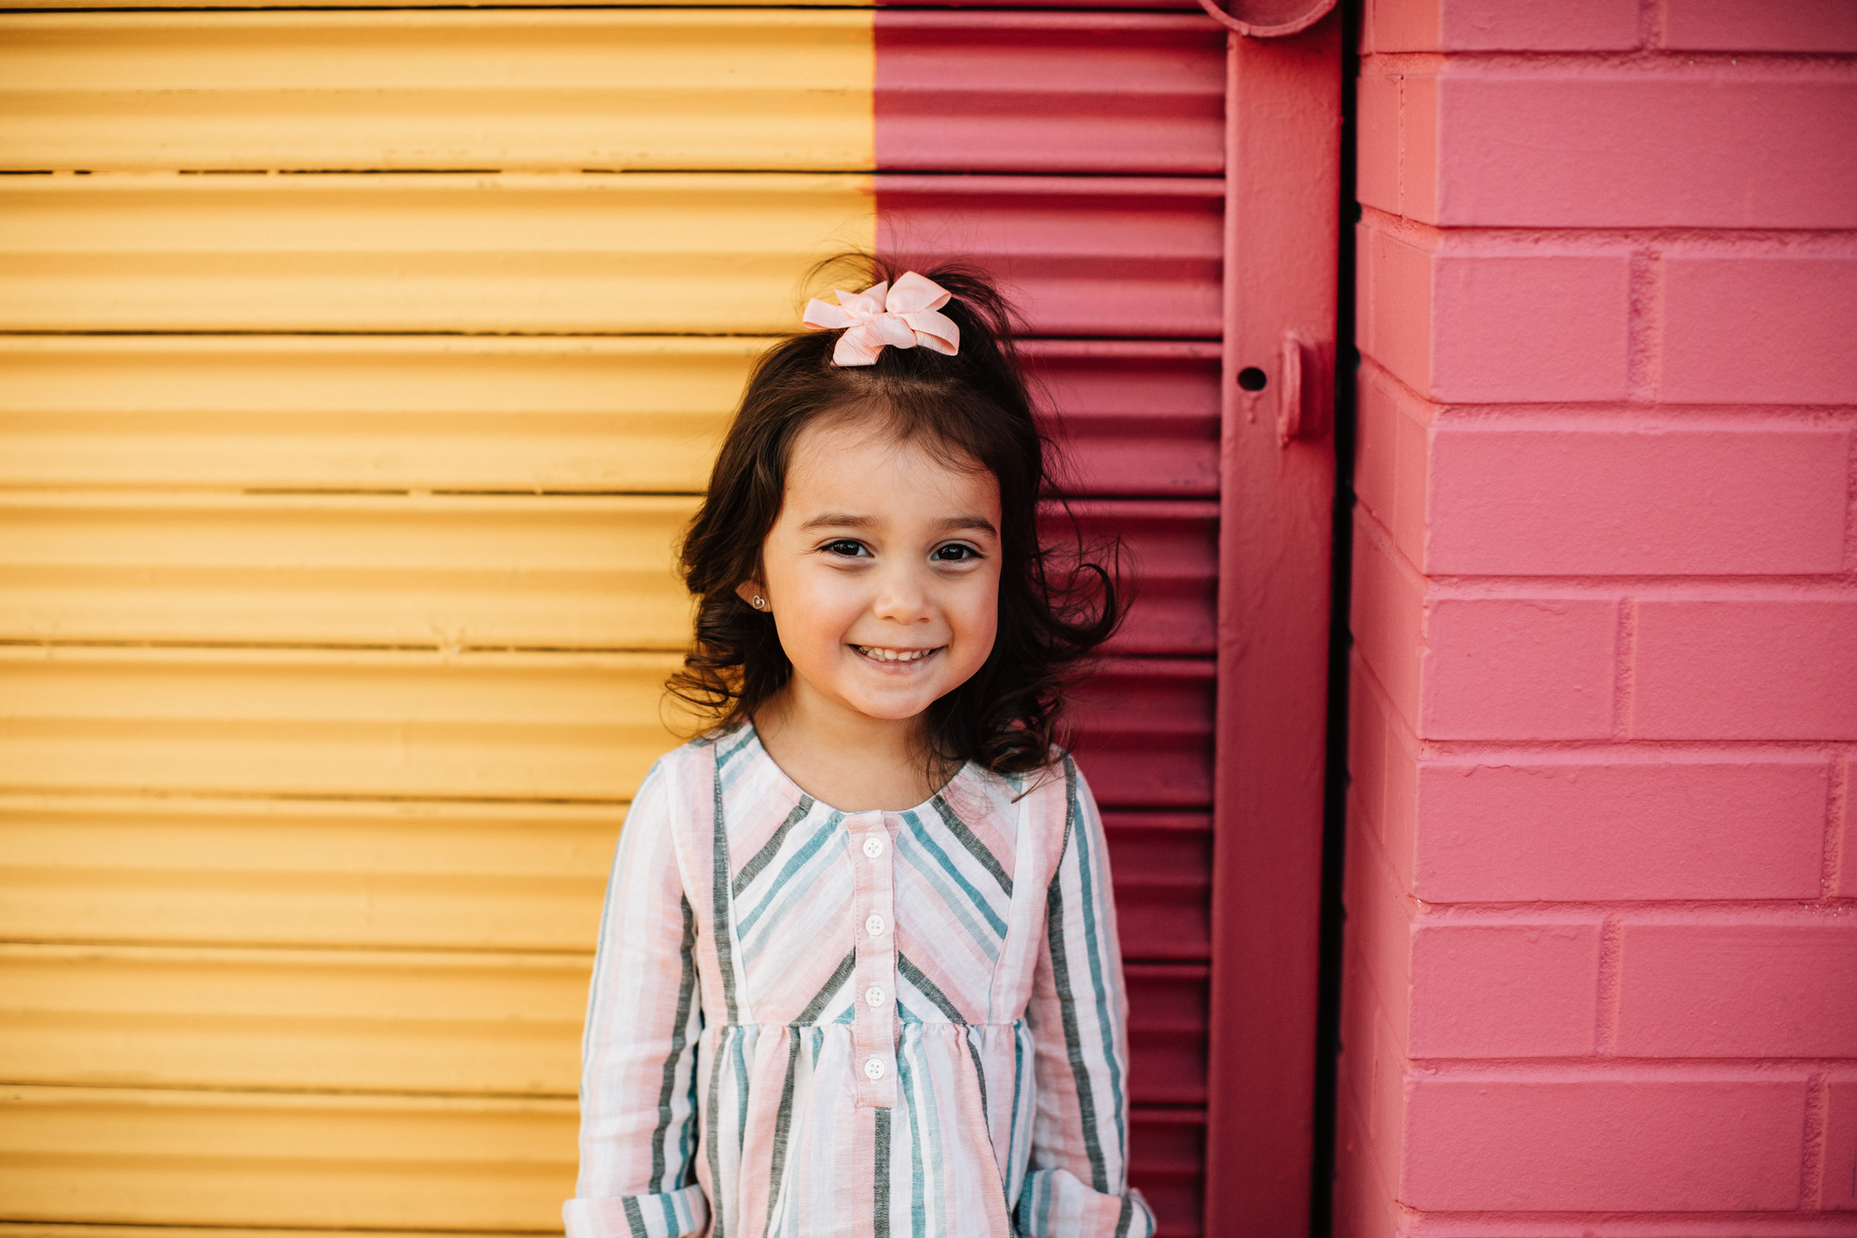
Our Winners!
Peter
Eric
Julie
Notes:
Replace photos and names with your students’ information.

Slide 17










Thank You!
See You Next Time.
Notes:
https://www.youtube.com/watch?v=SRyFiVeNjWs

