Slide 2








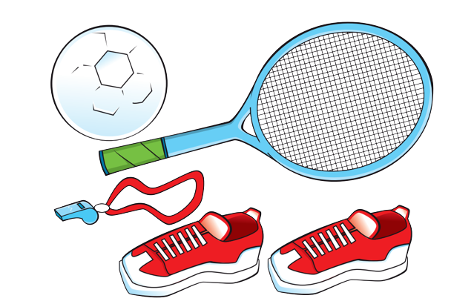
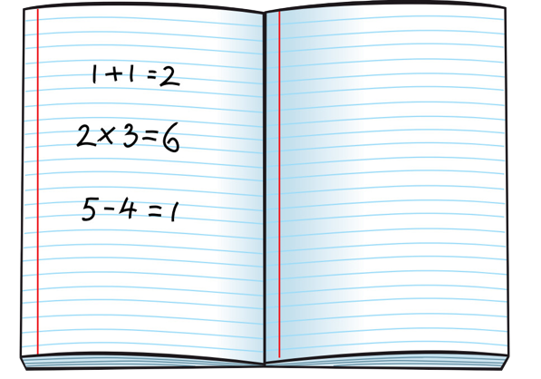

Unit 4
We have English!
Lesson 5 – Skills Time!

Slide 3






Slide 4
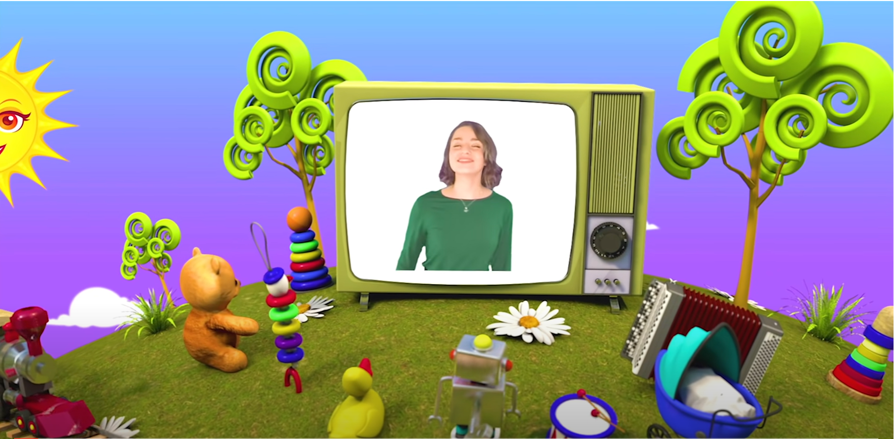
HELLO SONG
Notes:
https://www.youtube.com/watch?v=pqDEwPi7vxg

Slide 5


Game: MUSICAL CARDS
Notes:
Game: Musical cards
• Play lively music. Hand the schoolroom flashcards, and any other words you would like to review, to different children around the class.
• Ask them to pass them to each other until the music stops.
• Stop the music suddenly and ask each child holding a card to tell you what the picture is.

Slide 6



Slide 7
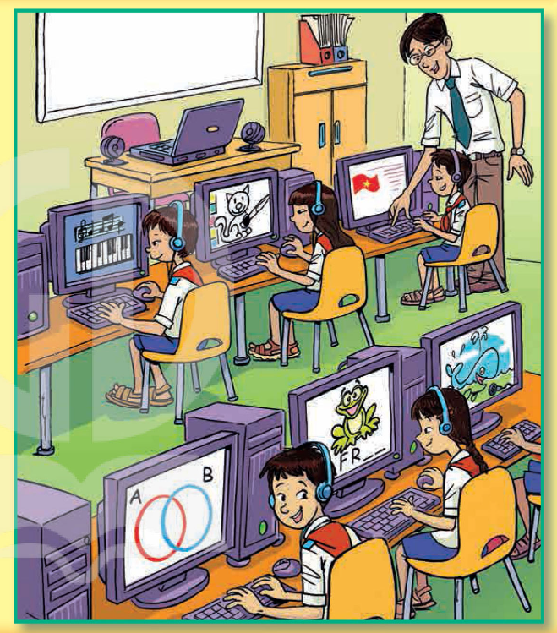
Look and Say.
Notes:
- Talk about computers with your class. Ask Do you like computers? Do you have computer lessons at school?
Focus on the picture. Encourage children to make predictions about the reading,
e.g., It’s about computer lessons in school.
Explain that they are going to read a web page that some children have written about the computer room at a school

Slide 8
Look and Answer.
What school subjects can you see?
How many computers are there?
Who is wearing glasses?
Notes:
- Ask children to look at the picture again and name the different subjects that children are studying in the computer room.
In pairs, children take turns pointing to a child and saying which subjects they are studying.
ANSWERS: English, math, art, Vietnamese

Slide 9
Look and Answer.
1. What school subjects can you see?
English, math, art, Vietnamese
2. How many computers are there?
6 computers
3. Who is wearing glasses?
The teacher.
Notes:
- Ask children to look at the picture again and name the different subjects that children are studying in the computer room.
In pairs, children take turns pointing to a child and saying which subjects they are studying.
ANSWERS: English, math, art, Vietnamese

Slide 10
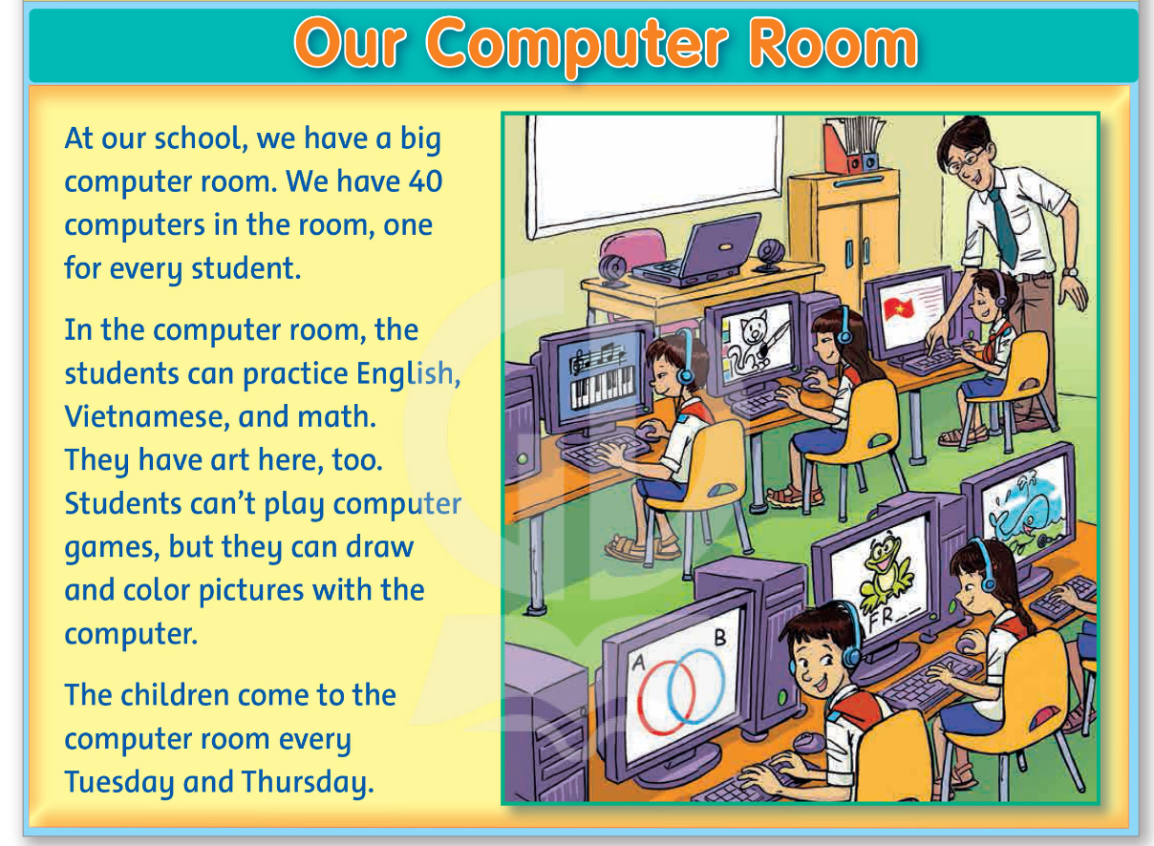
Listen
and
Follow the words.
Notes:
Play the recording.
Students listen and point to the words.

Slide 11
Read again and Answer.
Notes:
Ask students to open their books, read the text in silently.
Then answer the teacher’s questions.
e.g., What can children do on the computers?
How many children can go into the computer room?
Is the computer room big? (Yes).
Is there a computer for every student? (Yes).
Can the children practice P.E. in the computer room? (No).
What days of the week can the children come to the computer room? (Tuesday and Thursday)

Slide 12
Read again. Then answer.
What can children do on the computers?
How many children can go into the computer room?
Is the computer room big?
Is there a computer for every student?
Can the children practice P.E. in the computer room?
What days of the week can the children come to the computer room?

Slide 13
Read again and Answer the questions.
1. Do you have a computer room?
Yes, we do.
Notes:
Ask children to imagine that they have a new classmate who wants to know about the computer room in their school.
Ask children to read the first question and the example answer.

Slide 14
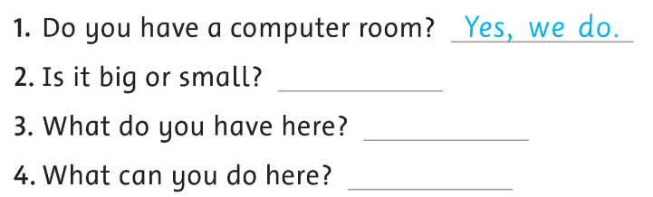
Read again and Answer the questions.
Notes:
Read the rest of the questions. Children write their answers in their notebooks.
Check answers by reading each question out loud and eliciting answers from different children.

Slide 15
Read again and Answer the questions.
2. Is it big or small?
Yes, it is. / No, it isn’t.
Notes:
Students’ own answers.

Slide 16
Read again and Answer the questions.
3. What do you have here?
We have ………...
Notes:
Students’ own answers.

Slide 17
Read again and Answer the questions.
4. What can you do here?
We can ………...
Notes:
Students’ own answers.

Slide 18
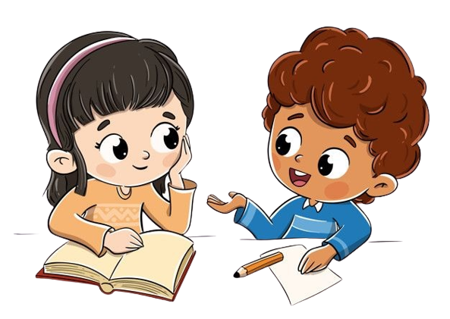
Work in Pairs.
Notes:
Ask two students to work in pairs to ask and answer the questions.

Slide 19
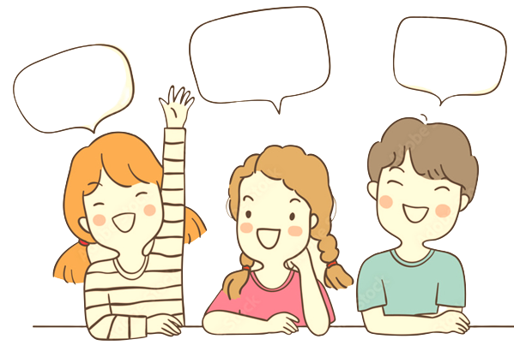
What’s your favorite room in your school? Why?
Notes:
What’s your favorite room in your school? Why?
Ask individuals the questions.
Demonstrate how to talk about the topic questions.
Encourage children to ask other children.

Slide 20

Good job!

Slide 21

HOMEWORK
Revise the words and the patterns.
Do the exercises in Workbook page 36.
Prepare for the next lesson
(Unit 4 - Lesson 6/Part 1).

Slide 22



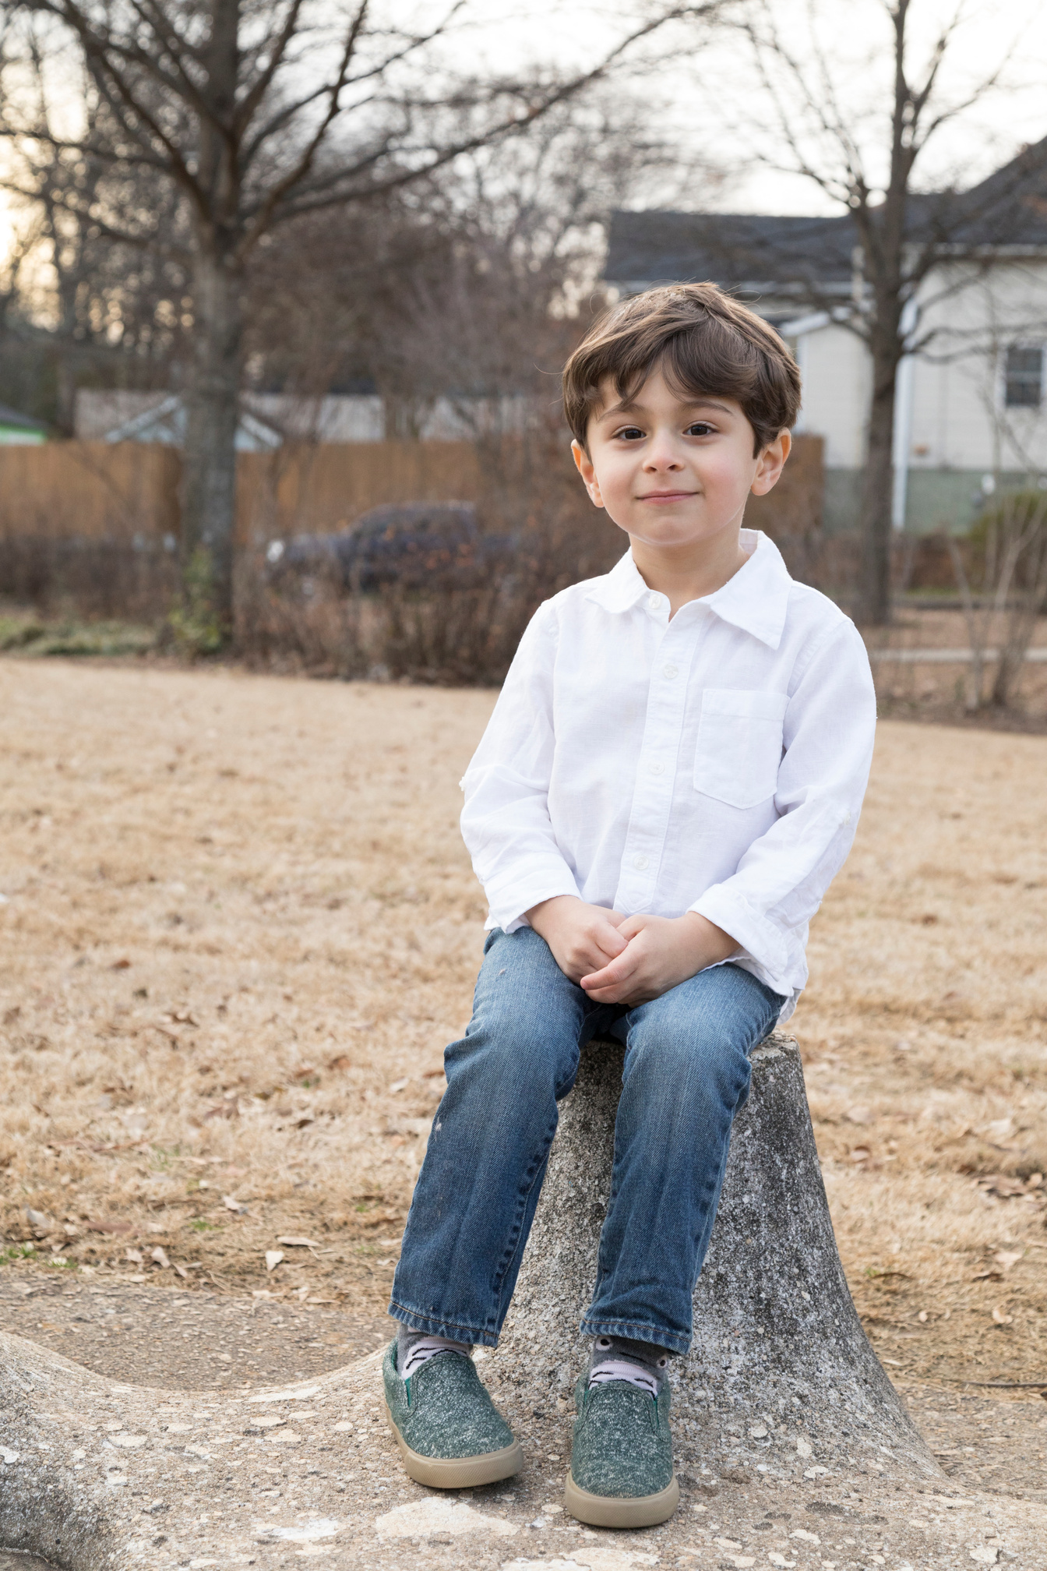
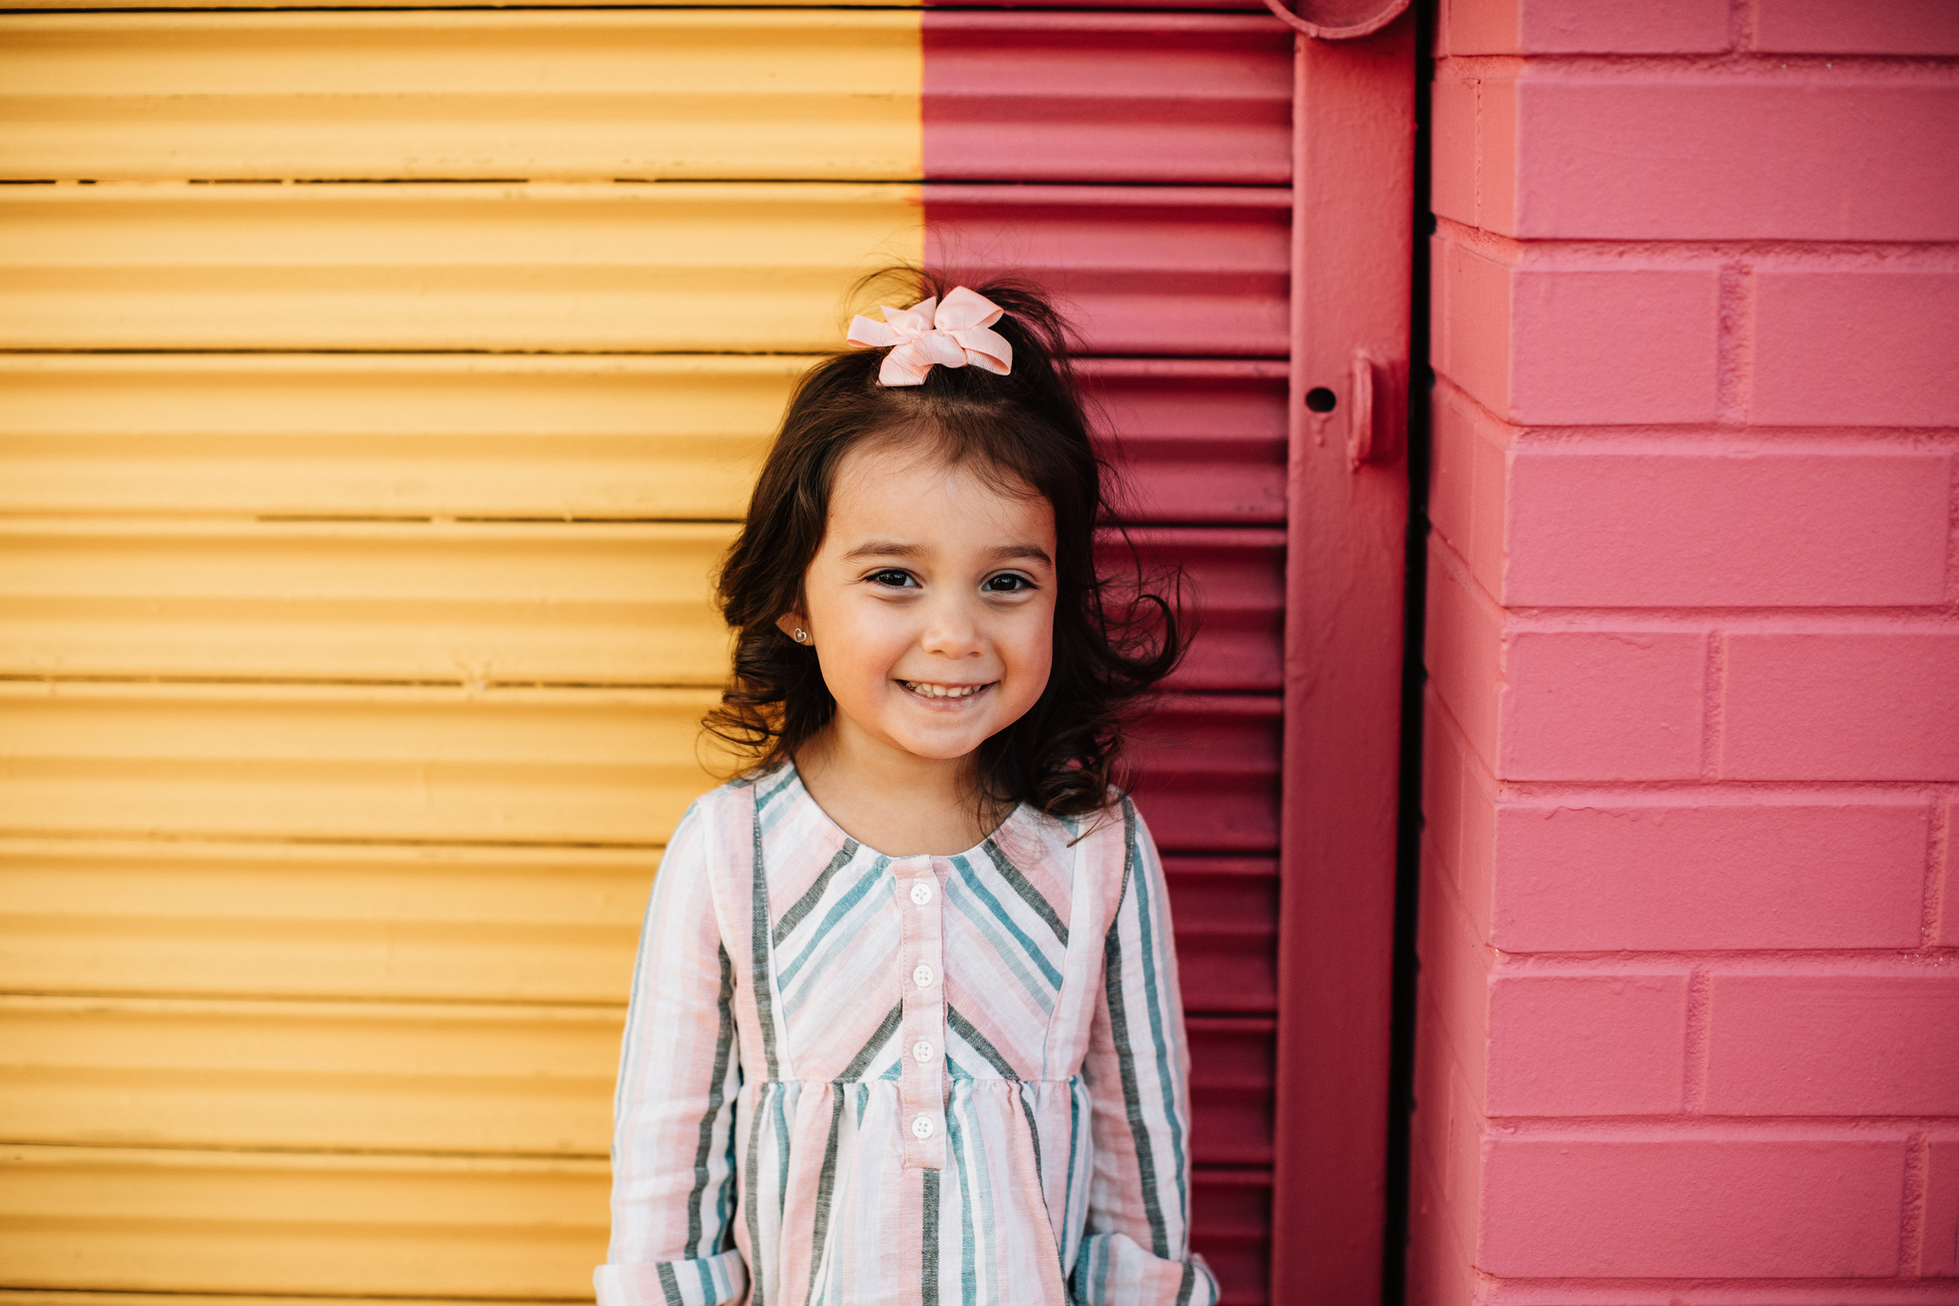
Our Winners!
Peter
Eric
Julie
Notes:
Replace photos and names with your students’ information.

Slide 23

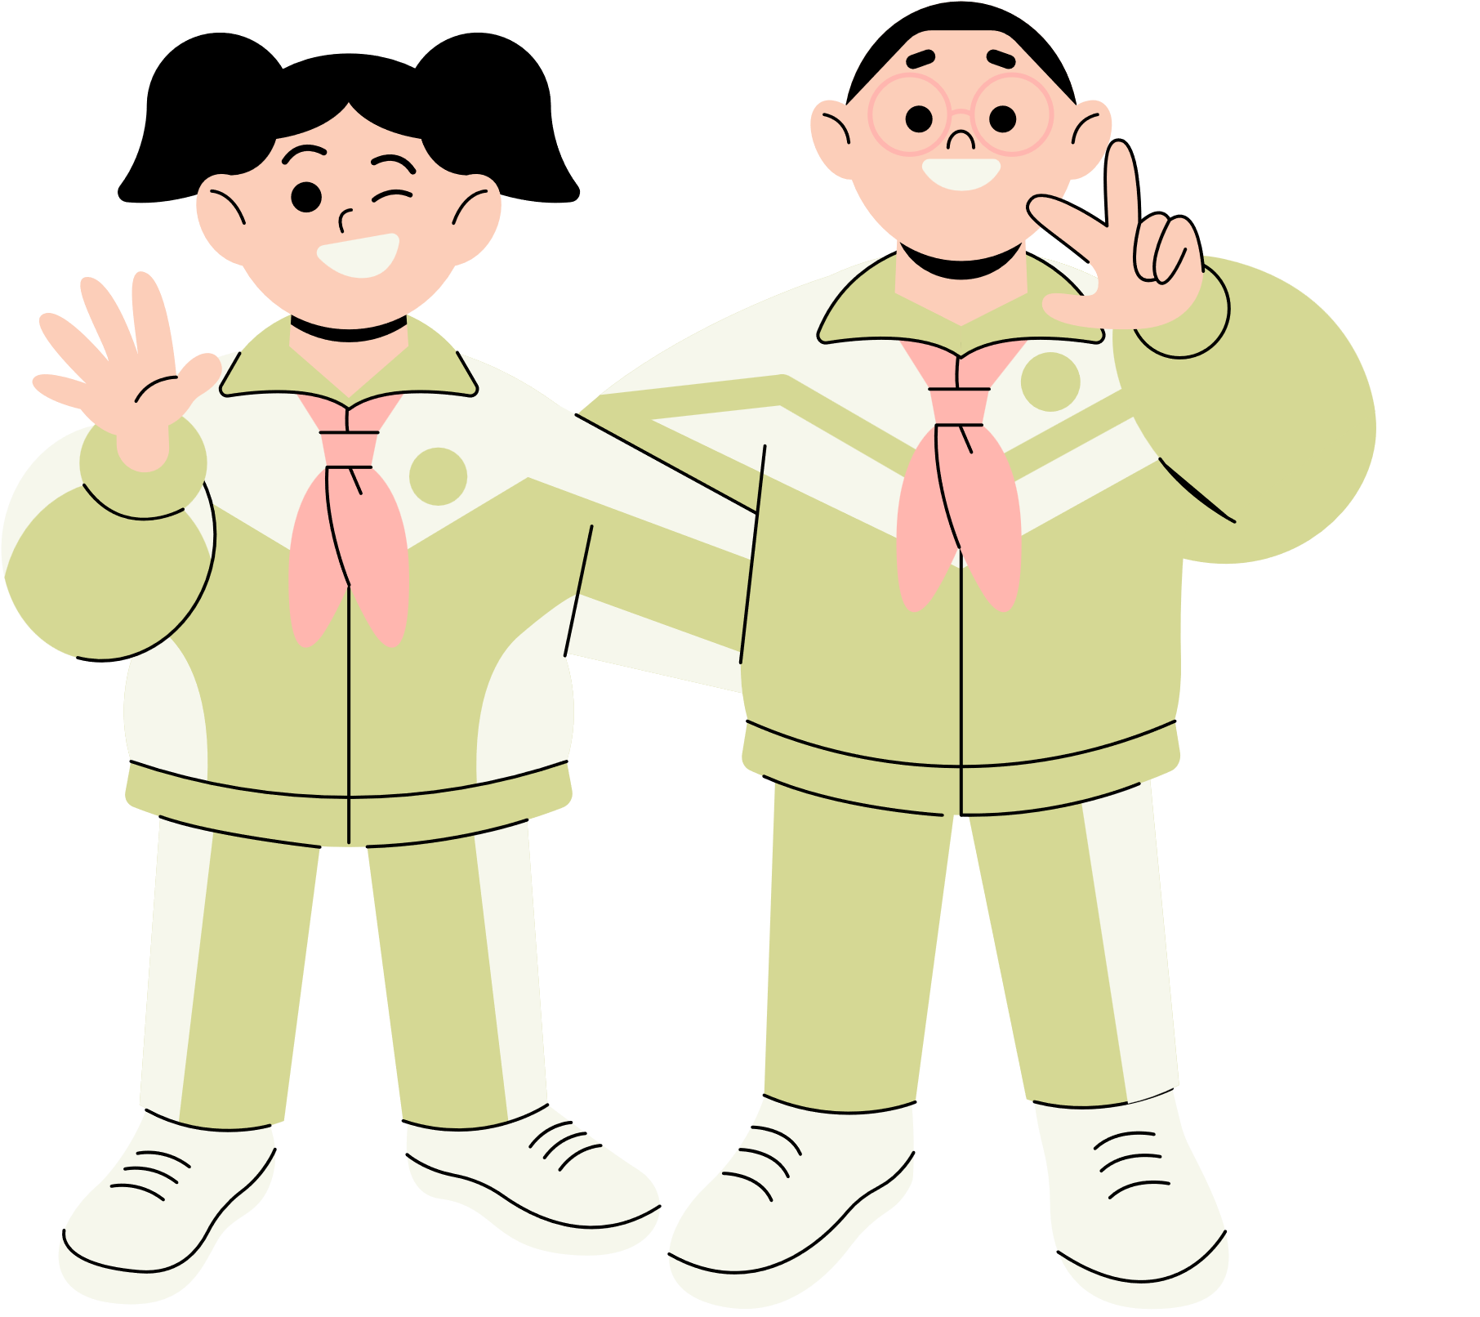








Thank You!
See You Next Time.
Notes:
https://www.youtube.com/watch?v=SRyFiVeNjWs

