Slide 2







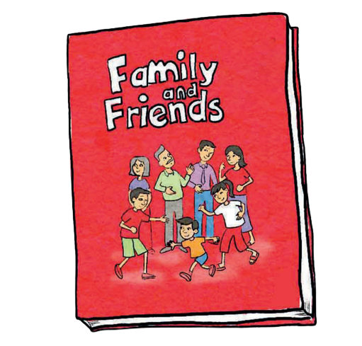
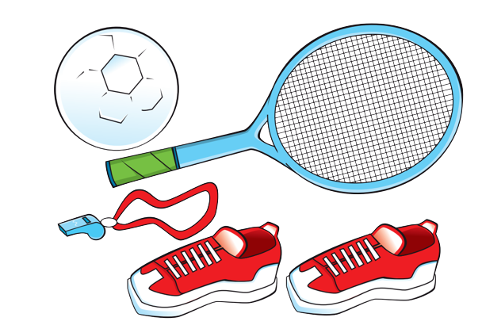
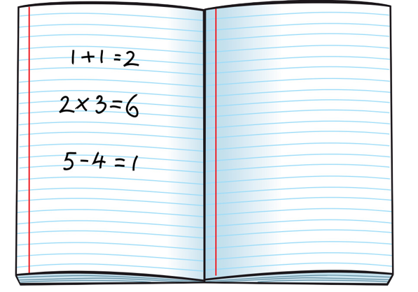

Unit 4
We have English!
Lesson 4 - Phonics

Slide 3



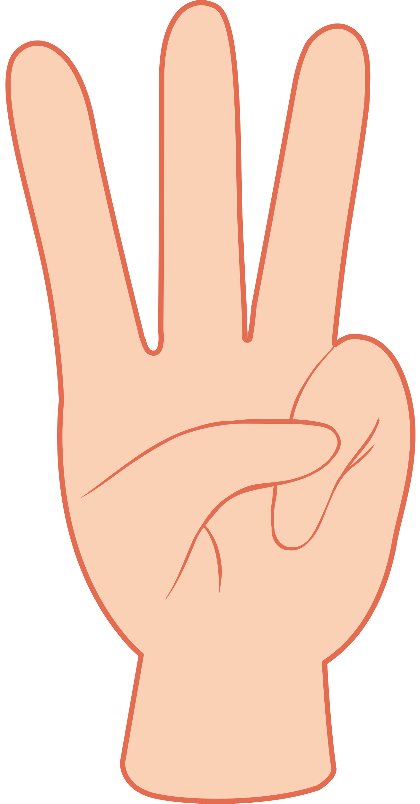


Slide 4
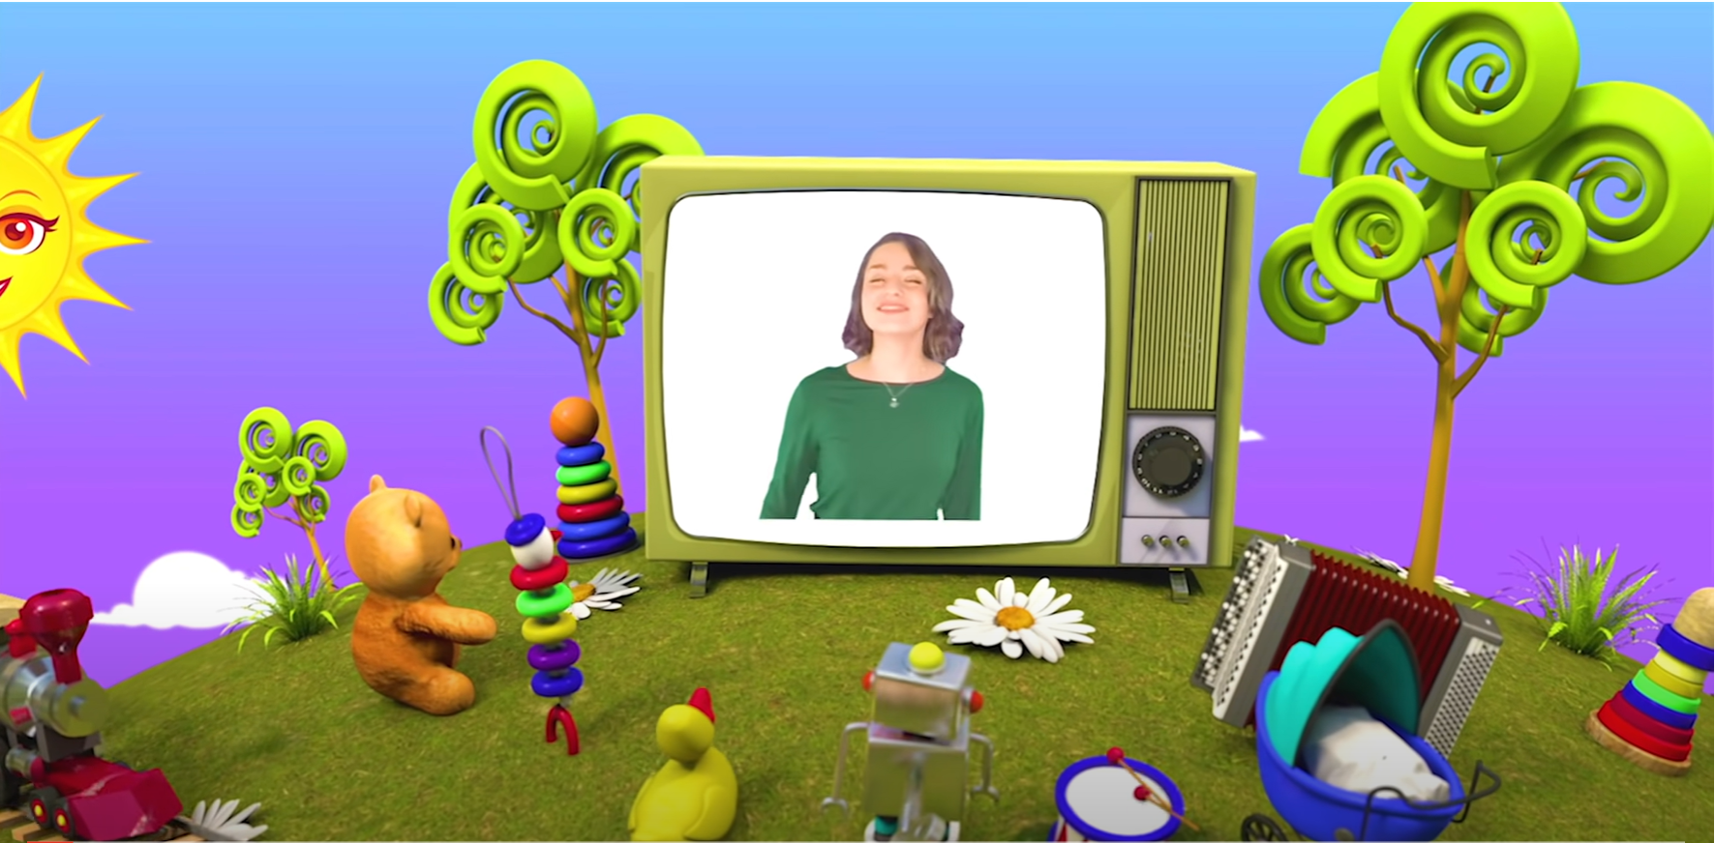
HELLO SONG
Notes:
https://www.youtube.com/watch?v=pqDEwPi7vxg

Slide 5
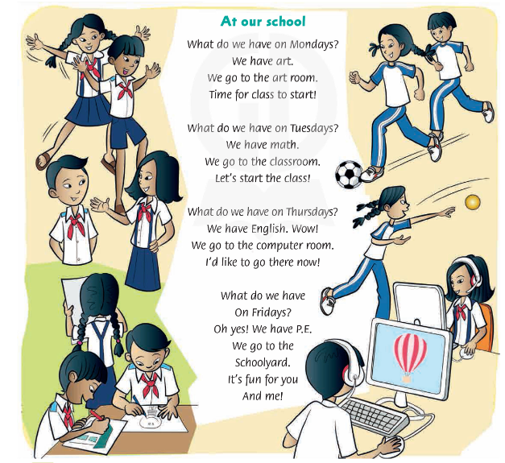

Sing and Do.

Slide 6

Game: I know, I know, I know
Notes:
Game: “I know, I know, I know”
Divide the class into four teams.
Use a variety of flashcards from previous lessons.
Show the class a flashcard very quickly. The first team to shout I know, I know, I know and tell you the correct word gets one point.

Slide 7



Slide 8
Look and Say the sounds.
Notes:
* Lead-in:
Ask children if they can remember the sounds from the previous phonics lesson (/kw/, /r/, and /s/). Say the words queen, rabbit, and sofa to help them remember.
Teach the sounds and letters in this lesson, using phonics cards. Hold up the first card and say the letter name, sound, and then the word, for children to repeat.
Repeat with the other phonics cards.
Hold up each card. Say the words for children to repeat.

Slide 9

Listen, Point and Repeat.
Notes:
Play the first part of the recording for children to point to the pictures.
Play the second part of the recording for children to repeat the sounds and words.
Play the whole recording. Children point and then repeat

Slide 10
Listen and Repeat.
Notes:
Hold up each phonics card in turn, showing only the picture. Ask the class for the sound and the word.

Slide 11
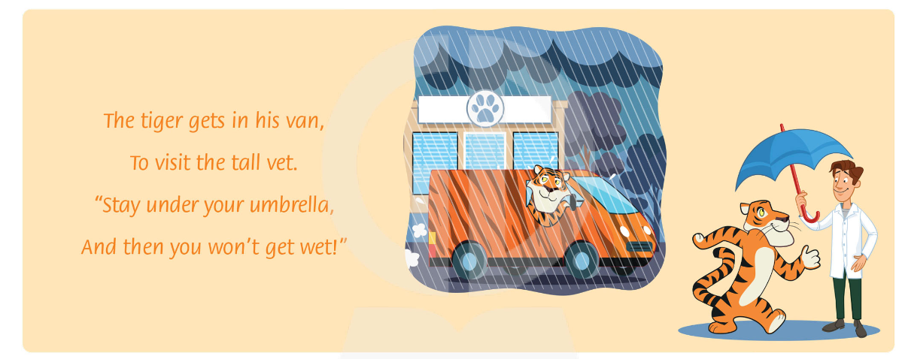
Listen and Chant.
Notes:
Ask children to look at the picture.
Ask What can you see? Play the recording for children to listen.
Say the chant line-by-line. Ask children to repeat after you.
Play the chant again, pausing after each line for children to repeat

Slide 12
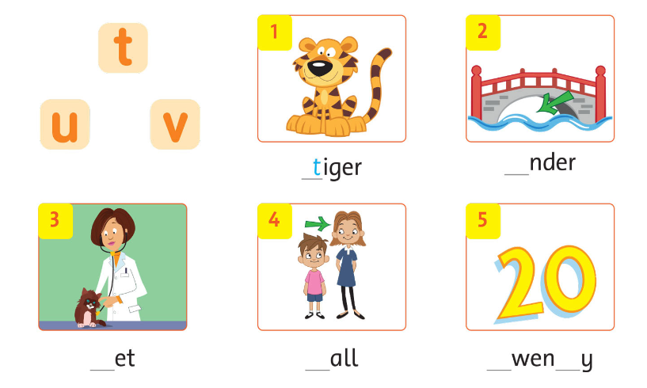
Read the chant again. Say the words with t, u, and v. Write.
Notes:
Read the chant again. Say the words with t, u, and v.
Focus on the chant. Write the first line on the board. Ask children to find an example of the letters.
Children read the chant silently and only say the words with t, u, and v out loud.
Children write the t, u, and v words in their notebooks.
Answer: tiger - under – tall – vet – twenty

Slide 13
Listen and Complete the words.
u
v
t
t
t
Notes:
Children look at the first picture. Play the recording. Ask What’s the word? (tiger). Ask What letter makes the first sound in that word? Draw attention to the example answer t.
Play the rest of the recording for children to write the missing letters.
Ask children to say the missing sounds, then the words.

Slide 14
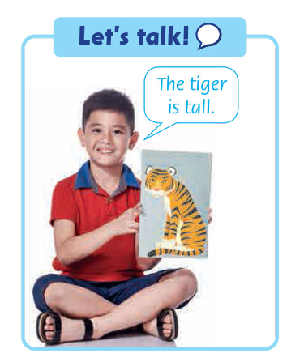
Let’s talk!
Notes:
Let’s talk
Ask children to look at the picture and speech bubble. Say The tiger is tall!
In pairs, children take turns saying sentences using other vocabulary from the page.

Slide 15
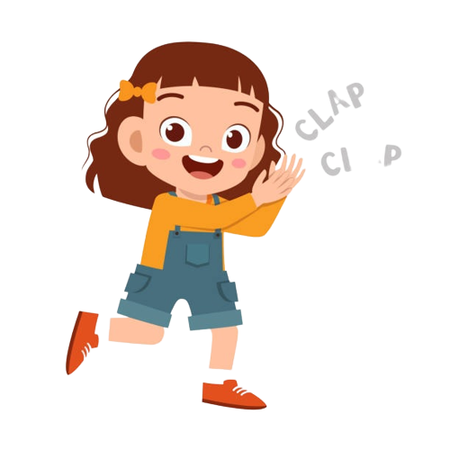
Good job!

Slide 16

HOMEWORK
Revise the words and the patterns.
Do the exercises in Workbook p. 35.
Prepare for the next lesson
(Unit 4 - Lesson 5).

Slide 17


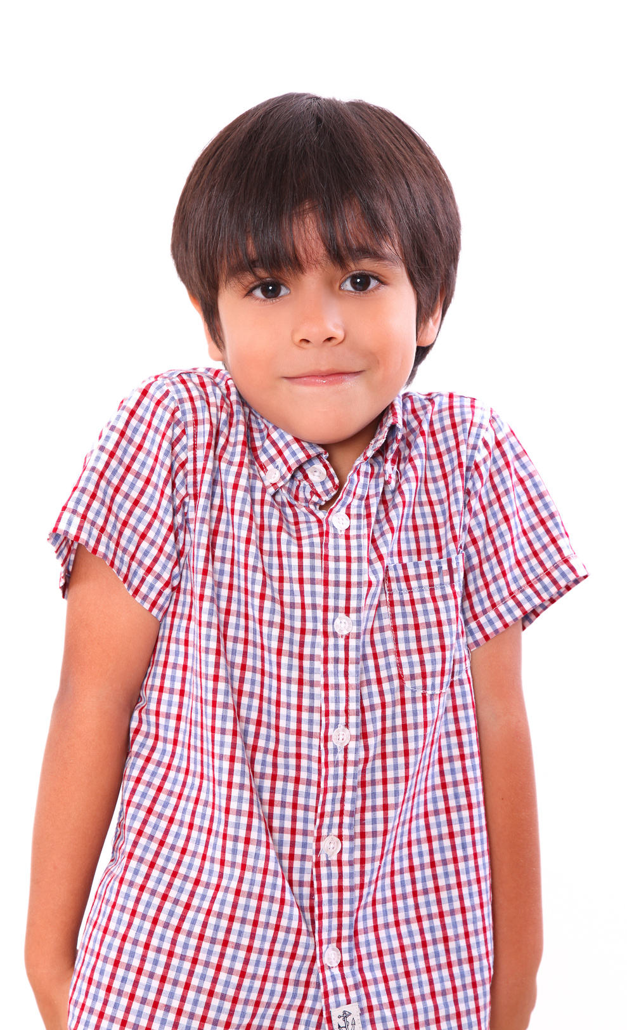
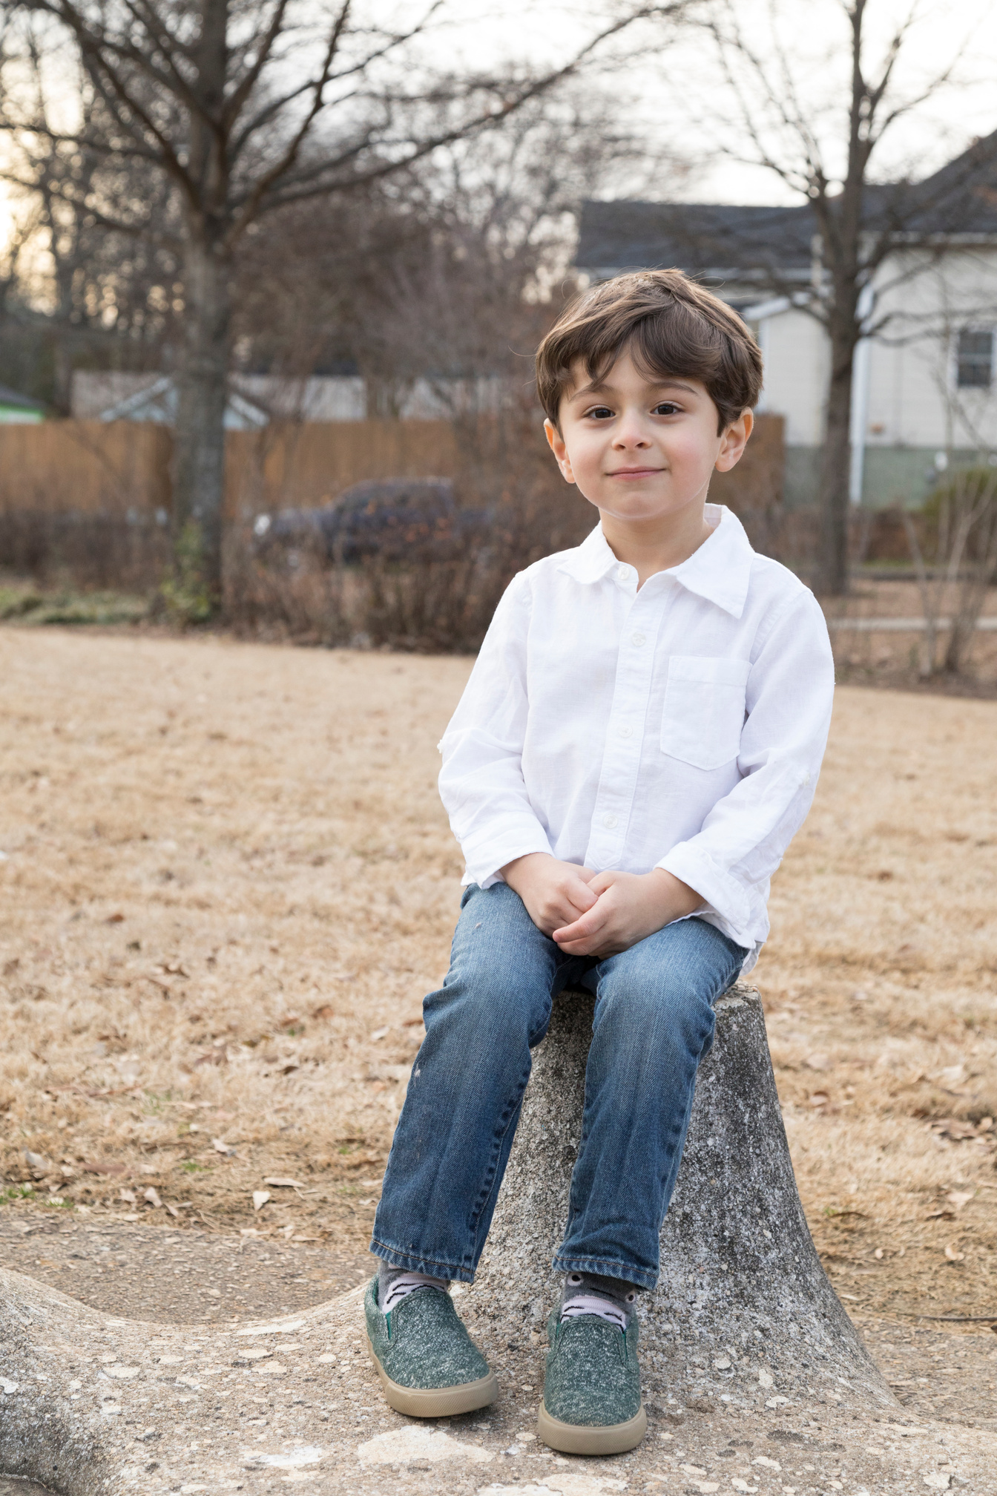
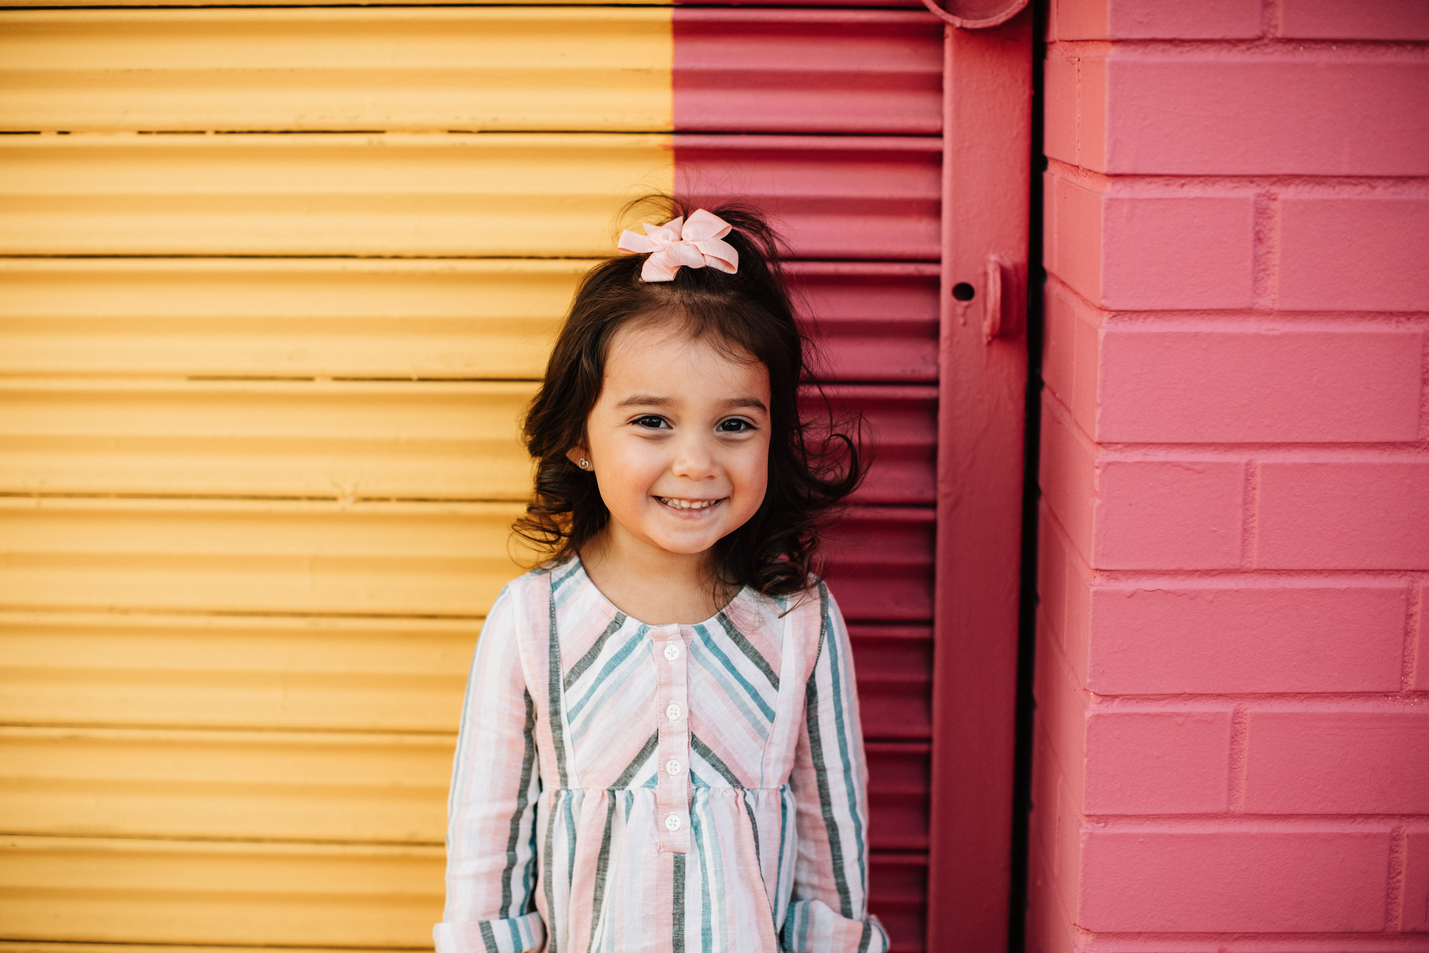
Our Winners!
Peter
Eric
Julie
Notes:
Replace photos and names with your students’ information.

Slide 18

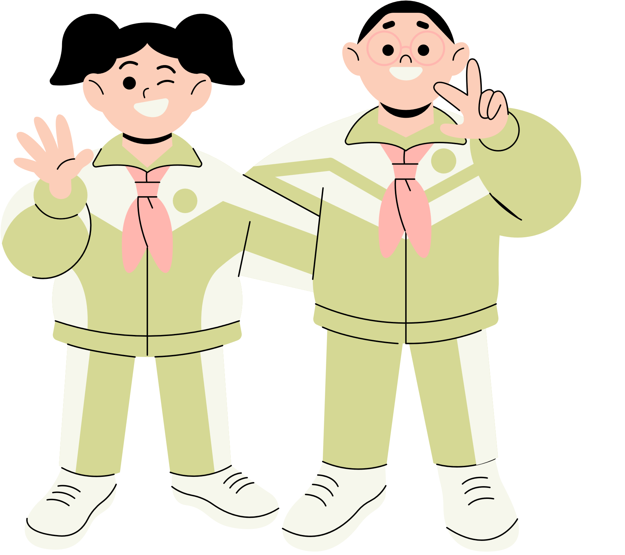








Thank You!
See You Next Time.
Notes:
https://www.youtube.com/watch?v=SRyFiVeNjWs

