Slide 2







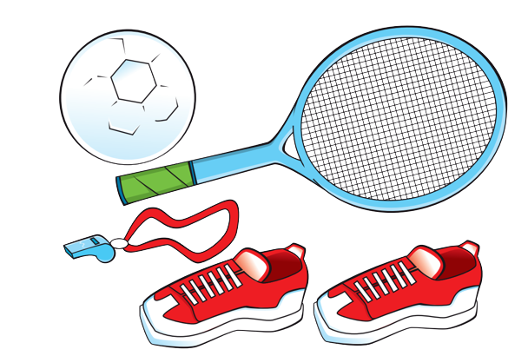

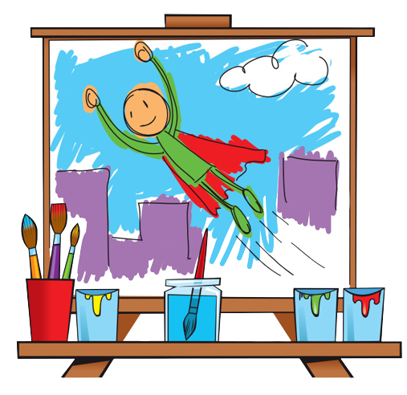
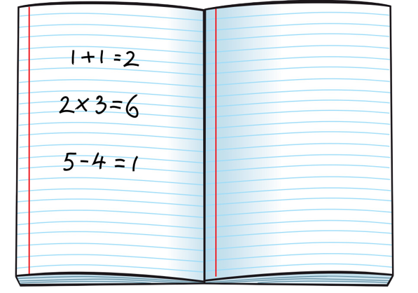
Unit 4
We have English!
Lesson 3 - Song

Slide 3
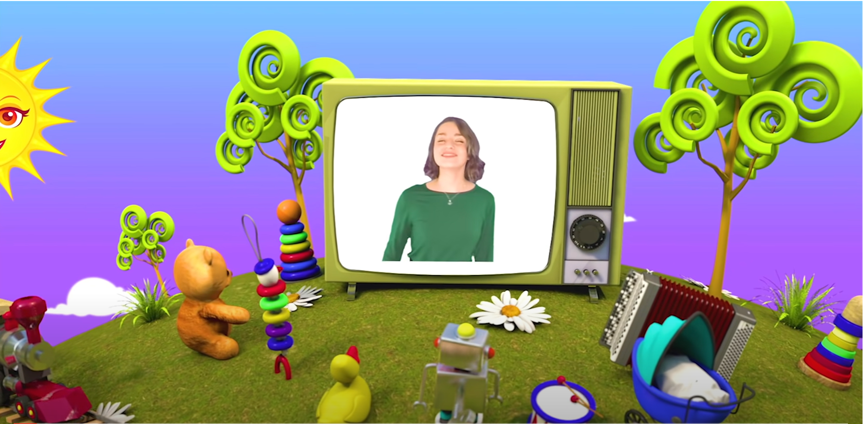
HELLO SONG
Notes:
https://www.youtube.com/watch?v=pqDEwPi7vxg

Slide 4






Slide 5
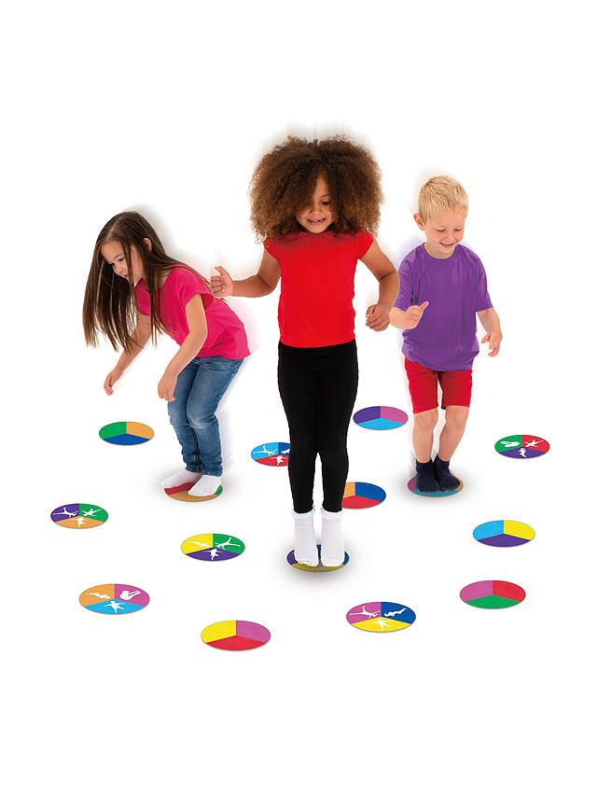
Game: JUMP!
Notes:
Give each child a word card with a school subject on it.
Ask them to stand behind their desks. Say a word at random.
If it is the same as the word on their card, they should jump.
If it isn’t, they should stay still.

Slide 6



Slide 7

Look and Say.
Notes:
Lead-in
• Talk about school subjects with the class to set up the context. Ask What do you have today? Art / Math / P.E.?
• Introduce the new vocabulary using the Places at school flashcards.
• Hold up the cards one at a time. Say the words for children to repeat.
• Show the cards in a different order. Children repeat.

Slide 8
Listen and Point.
Notes:
- Hold up the cards one at a time. Say the words for children to repeat.
- Play the second part for children to repeat.

Slide 9

Listen and Repeat.
Notes:
- Show the cards in a different order. Children repeat.
- Play the whole recording. Children listen and repeat.
- If you have all of these in your school, ask children Where do you have P.E. / art / computer lessons?

Slide 10
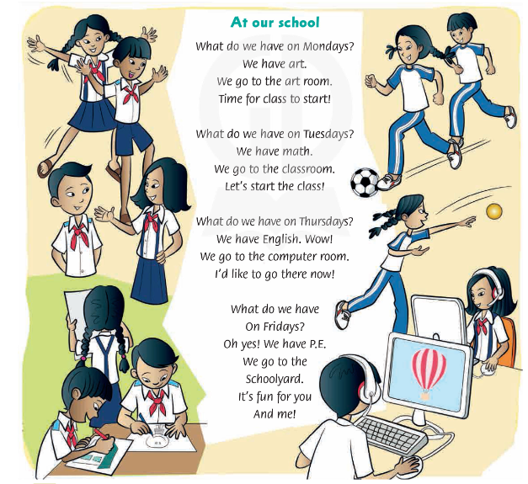
Listen and Sing.
Notes:
Point to the pictures. Children tell you what they see.
Play the whole song for children to listen. Then play it again as they follow the words in their books.
Read each line of the song line-by-line for children to repeat after you.
Play the recording for children to sing along.
Divide the class into four groups and assign each group a word: art room, schoolyard, computer room, and school.
Play the song. Each time children hear their word, they quickly stand up and sit down

Slide 11
Sing and Do.
Notes:
Song actions:
What do we have on Mondays? – show 1 with your finger to mean the first day of the week
We have art. – draw in the air
We go to the art room. – walk on the spot
Time for class to start! – point at your (imaginary) wristwatch or clock if you have one in the classroom
What do we have on Tuesdays? – show 2 with your fingers to mean the second day of the week
We have math. – mime counting on your fingers
We go to the classroom. – walk on the spot
Let’s start the class! – point at wristwatch or clock
What do we have on Thursdays? – show 4 with your fingers to mean the fourth day of the week
We have English. Wow! – mime reading a book
We go to the computer room. – walk on the spot
I’d like to go there now! – point at wristwatch or clock
What do we have on Fridays? – show 5 with your fingers to mean the fifth day of the week
Oh yes! We have P.E. – hop on the spot
We go to the schoolyard. – mime rope skipping
It’s fun for you and me! – children high-five each other

Slide 12
New version for the song
At our school
What do we have on _________ ?
We have _________ .
We go to the _______________ .
Time for class to start!
Notes:
Game: “New version for the song”
Show the song with blanks.
Ask the students to think of new words and use them to fill in the blanks.
Put the students into small groups of four or five and ask them to do the task.
Ask students to practice singing and doing the actions in groups.
Praise students if they have done well.

Slide 13
New version for the song
At our school
What do we have on _________ ?
We have _________ .
We go to the _______________ .
Let’s start the class!
Notes:
Game: “New version for the song”
Show the song with blanks.
Ask the students to think of new words and use them to fill in the blanks.
Put the students into small groups of four or five and ask them to do the task.
Ask students to practice singing and doing the actions in groups.
Praise students if they have done well.

Slide 14
New version for the song
At our school
What do we have on _________ ?
We have _________ . Wow!
We go to the _______________ .
I’d like to go there now!
Notes:
Game: “New version for the song”
Show the song with blanks.
Ask the students to think of new words and use them to fill in the blanks.
Put the students into small groups of four or five and ask them to do the task.
Ask students to practice singing and doing the actions in groups.
Praise students if they have done well.

Slide 15
New version for the song
At our school
What do we have on _________ ?
Oh yes! We have _________ .
We go to the _______________ .
It’s fun for you and me!
Notes:
Game: “New version for the song”
Show the song with blanks.
Ask the students to think of new words and use them to fill in the blanks.
Put the students into small groups of four or five and ask them to do the task.
Ask students to practice singing and doing the actions in groups.
Praise students if they have done well.

Slide 16
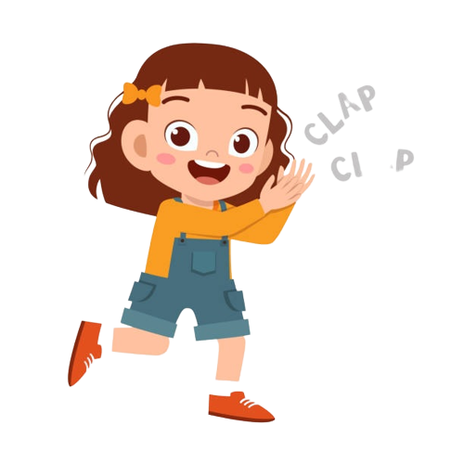
Good job!

Slide 17

HOMEWORK
Revise the words and the patterns.
Do the exercises in Workbook page 34.
Prepare for the next lesson
(Unit 4 - Lesson 4).

Slide 18


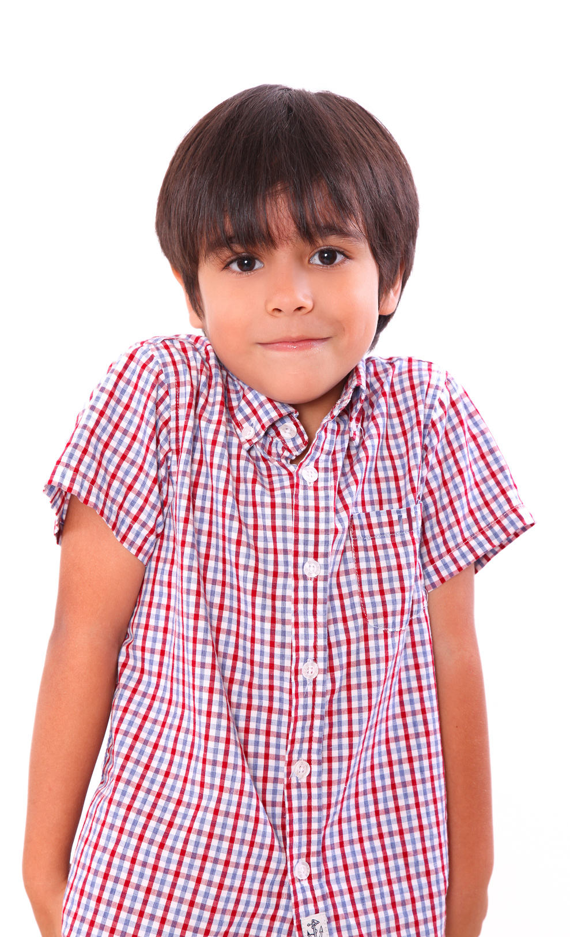
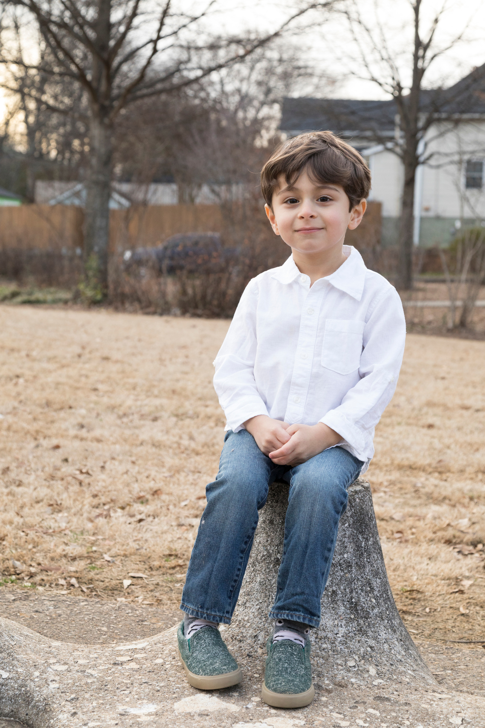
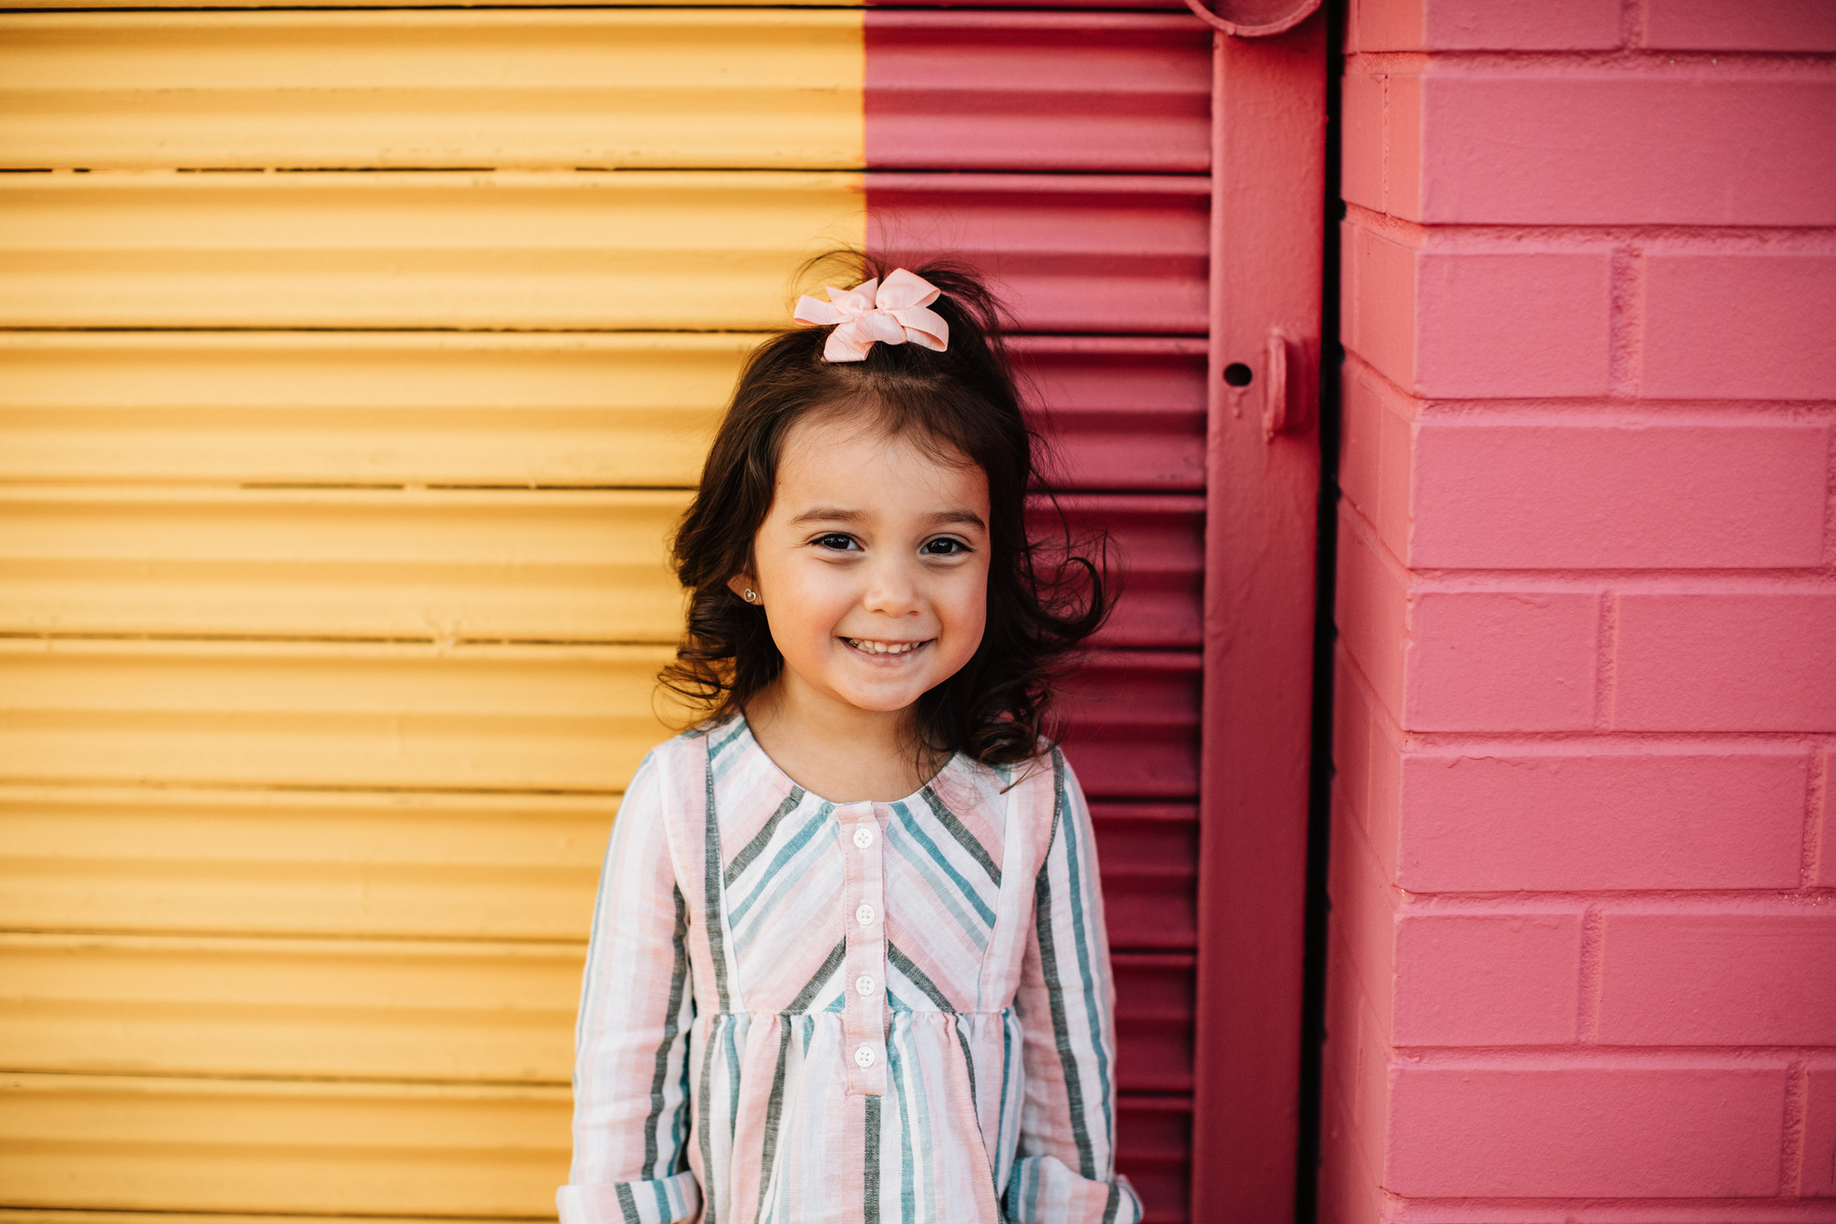
Our Winners!
Peter
Eric
Julie
Notes:
Replace photos and names with your students’ information.

Slide 19

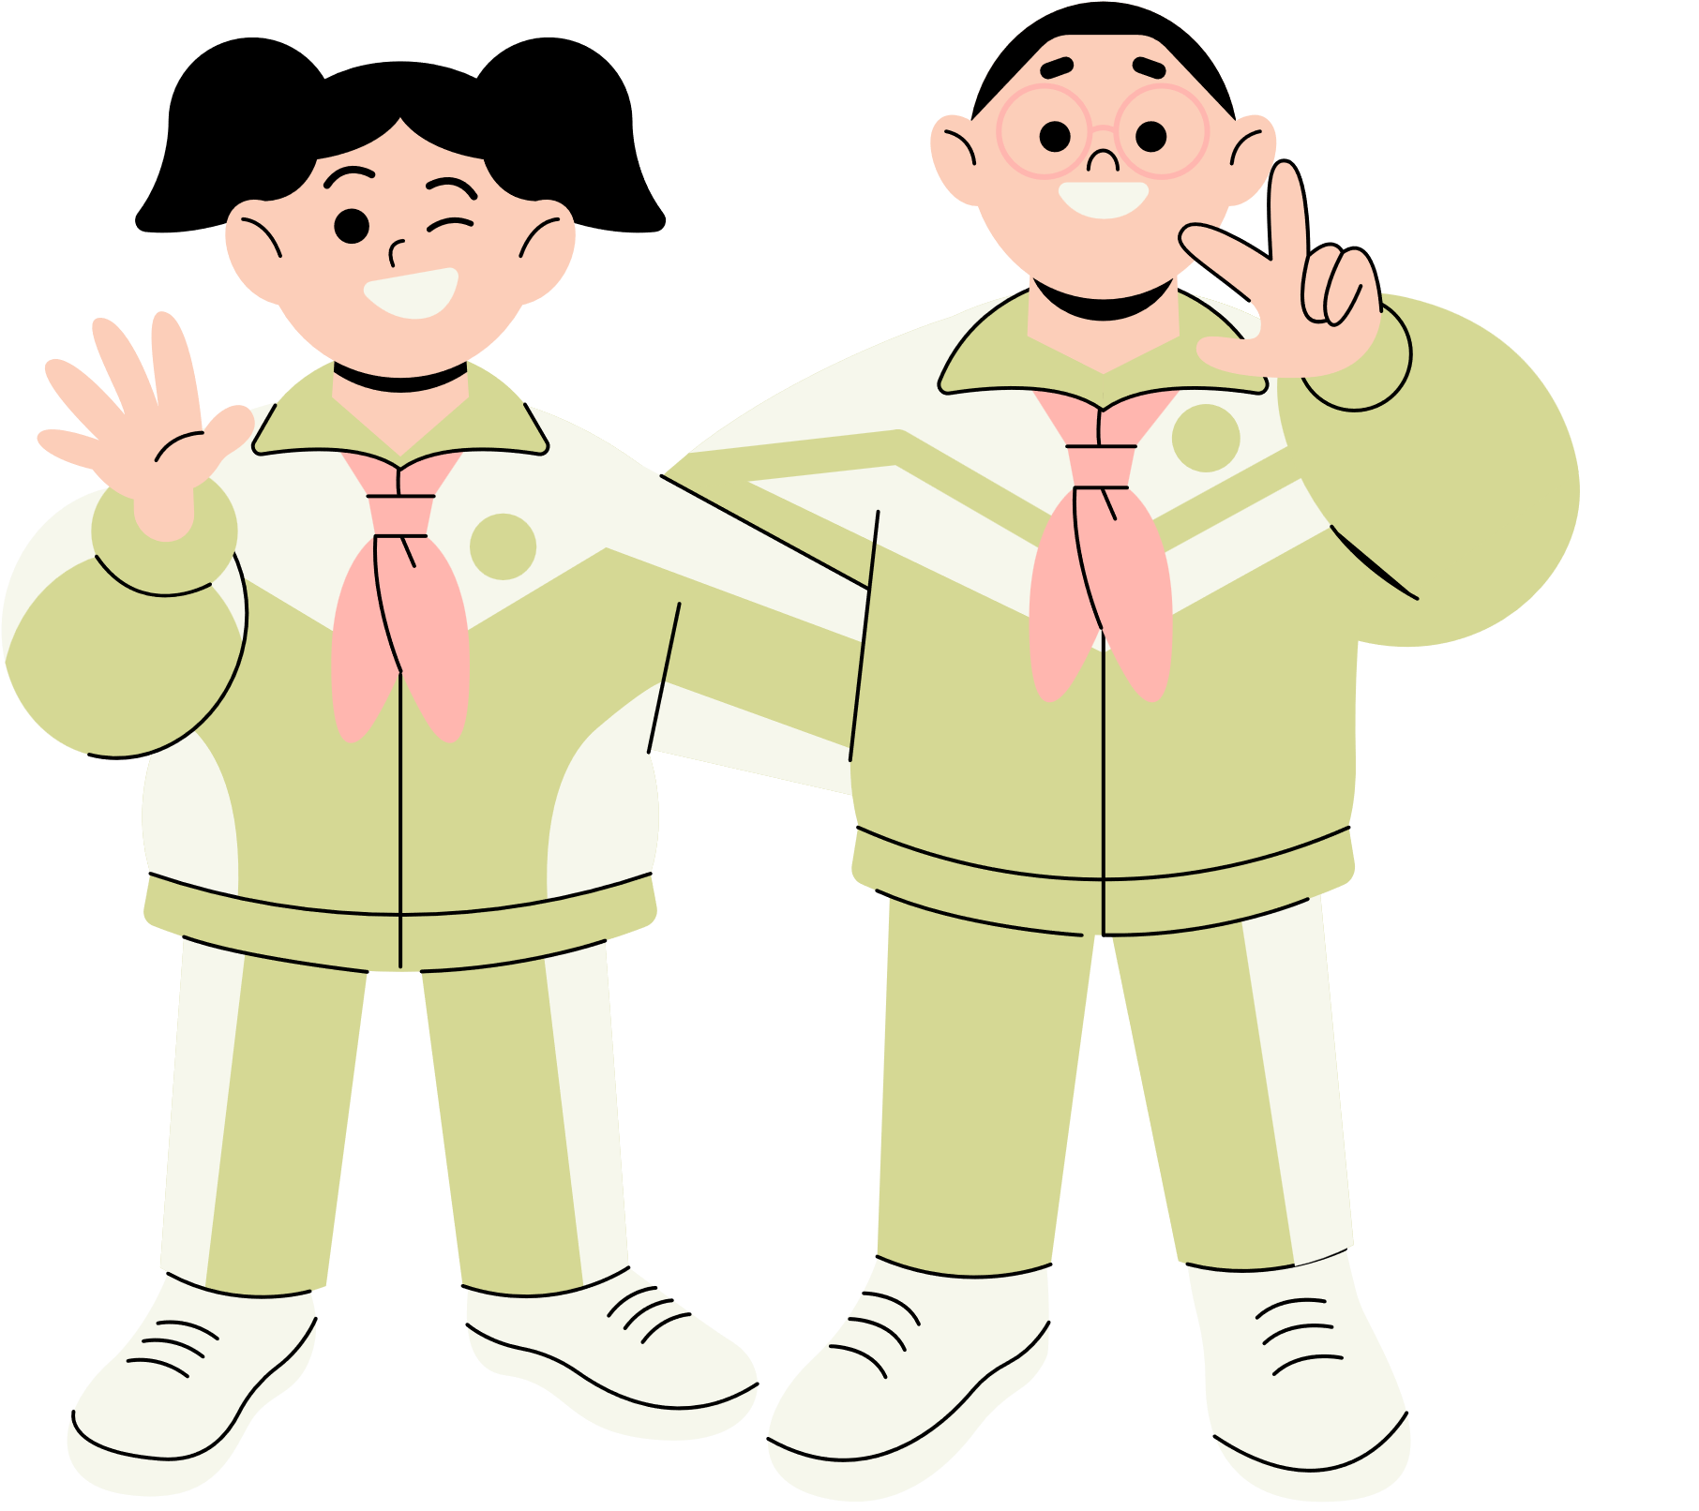








Thank You!
See You Next Time.
Notes:
https://www.youtube.com/watch?v=SRyFiVeNjWs

