Slide 2









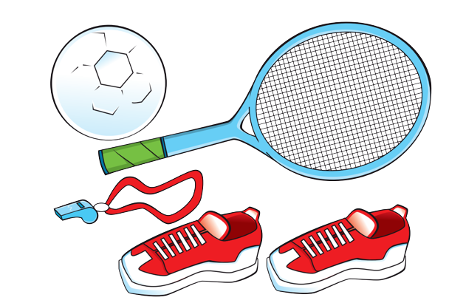
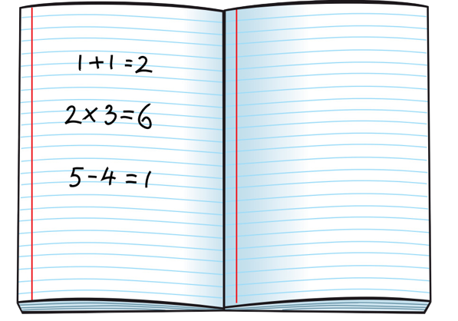
Unit 4
We have English!
Lesson 2 – Grammar - Period 2

Slide 3
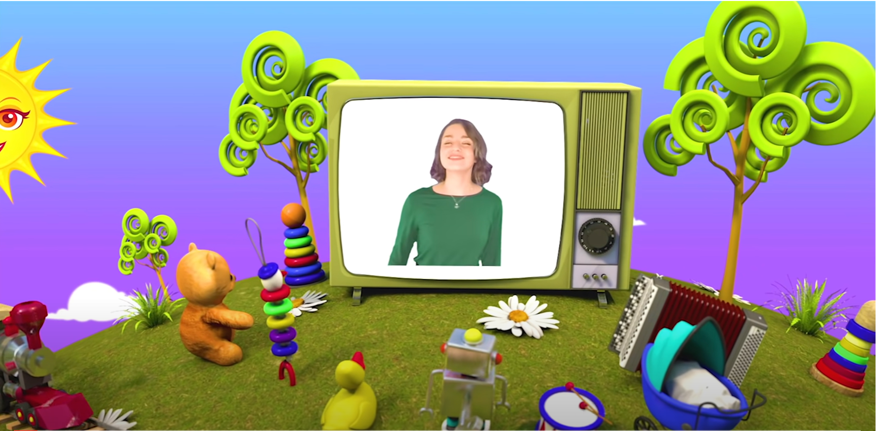
HELLO SONG
Notes:
https://www.youtube.com/watch?v=pqDEwPi7vxg

Slide 4






Slide 5
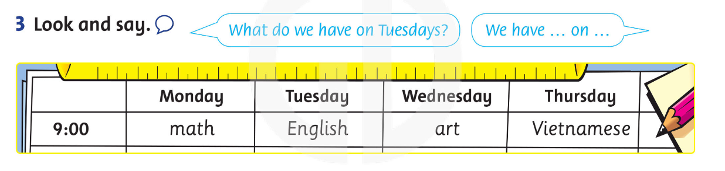
Game: INTERVIEW
Notes:
Game: “Interview”
Display the flashcards from the vocabulary set on the board.
Point to each one, one at a time, for children to say the words. Give the class a few seconds to look at them all.
Ask children to listen to music, move around with their schedule, ask questions about what subjects they have on different days of the week.
Stop music, ask students to sit down immediately.
Repeat the activity for more practice.

Slide 6



Slide 7
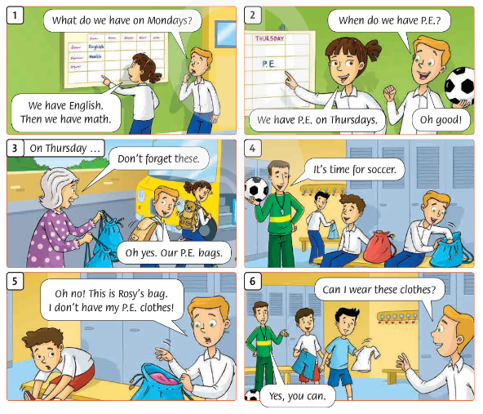
What happened
in the story?
2. Which subjects were mentioned in the story?
Notes:
Lead-in:
Ask children what happened in the story in the previous lesson. Hold up your book briefly on page 32 to encourage ideas. Then close your book and ask which subjects were mentioned in the story.

Slide 8

Look and Answer.
What can you see?
=> I can see……….
2. Can we take these bags?
=> Yes, you can.
Notes:
* Listen and say. (Track 50)
Ask children to look at the pictures in the Let’s learn! box.
Ask What can you see? Can we take these bags? Yes, you can. / No, you can’t.”

Slide 9
Look and Answer.
What can you see?
=> I can see……….
2. Can we take these bags?
=> No, you can’t.
Notes:
* Listen and say. (Track 50)
Ask children to look at the pictures in the Let’s learn! box.
Ask What can you see? Can we take these bags? Yes, you can. / No, you can’t.”

Slide 10

Point and Repeat.
Notes:
* Listen and say. (Track 50)
Children point to the picture and repeat.
Write the sentences and questions on the board. Play the recording again, miming the actions in the pictures to reinforce meaning. Children repeat.
Erase the last word in each sentence. Children suggest other words, e.g., Can we take these bags? Say the sentences for children to repeat.

Slide 11

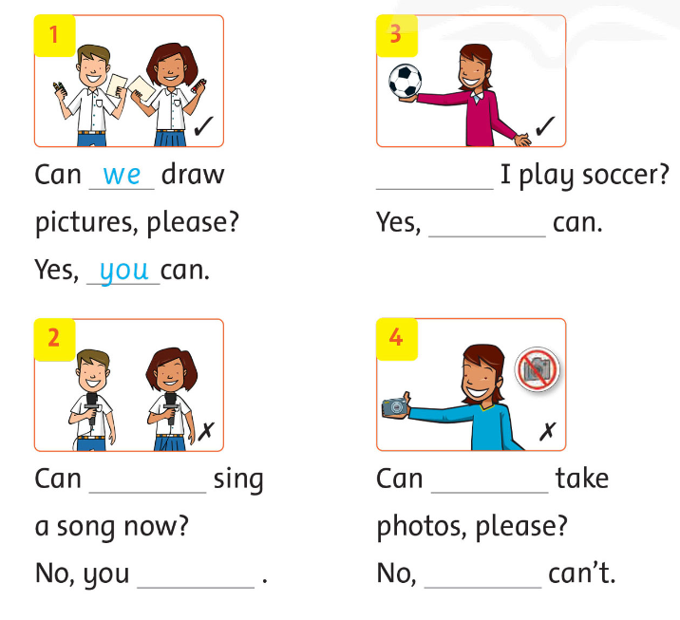
Look and Write.
Notes:
* Look and write.
Ask children to look at the pictures, the words, and the checks and crosses.

Slide 12
Look and Write.
Notes:
Show the first picture, the words, and the check. Ask Yes or no? (Yes). Show the example and ask two children to read the dialogue out loud.

Slide 13
Look and Write.
Notes:
Ask the children to write 1 to 4 in their notebooks and write the questions and answers.

Slide 14
Let’s see!
we
Can
I
you
can’t
you
Notes:
Answers
1 Can we draw pictures, please? Yes, you can.
2 Can we sing a song now? No, you can’t.
3 Can I play soccer? Yes, you can.
4 Can I take photos, please? No, you can’t.

Slide 15


Game: PASS THE BALL
Notes:
Passing the ball
Ask children to listen to music, pass the two balls (yellow and red) to each other.
Stop music, ask students with the two balls to ask for and give permission.
Repeat the activity for more practice.

Slide 16
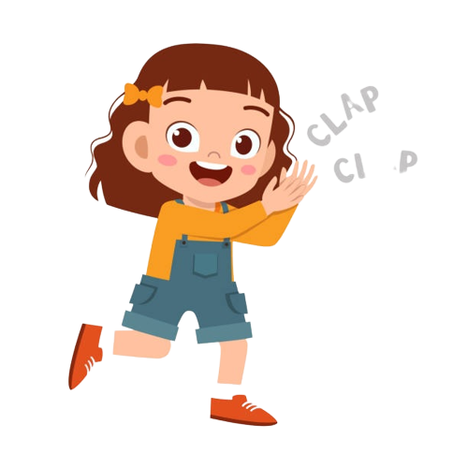
Good job!

Slide 17

HOMEWORK
Learn the patterns by heart.
Do the exercises in Workbook page 33.
Prepare for the next lesson
(Unit 4 - Lesson 3).

Slide 18



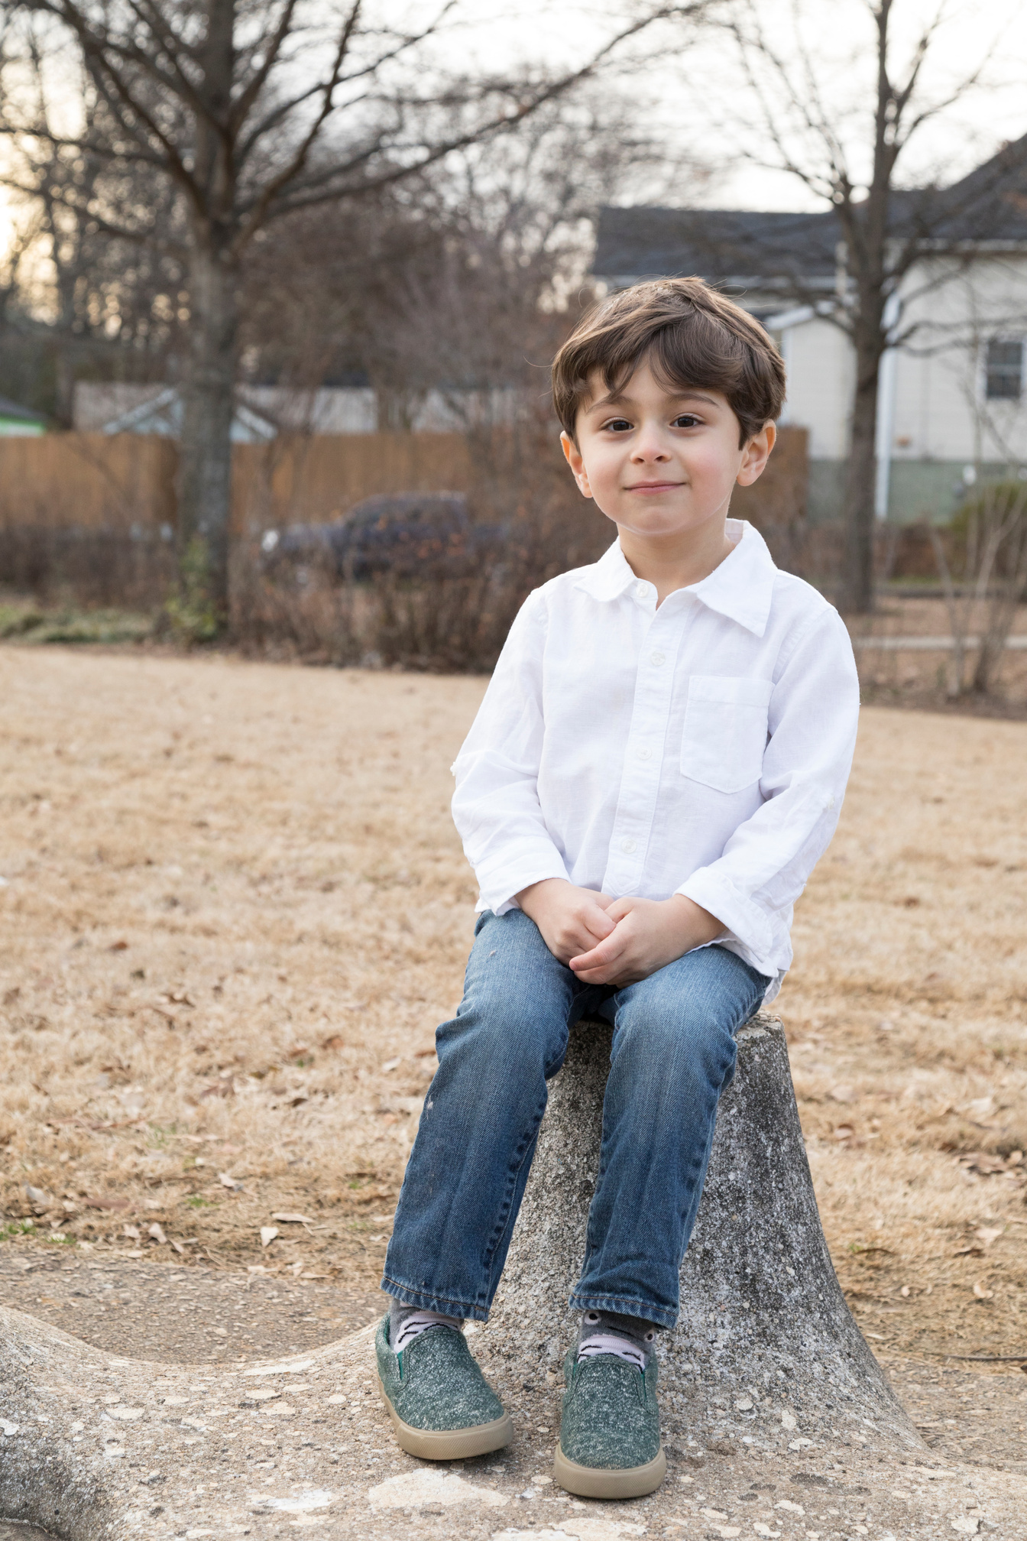
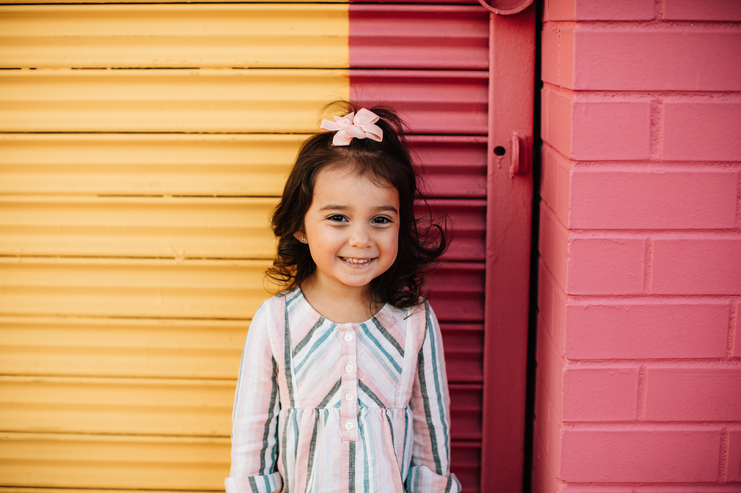
Our Winners!
Peter
Eric
Julie
Notes:
Replace photos and names with your students’ information.

Slide 19

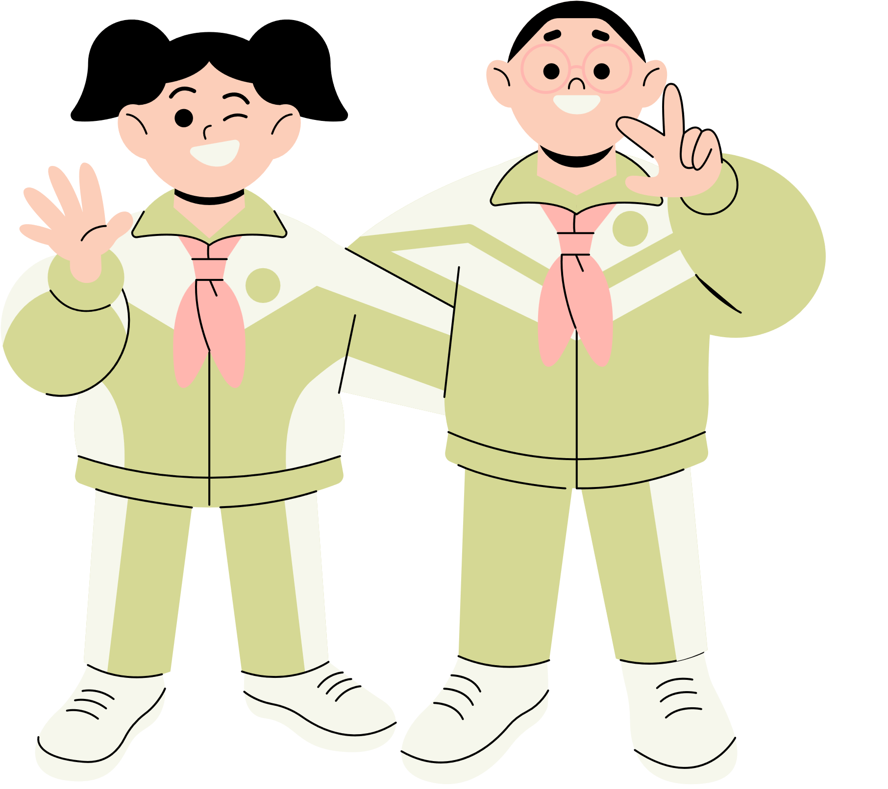








Thank You!
See You Next Time.
Notes:
https://www.youtube.com/watch?v=SRyFiVeNjWs

