Slide 2









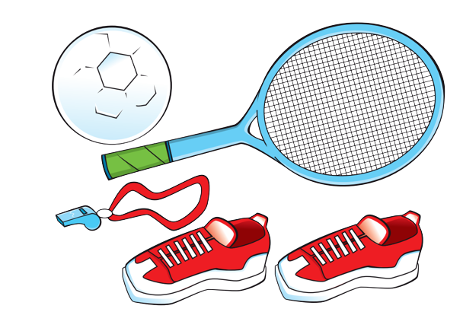
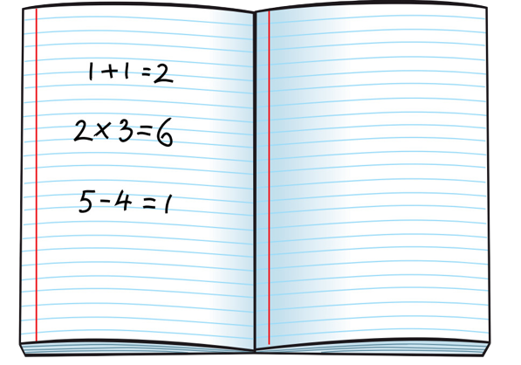
Unit 4
We have English!
Lesson 2 – Grammar - Period 1

Slide 3
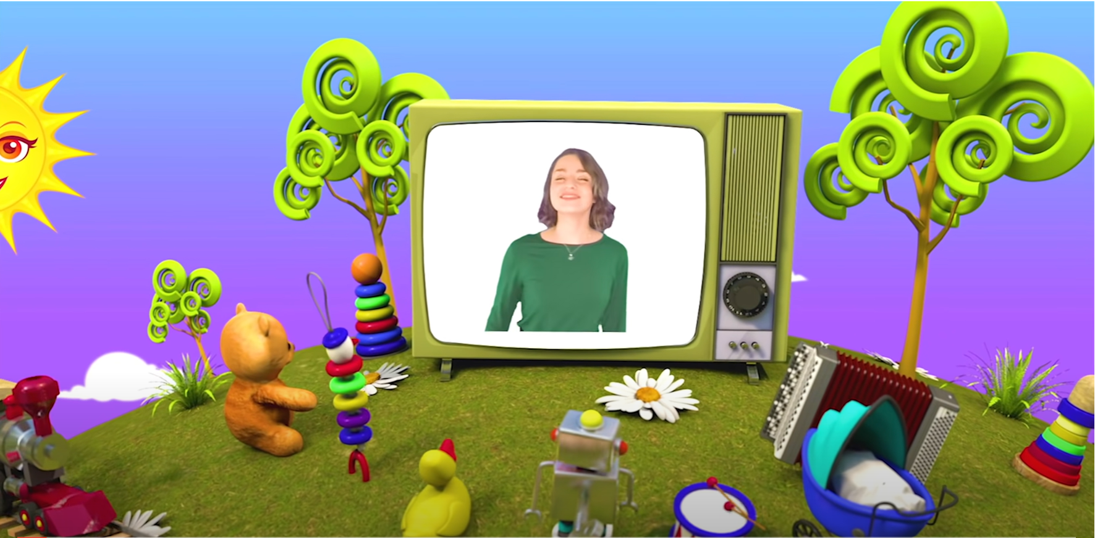

Let’s chant!

Slide 4






Slide 5

GAME: WHAT’S MISSING?
Notes:
Point to each one, one at a time, for children to say the words. Give the class a few seconds to look at them all.
Ask children to close their eyes and put their heads down. Remove a card and rearrange the others. Ask What’s missing?
Ask children to answer.
Repeat the activity to review all the vocabulary.

Slide 6
GAME: WHAT’S MISSING?

Slide 7



Slide 8
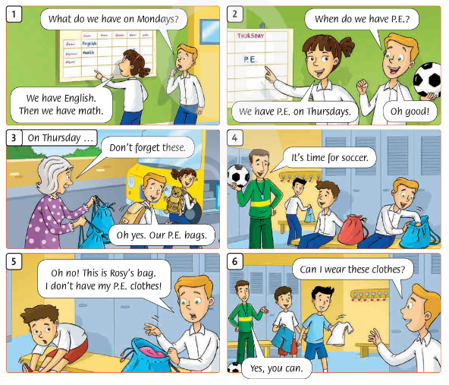
32
What happened in the story?
Which subjects were mentioned in the story?
Notes:
Lead-in:
Ask children what happened in the story in the previous lesson. Hold up your book briefly on page 32 to encourage ideas. Then close your book and ask which subjects were mentioned in the story.

Slide 9
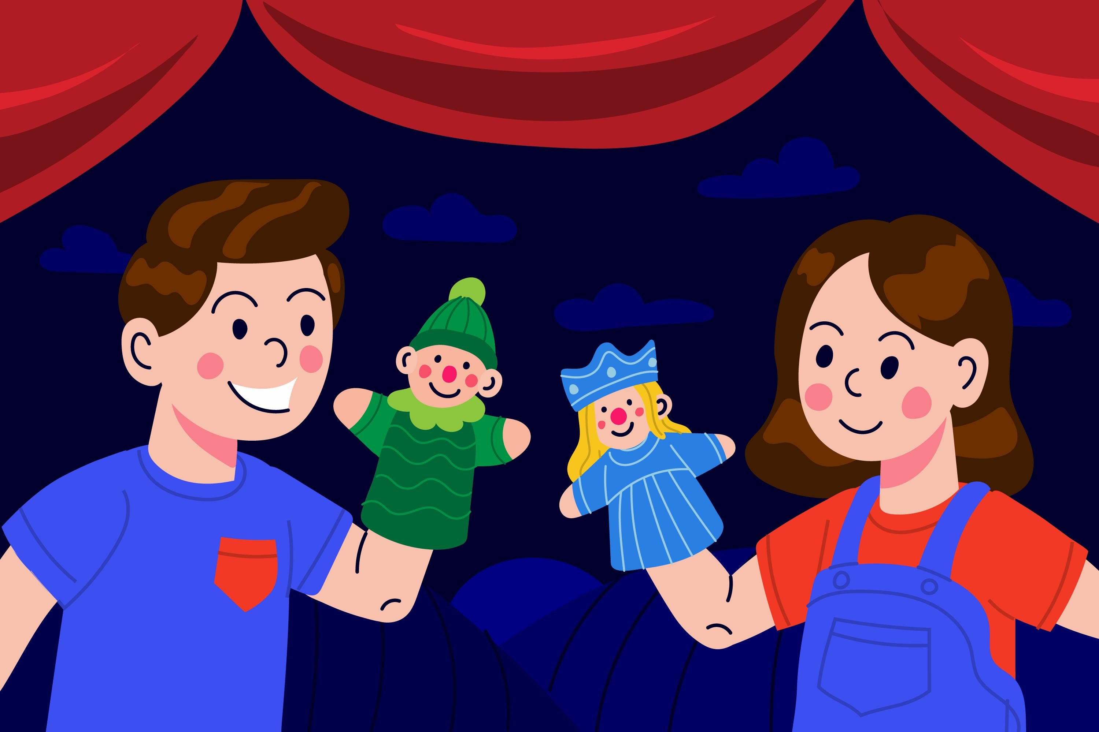
Role - Play
Notes:
Listen to the story again. (Track 49)
Children look at the story on page 32. Play Track 49, pausing for children to repeat.
As a class, choose actions for the story (see ideas below).
Play the recording again. Children mime the actions.
Divide the class into groups to play the characters and practice acting out the story.

Slide 10

Look and Answer.
33
What can you see?
I can see……….
2. What do we have on Mondays?
We have English on Mondays..
Notes:
Listen and say. (Track 50)
Ask children to look at the pictures in the Let’s learn! box.
Ask What can you see? What do we have on Mondays? We have English on Mondays

Slide 11
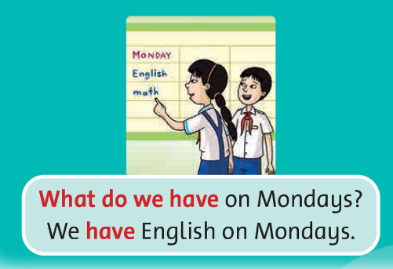
Listen and Say.
Notes:
Listen and say. (Track 50)
Play the recording, pausing after each sentence and question “What do we have on Mondays? We have English on Mondays.” Children point to the picture and repeat.
Write the sentences and questions on the board. Play the recording again, miming the actions in the pictures to reinforce meaning. Children repeat.
Erase the last word in each sentence. Children suggest other words, e.g., What do we have on Tuesdays? Say the sentences for children to repeat.

Slide 12
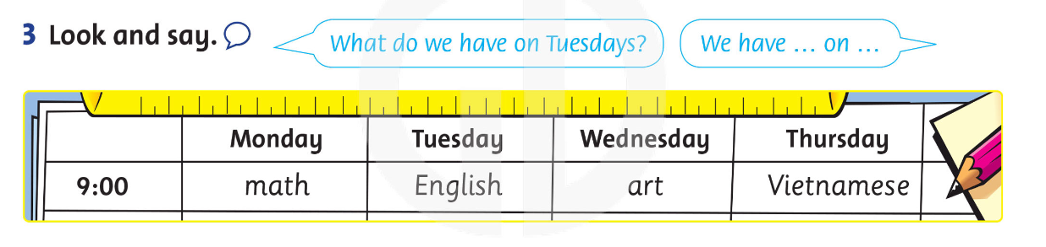
Look and Say.
Notes:
Look and say.
Ask the class to look at the schedule and read the days of the week and the school subjects out loud.
Focus on the speech bubbles. Ask a child to stand up. Ask the question for him/her to answer.
In pairs, children ask and answer questions about the other subjects in the schedule.

Slide 13

Let’s talk!
Notes:
• Focus on the picture and speech bubble. Ask a child to read We can play soccer in P.E. today.
• In pairs, children take turns saying the sentence using other vocabulary from the lesson

Slide 14
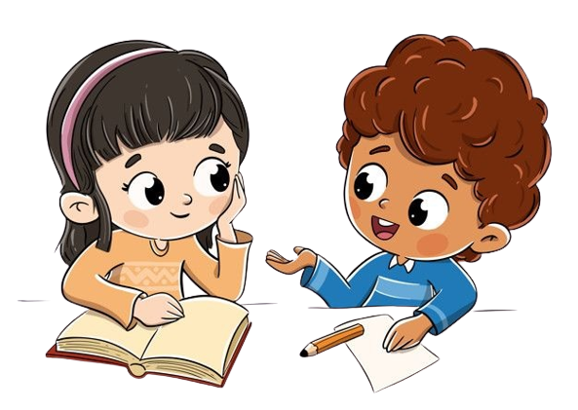
Work in Pairs.
We can play soccer in P.E. today.

Slide 15

Good job!

Slide 16

HOMEWORK
Learn the patterns by heart.
Do the exercises in Workbook p. 33.
Prepare for the next lesson
(Unit 4 - Lesson 2/Period 2).

Slide 17



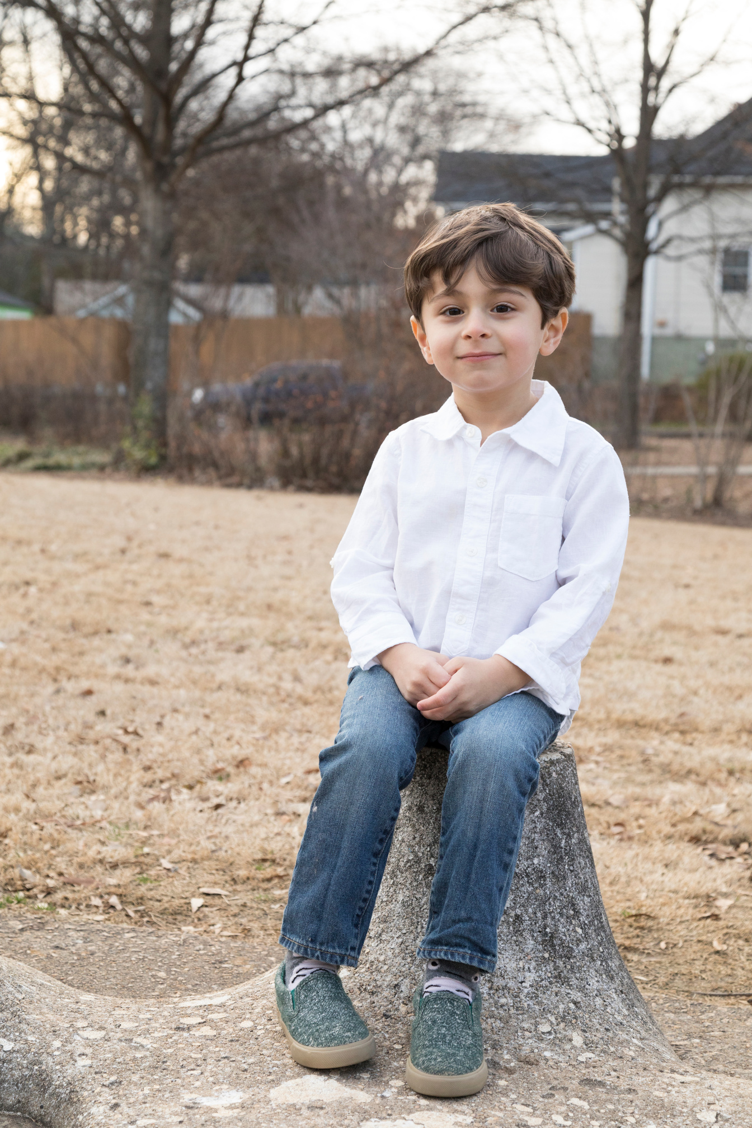
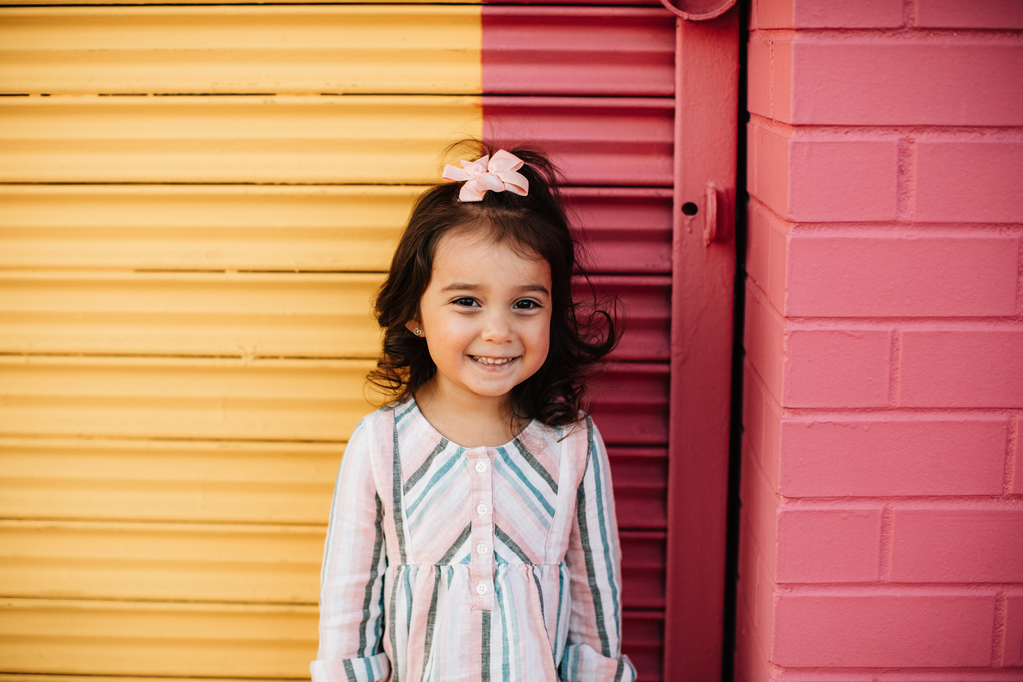
Our Winners!
Peter
Eric
Julie
Notes:
Replace photos and names with your students’ information.

Slide 18

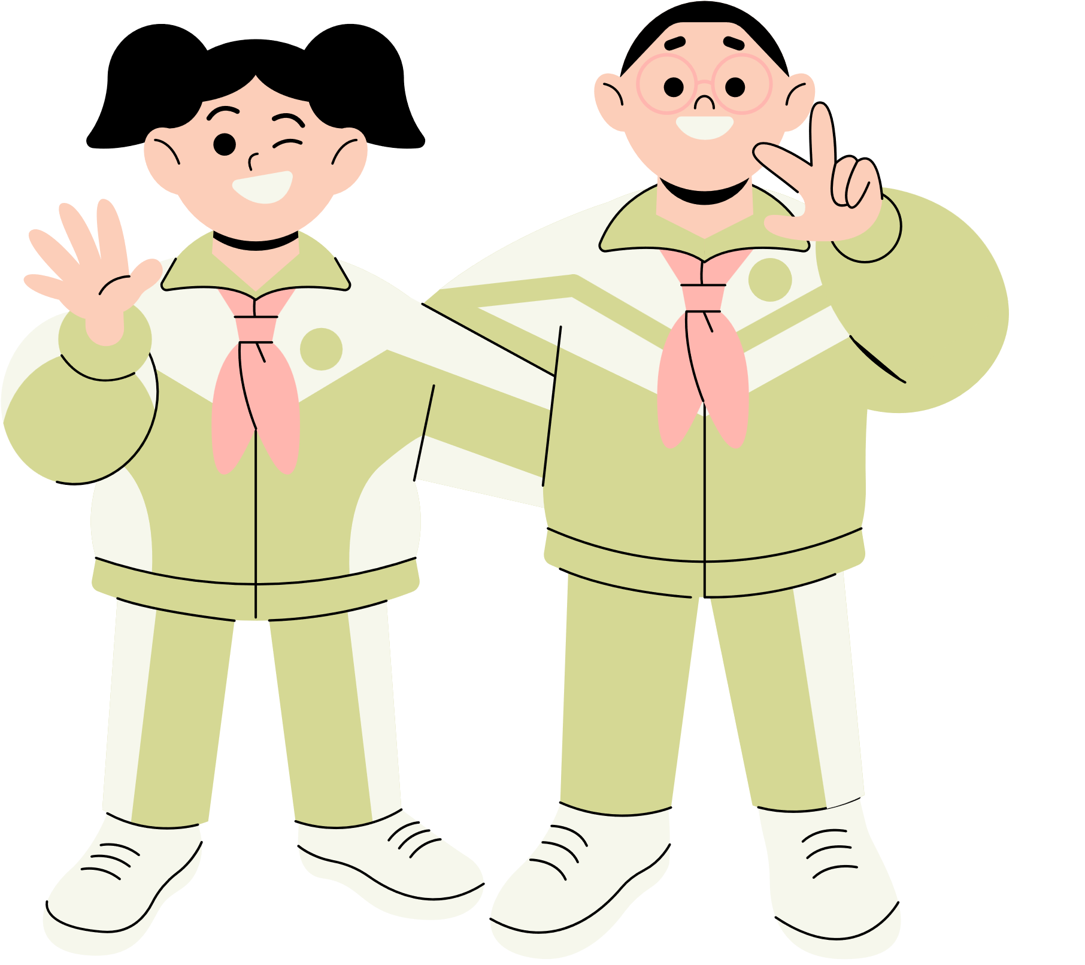








Thank You!
See You Next Time.
Notes:
https://www.youtube.com/watch?v=SRyFiVeNjWs

