Slide 1


Slide 2



Slide 3
What is missing ?

Slide 4

Unit 1 This is your doll. Lesson 5 – Skills Time

Slide 5
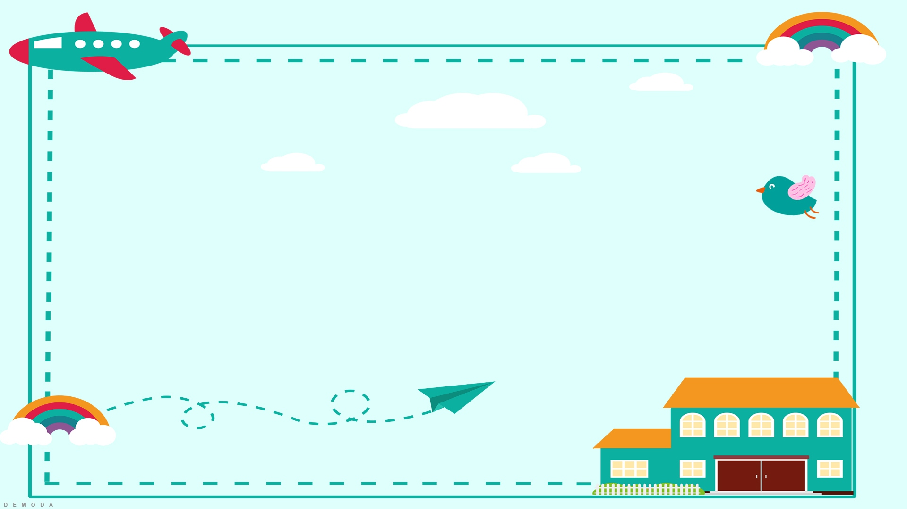
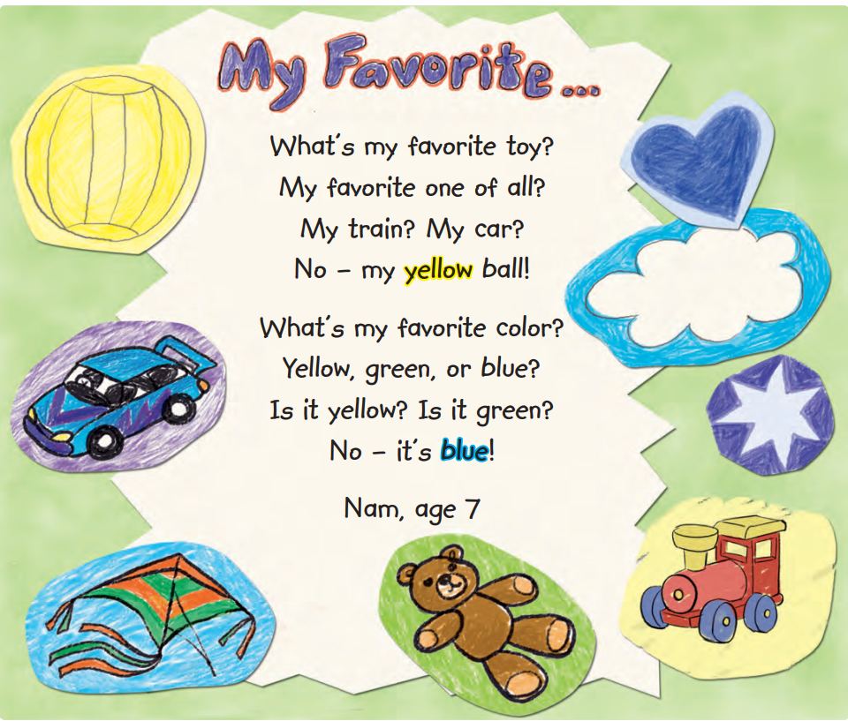

Slide 6

1. Point to a color and a toy. Say the words

Slide 7


2. Read and listen to the poem.

Slide 8


favorite

Slide 10
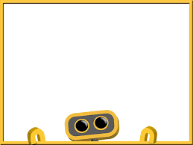
1. Nam’s favorite toy is a ______ .
ball
2. Nam’s favorite color is ______ .
blue

Slide 11
Nam’s favorite toy is a ball.
Nam’s favorite color is blue.

Slide 12
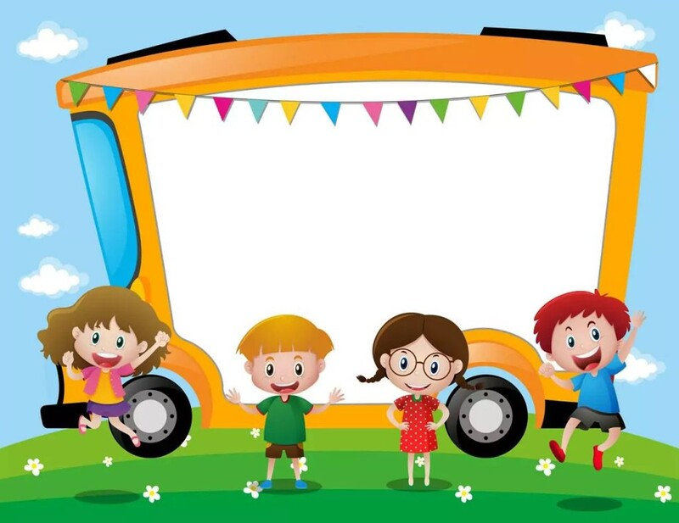
Work in groups

Slide 13
Talk about yourself
My favorite toy is a _______.
My favorite color is _______ .

Slide 14



Slide 15


Slide 16


