Slide 1
Unit 10.
Our houses in the future
LESSON 4. COMMUNICATION

Slide 2

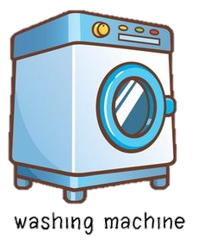
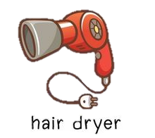


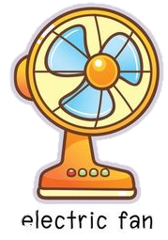

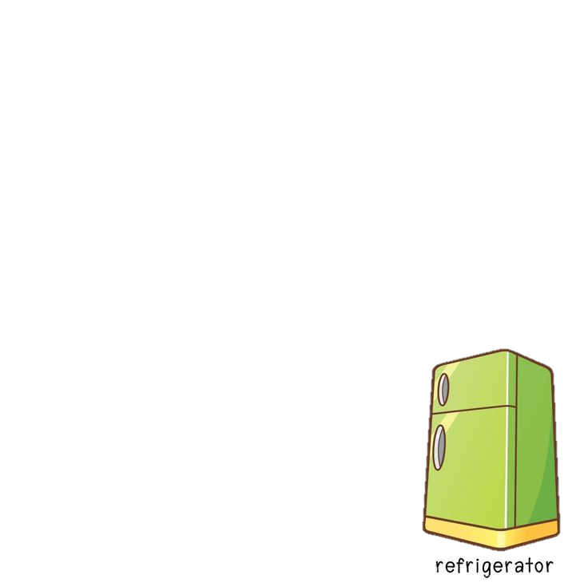
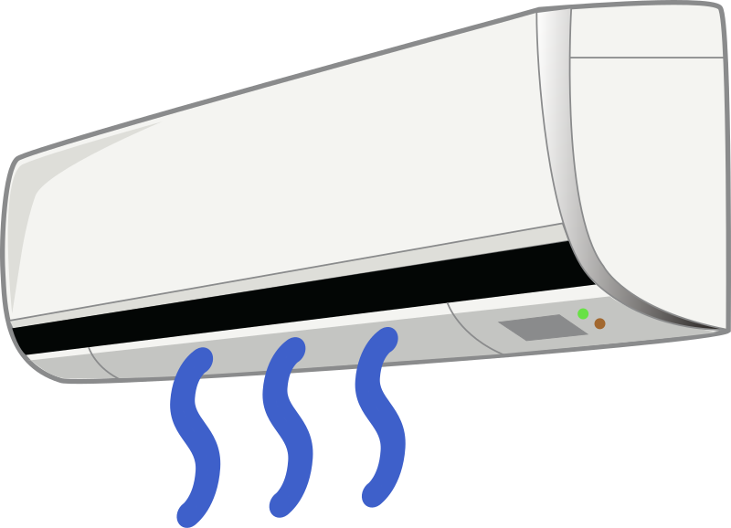
BINGO
Teacher makes model.
Ask student take turn to read out loud a household appliance.
Who has a line of 3 can shout: BINGO.
Read out loud household appliances.
Notes:
Bấm vào vòng tròn để hiện ra hình ảnh
Hàng ngang thứ 1: washing machine, hair dryer, blender
Hàng ngang thứ 2: electric cooker, iron, electric fan
Hàng ngang thứ 3: computer, fridge, air conditioner

Slide 3
OBJECTIVES
By the end of the lesson, students will be able to:
01
02
Express surprise.
Conduct a survey and report the result in verbal form.

Slide 4
Everyday English
Ex 2. (p 43) Work in pair. Express your surprise when you see your partner’s new watch, TV, mobile phone, etc.
Ex 1. (p 43) Listen and read the conversation.
DAVID | John! Hello!
JOHN | Oh, hi, David. Wow! Is that your computer? It looks great.
DAVID | Yes, it’s my new computer. My parents gave it to me for my birthday.
Oh, hi, David. Wow! Is that your computer? It looks great.
Point out the expressing surprise
(Wow! Is that + object?
It looks + adjective).
Notes:
Circle the word that you replace

Slide 5
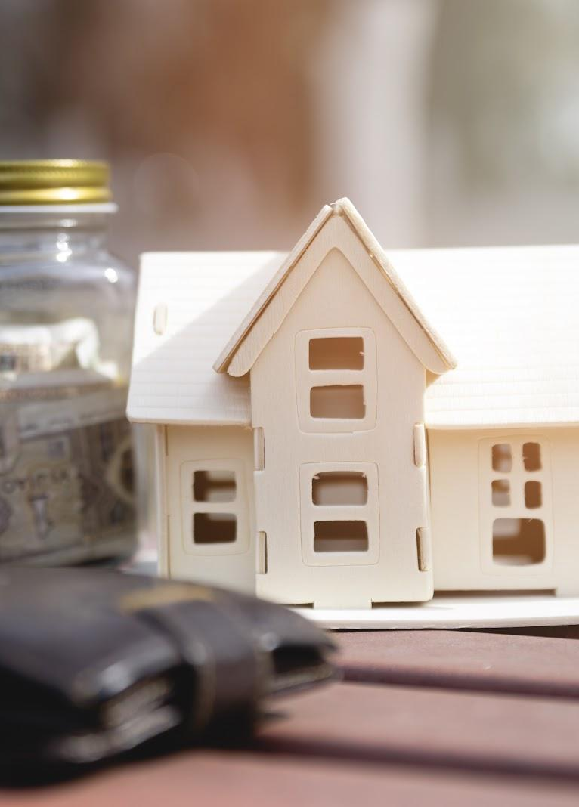
Houses and appliances in the future
Can you list types of houses and appliances?
Conduct a survey and report the result
in verbal form.

Slide 6
Ex 3. (p 43) Read the questions in the class survey below.
Tick (√) Y (Yes) or N (No).
No | Questions | Y | N
1 | Will you live in a hi-tech house?
2 | Will your house be in space?
3 | Will you have a lot of trees and flowers around your house?
4 | Will you have a fridge that can cook your meals?
5 | Will you have a robot that can look after your children?
6 | Will you have a car that can fly

Slide 7

Ex 4. (p 43) Work in pair.
Use the questions in Ex 3 to interview your partner.
Example
You | Hi, Nam. Will you live in a hi-tech house in the future?
Nam | Yes, I will.
You | Will your house be in space?
Nam | Oh, no. It won’t.
You | So where will it be?
Nam | I’m not sure. It might be by the sea.

Slide 8
Checking
Ex 5. (p 43) Tell the class about your interview.
Hello. I’d like to tell you about Nam’s house and appliances that will help him to do things in his house… His future house will be a UFO. It’ll be in space. He might have a robot to help him with his home. Thank you for listening.
Is the pronunciation correct?
Is the tense correct?
Is it full of ideas?

Slide 9
RECAP
WHAT HAVE YOU LEARNT TODAY?
01
Repeat houses and appliances
02
Express surprise
Talk about houses and appliances in the future
03

Slide 10
RECAP
Which sentence expresses surprise?
01
Wow! It’s awesome.
02
That’s terrible.
03
What a surprise!

Slide 11
Thank you

Slide 12

A PICTURE IS WORTH A THOUSAND WORDS

Slide 13
ICON PACK

Slide 14
ALTERNATIVE RESOURCES
Here’s an assortment of alternative resources whose style fits that of this template:
People earning money set of flat icons with isolated human characters coins banknotes books and gadgets vector illustration

