Slide 1
Unit 10. our houses in the future
LESSON 3: A CLOSER LOOK 2

Slide 2
objectives
By the end of the lesson, students will be able to use:
Grammar
Future simple
Might for future possibility

Slide 3




FILL IN THE LYRICS
What tense is it?
Future simple
And I... ____ always love you
I ____ always ____ you *4
I, I will always love you.
will
will love
You're here, there's nothing I fear
And I know that my heart ___ ___ on
We ___ stay forever this way
You are safe in my heart and
My heart will ___ ___ and on.
will go
’ll
go on

Slide 4
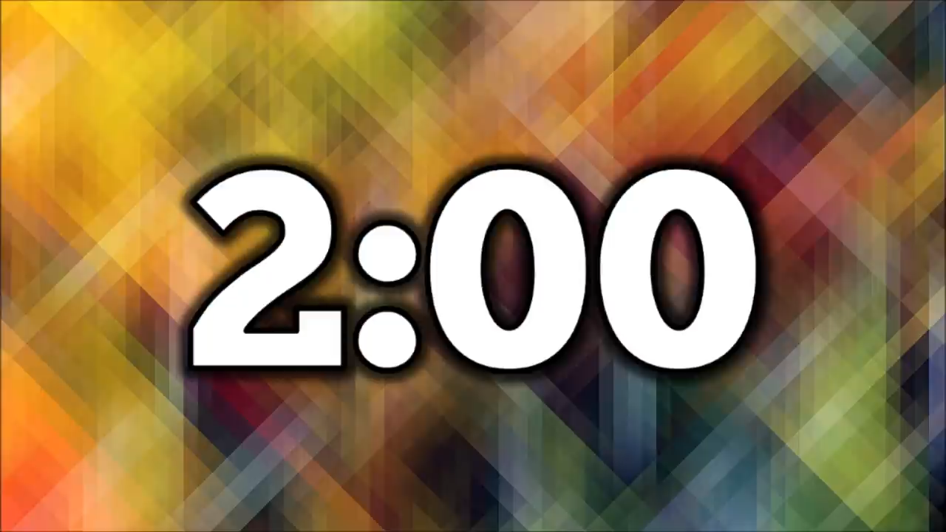
Chain game
Think of your activity in 2050
I will be older and I will be a president and I will get much money.
Repeat and add your own sentence.
I will be older.
I will be older and I will be a president.
Call
Call
Call
Student 1
Student 2
Student 3
Student 4

Slide 5
Which tense do you use in those sentence?
1
→ Future simple tense
2
When do we use this tense?
→ When we talk about an action that happens in the future.

Slide 6
structure
+
S + will + V
-
S + will not (won’t) + V
?
Will + S + V ?

Slide 7
Signal
1. Adverbs of time
Tomorrow
Next week/ month/ year/ day/ Sunday …
Someday
In + period of time: in 3 months, in 4 minutes
2. Some verbs
Think
Promise
Predict
Think/ believe/ suppose
3. Some adverbs
Perhaps
Probably
Maybe

Slide 8
Ex 1. Fill will (‘ll) or won’t to make the sentences true for you (P.41)
Ex 1. underline the signal in each sentence (P.41)
Example:
I think I’ll listen to music in the afternoon.
1.
I think I _______ stay at home tonight.
2.
My friends _______ go to the library this afternoon.
3.
My mum _______ make a cake today.
4.
I _______ have an English test tomorrow.
5.
Our family _______ move to the new house next week.

Slide 9
Ex 2. Complete the conversation with will ('ll) or won’t. (P.41)
A: Oh, no. The dog ran away again!
B: Don’t worry – he (1) _______ come back.
A: Are you sure he (2) _______?
B: OK, he might not come back today. But I’m sure he (3) _______
come back tomorrow.
A: I don’t believe you! He (4) _______ comeback. We (5) _______
never see him again. I’m sure.
B: Oh, look ... Here he is!
will / ‘ll
will
will / ‘ll
won’t
will / ’ll

Slide 10
Ex 3. Write sentences, using will ('ll) or won't and the words given. (P.41)
1.
computer / do / housework
A computer will / won’t help me to do my housework.
2.
robot / water / ﬂowers
A robot will help me to water the flowers.
3.
smart TV / cook / meal
A smart TV won’t help me to cook meals.
4.
washing machine / iron / clothes
A washing machine will / won’t help me to iron the clothes.
5.
smartphone / take care / children
A smartphone won’t help me to take care of the children.

Slide 11
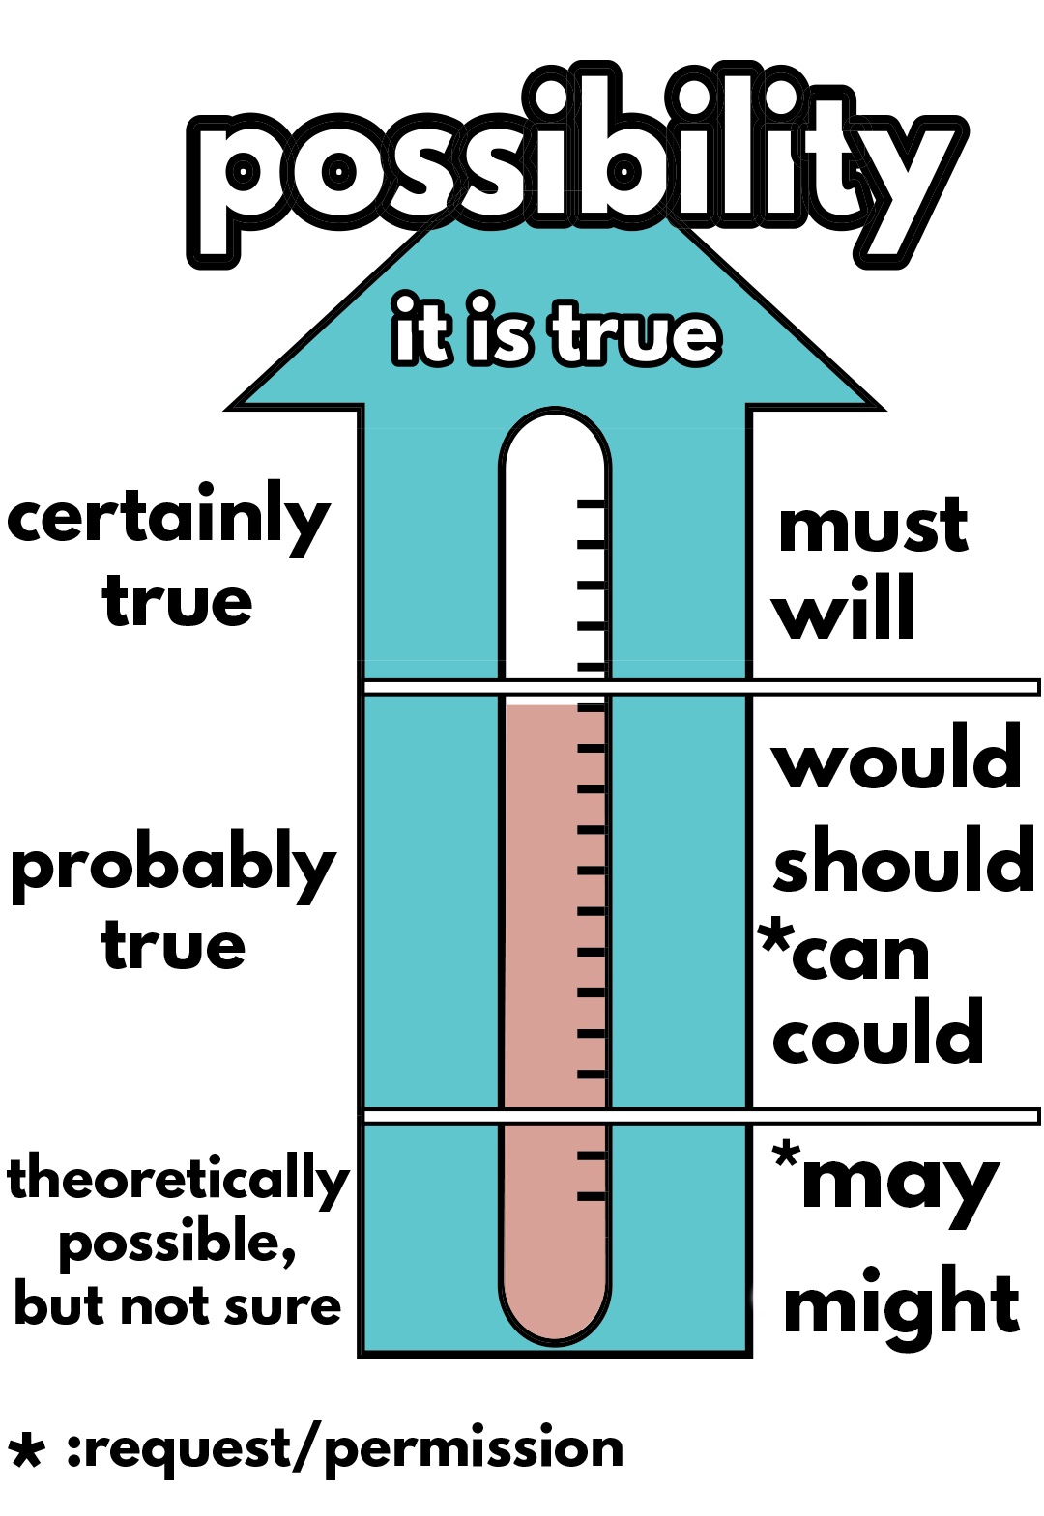
“We might live in a UFO.”
What structure do I use in this sentence?
might + V
Why do I use “might” instead of “will”?
We use might for future possibility.
Notes:
I’m not sure but I think robots might not do everything we want, because they are not human, they don’t have feelings … - What verb do I use in this sentence? (might) - Why do I use ‘might’ instead of ‘will’? Let’s see it more clearly.

Slide 12


Might for future possibility
We use might + V to talk about actions that are possible in the future (We are not sure if they will happen or not).
Example:
We might live in a UFO.
They might not travel in cars.

Slide 13


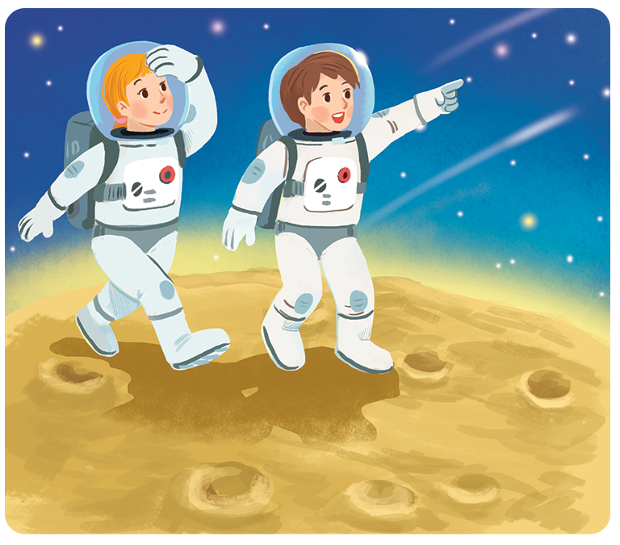
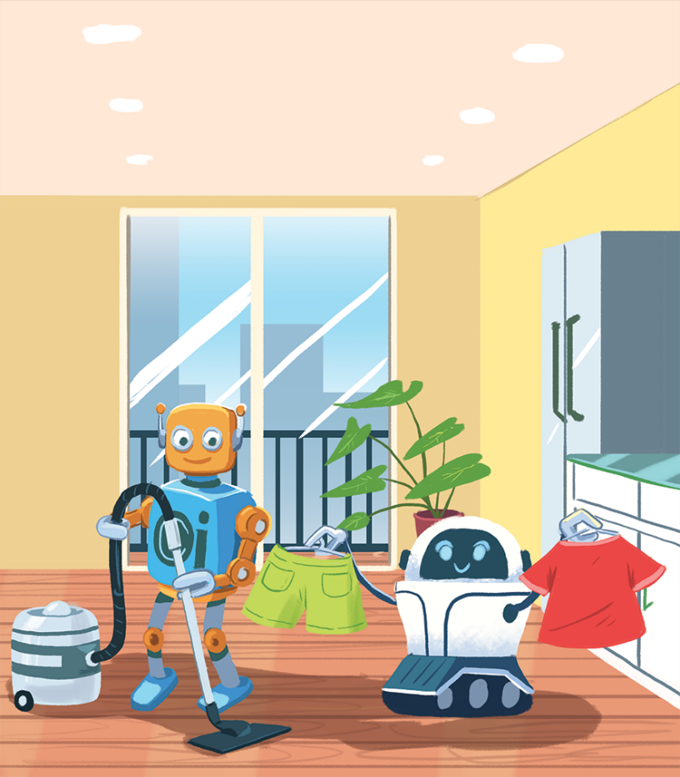
Ex 4. Read the two poems. (p.41)
In the future
We might live with robots.
They might clean our houses.
They might wash our clothes.
They might not talk to us.
Jenny, aged 12
In the future
We might go on holiday to the Moon.
We might stay there for a long time.
We might have a great time.
We might come home soon.
Henry, aged 11

Slide 14
Ex 4. Tick () T (TRUE) or F (FALSE). (p.41)
In the future
In the future
We might go on holiday to the Moon.
We might stay there for a long time.
We might have a great time.
We might come home soon.
We might live with robots.
They might clean our houses.
They might wash our clothes.
They might not talk to us.
Henry, aged 11
Jenny, aged 12
 | T | F
1. Jenny thinks we might live with robots.
2. Henry thinks we might travel to the Moon.
3. Jenny thinks robots might not clean our houses.
4. Henry thinks we will stay on the Moon for a short time.
5. Jenny thinks robots might help us do the housework.
6. Henry thinks we might not have a great time on the Moon.
✓
✓
✓
✓
✓
✓

Slide 15
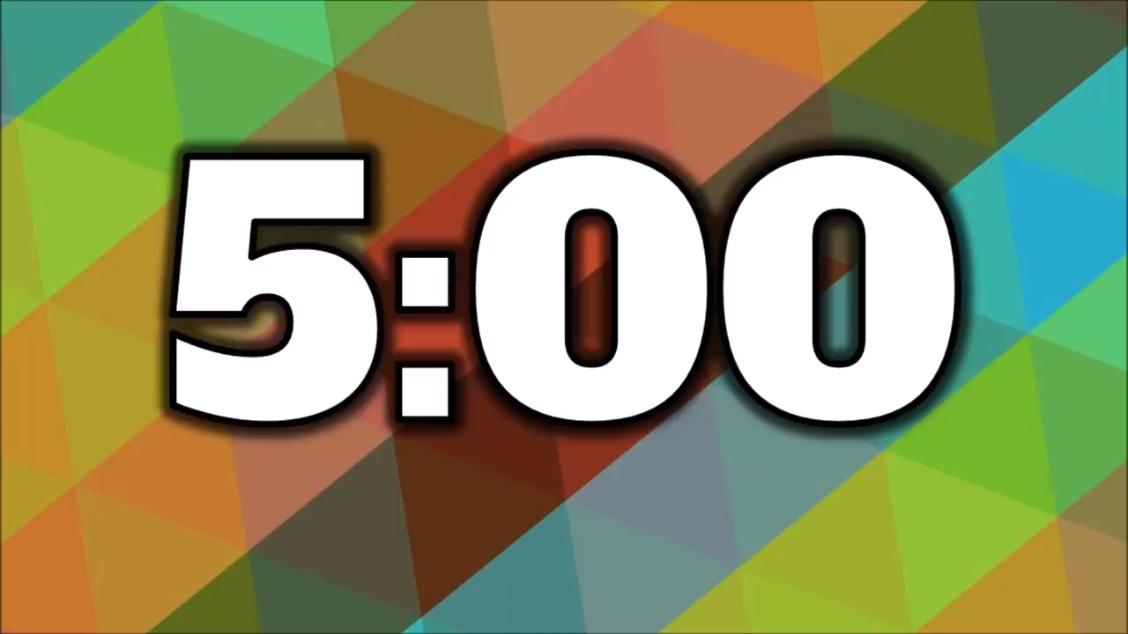
Ex 5. group work (p.41)
Your friends’ future ability
Work in groups of 3
Think about what you might do or have in the future.
Share your ideas with your friends
Listen and note down your friends’ ideas.
Then, report in front of the class.
Notes:
Above is Henry’s and Jenny’s ideas about what they might do in the future.
What about you, yourselves?
Do you think you and your friends might do the same things in the future?
Let’s make a survey in a group of 3 and then talk about your friends’ future ability.
You have 5 mins.

Slide 16
recap
What have you learnt today?
Use present simple, might for future possibility
Use future simple with “shall”, might for future possibility
✓
Use future simple with “will”, might for future possibility

Slide 17
Choose the correct answer
1
She is in the hospital now.________ we go and see her?
C. Will
A. Might
B. Might not
2
When you see Hoa, I'm sure that you________ her.
A. might like
B. will like
C. won’t likes
3
He has to do a lot of work, so he ________ home very late.
A. might come
B. will come
C. might not come

Slide 18
Thank you

