Slide 1
UNIT 10 OUR HOUSES IN THE FUTURE
Lesson 2: A closer look 1

Slide 2
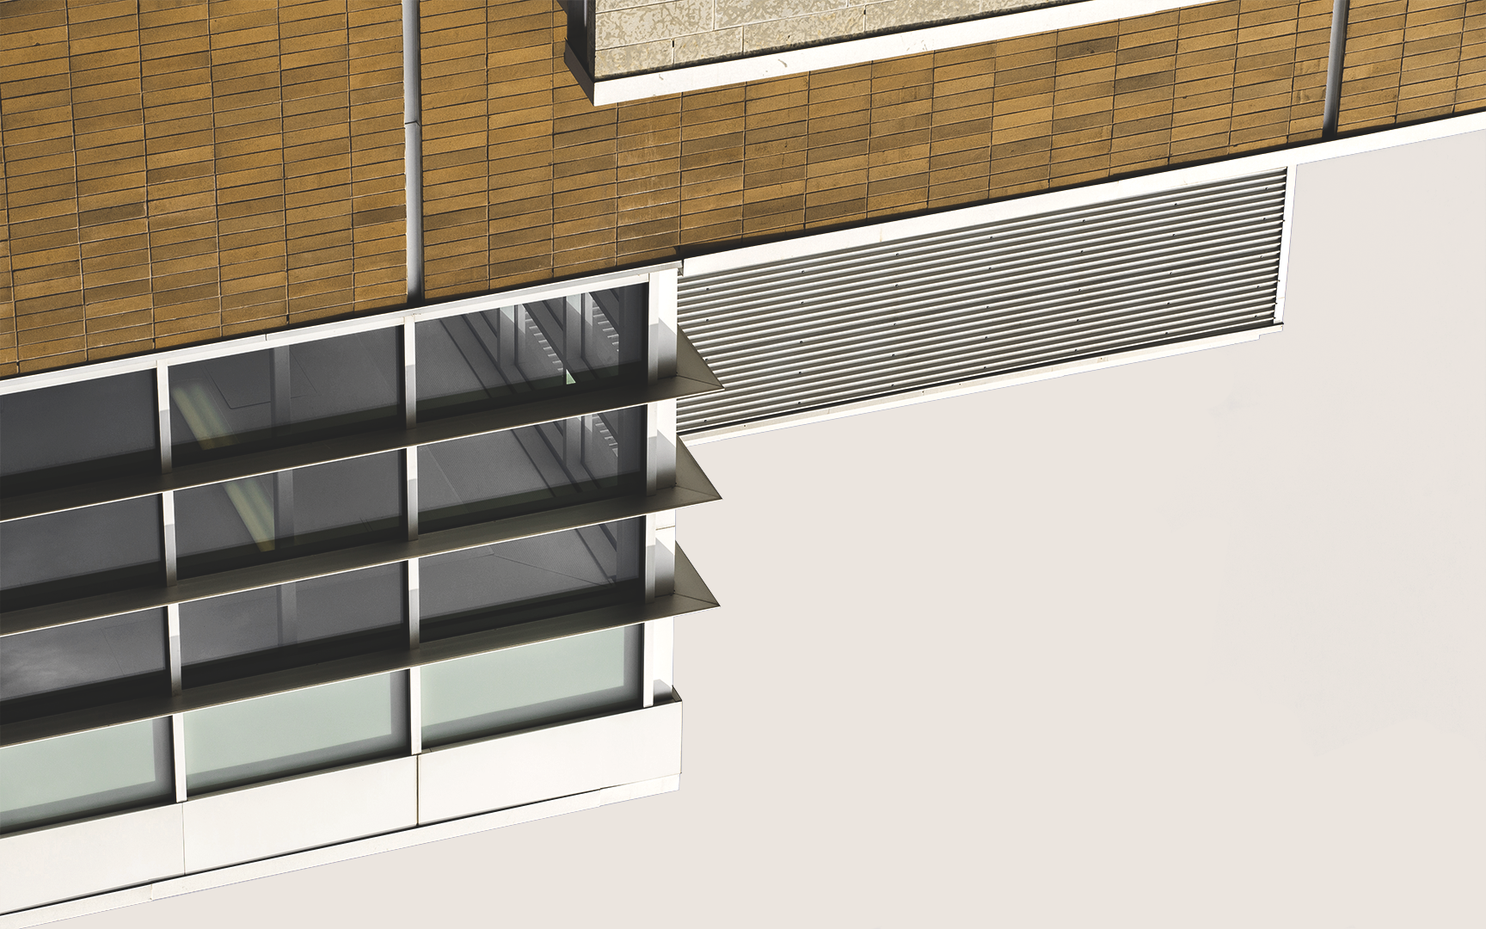
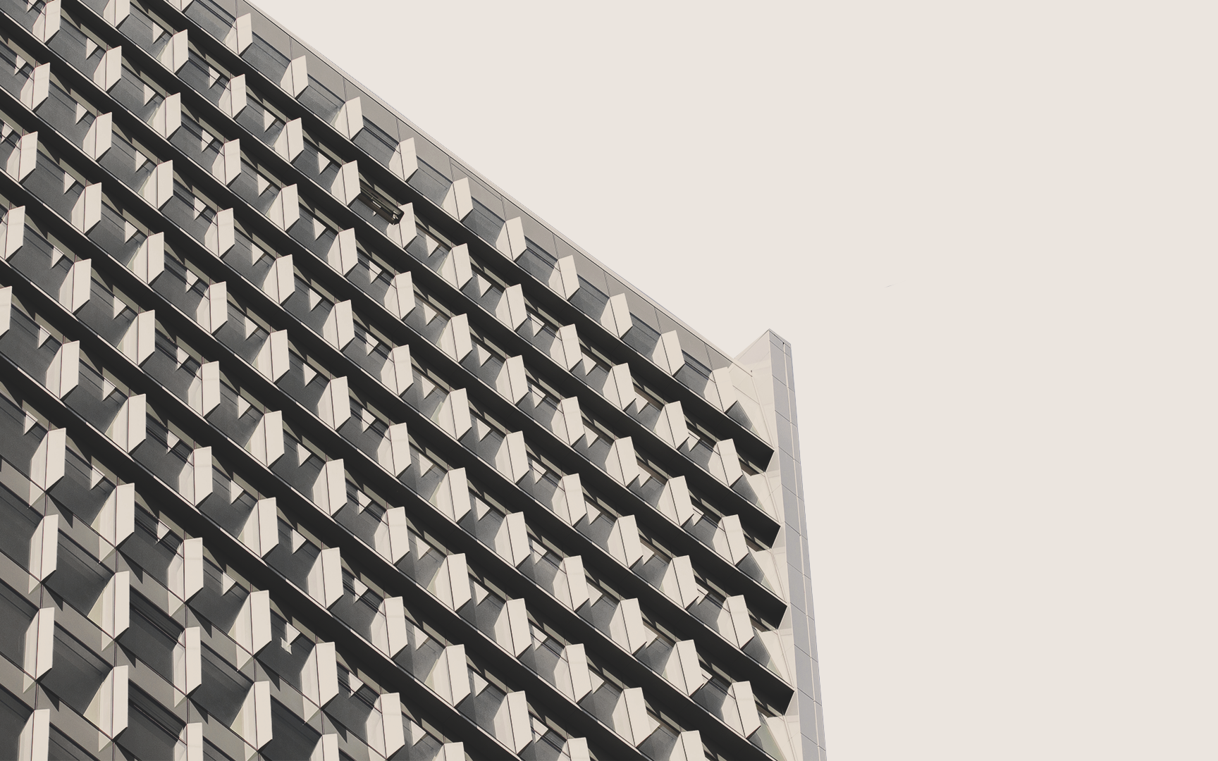
OBJECTIVES After this lesson, students will be able to:
Vocabulary
Pronunciation
use the words related to types of houses and appliances in the house;
pronounce the two-syllable words correctly

Slide 3
Vocabulary

Slide 4


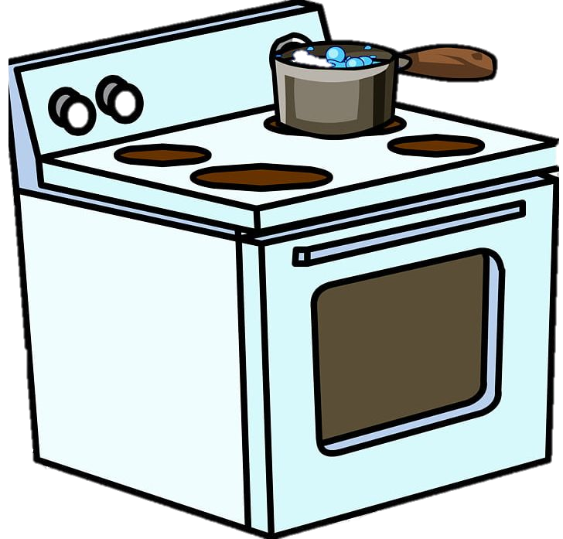
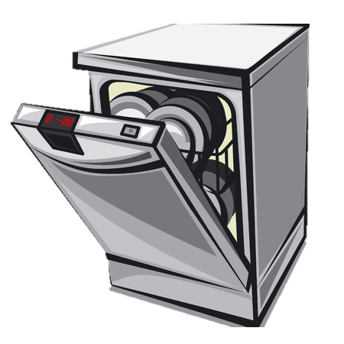
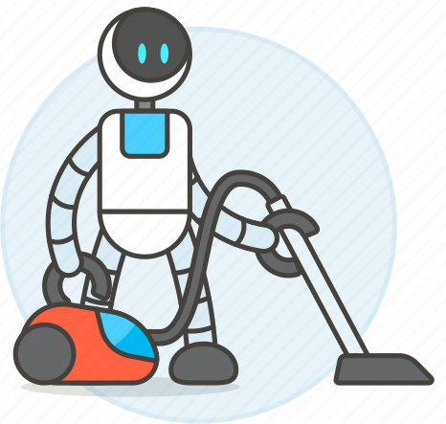
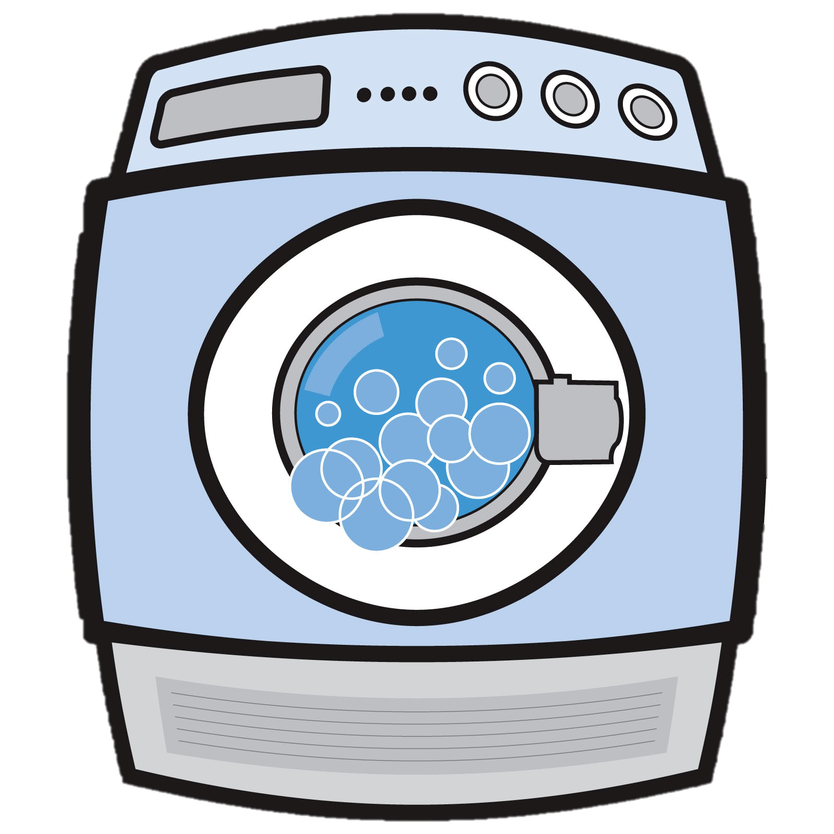

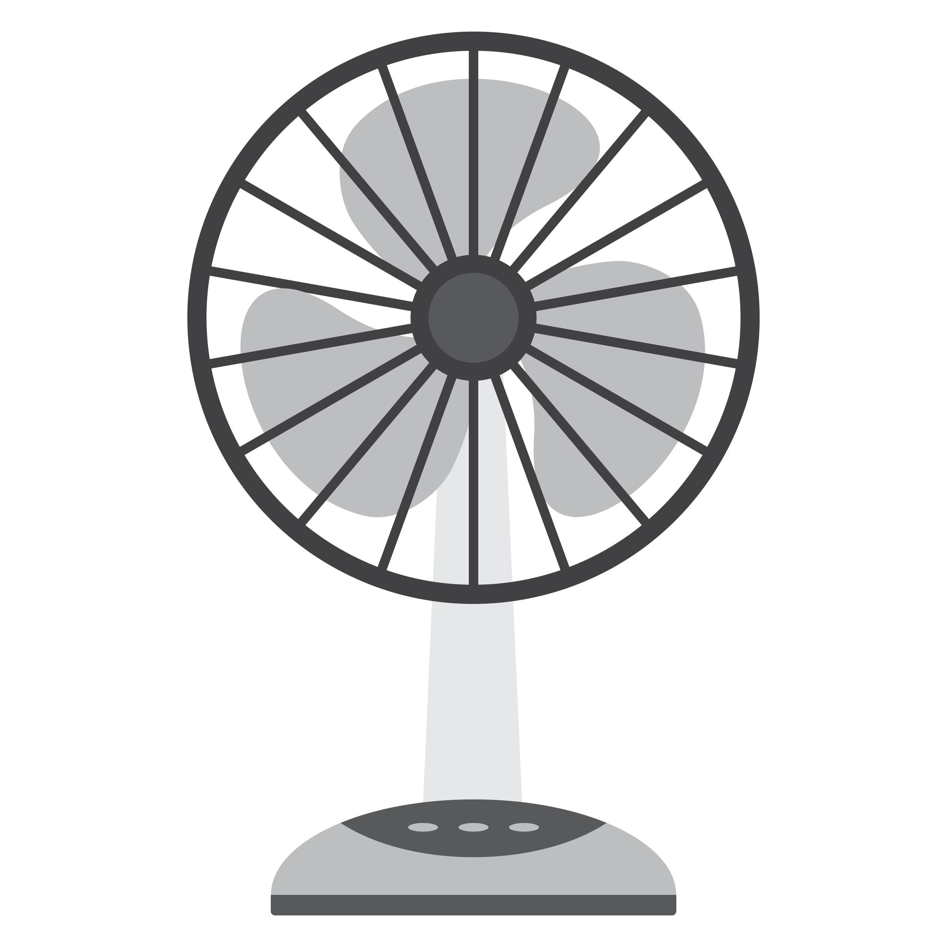
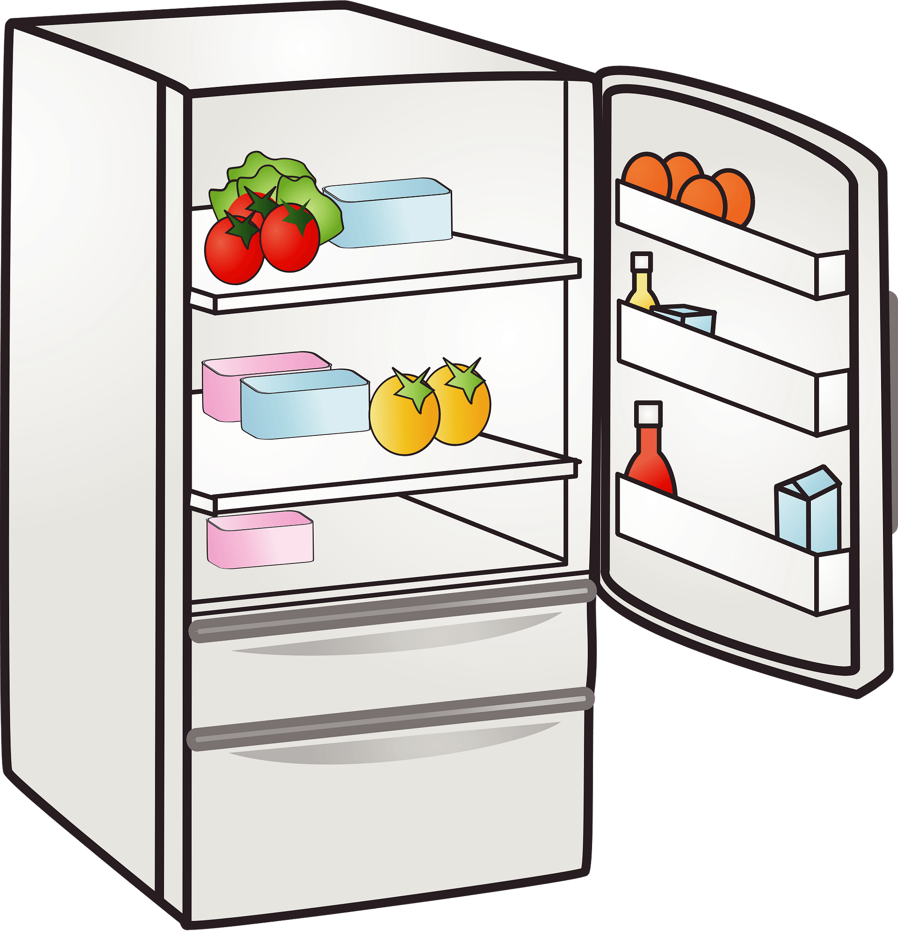


Listen and circle the appliances in the house.
Can you name these appliances in the house?
electric cooker
dishwasher
washing machine
wireless TV
fridge
electric fan
computer
smart clock
Notes:
dishwasher washing machine wireless TV fridge electric fan computer smart clock

Slide 5
Ex 1 (p.40) Put them in the appropriate columns. You may use some more than once.
electric cooker
fridge
dishwasher
electric fan
washing machine
computer
wireless TV
smart clock
living room | bedroom | kitchen
wireless TV
wireless TV
electric cooker
electric fan
smart clock
fridge
smart clock
computer
dishwasher
computer
washing machine

Slide 6
Ex 2 (p.40) Match the appliances in A with what they can help us to do in B.
A
B
1. electric cooker
a. receive and send emails
2. dishwasher
b. keep food fresh
3. fridge
c. cook rice
4. washing machine
d. wash and dry dishes
5. computer
e. wash and dry clothes
What do you think these appliances can or might do more?
Notes:
A
B

Slide 7

2 minutes. Find more uses of these appliances.
Individual
In pair
2 minutes.
Ask and answer.
Examples:
A: What does a wireless TV do?
B: It helps us watch TV programmes from space.

Slide 8
Pronunciation

Slide 9


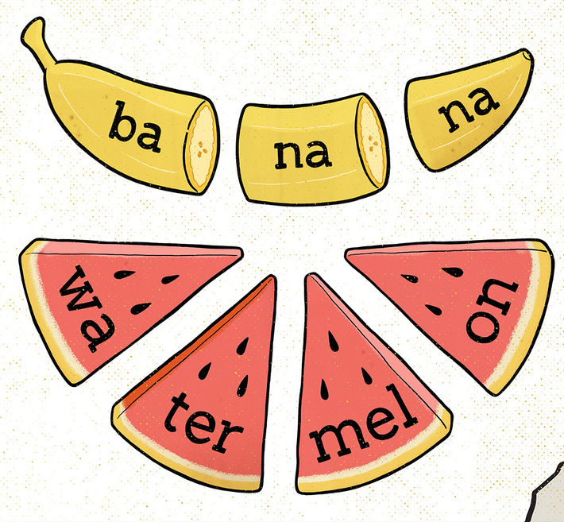

How many syllables are there?

Slide 10
Ex 4 (p.40) Listen and repeat the words.
'picture 'robot 'bedroom
'kitchen 'housework 'palace
'village 'mountains
1. How many syllables in each word are there?
Two
2. What type of the words are there?
Noun
3. What stress does the noun fall on?
The first

Slide 11
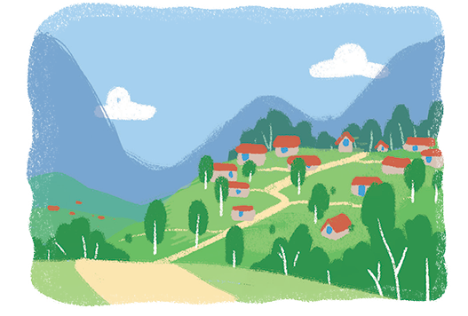
Ex 5 (p.40) Listen and repeat the sentences. Pay attention to the stress of the underlined words.
1.The picture is on the wall of the bedroom.
2. The robot helps me to do the housework.
3. There's a very big kitchen in the palace.
4. Their village is in the mountains.
picture
bedroom
robot
housework
kitchen
palace
village
mountains

Slide 12

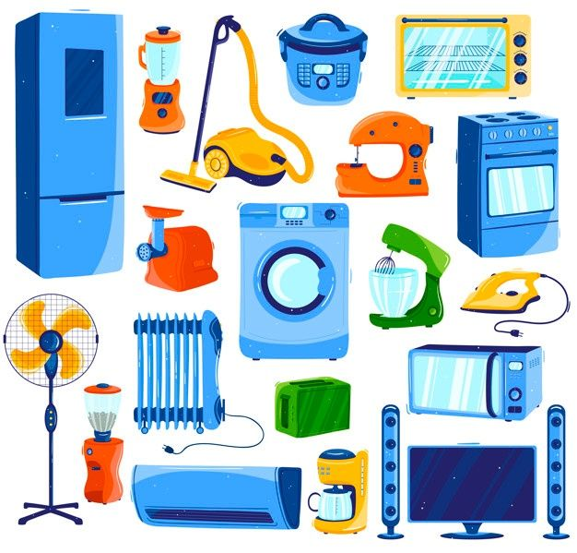
RECAP
1
What are they?
Appliances

Slide 13
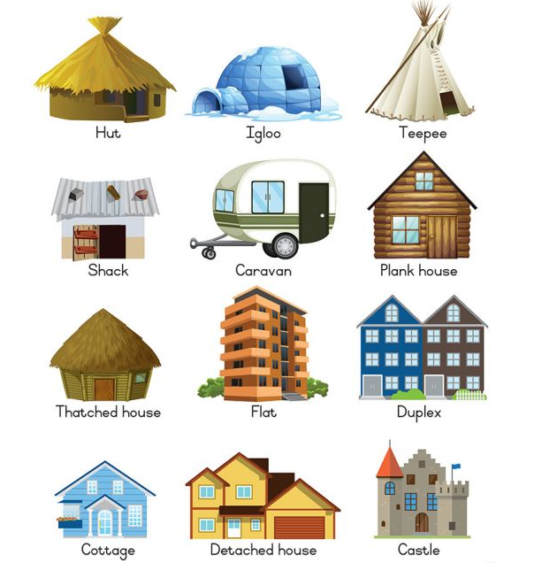
RECAP
2
What are they?
Types of houses

Slide 14
RECAP
3
4
Circle the correct answer
Cooker
Icebox
Receive
Blender
‘Cooker
‘Icebox
Re‘ceive
‘Blender
Island
Cottage
Housework
Invite
‘Island
‘Cottage
‘Housework
In‘vite

Slide 15
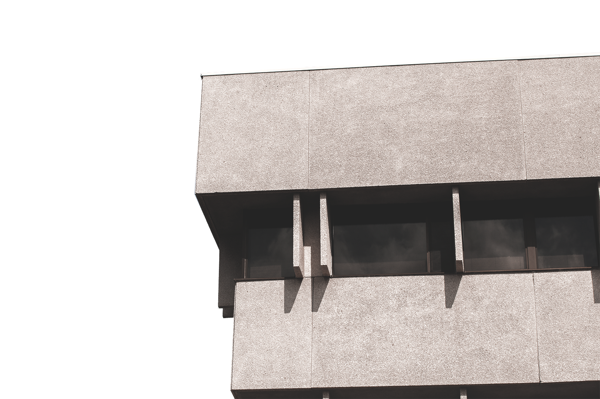
THANKS
Does anyone have any questions?

