Slide 1

Unit 9
Cities around the world
Lesson 6 – Skills 2

Slide 2
WARM UP

Slide 3
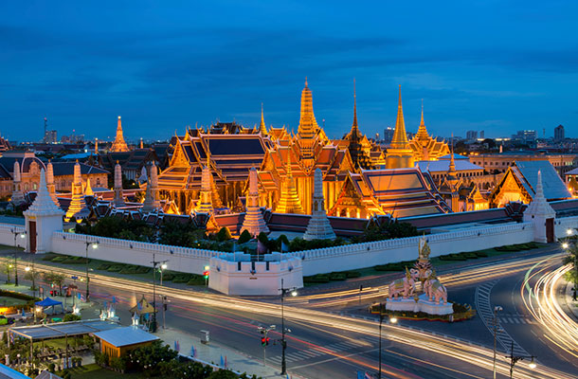
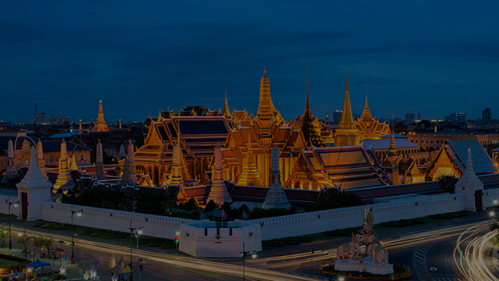
Let’s go to a secret country!
Can you guess what is it?
WARM UP

Slide 4
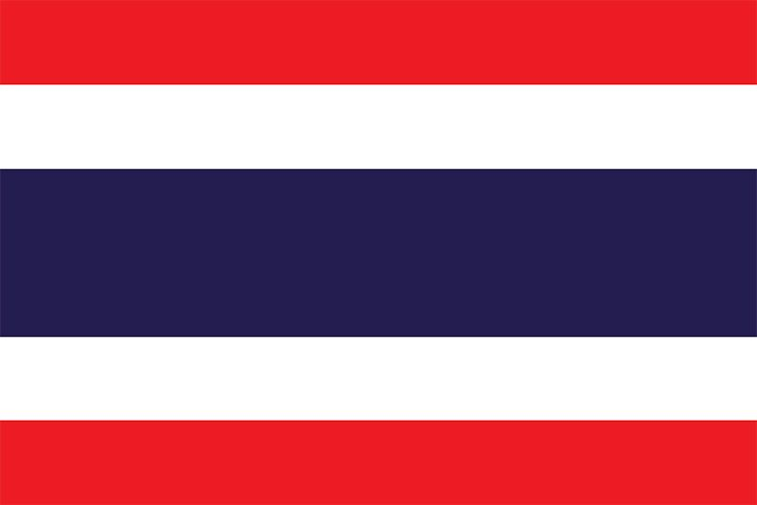
THAILAND
SHOW

Slide 5

OBJECTIVES
By the end of this lesson, students will be able to:
LISTENING
listen to a description of a city
WRITING
write a holiday postcard

Slide 6
LISTENING

Slide 7
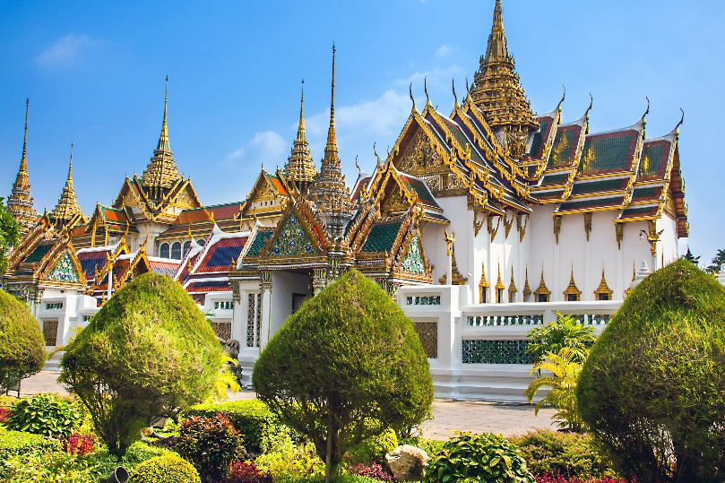

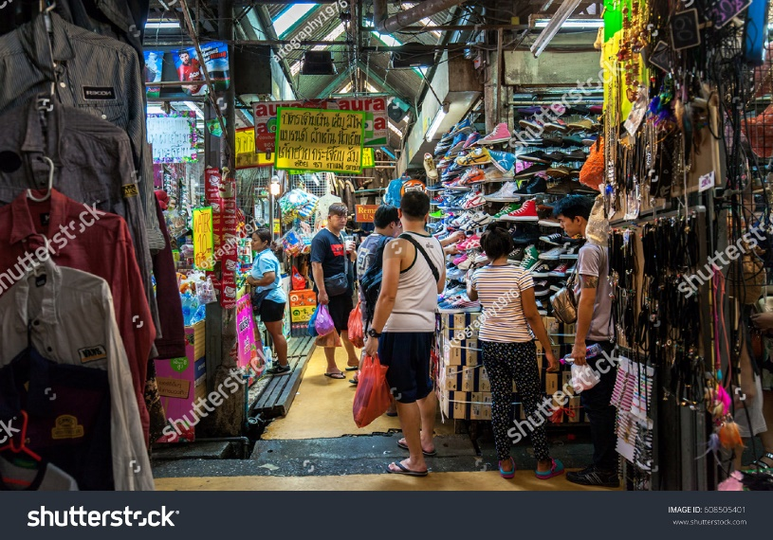
(pg 33). Work in groups.
Discuss and answer the questions.
1. Where is Bangkok?
2. What is Bangkok famous for?

Slide 8
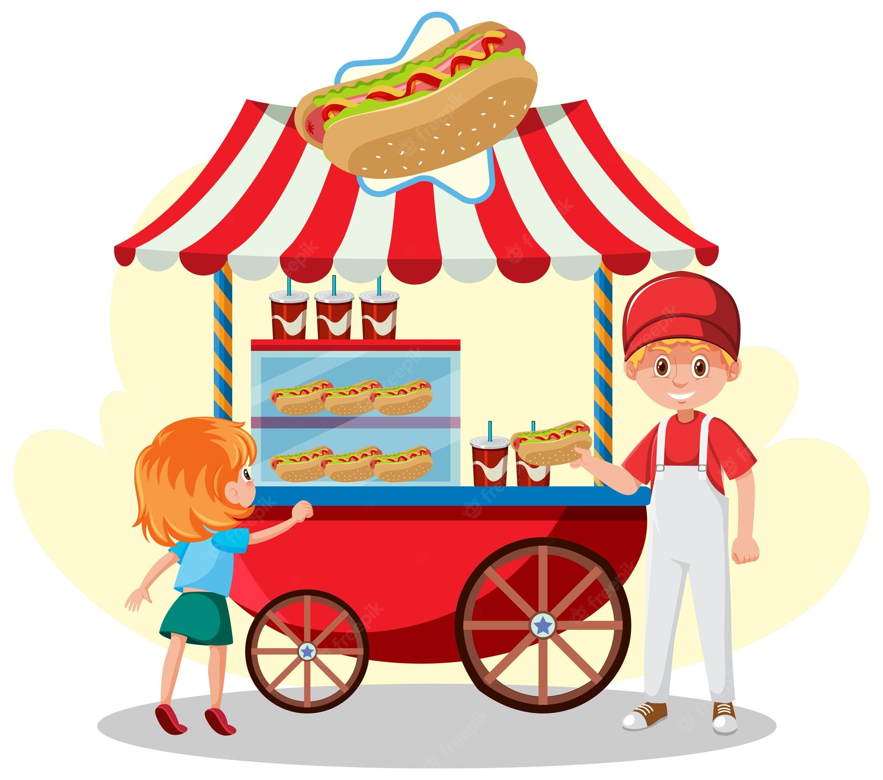
food stall
(noun)
/fuːd stɔːl/
quầy bán đồ ăn

Slide 9

floating market (noun)
/ˈfləʊtɪŋ ˈmɑːkɪt/
chợ nổi

Slide 10
Ex 2 (pg. 33). Read and underline key words.
STATEMENTS | TRUE | FALSE
1. Bangkok is famous for palace.
2. Things at Chatuchak market are expensive.
3. The floating market is on the sea.
4. You can find food stalls all around Bangkok.

Slide 11

Ex 2 (pg. 33). Listen and tick True or False
STATEMENTS | TRUE | FALSE
1. Bangkok is famous for palace.
2. Things at Chatuchak market are expensive.
3. The floating market is on the sea.
4. You can find food stalls all around Bangkok.

Slide 12

Ex 2 (pg. 33). Check your answer.
STATEMENTS | TRUE | FALSE
1. Bangkok is famous for palace.
markets and street food.
Bangkok is famous for its markets and street food.

Slide 13
Ex 2 (pg. 33). Check your answer.
STATEMENTS | TRUE | FALSE
2. Things at Chatuchak market are expensive.
cheap.
Visit the Chatuchak, the largest weekend market in the world. There are over 15,000 stalls selling nearly everything, at cheap prices.

Slide 14
Ex 2 (pg. 33). Check your answer.
STATEMENTS | TRUE | FALSE
3. The floating market is on the sea.
river.
Another interesting type of market is the floating market on the river.

Slide 15
Ex 2 (pg. 33). Check your answer.
STATEMENTS | TRUE | FALSE
4. You can find food stalls all around Bangkok.
It’s easy to find food stalls all around Bangkok, serving different Thai dishes. They are really delicious.

Slide 16
Ex 3 (pg. 33).
Listen again and fill each gap with ONE word / number.
1. Chatuchak market has over ______ stalls.
2. Chatuchak market is about ______ minutes' walk from the station.
3. You can see part of Thai people's ______ at a market.
4. Street food in Bangkok is _______.
number
number
noun
adjective

Slide 17
Ex 3 (pg. 33). Check your answer.
1. Chatuchak market has over ______ stalls.
2. Chatuchak market is about ______ minutes' walk from the station.
3. You can see part of Thai people's ______ at a market.
4. Street food in Bangkok is _______.
There are over 15,000 stalls selling nearly everything.
15,000
It’s only five minutes’ walk from the station
5/ five
When you visit this market, you can see part of Thai people’s life.
life
It’s easy to find food stalls all around Bangkok, …. They are really delicious.
delicious

Slide 18
LISTENING SCRIPT
Bangkok is famous for its markets and street food.
Visit the Chatuchak, the largest weekend market in the world. There are over 15,000 stalls selling nearly everything, at cheap prices. It’s only five minutes’ walk from the station. When you visit this market, you can see part of Thai people’s life.
Another interesting type of market is the floating market on the river. Don’t forget to try street food in Bangkok. It’s easy to find food stalls all around Bangkok, serving different Thai dishes. They are really delicious.

Slide 19
WRITING

Slide 20
1. What is it?
September 6
September 6
September 6
A postcard
Dear Grandpa and Grandma,
Dear Grandpa and Grandma,
Dear Grandpa and Grandma,
To: Grandpa & Grandma
Hoan Kiem, Ha Noi, Viet Nam
To: Grandpa & Grandma
Hoan Kiem, Ha Noi, Viet Nam
To: Grandpa & Grandma
Hoan Kiem, Ha Noi, Viet Nam
Stockholm is fantastic!
Its weather is perfect, sunny all the time! Our hotel is good. It has a swimming pool and a gym. It offers delicious breakfast. Yesterday Mum, Dad and I rented three bikes and cycled to the Old Town. My parents wore their helmets and I wore mine. We visited the Royal Palace first. What a beautiful place! Mum loved it. She said, “Swedish art is amazing.” People here are so friendly, too. After that, we had “fika”, a coffee break, in a traditional café. Everything is so wonderful!
Stockholm is fantastic!
Its weather is perfect, sunny all the time! Our hotel is good. It has a swimming pool and a gym. It offers delicious breakfast. Yesterday Mum, Dad and I rented three bikes and cycled to the Old Town. My parents wore their helmets and I wore mine. We visited the Royal Palace first. What a beautiful place! Mum loved it. She said, “Swedish art is amazing.” People here are so friendly, too. After that, we had “fika”, a coffee break, in a traditional café. Everything is so wonderful!
Stockholm is fantastic!
Its weather is perfect, sunny all the time! Our hotel is good. It has a swimming pool and a gym. It offers delicious breakfast. Yesterday Mum, Dad and I rented three bikes and cycled to the Old Town. My parents wore their helmets and I wore mine. We visited the Royal Palace f irst. What a beautiful place! Mum loved it. She said, “Swedish art is amazing.” After that, we had “fika”, a coffee break, in a traditional café. Everything is so wonderful!
2. What city is it?
Stockholm
3. What is it like? (the weather, the people, the food)
4. What can you see and do there?
Wish you were here!
Love,
Mai
Wish you were here!
Love,
Mai
Wish you were here!
Love,
Mai

Slide 21
Ex 4 (pg. 33). Work in groups. Think about a city in your country, using the mind map below as a guide.
What are the people like?
What can you do there?
CITY IN YOUR COUNTRY
What are the food like?
What is the weather like?

Slide 22
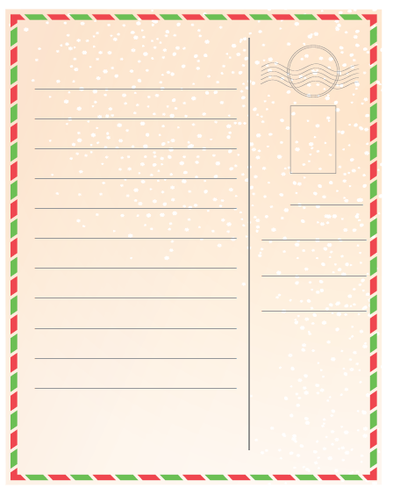

Ex 5 (pg. 33). Write a postcard of about 50 words about your holiday in a city. Use the information in 4.
- What city is it?
- What is it like? (the weather, the people, the food)
- What can you see and do there?

Slide 23
CLASS GALERY
Swap with your partner. Check
 | Yes | No
1. Did he/she answer all the questions?
2. Did he/she have spelling mistakes? If NO, please underline.
3. Did he/she use correct grammar? If NO, please underline.
4. Did he/she follow a form of the postcard?

Slide 24
RECAP
What have we learnt in the lesson today?
✓
□ listen for specific information about Bangkok.
□ Express exclamations with What;
□ read for specific information about Cities around the world;
□ write a holiday postcard
✓

Slide 25
THANKS!
Do you have any questions?
your-email@freepik.com
+91 620 421 838 | yourcompany.com
Credits: This presentation template was created by Slidesgo, including icons by Flaticon, and infographics & images by Freepik.
Please keep this slide for attribution

