Slide 1

Pelmanism
Sports game

Slide 2
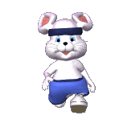

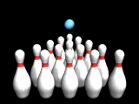

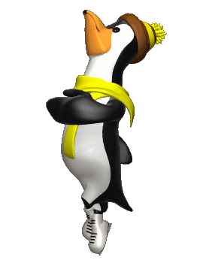
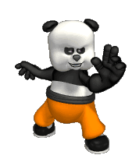
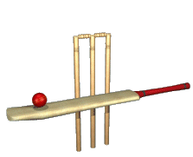
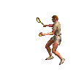
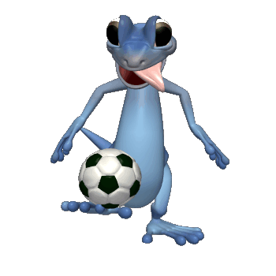
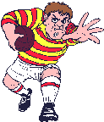

A B C D E F
1
Kung Fu
Jogging
Pelmanism
Sports game
2
Ice
Hockey
Football
Bowling
3
Ice
Skating
Basket
Ball
Cricket
4
Tennis
Golf
Rugby

Slide 3

GAME: Hang man
In group
Guess the word and save the man.
Every time you can say a letter.
E
1
Q
2
U
3
I
4
P
5
M
6
E
7
N
8
T
9
the tools, machines etc that you need to do sth
Notes:
Từ khóa EQUIPMENT
GV bấm vào ô để mở và hiện chữ cái cho HS

Slide 4
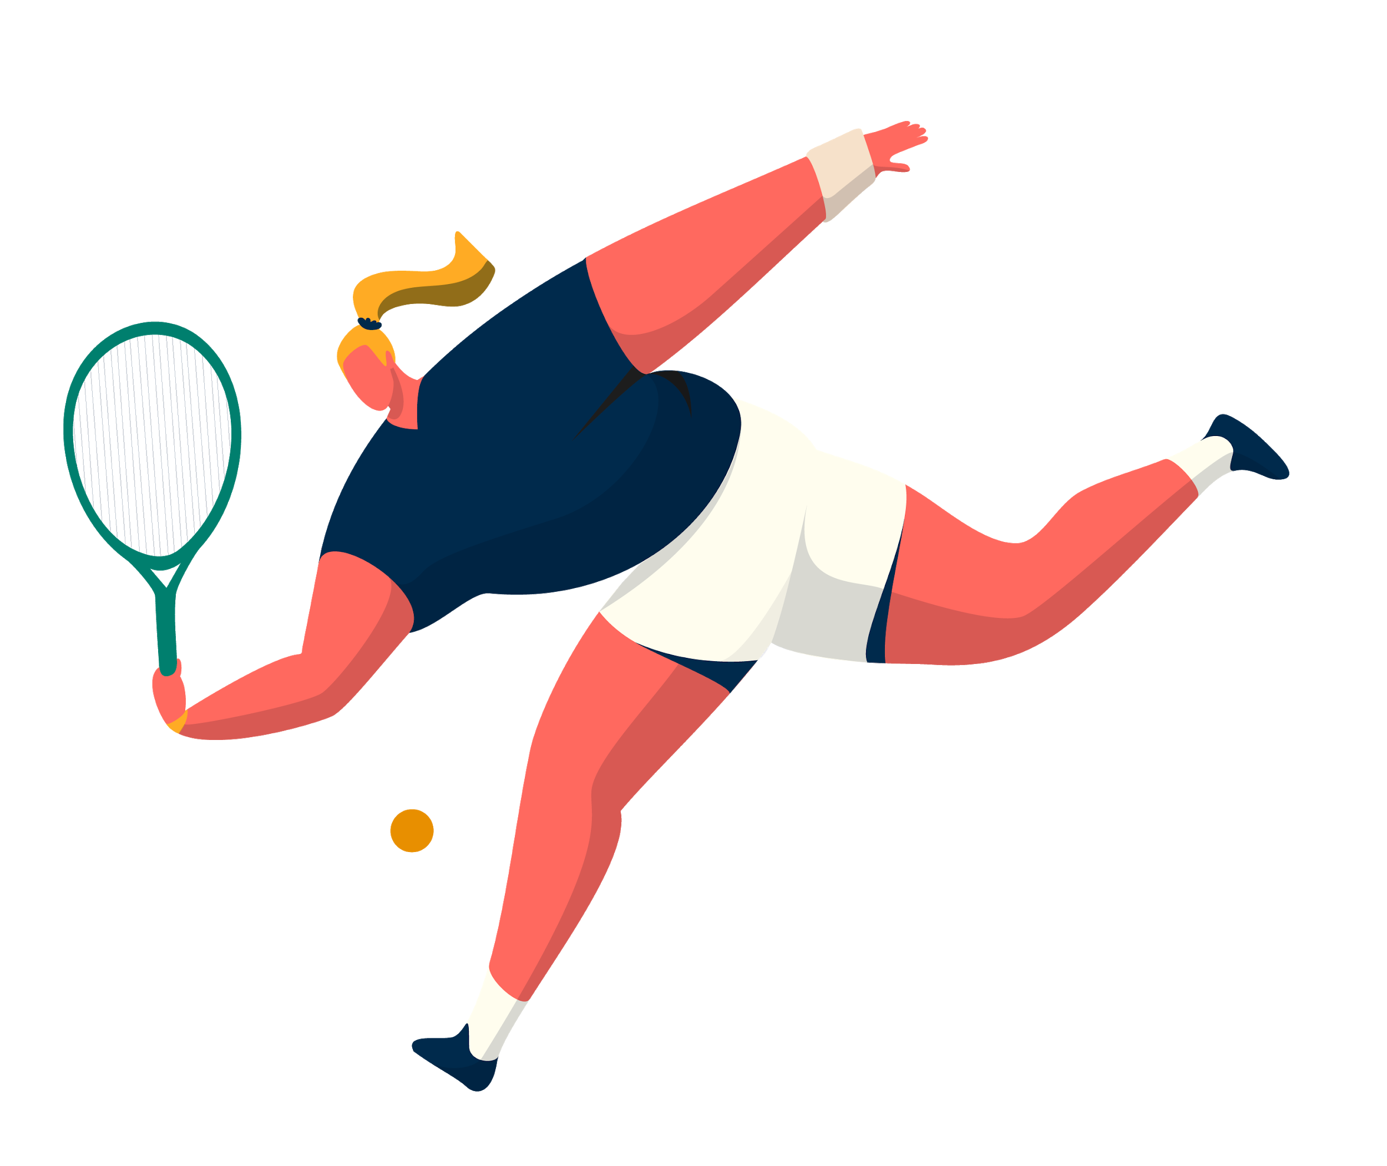
UNIT 8: Sports and games
Lesson 2:
A closer look 1

Slide 5
OBJECTIVES
By the end of the lesson, students will be able to:
□ Use the lexical items related to the topic “Sports and games“
□ Pronounce the sounds /e/ and /æ/ correctly in words and sentences.

Slide 6
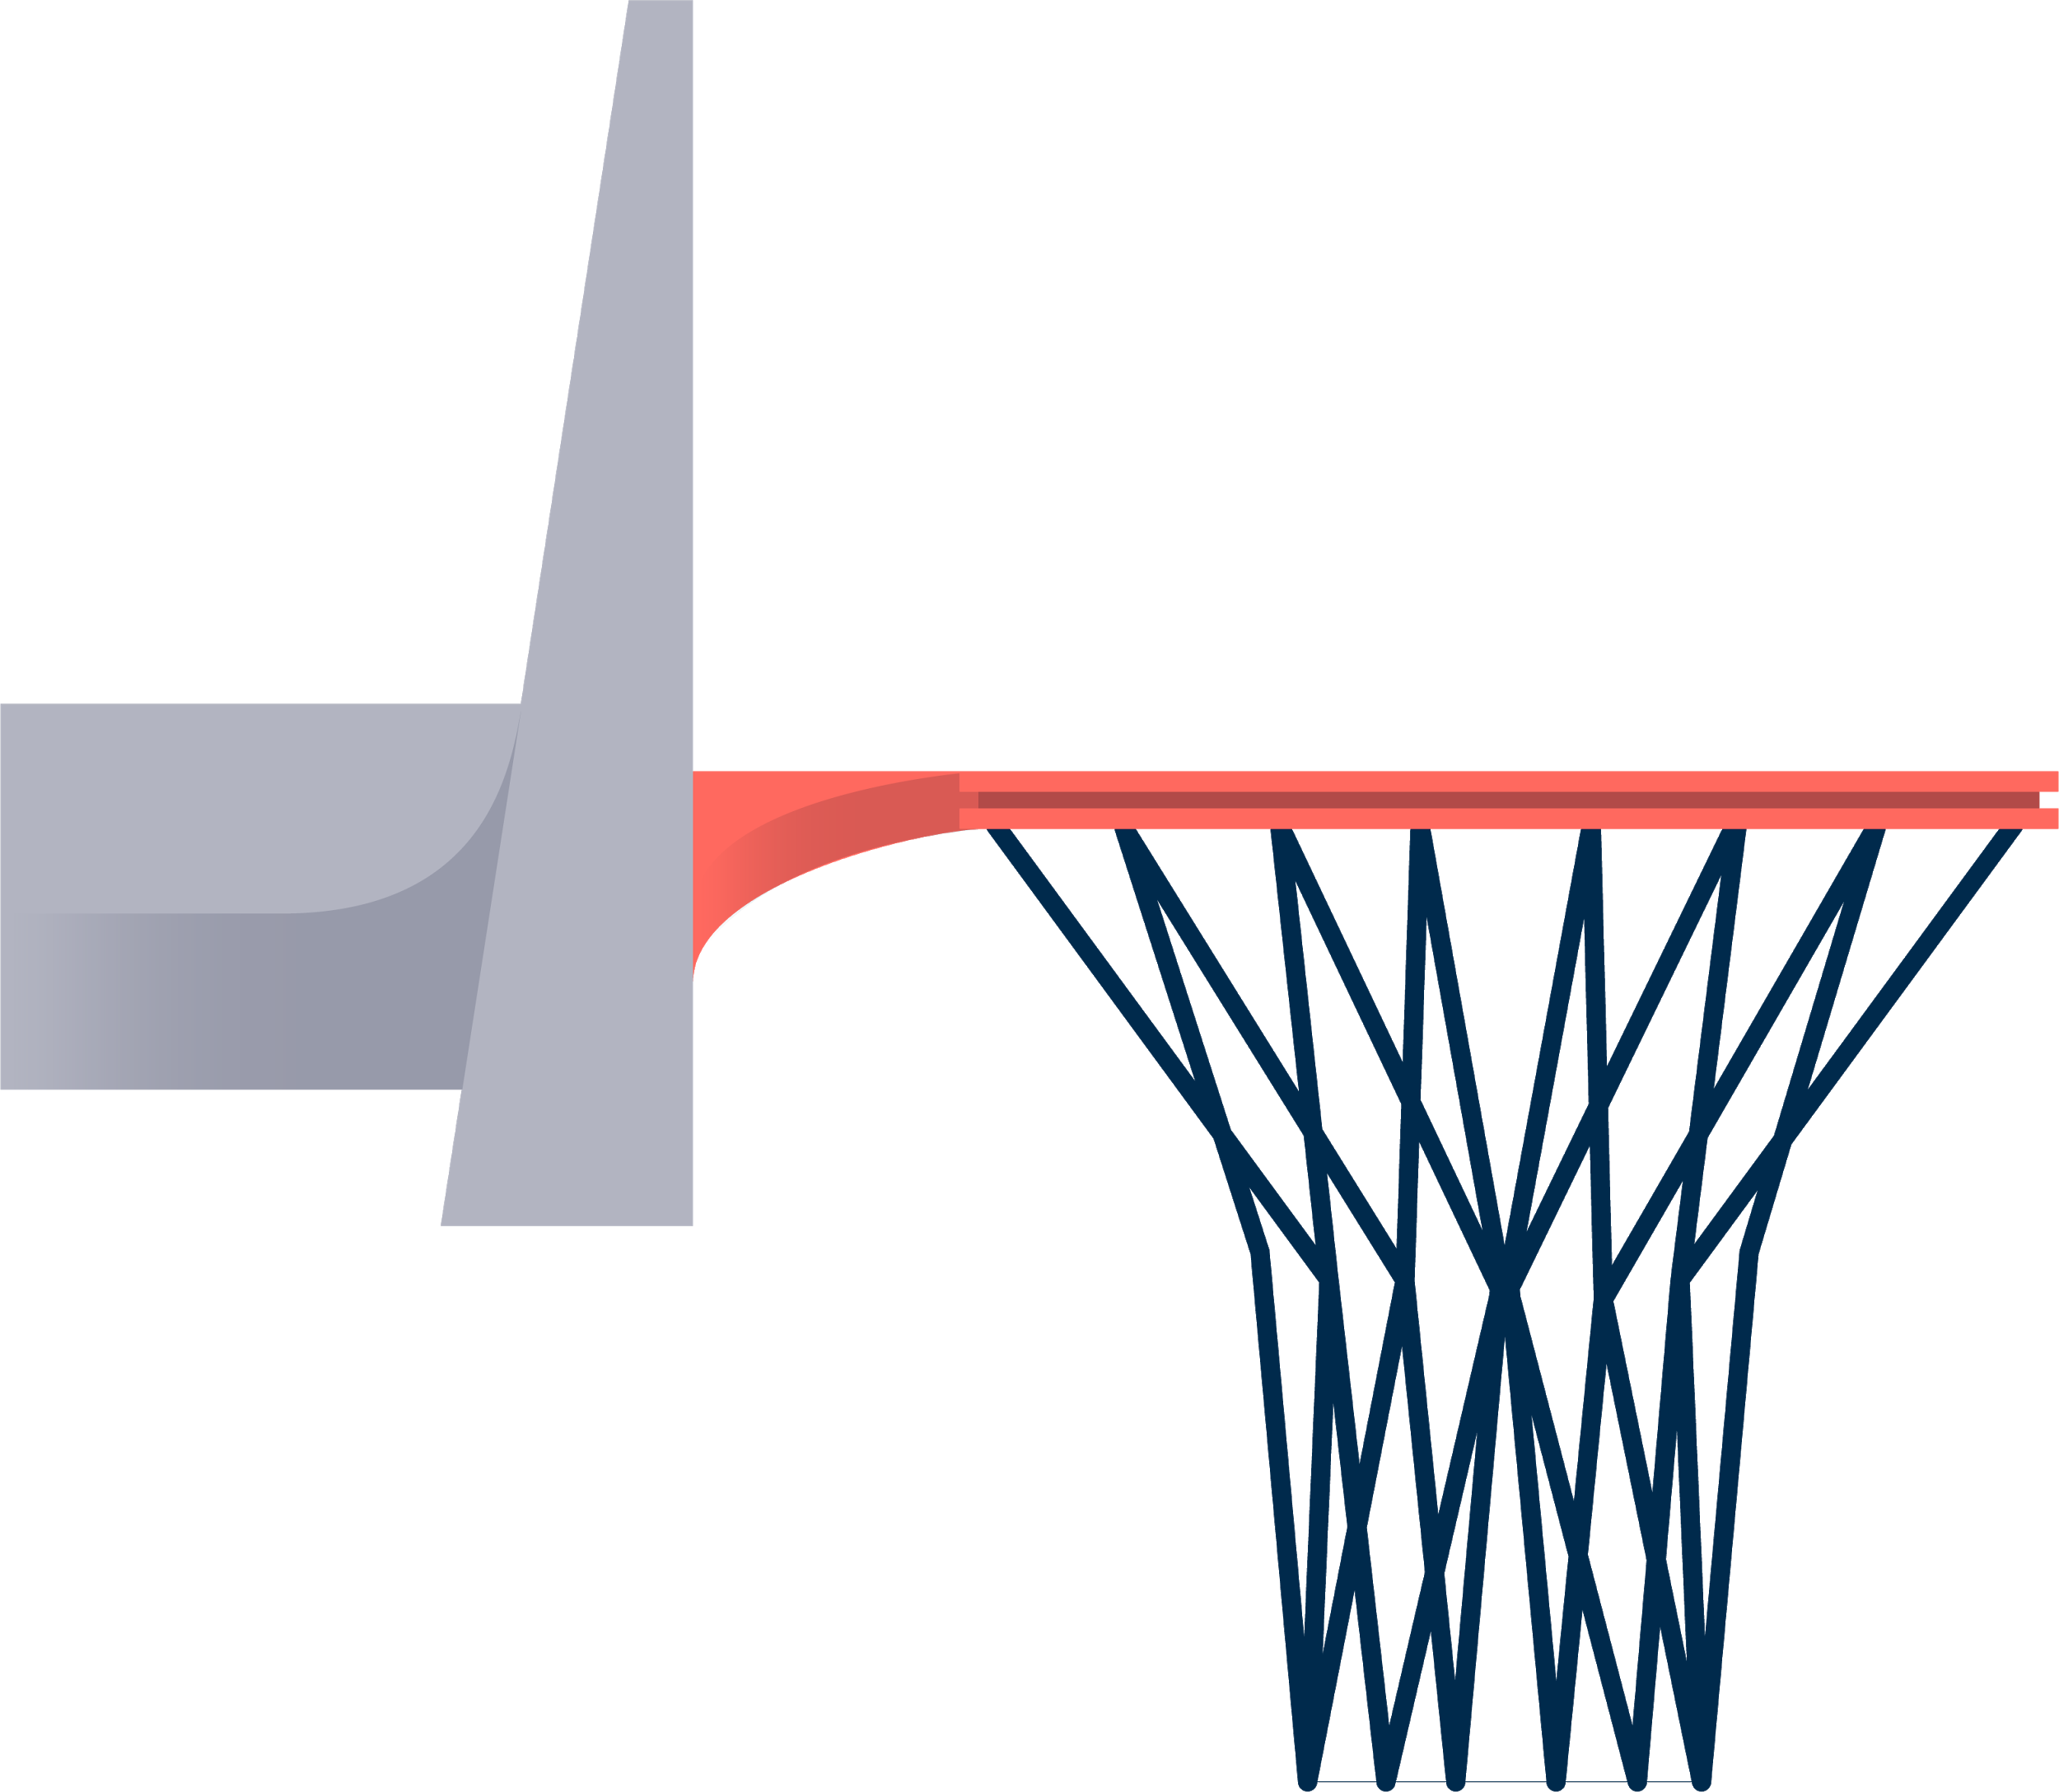
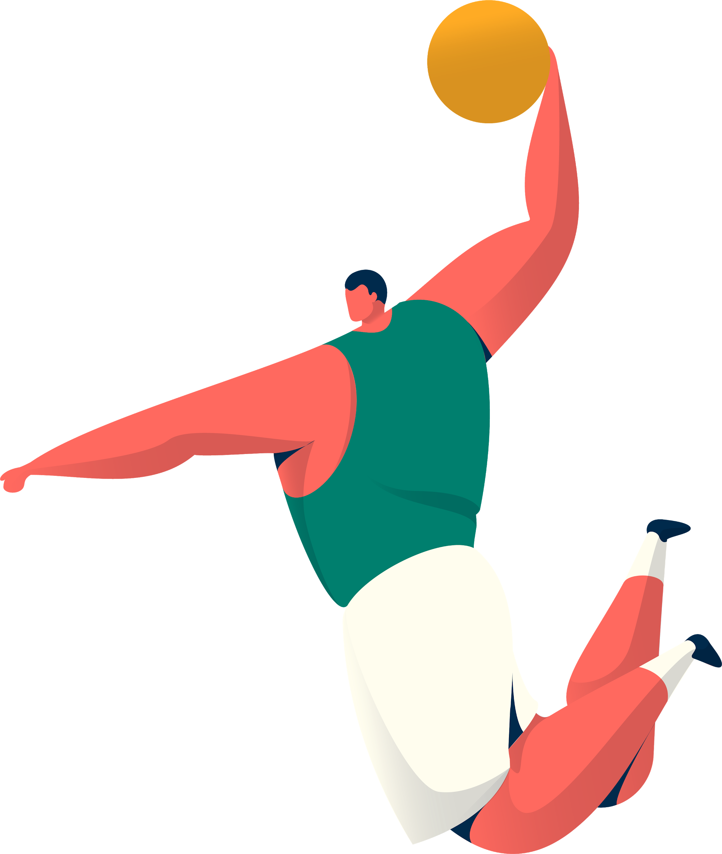
Hidden picture
Vocabulary
Look and guess.

Slide 7

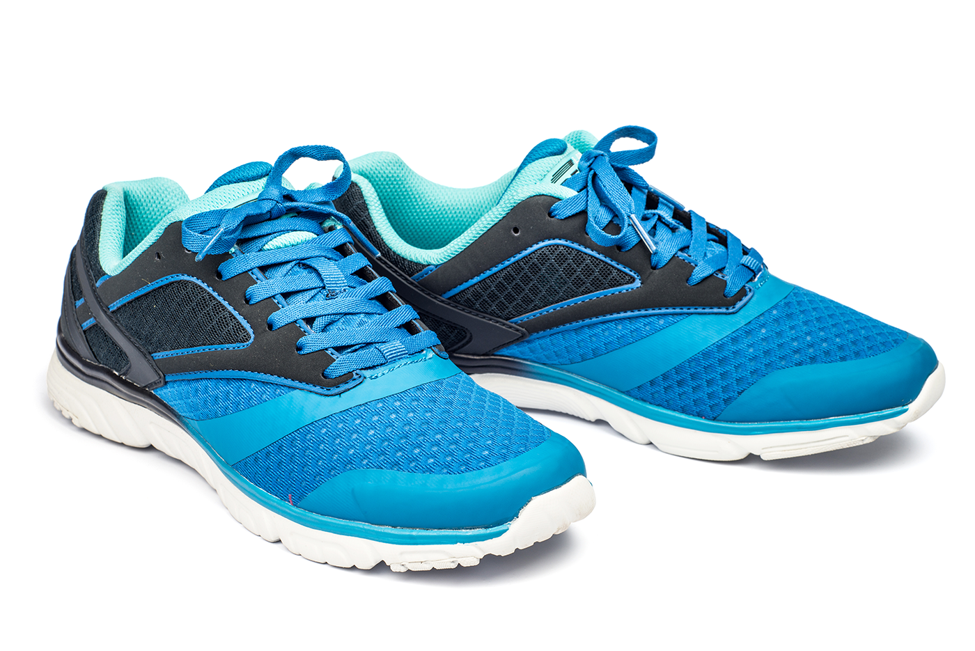
sports shoes
SHOW
KEY

Slide 8

boat
SHOW
KEY

Slide 9

ball
SHOW
KEY

Slide 10
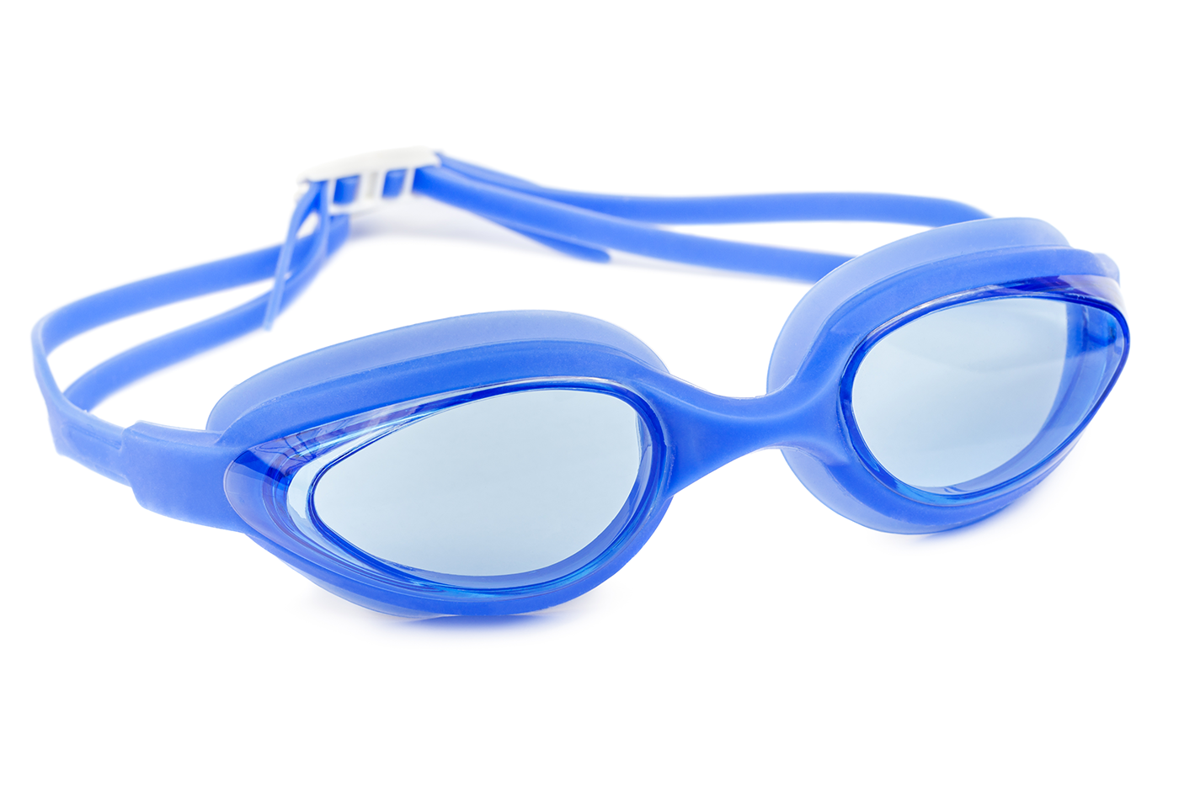
goggles
SHOW
KEY

Slide 11
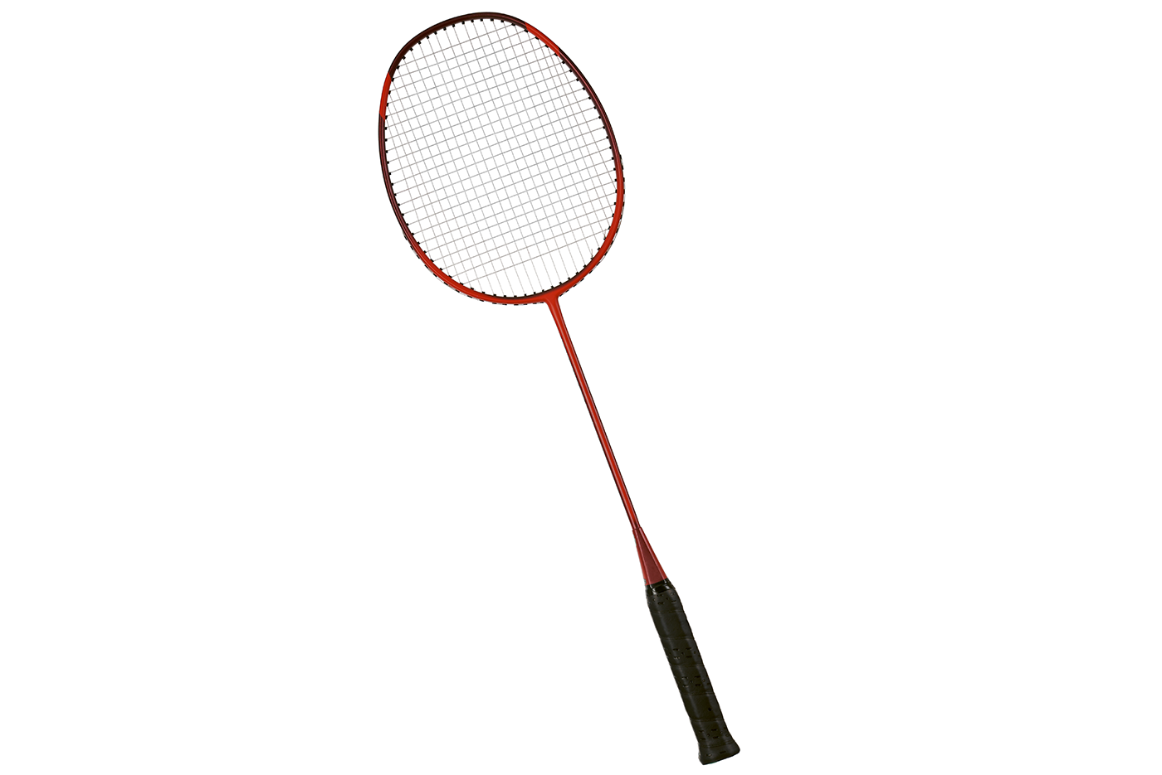
racket
SHOW
KEY

Slide 12
Vocabulary
Ex1 (p.18) Write the right words under the pictures.
ball boat racket googles sport shoes
ball
sport shoes
boat
1. _____________ 2. _____________ 3. _______________
racket
googles
4. _____________ 5. _____________

Slide 13
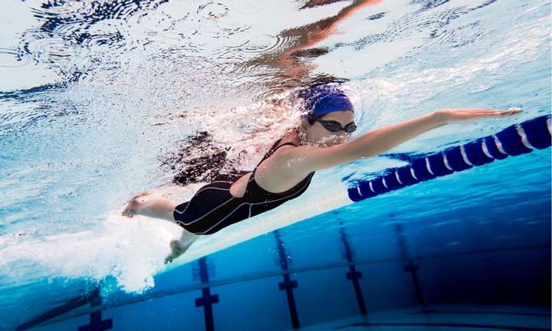
Vocabulary
What sports are these things for?
goggles
swimming

Slide 14
Vocabulary
Ex 2 (p.18) What sports are these things for? Match.
A
B
1. bicycle
a. boating
2. ball
b. swimming
3. boat
c. cycling
4. goggles
d. ball games
5. racket
e. badminton

Slide 15
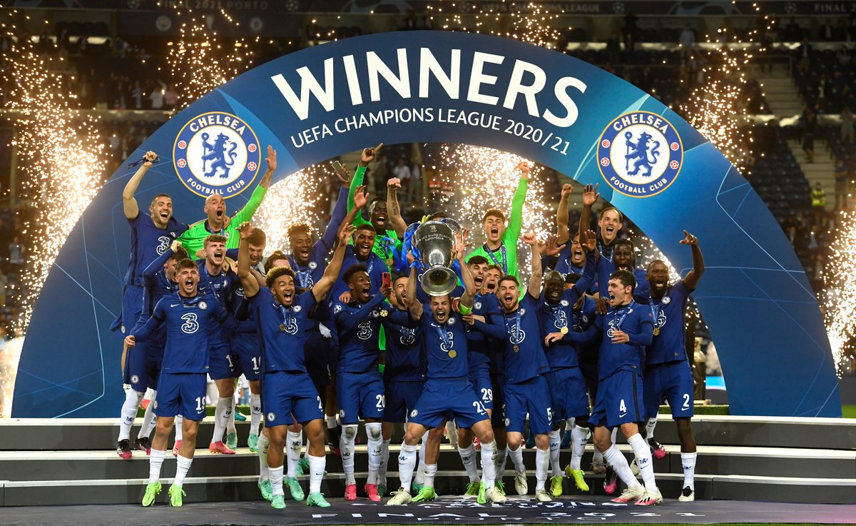
Vocabulary
1. champion
= winner
nhà vô địch

Slide 16


Vocabulary
1. champion
= winner
nhà vô địch
2. competition
cuộc thi

Slide 17

Vocabulary
1. champion
= winner
nhà vô địch
2. competition
cuộc thi
3. congratulations
chúc mừng

Slide 18
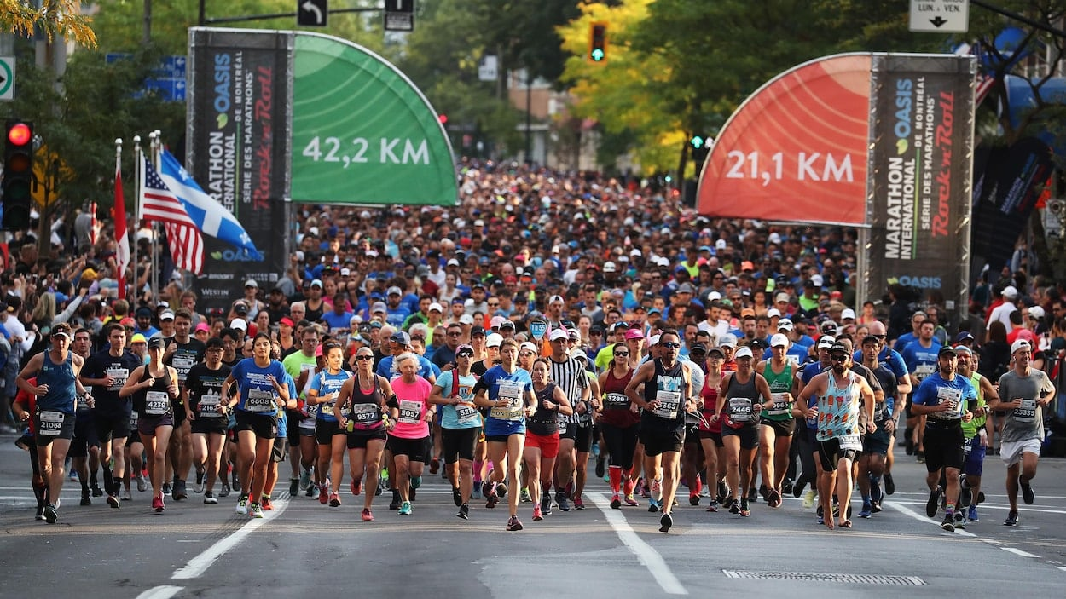
Vocabulary
1. champion
= winner
nhà vô địch
2. competition
cuộc thi
3. congratulations
chúc mừng
4. marathon
= long race of about 42 km
cuộc thi chạy ma-ra-tông

Slide 19
Vocabulary
Ex 3 (p.18) Fill in the blank.
champion competition sporty
marathon congratulations
competition
1. She won an international sports _________.
2. He became the world tennis ____________ when he was very young.
3. "Can you send my ______________ to the winner of the contest?"
4. My friend David is very _________. He does exercise every day.
5. The first _____________ took place in 1896.
champion
congratulations
sporty
marathon

Slide 20
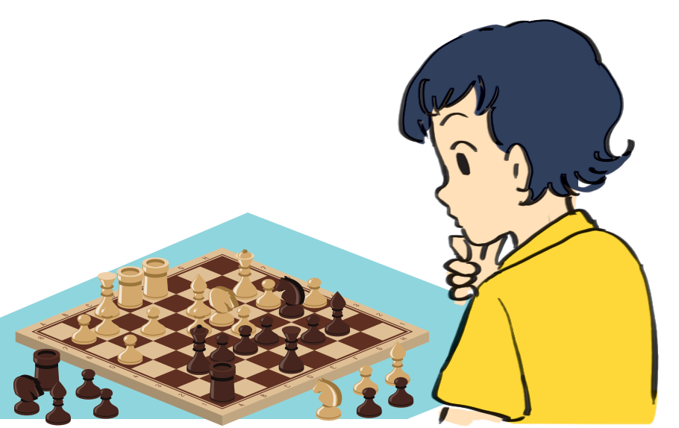
Guess the word.
Pronunciation
chess
racket
/e/
/æ/

Slide 21

/e/

Slide 22

/æ/

Slide 23
Ex 4 (p.17) Listen and repeat. Pay attention to the sounds /e/ and /æ/.
1. /e/
chess tennis exercise contest
Pronunciation
2. /æ/
racket match marathon active

Slide 24
Ex 5 (p.17) Listen and repeat. Underline the words having the sounds /e/ and /æ/.
1. They cannot take part in this contest.
2. They began the match very late.
3. Please get the racket for me.
4. We play chess every Saturday.
5. My grandpa is old, but he's active.
a
/æ/
Pronunciation
a
a
e
/æ/
/æ/
/e/
e
a
/e/
/æ/
e
e
a
/e/
/e/
/æ/
a
a
/æ/
/æ/

Slide 25
OBJECTIVES
By the end of the lesson, students have been able to:
☑ Use the lexical items related to the topic “Sports and games“
☑ Pronounce the sounds /e/ and /æ/ correctly in words and sentences.

Slide 26
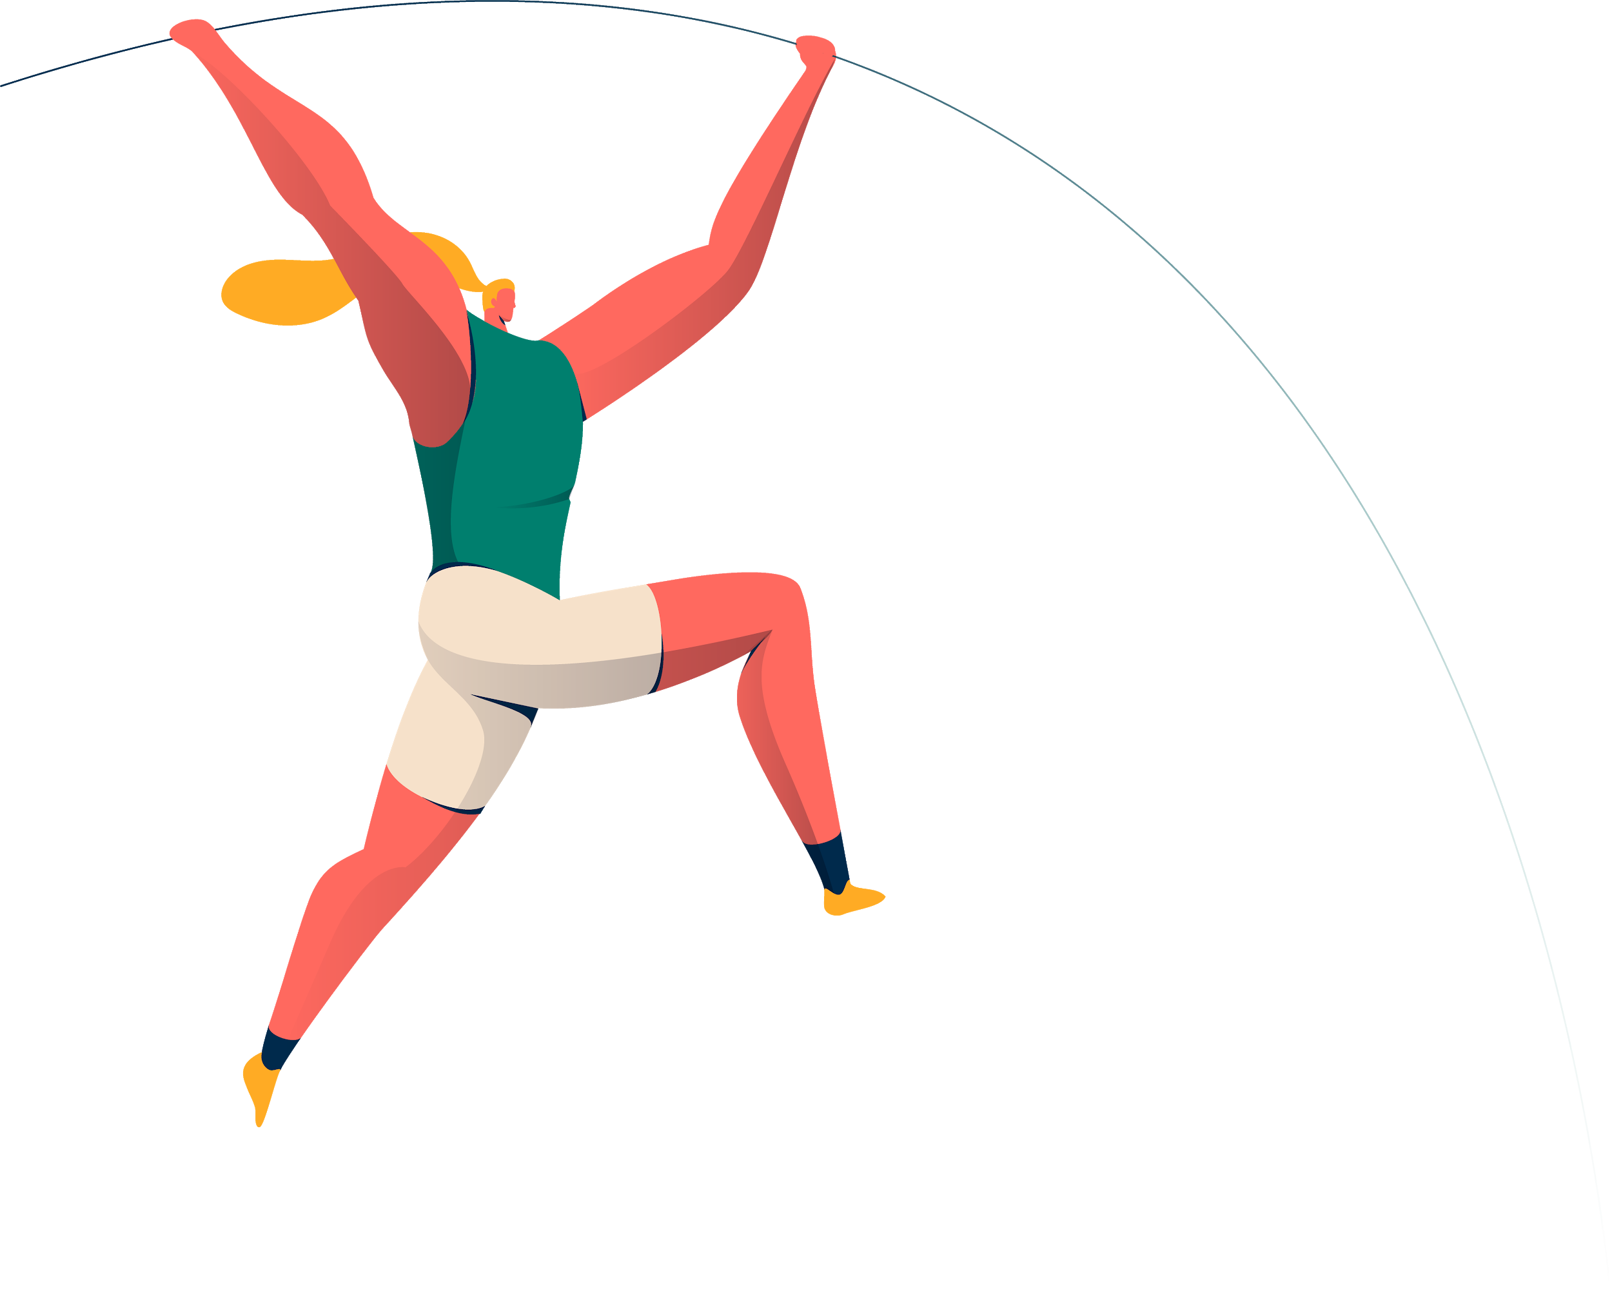
THANKS

