Slide 1
Unit 1
Family
Lesson 5 – Page 22

Slide 2

By the end of this lesson, pupils will be able to ask and answer about jobs.
Vocabulary: a housewife, a driver, a teacher, a doctor
Structure: Is your father a driver? – Yes, he is.
Is your mother a teacher? – No, she isn’t.

Slide 3



Slide 4

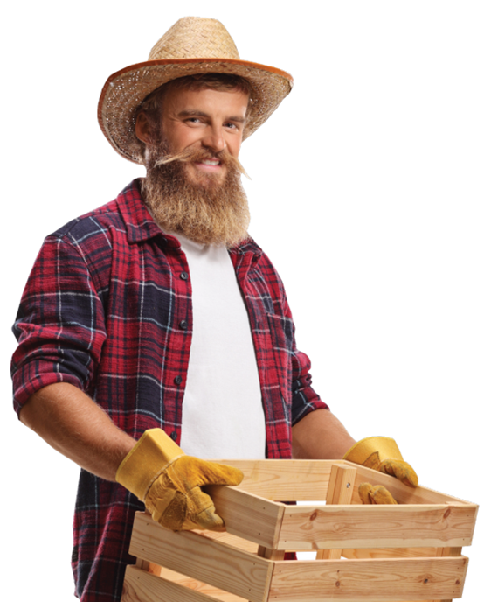







REVIEW
an engineer
a farmer
a cook
a dentist

Slide 5
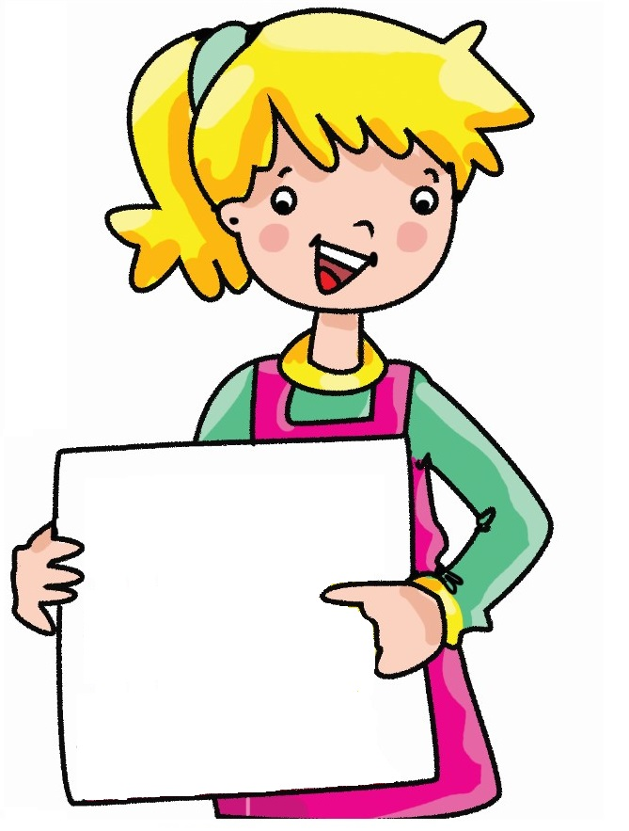

Look. Say.
My father is an engineer.
father

Slide 6

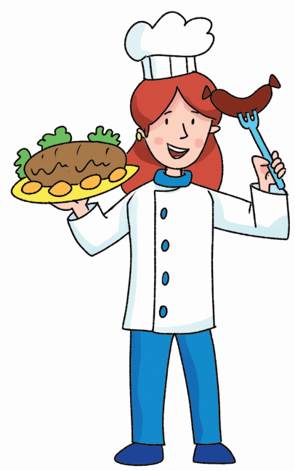
Look. Say.
My aunt is a cook.
aunt

Slide 7

Look. Say.
My uncle is a dentist.
uncle

Slide 8
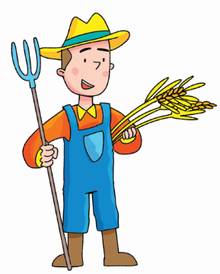
Look. Say.
My brother is a farmer.
brother

Slide 9


It’s time to learn …

Slide 10





Slide 11


Presentation

Slide 12




Presentation
New words
a housewife
a driver
a teacher
a doctor

Slide 13




Practice
Look and say.
a driver

Slide 14
Complete the words.
r v r
1. d__i__e__
o c o
2. d__ __t__r
3. t__ __c__ __r
e a h e
4. h__ __se__i__e
o u w f

Slide 15

(Activity Book)
Write. Point. Say.
a housewife
a teacher
a doctor
a driver

Slide 16


Presentation
Structure

Slide 17
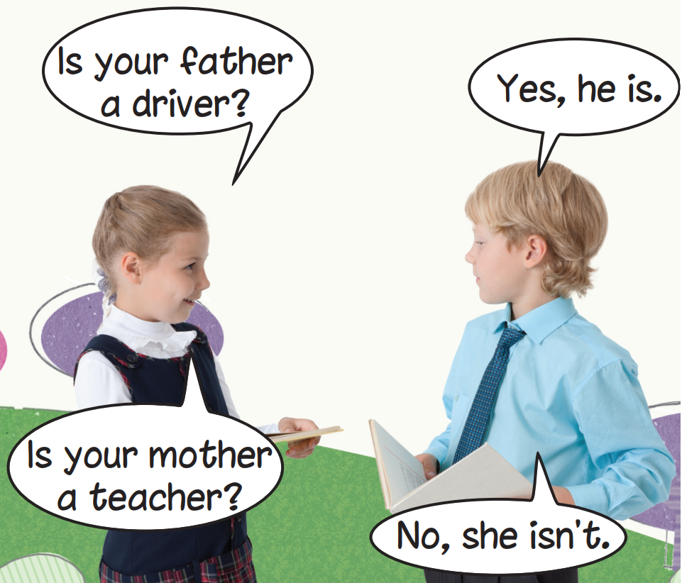
Presentation
Structure

Slide 18
Presentation
Structure
Is your father a driver?
Yes, he is.
Is your mother a teacher?
No, she isn’t.

Slide 19
Presentation
Structure
Is your father a driver? – Yes, he is.
Is your mother a teacher? – No, she isn’t.
Usage
- To ask and answer about family member’s job.

Slide 20
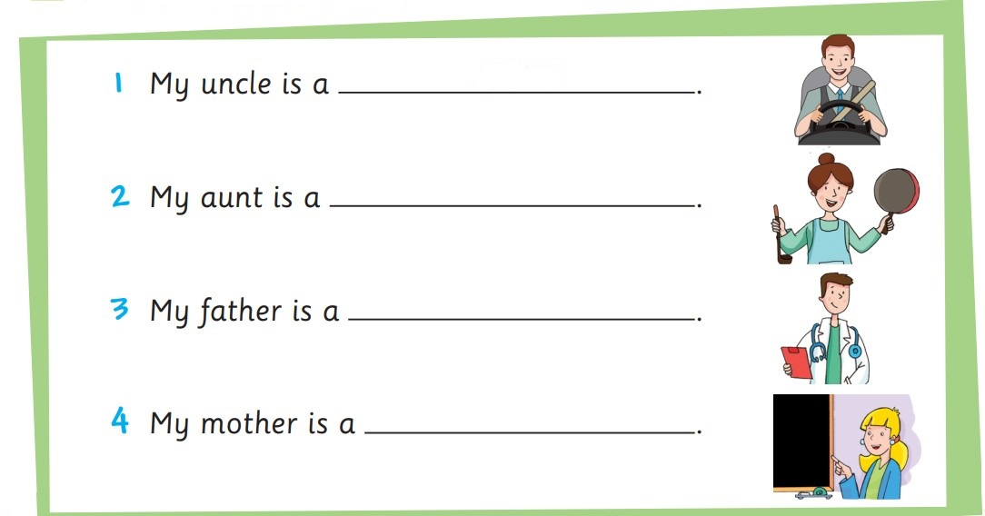
(Activity Book)
Complete. Say.
driver
housewife
doctor
teacher

Slide 21

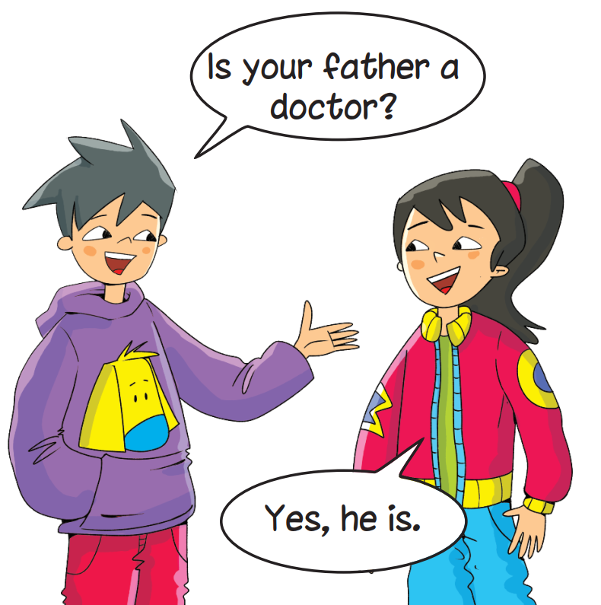
Practice

Slide 22
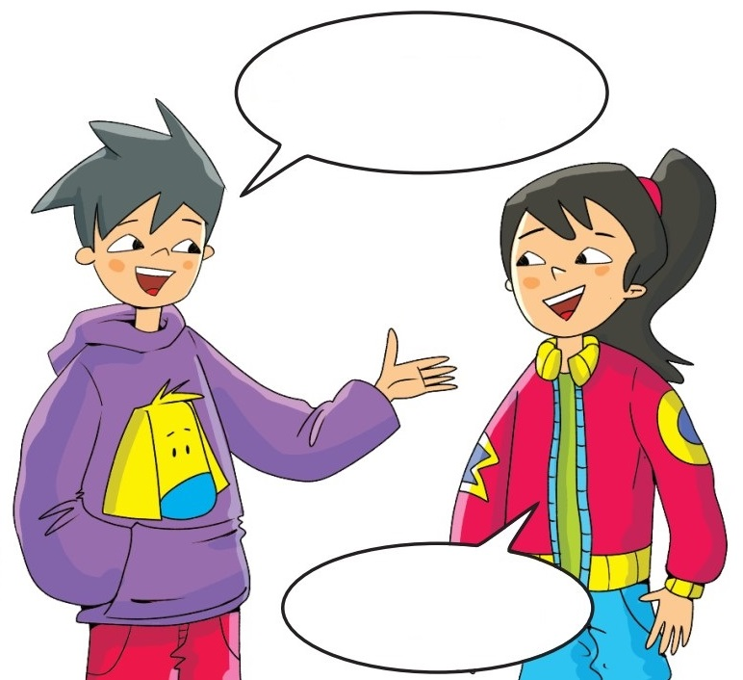


Early Production
Look. Ask and answer.
uncle
Is your uncle a teacher?
Yes, he is.

Slide 23
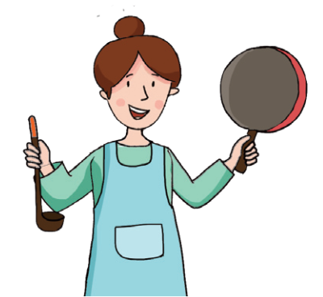

Early Production
Look. Ask and answer.
aunt
Is your aunt a housewife?
No, she isn’t.

Slide 24

Early Production
Look. Ask and answer.
father
Is your father a doctor?
Yes, he is.

Slide 25
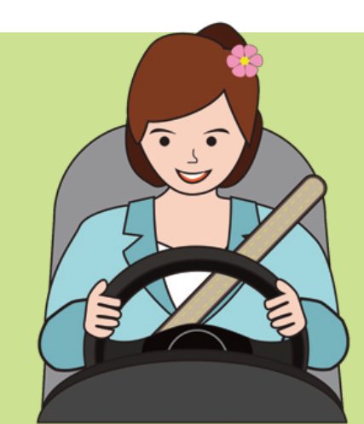
Early Production
Look. Ask and answer.
mother
Is your mother a driver?
No, she isn’t.

Slide 26

Today’s lesson:
Vocabulary
a housewife
a driver
a teacher
a doctor

Slide 27
Today’s lesson:
Structure

Slide 28
Homework
Practise the vocabularies and structure; and make sentences using them.
Prepare the next lesson (page 23 Pupil’s Book).
Do the exercises in Activity Book page 22.
Do the exercises in Tiếng Anh 3 Extra & Friends Notebook (Page 16).

Slide 29
