Slide 1
Unit 1
Family
Lesson 4 – Page 21

Slide 2

By the end of this lesson, pupils will be able to talk about jobs.
Vocabulary: an engineer, a farmer, a cook, a dentist
Structure: My father is a cook.
Phonics: /ɪə/ - engineer

Slide 3



Slide 4

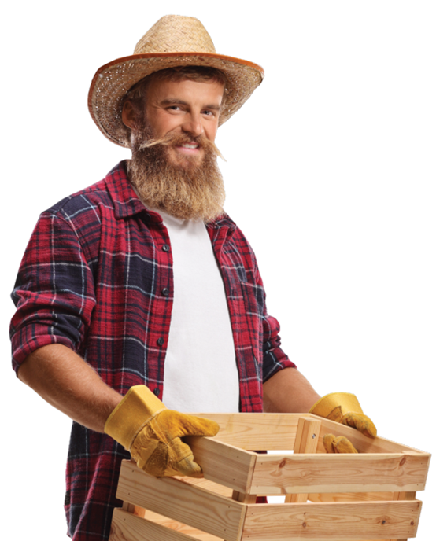







REVIEW
an engineer
a farmer
a cook
a dentist

Slide 5
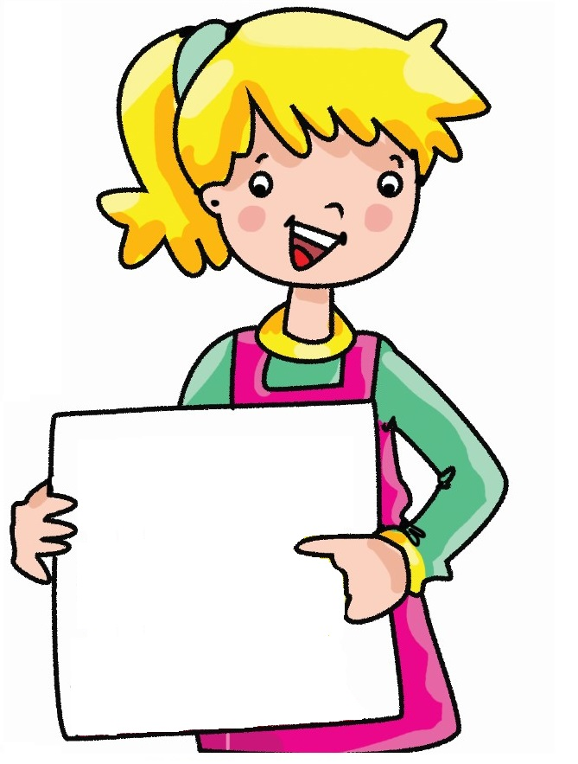

Look. Complete. Say.
This is my father. He’s __________.
an engineer

Slide 6

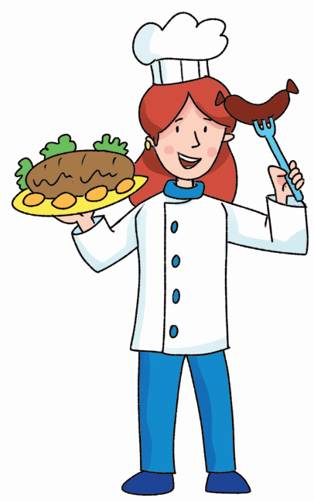
Look. Complete. Say.
This is my aunt.
_______________.
She’s a cook

Slide 7

Look. Complete. Say.
_____ is my uncle.
______________.
This
He’s a dentist

Slide 8
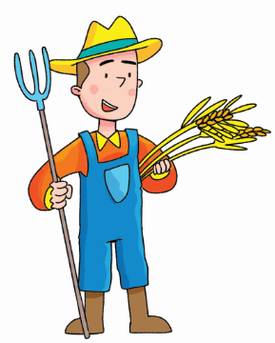
Look. Complete. Say.
_________ brother.
_______________.
This is my
He’s a farmer

Slide 9

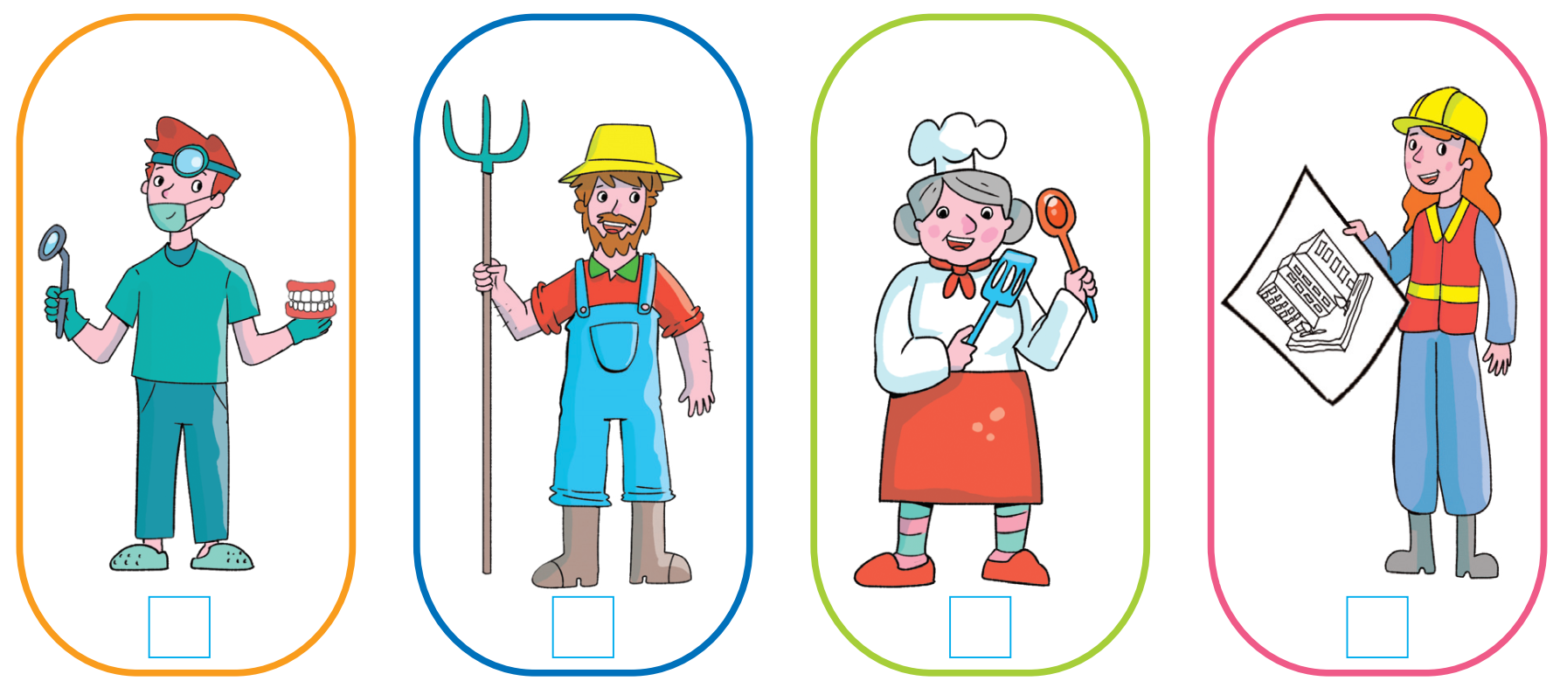
Practice
3
1
4
2

Slide 10
Listen and write.
1. My uncle is ______________.
2. My aunt is _______________.
3. My brother is ____________.
4. My grandmother is ________.
a farmer
an engineer
a dentist
a cook

Slide 11
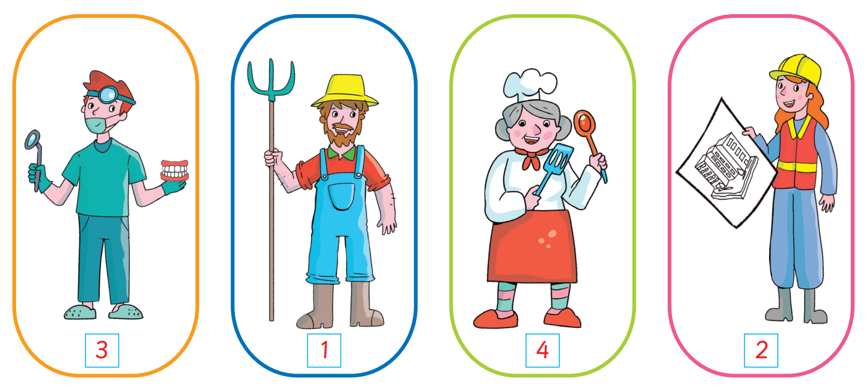
Practice
script

Slide 12
Extra Practice
Make sentences and say.
1
dentist.
My
a
mother
is
My
mother
is
a
dentist.
2
an
is
engineer.
My
uncle
My
uncle
is
an
engineer.
3
grandmother
is
My
cook.
a
My
grandmother.
is
a
cook.

Slide 13
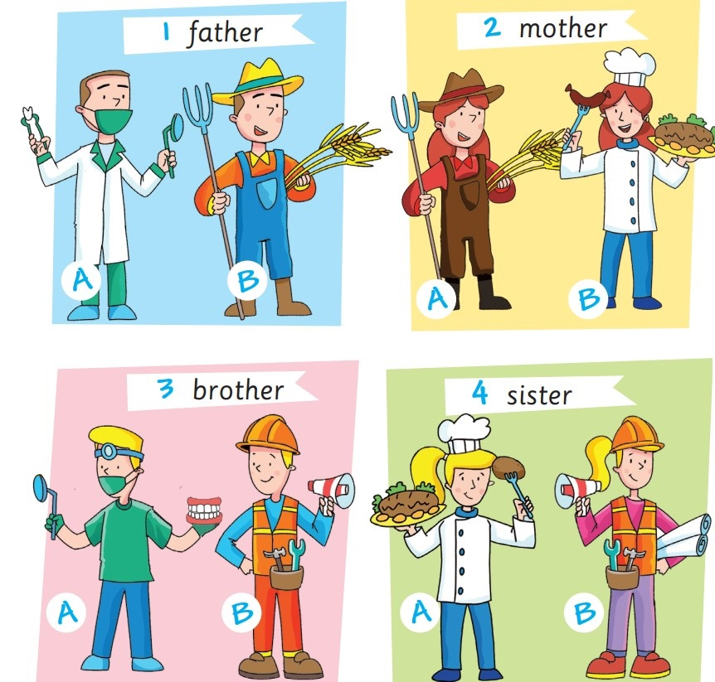
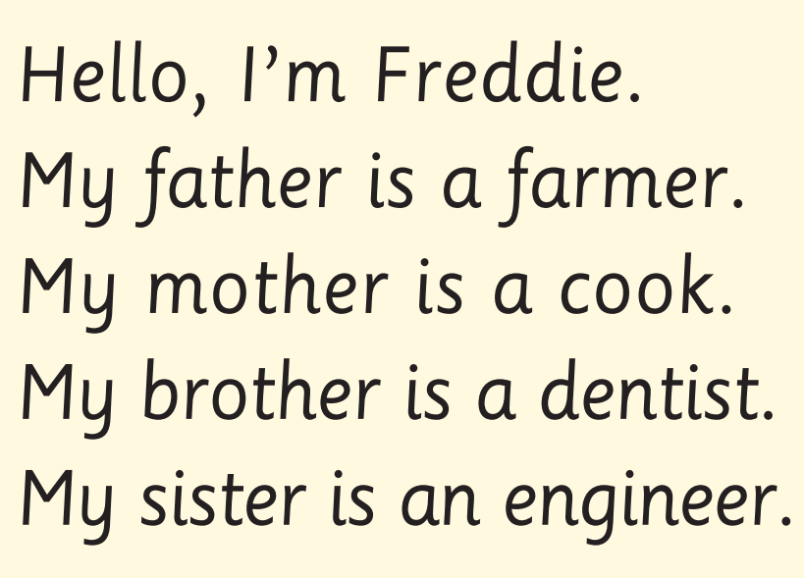
(Activity Book)
Look. Read. Circle. Point. Say.

Slide 14


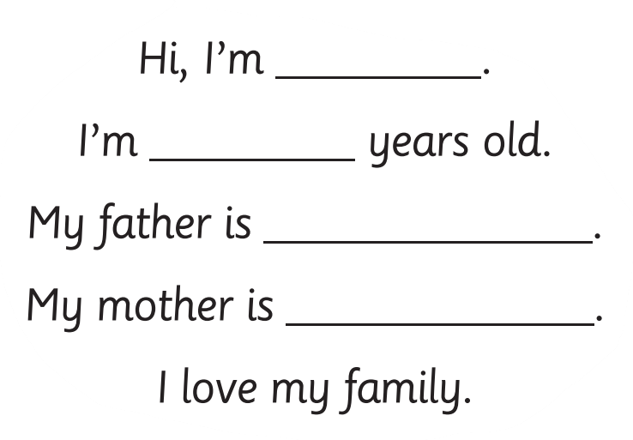
Production
(Khoa)
(eight)
(an engineer)
(a cook)

Slide 15
Production
Let’s talk.

Slide 16




Slide 17

/ɪə/
engineer

Slide 18
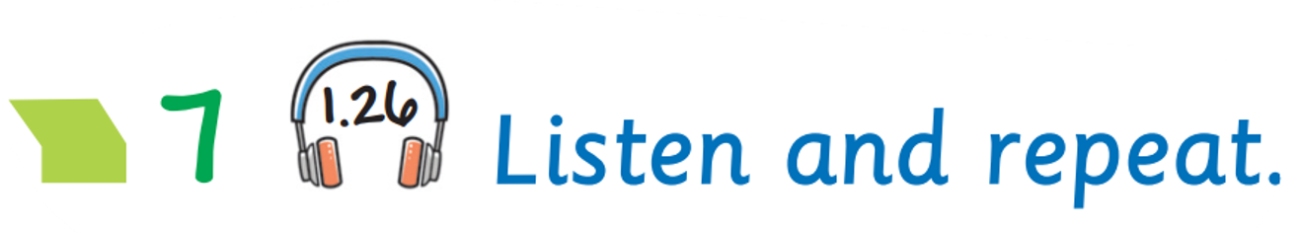




Slide 19

(Activity Book)
e e

Slide 20

Today’s lesson:
Vocabulary
an engineer
a farmer
a cook
a dentist

Slide 21
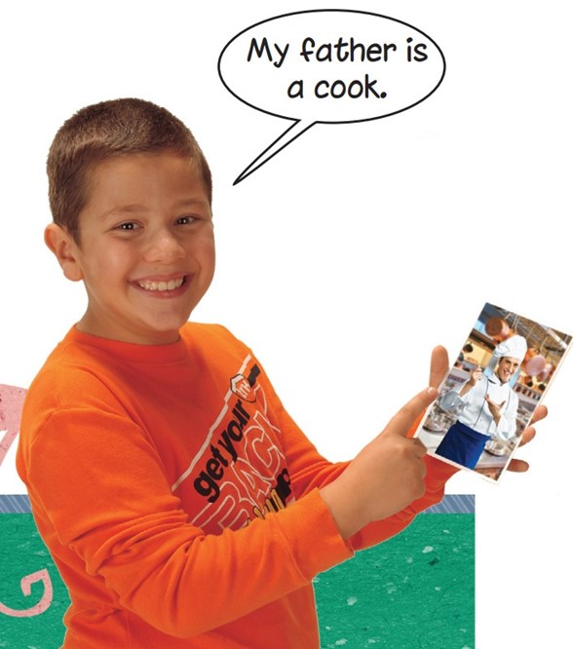
Today’s lesson:
Structure

Slide 22
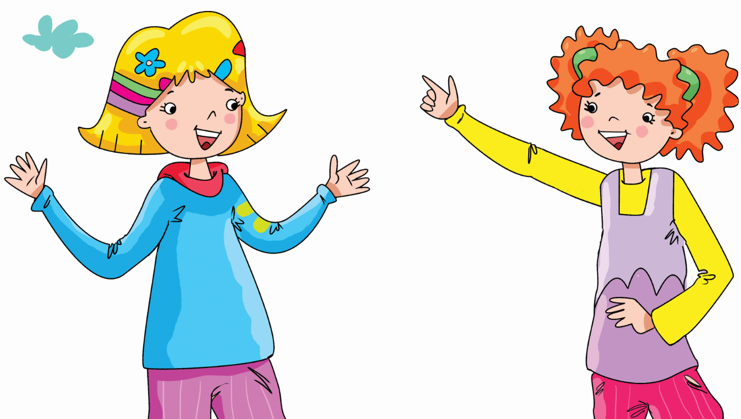

Mime and say.
i
An engineer

Slide 23
Homework
Practise the vocabularies and structure; and make sentences using them.
Prepare the next lesson (page 22 Pupil’s Book).
Do the exercises in Activity Book page 21.
Do the exercises in Bài tập bổ trợ Tiếng Anh 3 Extra & Friends (Pages 18 & 19) – Recommended.

Slide 24
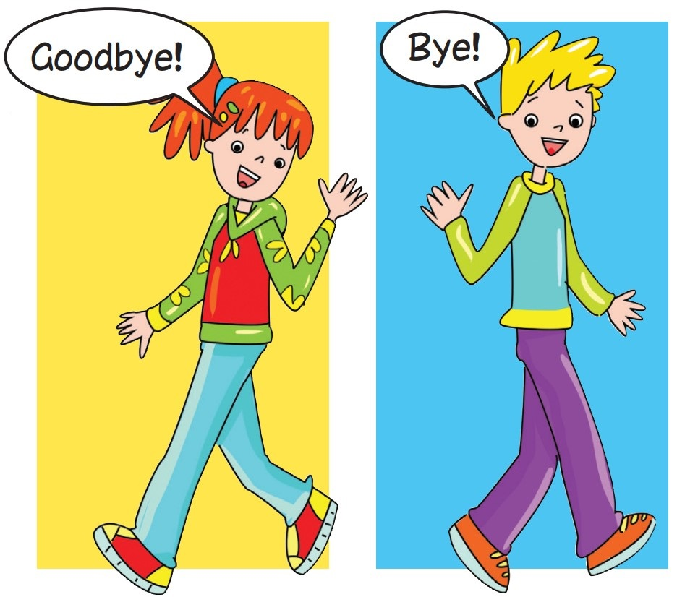

Slide 25

1. My uncle is a farmer.
2. My aunt is an engineer.
3. My brother is a dentist.
4. My grandmother is a cook.
back

Slide 26

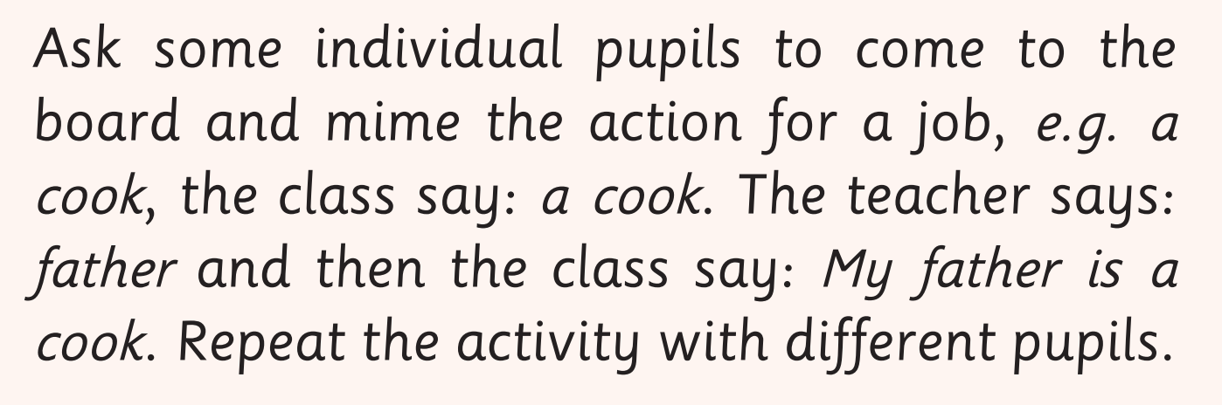
back

