Slide 1

Unit 7 – Holiday
Lesson 1.1 - Page 92

Slide 2


Slide 3


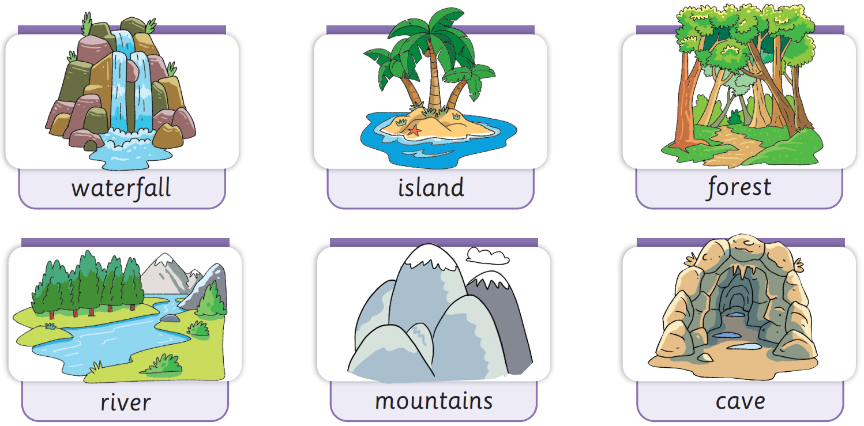
Presentation

Slide 4

Presentation
New words
Click on the picture for the sound.
waterfall
/ˈwɔːtəfɔːl/
thác nước
waterfall

Slide 5

Presentation
New words
Click on the picture for the sound.
island /ˈaɪlənd/
hòn đảo
island

Slide 6
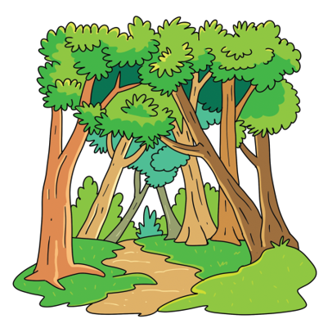
Presentation
New words
Click on the picture for the sound.
forest
/ˈfɒrɪst/
rừng
forest

Slide 7
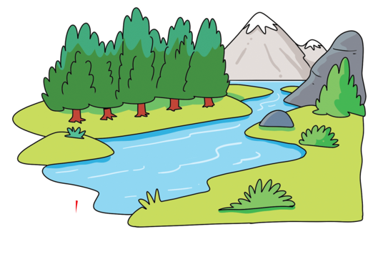
Presentation
New words
Click on the picture for the sound.
river
/ˈrɪvə/
con sông,
dòng sông
river

Slide 8

Presentation
New words
Click on the picture for the sound.
mountains
/ˈmaʊntənz/
núi
mountains

Slide 9
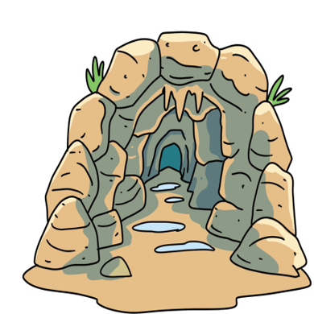
Presentation
New words
Click on the picture for the sound.
cave
/keIv/
cái hang
cave

Slide 10

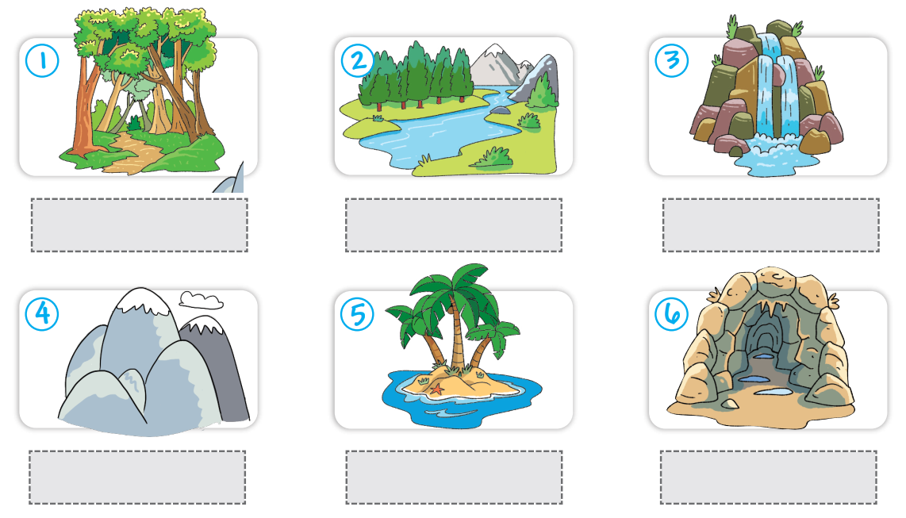
Extra Practice
Activity Book – p.86
Click on the pictures to find the stickers.
waterfall
island
forest
river
mountains
cave

Slide 11



Goodbye!

