Slide 1

Unit 7 - Animals
Lesson 1.1 - Page 86

Slide 2
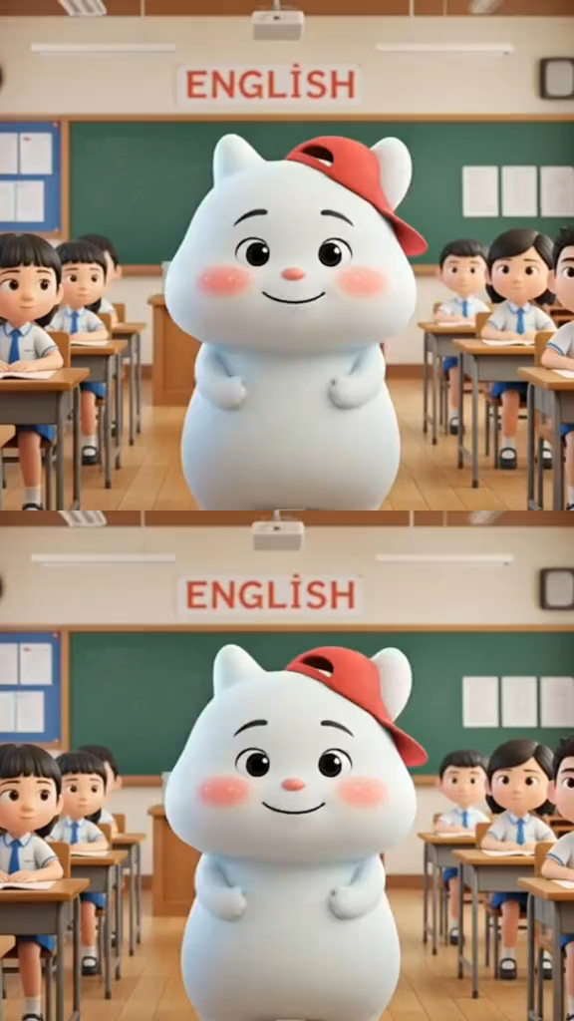

Slide 3


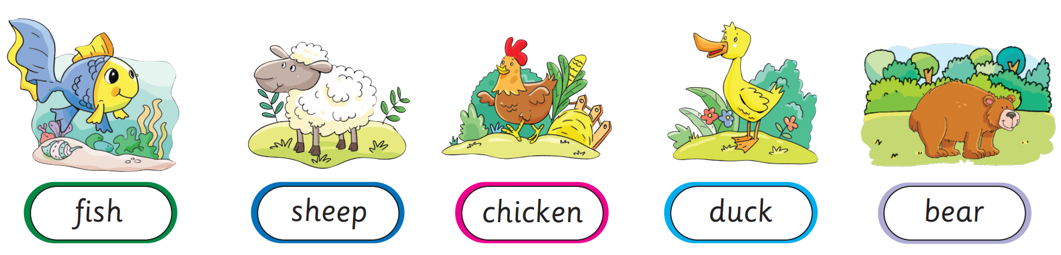
Presentation
Lesson 1.1

Slide 4
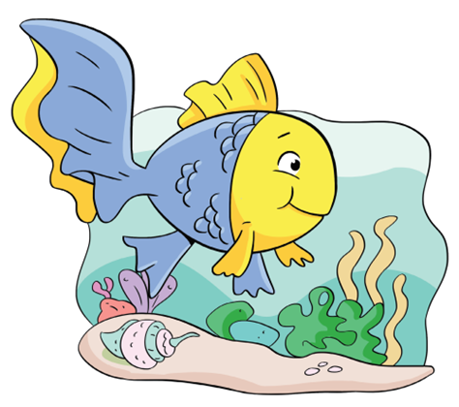
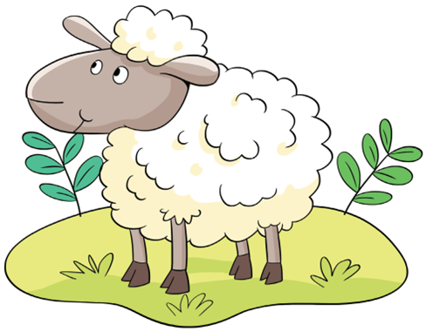
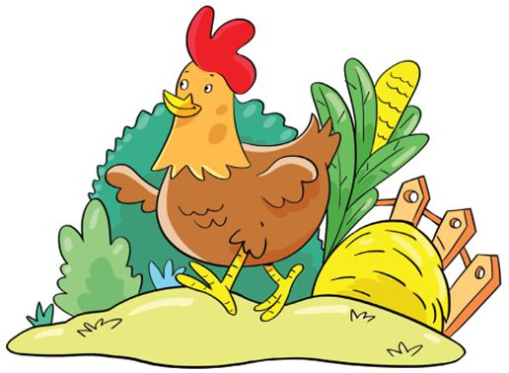
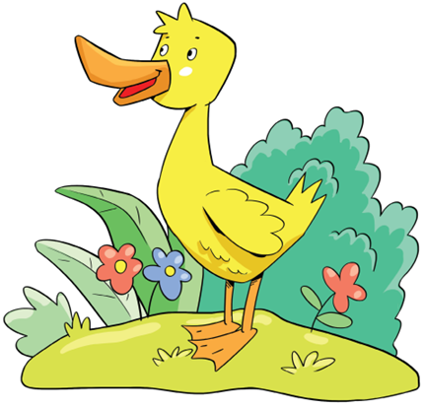
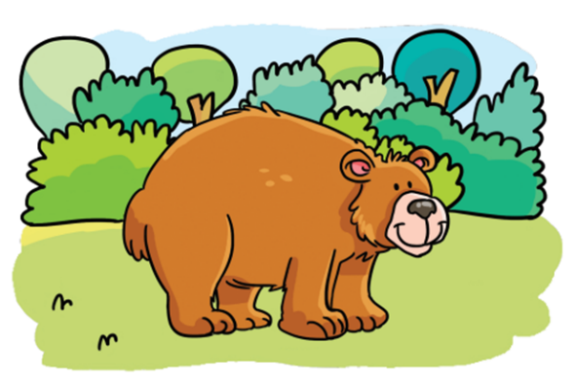





Presentation
Lesson 1.1
Click on each picture for the sound and the word.
New words
fish
sheep
chicken
duck
bear

Slide 5

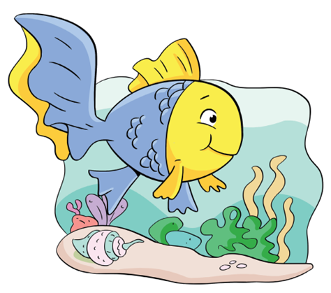


Practice
Lesson 1.1
Look and say.
bear

Slide 6
Practice
Lesson 1.1
What’s missing?
START

Slide 7
Practice
Lesson 1.1
What’s missing?
NEXT

Slide 8
Practice
Lesson 1.1
What’s missing?
NEXT

Slide 9
Practice
Lesson 1.1
What’s missing?
NEXT

Slide 10
Practice
Lesson 1.1
What’s missing?
NEXT

Slide 11
Practice
Lesson 1.1
What’s missing?
END

Slide 12
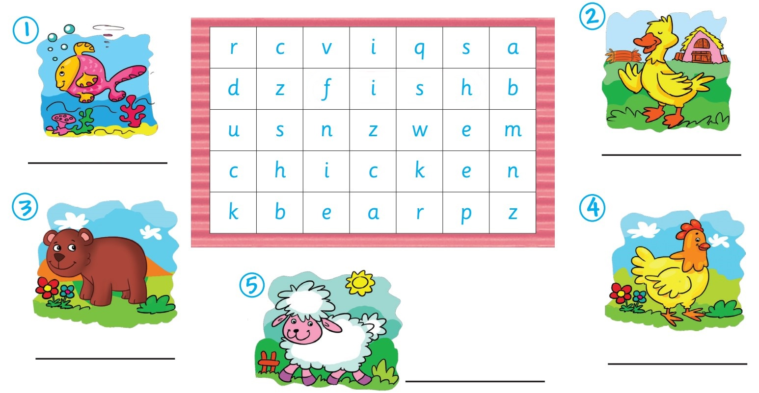
Activity Book – p.84
Lesson 1.1
fish
duck
bear
chicken
sheep

Slide 13


Lesson 1.1
Goodbye!

