Slide 1
Unit 5
Time and Hobbies
Lesson 4.1 - Page 68

Slide 2

By the end of this lesson, pupils will be able to identify types of weather and practise asking and answering about how the weather is today.
Vocabulary: sunny, rainy, cloudy, snowy
Structure: What’s the weather like today?
It’s sunny.

Slide 3



Slide 4
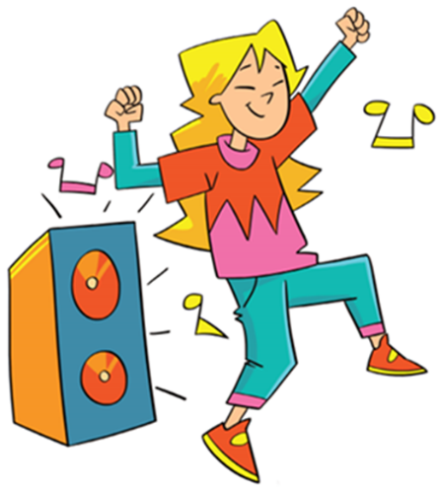
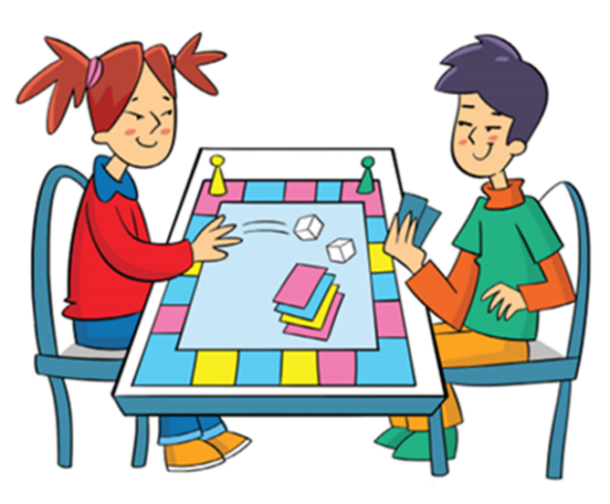
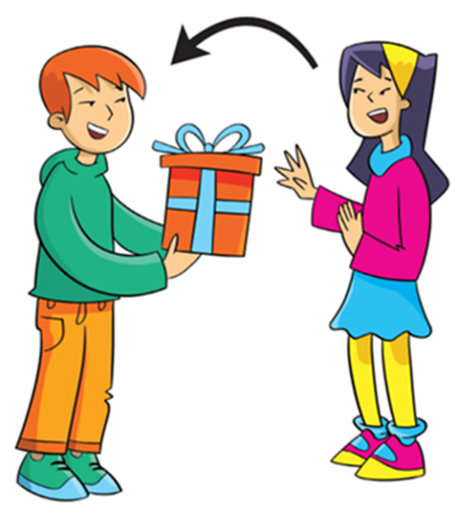
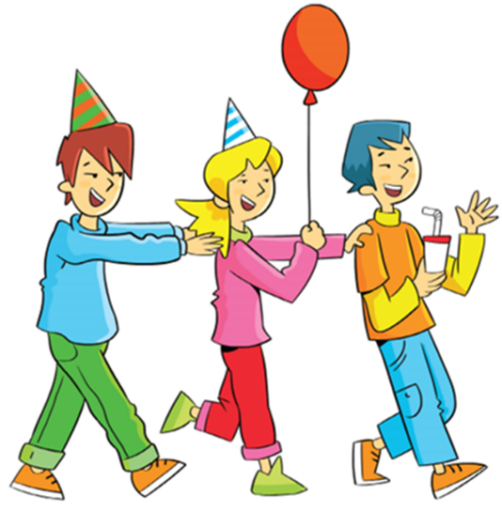
REVIEW 1
Look and say.
have a party

Slide 5



REVIEW 2
Read and choose.
What would you like to do on your birthday?
I would like to get presents.
A
B
C
NEXT

Slide 6

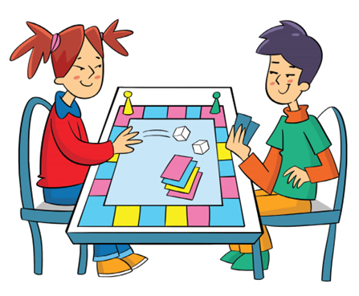
Read and choose.
What would you like to do on your birthday?
I would like to dance.
A
B
C
NEXT

Slide 7
Read and choose.
What would you like to do on your birthday?
I would like to play board games.
A
B
C
NEXT

Slide 8
Read and choose.
What would you like to do on your birthday?
I would like to have a party.
A
B
C
END

Slide 9
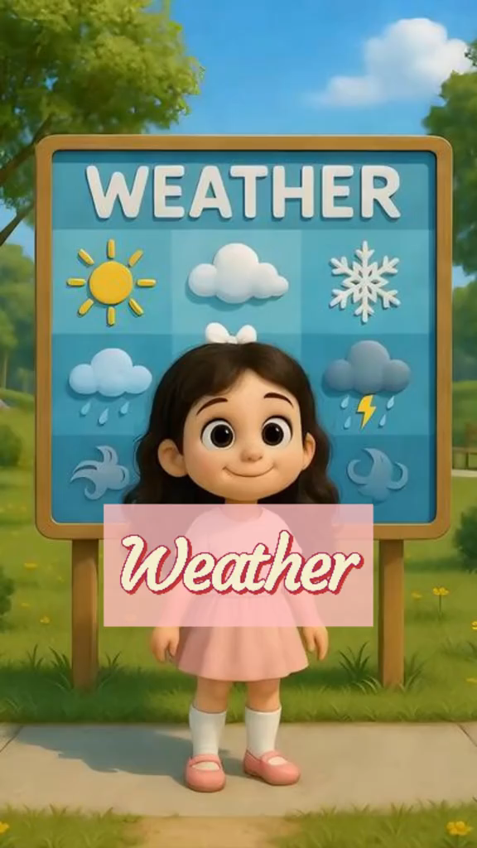

Slide 10


It’s time to learn …

Slide 11



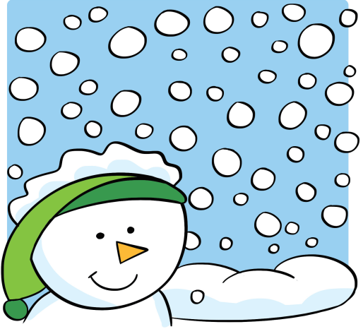

Slide 12






Presentation

Slide 13








Presentation
Click on each picture for the sound and the phrase.
New words
sunny
rainy
cloudy
snowy

Slide 14

Practice
Read and match.
sunny
rainy
cloudy
snowy
1
2
3
4
a
b
c
d

Slide 15


Practice
Listen and choose.

Slide 16


Practice
Listen and choose.

Slide 17

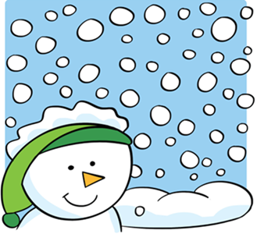
Practice
Listen and choose.

Slide 18


Practice
Listen and choose.

Slide 19
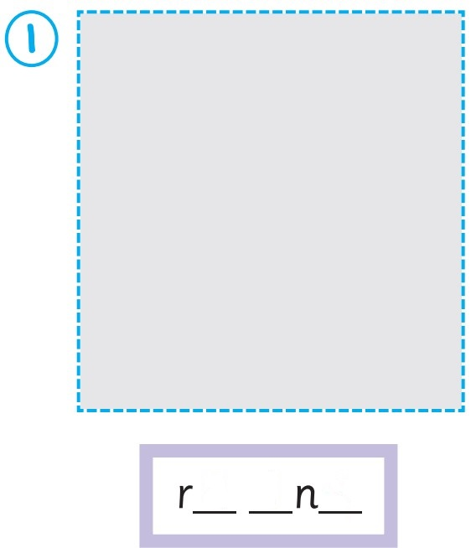
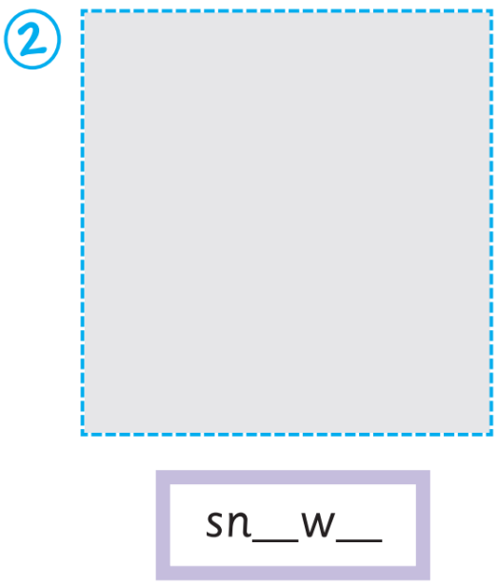


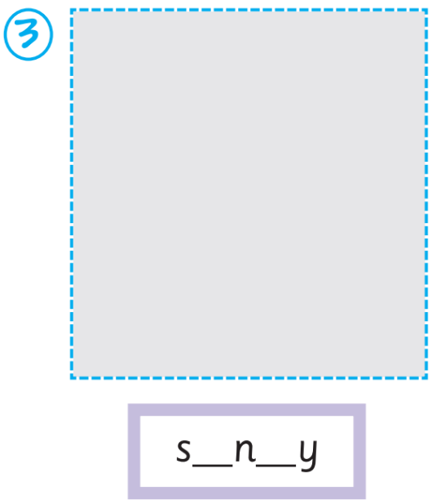
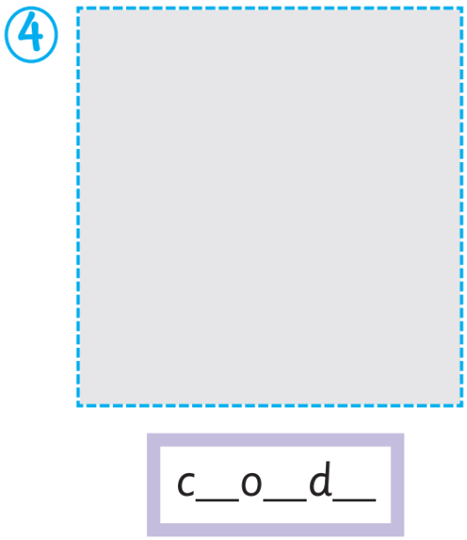


Activity Book – p.66
a i y
o y
u n
l u y

Slide 20
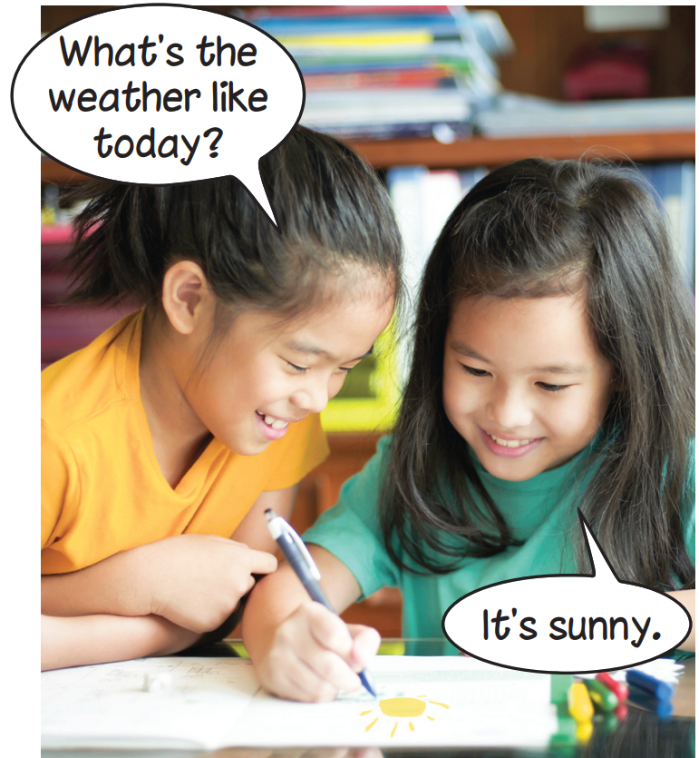


Presentation

Slide 21
Presentation

Slide 22

Presentation
What’s the weather like today?
It’s sunny.

Slide 23
Presentation
Structure
What’s the weather like today?
It’s sunny.
Usage
To ask and answer about weather.

Slide 24
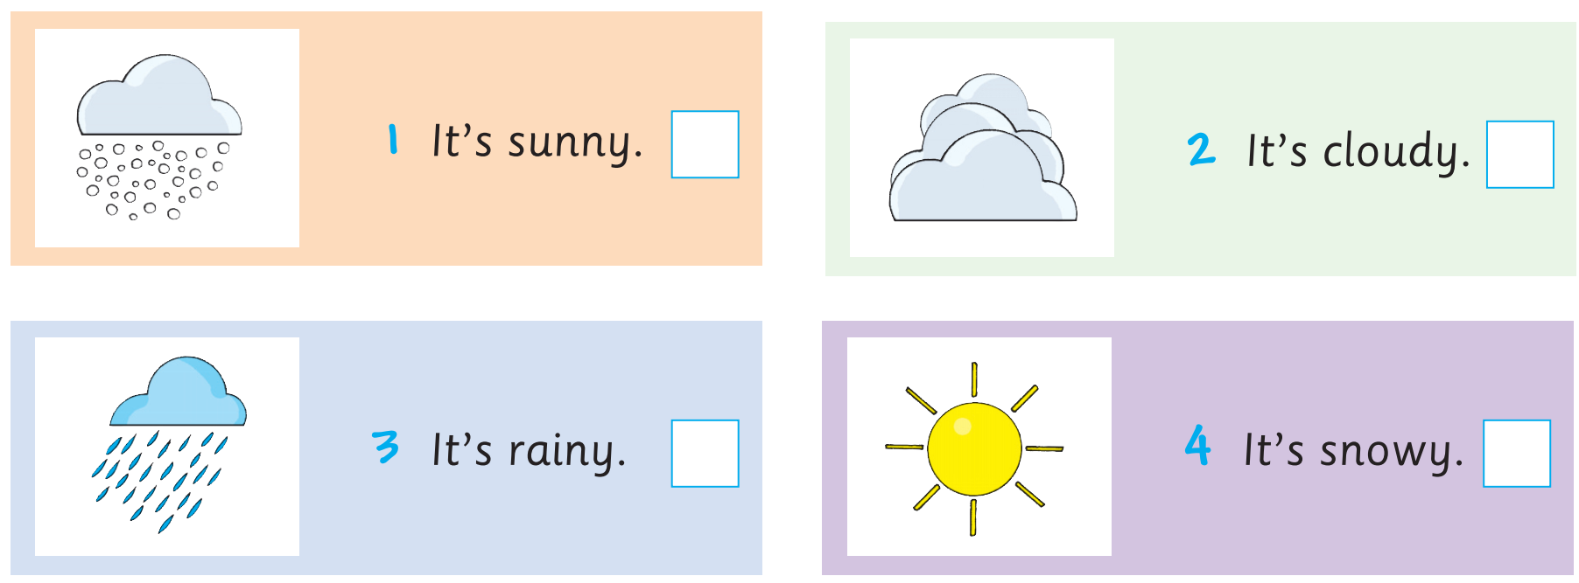
Activity Book – p.66
✗
✓
✓
✗

Slide 25




Practice
Look and say.
It’s sunny.

Slide 26

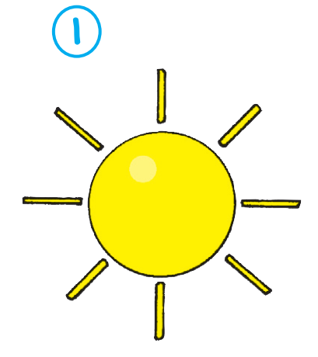
What’s the weather like today?
It’s sunny.

Slide 27
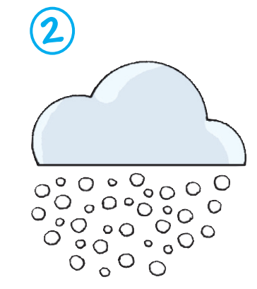
What’s the weather like today?
It’s snowy.

Slide 28

What’s the weather like today?
It’s rainy.

Slide 29

What’s the weather like today?
It’s cloudy.

Slide 30

Click on each picture for the sound and the word.
Today’s lesson:
Vocabulary

Slide 31
Today’s lesson:
Structure

Slide 32
Homework
Practise the vocabularies and structure; and make sentences using them.
Prepare the next lesson (page 69 Pupil’s Book).
Do the exercises in Activity Book page 66.
Do the exercises in Tiếng Anh 4 Extra and Friends notebook (page 37) - recommended

Slide 33

Goodbye!

