Slide 1

Unit 5 – Where I Live
Lesson 1.1 - Page 68

Slide 2



Slide 3
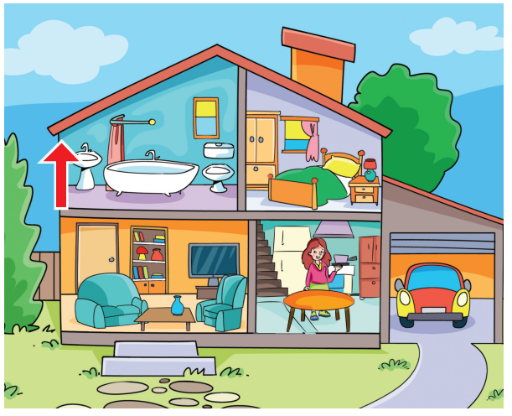

Presentation
Click on the picture for the sound and the word.
New words
upstairs
/ˌʌpˈsteəz/
trên lầu, tầng trên

Slide 4
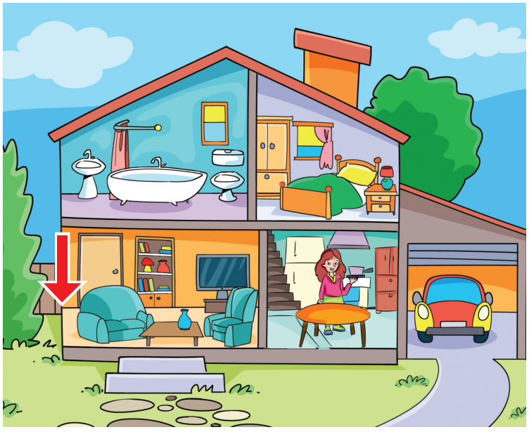
Presentation
Click on the picture for the sound and the word.
New words
downstairs
/ˌdaʊnˈsteəz/
dưới lầu, tầng dưới

Slide 5
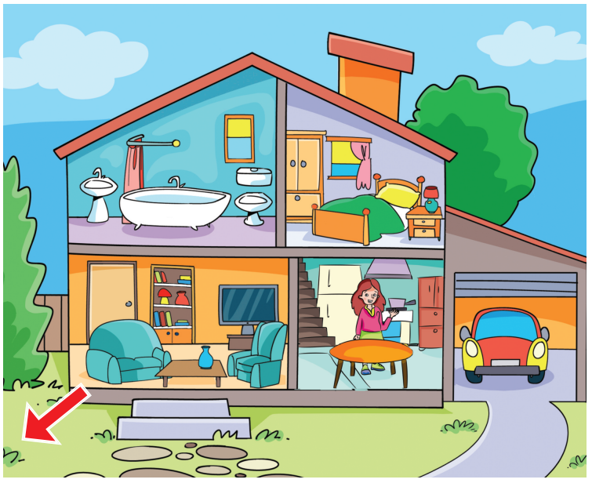
Presentation
Click on the picture for the sound and the word.
New words
outside
/ˌaʊtˈsaɪd/
bên ngoài

Slide 6
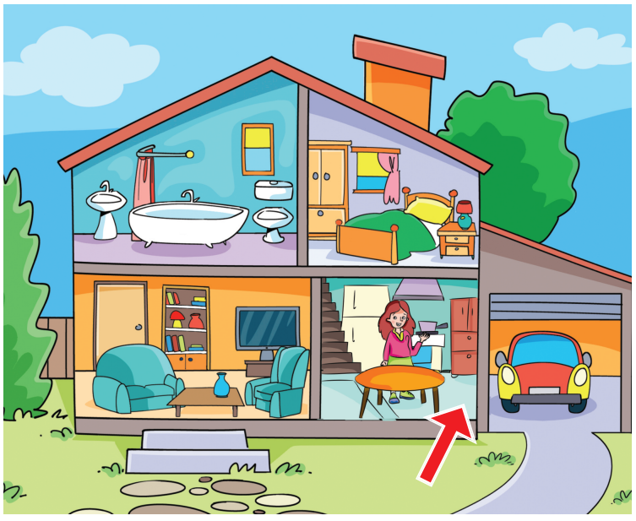
Presentation
Click on the picture for the sound and the word.
New words
inside
/ˌɪnˈsaɪd/
bên trong

Slide 7
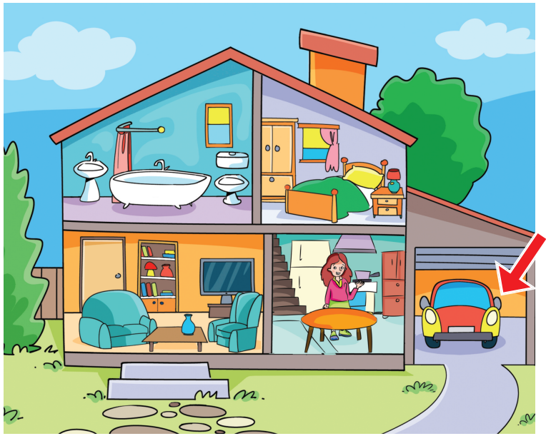
Presentation
Click on the picture for the sound and the word.
New words
in the garage
/ˈɡærɪdʒ/
trong ga-ra

Slide 8
Presentation
Click on the picture for the sound.
New words
upstairs
downstairs
outside
inside
in the garage

Slide 9

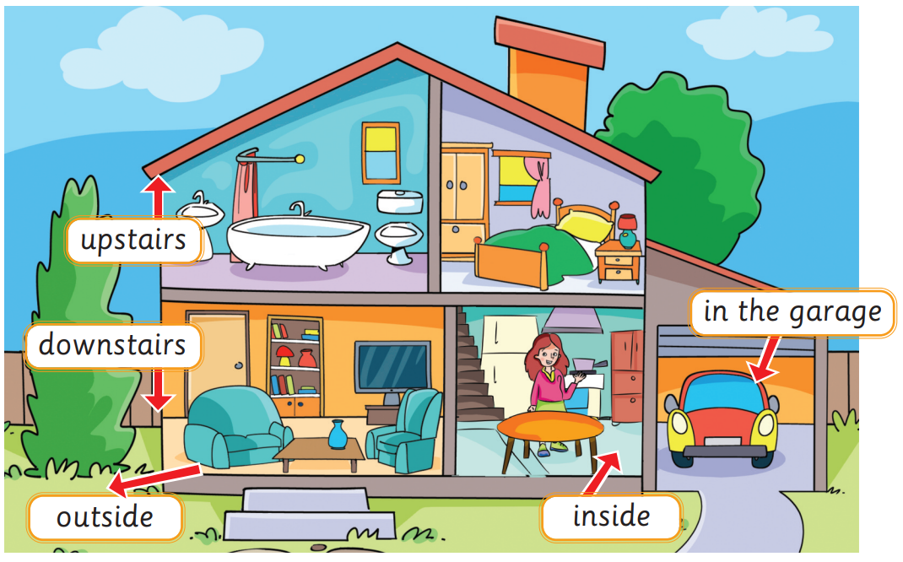
Practice 1
Click on the speaker for the sound.

Slide 10



Goodbye!

