Slide 1
Unit 5
Time and Hobbies
Lesson 1.1 - Page 62

Slide 2

By the end of this lesson, pupils will be able to identify months of the year and practise asking and answering about them.
Vocabulary: January, February, March, April, May, June
Structure: What month is it now?
It’s January.

Slide 3

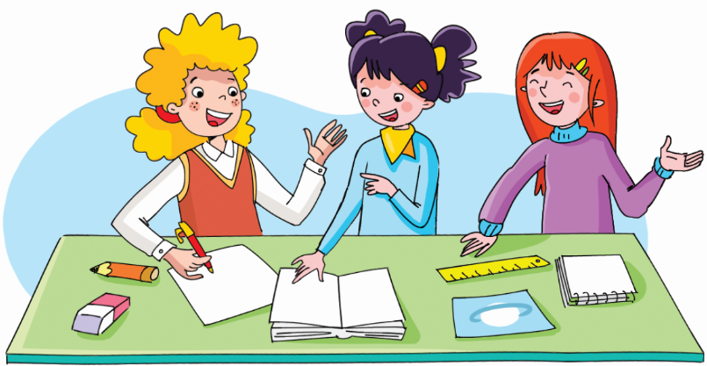

Slide 4
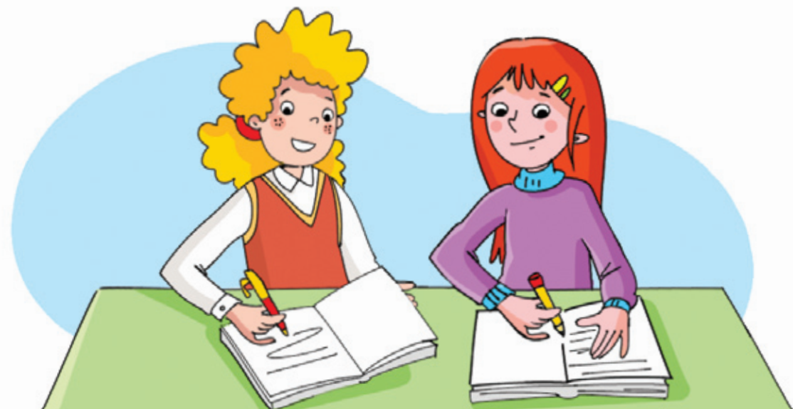
REVIEW
Look. Ask and answer.
What are they doing?
They’re taking notes.

Slide 5

Look. Ask and answer.
What are they doing?
They’re listening to the teacher.

Slide 6
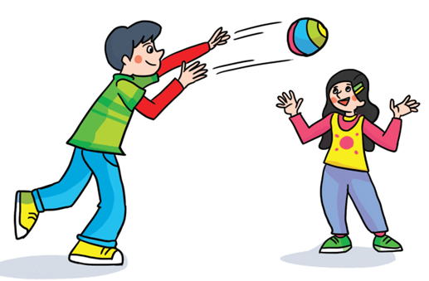
Look. Ask and answer.
What are they doing?
They’re playing ball games.

Slide 7
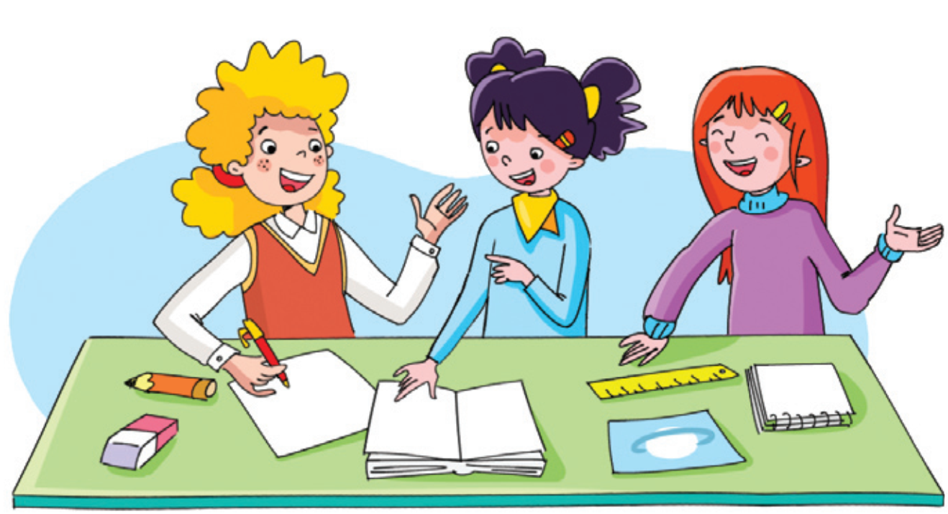
Look. Ask and answer.
What are they doing?
They’re working in groups.

Slide 8
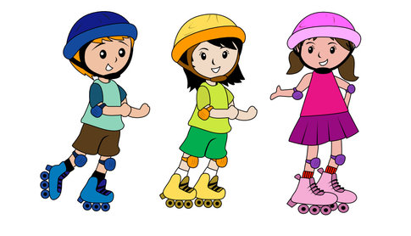
Look. Ask and answer.
What are they doing?
They’re going roller skating.

Slide 9
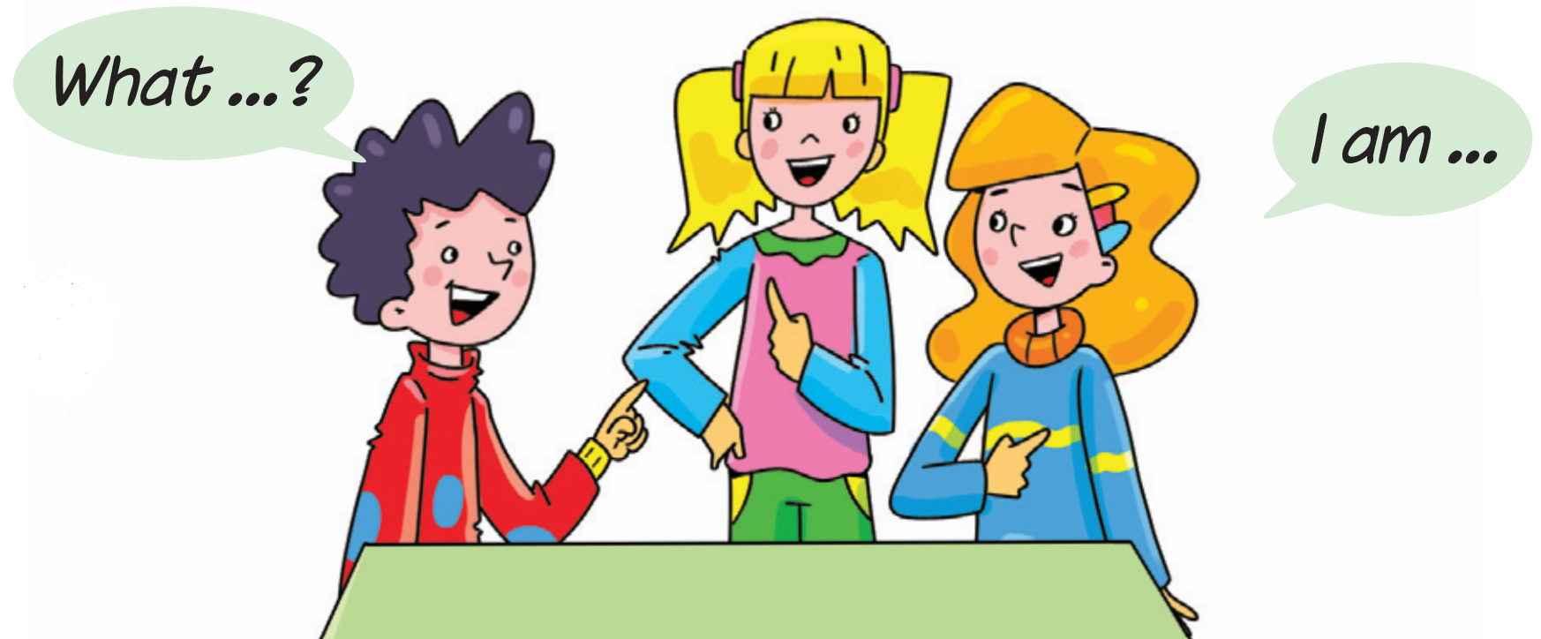
Look. Ask and answer.
What are they doing?
They’re practising English.

Slide 10
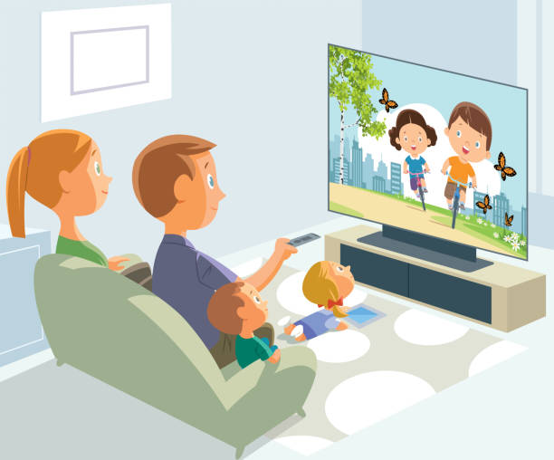
Look. Ask and answer.
What are they doing?
They’re watching television.

Slide 11
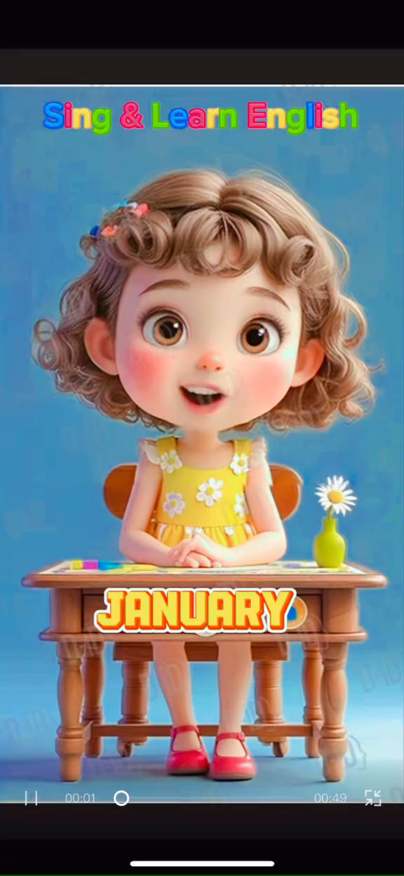

Slide 12


It’s time to learn …

Slide 13
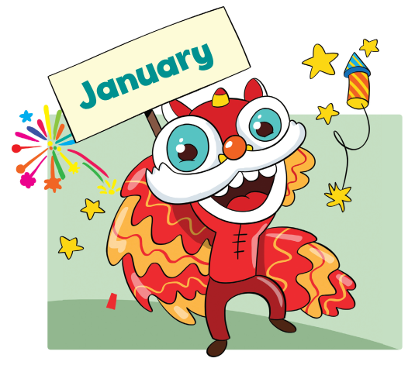

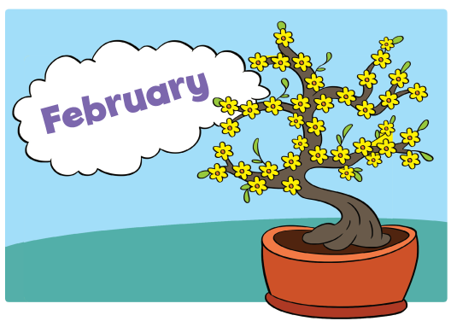
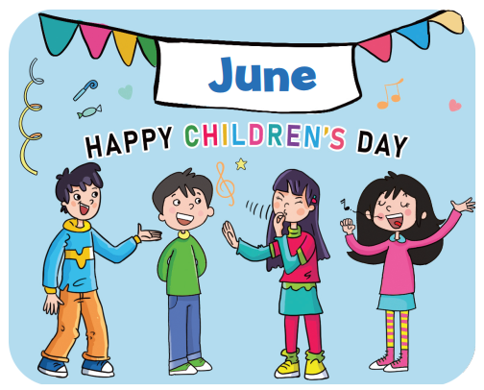



Slide 14


Presentation

Slide 15
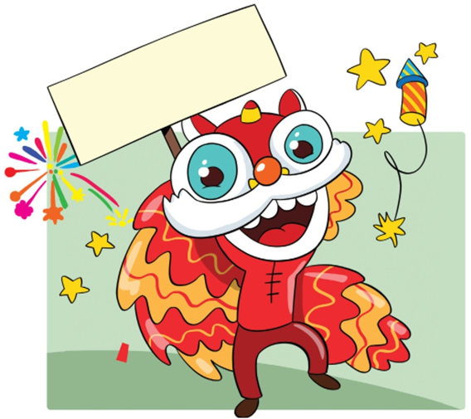
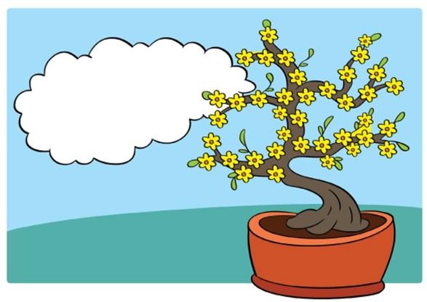
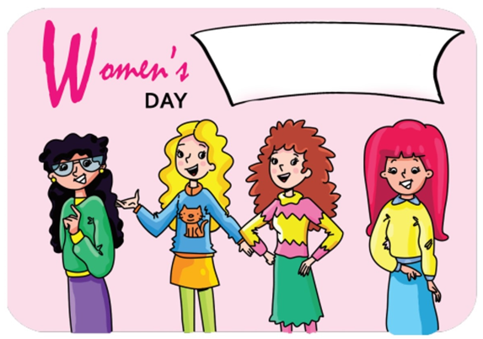



Presentation
New words
January
February
March
Click on each picture for the sound and the word.

Slide 16

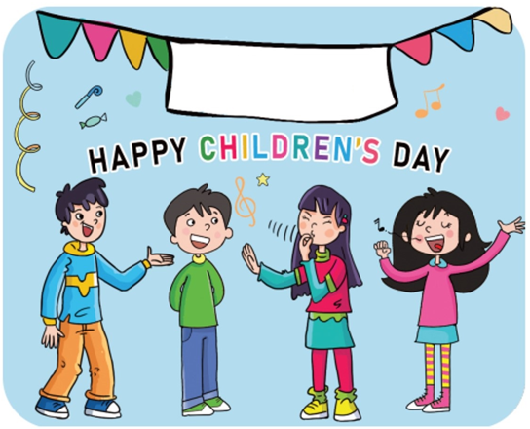
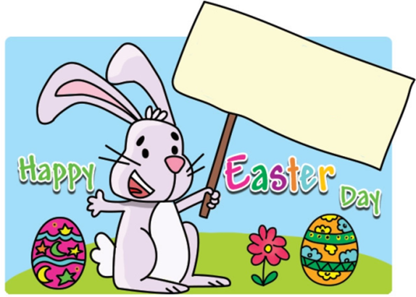



Presentation
New words
April
May
June
Click on each picture for the sound and the word.

Slide 17






Practice
Look and say.
March

Slide 18
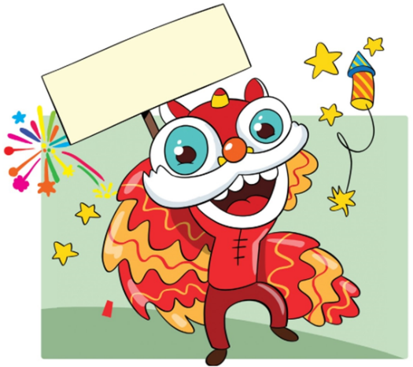

Practice
What’s missing?
START

Slide 19
Practice
What’s missing?
NEXT

Slide 20
Practice
What’s missing?
NEXT

Slide 21
Practice
What’s missing?
NEXT

Slide 22
Practice
What’s missing?
NEXT

Slide 23
Practice
What’s missing?
NEXT

Slide 24
Practice
What’s missing?
END

Slide 25

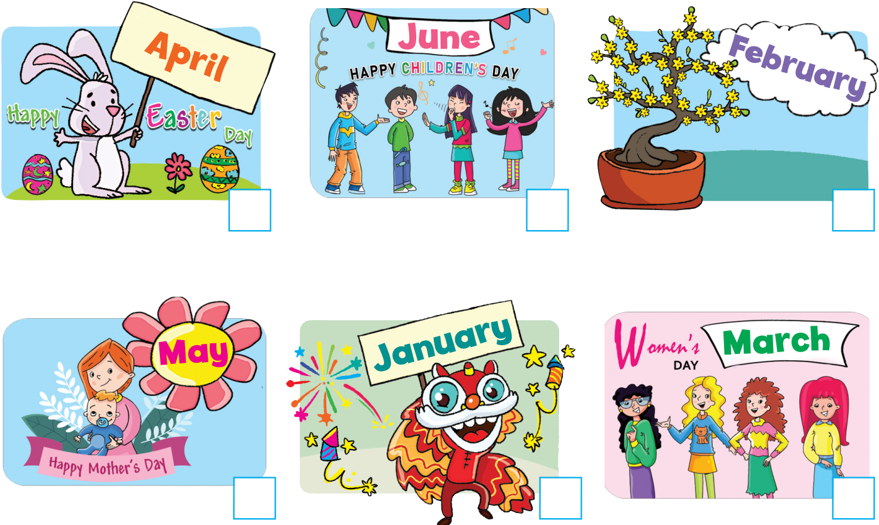
Activity Book – p.60
4
6
2
5
1
3

Slide 26

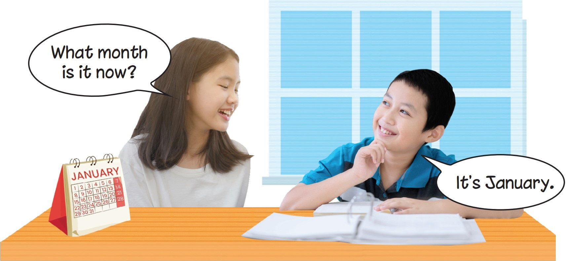

Presentation

Slide 27
Presentation

Slide 28

Presentation
What month is it now?
It’s January.

Slide 29
Presentation
Structure
What month is it now?
It’s January.
Usage
To ask and answer about months of the year.

Slide 30
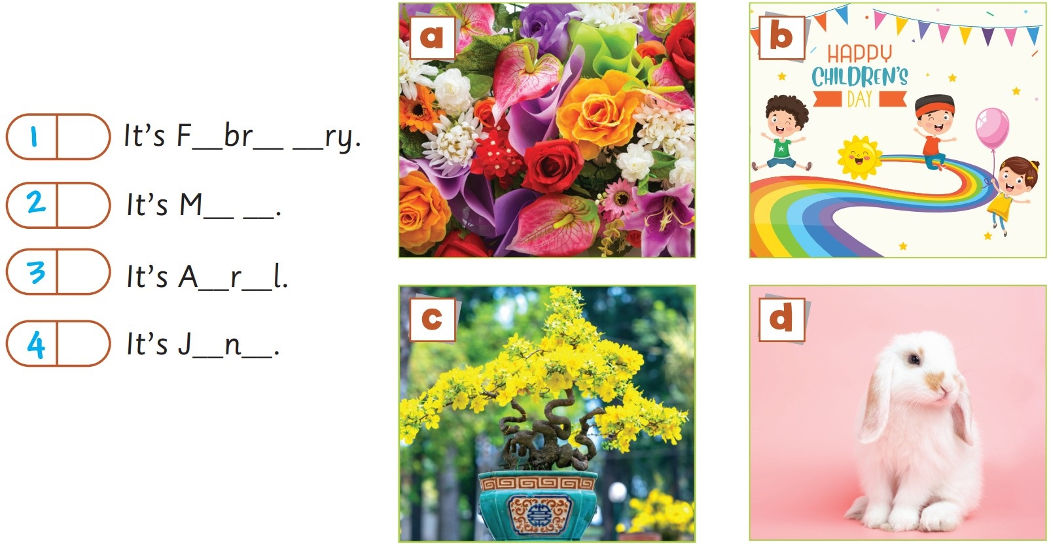
Activity Book – p.60
c
e u a
a
a y
d
p i
b
u e

Slide 31

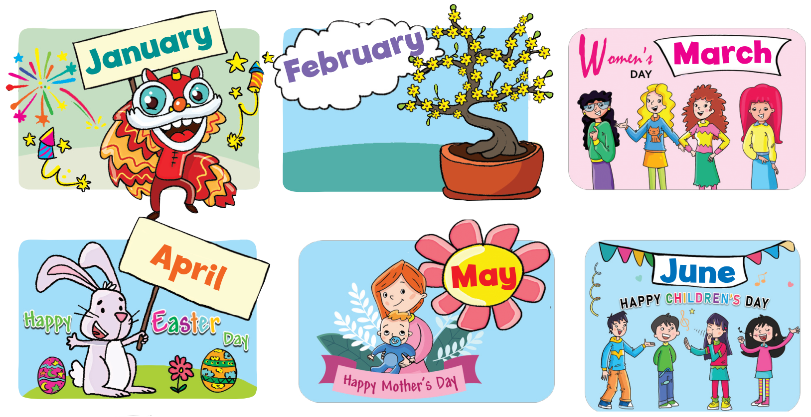
Practice

Slide 32
Practice
What month is it now?
It’s May.

Slide 33

Practice
What month is it now?
It’s February.

Slide 34

Practice
What month is it now?
It’s April.

Slide 35

Practice
What month is it now?
It’s June.

Slide 36
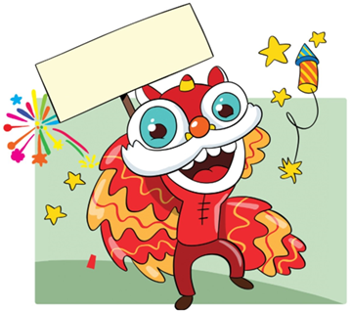
Practice
What month is it now?
It’s January.

Slide 37

Practice
What month is it now?
It’s March.

Slide 38

Click on each picture for the sound.
Today’s lesson:
Vocabulary

Slide 39
Today’s lesson:
Structure

Slide 40
Homework
Practise the vocabularies and structure; and make sentences using them.
Prepare the next lesson (page 63 Pupil’s Book).
Do the exercises in Activity Book page 60.
Do the exercises in Tiếng Anh 4 Extra and Friends notebook (page 34) - recommended

Slide 41

Goodbye!

