Slide 1

Unit 4 – Hobbies and Dreams
Lesson 2.1 - Page 50

Slide 2
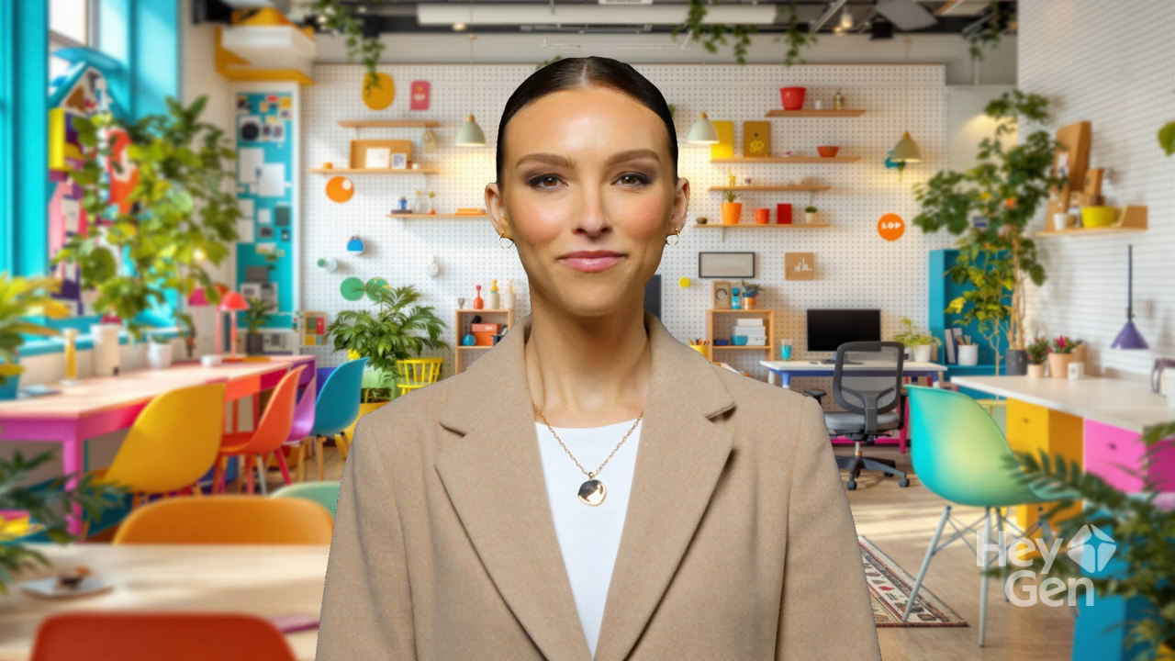

Slide 3
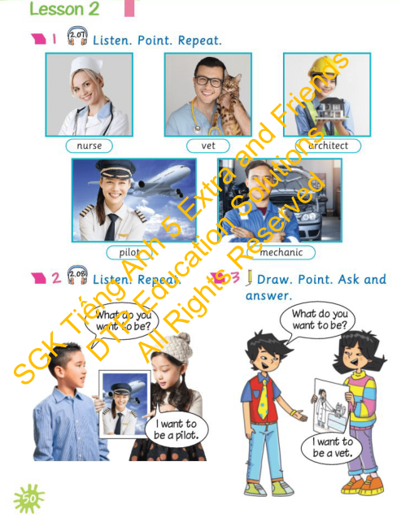


Lesson Outline
Warm-up
Vocabulary
Structure
Wrap-up

Slide 4

By the end of this lesson, pupils will be able to identify some jobs and practise asking and answering about what someone wants to be.
Vocabulary: nurse, vet, architect, pilot, mechanic
Structure: What do you want to be? - I want to be a pilot.

Slide 5

Review 1
Read and match.
A
B
do
for a walk
hang out
a nap
collect
with friends
go
a puzzle
take
stickers

Slide 6

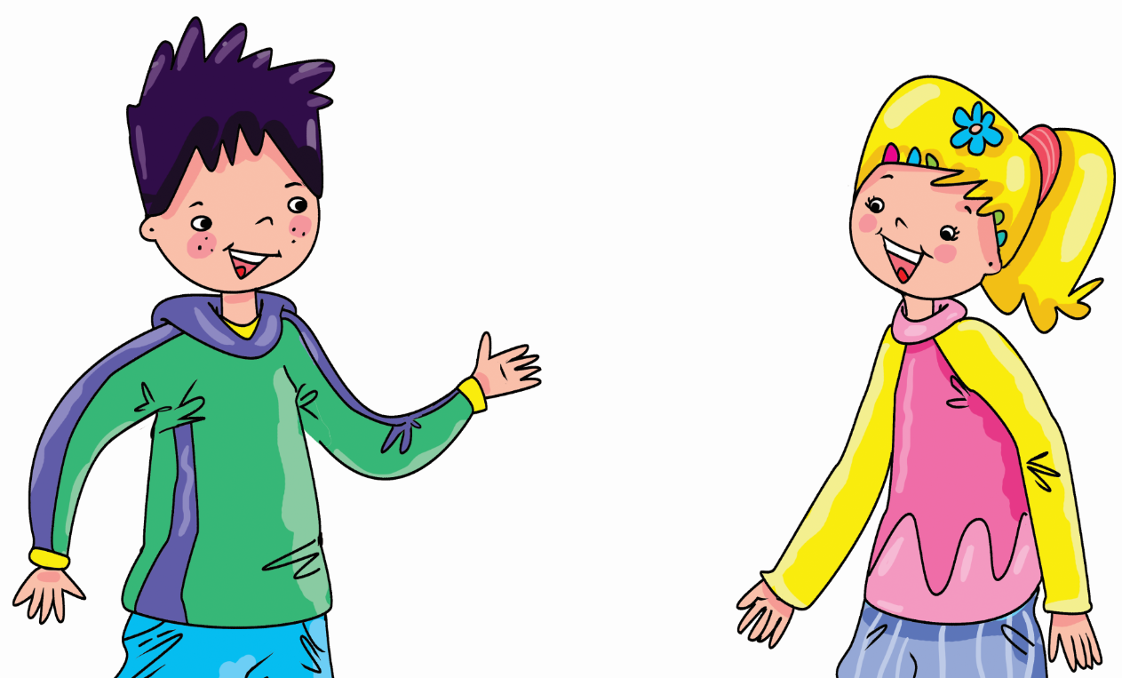
Review 2
Ask and Answer.
What do you do in your free time?
I hang out with friends.

Slide 7

Review 2
Ask and Answer.
What do you do in your free time?
I collect stickers.

Slide 8

Review 2
Ask and Answer.
What do you do in your free time?
I take a nap.

Slide 9

Review 2
Ask and Answer.
What do you do in your free time?
I go or a walk.

Slide 10

Review 2
Ask and Answer.
What do you do in your free time?
I do a puzzle.

Slide 11


It’s time to learn …

Slide 12






Slide 13


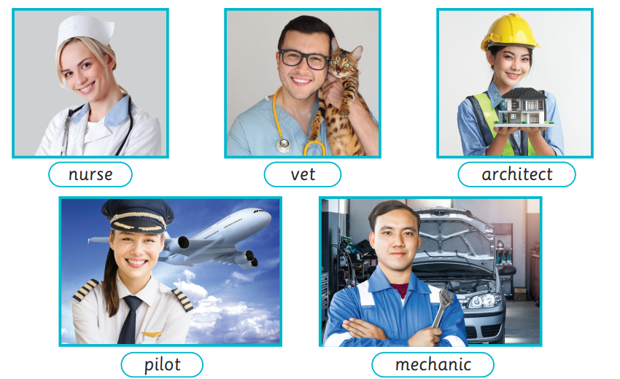
Presentation

Slide 14

Presentation
nurse
/nɜːs/
y tá
Click on the picture to hear the sound.

Slide 15

Presentation
vet
/vet/
bác sĩ thú y
Click on the picture to hear the sound.

Slide 16

Presentation
architect
/ˈɑːkɪtekt/
kiến trúc sư
Click on the picture to hear the sound.

Slide 17

Presentation
pilot
/ˈpaɪlət/
phi công
Click on the picture to hear the sound.

Slide 18

Presentation
mechanic
/məˈkænɪk/
thợ máy
Click on the picture to hear the sound.

Slide 19
Click on the picture to hear the sound.
New words

Slide 20

Practice
Listen and choose.
Click on the sound icon to hear the sound.
A
B
C
NEXT

Slide 21
Practice
Listen and choose.
Click on the sound icon to hear the sound.
A
B
C
NEXT

Slide 22
Practice
Listen and choose.
Click on the sound icon to hear the sound.
A
B
C
NEXT

Slide 23
Practice
Listen and choose.
Click on the sound icon to hear the sound.
A
B
C
NEXT

Slide 24
Practice
Listen and choose.
Click on the sound icon to hear the sound.
A
B
C
END

Slide 25
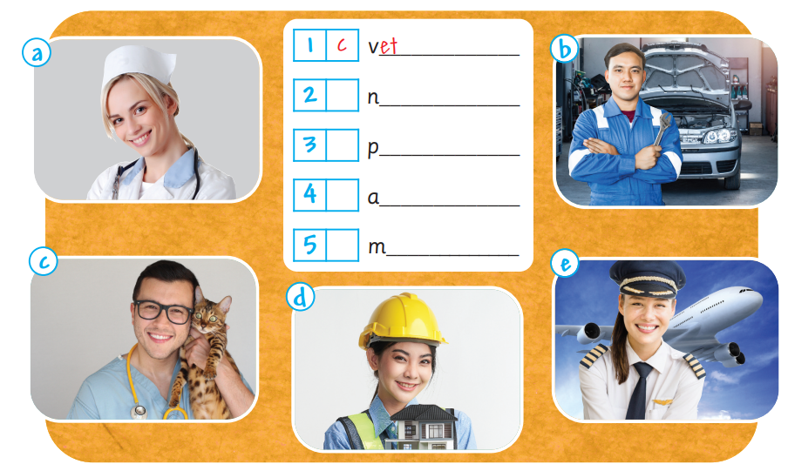
Activity book/ p.50

Slide 26
Activity book/ p.50
urse
et
rchitect
n…………
v…………
a……………
ilot
echanic
p…………
m………….…

Slide 27
Activity book/ p.50
a
urse
e
ilot
d
rchitect
b
echanic

Slide 28
Activity book/ p.50
a
urse
e
ilot
d
rchitect
b
echanic

Slide 29

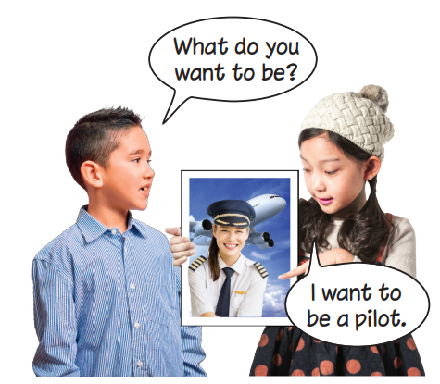
Presentation

Slide 30
Presentation

Slide 31
Presentation
What do you want to be?
I want to be a pilot.

Slide 32
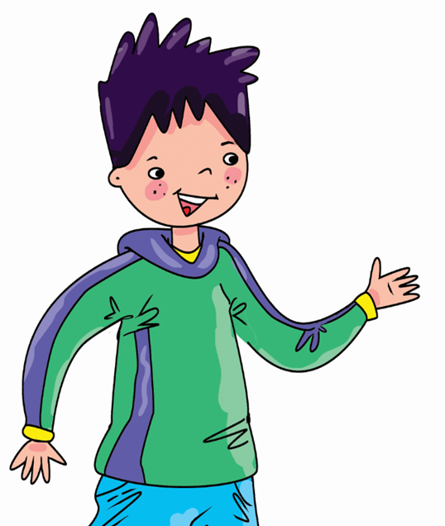
Practice
Ask and answer.
What do you want to be?
I want to be a …………
nurse.

Slide 33
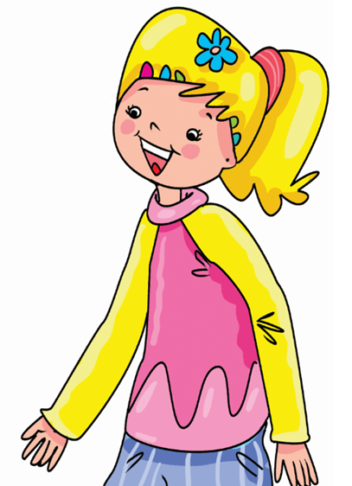
Practice
Ask and answer.
I want …………….….
What do you want to be?
to be a vet.

Slide 34
Practice
Ask and answer.
What do you want to be?
I ……………….
…………..…….
want to be an architect.

Slide 35
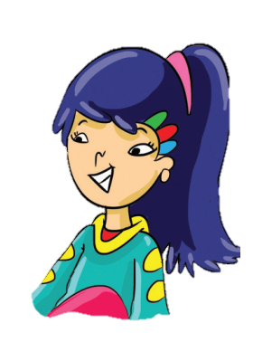
Practice
Ask and answer.
What do you ………………….
I ……………….
…………..…….
want to be a pilot.
want to be?

Slide 36
Practice
Ask and answer.
………………………
……………………...
…………………….
…………………….
What do you want to be?
I want to be
a mechanic.

Slide 37

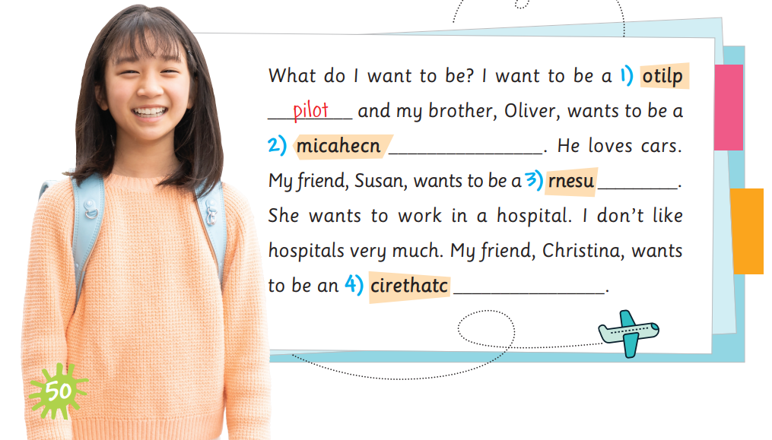
Activity book/ p.50
mechanic
nurse
architect

Slide 38


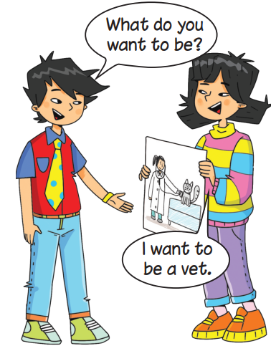
Early Production
i

Slide 39
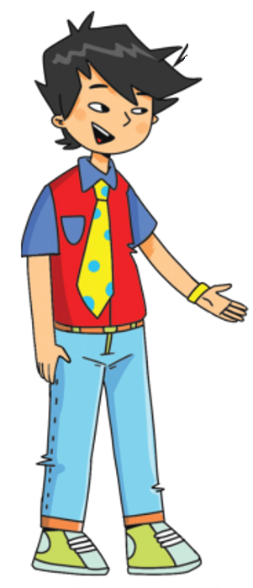
Early Production
What do you want to be?
I want to be a nurse.

Slide 40
Early Production
I want to be a mechanic.
What do you want to be?

Slide 41
Early Production
What do you want to be?
I want to be a pilot.

Slide 42
Early Production
What do you want to be?
I want to be an architect.

Slide 43
Early Production
What do you want to be?
I want to be a vet.

Slide 44
Today’s lesson
New words

Slide 45
Today’s lesson
Structure

Slide 46
Exercise 3. Draw. Point. Ask and answer.
Each pupil draws a picture of a job (from Exercise 1) they would like to do.
In pairs, the pupils take turns holding their pictures, and asking and answering questions to find out what their partner wants to be, as in the example.
Ask some pairs to go to the front of the class to demonstrate the
exchange.
Back

Slide 47
Homework
Practise the vocabularies and structure and make sentences using them.
Prepare the next lesson (page 51 Pupil’s Book).
Do the exercises in Activity Book page 50.
Do the exercises in Tiếng Anh 5 Extra and Friends notebook (page 28) - recommended

Slide 48

Goodbye!

