Slide 1
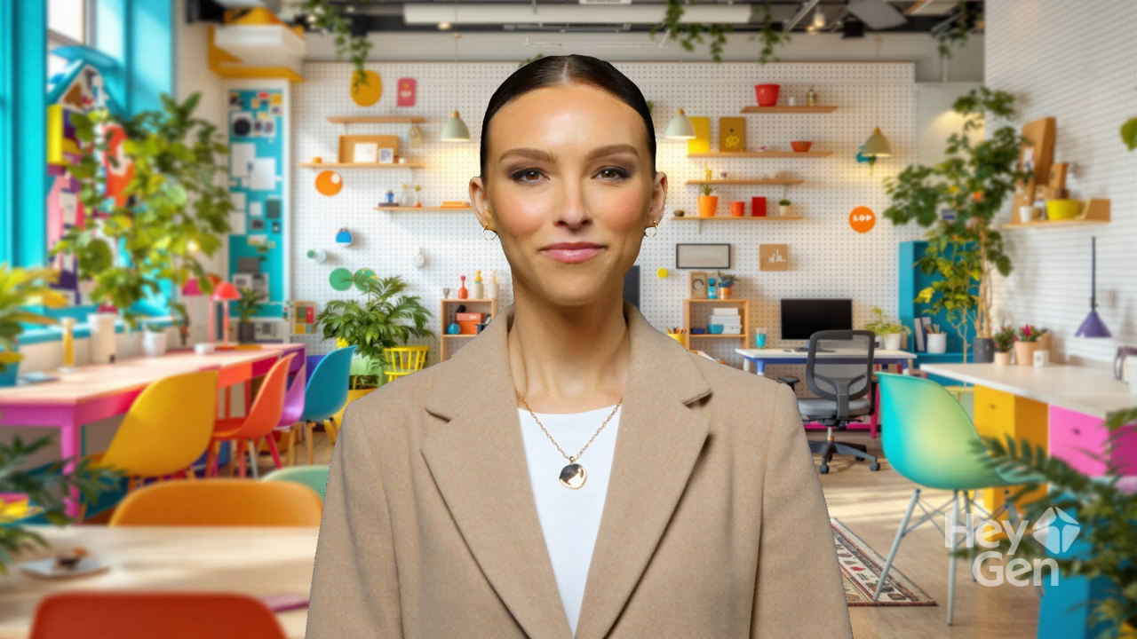

Slide 2
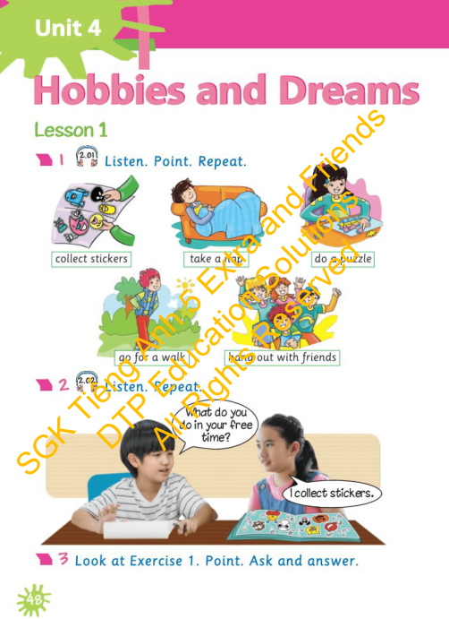


Lesson Outline
Warm-up
Vocabulary
Structure
Wrap-up

Slide 3

By the end of this lesson, pupils will be able to present free-time activities, and practise asking and answering about what someone does in his/her free time.
Vocabulary: collect stickers, take a nap, do a puzzle, go for a walk, hang out with friends
Structure: What do you do in your free time? I collect stickers.

Slide 4

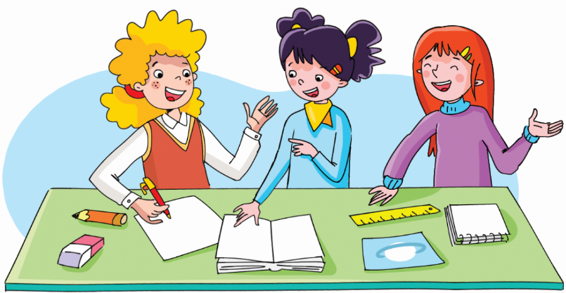

Slide 5
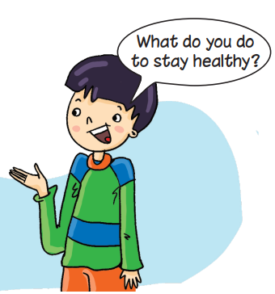
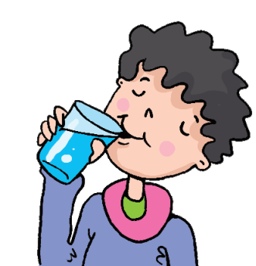
Look. Ask. Answer.
I drink enough water.

Slide 6
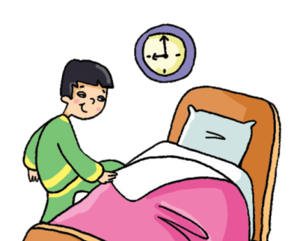
Look. Ask. Answer.
I go to bed early.

Slide 7
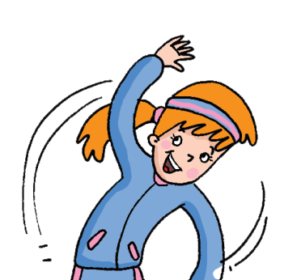
Look. Ask. Answer.
I do exercise every day.

Slide 8
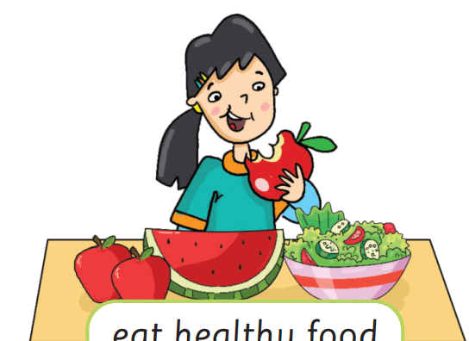
Look. Ask. Answer.
I eat healthy food.

Slide 9
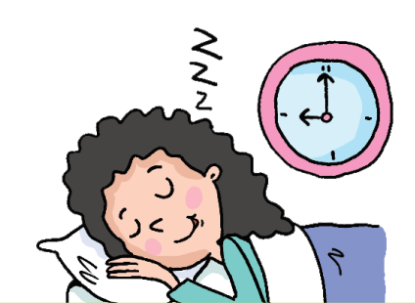
Look. Ask. Answer.
I get a good night’s sleep.

Slide 10


It’s time to learn …

Slide 11
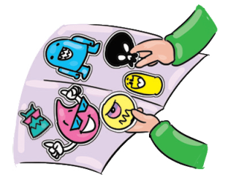
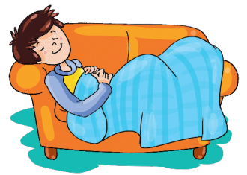
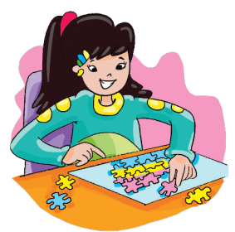
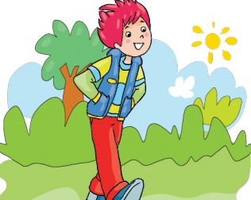


Slide 12
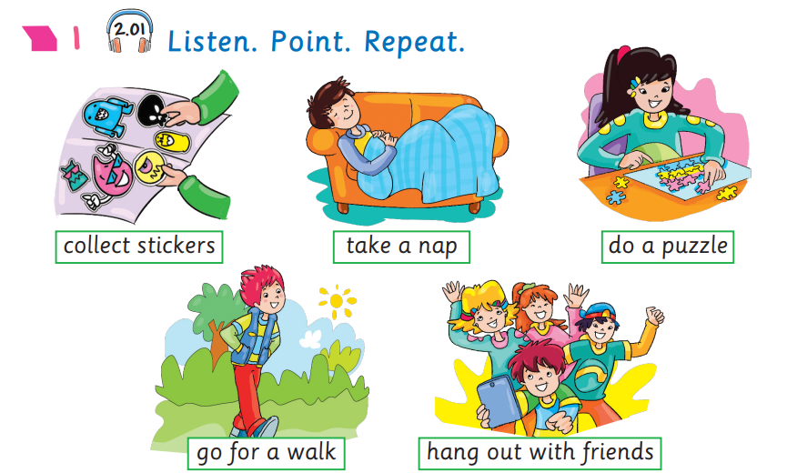

Presentation

Slide 13

Presentation
Click on each picture for the sound and the name.
New words
collect stickers
/kəˈlekt ˈstɪkəz/
sưu tập nhãn dán

Slide 14

Presentation
Click on each picture for the sound and the name.
New words
take a nap
/teɪk ə næp/
Ngủ một giấc ngắn

Slide 15

Presentation
Click on each picture for the sound and the name.
New words
do a puzzle
/duː ə ˈpʌzl/
chơi ghép hình

Slide 16

Presentation
Click on each picture for the sound and the name.
New words
go for a walk
/ɡəʊ fə(r) ə wɔːkˈ/
đi dạo

Slide 17

Presentation
Click on each picture for the sound and the name.
New words
hang out with friends
/hæŋ ˈaʊt wɪð ˈfrendz
đi chơi với bạn

Slide 18
Presentation
Click on each picture for the sound and the name.
New words

Slide 19
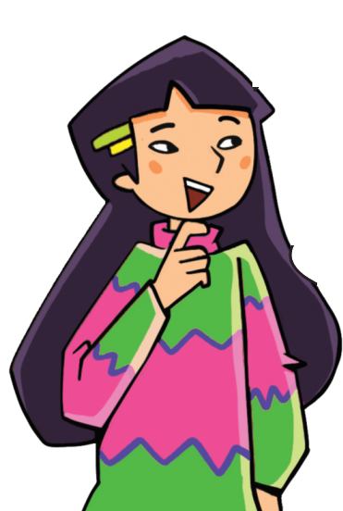
Practice 1
Look and say.
???
collect stickers

Slide 20
Practice 1
Look and say.
???
go for a walk

Slide 21
Practice 1
Look and say.
???
do a puzzle

Slide 22
Practice 1
Look and say.
???
take a nap

Slide 23
Practice 1
Look and say.
???
hang out with friends

Slide 24
Practice 2
What’s missing?
START

Slide 25
Practice 2
What’s missing?
NEXT

Slide 26
Practice 2
What’s missing?
NEXT

Slide 27
Practice 2
What’s missing?
NEXT

Slide 28
Practice 2
What’s missing?
NEXT

Slide 29
Practice 2
What’s missing?
END

Slide 30
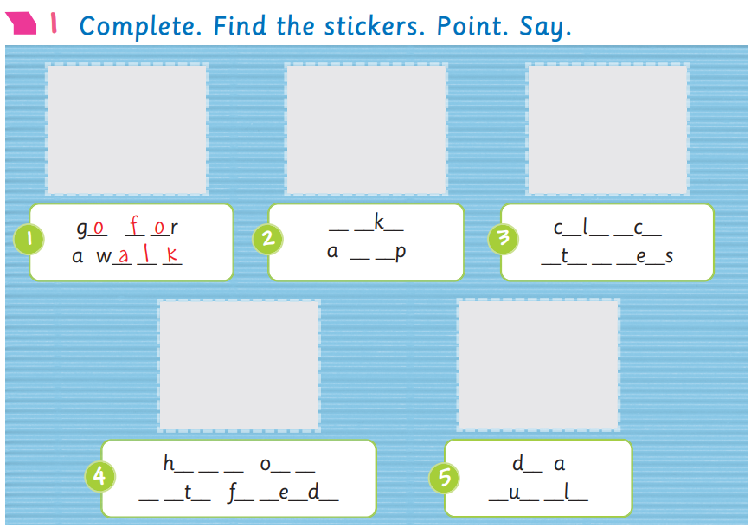
Activity Book – p.48

Slide 31
Activity Book – p.48
t
a
e
o
l
e
t
n
a
s
i
c
k
r
a
n
g
u
t
o
w
i
h
r
i
n
s
p
z
z
e

Slide 32
Activity Book – p.48
t a e
o l e t
n a
s i c k r
a n g u t
o
w i h
r i n s
p z z e

Slide 33
Activity Book – p.48
t a e
o l e t
n a
s i c k r
a n g u t
o
w i h
r i n s
p z z e

Slide 34

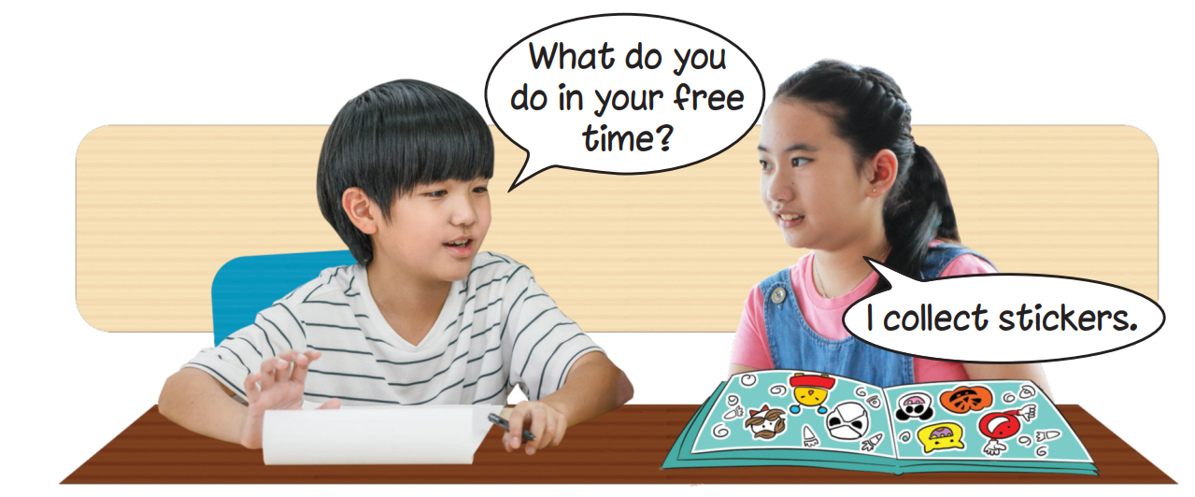

Presentation

Slide 35
Presentation

Slide 36
Presentation
What do you do in your free time?
I collect stickers

Slide 37
Presentation
Structure
What do you do in your free time?
I collect stickers.
Usage
To ask and answer about what someone does in his/her free time.

Slide 38

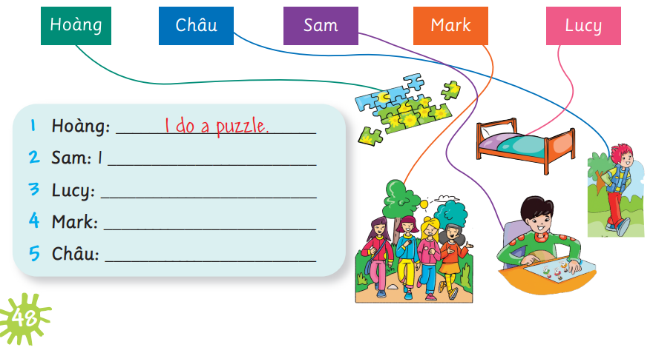
Activity Book – p.48
collect stickers.
I take a nap.
I hang out with friends.
I go for a walk.

Slide 39
Activity Book – p.48
collect stickers.
I take a nap.
I hang out with friends.
I go for a walk.

Slide 40

Practice
What do you do in your free time?
I collect stickers.

Slide 41
Practice
What do you do in your free time?
I take a nap.

Slide 42
Practice
What do you do in your free time?
I do a puzzle.

Slide 43
Practice
What do you do in your free time?
I go for a walk.

Slide 44
Practice
What do you do in your free time?
I hang out with friends.

Slide 45
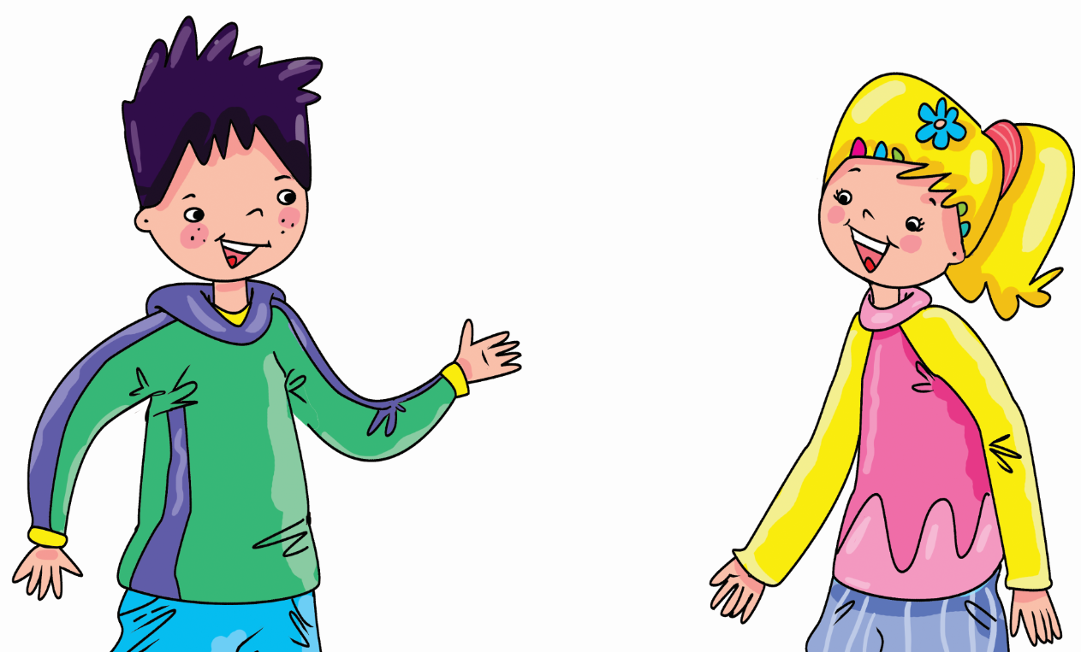
Early Production
Ask and Answer.
What do you do in your free time?
I hang out with friends. How about you?
I do a puzzle.

Slide 46

Click on each picture for the sound and the name.
Today’s lesson:
Vocabulary

Slide 47
Today’s lesson:
Structure

Slide 48
Homework
Practise the vocabularies and structure and make sentences using them.
Prepare the next lesson (page 49 Pupil’s Book).
Do the exercises in Activity Book page 48.
Do the exercises in Tiếng Anh 5 Extra and Friends notebook (page 27) - recommended

Slide 49
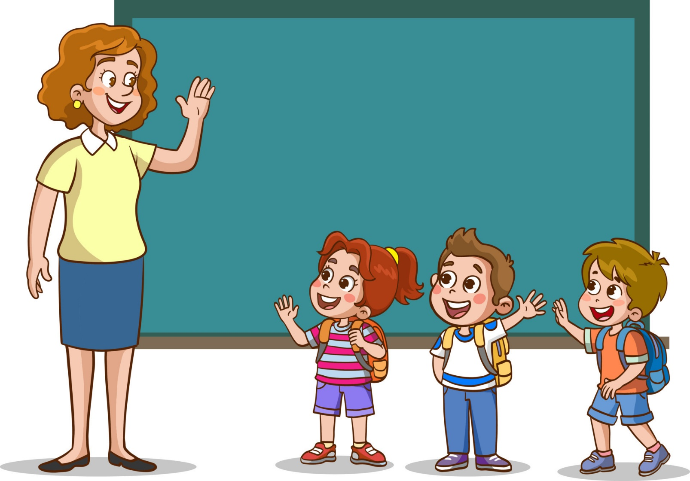
Goodbye!

