Slide 1
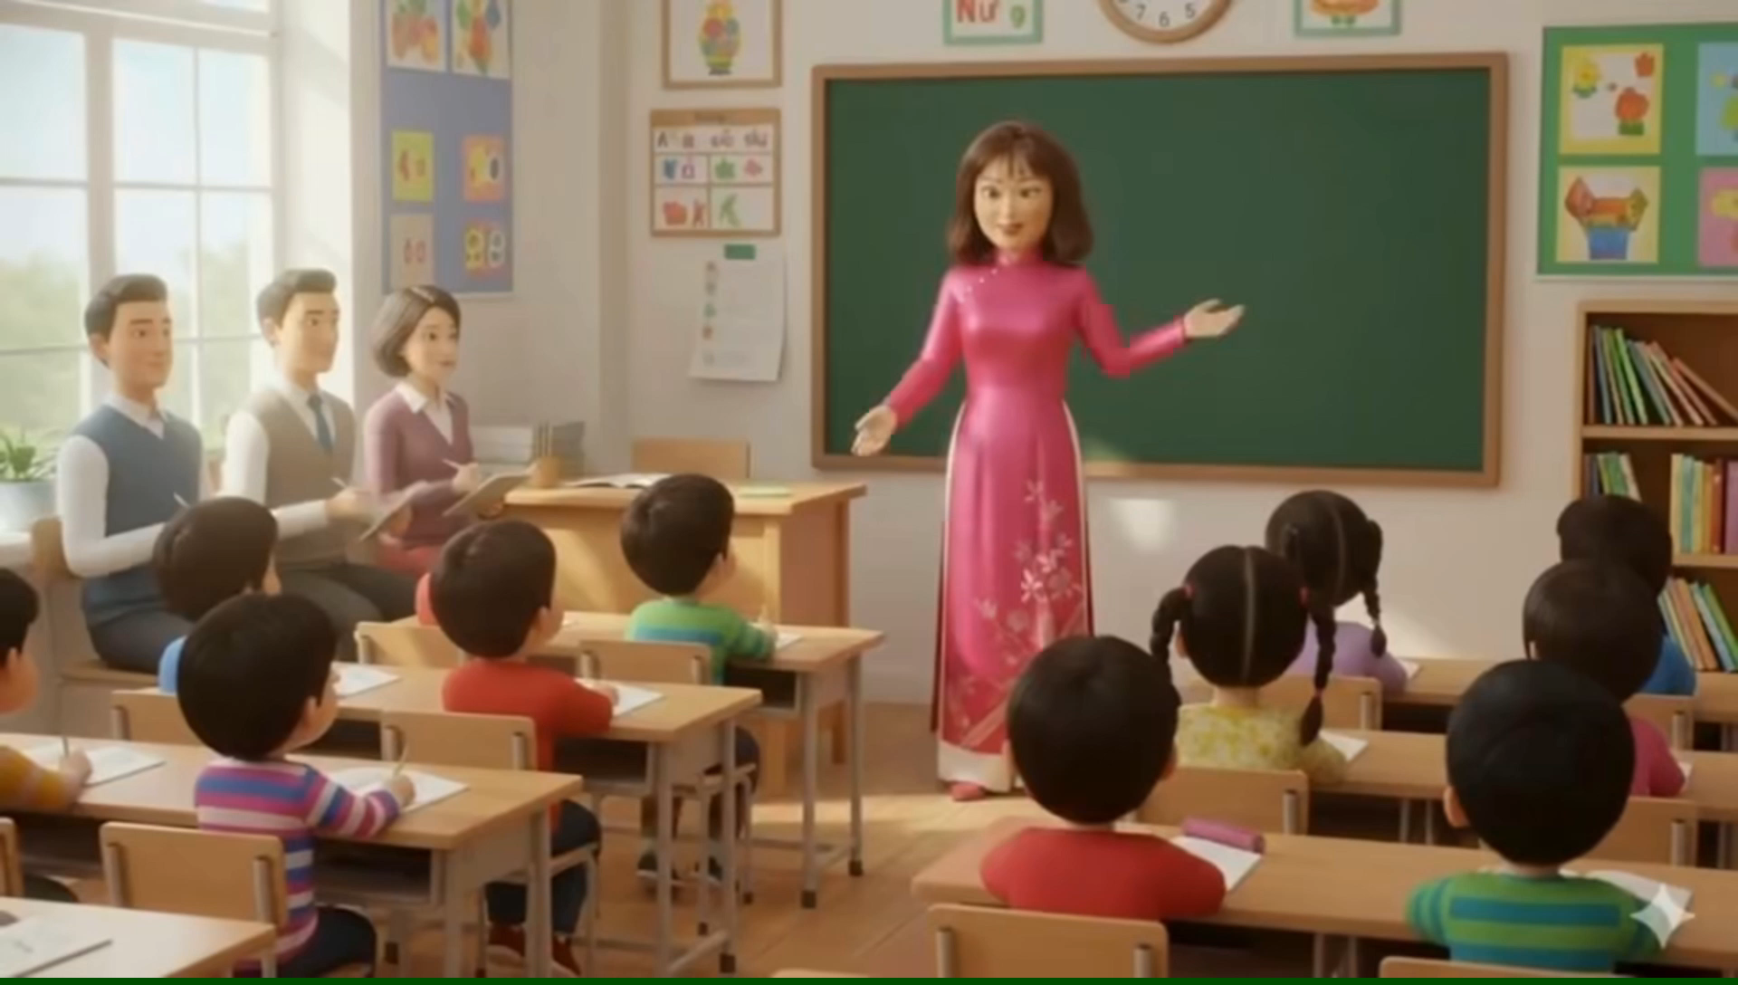

Slide 2
Unit 3
My Home
Lesson 5 – Page 46

Slide 3



Slide 4

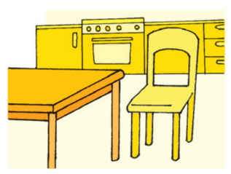
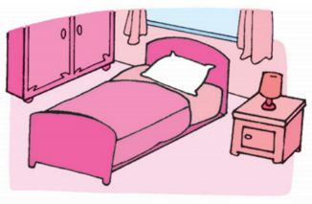
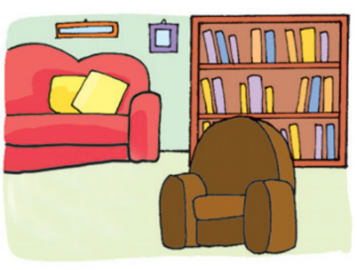
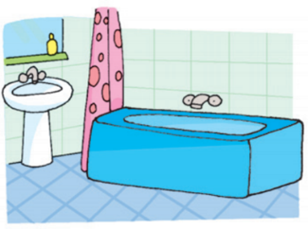
REVIEW 1
Look and say.
kitchen

Slide 5
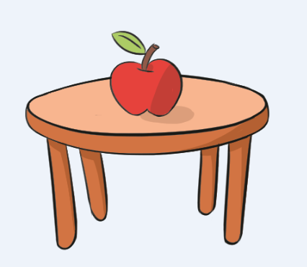
REVIEW 2
Look. Read the question and answer.
Is the apple on the table?
Yes, it is.

Slide 6
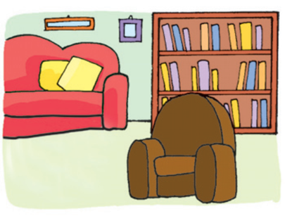
Look. Read the question and answer.
Is the armchair next to the sofa?
No, it isn’t.

Slide 7

Look. Read the question and answer.
Is the bed next to the bookcase?
Yes, it is.

Slide 8

Look. Read the question and answer.
Is the pencil under the schoolbag?
No, it isn’t.

Slide 9
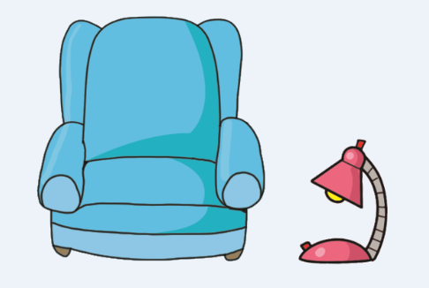
Look. Read the question and answer.
Is the lamp on the armchair?
No, it isn’t.

Slide 10

Look. Read the question and answer.
Is the chair on the table?
No, it isn’t.

Slide 11
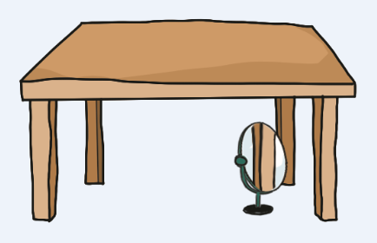
Look. Read the question and answer.
Is the mirror under the table?
Yes, it is.

Slide 12


It’s time to learn …

Slide 13





Slide 14


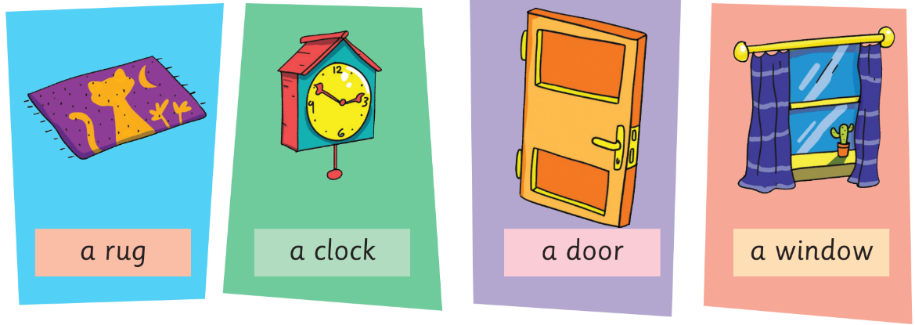
Presentation

Slide 15




Presentation
New words
a rug
a clock
a door
a window

Slide 16
What’s missing?

Slide 17



What’s missing?

Slide 18



What’s missing?

Slide 19



What’s missing?

Slide 20



What’s missing?

Slide 21

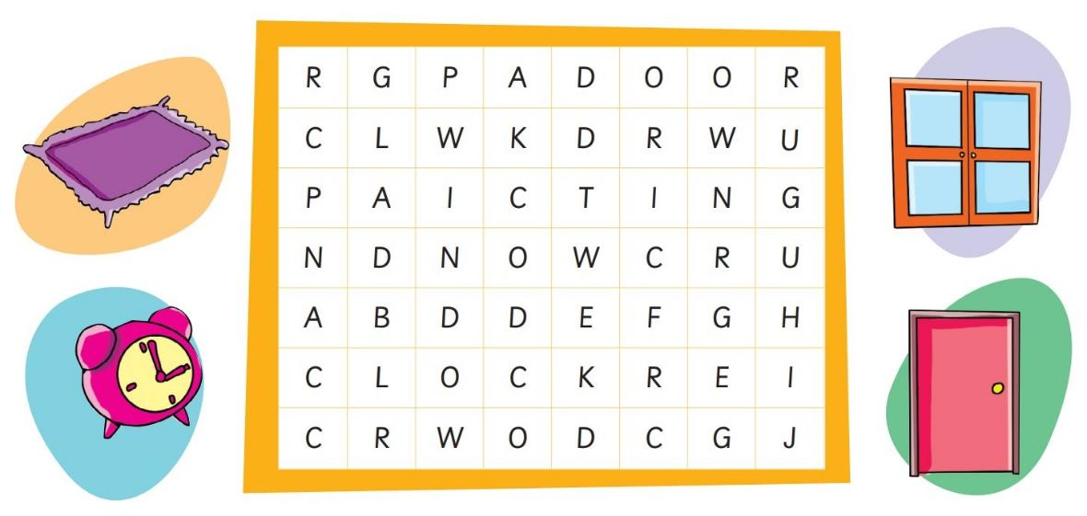
(Activity Book)

Slide 22

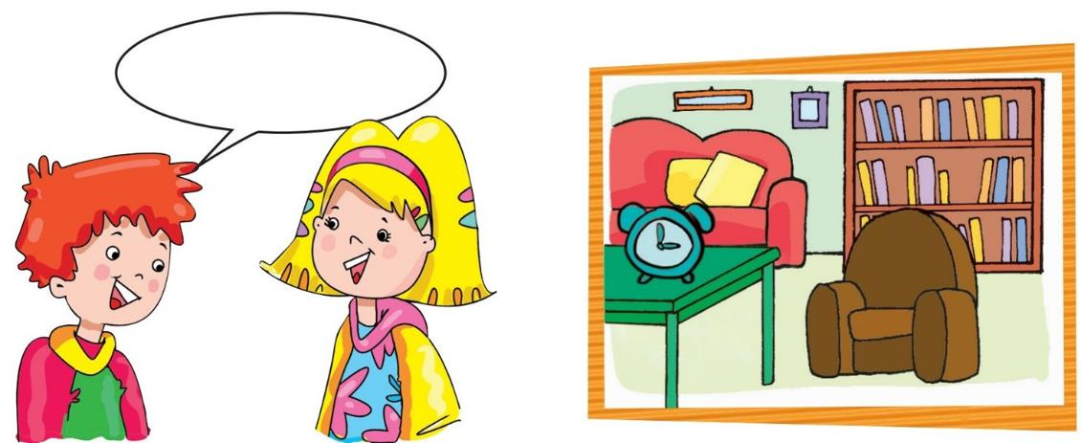
Presentation
Structure

Slide 23
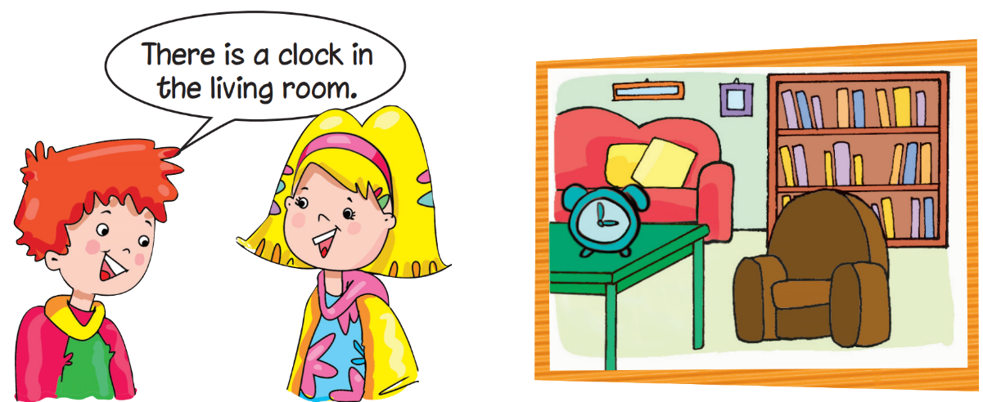
Presentation

Slide 24

Presentation
There is a clock in the living room.

Slide 25
Presentation
Structure
There is a clock in the living room.
Usage
To talk about things in a room in a house.

Slide 26
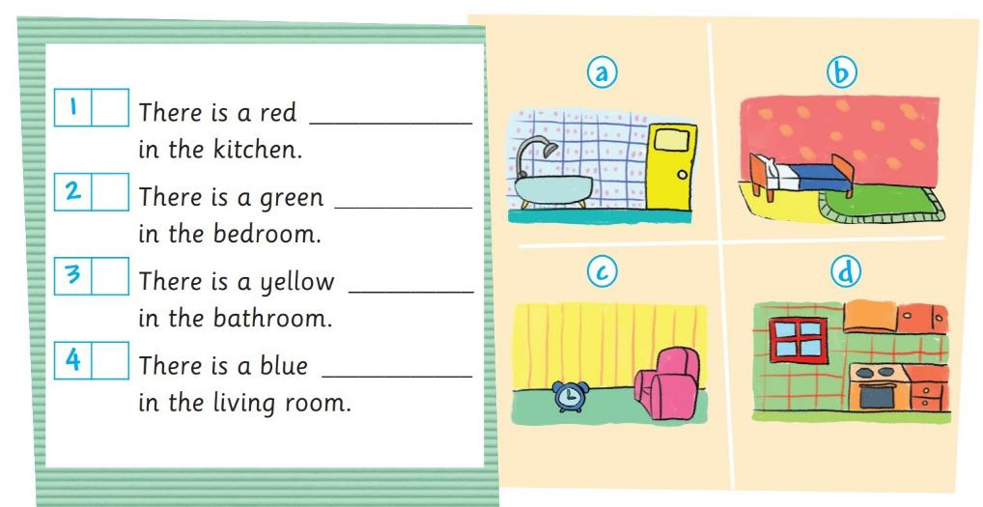
(Activity Book)
d
window
b
rug
a
door
c
clock

Slide 27
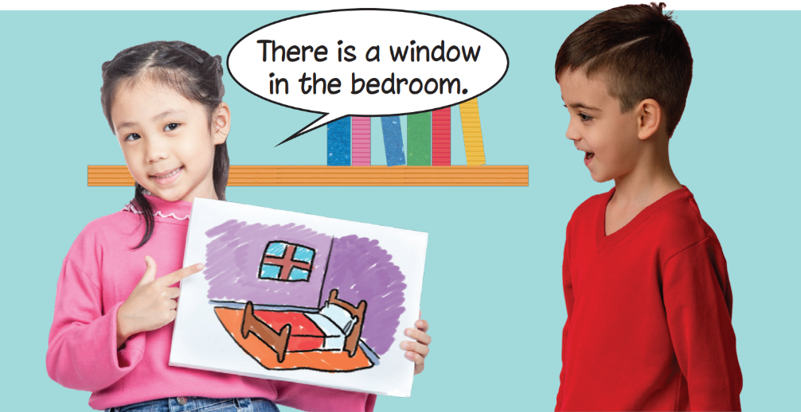
Practice

Slide 28
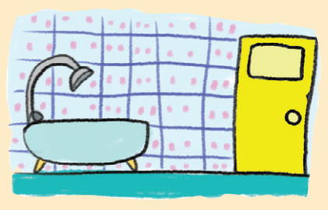
Early Production
Look and say.
There is a yellow door in the bathroom.

Slide 29
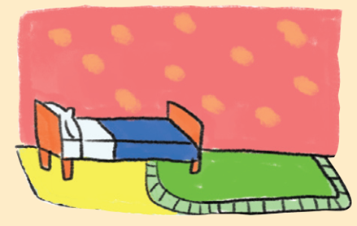
Early Production
Look and say.
There is a green rug in the bedroom.

Slide 30
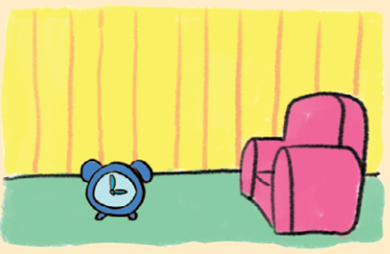
Early Production
Look and say.
There is a blue clock in the living room.

Slide 31
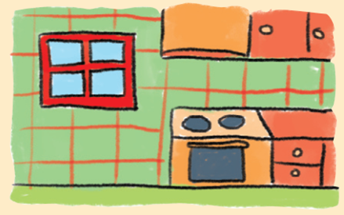
Early Production
Look and say.
There is a red window in the kitchen.

Slide 32

Today’s lesson:
Vocabulary
a rug
a clock
a door
a window

Slide 33
Today’s lesson:
Structures

Slide 34
Homework
Practice the vocabularies and structure; and make sentences using them.
Prepare the next lesson (page 47 Pupil’s Book).
Do the exercises in Activity Book page 46.
Do the exercises in Tiếng Anh 3 Extra & Friends Notebook (Page 28).

Slide 35
