Slide 1

Truong Son primary school
Welcome to class 5A
Nguyen Le Thuy Ha

Slide 2


Let's sing

Slide 3

Let’s play a game

Slide 4
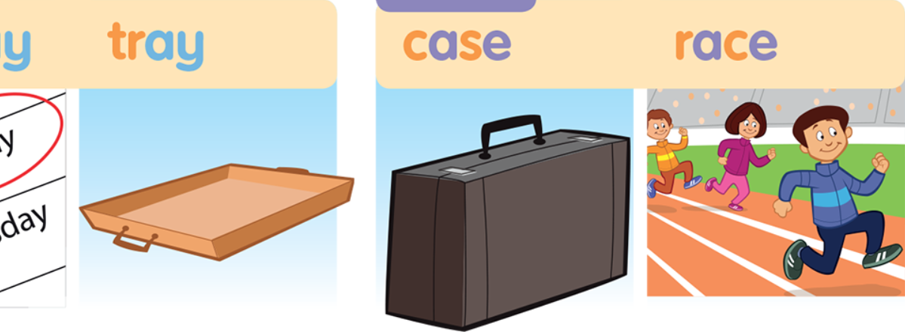
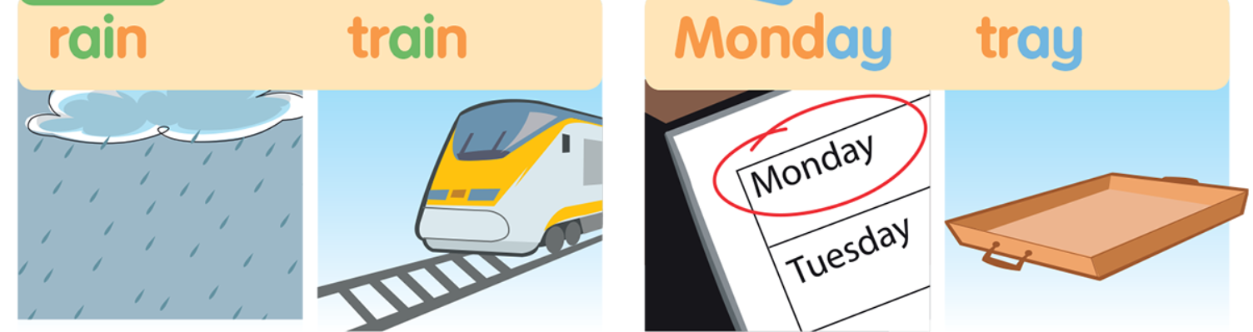


Slide 5
ai
3
2
1

Slide 6
ay
3
2
1

Slide 7
a_e
3
2
1

Slide 8

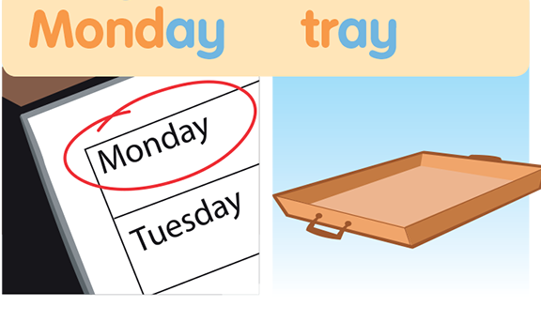
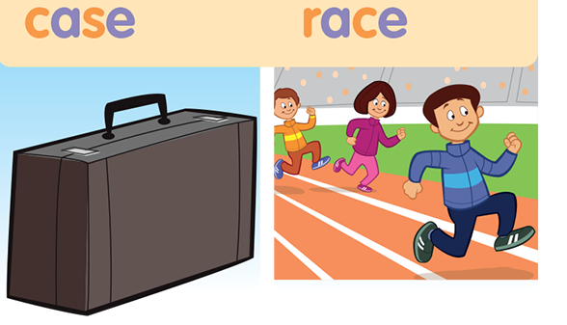
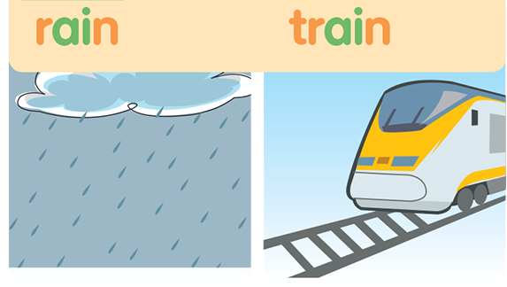

Slide 9
Fill in the blank

Slide 10
Tuesday, April 6th 2021
UNIT 10: IN THE PARK
Lesson four: Phonics

Slide 11

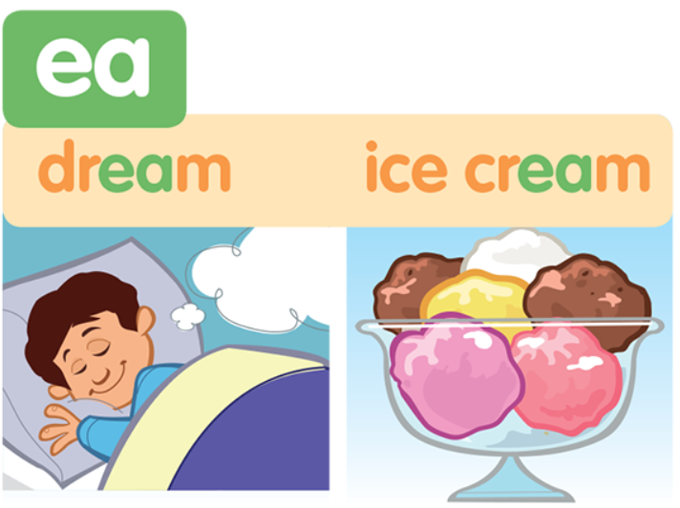
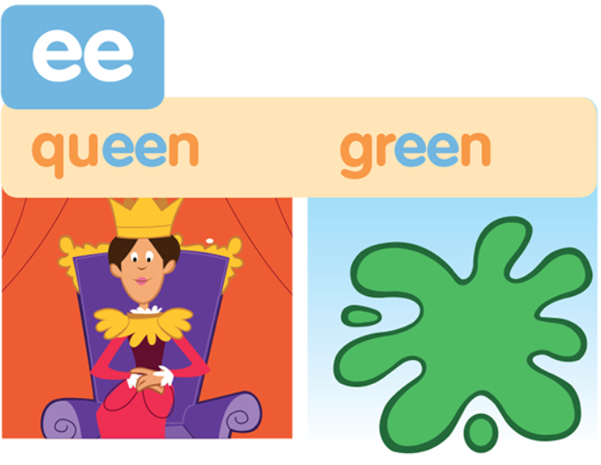
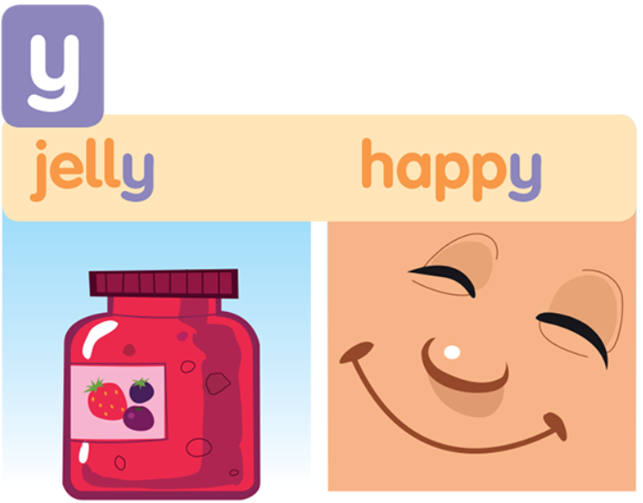
Listen and point

Slide 12
Listen and repeat

Slide 16

Pass the picture and say

Slide 17
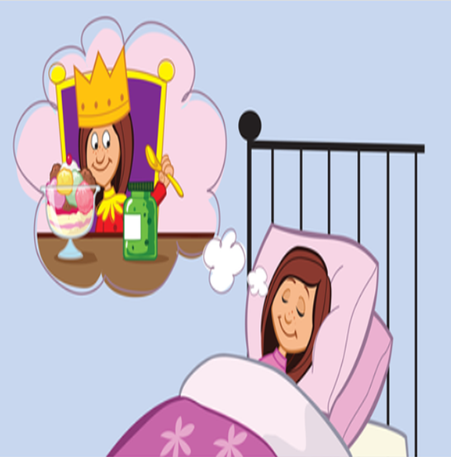

Slide 18
In my dream,
I am a queen, queen, queen.
I eat green jelly,
and ice cream, cream, cream
I’m very happy,
in my dream, dream, dream

Slide 19
In my dream,
I am a queen, queen, queen
I eat green jelly,
and ice cream, cream, cream
I’m very happy,
In my dream, dream, dream

Slide 20
Let’s chant in group

Slide 21


Slide 22
Listen and choose
I eat ………. in my dream.
A. candy B. ice cream C. jelly

Slide 23
Listen and choose the correct sentence
Would you like to eat a pink ice cream?
B. Would you like to eat a green ice cream?
C. Would you like to eat a big ice cream?

Slide 24
Which word has the underline part pronounced differently from the others
A. queen B. ice cream C. happy

Slide 25
Listen and write
dream
I have a ……………, a song to sing.

Slide 26


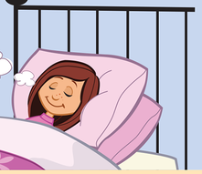
In my dream,
I am a ……………………
I ………………………….
I’m……………………….

Slide 27


Homework
Learn by heart new words
-Read the chant many times
- Prepare part 3 and part 4.

Slide 28
