Slide 1
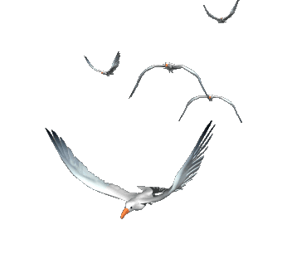
WELCOME TO OUR CLASS 7A3
Teacher: Đỗ Thị Kim Huế

Slide 2
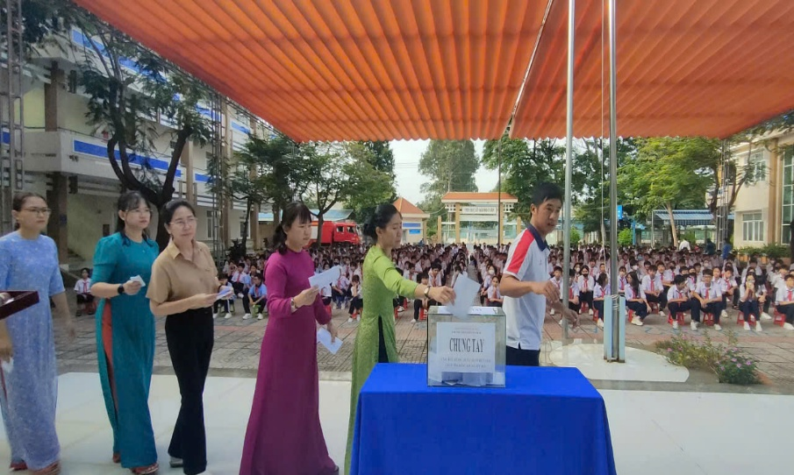
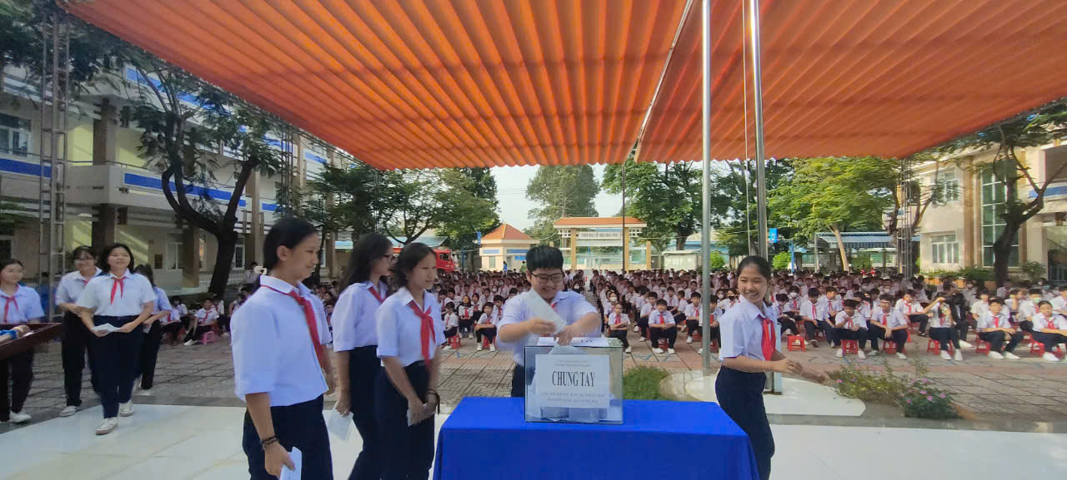
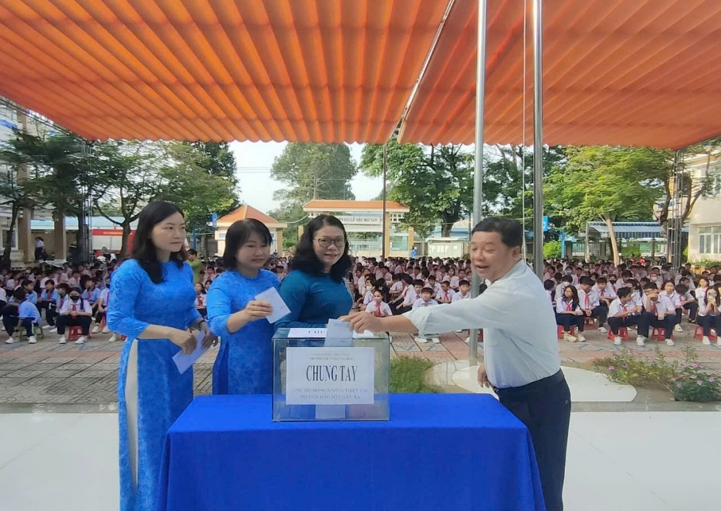
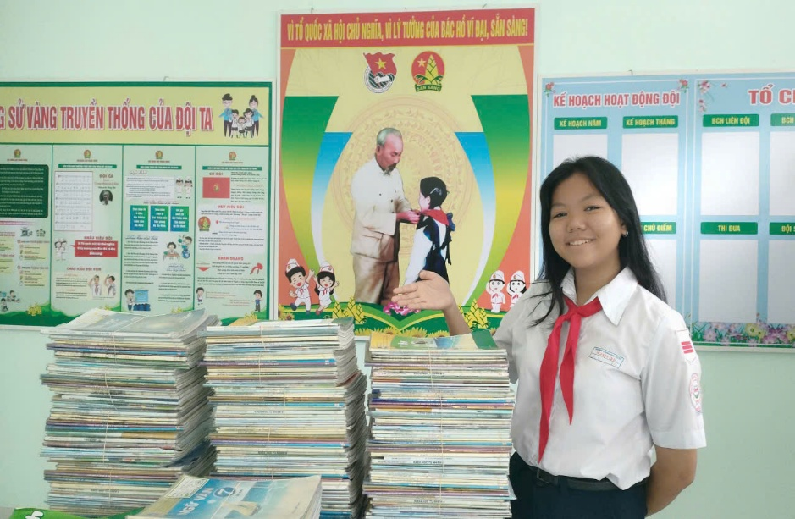
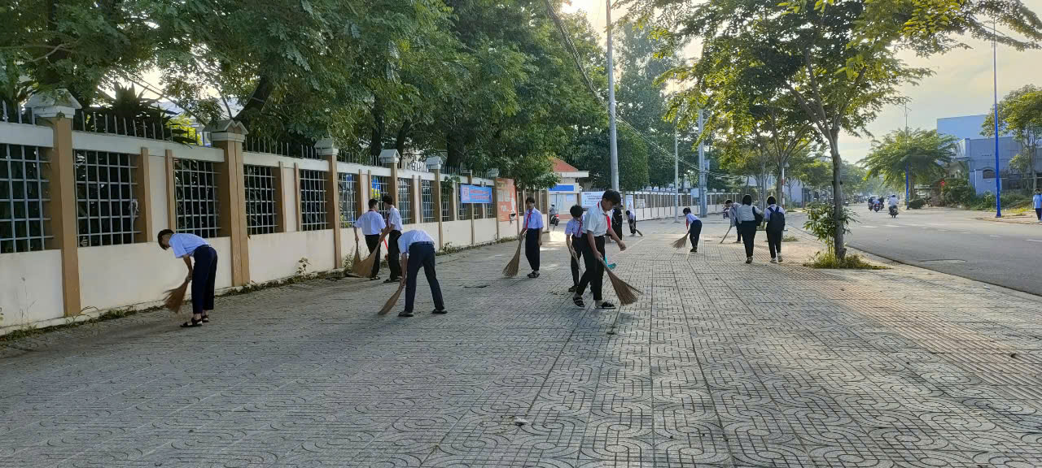
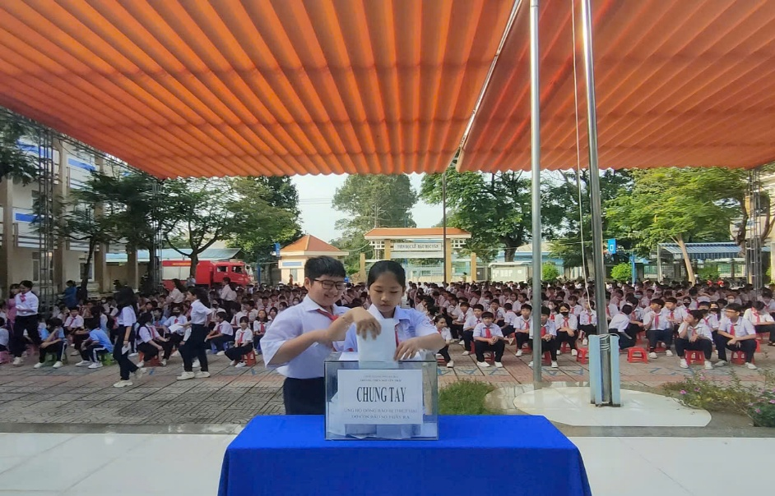
WHO IS FASTER?

Slide 3
WARM UP: WHO IS FASTER?
Find the key word of the picture
COMMUNITY SERVICE
AT NGUYEN TRAI SECONDARY SCHOOL

Slide 4
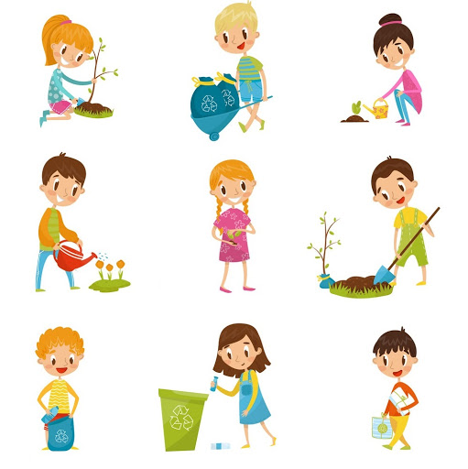
Thirsday, October 24th , 2024
Unit
3
COMMUNITY SERVICE
PERIOD 20th Lesson 5: SKILLS 1
READING
SPEAKING
Projects in Bright Future School
What project you can do?

Slide 5
PRE-READING
I. New words:
1.monthly (adj/adv)/ˈmʌnθli/
hằng tháng
2. proud (adj) /praʊd/
hài lòng, tự hào

Slide 6
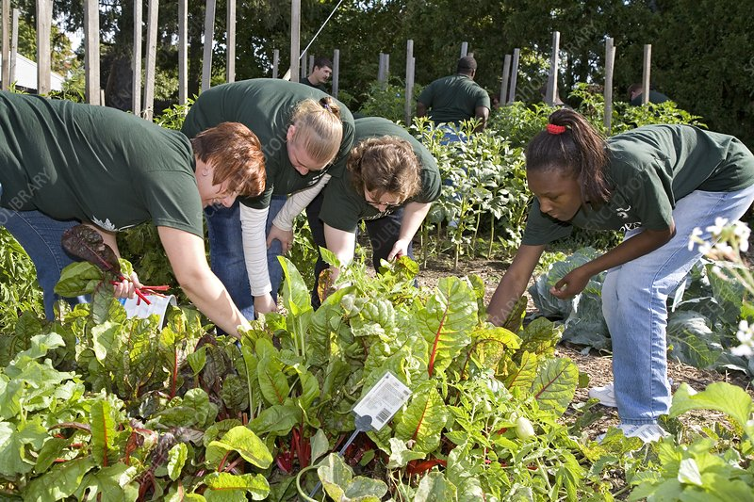
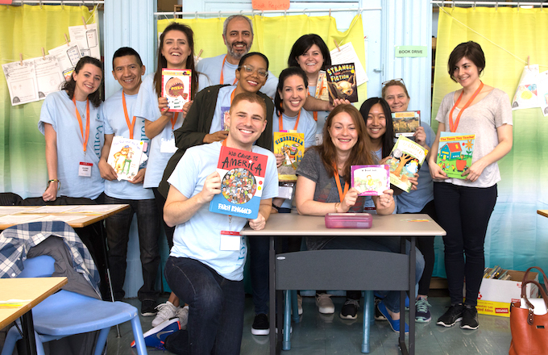
1. Work in pairs. Circle the activities you would like to do at your school.
II. Practice: READING
A. growing vegetables in the school garden B. tutoring other students C. collecting books for the school library
What activity would you like to do?

Slide 7
2. Read the passage and match the highlighted words with their meanings.
WHILE-READING:
1. give 2. give and receive 3. every month 4. pleased 5. teach
Bright Future School has many community activities for students. The school believes that a good way for students to develop themselves is through community service. All students can join any of these different projects:
– Tutoring: Upper grade students tutor lower grade students.
– Postcard-to-Help: Students make and sell postcards to raise money for local children.
– Visit-to-Read: Students visit a nursing home monthly and read books to the elderly.
– Garden-to-Give: Students grow vegetables and donate them to local schools.
– Paper-Plant-Exchange: Students collect paper and exchange it for plants. They then look after the plants in their school garden.
Students learn that they can help people and the world around them when they do community service. They feel useful and proud because they do good things.
5. teach
3. every month
1. give
2. give and receive
4. pleased

Slide 8
WHILE-READING
3. Read the passage again and tick True or False.
 | True | False
1. Community service allows students to develop themselves.
2. Each student can join only one project.
3. They tutor younger students.
4. Local children receive postcards from the Postcard-to-Help project.
5. Students receive plants when they give paper.

Slide 9
3. Read the passage again and tick True or False.
 | True | False
1. Community service allows students to develop themselves.
✓
Bright Future School has many community activities for students. The school believes that a good way for students to develop themselves is through community service.

Slide 10
3. Read the passage again and tick True or False.
 | True | False
2. Each student can join only one project.
✓
All students can join any of these different projects:
 | True | False
3. They tutor younger students.
✓
– Tutoring: Upper grade students tutor lower grade students.

Slide 11
3. Read the passage again and tick True or False.
 | True | False
4. Local children receive postcards from the Postcard-to-Help project.
✓
– Postcard-to-Help: Students make and sell postcards to raise money for local children.
 | True | False
5. Students receive plants when they give paper.
✓
– Paper-Plant-Exchange: Students collect paper and exchange it for plants. They then look after the plants in their school garden.

Slide 12
3. Read the passage again and tick True or False.
 | True | False
1. Community service allows students to develop themselves.
2. Each student can join only one project.
3. They tutor younger students.
4. Local children receive postcards from the Postcard-to-Help project.
5. Students receive plants when they give paper.
✓
✓
✓
✓
✓

Slide 13
** SPEAKING

Slide 14
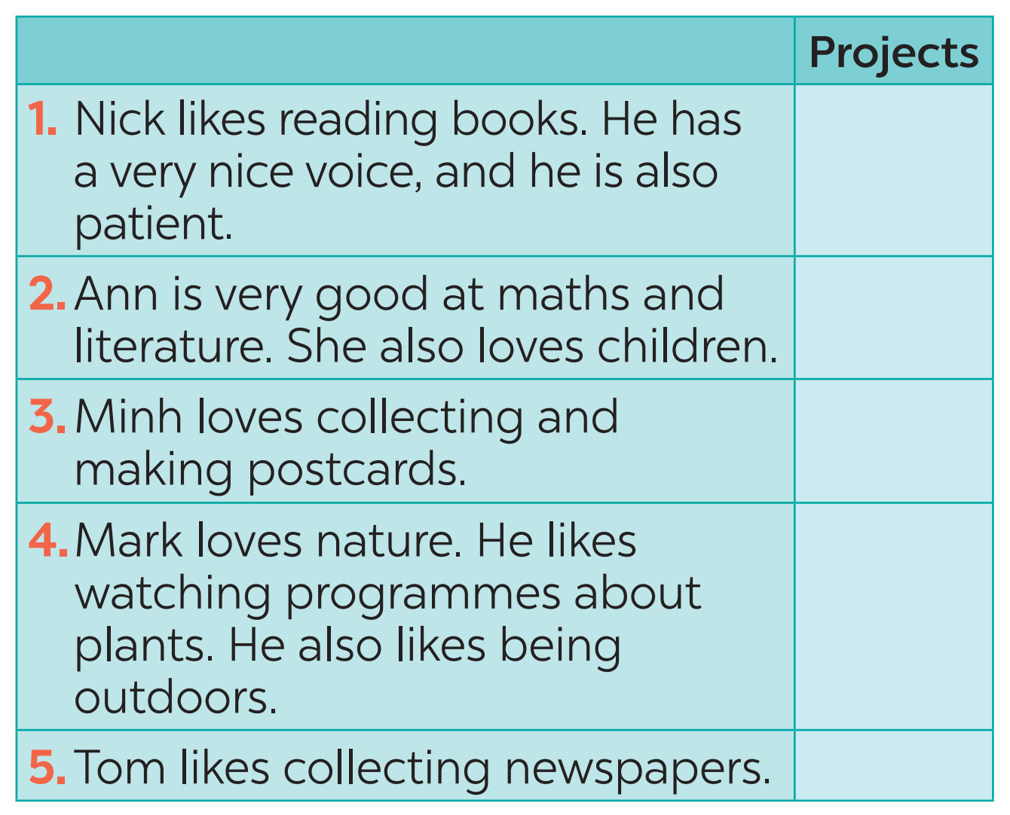
PRE-SPEAKING
4. Read about these students. Write the names of the projects you think they should join in the Projects column.

Slide 15
PRE-SPEAKING
4. Read about these students. Write the names of the projects you think they should join in the Projects column.
C
A
B
D
E

Slide 16
5. Discuss which project in 4 you would like to join and why.
C
A
Example: Lan will join the Tutoring project because I love teaching English and I want to help others study better.
B
D
E

Slide 17
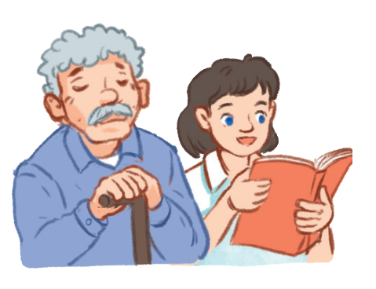
5. Group of 6. 5 mins. Discuss.
Which project you would like to join? Why?
Tutoring
Postcard-to-Help
Visit-to-Read
Garden-to-Give
Paper-Plant-Exchange
Example: I will join the Visit-to-Read project because I love reading books and help elderly people

Slide 18
5. Group of 6. 5 mins. Discuss.
Collecting-book
Donate-money
Cleaning – the pavement

Slide 19
HOME WORK
Plan some school activities for next summer holiday.
Prepare Skills 2.

Slide 20
Website: sachmem.vn
Fanpage: facebook.com/sachmem.vn/

