Slide 1
Class: 7A1
Teacher: Duong Thi Hoa

Slide 4
Which team has the best

Slide 8
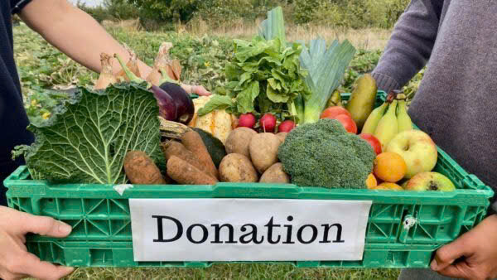
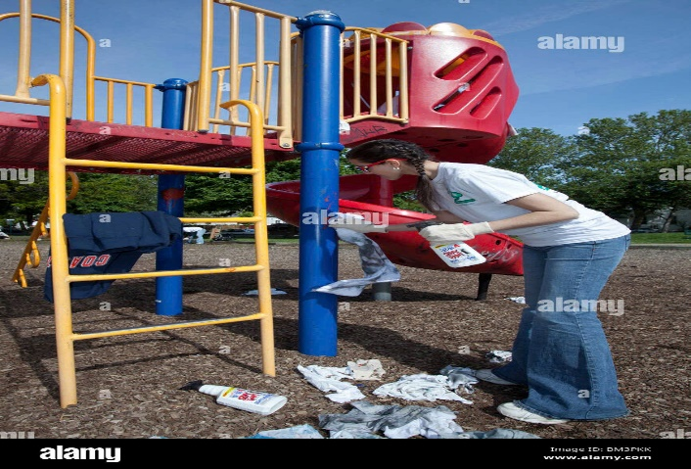
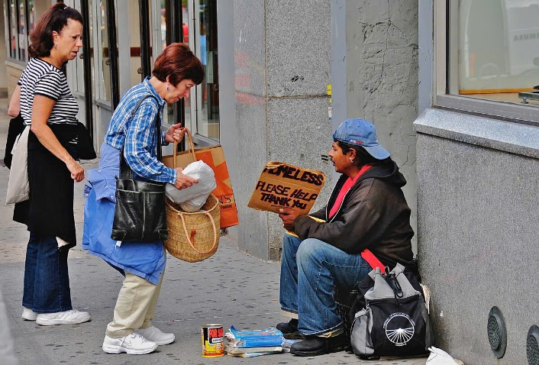
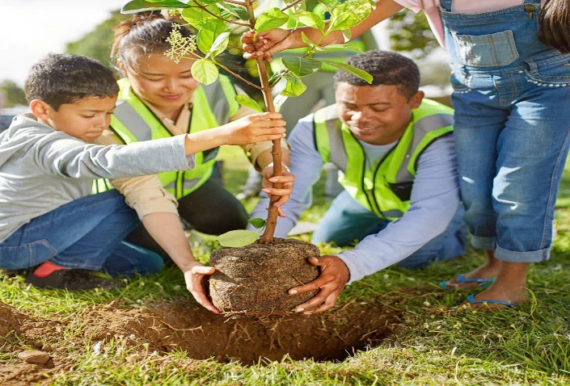
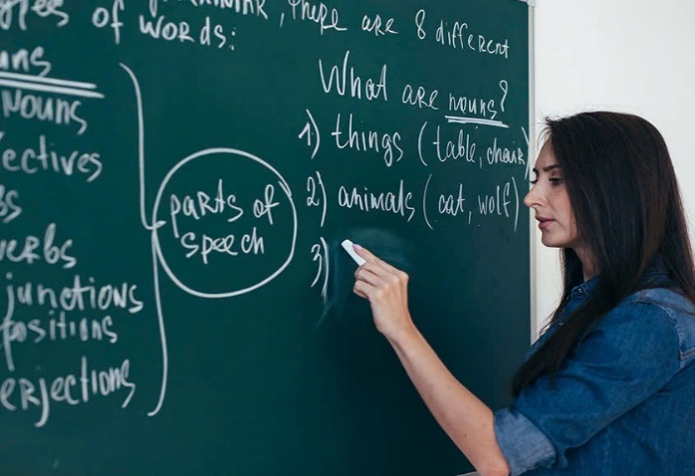
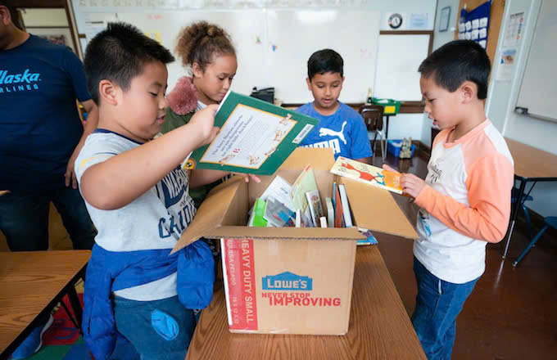
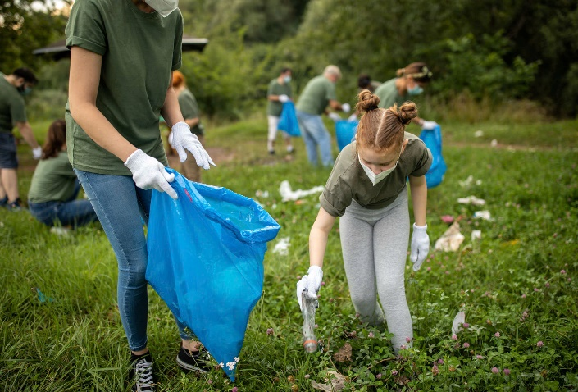
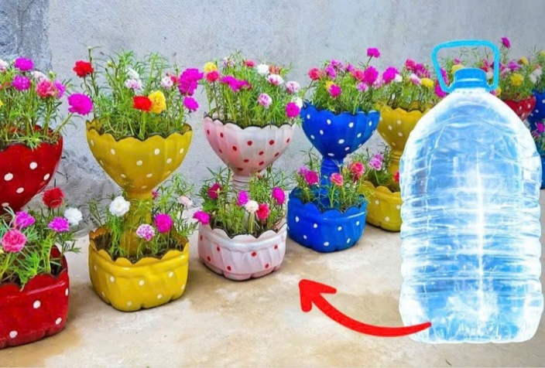
donating
vegetables
cleaning the playground
helping homeless people
planting trees
teaching English
donating books
picking up litter
recycling bottles

Slide 10
Wednesday, October 24th, 2024.
UNIT 3: COMMUNITY SERVICE
Lesson 7: LOOKING BACK + PROJECT

Slide 12
VOCABULARY REVIEW
1. Complete the table with the words and phrases from the box.
help | pick up | donate
homeless children
litter
food
bottles
books
the elderly
Zalo

Slide 13
2. Complete each sentence with one phrase from Task 1. Remember to use the correct forms of the verbs.
help the elderly
help homeless children
pick up bottles
donate books
donate food
1. The club ___________ to some poor farmers last week. 2. Yesterday, we ______________ around our area and recycled them. 3. We ________________do the cleaning last summer. 4. Last month, our club ____________ to the community library. 5. In our recent project, we _______________________ learn to read and write.

Slide 14
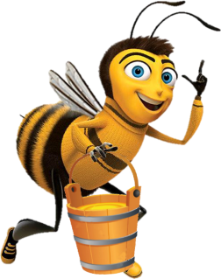
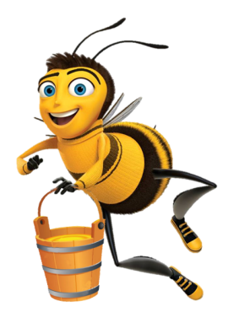
BUSY BEES
Play

Slide 15
1
2
5
3
4
Back

Slide 16
The club ___to some poor farmers last week.
A. donated food
B. donates food.
C. donating food
D. donate food
Back

Slide 17
Yesterday, we _____ around our area and recycled them.
A. picking up bottles
B. picked up bottles
C. picks up bottles
D. pick up bottles
Back

Slide 18
We ________ do the cleaning last summer.
A. helped the elderly
B. help the elderly.
C. helps the elderly
D. helping the elderly
Back

Slide 19
Last month, our club ______to the community library.
A. donate books
B. donates books
C. donated books
D. donating books
Back

Slide 20
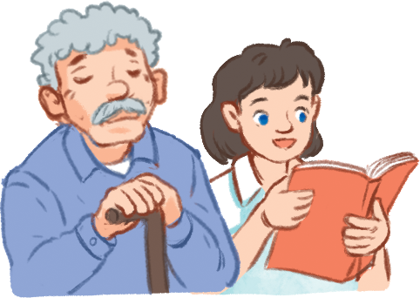
In our recent project, we ___ learn to read and write.
A. helped the elderly
B. donated books
C. picked up bottle
D. helped homeless children
Back

Slide 22
2. Complete each sentence with one phrase from Task 1. Remember to use the correct forms of the verbs.
1. The club ___________ to some poor farmers last week. 2. Yesterday, we ______________ around our area and recycled them. 3. We ________________do the cleaning last summer. 4. Last month, our club ____________ to the community library. 5. In our recent project, we _______________________ learn to read and write.
donated food
picked up bottles
helped the elderly
donated books
helped homeless children

Slide 24
GRAMMAR REVIEW

Slide 25
GRAMMAR REVIEW
3.Use the correct form of the verbs from the box to complete the passage.
Warm Clothes is a famous volunteer group in Viet Nam. Its members are both parents and their children. Last year, they (1) ______ many activities to help their community.The group (2) _________clothes and sent them to poor people in rural areas. The parents taught their children to make things from bamboo and bottles. They then (3) ______ these to buy books, and (4) ________ them to village children. They also (5) _______ to the villages and tutored small kids there. They really brought love to those small villages.
had
collected
sold
donated
went

Slide 26
4. Write full sentences about the activities the students did to help their community last year.
1. Mi: singing and dancing for the elderly at a nursing home 2. Mark and his friends: collecting books and setting up a community library 3. Lan and Mai: growing and donating vegetables to a primary school 4. Minh and his friends: giving food to young patients in a hospital 5. Tom: making and sending postcards to the elderly at Christmas
Mi sang and danced for the elderly at a nursing home.
Mark and his friends collected books and set up a community library.
Lan and Mai grew and donated vegetables to a primary school.
Minh and his friends gave food to young patients in a hospital.
Tom made and sent postcards to the elderly at Christmas.
Zalo

Slide 27
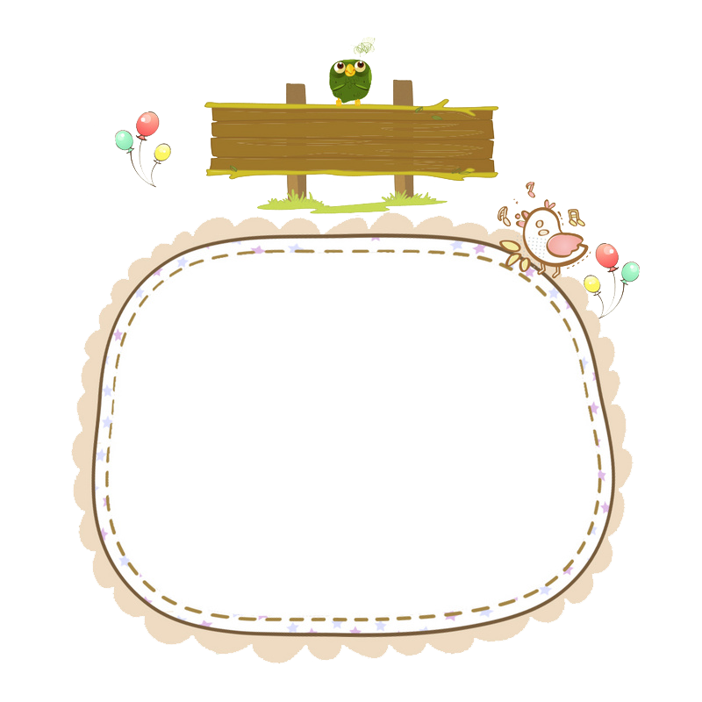
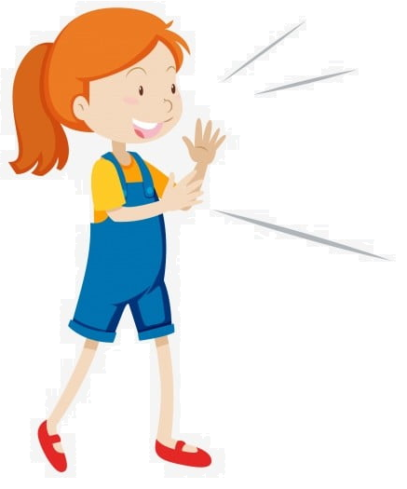
Topic
Our Green Neighbourhood
Zalo

Slide 29
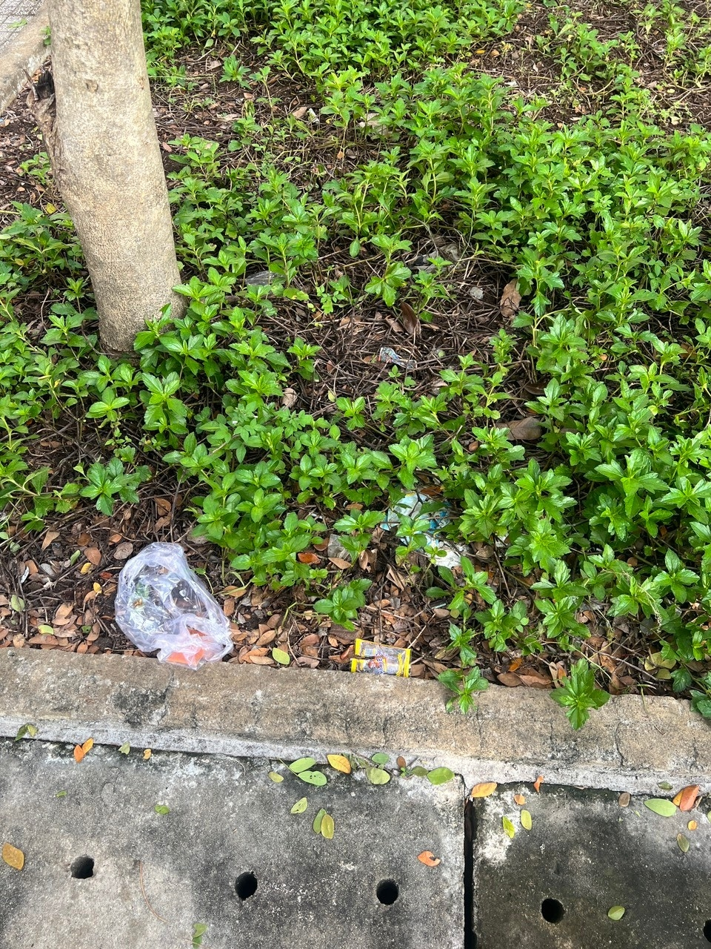
What should you do to protect greener and cleaner school?

Slide 30
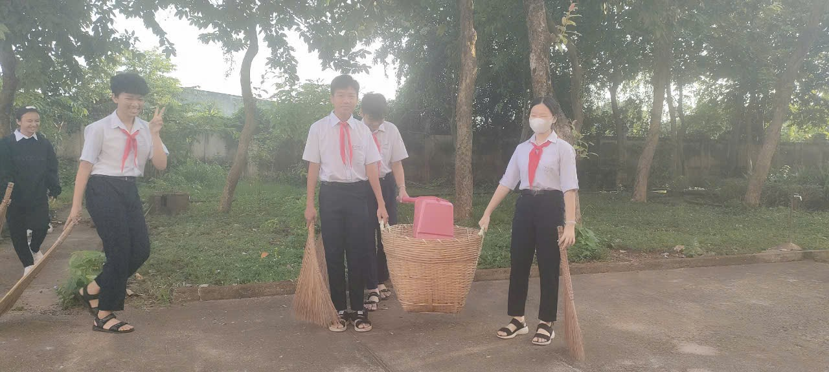
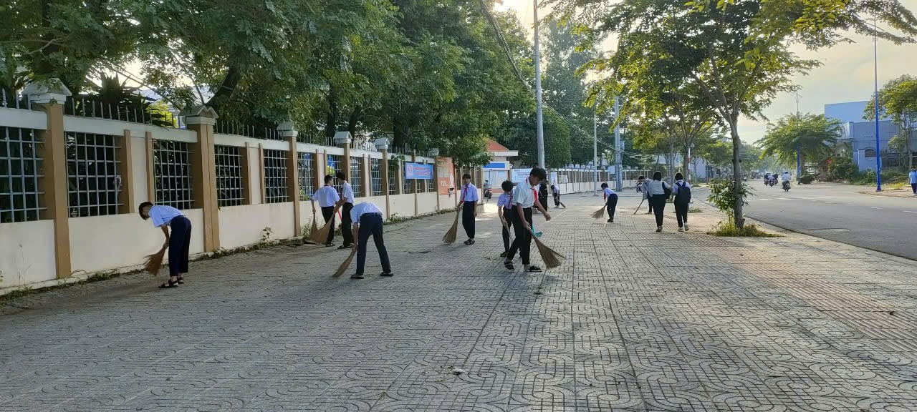
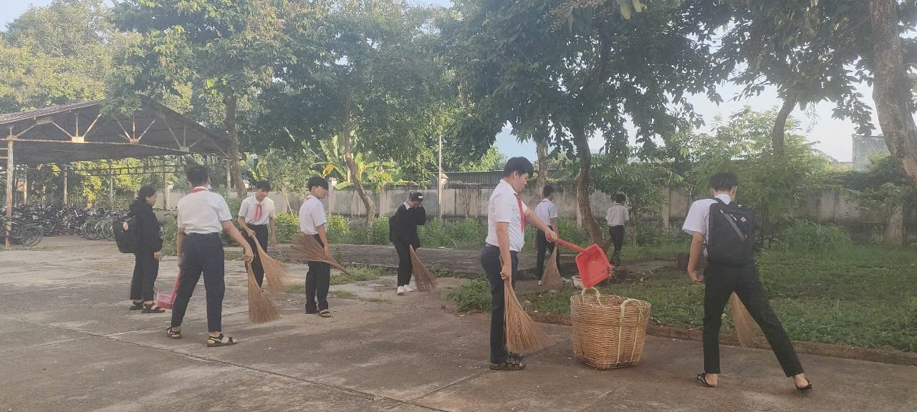
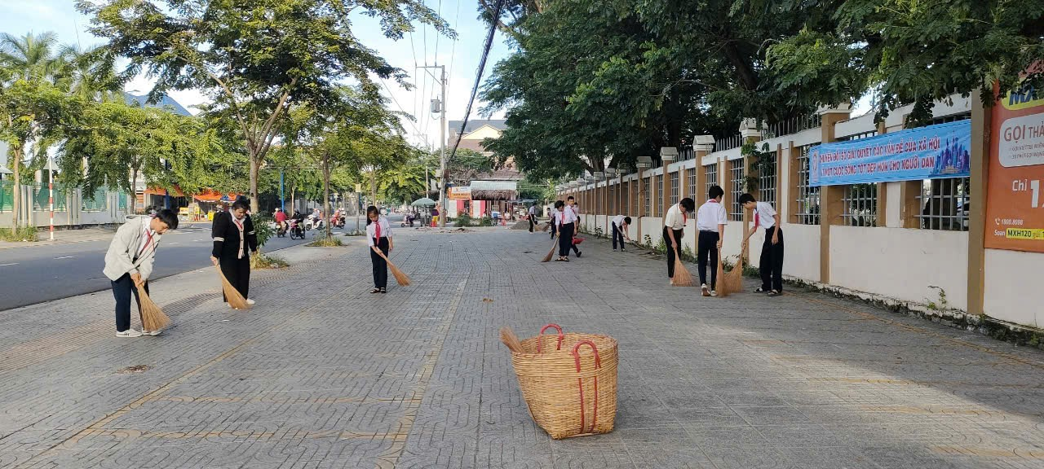
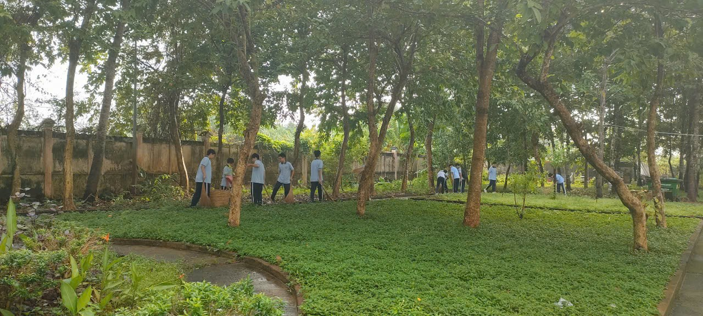
GREEN THURSDAY

Slide 31
CONSOLIDATION
1
WRAP-UP
Words related to community activities
Grammar
Discuss some environmental problems and the solutions to them.
The past simple
Vocabulary
Project

Slide 32
HOMEWORK:
Review vocabulary and the simple past.
Do part B, page …, student’s book.
Prepare the new lesson: Review 1- Language

Slide 34
What should you do to protect greener and cleaner school?
- we mustn't litter
- We shouldn't use plastic bottles, plastic bags
- We should recycle plastic bottles, waste paper, cans, plastic bags
- We must put trash in the right place and sort trash
- We should participate in planting and watering trees as well as green Thursday activities actively .
- We should promote and encourage your friends to protect the environment at school as well as in your neighborhood regularly

Slide 36
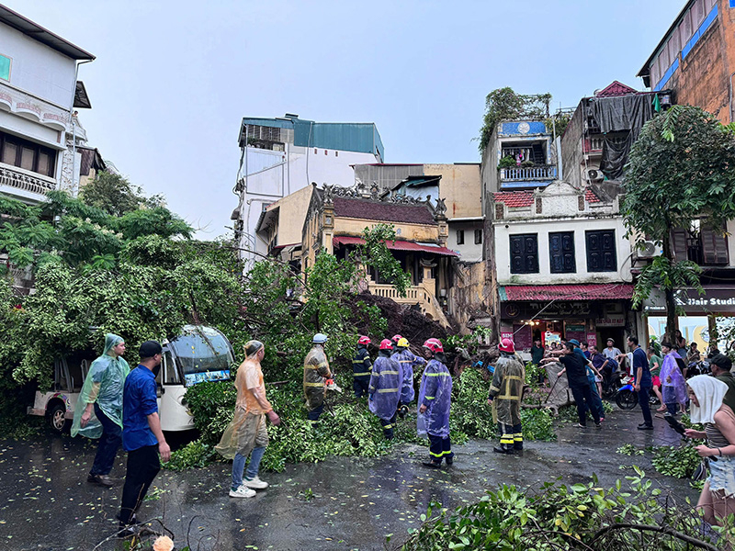
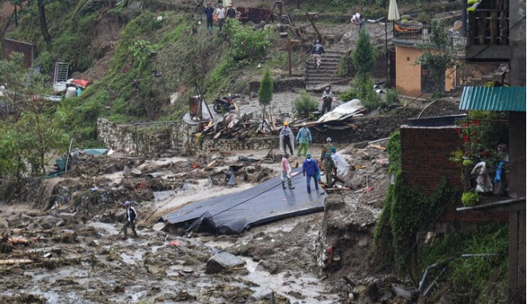

Slide 37
