Slide 1
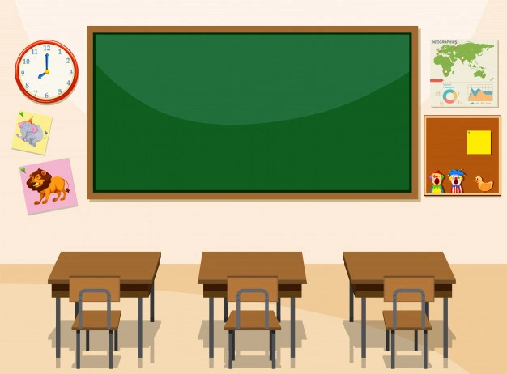

Hello everyone !!!

Slide 2


Unit
3
HEALTHY LIVING FOR TEENS
LESSON 6: SKILLS 2
LISTENING
WRITING

Slide 3
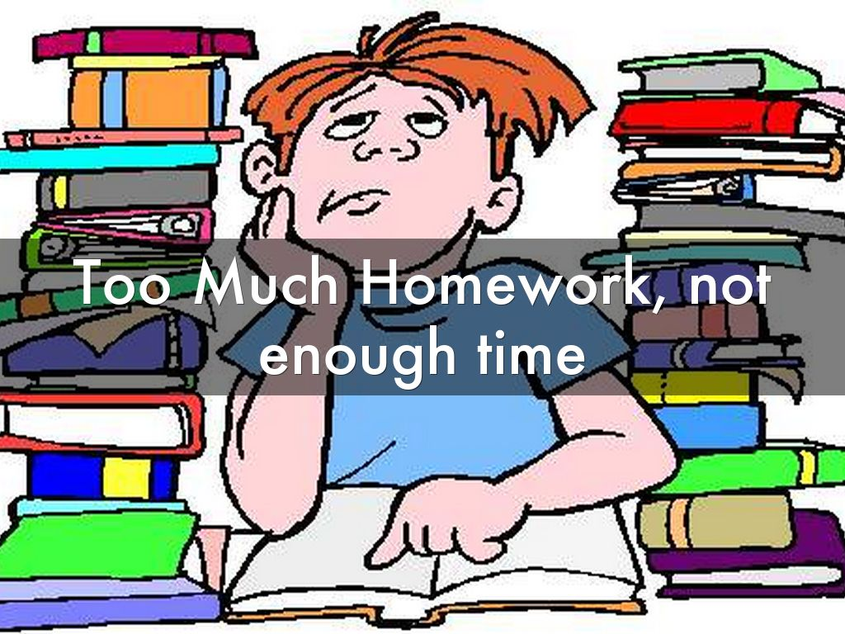

VOCABULARY
schoolwork (n)
.
/ˈskuːl.wɝːk/
việc học tập
Notes:
studying done by a child at school or at home

Slide 4
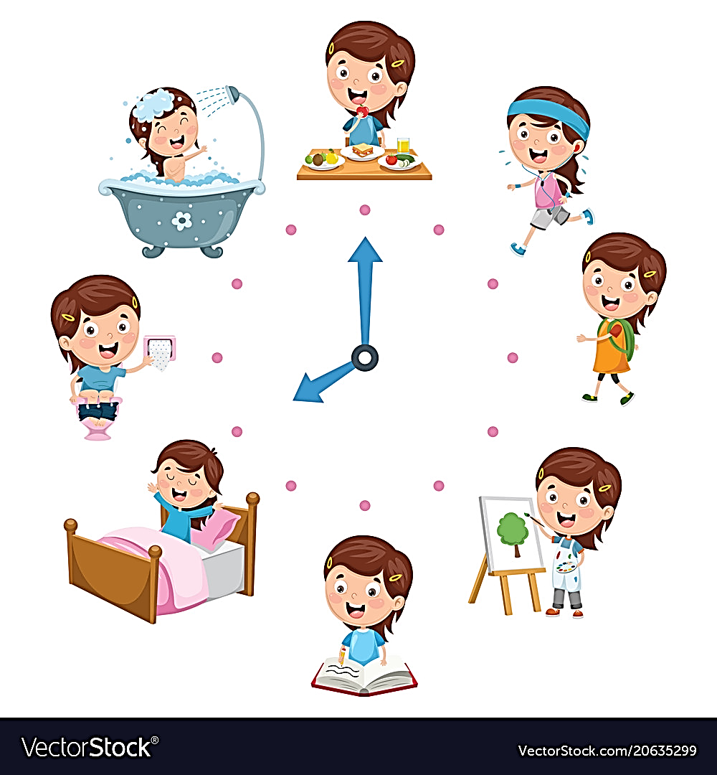
VOCABULARY
routine (n)
.
/ruːˈtiːn/
việc thường làm hàng ngày
Notes:
a usual or fixed way of doing things:

Slide 5
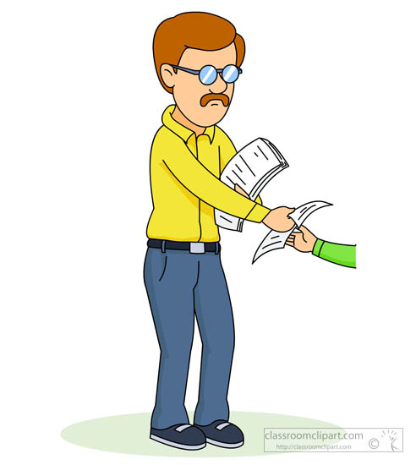
VOCABULARY
submit (v)
.
/səbˈmɪt/
nộp, đệ trình
Notes:
to give or offer something for a decision to be made by others

Slide 6

VOCABULARY
minimize (v)
.
/ˈmɪn.ɪ.maɪz/
giảm đến mức tối thiểu
Notes:
to reduce something to the least possible level or amount:

Slide 7
VOCABULARY
New words | Pronunciation | Meaning
1. schoolwork (n) | /ˈskuːl.wɝːk/ | việc học tập
2. routine (n) | /ruːˈtiːn/ | việc thường làm hàng ngày
3. submit (v) | /səbˈmɪt/ | nộp, đệ trình
4. minimize (v) | /ˈmɪn.ɪ.maɪz/ | giảm đến mức tối thiểu

Slide 8
Checking vocab
New words | Pronunciation | Meaning
1. | /ˈskuːl.wɝːk/ | việc học tập
2. | /ruːˈtiːn/ | việc thường làm (hàng ngày)
3. | /səbˈmɪt/ | nộp, đệ trình
4. | /ˈmɪn.ɪ.maɪz/ | giảm đến mức tối thiểu
schoolwork (n)
routine (n)
submit (v)
minimize (v)

Slide 9

I. LISTENING

Slide 10

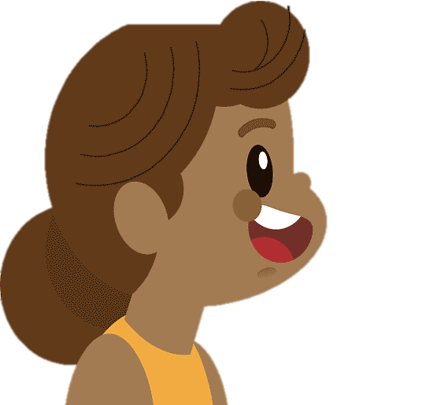
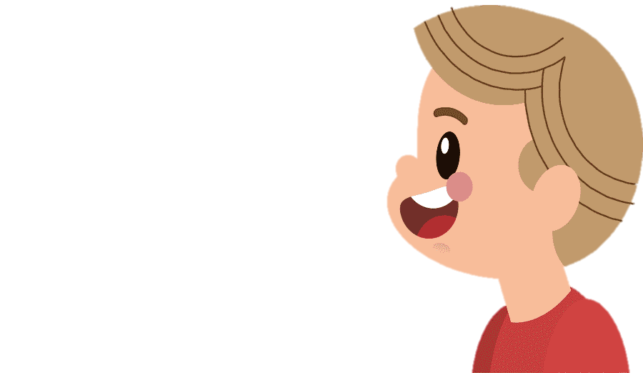
1
Work in pairs. Discuss the following question.
How do you make time for study and other activities?

Slide 11
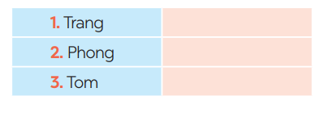
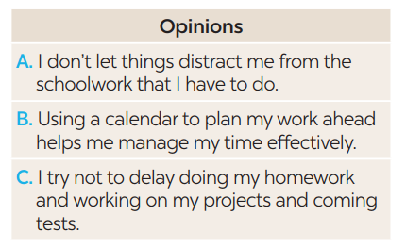
2
You will hear Trang, Phong, and Tom talking about how to manage their time effectively. For each student (1 – 3), choose the opinion (A – C) each of them expresses.
B
A
C

Slide 12
3
Listen again and choose the correct answer A, B, or C.
1. Trang enters what she has to do into a ______ at the beginning of each term.
A. poster B. routine C. calendar
2. Trang often uses ______ colours to mark project due dates and exam times on her calendar.
A. different B. the same C. similar
Notes:
1. C

Slide 13
3
Listen again and choose the correct answer A, B, or C.
3. Phong turns off his cell phone and signs out of social media ______ when he starts his work.
A. accounts B. networks C. websites
4. Tom tries not to ______ homework until just before the due date.
A. leave B. complete C. submit
5. Tom ______ his projects and coming tests and adds them to his schedule.
A. prepares B. reviews C. revises
Notes:
1.

Slide 14
3
Listen again and choose the correct answer A, B, or C.
1. Trang enters what she has to do into a ____ at the beginning of each term.
A. poster B. routine C. calendar
2. Trang often uses ______ colours to mark project due dates and exam times on her calendar.
A. different B. the same C. similar
3. Phong turns off his cell phone and signs out of social media ______ when he starts his work.
A. accounts B. networks C. websites
4. Tom tries not to ______ homework until just before the due date.
A. leave B. complete C. submit
5. Tom ______ his projects and coming tests and adds them to his schedule.
A. prepares B. reviews C. revises

Slide 15


Audio script:
Trang: I use a calendar to plan my work ahead. At the beginning of each term, I take a broad view of what I have to do by entering the due dates and test dates into a calendar. I often do these with different colours, for example, red for deadlines, green for exams ...
Phong: I try to minimise distractions. Besides cell phones, social media, and friends, there are a lot of activities that can take my attention away from my schoolwork. When it's time to start my work, I turn off my cell phone and sign out of social media accounts.
Tom: I never leave homework until the day before it's due. I review my projects and coming tests and add them to my schedule. I arrange to start working on them well before they're due, so I'm not stressed out to meet the due

Slide 16


II. WRITING

Slide 17
4
Match the time management tips in column A with the explanations and / or reasons in column B.
A | B
1. Making a plan or schedule for things you need to do, including appointments, projects, homework and tests | a. You should decide which is the most urgent and important task so that you can concentrate on it first. By doing this, you may not be at a loss to deal with too much work at the same time.
2. Giving priority to the most important task | b. An effective routine can help you accomplish the things you need to do. The more you follow a daily routine, the less you will worry or get stressed.
3. Building an effective daily routine | c. You can plan your work ahead by using a calendar, a diary, or a mobile app. It helps you remember what you need to accomplish and when you should do it.

Slide 18
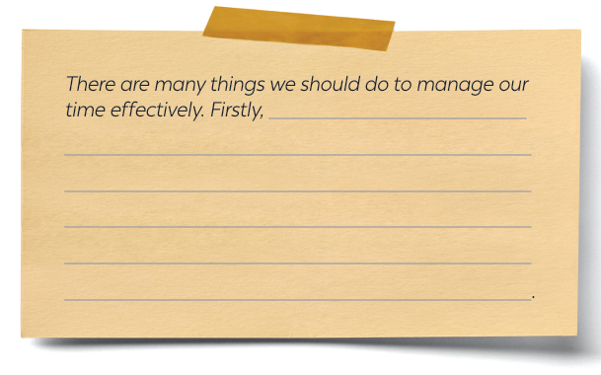
5
Write a paragraph (about 100 words) about how to manage your time effectively. Use the tips in 4 or your own ideas.

Slide 19
5
Write a paragraph (about 100 words) about how to manage your time effectively. Use the tips in 4 or your own ideas.
Suggested answer:
There are many things we should do to manage our time effectively. Firstly, we should set specific goals and prioritise them according to their importance level. This will help us keep focused on our most important tasks and avoid wasting time on tasks that do not contribute to our goals. Secondly, creating a schedule or to-do list can help us manage our time efficiently by breaking down our day into manageable chunks. We should also be realistic about how long each task will take and build in extra time for unexpected interruptions or delays. Thirdly, it is essential to eliminate distractions and time-wasting activities, such as social media or unnecessary meetings, which can reduce our productivity. By following these tips, you we can effectively manage your time and achieve success in all aspects of your life.

Slide 20
5
Write a paragraph (about 100 words) about how to manage your time effectively. Use the tips in 4 or your own ideas.
Suggested answer:
There are many things we should do to manage our time effectively. Firstly, making a plan or schedule for things you need to do, including appointments, projects, homework and tests. You can plan your work ahead by using a calendar, a diary, or a mobile app. It helps you remember what you need to accomplish and when you should do it. Secondly, giving priority to the most important task. You should decide which is the most urgent and important task so that you can concentrate on it first. By doing this, you may not be at a loss to deal with too much work at the same time. Finally, building an effective daily routine. An effective routine can help you accomplish the things you need to do. The more you follow a daily routine, the less you will worry or get stressed.

Slide 21

CONSOLIDATION
What have we learnt in this lesson?
Listening skill for specific information.
Writing a paragraph about how to manage their time effectively, using the given tips or their own ideas.

Slide 22

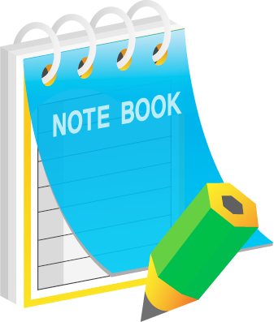
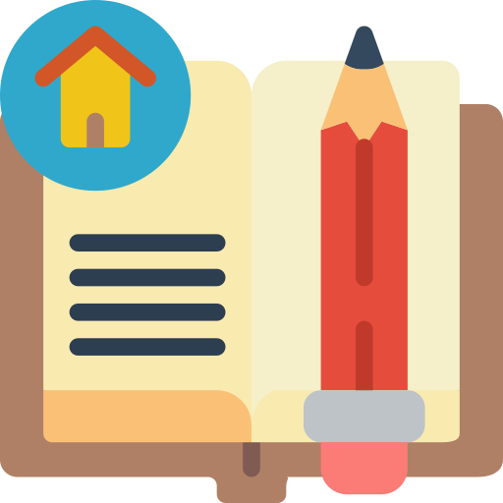
Homework
Rewrite the paragraph in the notebooks.
Do exercises in the Workbook.
Prepair lesson 7 ( looking back & Project)

Slide 23

Goodbye
SEE YOU AGAIN

Slide 24
1
Work in pairs. Discuss the following question.
How do you make time for study and other activities?
I usually create a daily, weekly or monthly schedule that includes dedicated time for studying, and other activities. I give priority to learning responsibilities, but also allocate time for other essential activities like exercise, socializing, and relaxation.

Slide 25
UNSCRAMBLE THE WORD
WARM UP
Play in 2 teams.
Write unscrambled words in notebooks.
Raise hand and say out “FINISH”.
LET’S PLAY!

Slide 26
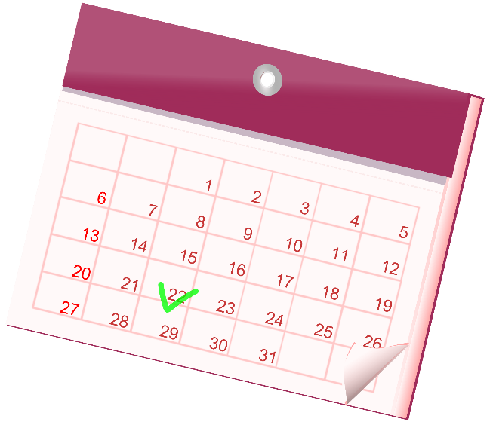
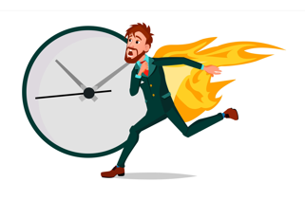

UNSCRAMBLED WORDS
SCHOOLWORK
ROUTINE
CALENDAR
SUBMIT
DEADLINE
MINIMIZE

