Slide 1
ENGLISH 9
Hello everyone !!!

Slide 2
WARM-UP
BRAINSTORM
* Answer the following question:
+ Do you have a well-balanced life?
+ How is a well-balanced life important for students?

Slide 3
WARM-UP
A well-balanced life
work/
school
family/
friends
hobbies/
interests
self-care

Slide 4
Unit
3
HEALTHY LIVING FOR TEENS
LESSON 5: SKILLS 1
READING
SPEAKING

Slide 5
I. READING

Slide 6
VOCABULARY
celebrity (n)
.
/səˈleb.rə.ti/
Sự/ người nổi tiếng
Notes:
celebrity (v): someone who is famous, especially in the entertainment business

Slide 7
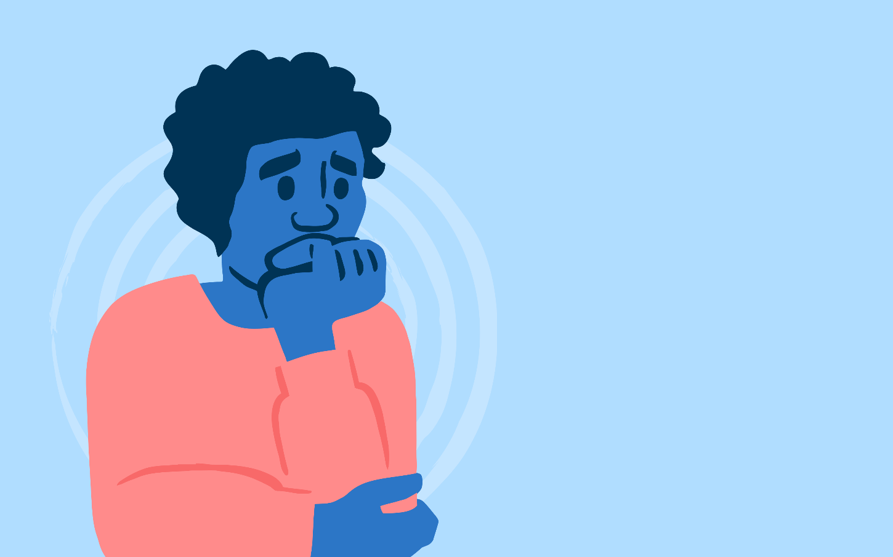
VOCABULARY
anxiety (n)
.
/æŋˈzaɪ.ə.ti/
sự lo lắng
Notes:
anxiety (n) an uncomfortable feeling of nervousness or worry about something that is happening or might happen in the future

Slide 8
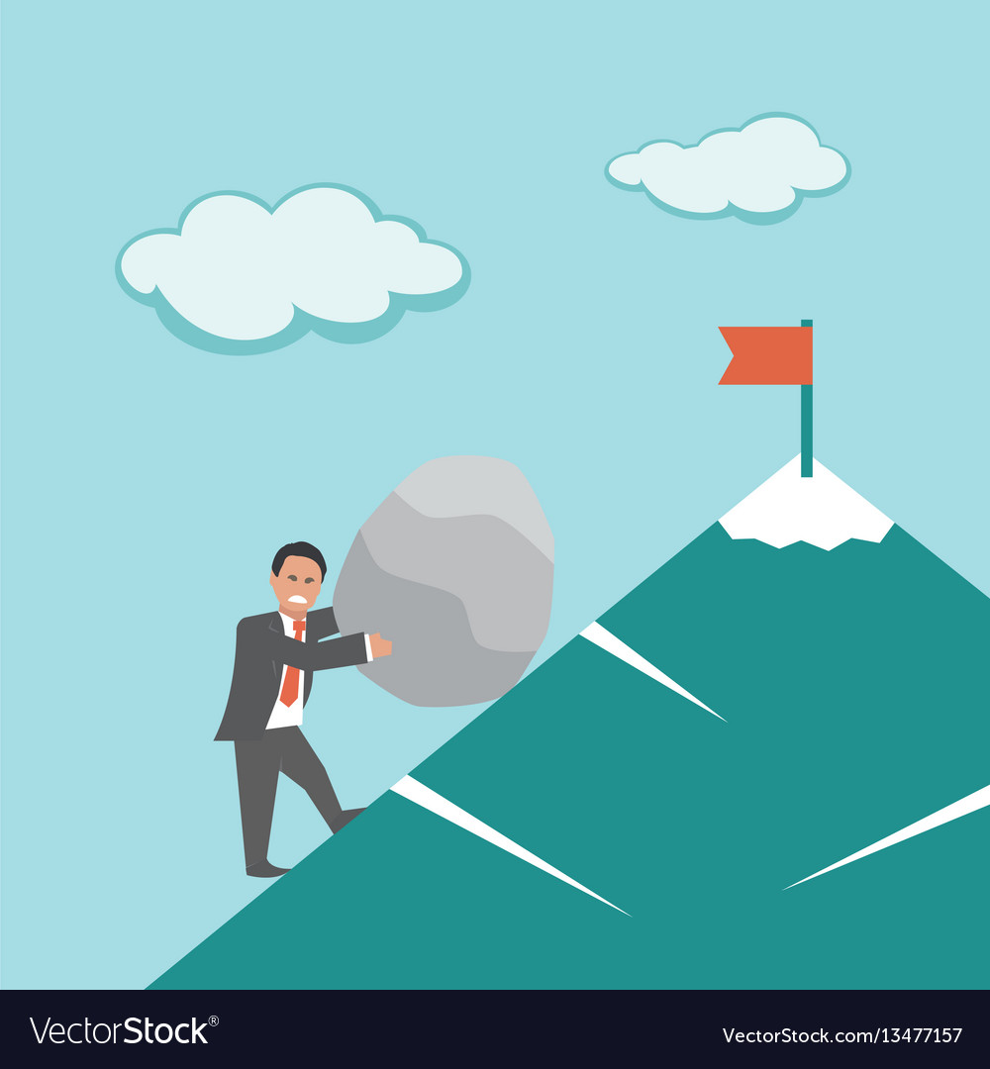
VOCABULARY
effort (n)
.
/ˈef.ət/
sự cố gắng, nổ lực
Notes:
effort (n) physical or mental activity needed to achieve something:

Slide 9
VOCABULARY
additional (a)
.
/əˈdɪʃ.ən.əl/
thêm, bổ sung
Notes:
additional (a) extra

Slide 10
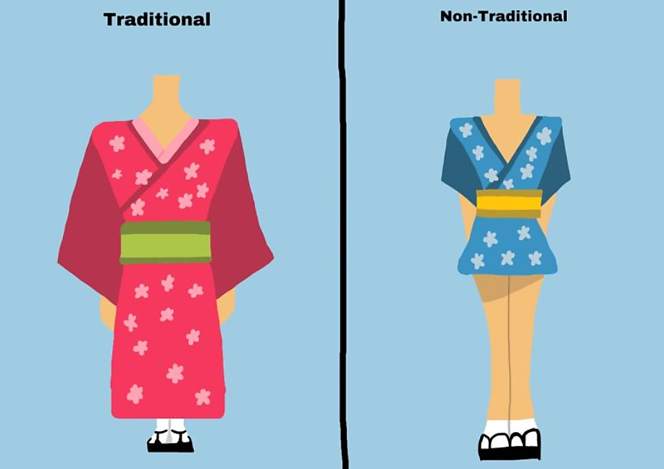
VOCABULARY
appropriately (adv)
.
/əˈprəʊ.pri.it.li/
một cách thích hợp
Notes:
appropriately (adv) close to a particular number or time although not exactly that number or time:

Slide 11
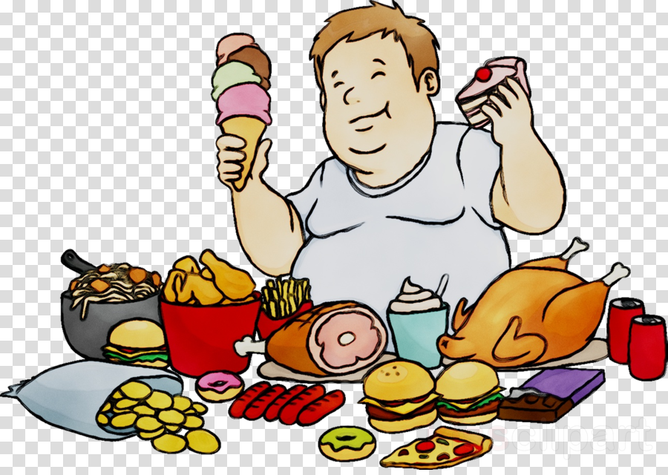
VOCABULARY
fattening (a)
.
/ˈfæt.ən.ɪŋ/
gây béo
Notes:
fattening (a) Fattening food contains a lot of fat, sugar, etc. that would quickly make you fatter if you ate a lot of it:

Slide 12
VOCABULARY
New words | Pronunciation | Meaning
1. celebrity (n) | /səˈleb.rə.ti/ | người nổi tiếng
2. anxiety (n) | /æŋˈzaɪ.ə.ti/ | sự lo lắng
3. effort (n) | /ˈef.ət/ | sự cố gắng
4. additional (adj) | /əˈdɪʃ.ən.əl/ | thêm, bổ sung
5. appropriately (adv) | /əˈprəʊ.pri.it.li/ | một cách thích hợp
6. fattening (adj) | /ˈfæt.ən.ɪŋ/ | gây béo

Slide 13
Checking vocab
New words | Meaning
1.
2.
3.
4.
5.
6.
effort (n)
sự cố gắng
appropriately (adv)
một cách thích hợp
celebrity (n)
người nổi tiếng
fattening (adj)
gây béo
anxiety (n)
sự lo lắng
additional (adj)
thêm, bổ sung

Slide 14
2
The following text is about how a successful teen celebrity kept
a well-balanced life when he was at school. Read the text and match each highlighted word with its meaning.
When I was at school, I had to learn how to have a well-balanced life in order to reduce stress and anxiety. Below are some of the typical things I did.
Firstly, I managed my time properly. I started to plan my schedule, made a weekly work list and gave priority to some of my work. This helped me concentrate my efforts on my most important tasks.
In addition, I communicated with my family, friends, and teachers about my busy schedule and problems, so they would offer me additional support.
I also took breaks appropriately because they helped me keep away from stress and anxiety, and gave my brain a rest and improved my mood.
Finally, I looked after my physical health. I got at least eight hours of sleep a day. I played football with my classmates twice a week and went for a walk with my grandparents early every morning. Besides, I also tried to follow a healthy diet. I ate a lot of fruit and vegetables. I ate little fattening foods and avoided junk foods like chips, cookies, pizza, etc.

Slide 15
2
Read the text and match each highlighted word with its meaning.
a. more than the amount you expected oragreed to
b. likely to make you fat
c. the state of feeling nervous or worriedthat something bad is going to happen
d. in a way that is suitable or right for a particular situation
1. anxiety
2. additional
3.appropriately
4. fattening
1. c 2. a 3. d 4. b

Slide 16
3
Read the text again and answer the following questions.
1. Why did the teen celebrity have to learn how to have a well-balanced life when he was a student?
2. What did he do to manage his time properly?
3. Why did he communicate with his family, friends, and teachers about his schedules and problems?
4. Why did he take breaks?
5. How did he follow a healthy diet?

Slide 17
3
Read the text again and answer the following questions.
1. Why did the teen celebrity have to learn how to have a well-balanced life when he was a student?
2. What did he do to manage his time properly?
Because he wanted to avoid/ reduce stress and anxiety.
He planned his schedule, made a weekly work list and gave priority to his work, which helped him concentrate his efforts on his most important tasks.
Notes:
1.

Slide 18
3
Read the text again and answer the following questions.
3. Why did he communicate with his family, friends, and teachers about his schedules and problems?
4. Why did he take breaks?
5. How did he follow a healthy diet?
Because they would offer him additional support.
Because they helped him keep away from stress and anxiety, and gave his brain a rest and improved his mood.
He ate a lot of fruit and vegetables. He ate little fattening foods and avoided junk foods like chips, cookies, pizza, etc.

Slide 19
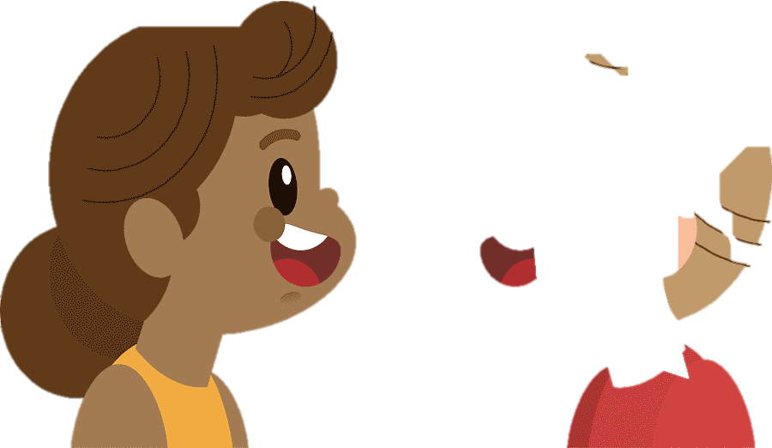
II. SPEAKING

Slide 20
4
Work in pairs. Ask and answer the following questions about how to have a well-balanced life. Make notes of your partner’s answers.
1. How can we manage our time properly?
2. How can we spend time with our friends, teachers, and parents?
3. How can we avoid stress and anxiety?
4. How can we take care of our physical health?

Slide 21
5
Work in groups. Take turns to talk about your partner’s ideas about how to have a well-balanced life.
Suggested answers:
I talked with An about how she manages a well-balanced life. First, she manages her time properly by creating a to-do list and give priority to her tasks based on their importance and deadlines. Second, she plans regular times to connect with friends, through study groups or social outings. She also maintains open communication with her teachers by asking questions and seeking help when needed. Next, she practises mindfulness techniques such as deep breathing, meditation, or yoga to manage stress and maintain a clear mind. Finally, she engages in regular physical activities that she enjoys like jogging, dancing, swimming, etc to help boost her energy.

Slide 22
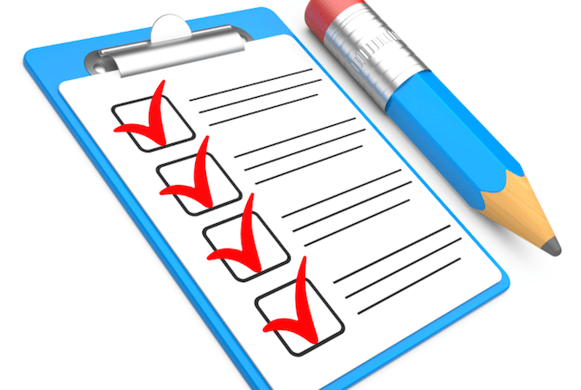
CONSOLIDATION
What have we learnt in this lesson?
Vocabulary related to related to students’ life and schoolwork.
Reading for specific information.
Talking about partner’s ideas about how to have a well-balanced life.

Slide 23
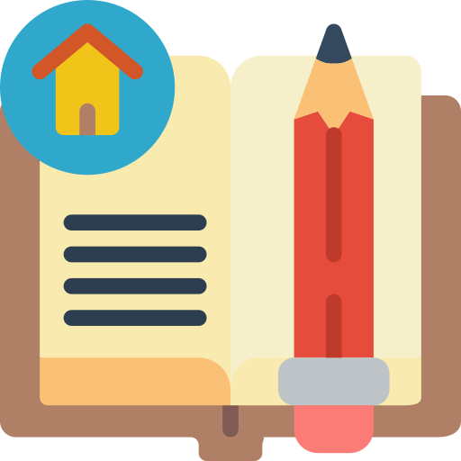
* Homework
Do exercises in the Workbook.
Prepair lesson 6 : Skills 2

Slide 25
WARM-UP
BRAINSTORM
Take out 1 piece of paper and a pen.
Draw a circle and divide it into four equal parts, like a pizza. Label each section of the circle with 4 different categories:
+ work/school
+ family/friends
+ hobbies/interests
+ self-care
Brainstorm activities that fit into each category and write them in the corresponding section of the circle.

Slide 26
WARM-UP
BRAINSTORM
* Answer the following question:
+ Do you have a well-balanced life?
+ Can you make any adjustments to achieve a more well-balanced life?
- adjustment : điều chỉnh
- achieve: đạt được

