Slide 1

ENGLISH 9
Hello everyone !!!

Slide 2



Unit
3
HEALTHY LIVING FOR TEENS
LESSON 3: A CLOSER LOOK 2
Grammar: Modal verbs in first conditional sentences

Slide 3
Grammar: Modal verbs in first conditional sentences
 | IF - CLAUSE | MAIN CLAUSE
 | If you do physical exercise regularly, | Your health will improve.
 | If she trains harder, | she can run faster than you.
 | If he finishes his paper, | he can hand it in and leave for home.
 | If you want to have good mental health, | you should balance your study and life.
 | If he is good at IT, | he may / might get a good job.
 | If you want to manage your time effectively, | you must get rid of all the distractions.
standard form
ability
permission
advice
possibility
necessity

Slide 4
Grammar: Modal verbs in first conditional sentences
(Động từ khiếm khuyết trong câu điều kiện loại 1)
Form:
If + S + V1/ Vs/es, S + will/ can/ should/ may/ might/ must + V1
Can: có thể (khả năng (tài năng) , sự cho phép)
Should: nên (lời khuyên)
May/ might : có thể, có lẽ (khả năng)
Must: phải (sự cần thiết, bắt buộc)

Slide 5
Will : sẽ (dạng chuẩn)
Can: có thể (khả năng (tài năng) , sự cho phép)
Should: nên (lời khuyên)
May/ might : có thể, có lẽ (khả năng xảy ra)
Must: phải (sự cần thiết, bắt buộc)

Slide 6
Grammar: Modal verbs in first conditional sentences
(Động từ khiếm khuyết trong câu điều kiện loại 1)
Form:
If + S + V1/ Vs/es, S + will/ can/ should/ may/ might/ must + V1
Ex:
If it rains, we will stay at home.
If you try your best, you can achieve success.

Slide 7

PRACTICE

Slide 8
mental
counsellor
well-balanced
physical
1
Write the correct form of each verb in brackets.
1. If Mai (not want) _____________________ to gain weight, she shouldn’t eat much fast food.
2. If you stay up too late tonight, you might (feel) __________ tired tomorrow morning.
3. You should (sleep) __________ eight hours a night if you want to be awake and fully alert.
4. If Tom (complete) ___________ his assignment on Friday, he can go out with his friends at the weekend.
5. You must (be) _____ careful if you don’t want to get burnt.
doesn’t want
feel
sleep
completes
be

Slide 9
2
Circle the correct modal verbs to complete the following sentences.
1. She can / should go home early if she finishes her work.
2. If you train hard, you might / shouldn’t win the first prize.
3. If they don’t want to be punished, they must / may follow the rules.
4. If students have an upcoming exam, they shouldn’t / can’t wait to study until the day before it.
5. If you’re having a bad day, you should / may do your best to get through it.

Slide 10
3
Match the first half of the sentence in A with the second half in B.
1. If you spend too much time on the computer,
2. If you put too much sugar in your coffee,
3. If you want to manage your time effectively,
4. If you want to have perfect white teeth,
5. If you take a cooking class,
a. you can make your favourite food at home.
b. you should use a calendar to plan your work ahead.
c. you may put on more weight.
d. you might get shoulder pains.
e. you must brush your teeth regularly.

Slide 11
3
KEY
Match the first half of the sentence in A with the second half in B.
1. If you spend too much time on the computer,
2. If you put too much sugar in your coffee,
3. If you want to manage your time effectively,
4. If you want to have perfect white teeth,
5. If you take a cooking class,
d. you might get shoulder pains.
c. you may put on more weight.
b. you should use a calendar to plan your work ahead.
e. you must brush your teeth regularly.
a. you can make your favourite food at home.

Slide 12
PRODUCTION
5
Complete the sentences with your own ideas using the modal verbs you have learnt.
1. If you spend too much time playing computer games, _____.
2. If you want to get a good night’s sleep,_________________.
3. If you don’t feel well, _______________________________.
4. If you want to be a good student, _____________________.

Slide 13
4
What will you say in each situation below? Use first conditional
sentences with modal verbs.
1. Your friend wants to lose weight. You advise him / her to eat less high fat food and do more exercise.
=> If you want to lose weight, you should eat less high fat food and do more exercise.

Slide 14

4
What will you say in each situation below? Use first conditional
sentences with modal verbs.
2. Your friend invites you out for an ice cream, but it’s possible that you will have a sore throat.
=> If I have/ eat an ice cream, I may have a sore throat.

Slide 15
4
What will you say in each situation below? Use first conditional
sentences with modal verbs.
3. Your roommate often stays up late at night. You think it is necessary to get enough sleep every night; otherwise, his health will suffer.
If you want to have good health, you must get 8 hours of sleep per night.
If you don't get enough sleep every night, your health will suffer.

Slide 16

4
What will you say in each situation below? Use first conditional
sentences with modal verbs.
4. Your little brother wants to go for a swim. You agree but ask him to finish all his homework first.
=> You can go for a swim if you finish all your homework.

Slide 17

4
What will you say in each situation below? Use first conditional
sentences with modal verbs.
5. You’re able to make a delicious pizza when
you have all the needed ingredients.
=> If I have all the needed ingredients, I can make a delicious pizza.

Slide 18

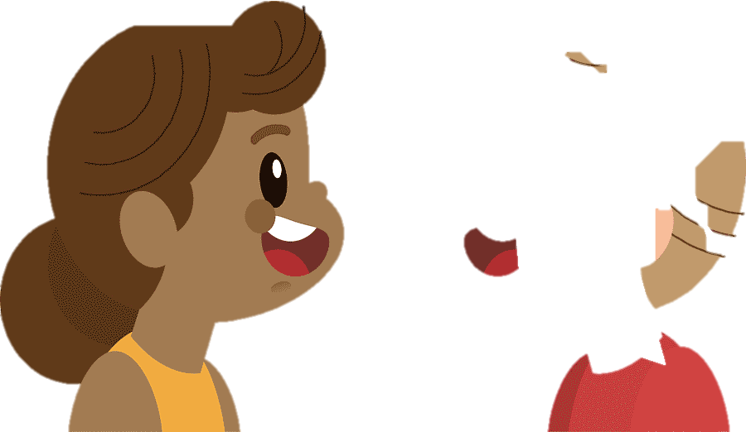

PRODUCTION
5
Complete the sentences with your own ideas using the modal verbs you have learnt.
1. If you spend too much time playing computer games, _____________.
2. If you want to get a good night’s sleep,_________________________.
3. If you don’t feel well, ______________________________________.
4. If you want to reduce stress, ________________________________.
5. If you want to be a good student, _____________________________.
6. If you want to become a footballer,
Game

Slide 19
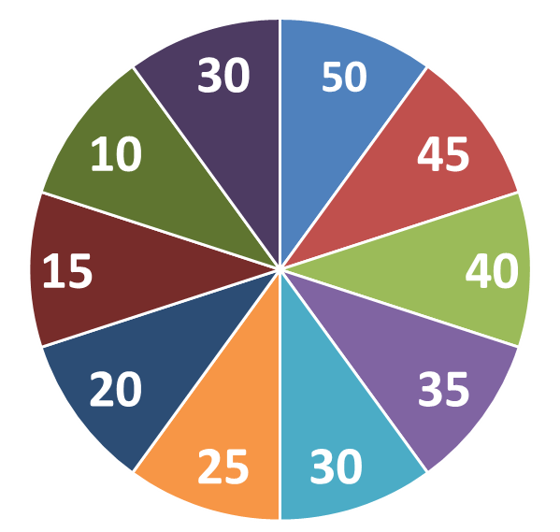
Spinning the number
Work in 2 groups
QUESTIONS
1
2
3
4
5
6

Slide 20
PRODUCTION
5
Complete the sentences with your own ideas using the modal verbs you have learnt.
1. If you spend too much time playing computer games, ________ _____________.
you may feel tired and less energetic

Slide 21
PRODUCTION
5
Complete the sentences with your own ideas using the modal verbs you have learnt.
2. If you want to get a good night’s sleep,______________________.
you should avoid caffeine and electronic devices
before bedtime.

Slide 22
PRODUCTION
5
Complete the sentences with your own ideas using the modal verbs you have learnt.
3. If you don’t feel well, __________________________________.
you should see a doctor

Slide 23
PRODUCTION
5
Complete the sentences with your own ideas using the modal verbs you have learnt.
4. If you want to reduce stress, _____________________________.
You should stop working and relax a bit

Slide 24
PRODUCTION
5
Complete the sentences with your own ideas using the modal verbs you have learnt.
5. If you want to be a good student, _________________________.
You must study hard

Slide 25
PRODUCTION
5
Complete the sentences with your own ideas using the modal verbs you have learnt.
6. If you want to become a footballer,
You must have good health and practice every day

Slide 26

CONSOLIDATION
What have we learnt in this lesson?
Summarise the main points of the lesson.
Make first conditional sentences about yourselves, using modal verbs instead will.

Slide 27

Homework
Do exercises in the workbook.
Start preparing for the Project of the unit.
Prepair lesson 4 : Communication
.

Slide 28

Thank you!
Goodbye!

Slide 30
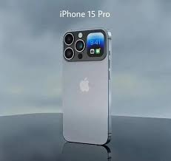
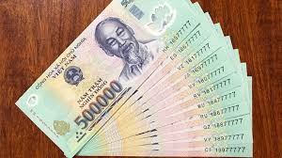

Slide 31
* PRODUCTION
5
Complete the sentences with your own ideas using the modal verbs you have learnt.
SUGGESTED ANSWER
1. If you spend too much time playing computer games, ________________________________________________________
2. If you want to get a good night’s sleep, _____________
________________________________________________________
3. If you don’t feel well, __________________________
________________________________________________________
you might miss out on other important activities like exercising, socialising, and studying.
you should avoid
drinking caffeine or alcohol before bed and try to establish a regular sleep schedule.
.
you should consult a doctor
or a medical professional to get a proper diagnosis and treatment.

Slide 32

EXTRA ACTIVITY
LUCKY NUMBERS
1
2
3
4
5
6
7
END GAME

Slide 33

WARM-UP
LUCKY NUMBERS
You have 2 points.
GO BACK

Slide 34

WARM-UP
LUCKY NUMBERS
Question 2:
Make a first conditional sentence
using the suggested words.
Do exercise regularly.
maintain good health/ can
Have a balanced diet
GO BACK

Slide 35
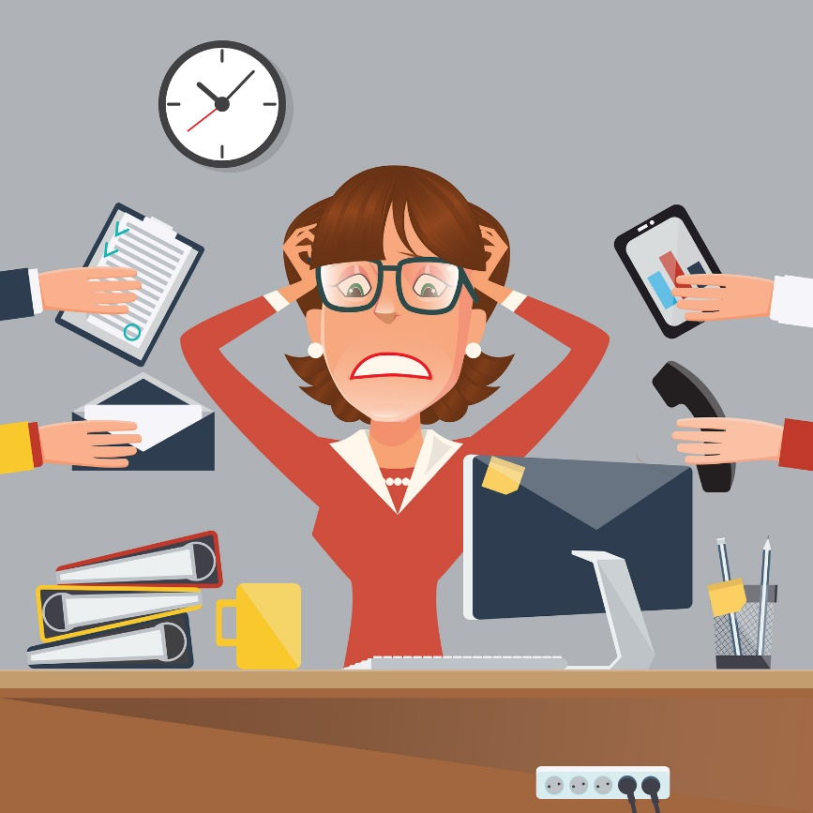
WARM-UP
LUCKY NUMBERS
Question 3:
Make a first conditional sentence
using the suggested words.
reduce stress/ should
You should stop working and relax a bit
GO BACK

Slide 36

WARM-UP
LUCKY NUMBERS
Question 4:
Make a first conditional sentence
using the suggested words.
mangage time/ must
focus on work
GO BACK

Slide 37
WARM-UP
LUCKY NUMBERS
You have 2 points.
GO BACK

Slide 38

WARM-UP
LUCKY NUMBERS
Question 6:
Make a first conditional sentence
using the suggested words.
balance study and play time/ may
GO BACK

Slide 39

WARM-UP
LUCKY NUMBERS
Question 7:
Make a first conditional sentence using
the suggested words.
delay/ must
GO BACK

Slide 40
PRACTICE
Work in pairs.
Write a short dialogue where you use at least three different modal verbs in first conditional sentences.
Example:
A: If you have time tonight, you should go to the cinema.
B: I agree. If I don’t, I might watch a movie at home……"

