Slide 1
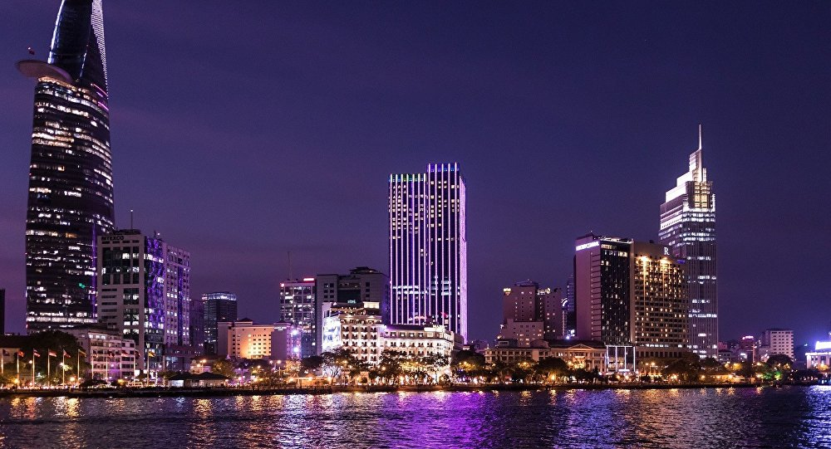
UNIT 2: CITY LIFE
Lesson 7: Looking back + Project

Slide 2
WARM-UP
BRAINSTORMING
- Work in teams.
- Members of each team take turns and write adj related the city ( in 2 minutes)
- The group having more correct answers is the winner.

Slide 3
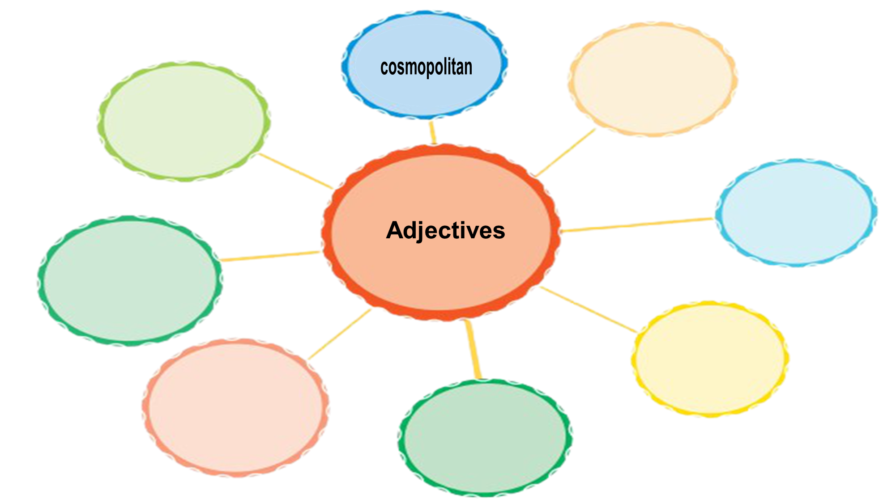
2 minutes to start
noisy
convenient
livable
polluted
modern
downtown
expensive
populous

Slide 4
Unit
2
CITY LIFE
LESSON 7: LOOKING BACK & PROJECT

Slide 5
VOCABULARY
1
Choose the correct answer to complete each sentence below.
1. It takes Jane 30 minutes to travel from her house in the suburbs / downtown to her office in the city centre.
2. Minh prefers the metro / sky train. He finds it more comfortable to go underground than above the ground.
3. The city centre is now packed with high buildings. It looks like an ugly public amenity / concrete jungle.
4. He loves the nightlife of his city. He thinks that it is lively / noisy.
5. Ho Chi Minh City is a slow / bustling city. It is always full of activities.

Slide 6
VOCABULARY
2
Fill in each gap with a word from the box to complete the passage.
congestion peaceful safe liveable itch
Mia lives in a small town. In the past, there were not many people living in the town, so it was rather quiet and (1) _______________. Nowadays, it is totally different. The more crowded the town is, the less (2) ___________ it becomes. Crime rates are increasing quickly. Moreover, many car drivers don’t obey traffic rules, so they indirectly cause traffic (3) ______________. Construction sites are everywhere in the town.
The dust and dirt from these sites have caused many problems for people’s health, for example (4) _________ eyes, runny noses, and acne. All these things make Mia feel that her town is not as (5) __________ as before.
peaceful
safe
congestion
itchy
liveable

Slide 7
GRAMMAR
3
Complete the sentences with the particles in the box
out (x2) down with down on away
People are throwing _______ tons of food each year. This is such a waste!
Shopping malls are a popular place for teens to hang _______ one another these days.
The city council wants to cut _______ construction noise by 20% in the next five years.
The researchers carried _______ a study about people's attitudes towards their cities.
Many people come _______ the flu in winter.
Game

Slide 8
Game: Lucky numbers
1
2
3
4
5
6
7
8
GA
GB
GA
2
4
6
8
10
12
14
GB
2
4
6
8
10
12
14

Slide 9
LUCKY NUMBER!

Slide 10
LUCKY NUMBER!

Slide 11
UNLUCKY NUMBER

Slide 12
GRAMMAR
3
Complete the sentences with the particles in the box
out (x2) down with down on away
away
1. People are throwing __________ tons of food each year. This is such a waste!

Slide 13
GRAMMAR
3
Complete the sentences with the particles in the box
out (x2) down with down on away
2. Shopping mall is a popular place for teens to hang _____________ with one another these days.
these days.
out

Slide 14
GRAMMAR
3
Complete the sentences with the particles in the box
out (x2) down with down on away
down on
3. The city council wants to cut ___________ construction noise by 20% in the next five years.

Slide 15
GRAMMAR
3
Complete the sentences with the particles in the box
out (x2) down with down on away
out
4. The researchers carried _________ a study about people’s attitudes towards their cities.

Slide 16
GRAMMAR
3
Complete the sentences with the particles in the box
out (x2) down with down on away
down with
5. Many people come ____________ the flu in winter.

Slide 17
GRAMMAR
3
Complete the sentences with the particles in the box
out (x2) down with down on away
People are throwing _______ tons of food each year. This is such a waste!
Shopping malls are a popular place for teens to hang _______ one another these days.
The city council wants to cut _______ construction noise by 20% in the next five years.
The researchers carried _______ a study about people's attitudes towards their cities.
Many people come _________ the flu in winter.
away
out
down on
out
down with

Slide 18
GRAMMAR
Double Comparative
The + tính từ so sánh hơn + S1 + V1, the + tính từ so sánh hơn + S2 + V2
E.g. The more expensive the rent in the city is, the fewer people can afford to live there.

Slide 19
GRAMMAR
4
4
Find a grammar mistake in each sentence and correct it.
the more difficult
1. The dirtier the air gets, more difficult it is for people to breathe.
around
2. My brother likes to get up the city by bike, but I prefer using public transport.
The nearer
3. Nearer the school is, the more convenient it is for the students.

Slide 20
Note:
GRAMMAR
4
4
Find a grammar mistake in each sentence and correct it.
came down with
4. She came up with a cold after walking in the heavy rain.
slower
5. The more slow the Internet is, the angrier the users get.

Slide 21
GRAMMAR
Notes:
go around = turn round in a circle
go around (to) = visit sb / a place that is near
get around = to go to a lot of different places

Slide 22
PROJECT
A city in the future

Slide 23
PROJECT
A city in the future
- Work in groups. You have a few minutes to prepare for the presentation (which you prepare from lesson 1).
- Tick appropriate items while listening to your classmates’ presentations and write comments if you have any in checklists.
- The presenters should complete their self-assessment checklists after completing their presentation.

Slide 24
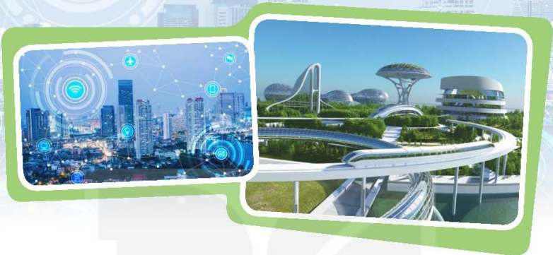
PROJECT
A city in the future

Slide 25
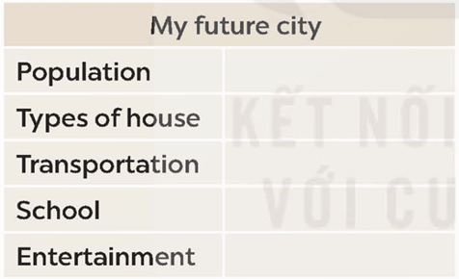
PROJECT
A city in the future
1. Imagine a future city you would like to live in. Complete the table.

Slide 26
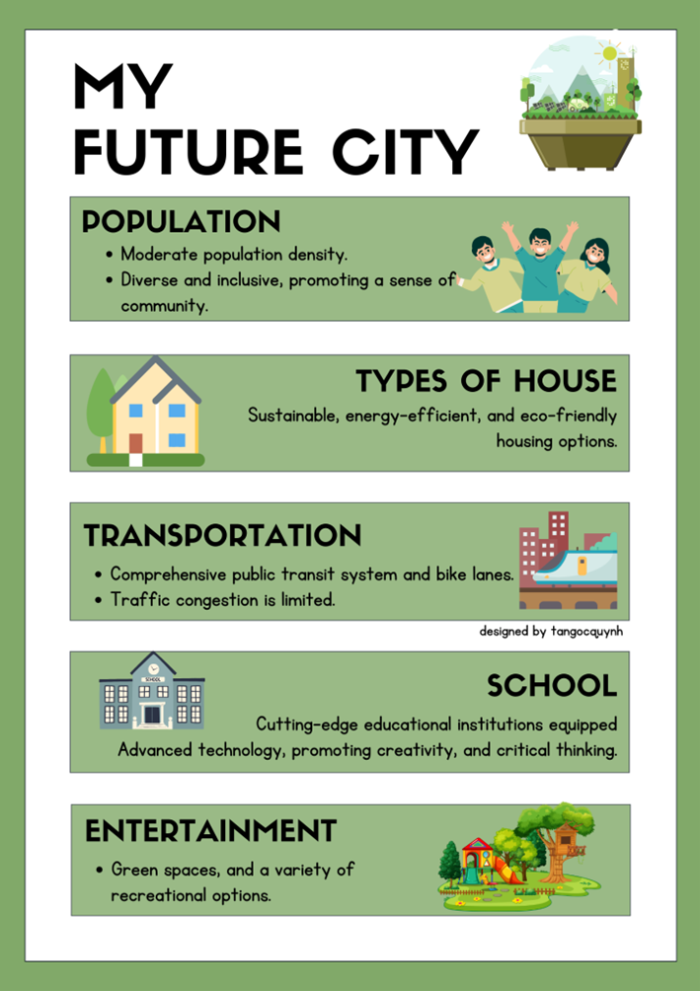
PROJECT
A city in the future
2. Prepare a poster presentation on your future city. Use the information from your table in 1.

Slide 27
PROJECT
A city in the future
3. Present your poster of the future city to your class.
Good morning everyone! Welcome to our future city, a place designed for a harmonious and sustainable lifestyle.
…………………..

Slide 28
CONSOLIDATION
What have we learnt in this lesson?
Review the vocabulary and grammar of Unit 2;
Apply what they have learnt (vocabulary and grammar) into practice through a project.

Slide 29
* Homework
Do exercises in the Workbook.
Prepare Unit 3 (Getting started)

Slide 30
Thank you!
Goodbye!

Slide 31
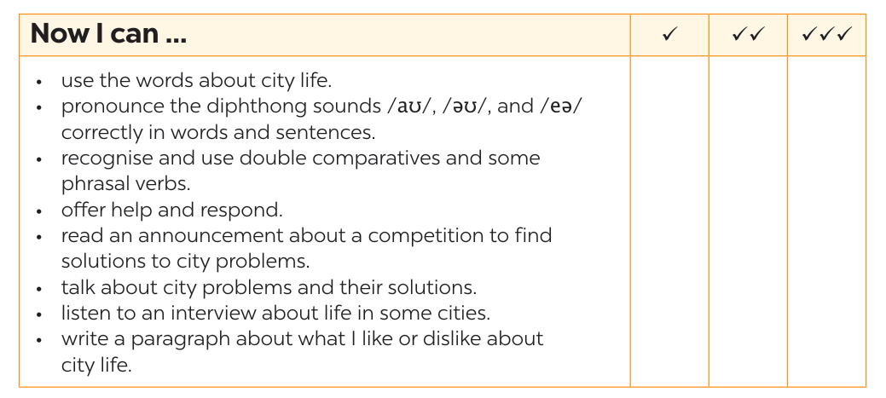
NOW I CAN...
Complete the self-assessment table.

