Slide 1
ENGLISH 9
Hello everyone !!!

Slide 2
WARM-UP
EMOJI/PICTURES QUIZ

Slide 3
WARM-UP
EMOJI/PICTURES QUIZ
- There are some emojis/pictures.
- Try to guess the secret word from the emojis/pictures

Slide 4
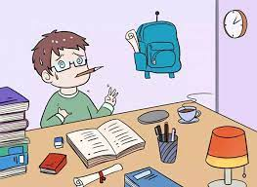
* Example
Look at the picture below! What English word do you think about?
+
Homework

Slide 5
🚌
bus driver

Slide 6
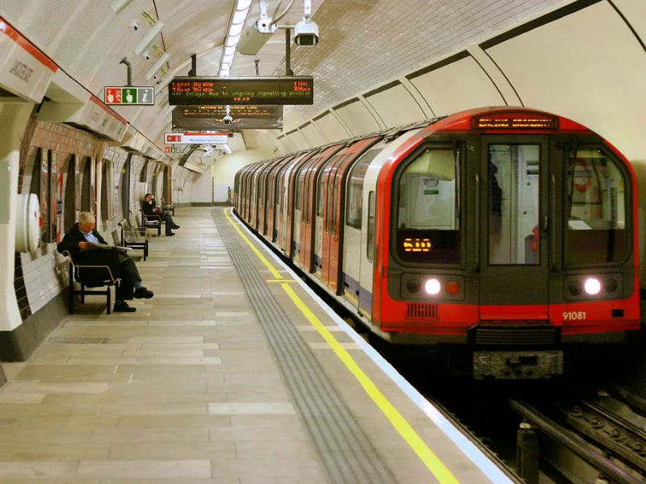
underground

Slide 7
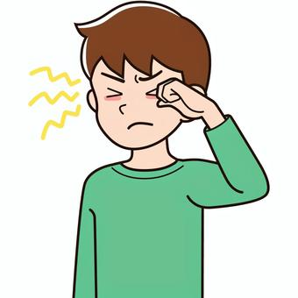
👁️
itchy eye

Slide 8
downtown

Slide 9
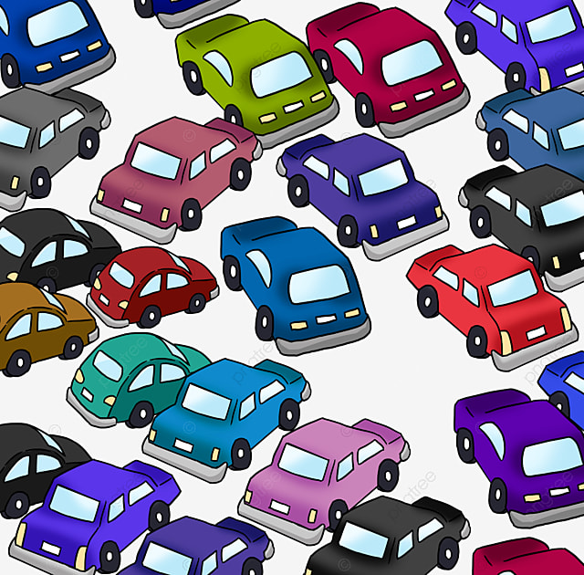
traffic jam

Slide 10
THE END

Slide 11
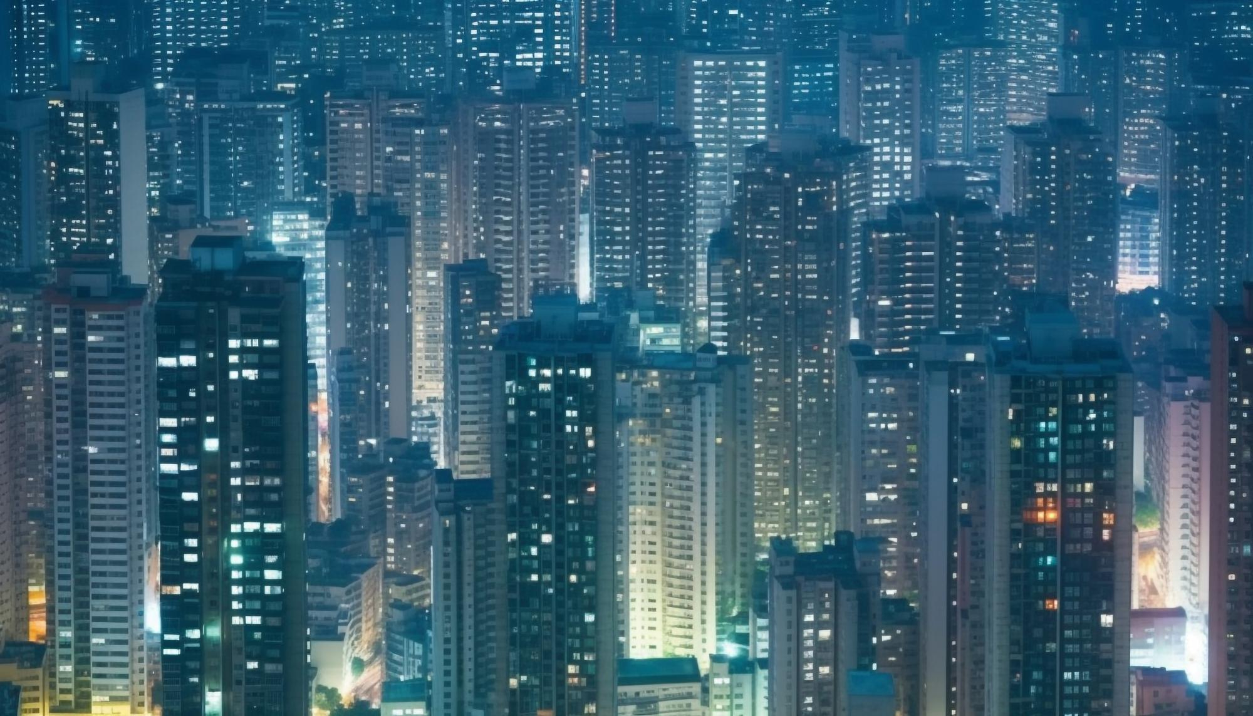
Unit
2
CITY LIFE
LESSON 2: A CLOSER LOOK 1

Slide 12
VOCABULARY
concrete jungle (n)
/ˌkɒŋkriːt ˈdʒʌŋɡl/
rừng bê tông

Slide 13
VOCABULARY
metro (n)
/ˈmetrəʊ/
hệ thống tàu điện ngầm

Slide 14
VOCABULARY
public amenity
/ˈpʌblɪk əˈmiːnəti/
tiện ích công cộng

Slide 15
VOCABULARY
someone who regularly travels between work and home
commuter (n)
/kəˈmjuː.t̬ɚ/
người đi làm

Slide 16
VOCABULARY
a thief who steals things out of pockets or bags, especially in a crowd
pickpocketing (n)
/ˈpɪkˌpɑː.kɪ.t̬ɪŋ/
móc túi

Slide 17
VOCABULARY
an area on the edge of a large town or city where people who work in the town or city often live
suburb (n)
/ˈsʌb.ɝːb/
ngoại ô

Slide 18
VOCABULARY
bustling (a)
/ˈbʌs.lɪŋ/
hối hả, nhộn nhịp, náo nhiệt.

Slide 19
VOCABULARY
suitable or good for living in
liveable (a)
/ˈlɪvəbl/
(nơi, địa điểm) đáng sống

Slide 20
VOCABULARY
New words | Pronunciation | Meaning
1.concrete jungle (n) | /ˌkɒŋkriːt ˈdʒʌŋɡl/ | rừng bê tông
2. metro (n) | /ˈmetrəʊ/ | hệ thống tàu điện ngầm
3.public amenity | /ˈpʌblɪk əˈmiːnəti/ | tiện ích công cộng
4. commuter (n) | /kəˈmjuː.t̬ɚ/ | người đi làm

Slide 21
VOCABULARY
New words | Pronunciation | Meaning
5. pickpocketing (n) | /ˈpɪkˌpɑː.kɪ.t̬ɪŋ/ | móc túi
6. suburb (n) | /ˈsʌb.ɝːb/ | ngoại ô
7. bustling (adj) | /ˈbʌs.lɪŋ/ | hối hả, nhộn nhịp, náo nhiệt
8. liveable (adj) | /ˈlɪvəbl/ | (nơi, địa điểm) đáng sống

Slide 22
Checking vocab
read words in English
concrete jungle
rừng bê tông
hối hả, nhộn nhịp
hệ thống tàu điện ngầm
bustling
metro
móc túi
đáng sống
người đi làm
pickpocket
ing
liveable
commuter
tiện ích công cộng
ngoại ô
public
amenity
suburb

Slide 23
1
Match the words/phrases with their explanations.( p.20)
c
1. downtown | a. an underground train system | 1.
2. concrete jungle | b. a city or part of a city with many buildings next to each other | 2.
3. sky train | c. the centre of a city, especially its main business area | 3.
4. metro | d. things in a neighbourhood that make life more comfortable such as parks and shopping centres | 4.
5. public amenities | e. a type of train that runs on a railway high above the ground | 5.
b
e
a
d

Slide 24
2
Choose the correct answer A, B, C, or D (p.20)
1. The sky train is _______ with commuters at rush hour.
A. packed B. full C. busy D. interesting
2. The town's public amenities make it a _______ place for its residents.
A. crowded B. boring C. liveable D. dull
3. It's not always _______ on the metro. Pickpocketing sometimes takes place.
A. Careful B. dangerous C. noisy D. safe
4. It is often more _______ to live in the downtown than in the suburbs.
A. convenient B. peaceful C. quiet D. silent
5. Hong Kong is like a concrete jungle with so many people in it. It's a _______ city.
A. calm B. quiet C. bustling D. high
Game

Slide 25
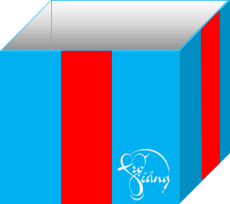
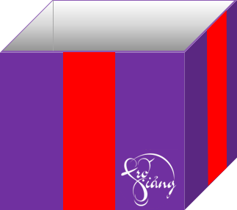
Game
Gift box secret game
keys

Slide 26
2
Choose the correct answer A, B, C, or D (p.20)
1. The sky train is ______ with commuters at rush hour.
A. packed | B. full
C. busy | D. interesting
You are given 2 candies
GO HOME

Slide 27
2
Choose the correct answer A, B, C, or D (p.20)
2. The town’s public amenities make it a ______ place for its residents
A. crowded | B. boring
C. liveable | D. dull
GO HOME
You are given 1 candies

Slide 28
2
Choose the correct answer A, B, C, or D (p.20)
3. It’s not always ______ on the metro. Pickpocketing sometimes takes place.
A. careful | B. dangerous
C. noisy | D. safe
You are given 9 mark
GO HOME

Slide 29
2
Choose the correct answer A, B, C, or D (p.20)
4. It is often more ______ to live in the downtown than in the suburbs.
A. convenient | B. peaceful
C. quiet | D. silent
You are given 5k
GO HOME

Slide 30
2
Choose the correct answer A, B, C, or D (p.20)
5. Hong Kong is like a concrete jungle with so many people in it. It’s a ______ city.
A. calm | B. quiet
C. bustling | D. high
You are given 1 candies
GO HOME

Slide 31
2
Choose the correct answer A, B, C, or D (p.20)
1. The sky train is _______ with commuters at rush hour.
A. packed B. full C. busy D. interesting
2. The town's public amenities make it a _______ place for its residents.
A. crowded B. boring C. liveable D. dull
3. It's not always _______ on the metro. Pickpocketing sometimes takes place.
A. careful B. dangerous C. noisy D. safe
4. It is often more _______ to live in the downtown than in the suburbs.
A. convenient B. peaceful C. quiet D. silent
5. Hong Kong is like a concrete jungle with so many people in it. It's a _______ city.
A. calm B. quiet C. bustling D. high

Slide 32
3
Complete the texts, using the words and phrases from the box. (p.20)
John: City life is great! People can travel by public transport, like buses and the (1) ________. There are good schools and hospitals, and other (2) ____________ such as parks, cinemas, and sports facilities. They make cities (3) __________ places for people.
metro
metro
liveable
public amenities
downtown
liveable
safe
concrete jungles
Jenny: City life is terrible! The (4) _________area is too crowded. Public transport is always packed with people. Some cities are like (5) _________ with so many buildings. Some cities are not (6) _________ because of high crime rates.
downtown
public amenities
tiện ích công cộng
concrete jungles
safe

Slide 33
3
Complete the texts, using the words and phrase from the box. (p.20)
- Who you agree with, John or Jenny, and explain why.
Example answers:
I agree with John. I think that life in the city is great. There are many good public amenities. The public transport system is convenient, too.

Slide 34
Example answers:
I agree with Jenny. City life is terrible. Cities are often too crowded. They don’t have much green space. They are not liveable.

Slide 35
PRONUNCIATION
Review the diphthong sounds.
Listen and repeat:
/aʊ/
/əʊ/
/eə/

Slide 36
PRONUNCIATION
Review the diphthong sounds.
/aʊ/
/əʊ/
/eə/

Slide 38
PRONUNCIATION
4
Put the words in the correct column. Then listen and check.
crowded locate square
outdoor repair airport
council coastal overseas
- Say some words you know that have diphthong sounds /aʊ/, /əʊ/, and /eə/
/aʊ/ | /əʊ/ | /eə/
crowded
locate
repair
outdoor
coastal
square
council
overseas
airport

Slide 39
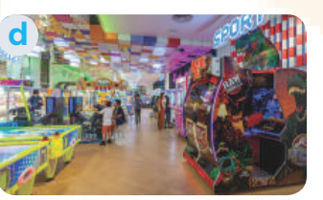
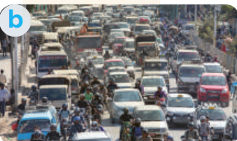
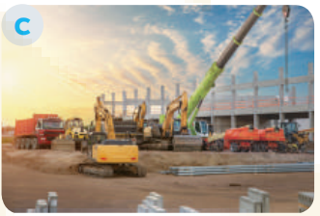
PRONUNCIATION
5
Read the sentences. Circle the words with /aʊ/, underline those with /əʊ/, and put a tick (√) next to those with /eə/. Then listen, check, and practise the sentences.
- Look at the sentences in exercise 5 p.20
- You need to circle the words with /aʊ/, underline those with /əʊ/, and put a tick (√) next to those with /eə/.

Slide 40
PRONUNCIATION
1. They go shopping downtown.
2. The chairman comes from a coastal city.
3. Buses in the old days were not as crowded as they are now.
4. She gets around the city easily thanks to the apps on her phone.
5. I hope we will arrive at the city square in time for the fashion show.
√
√
Now, listen and check.

Slide 41
CONSOLIDATION
What have we learnt in this lesson?
Use the lexical items related to the topic City life;
Pronounce the diphthong sounds /aʊ/, /əʊ/, and /eə/ in words and sentences correctly.

Slide 42
Homework
- Do exercises in the workbook.
- Find 3 more words that have the diphthong sounds /aʊ/, /əʊ/, and /eə/.

Slide 43
Thank you!
Have a nice day!

Slide 44
WARM-UP
OPTION 1
J
B
M
U
E
L
O
R
W
S
D

Slide 45
WARM-UP
OPTION 1
HOW TO PLAY
- There are some JUMBLE WORDS.
- Work in teams to unscramble them.
J
M
B
E
U
L
W
O
R
D
S

Slide 46
WARM-UP
OPTION 1
O | N | C | E | S | E | D | T | G
 |  |  | D | A | R | O
C | O | N | G | E | S | T | E | D
 |  |  | R | O | A | D

Slide 47
WARM-UP
OPTION 1
N | E | R | R | G | N | D | U | O
U | D | E | R | G | R | O | U | N | D

Slide 48
WARM-UP
OPTION 1
c | e | e | h | y | i | t | y
i | t | c | h | y |  | e | y | e

Slide 49
WARM-UP
OPTION 1
o | n | d | t | n | o | w | w
d | o | w | n | t | o | w | n

Slide 50
WARM-UP
OPTION 1
r | f | a | i | f | c | t | m | a | j
t | r | a | f | f | i | c |  | j | a | m

Slide 51
WARM-UP
OPTION 1
O | N | C | T | S | U | C | R | N | O | T | I
 |  |  | I | E | T | S
C | O | N | S | T | R | U | C | T | I | O | N
 |  |  | S | I | T | E

Slide 52
- Work in teams.
- Each team choose 4 members to join the game and stand in a line.
- When you hear a word / phrase, you need to run quickly to the board and write that word/ phrase on the board.
- The team with the most number of correct answers will be the winner.

Slide 53
LET’S PLAY

