Slide 1





WELCOME TO OUR CLASS!
Presented by: ………………………………

Slide 2



GAME: LABELLING

Slide 3
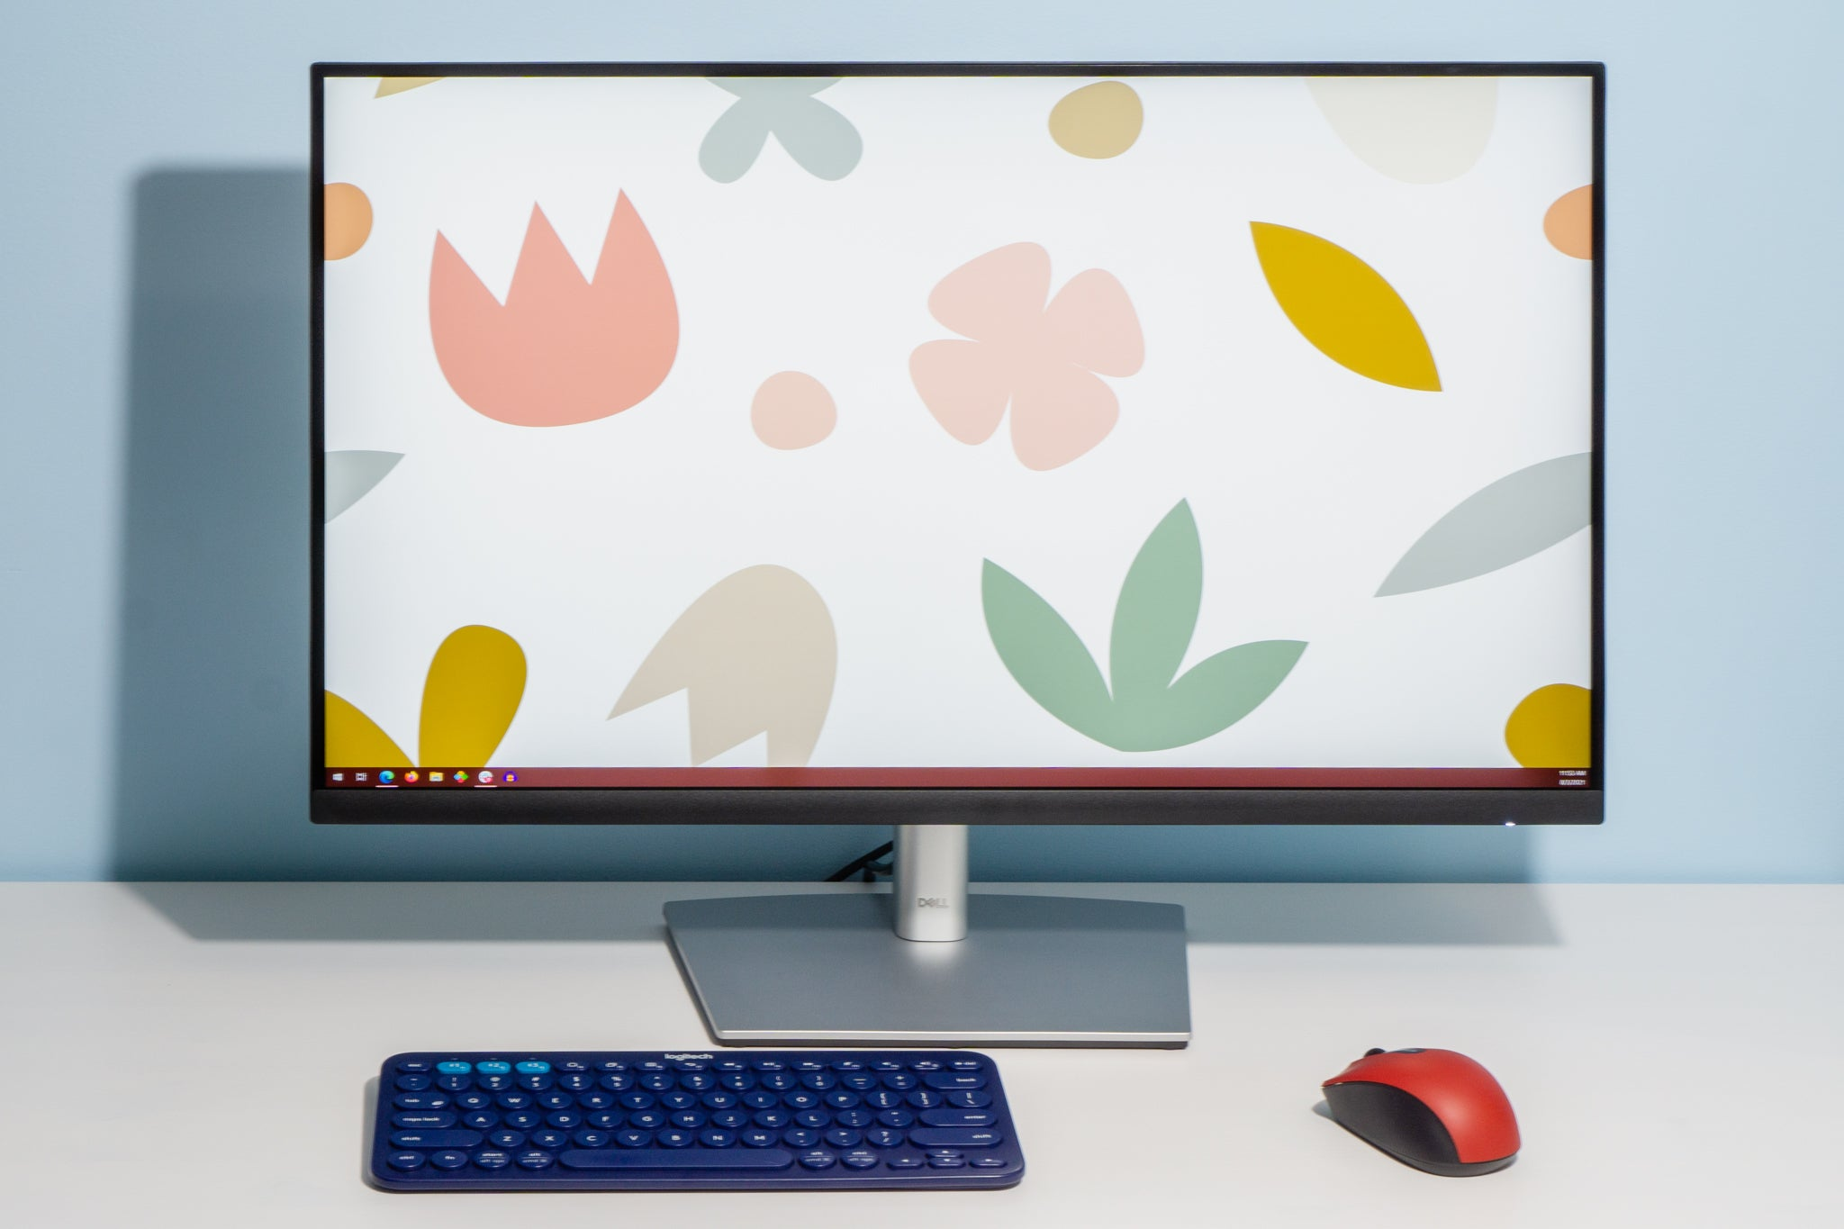


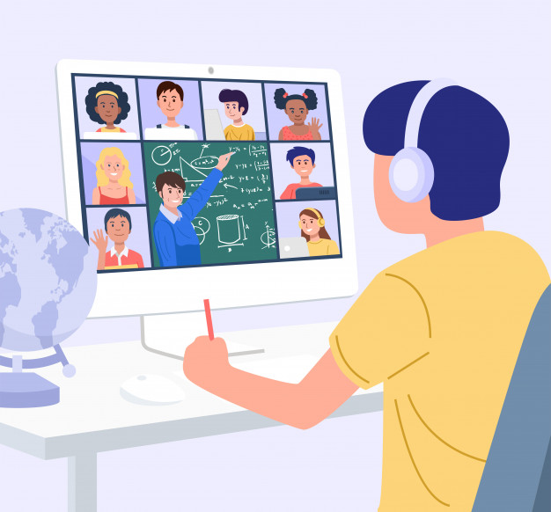
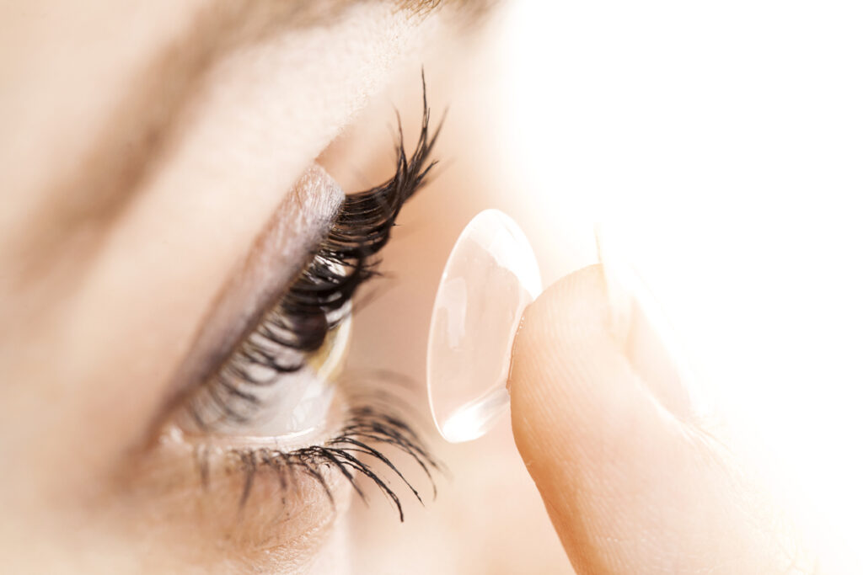
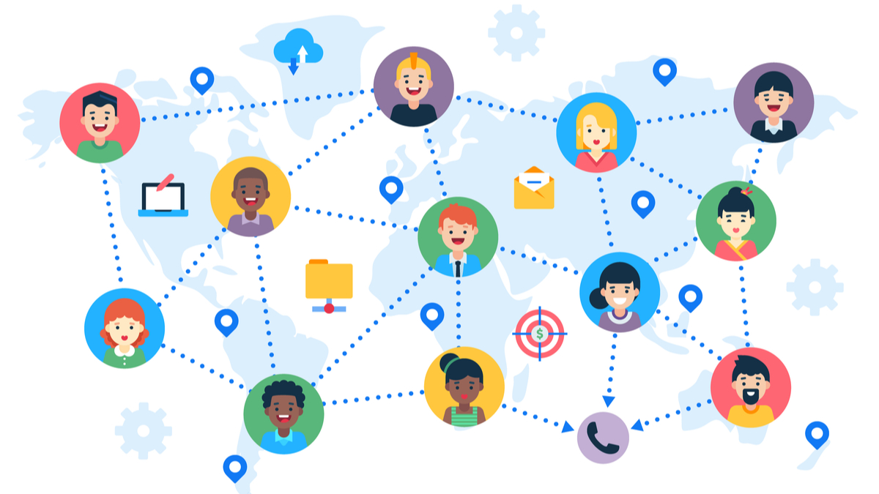

Game: Labelling
computer screen
breakout rooms
robot teacher
online class
3D contact lenses
connection

Slide 4


Unit 11:
SCIENCE AND TECHNOLOGY
Lesson 2: A Closer Look 1

Slide 5
VOCABULARY

Slide 6

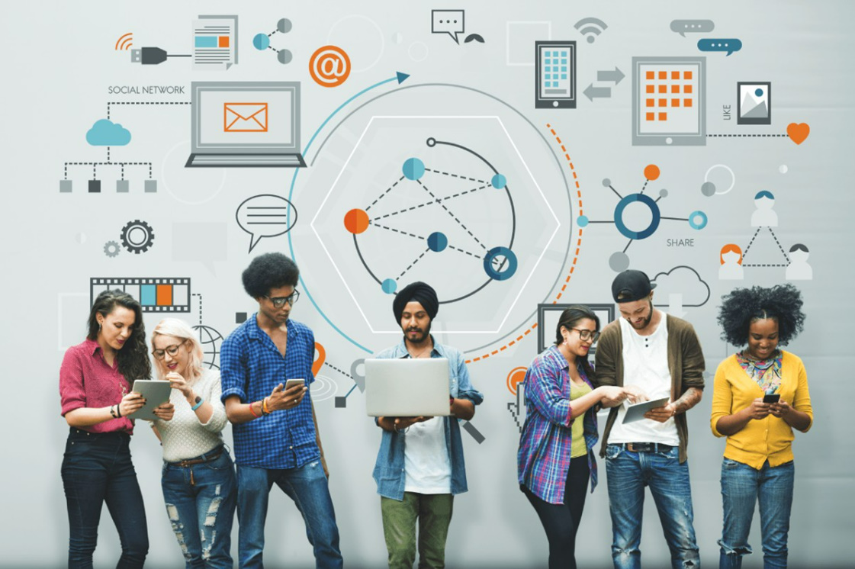
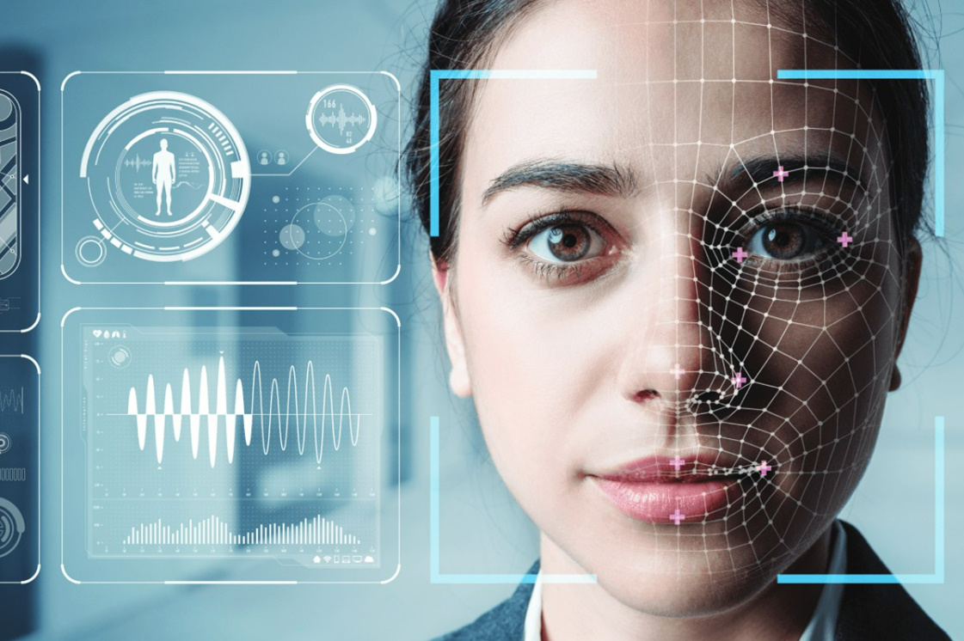
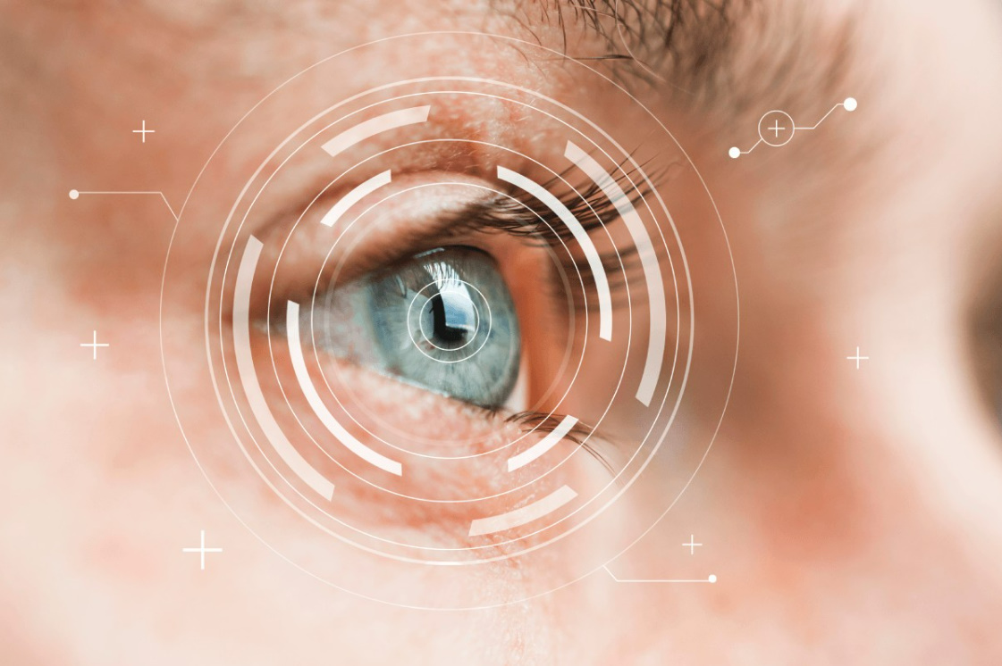
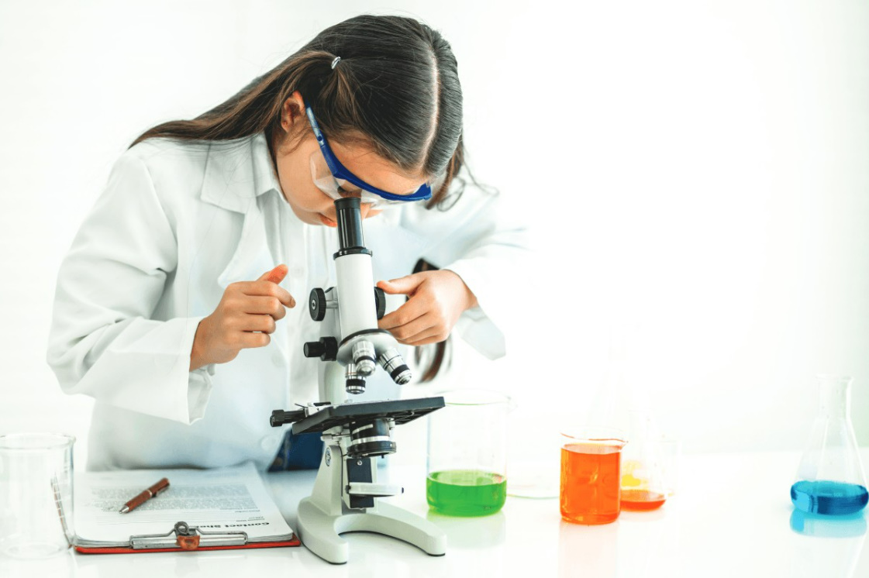
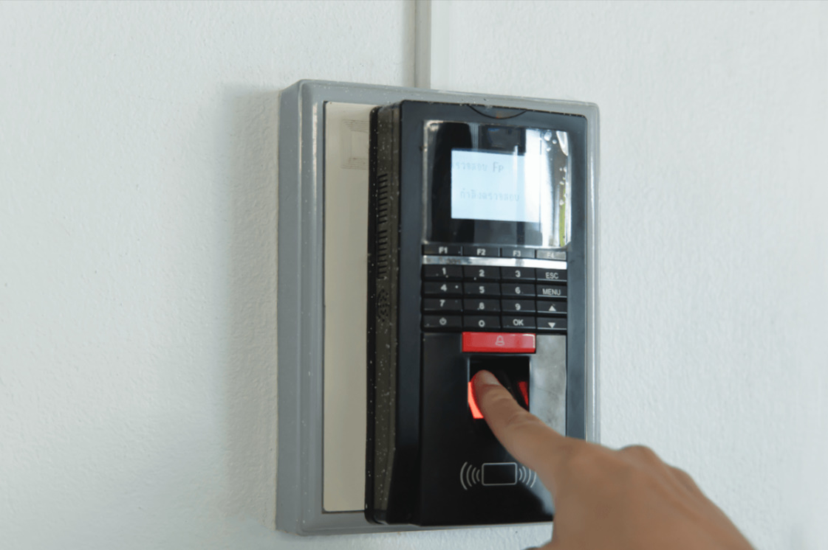

1. Write a word or phrase from the box under each picture
face recognition
experiment
video conference
eye tracking
fingerprint scanner
digital communication
1. ___________________
2. __________________
3. ___________________
4. ___________________
5. ___________________
6. ___________________

Slide 7
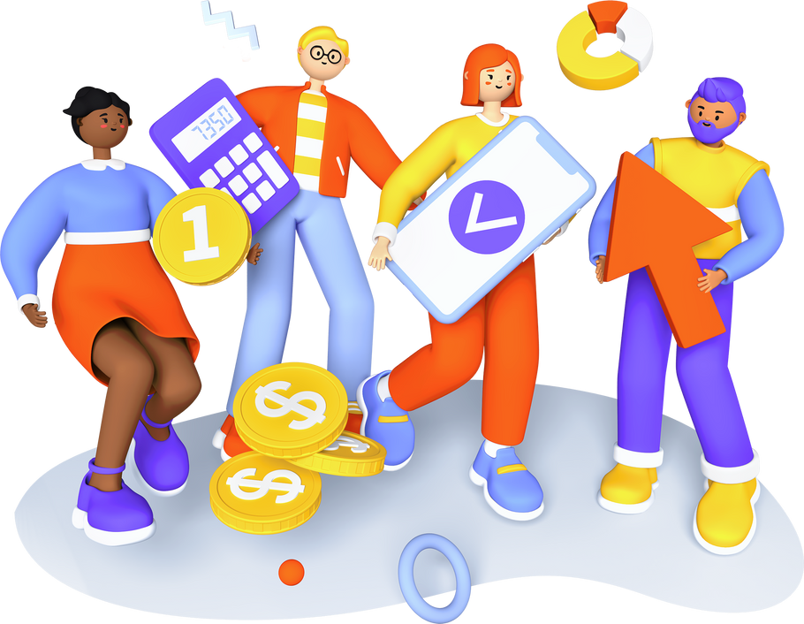
Vocabulary
New words | Pronunciation | Meaning
1. face recognition (n) | /feɪsˌrekəɡˈnɪʃn/ | Công nghệ nhận diện/nhận biết gương mặt
2. experiment (n) | /ɪkˈsperɪmənt/ | Thí nghiệm
3. eye tracking (n) | /’ai ,trækɪŋ/ | Công nghệ dõi (cử động) mắt
4. fingerprint scanner(n) | /ˈfɪŋɡəprɪnt ˈskænə(r)/ | Máy quét vân tay
5. digital communication (n) | /ˈdɪdʒɪtl /kəˌmjuːnɪˈkeɪʃn/ | Giao tiếp kỹ thuật số

Slide 8
2. Choose the option that best completes each phrase
A. a device
1.
invent
B. a new area
A. a chemical element
discover
2.
B. a technology
A. the weather
3.
create
B. a medicine
develop
A. a planet
4.
B. a technology

Slide 9
Look at the answers again
1 - A: invent a device: sáng chế ra một thiết bị
2 - A: discover a chemical element: khám phá ra một nguyên tố hóa học mới
3 - B: create a medicine: tạo ra thuốc
4 - B: develop a technology: phát triển một công nghệ

Slide 10
3. Complete the sentences with the words and phrases from the box
invented
created
experiments
discovered
fingerprint scanner
Marie Curie and Pierre Curie _____________ radium and polonium.
Thomas Edison __________ the light bulb in 1880.
Sarah Gilbert is the creator of a vaccine. She _________ it in 2020.
Scientists have carried out many _____________ to find a cure for cancer.
Scan your finger on this _________________to check attendance, please.

Slide 11
PRONUNCIATION
Sentence stress

Slide 12

Listen and stress
How important is science to students?
Will you use your computer to learn?
Did he buy a new smartphone yesterday?
- No, he didn’t.
How important is science to students?
Will you use your computer to learn?
Did he buy a new smartphone yesterday?
- No, he didn’t.

Slide 13
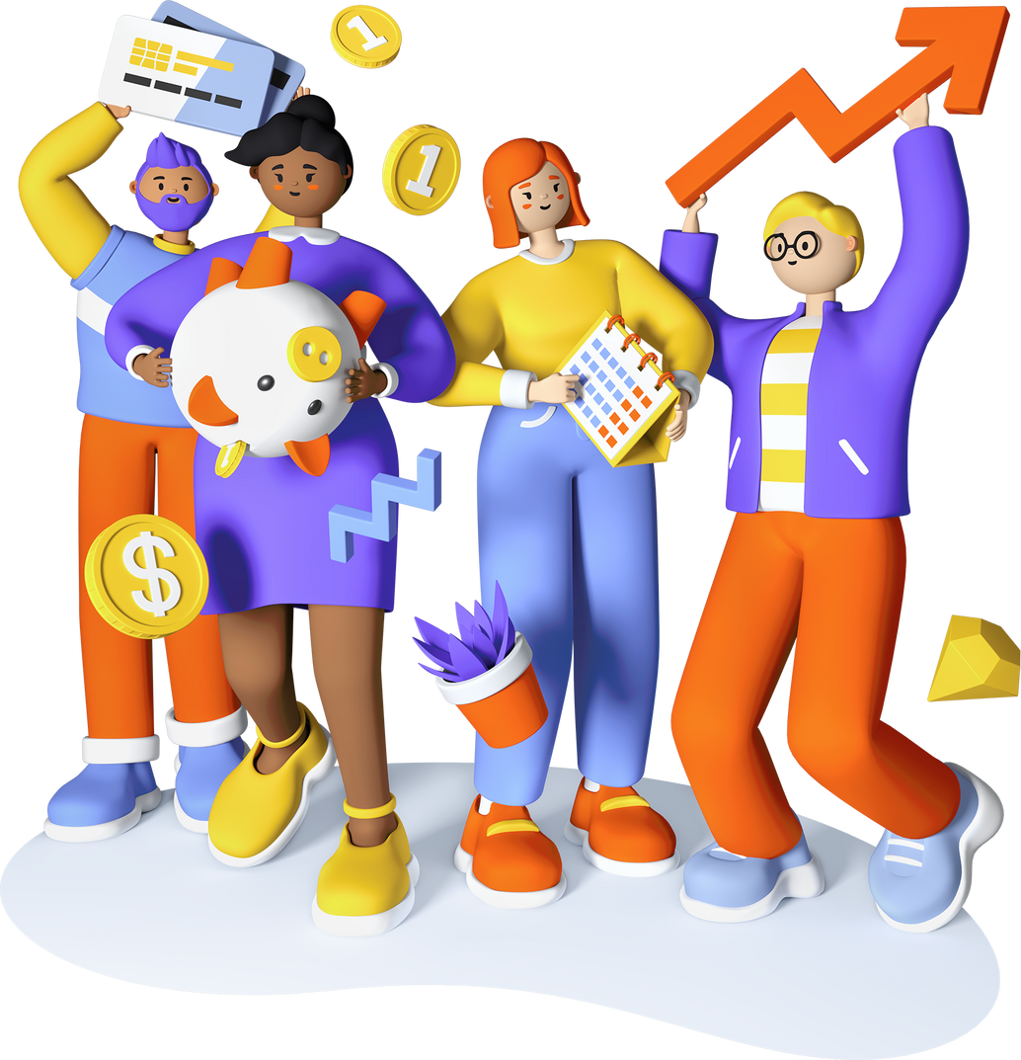
SENTENCE STRESS
Remember!
Sentence have stressed and unstressed words. We usually stress nouns, main verbs, adjectives, adverbs, negative auxiliaries, and question words.
We normally stress the words Yes and No as well as auxiliary verbs in short answers.

Slide 14
4. Listen and repeat the sentences. Pay attention to the bold syllables.
1. I don’t have a computer.
2. Do you call her every day? – No, I don’t.
3. They are not familiar with that new computer.
4. Did you lend her your laptop? – Yes, I did.
5. Who do you work with on Sundays?

Slide 15
5. Listen and repeat the sentences. How many stressed words are there in each sentence.
1. He is an inventor.
2. We won’t have a robot teacher next year.
3. She likes learning online.
4. Was she checking attendance when you came? - No, she wasn’t.
5. What did he invent?
1. He is an inventor.
2. We won’t have a robot teacher next year.
3. She likes learning online.
4. Was she checking attendance when you came? - No, she wasn’t.
5. What did he invent?

Slide 16



What have we learnt in this lesson?
Words and phrases related to new technologies
New verb phrases that are used to talk about inventions, discoveries, creation, and development
Sentence stress

Slide 17



Learn by heart vocabulary
HOMEWORK
Do exercises in the workbook
Prepare for the next lesson

Slide 18


THANK YOU!

