Slide 1
Unit 15:
AT THE DINING TABLE
LESSON 2.2

Slide 2
WARM UP

Slide 4
REVIEW
01

Slide 5
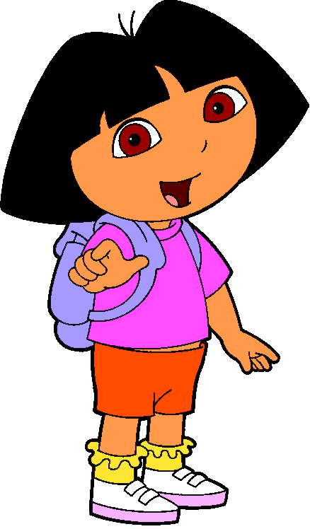
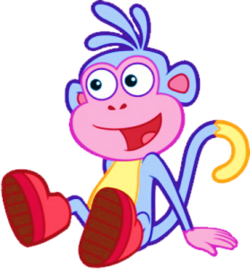

Slide 6
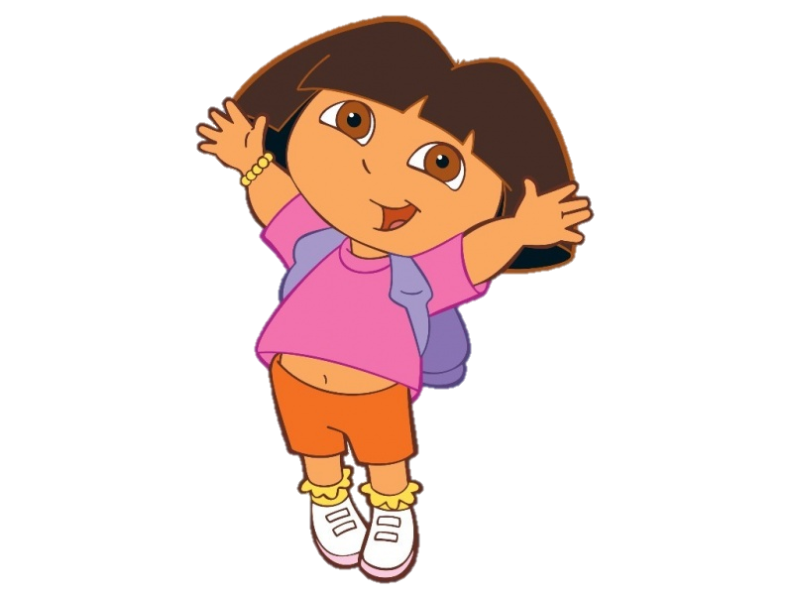
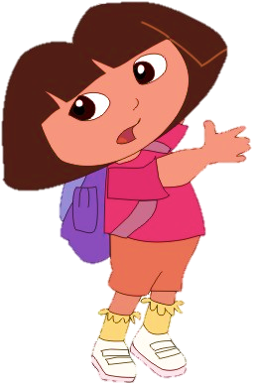
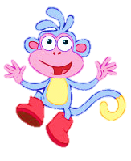
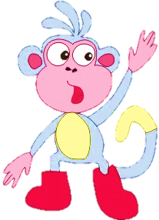
NEXT
What would you like to eat?
I'd like some.....,please.
We did it!
milk
egg
chicken

Slide 7
NEXT
What would you like to eat?
We did it!
I'd like some egg.
I'd like some water

Slide 8
NEXT
We did it!
I'd like some bread,please.
I'd like some meat, please.

Slide 9
I'd like some.....
NEXT
We did it!
milk
water
juice

Slide 10
NEXT
We did it!

Slide 11
Reorder
would/you/ to/What/ drink?/like
NEXT
We did it!
Would you like to drink what?
What would you like to drink?

Slide 12
NEXT
like/please/ I'd/egg./some
We did it!
I'd like some egg, please.
I'd like please some egg.

Slide 13
I'd like some bread.
NEXT
We did it!

Slide 14
NEXT
I'd= ?
We did it!
I want
I would
I like

Slide 16
LISTEN & READ
02

Slide 17
3
4
1
2

Slide 18
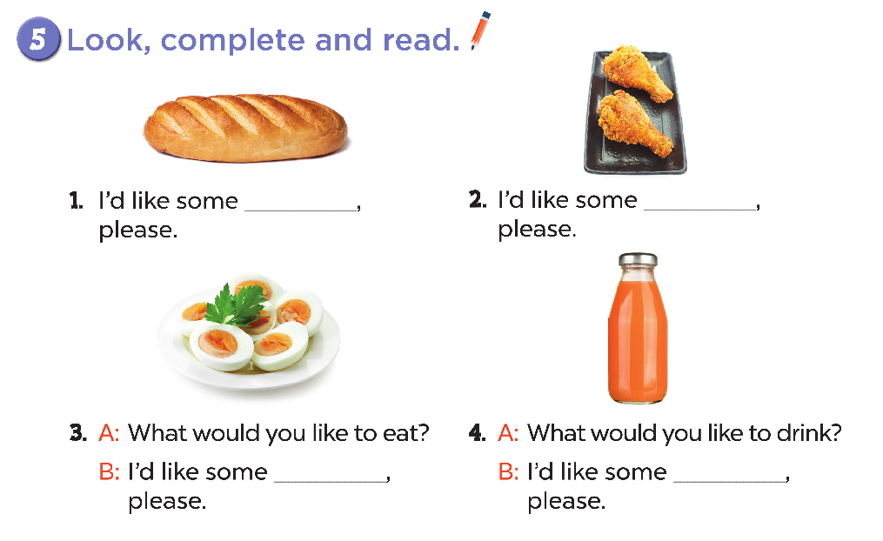
bread
chicken
egg
juice

Slide 19
ACTIVITY
03

Slide 21
BYE BYE!!!

