Slide 1
Unit 15: AT THE DINING TABLE
LESSON 1.2

Slide 2
WARM UP

Slide 4
REVIEW

Slide 5
DIRECTIONS
PLAY

Slide 6
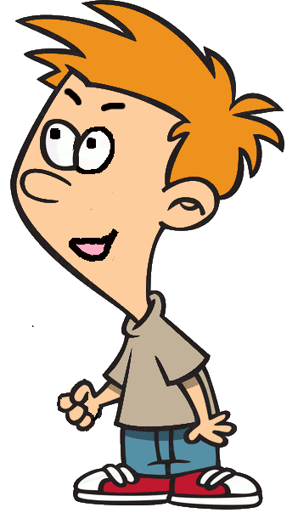
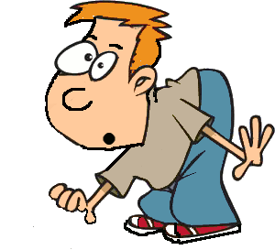
Would you like some.....?
juice
?
>
STOP

Slide 7
Listen and say
meat
?
>
STOP

Slide 8
Look and guess
bean
?
>
STOP

Slide 9
Look and guess
Yes, please.
?
>
STOP

Slide 10
Uncreamble : i-r-c-e
rice
?
>
STOP

Slide 11
Listen and choose?
Q:Would you like some fish?
A: ?
Yes, please.
?
>
STOP

Slide 12
Look and choose?
Q:Would you like some meat?
A: ?
No, thanks
?
>
STOP

Slide 13
Say the question?
Q: ?
A: No, thanks.
Would you like some rice?
?
>
STOP

Slide 15
ACTIVITY

Slide 17
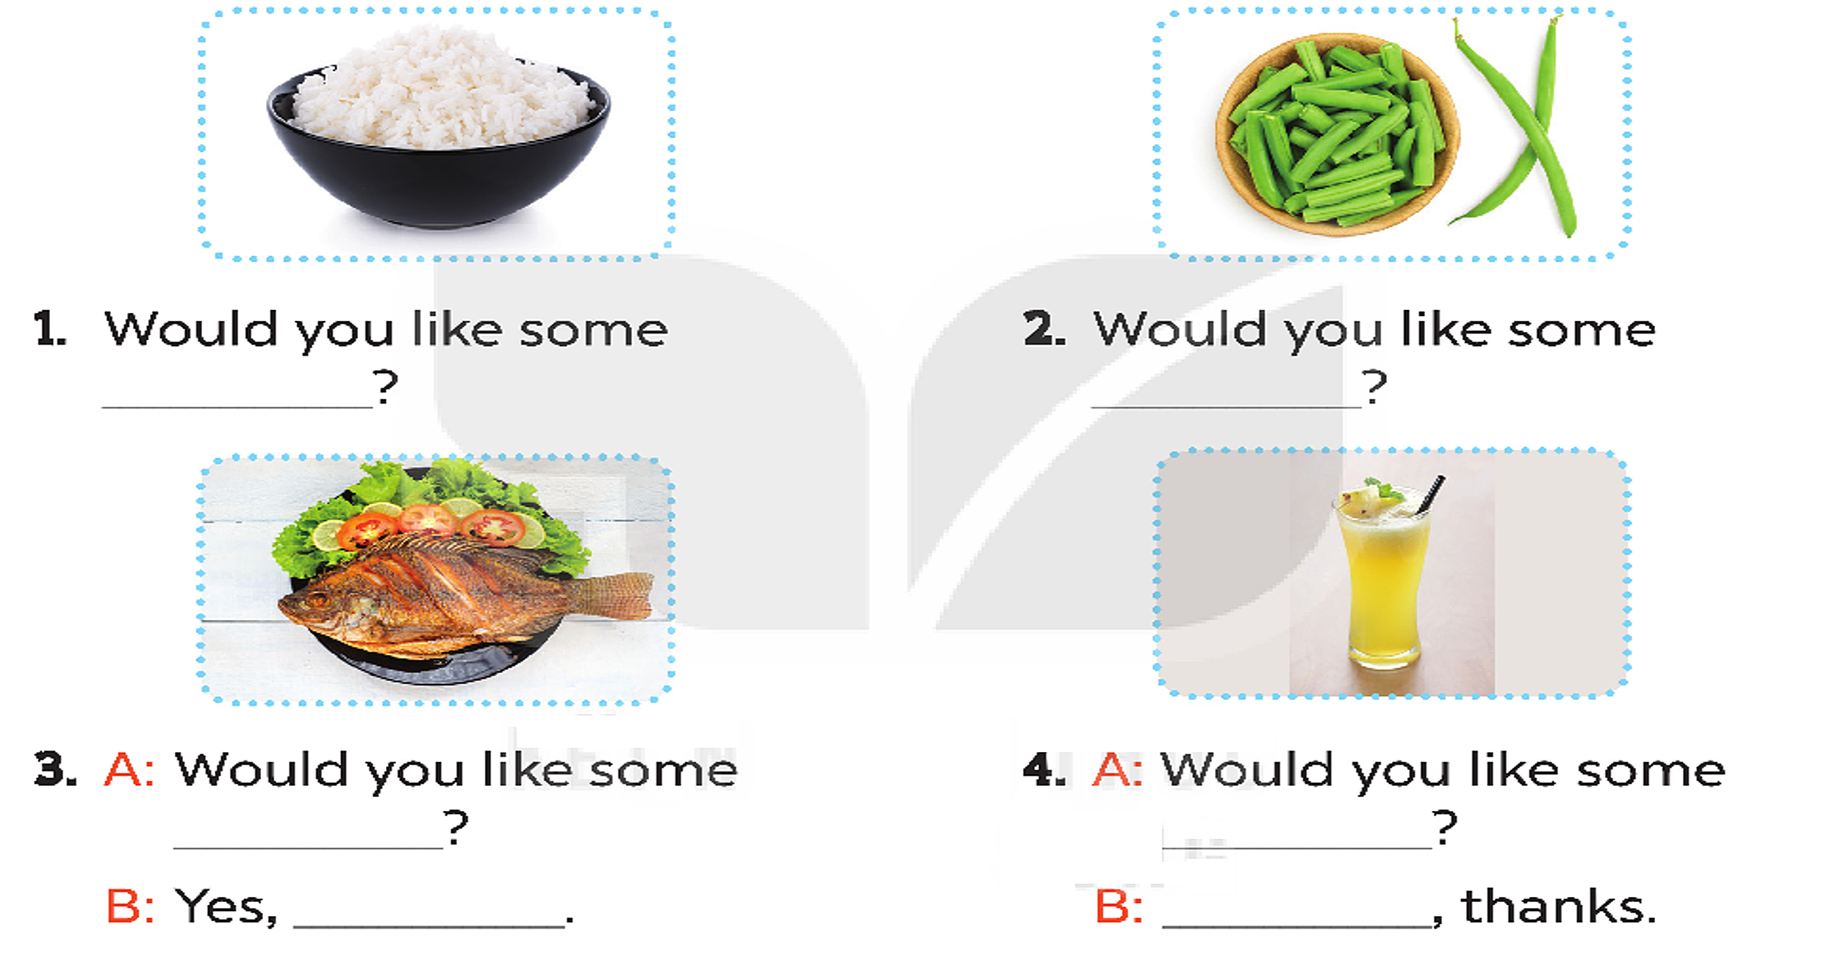
rice
bean
fish
juice
please
No

Slide 18
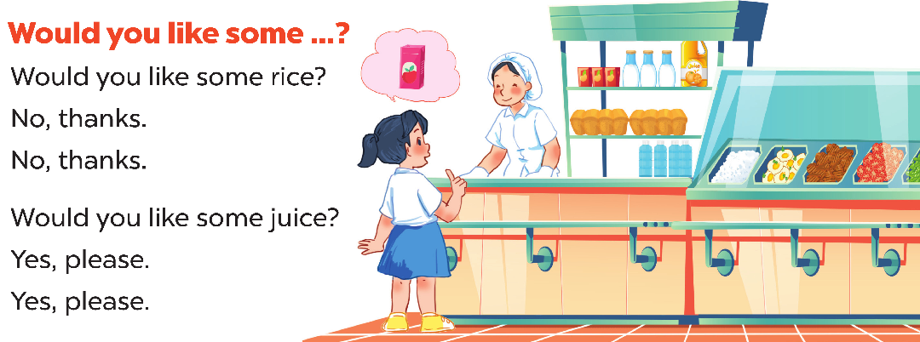

Slide 19
BYE BYE!!!

