Slide 1
Unit 14:
MY BEDROOM
HELLO!
N
LESSON 3.2

Slide 2
WARM UP!

Slide 3


Slide 4
01
REVIEW

Slide 5








Sun Flowers

Slide 6


The ......is new
C
A
B
desk
door
window

Slide 7
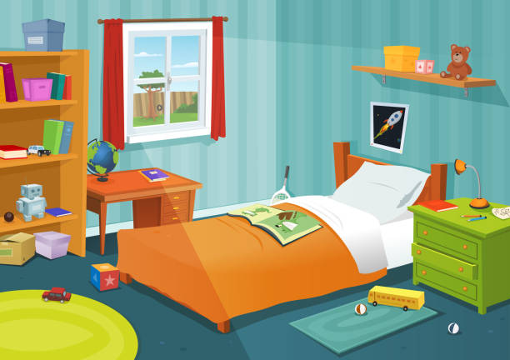
...... a bed in the bedroom.
A
B
There are
There is

Slide 8
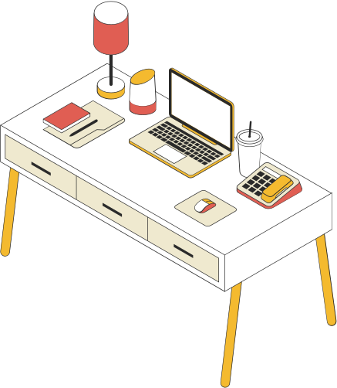
C
A
B
table
door
desk

Slide 9
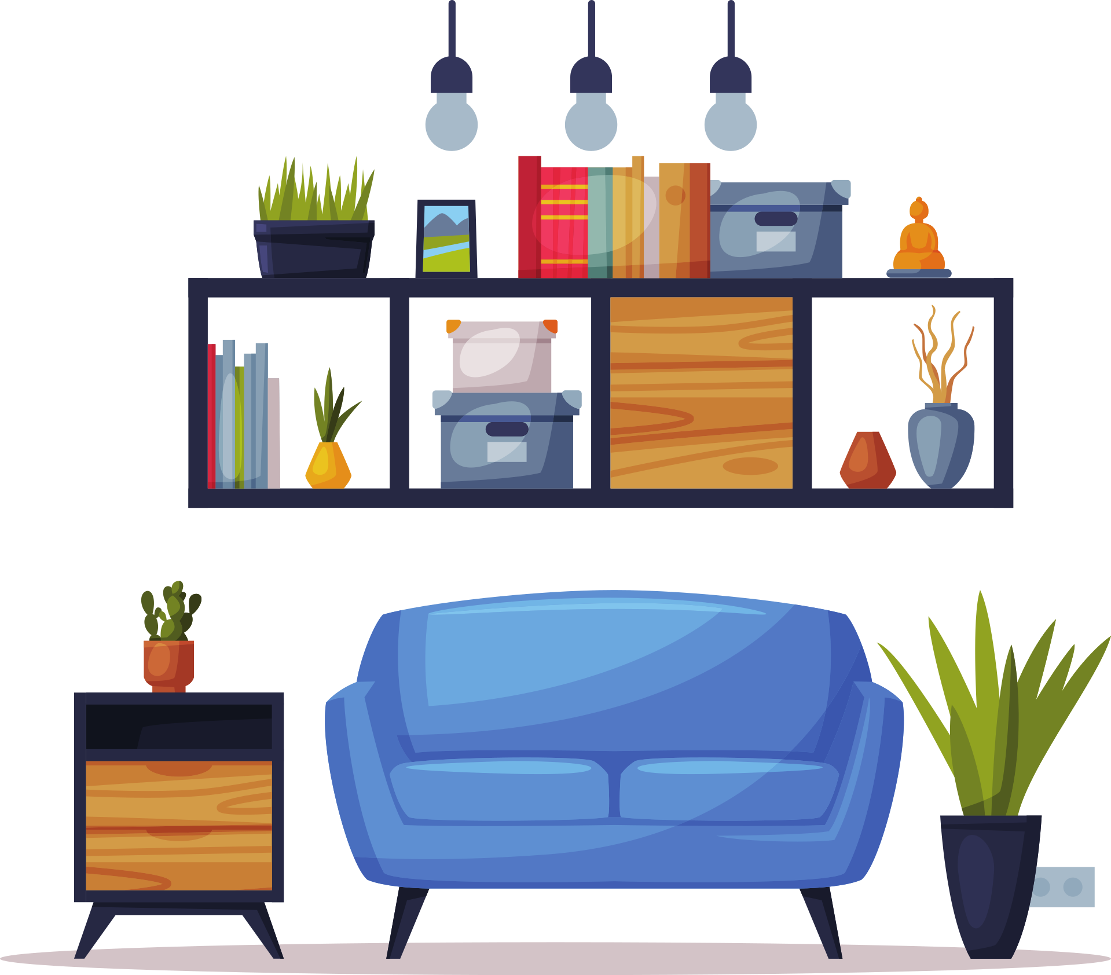
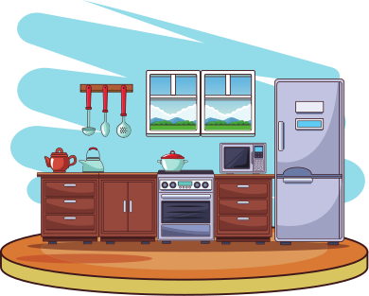
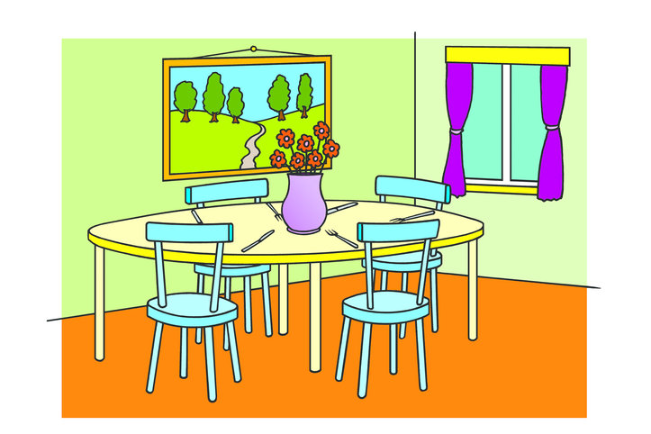
There are 4 chairs in the kitchen.
A
B
C

Slide 10
A
B
C
There is two desks in the room.
There are two desks in the room.
There is one desk in the room.

Slide 11



It's old.
A
B
C

Slide 12
A
B
C
The door is small.
The window is small.
The window is big.

Slide 13
N-I-W-D-W-O
A
B
C
WINOWD
WOWDIN
WINDOW

Slide 14
There are ......... in the bedroom.
A
B
C
4 chairs
2 lamps
3 books

Slide 15
The door is ......
A
B
C
big
small
new

Slide 16
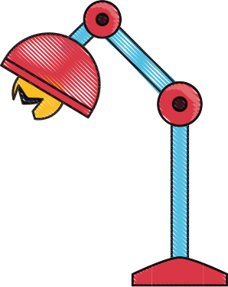
Choose the best answer.
C
A
B

Slide 17



Slide 18
02
READ & WRITE
N

Slide 19

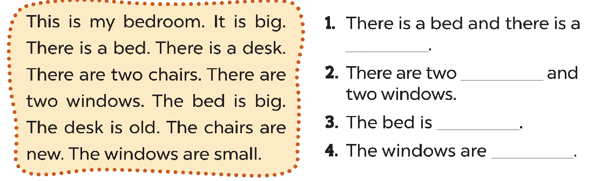
desk
chairs
big
small

Slide 20

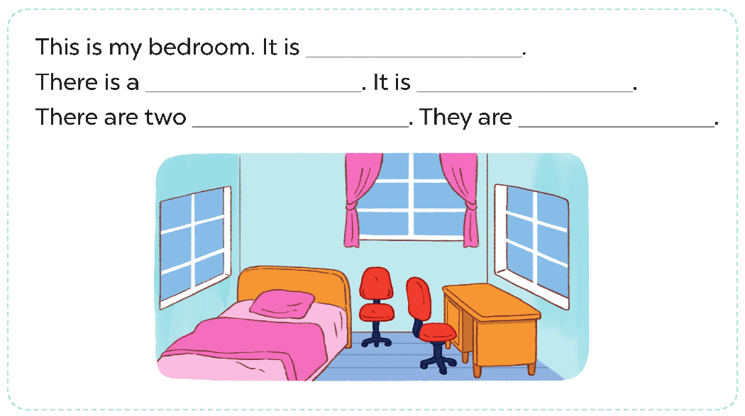

Slide 21
ACTIVITY
03
N

Slide 22

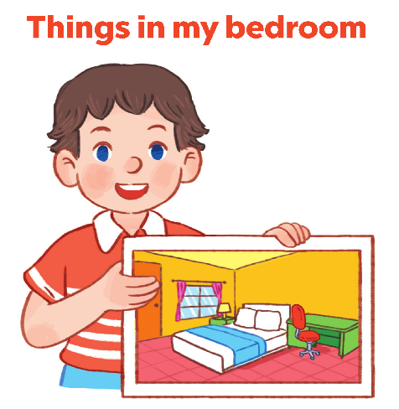

Slide 23

GOOD BYE !

