Slide 1
Unit 14:
MY BEDROOM
HELLO!
N
LESSON 3.1

Slide 2
WARM UP!

Slide 3


Slide 4
01
PHONICS SONG

Slide 5


Slide 6



Slide 7
02
REVIEW
N

Slide 8







0.1
Words

Slide 9



1/13
A. boot
B. cook
C. book
GREAT!
NEXT
What’s this?

Slide 10

2/13
A. door
B. book
C. foot
GREAT!
NEXT
What’s this?

Slide 11

3/13
A. moon
B. spoon
C. room
GREAT!
NEXT
What’s this?

Slide 12

4/13
A.moon
B. spoon
C. cook
GREAT!
NEXT
What’s this?

Slide 13

5/13
moon
baloon
foot
GREAT!
NEXT
What’s this?

Slide 14

Click on the right article
6/13
A. cook
B. book
C. look
GREAT!
NEXT
What’s this?

Slide 15

Click on the right article
7/13
cook
look
foot
GREAT!
NEXT
What’s this?

Slide 16


Slide 17
ACTIVITY
03
N

Slide 18



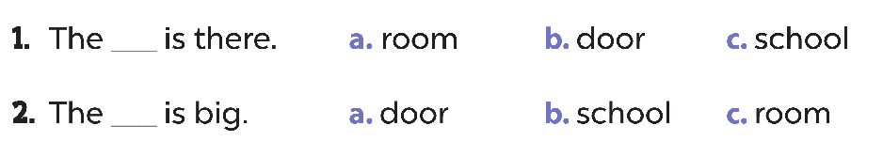
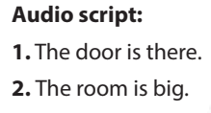

Slide 19

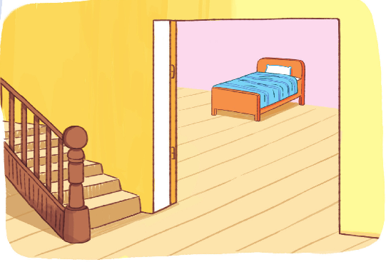
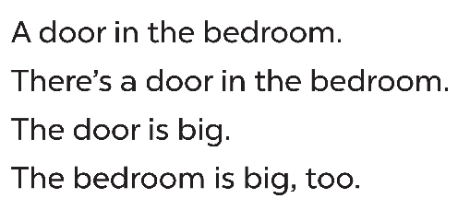
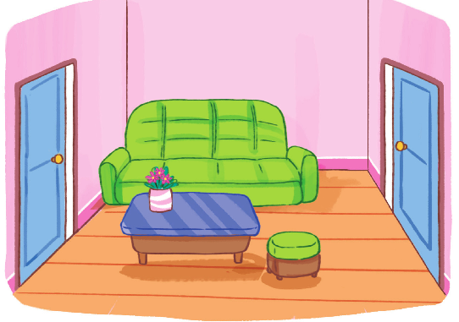
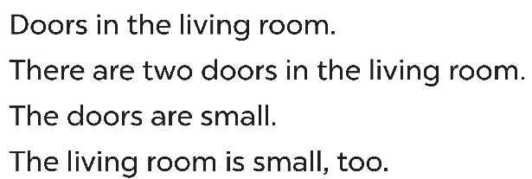

Slide 20

GOOD BYE !

