Slide 1
Unit 14: MY BEDROOM
HELLO!
LESSON 1.2

Slide 2
Table of contents
01
03
Vocabulary
Activity
02
Sentence
Jo-hn

Slide 3
Warm Up!
Dia-na

Slide 5
01
Review

Slide 6
Time’s up
1
2
3
4
5
6
7
8
9
10
next
A. two windows
B. two door
C. two doors
A.

Slide 7
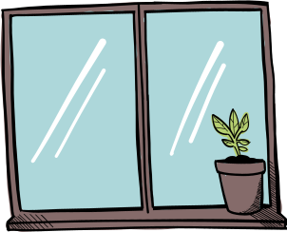
Time’s up
1
2
3
4
5
6
7
8
9
10
.....IN......OW
Next
A. W/W
B. D/W
C. W/D
A.

Slide 8
Time’s up
1
2
3
4
5
6
7
8
9
10
Next
A.

Slide 9
Time’s up
1
2
3
4
5
6
7
8
9
10
are/ There/ windows/ two/ the/ room./in
next
A.Are there two windows in the room.
B. There are two windows in the room.
There are in the room two windows.
A.

Slide 10
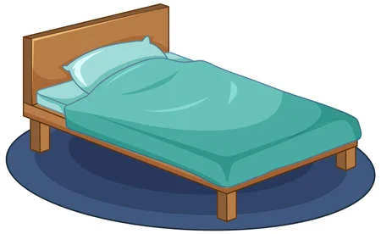
Time’s up
1
2
3
4
5
6
7
8
9
10
next
A. window
B. desk
C. bed
A.

Slide 11
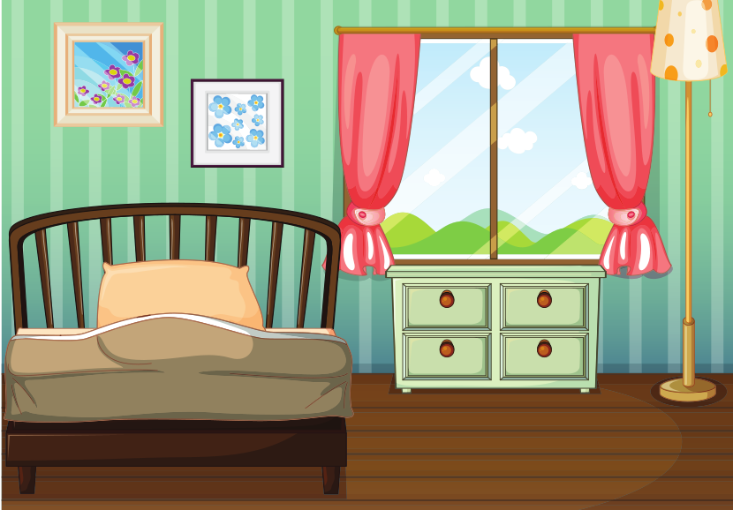
Time’s up
1
2
3
4
5
6
7
8
9
10
next
A.
B.
C.
A.

Slide 12
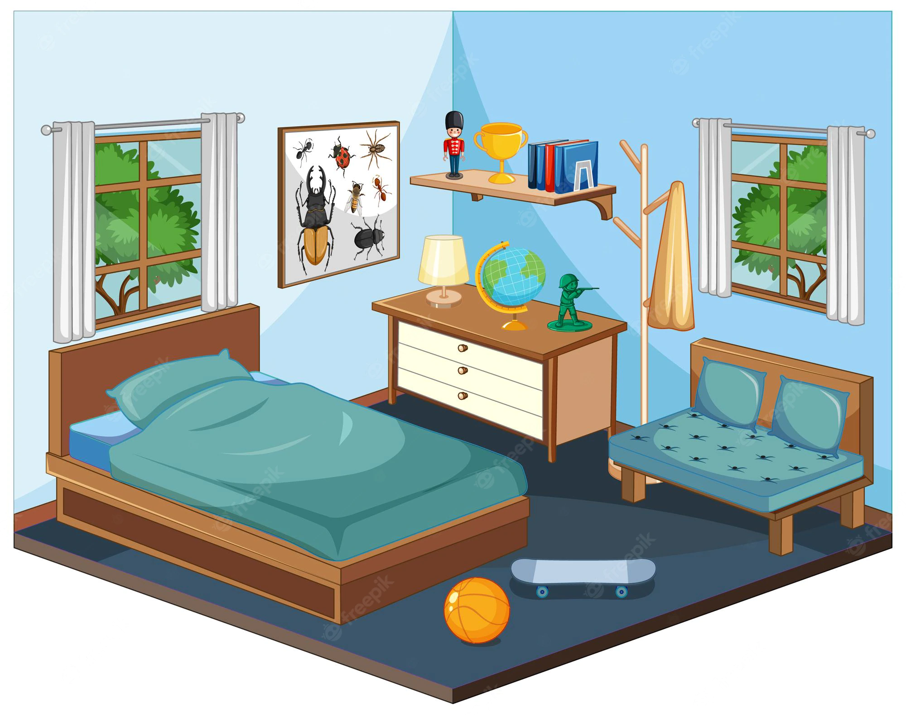
Time’s up
1
2
3
4
5
6
7
8
9
10
C. There's a door.
next
A. There are 2 desks.
B. There are 2 windows.
A.

Slide 13
Time’s up
1
2
3
4
5
6
7
8
9
10
next
A. There's a chair in the room.
B. There's a lamp in the room.
C. There's a door in the room.
A.

Slide 14
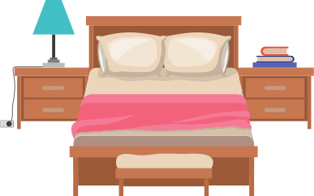
Time’s up
1
2
3
4
5
6
7
8
9
10
END
A. There's a chair in the room.
B. There's a lamp in the room.
C. There's a desk in the room.
A.

Slide 16
02
Listen & Read

Slide 17
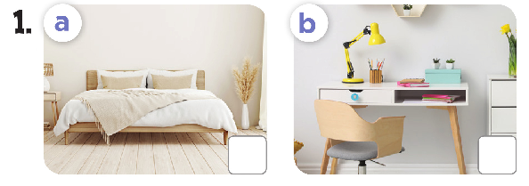
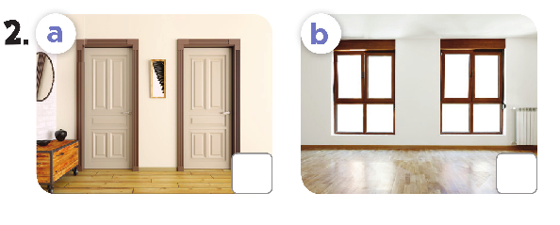

Slide 18
bed
a desk

Slide 19
two windows
lamps

Slide 20
03
Activity

Slide 21
