Slide 1
Unit 14:
MY BEDROOM
HELLO!
LESSON 1.1

Slide 2
Table of contents
01
03
Vocabulary
Activity
02
Sentence
Jo-hn

Slide 3
Warm Up!
Dia-na

Slide 4


Slide 5
01
Vocabulary

Slide 6
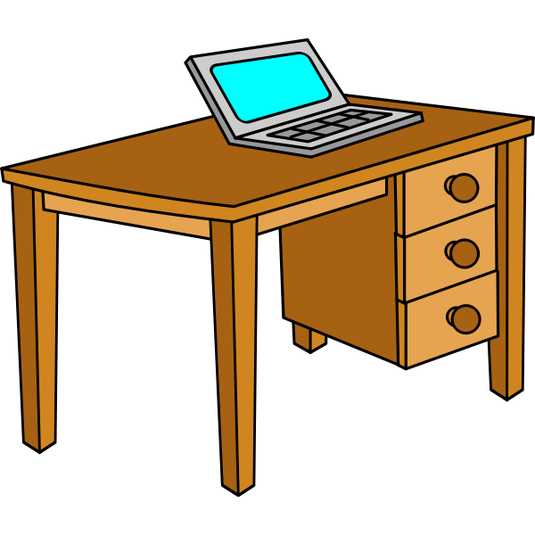

desk

Slide 7
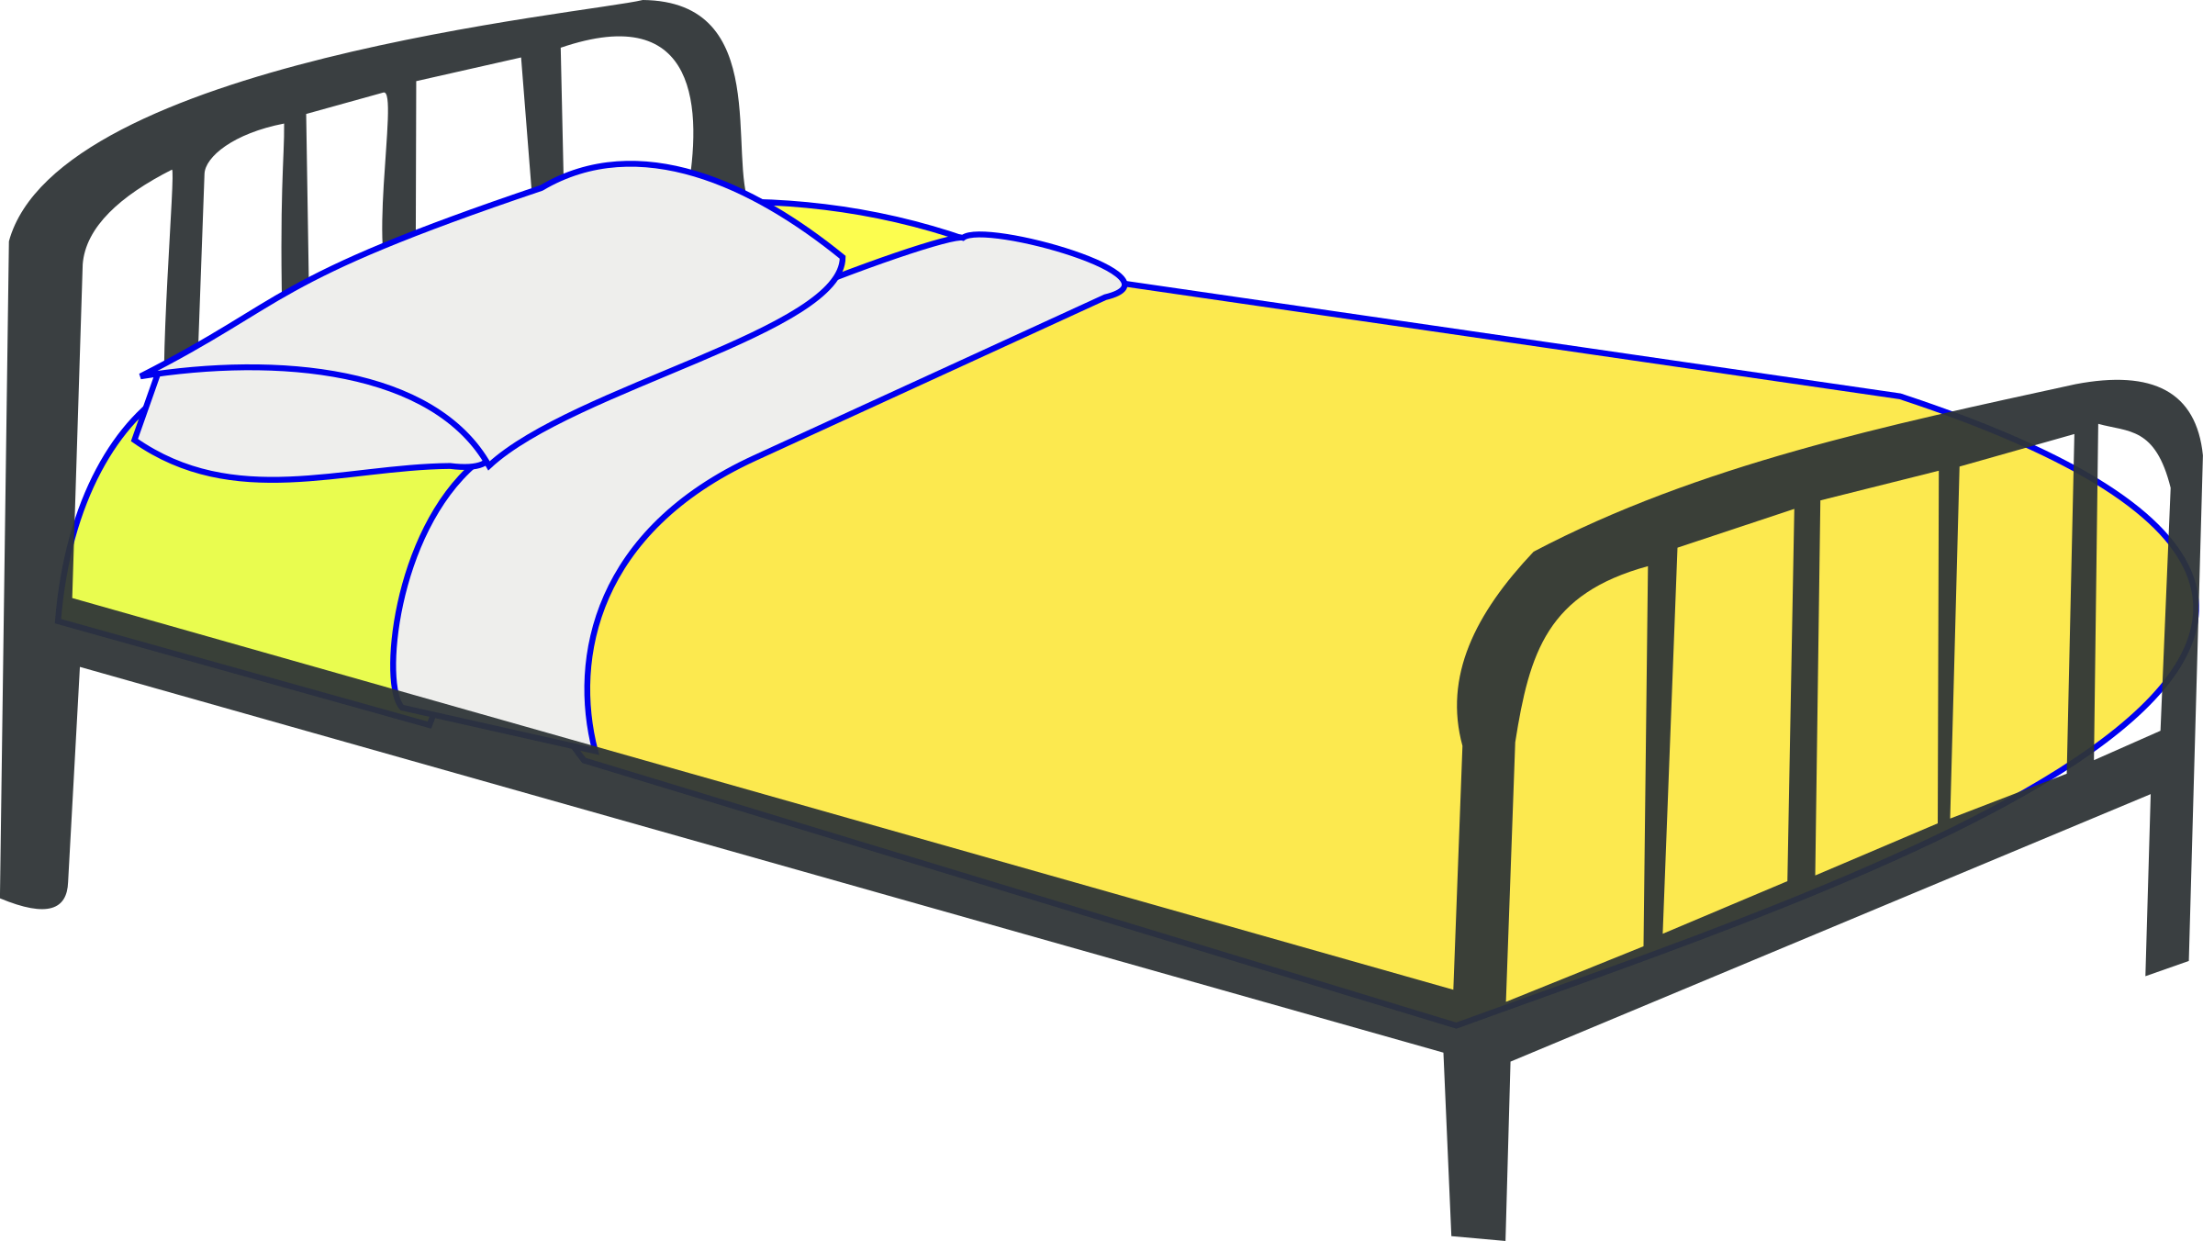
bed

Slide 8

door

Slide 9
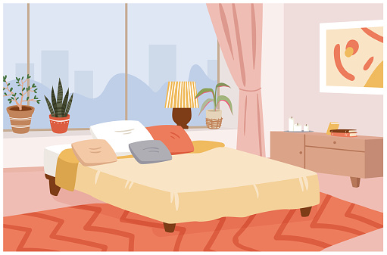
room

Slide 10

window

Slide 11







LITTLE BIRDS

Slide 12


6
5
4
3
2
1

Slide 13



Slide 14

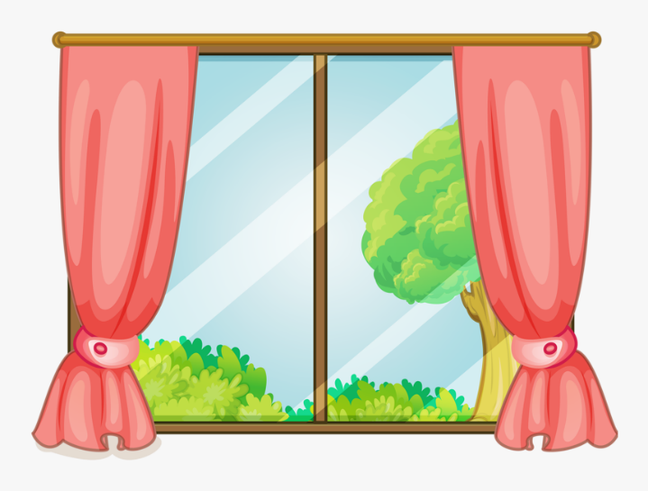




Look and choose
window
lamp
door
bed

Slide 15
Listen and choose
one window
two windows
one windows
two window

Slide 16
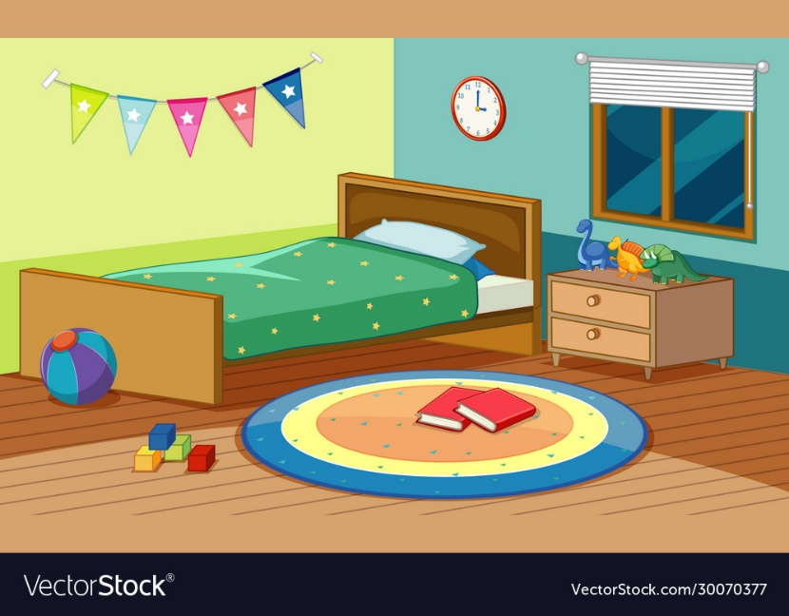
Look and choose
one door
two beds
two windows
one bed

Slide 17

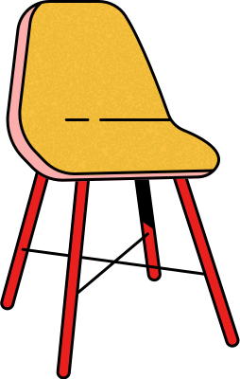


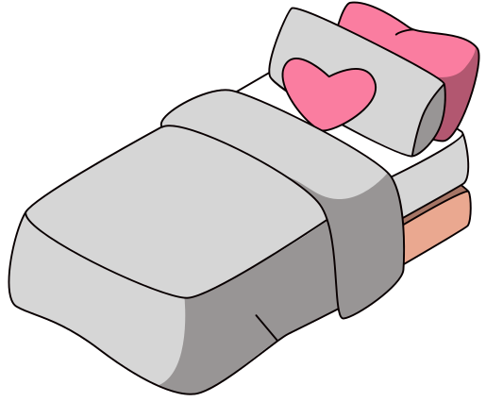
Listen and choose.

Slide 18
Unscramble S-D-E-K
desk
kesd
dsek
dkes

Slide 19
Look and fill. _OOR
D
F
R
T

Slide 20
WELL DONE!!!

Slide 21
02
Sentence

Slide 22



There's + Noun( singular) in the room.
There‘re + Noun( plural) in the room.

Slide 23
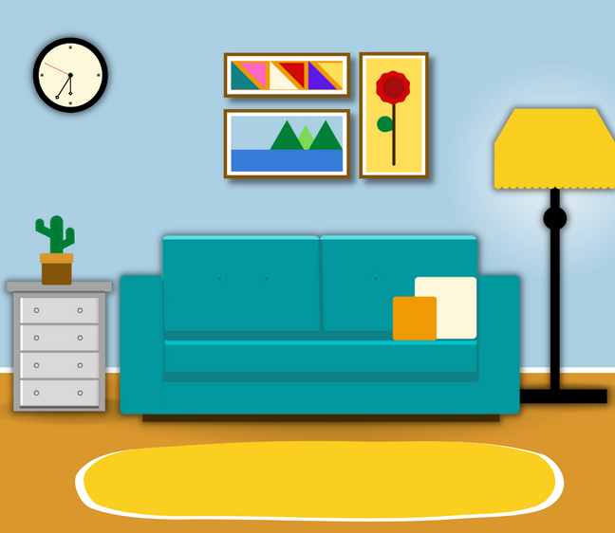
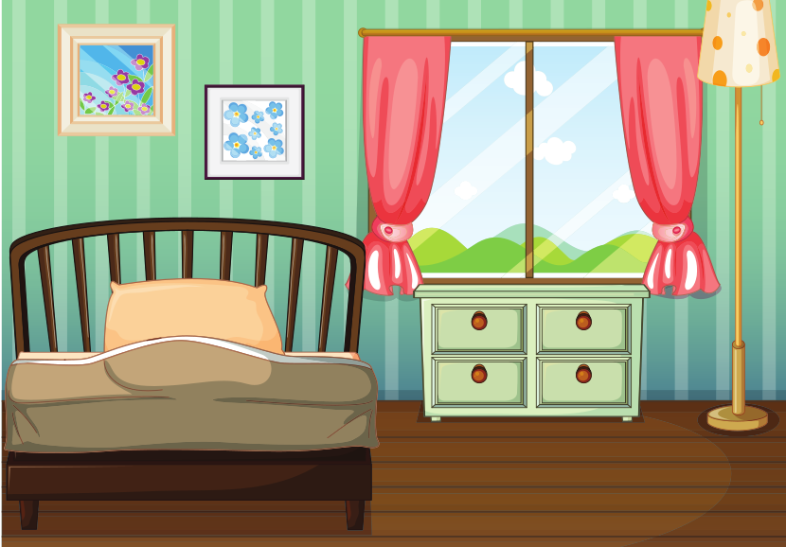
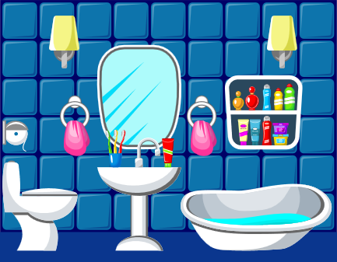
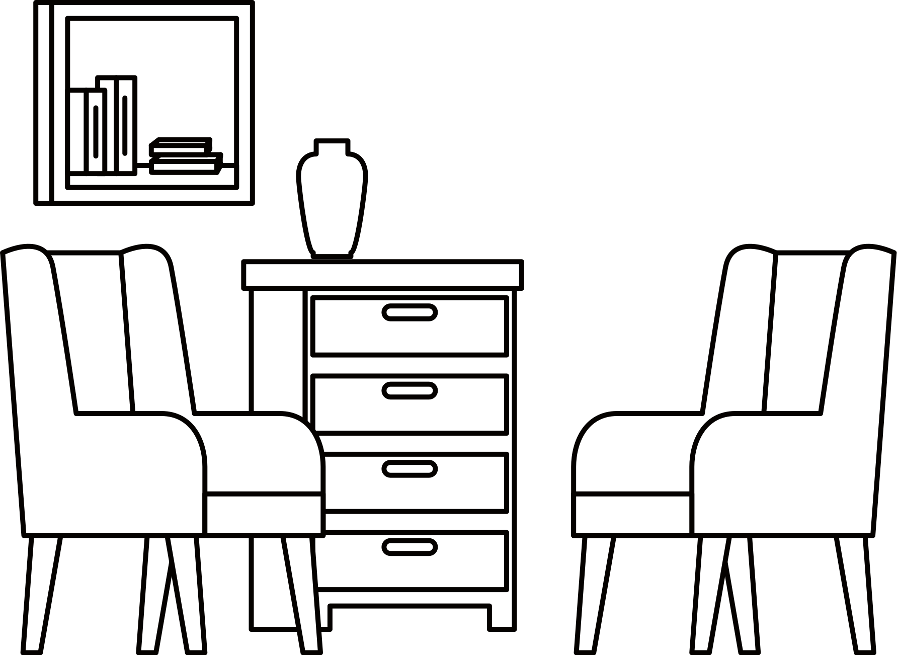
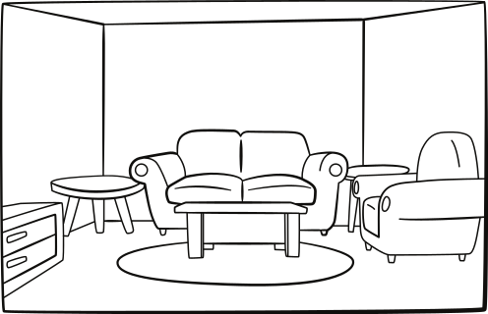



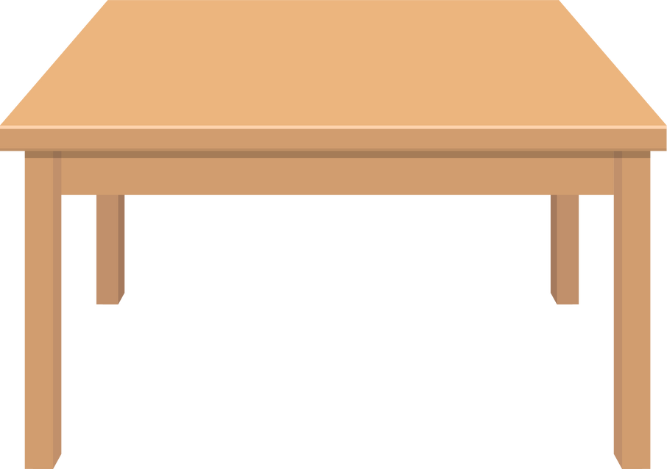
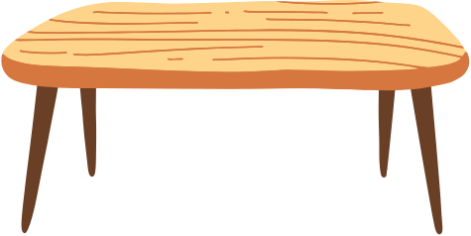
There's a lamp in the room.
There are 2 lamps in the room.

Slide 24





PLAY

Slide 25
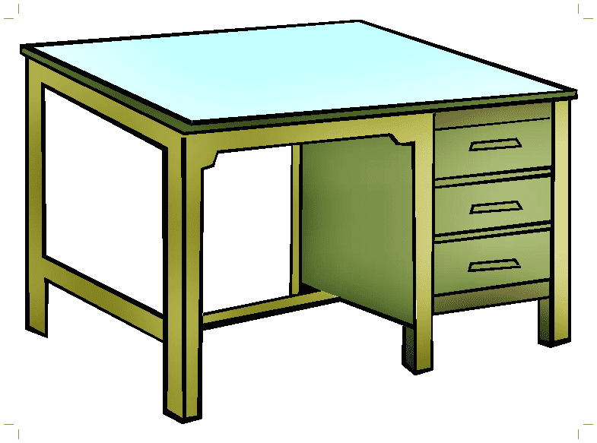




There ....... a desk in the room.
aren't
are
isn’t
is

Slide 26

a/in/There's/ room/window/the
There's a window in the room.
There's the window in a room.

Slide 27
There're ...... in the room.
a chair
three chairs
two chairs
four chairs

Slide 28
.......a lamp in the room.
There're
These
There's
These are

Slide 29

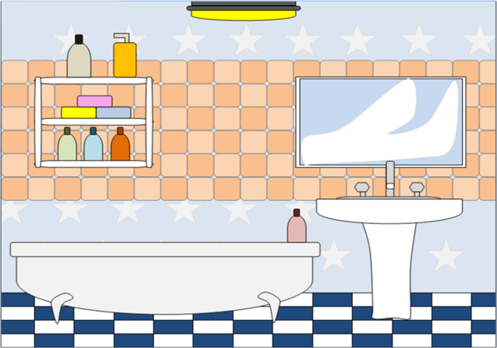
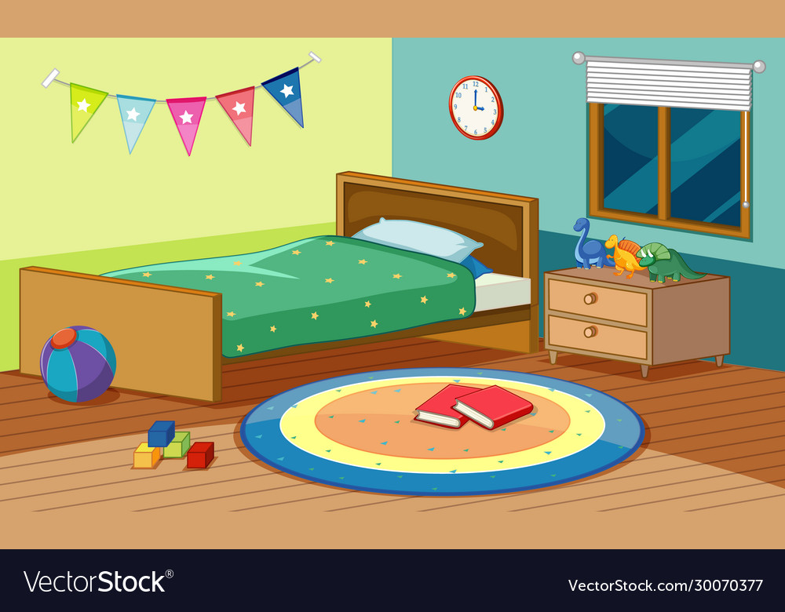
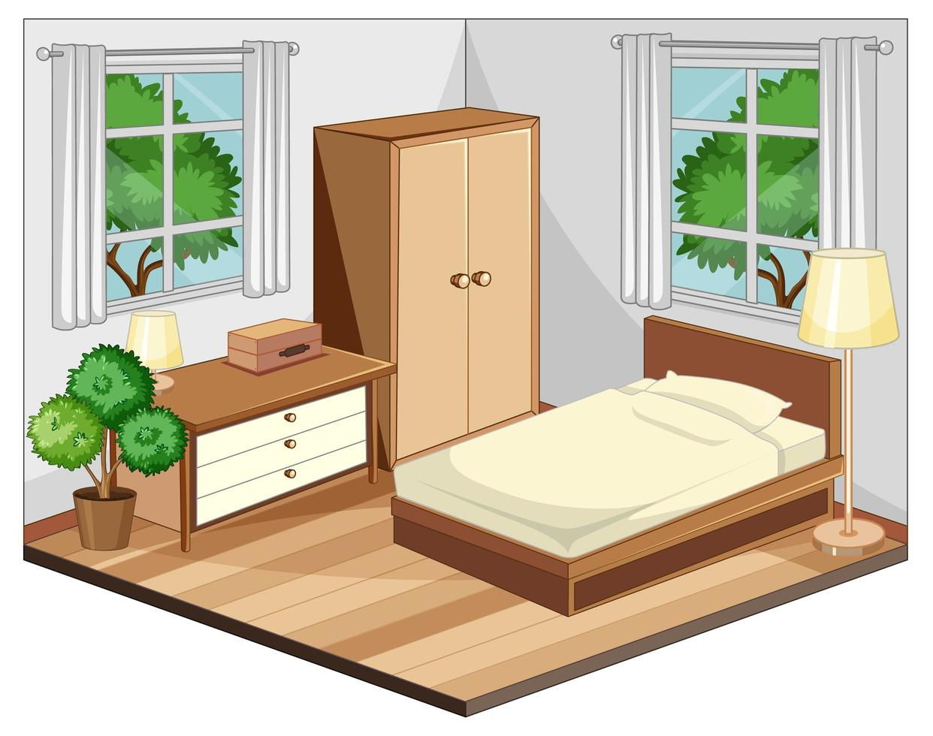
There're two books in the room.

Slide 30
There's a lamp in the room.

Slide 31
..... two chairs in the room.
These are
There is
It is
There are

Slide 32
There's ........ in the room.
two windows
a desk
a bed
a chair

Slide 33


EXIT

Slide 34

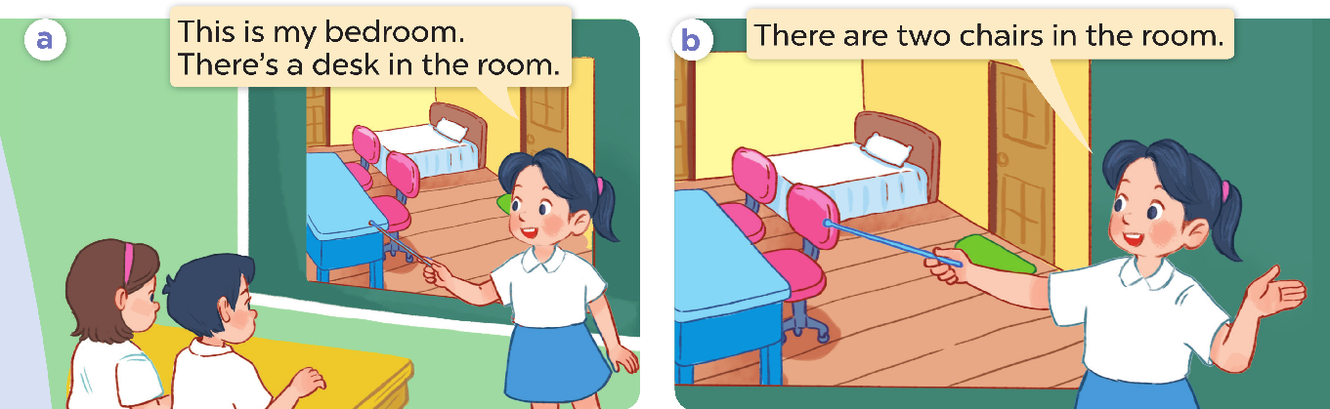

Slide 36

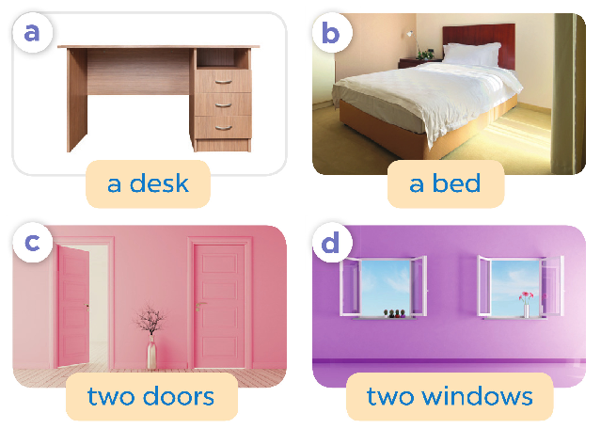
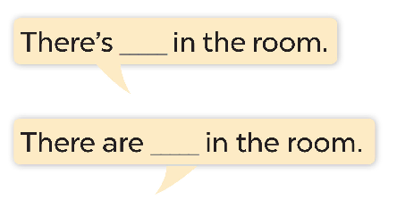

Slide 37
03
Activity

Slide 38

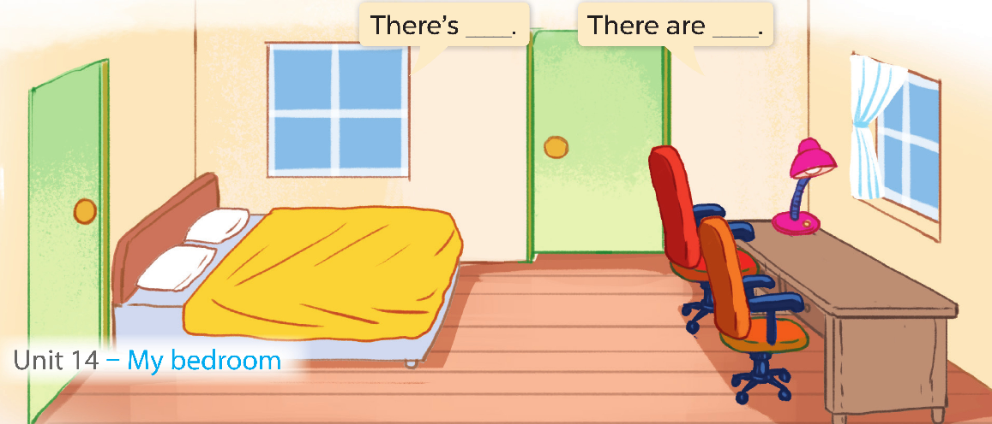

Slide 39


