Slide 2
Unit 10 Our school trip
Lesson 2 - Period 3

Slide 3
Table of content
01
Warm-up and Review
02
Activity 1. Look, listen and repeat
03
Activity 2. Listen, point and say
04
Activity 3. Let’s talk
05
Fun Corner and Wrap-up

Slide 4
01
Warm-up and Review

Slide 5
Secret boxes
Game

Slide 6
Secret boxes

Slide 7
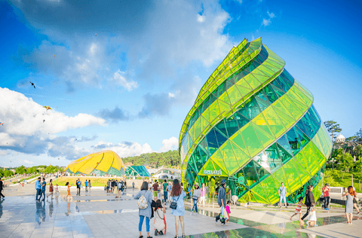
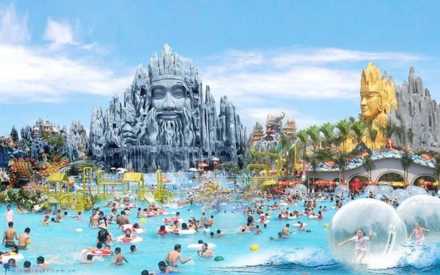
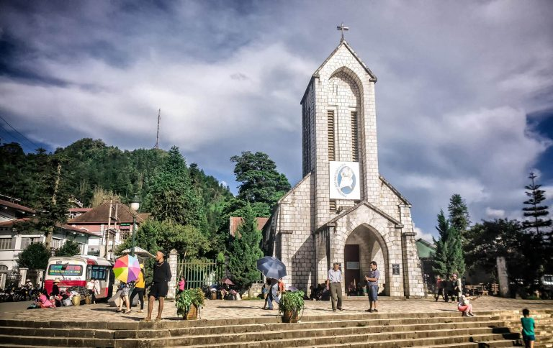
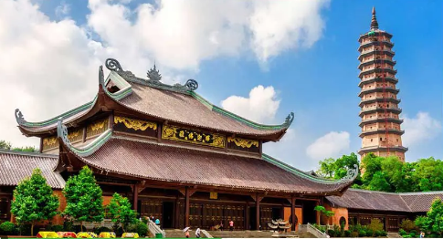
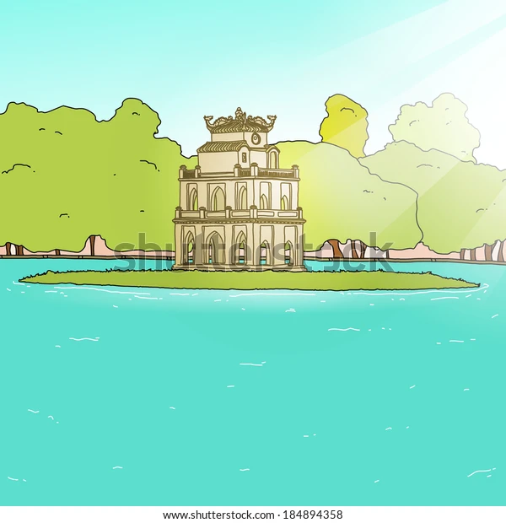
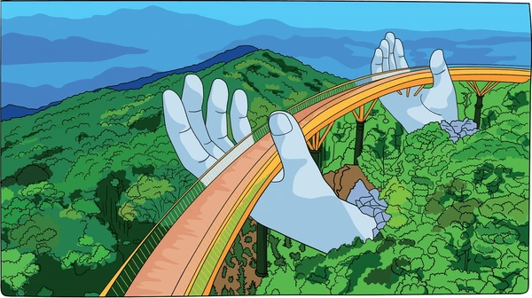
Secret boxes
Notes:
Click vào hộp quà xuất hiện bức tranh. HS hỏi đáp về bức tranh.
Click vào hình ảnh để làm biến mất nó.
Cick và tên team để hiện Stick ghi điểm

Slide 9
02
Activity 1.
Look, listen and repeat

Slide 10
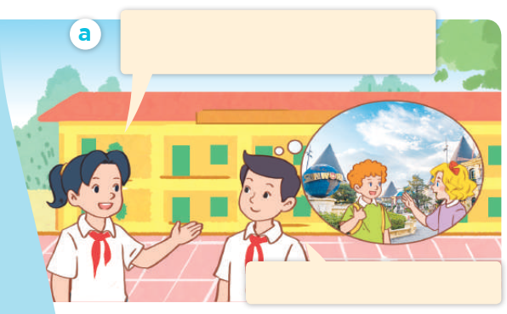
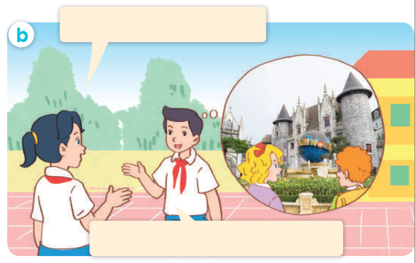
Look, listen and repeat.

Slide 11
Look, listen and repeat.
Where did Mary and Bill go on the school trip last weekend?
They went to Ba Na Hills.

Slide 12
Look, listen and repeat.
What did they do there?
They visited the old buildings.

Slide 13
Look, listen and repeat.
Where did Mary and Bill go on the school trip last weekend?
What did they do there?
They went to Ba Na Hills.
They visited the old buildings.

Slide 14
03
Activity 2.
Listen, point and say

Slide 15
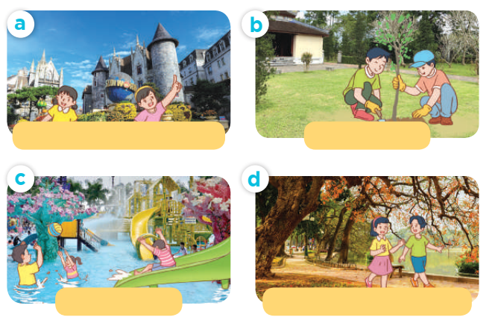
Listen, point and say.

Slide 16
Listen, point and say.
visit the old buildings

Slide 17
Listen, point and say.
plant trees

Slide 18
Listen, point and say.
play games

Slide 19
Listen, point and say.
walk around the lake

Slide 20
What did they do there?
They _______.

Slide 21
Listen, point and say.
What did they do there?
They visited the old buildings.
visit the old buildings

Slide 22
Listen, point and say.
What did they do there?
They planted trees.
plant trees

Slide 23
Listen, point and say.
What did they do there?
They played games.
play games

Slide 24
Listen, point and say.
What did they do there?
They walked around the lake.
walk around the lake

Slide 25
Listen, point and say.
What did they do there?
visit the old buildings
plant trees
They ______.
play games
walk around the lake

Slide 26
04
Activity 3. Let’s talk

Slide 27
Let’s talk.
What did they do there?
___.

Slide 28
What did they do there?
They ___.

Slide 29
05
Fun corner and Wrap-up

Slide 30
Game
Sentence puzzle

Slide 31
Sentence puzzle
1. visited / They / old / buildings. / the
2. trees. / They / planted
3. walked / lake. / around / They/ the
4. games. / played / They

Slide 32
Sentence puzzle
1. visited / They / old / buildings. / the
They visted old the buildings.

Slide 33
Sentence puzzle
2. trees. / They / planted
They planted trees.

Slide 34
Sentence puzzle
3. walked / lake. / around / They/ the
They walked around the lake.

Slide 35
Sentence puzzle
4. games. / played / They
They played games.

Slide 36
Very Good!

Slide 37
Website: hoclieu.vn
Fanpage: https://www.facebook.com/tienganhglobalsuccess.vn/

