Slide 2
Unit 8
IN OUR CLASSROOM
Lesson 2 – Period 3

Slide 3
/
TABLE OF CONTENTS
Warm-up & Review
Look, listen and repeat.
Listen, point and say.
Let’s talk.
Fun corner & Wrap-up

Slide 4
01
Warm-up & Review

Slide 5
Game
SENTENCE BUILDING
Where
the
are
?
pictures

Slide 6
Game
SENTENCE BUILDING
Where
are
the
pictures
?

Slide 7
Game
SENTENCE BUILDING
are
above
bookcase
the
pictures
The
.

Slide 8
Game
SENTENCE BUILDING
The
pictures
are
above
the
bookcase
.

Slide 9
Game
SENTENCE BUILDING
.
are
in front of
The
the
books
clock

Slide 10
Game
SENTENCE BUILDING
The
books
are
in front of
.
the
clock

Slide 11
Game
SENTENCE BUILDING
behind
.
are
the
The
pencil case
erasers

Slide 12
Game
SENTENCE BUILDING
The
erasers
are
behind
pencil case
.
the
.

Slide 13
Game
SENTENCE BUILDING
under
are
chair
the
The
.
rulers

Slide 14
Game
SENTENCE BUILDING
The
rulers
are
under
the
chair
.

Slide 16
02
Look, listen and repeat.

Slide 17
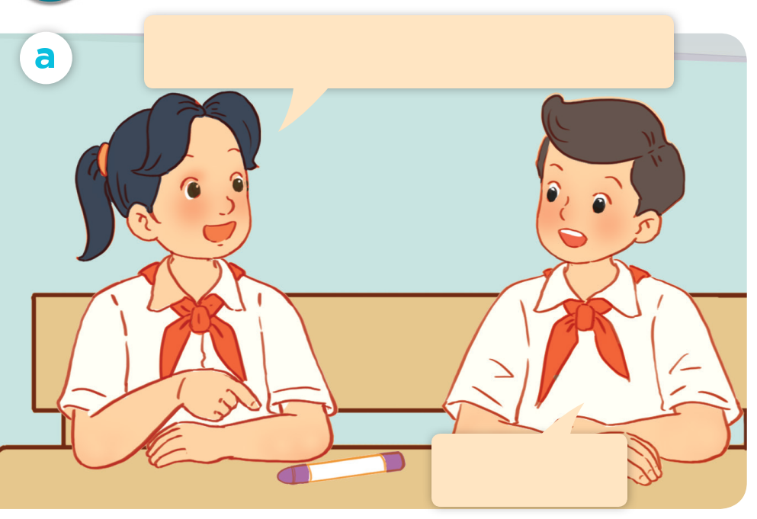
LOOK and SAY.

Slide 18
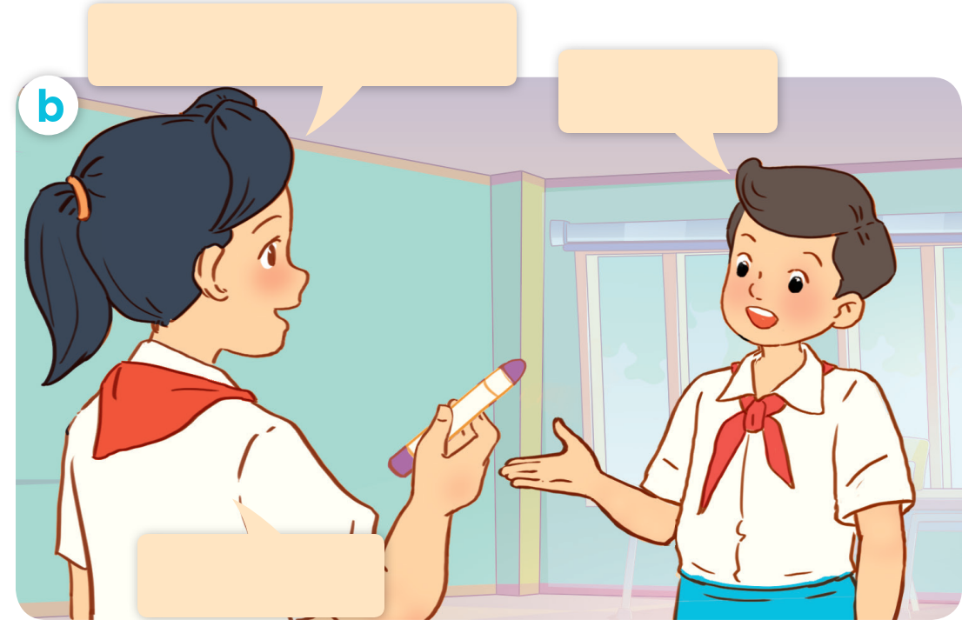
LOOK and SAY.

Slide 19
LISTEN and POINT.

Slide 20
LISTEN and REPEAT.
Excuse me, is this your crayon?
No, it isn’t.

Slide 21
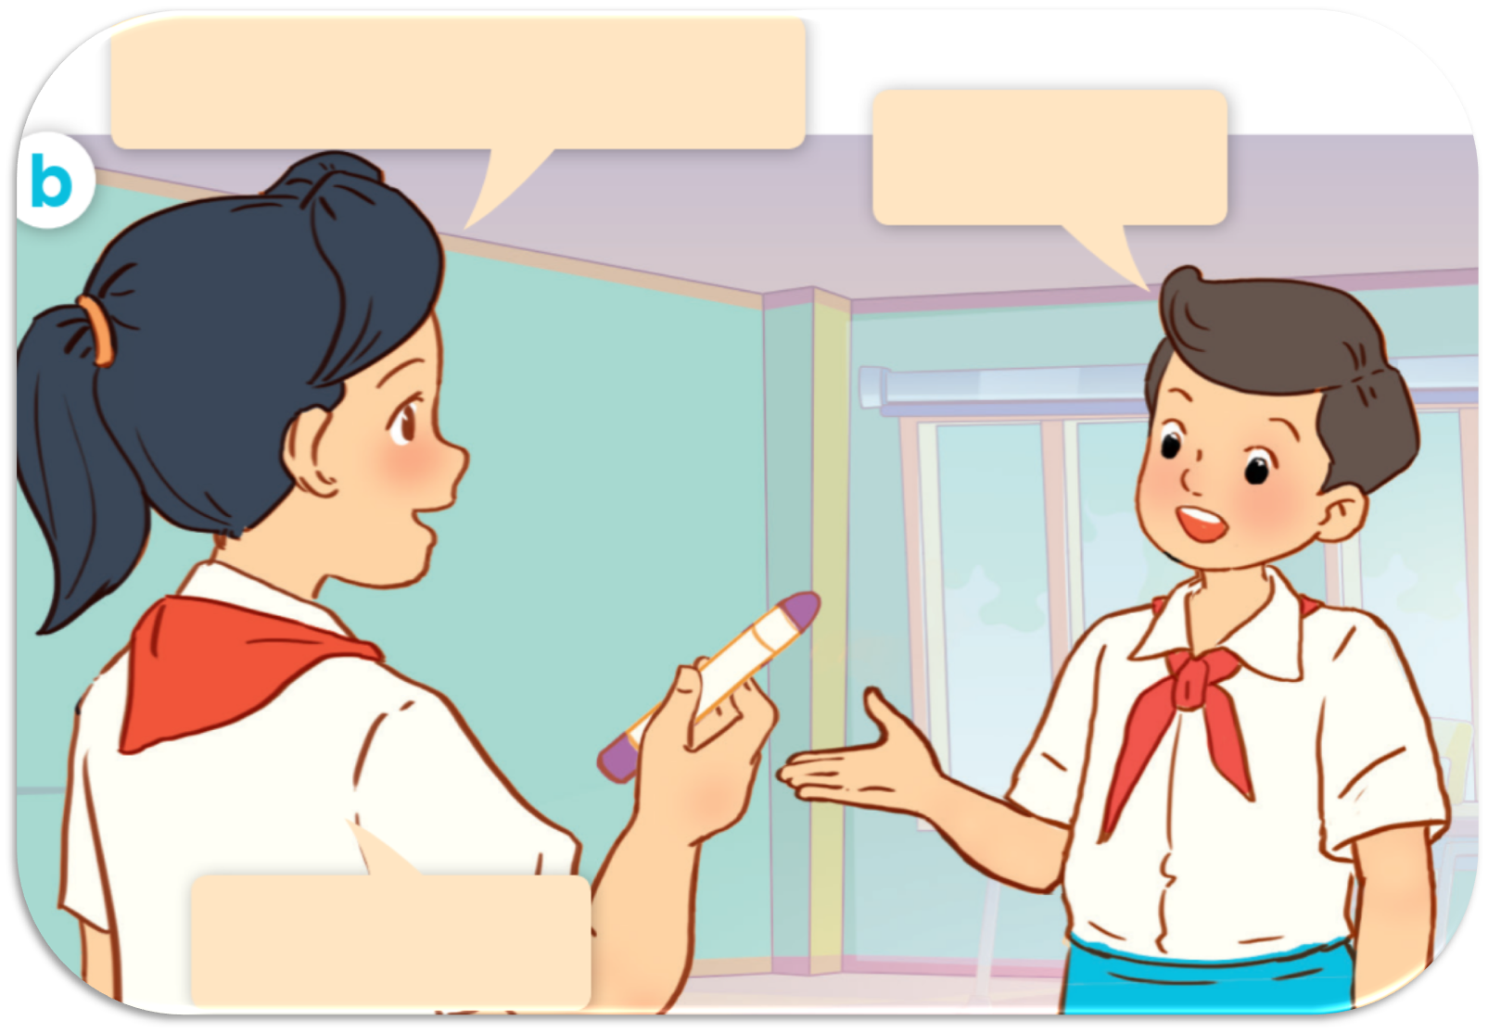
LISTEN and REPEAT.
Whose crayon
is this?
It’s Linh.
Thank you.

Slide 22
LISTEN and REPEAT.
Whose crayon is this?
Excuse me, is this your crayon?
It’s Linh.
No, it isn’t.
Thank you.

Slide 23
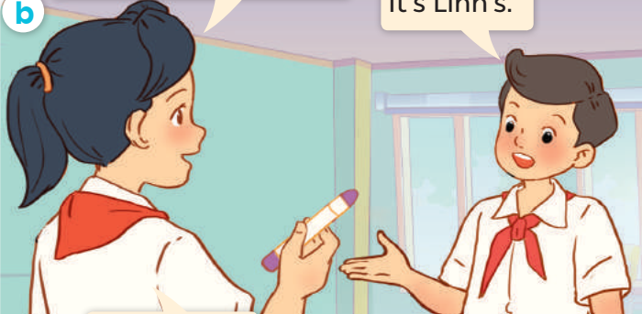
LISTEN and REPEAT.
It’s Linh’s.
Whose crayon is this?

Slide 24
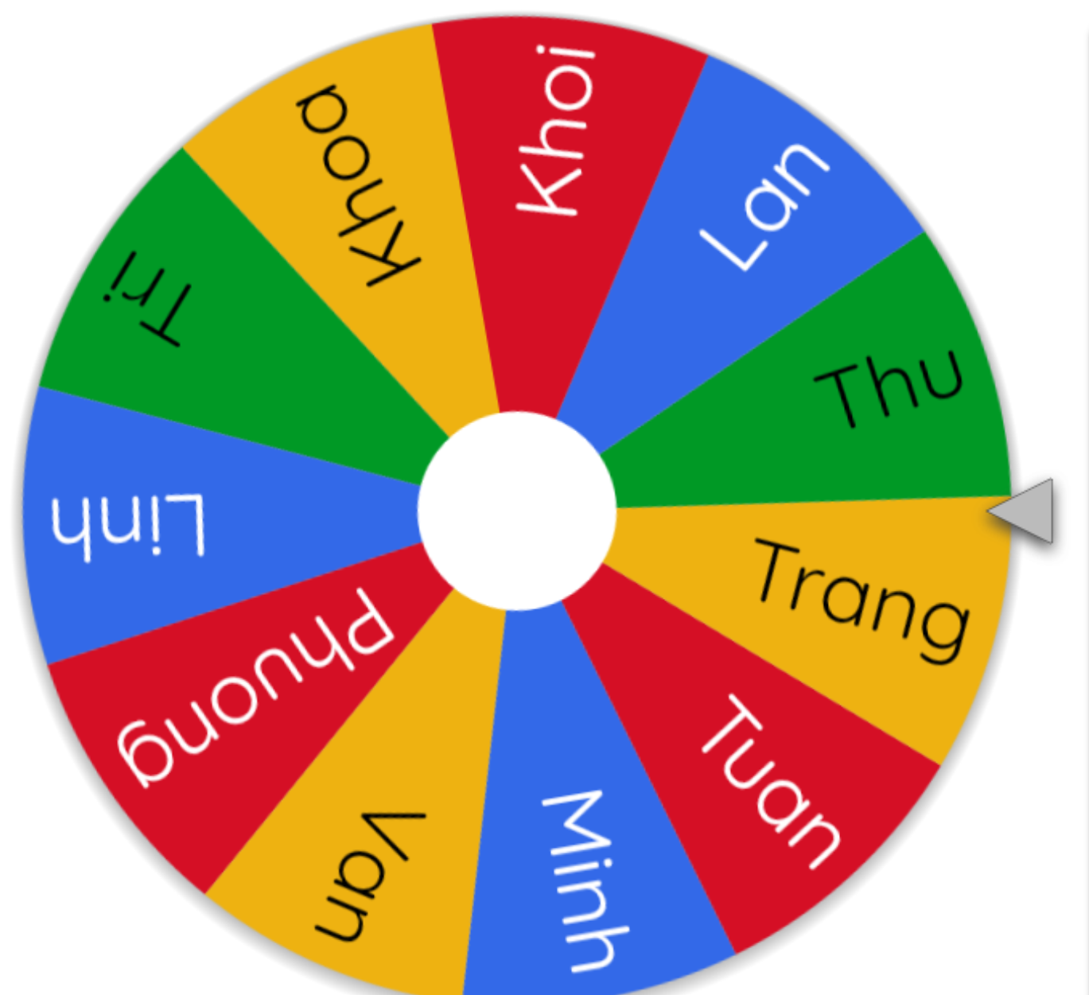
ASK and ANSWER.
Whose crayon is this?
Excuse me, is this your crayon?
It’s Linh.
No, it isn’t.
Thank you.

Slide 26
03
Listen, point and say.

Slide 27
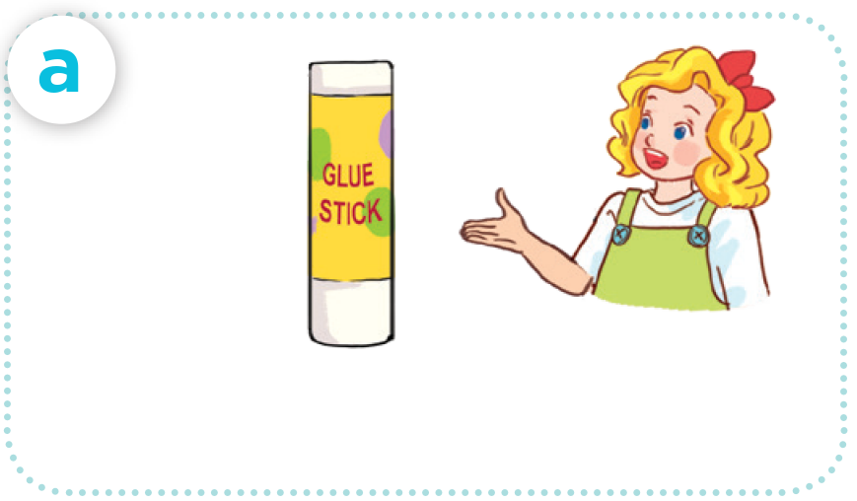
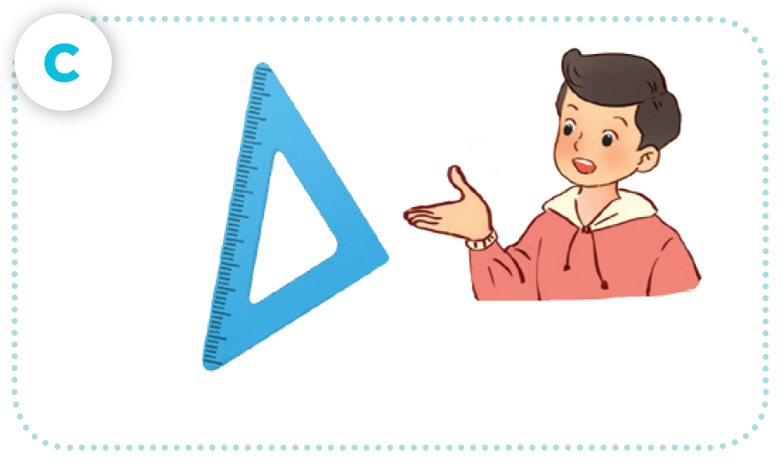
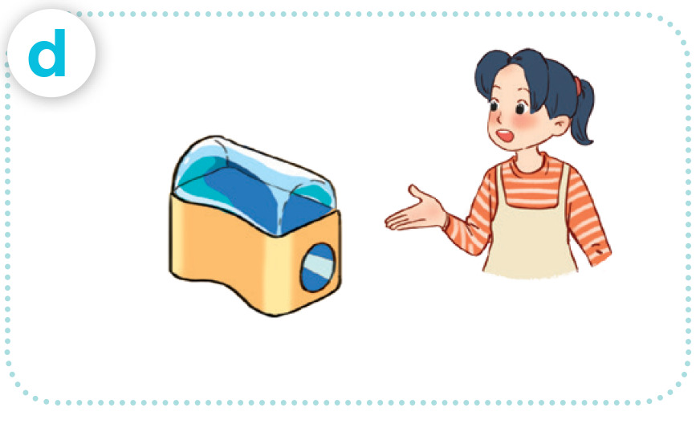
LOOK AND SAY
glue stick / Mary’s
crayon / Bill’s
set square / Nam’s
pencil sharpener / Mai’s

Slide 28
LISTEN AND REPEAT.
glue stick / Mary’s

Slide 29
LISTEN AND REPEAT.
crayon / Bill’s

Slide 30
LISTEN AND REPEAT.
set square / Nam’s

Slide 31
LISTEN AND REPEAT.
pencil sharpener / Mai’s

Slide 32
LISTEN AND REPEAT.
Whose glue stick is this?
glue stick / Mary’s
It’s Mary’s.

Slide 33
LISTEN AND REPEAT.
Whose crayon is this?
It’s Bill’s.

Slide 34
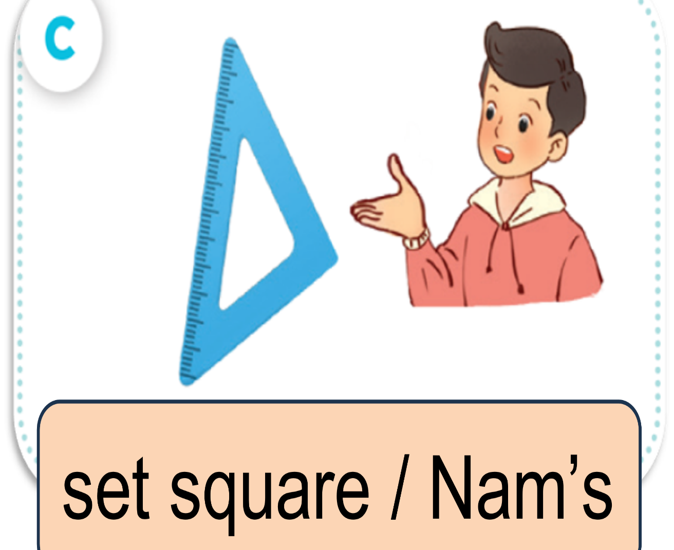
LISTEN AND REPEAT.
Whose set square is this?
It’s Nam’s.

Slide 35
LISTEN AND REPEAT.
Whose pencil sharpener
is this?
It’s Mai’s.

Slide 36
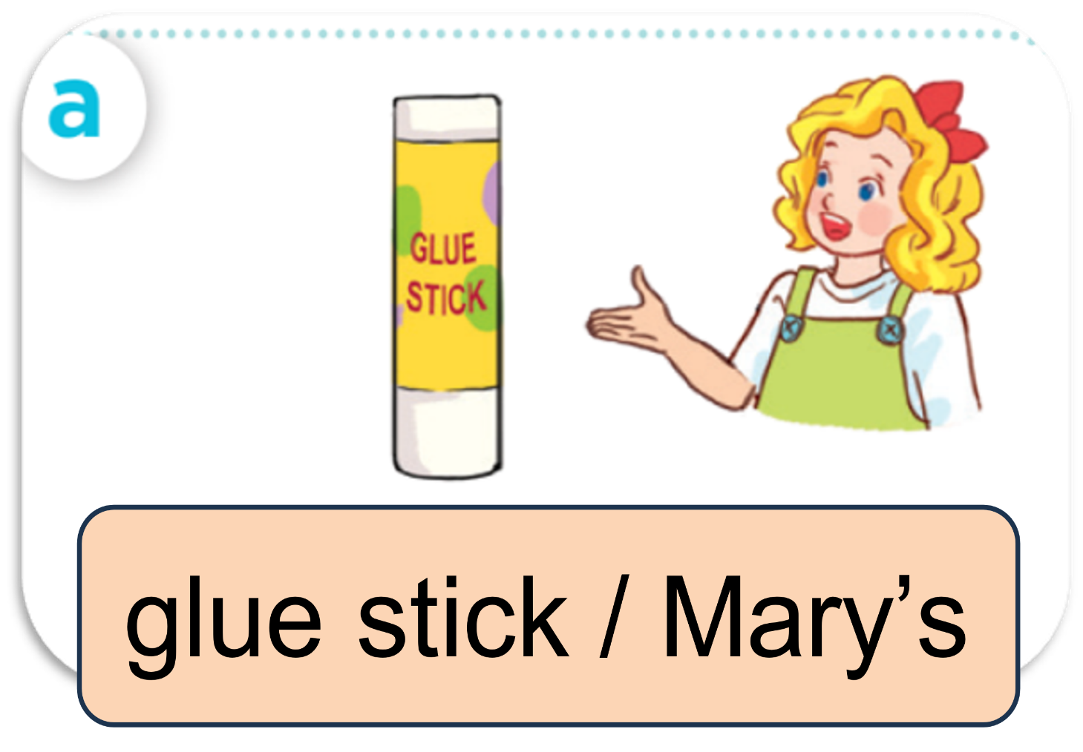
ASK AND ANSWER

Slide 37
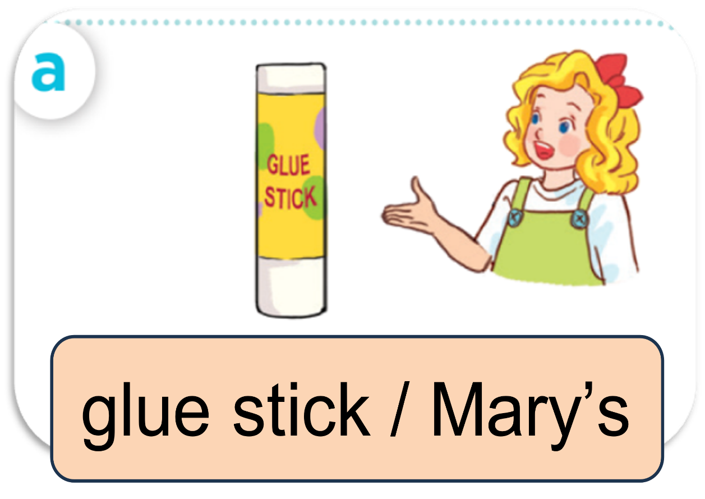
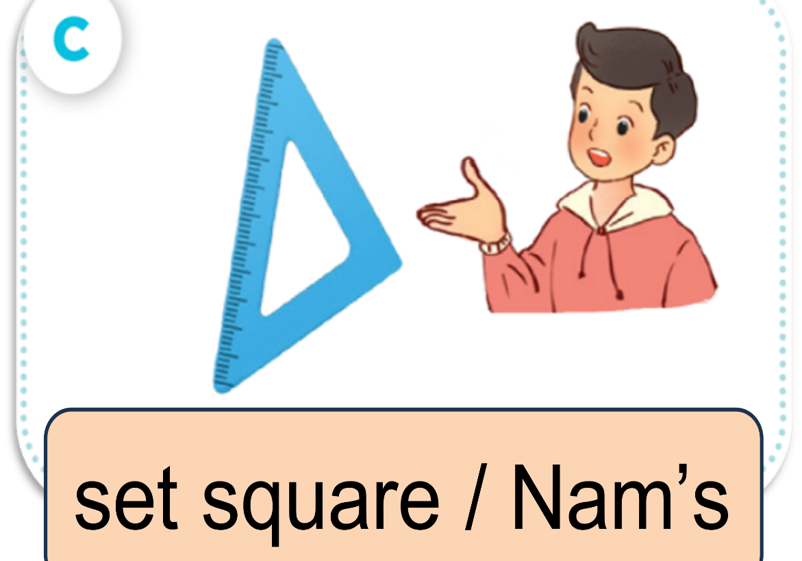
ASK AND ANSWER.

Slide 39
04
Let’s talk.

Slide 40
LOOK AND SAY.
It this your ___?
____.
Whose ___ is this?
____.

Slide 41
ASK AND ANSWER.
Whose set square is this?
It’s Minh’s.

Slide 42
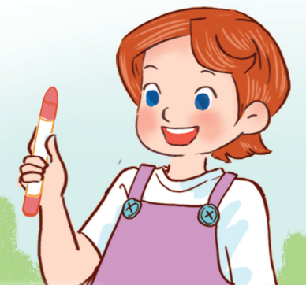
ASK AND ANSWER.
Whose crayon is this?
It’s Lucy’s.

Slide 43
ASK AND ANSWER.
Whose pencil sharpener
is this?
It’s Linh’s.

Slide 44
ASK AND ANSWER.
Whose glue stick is this?
It’s Bill’s.

Slide 45
WORK in PAIRS.
Ask and answer.

Slide 47
05
Fun corner & Wrap-up

Slide 48
Game
DISPPEAR !!!

Slide 49
THE ANSWER IS …..
pencil sharpener

Slide 50
Game
DISPPEAR !!!

Slide 51
THE ANSWER IS …..
glue stick

Slide 52
Game
DISPPEAR!

Slide 53
THE ANSWER IS …..
set square

Slide 54
Game
DISPPEAR !!!

Slide 55
THE ANSWER IS …..
crayon

Slide 57
See you
next time!

Slide 58
Website: hoclieu.vn
Fanpage: https://www.facebook.com/tienganhglobalsuccess.vn/

