Slide 2
Unit 8
IN OUR CLASSROOM
Lesson 1 – Period 2

Slide 3
/
TABLE OF CONTENTS
Warm-up & Review
Listen and tick or cross.
Read and complete.
Let’s sing.
Fun corner & Wrap-up

Slide 4
01
Warm-up & Review

Slide 5
Game
FLOWER BLOOMING

Slide 6
Game
FLOWER BLOOMING
Notes:
Click numbers to move to the Question slides.
Click the flower to disappear it.
Click the Red symbol to end the game (slide 20).

Slide 7
TEAM A
TEAM B
Notes:
Click Blue/Red/Green/Purple from each team in order to make their team’s flower bloom.
Click the Red symbol to end the game (slide 20).
Click the Blue symbol to back to the Number slide (slide 11).

Slide 8
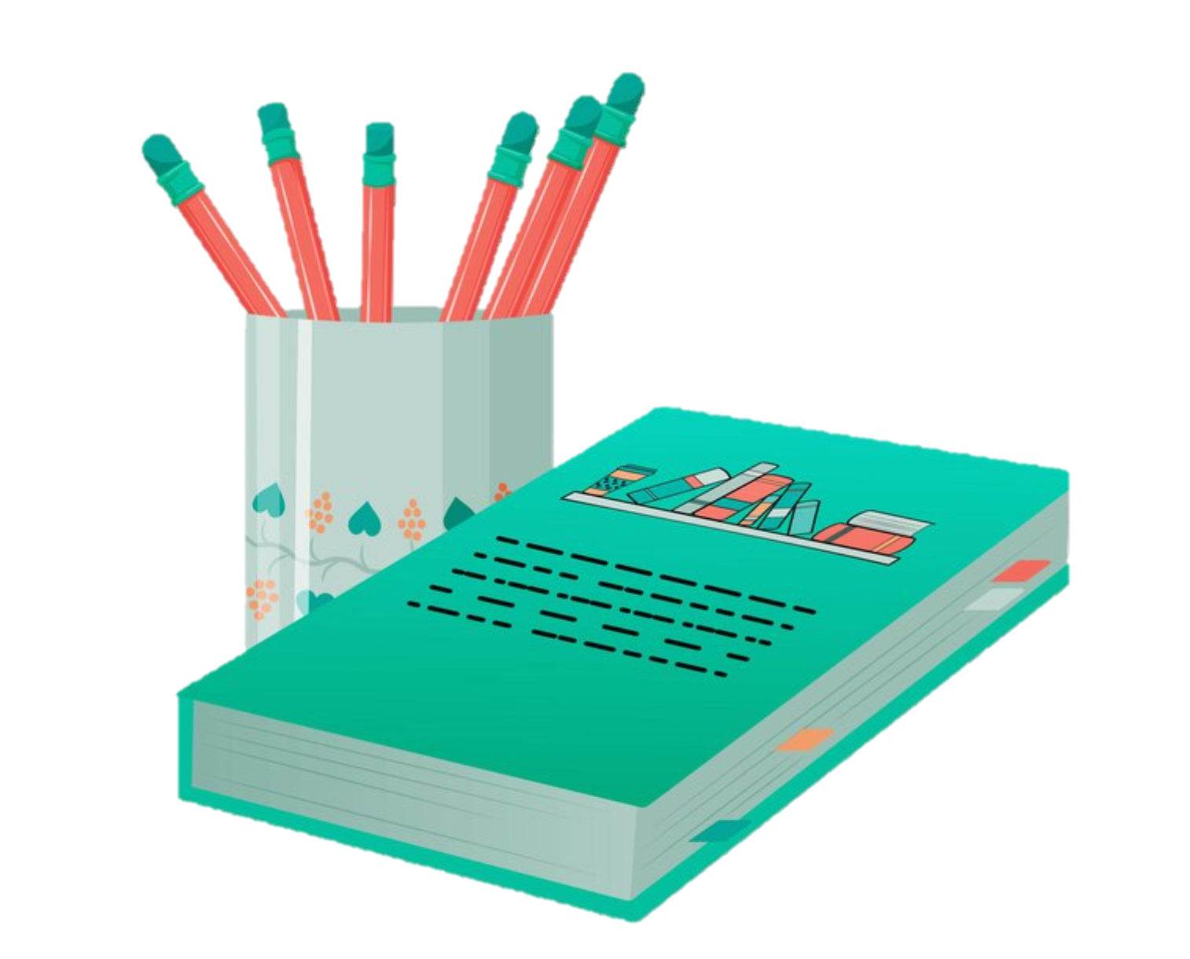
READ AND CHOOSE THE CORRECT ANSWERS.
under
above
A: Where are the pencils?
beside
B: They’re _____ the book.
Notes:
Click the instructions to back to the Score slide (slide 12).

Slide 9
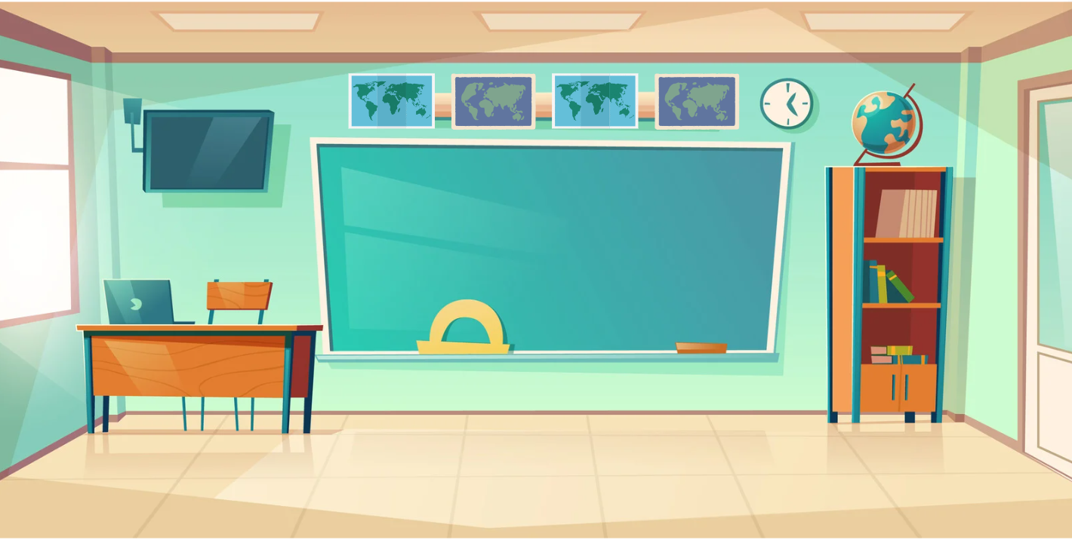
READ AND CHOOSE THE CORRECT ANSWERS.
under
above
A: Where are maps?
in front of
B: They’re _____ the board.
Notes:
Click the instructions to back to the Score slide (slide 12).

Slide 10
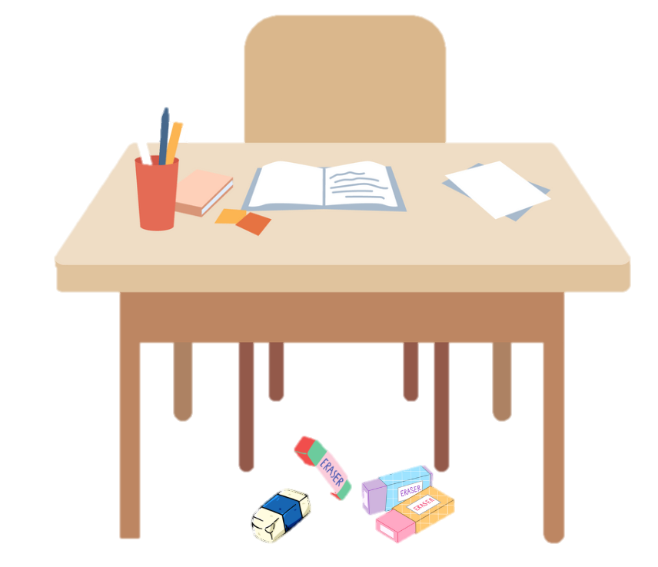
READ AND CHOOSE THE CORRECT ANSWERS.
under
beside
A: Where are erasers?
above
B:They’re ______ the desk.
Notes:
Click the instructions to back to the Score slide (slide 12).

Slide 11
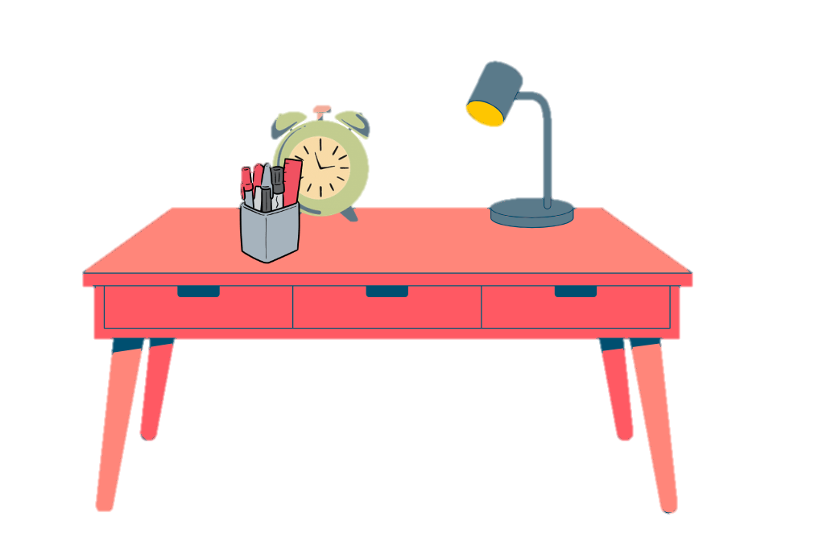
READ AND CHOOSE THE CORRECT ANSWERS.
under
in front of
A: Where are pens?
beside
B: They’re _____ the clock.
Notes:
Click the instructions to back to the Score slide (slide 12).

Slide 12
READ AND CHOOSE THE CORRECT ANSWERS.
under
above
A: Where are school bags?
on
B: They’re _____ the desk.
Notes:
Click the instructions to back to the Score slide (slide 12).

Slide 13
READ AND CHOOSE THE CORRECT ANSWERS.
beside
above
A: Where is the clock?
on
B: It’s _____ the bookcase.
Notes:
Click the instructions to back to the Score slide (slide 12).

Slide 14
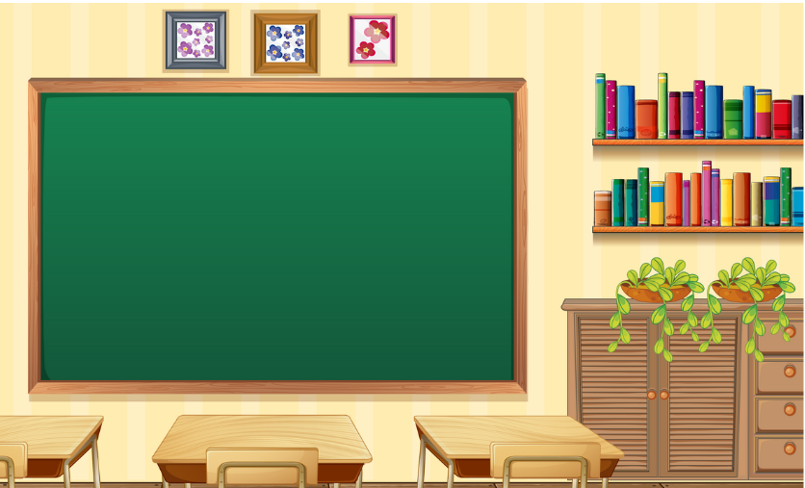
READ AND CHOOSE THE CORRECT ANSWERS.
above
in front of
A: Where is the bookcase?
beside
B: It’s _____ the board.
Notes:
Click the instructions to back to the Score slide (slide 12).

Slide 16
02
Listen and tick or cross.

Slide 17
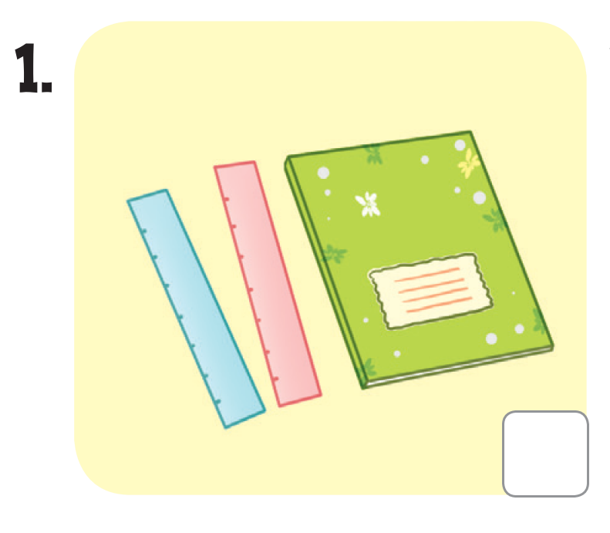
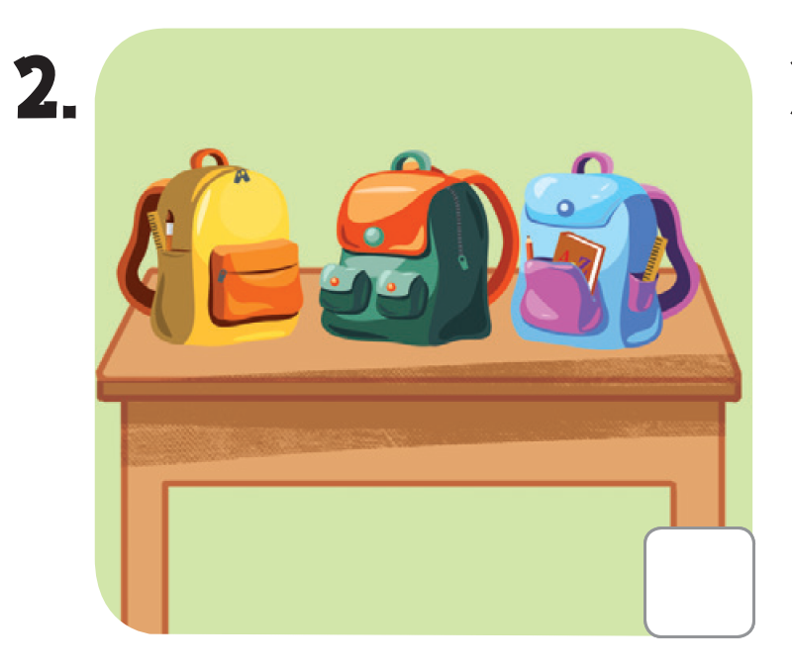
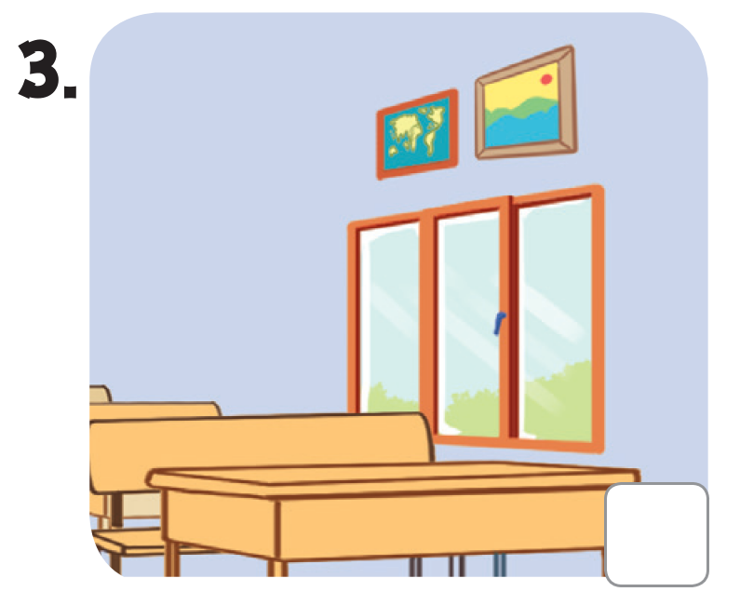
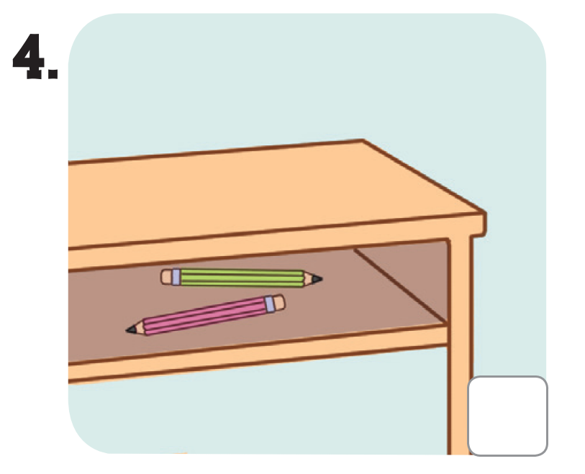
LOOK AND SAY.

Slide 18
LISTEN AND POINT.

Slide 19
LISTEN AND TICK OR CROSS.

Slide 20
SWAP YOUR BOOKS!
Notes:
Step 3: Get pupils to swap books with a partner to check their answers before checking as a class. Correct the answers if necessary.

Slide 21
LET’S CHECK!

Slide 23
03
Read and complete.

Slide 24
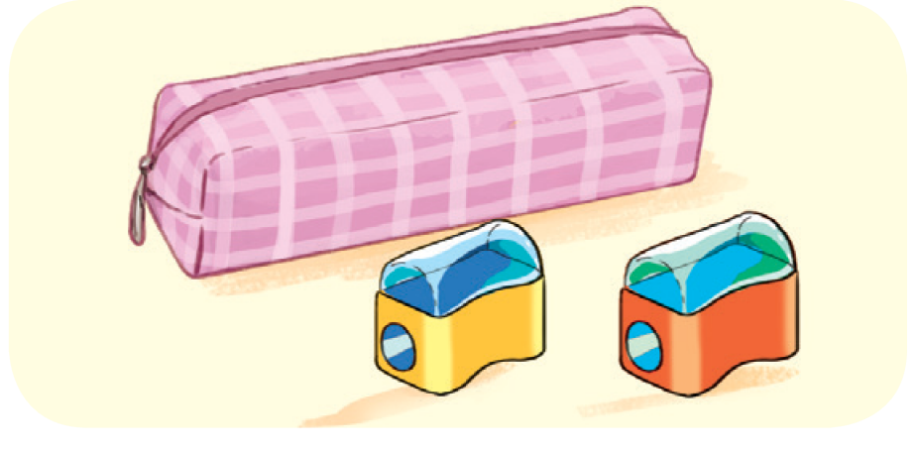
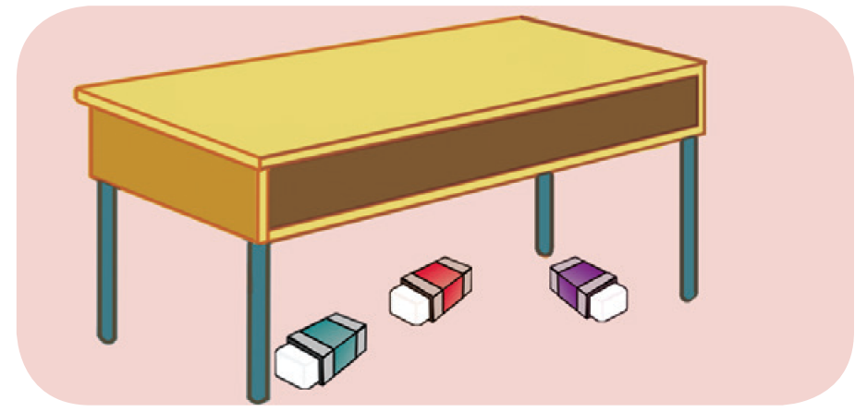
LOOK AND SAY

Slide 25
LOOK AND GUESS.
A: Where are the pens?
B: They’re _________ the notebook.

Slide 26
LOOK AND GUESS.
2. A: Where ___ the pencil sharpeners?
B: They’re in front of _____.

Slide 27
LOOK AND GUESS.
3. A: Are the ______ on the desk?
B: No, they aren’t.
A: Where are they?
B: They are __________ the desk.

Slide 28
LOOK AND GUESS.
4. A: ___________ are the pictures?
B: They’re _________ the bookcase.
A: Thank you.

Slide 29
READ AND COMPLETE.
A: Where are the pens?
B: They’re _______ the notebook.
beside

Slide 30
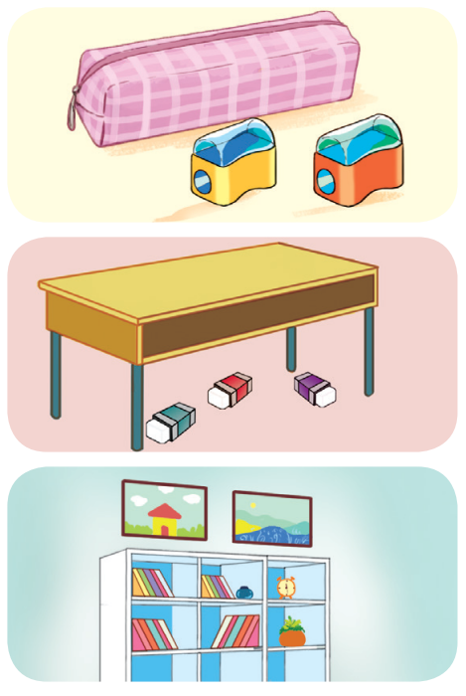
READ AND COMPLETE.
2. A: Where _____ the pencil sharpeners?
B: They’re in front of _________.
3. A: Are the __________ on the desk?
B: No, they aren’t.
A: Where are they?
B: They are __________ the desk.
4. A: ___________ are the pictures?
B: They’re _________ the bookcase.
A: Thank you.

Slide 31
SWAP YOUR BOOKS!

Slide 32
LET’S CHECK!
2. A: Where ____ the pencil sharpeners?
B: They’re in front of _______________.
are
the pencil case

Slide 33
LET’S CHECK!
3. A: Are the _______ on the desk?
B: No, they aren’t.
A: Where are they?
B: They are ______ the desk.
erasers
under

Slide 34
LOOK AND GUESS.
4. A: _______ are the pictures?
B: They’re _______ the bookcase.
A: Thank you.
Where
above

Slide 36
04
Let’s sing.

Slide 37
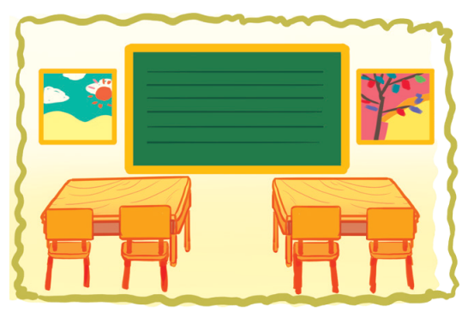
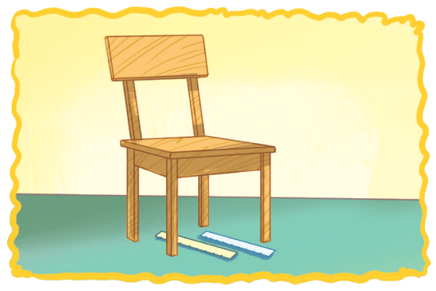
LOOK AND POINT.
WHERE ARE THEY?
Pictures, pictures, pictures.
Where are the pictures?
Beside the board.
Beside the board.
They’re beside the board.
Rulers, rulers, rulers.
Where are the rulers?
Under the chair.
Under the chair.
They’re under the chair.

Slide 38
LISTEN AND POINT.
WHERE ARE THEY?
Pictures, pictures, pictures.
Where are the pictures?
Beside the board.
Beside the board.
They’re beside the board.

Slide 39
LISTEN AND POINT.
WHERE ARE THEY?
Rulers, rulers, rulers.
Where are the rulers?
Under the chair.
Under the chair.
They’re under the chair.

Slide 40
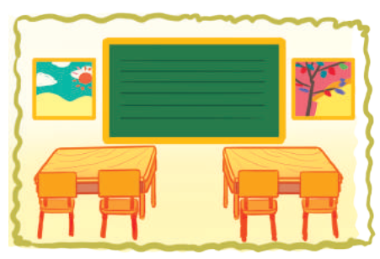
LISTEN AND REPEAT.
WHERE ARE THEY?
Pictures, pictures, pictures.
Where are the pictures?
Beside the board.
Beside the board.
They’re beside the board.

Slide 41
LISTEN AND REPEAT.
WHERE ARE THEY?
Rulers, rulers, rulers.
Where are the rulers?
Under the chair.
Under the chair.
They’re under the chair.

Slide 42
LISTEN AND SING.
WHERE ARE THEY?
Pictures, pictures, pictures.
Where are the pictures?
Beside the board.
Beside the board.
They’re beside the board.
Rulers, rulers, rulers.
Where are the rulers?
Under the chair.
Under the chair.
They’re under the chair.

Slide 43
SING AND CLAP.
WHERE ARE THEY?
Pictures, pictures, pictures.
Where are the pictures?
Beside the board.
Beside the board.
They’re beside the board.
Rulers, rulers, rulers.
Where are the rulers?
Under the chair.
Under the chair.
They’re under the chair.

Slide 45
05
Fun corner & Wrap-up

Slide 46
Game
ANGRY BIRDS
Let’s start!

Slide 47
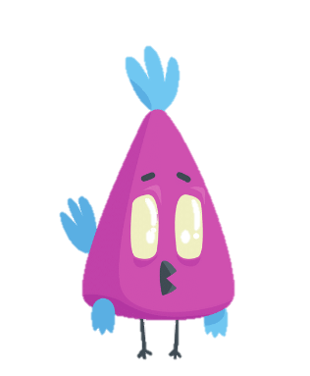
ANGRY BIRDS
Let’s choose a number.
Notes:
Click on the number to move to the Question slide.
Click on the red symbol at the right bottom to end the game.

Slide 48
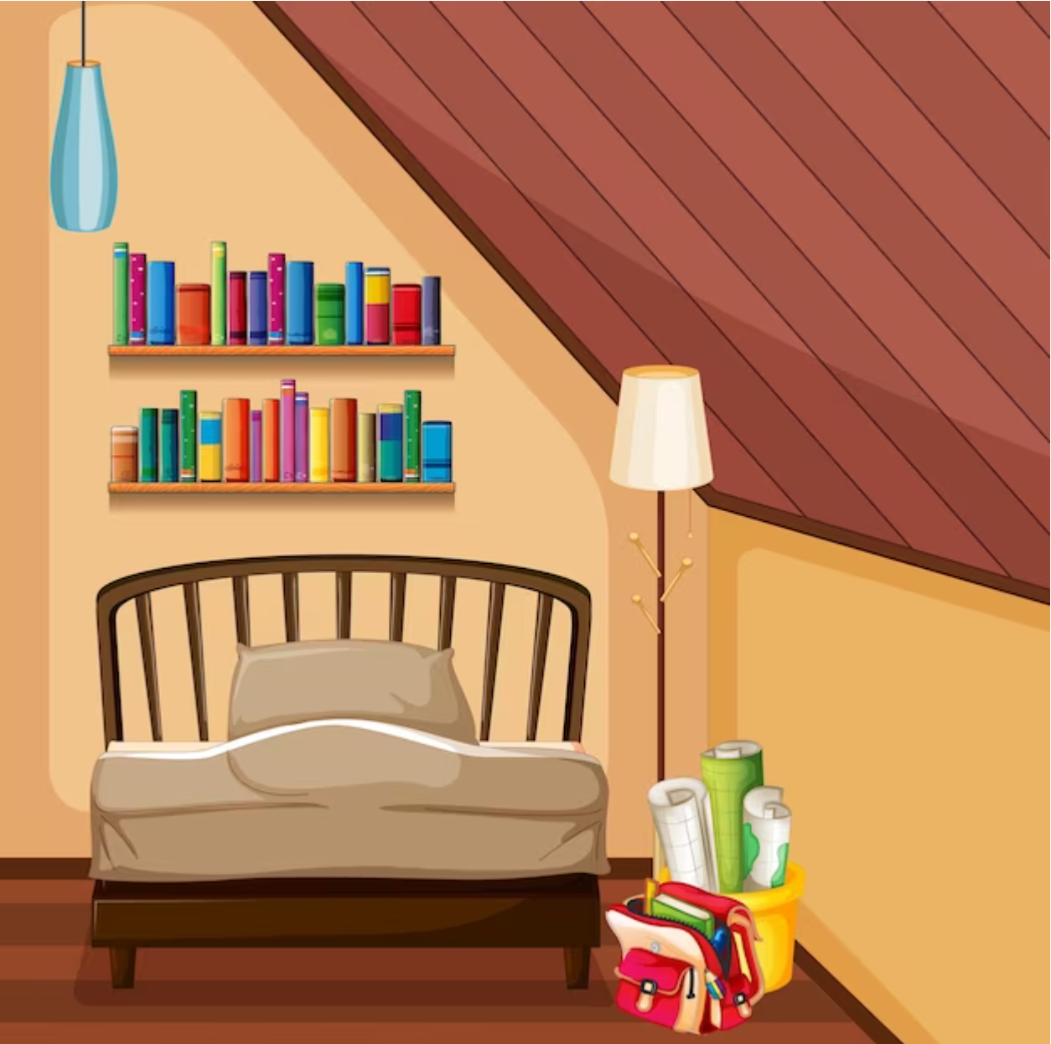
LOOK AND ANSWER.
A: Where are the books?
They’re on the bookcase.
B: ___________________
Notes:
Click on the Answer to back to the Number slide.

Slide 49
LOOK AND ANSWER.
A: Where are the pens?
They’re under the table.
B: _________________
Notes:
Click on the Answer to back to the Number slide.

Slide 50
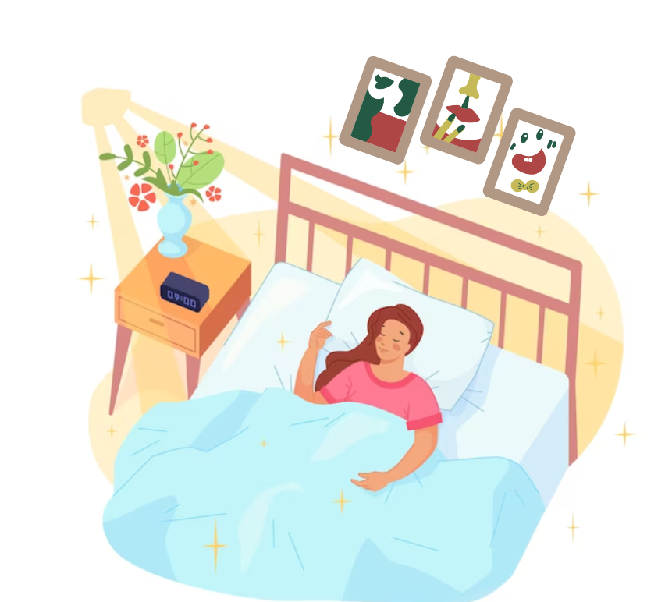
LOOK AND ANSWER.
A: Where are the pictures?
They’re above the bed.
B: _________________
Notes:
Click on the Answer to back to the Number slide.

Slide 51
LOOK AND ANSWER.
A: Where are the bags?
They’re beside the plant.
B: __________________
Notes:
Click on the Answer to back to the Number slide.

Slide 52
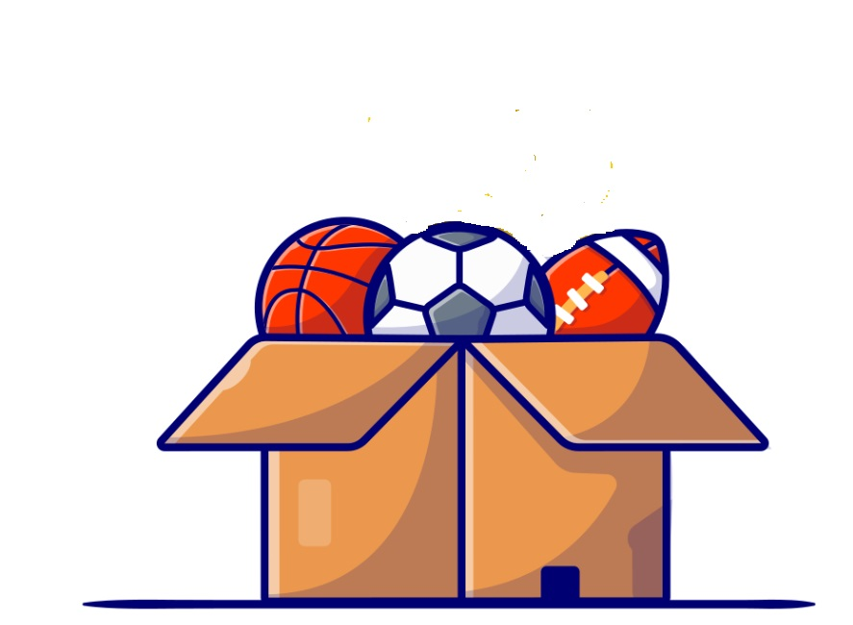
LOOK AND ANSWER.
A: Where are the balls?
They’re in the box.
B: ______________
Notes:
Click on the Answer to back to the Number slide.

Slide 53
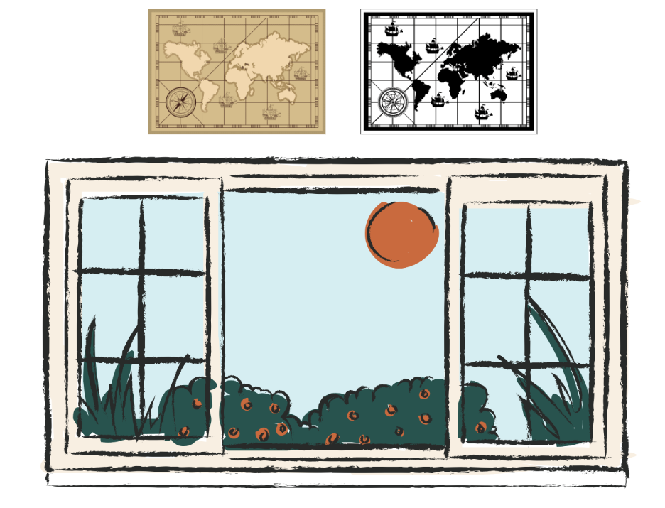
LOOK AND ANSWER.
A: Where are the maps?
They’re above the window.
B: ____________________
Notes:
Click on the Answer to back to the Number slide.

Slide 54
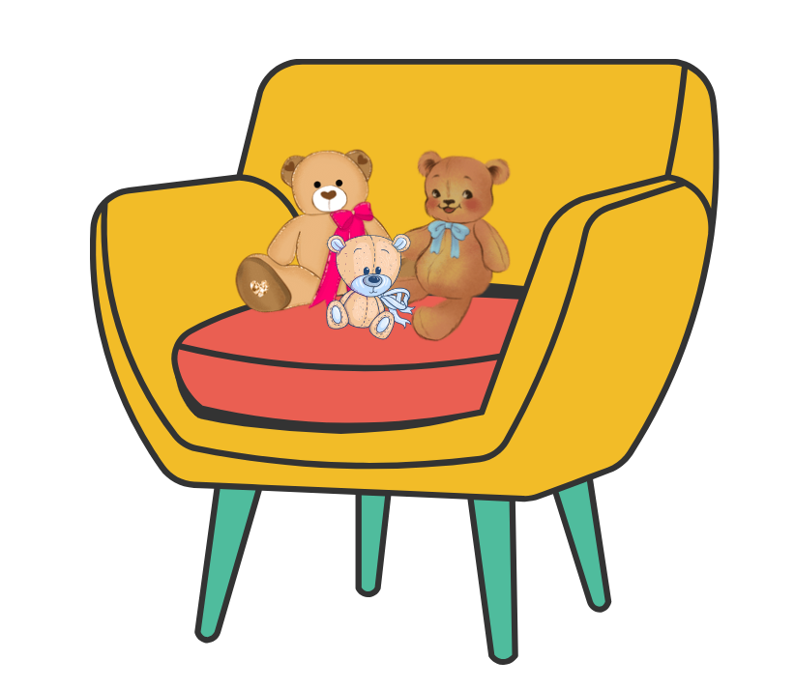
LOOK AND ANSWER.
A: Where are the teddy bears?
They’re on the chairs.
B: _________________
Notes:
Click on the Answer to back to the Number slide.

Slide 55
LOOK AND ANSWER.
A: Where are the windows?
They’re beside the board.
B: ___________________
Notes:
Click on the Answer to back to the Number slide.

Slide 56
Good Job!

Slide 57
See you
next time!

Slide 58
Website: hoclieu.vn
Fanpage: https://www.facebook.com/tienganhglobalsuccess.vn/

