Slide 1







Unit 8
IN OUR CLASSROOM
Lesson 1 – Period 1

Slide 2





/
TABLE OF CONTENTS
Warm-up & Review
Look, listen and repeat.
Listen, point and say.
Let’s talk.
Fun corner & Wrap-up

Slide 3




01
Warm-up & Review

Slide 4






KIM’S GAME
Remember and say!
START
FINISH

Slide 5
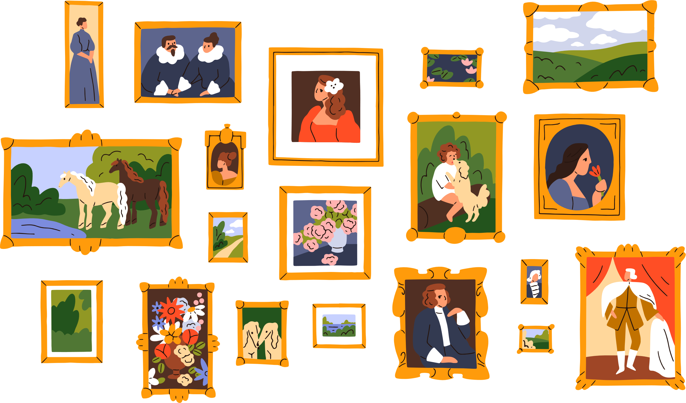



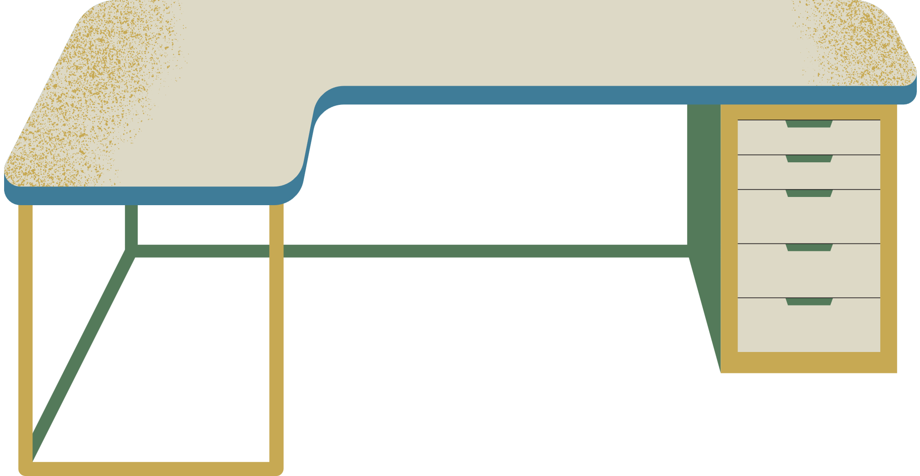
KIM’S GAME
START
FINISH

Slide 6




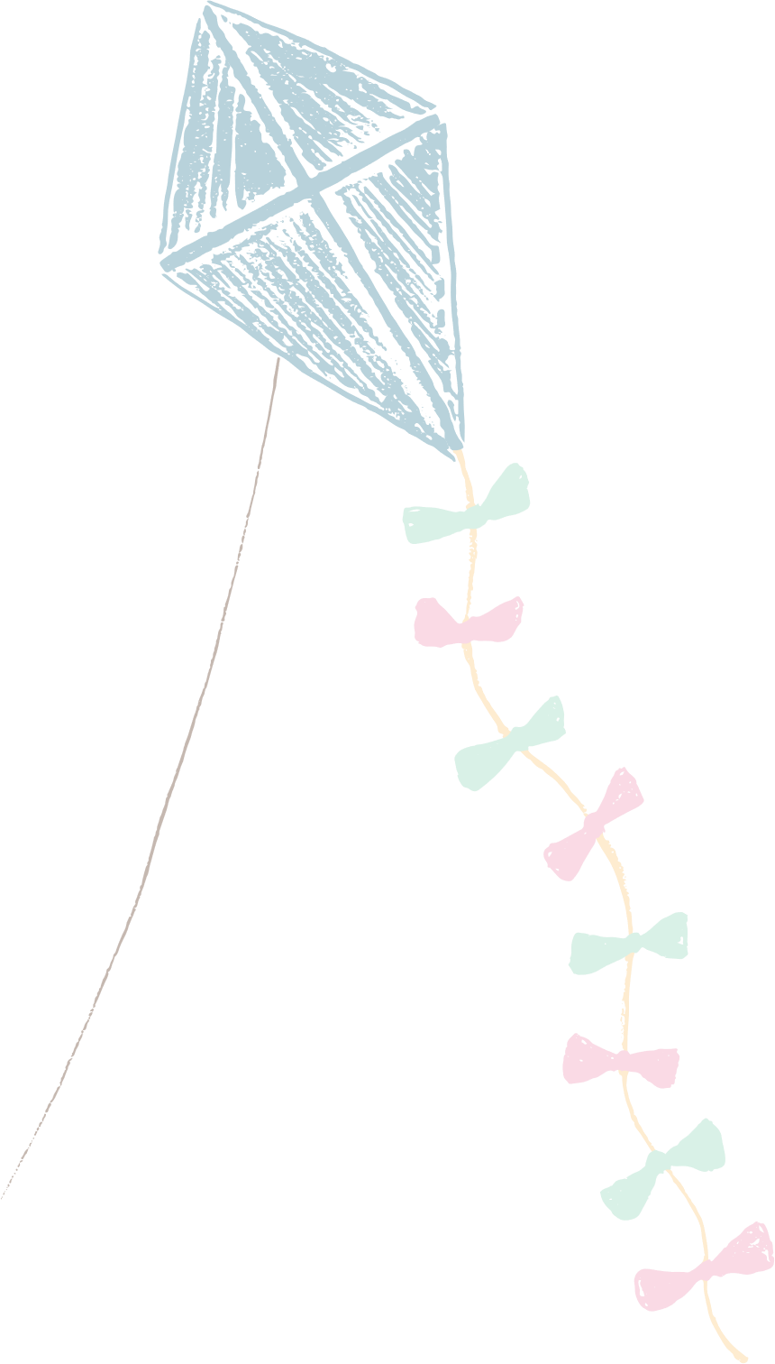






Slide 7
02
Look, listen and repeat.

Slide 8



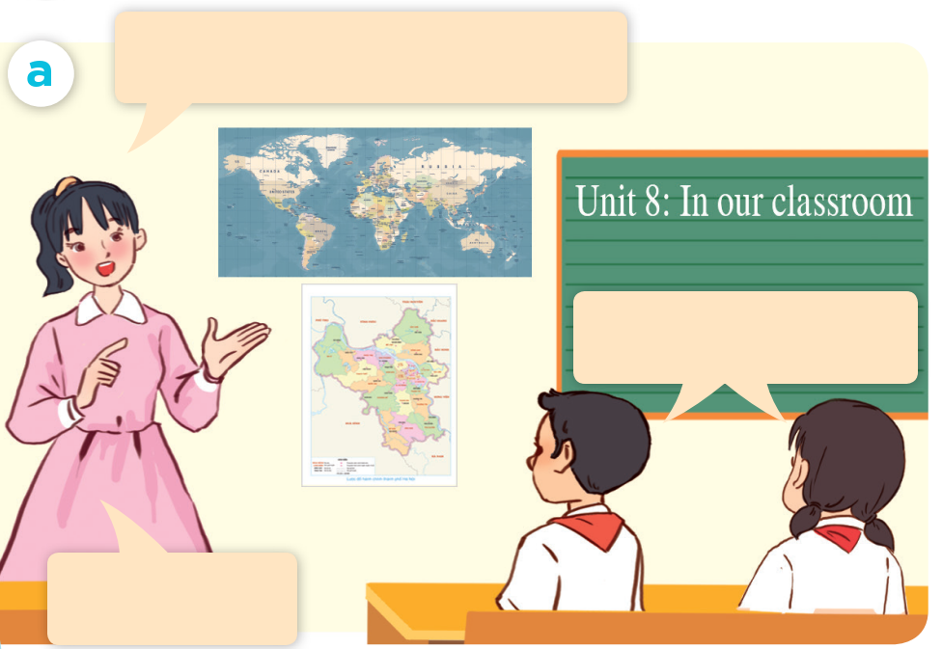

LOOK AND SAY.

Slide 9
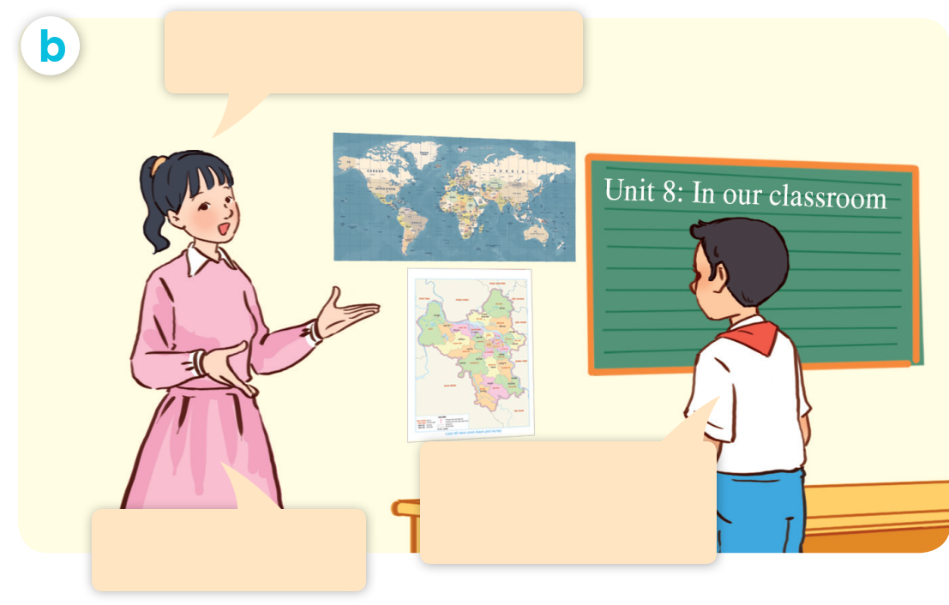
LOOK AND SAY.

Slide 10

LISTEN AND POINT.

Slide 11
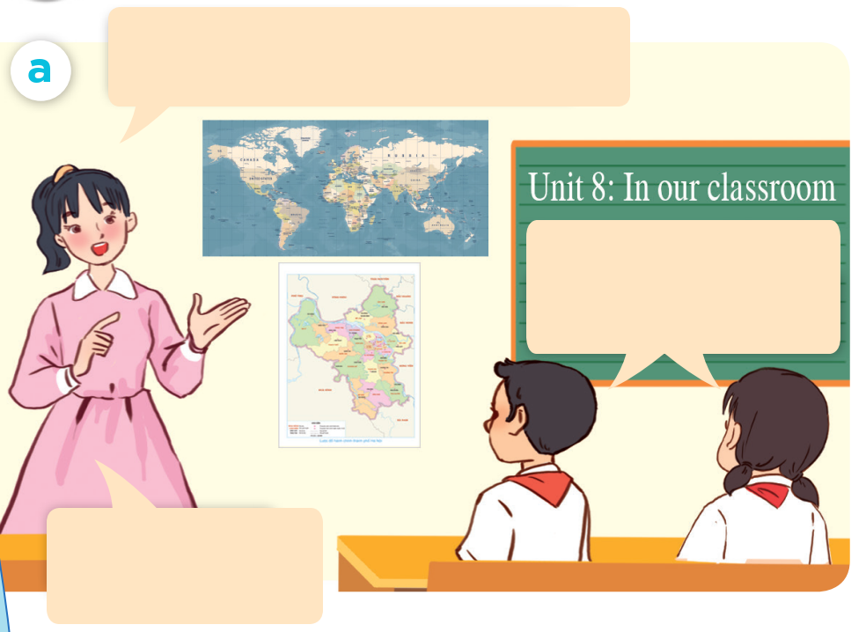
LISTEN AND REPEAT.
Class, what are these?
They are maps.
Well done.

Slide 12
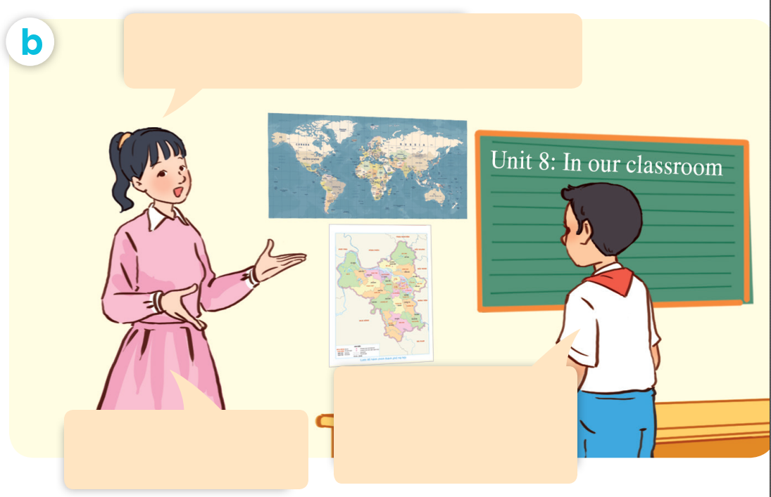
LISTEN AND REPEAT.
Where are the maps ?
They’re beside the board.
That’s right.

Slide 13
LISTEN AND REPEAT.
Where are the maps?
Class, what are these?
They are maps.
Well done.
They’re beside the board.
That’s right.

Slide 14
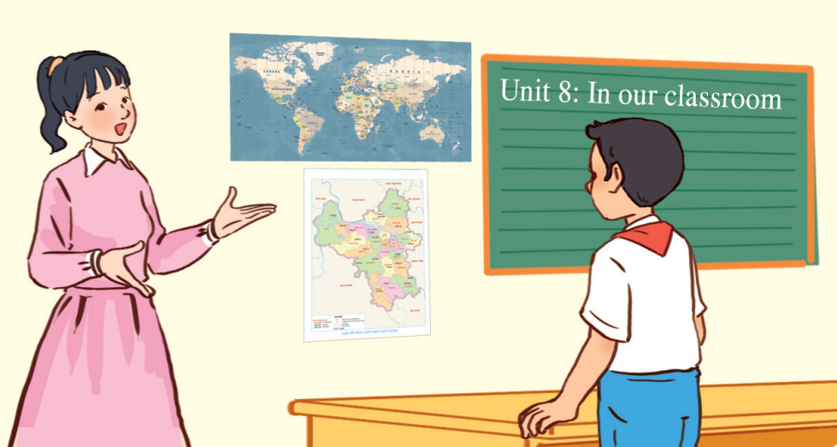

LISTEN AND REPEAT.
Where are the maps?
They’re beside the board.

Slide 15
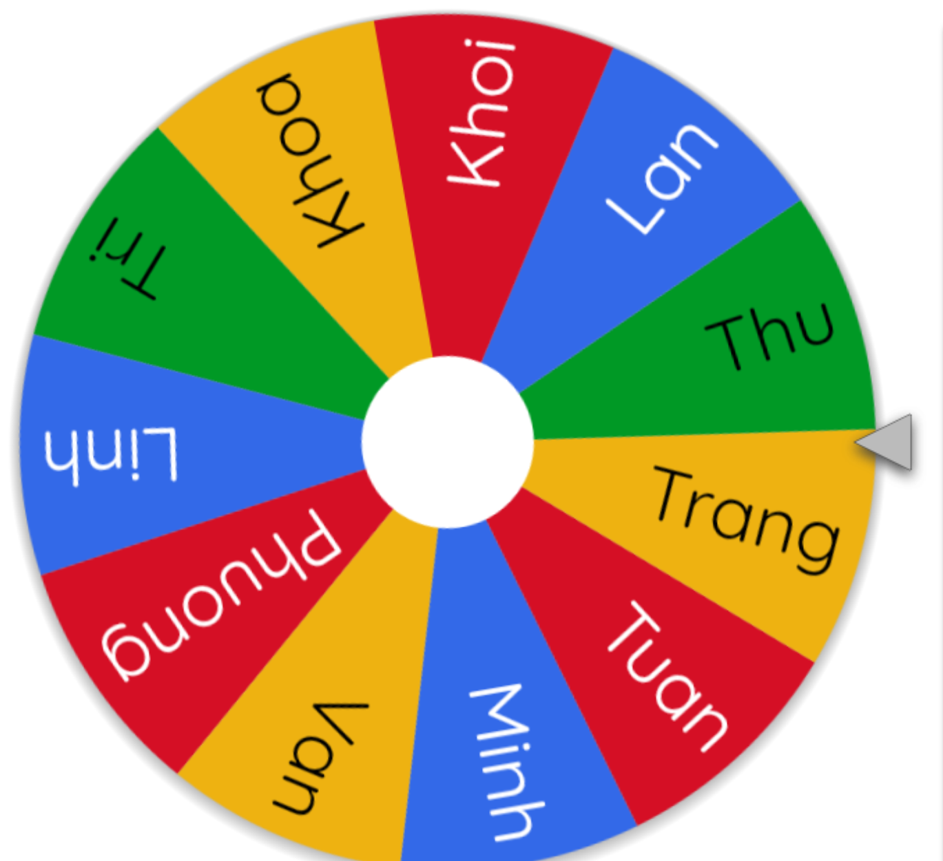
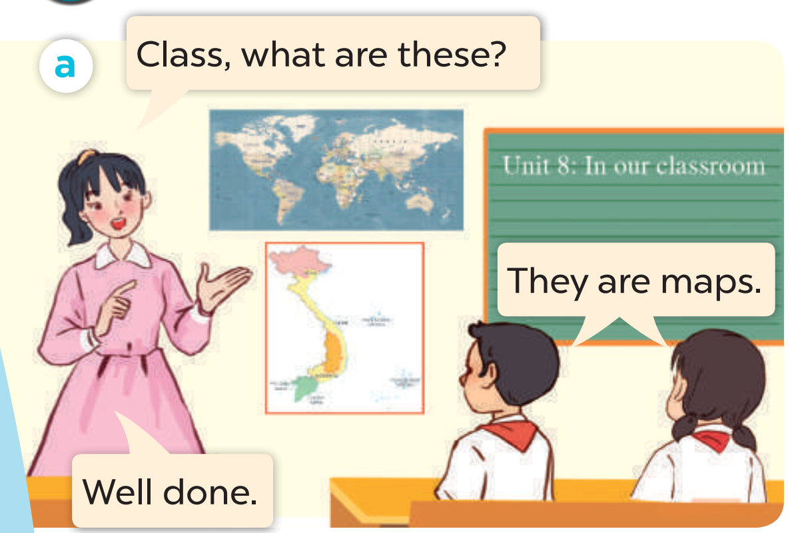
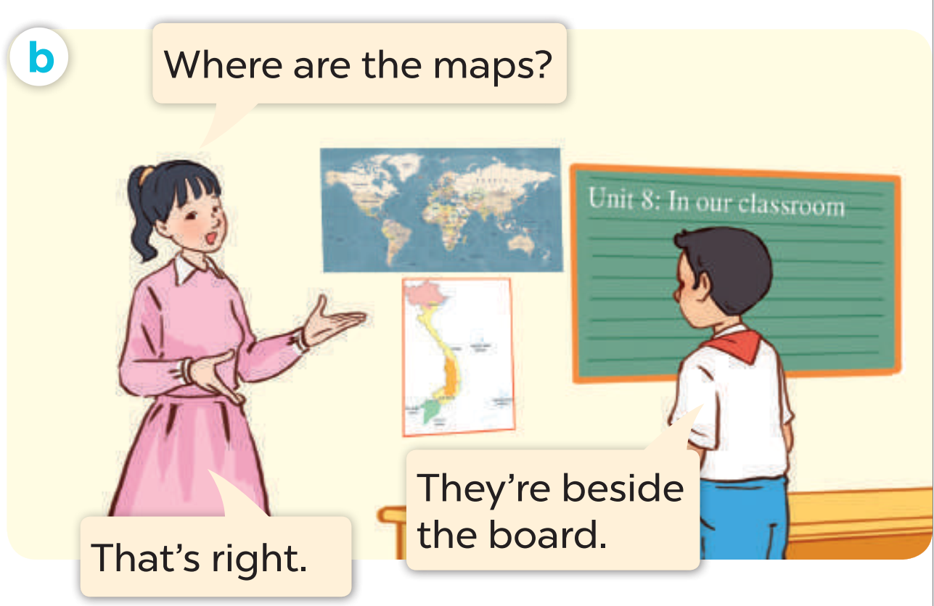
ASK AND ANSWER.

Slide 17
03
Listen, point and say.

Slide 18





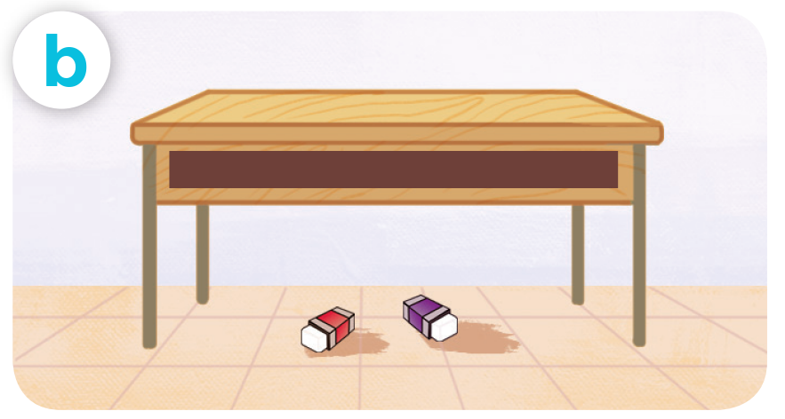
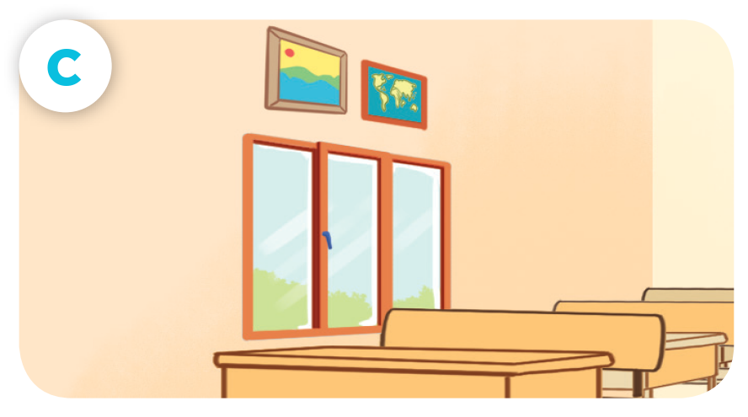
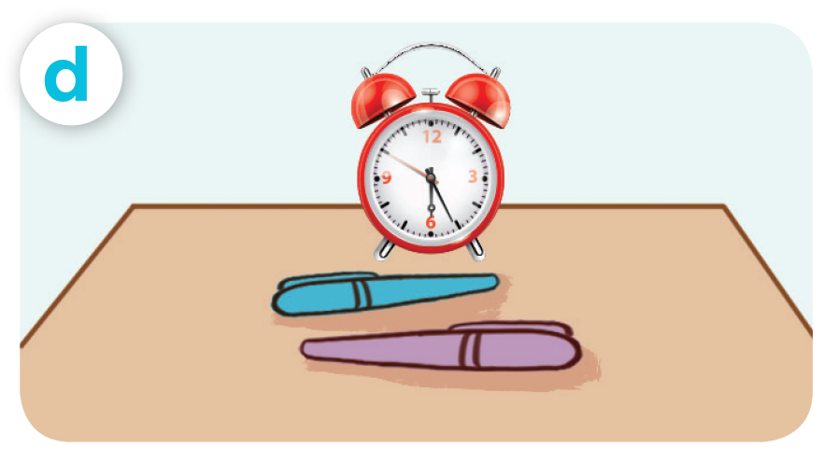
LOOK AND SAY
pencils / beside / book
erasers / under / desk
pictures / above / window
pens / in front of / clock

Slide 19





LISTEN AND REPEAT.
pencils / beside / book

Slide 20
LISTEN AND REPEAT.
erasers / under / desk

Slide 21
LISTEN AND REPEAT.
pictures / above / window

Slide 22
LISTEN AND REPEAT.
pens / in front of / clock

Slide 23




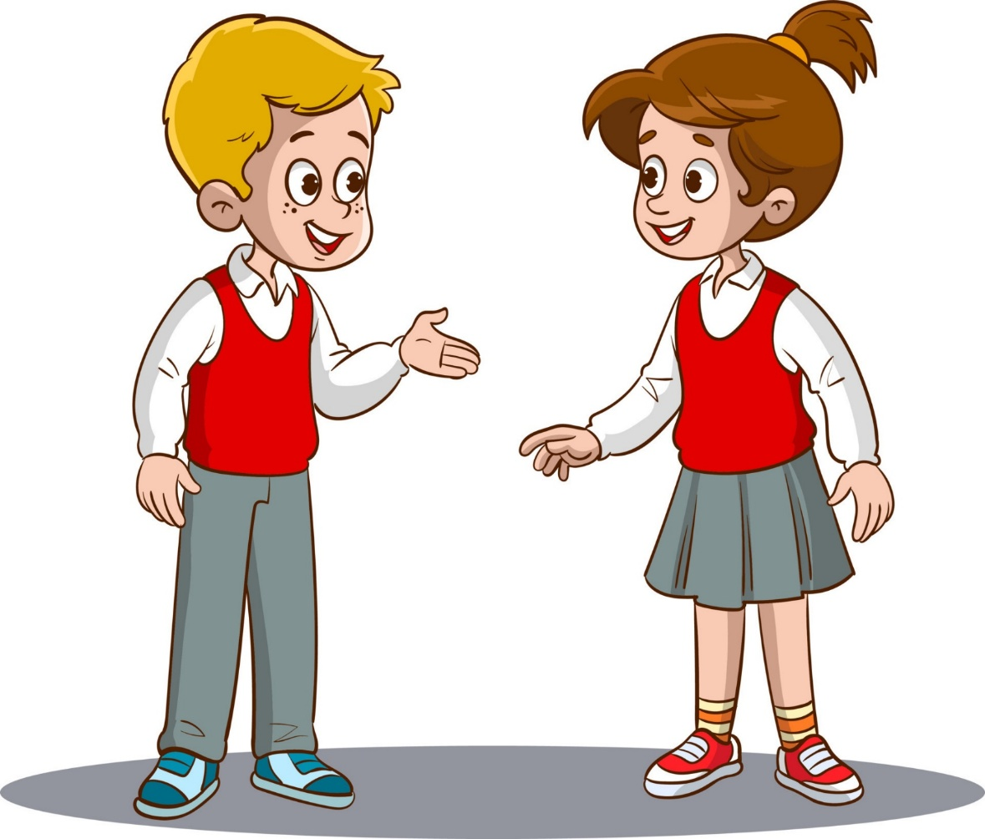

LISTEN AND REPEAT.
Where are the pencils?
pencils / beside / book
They’re beside
the book.

Slide 24

LISTEN AND REPEAT.
Where are the erasers?
erasers / under / desk
They’re under
the desk.

Slide 25


LISTEN AND REPEAT.
Where are the pictures?
pictures / above / window
They’re above
the window.

Slide 26
LISTEN AND REPEAT.
Where are the pens?
pens / in front of / clock
They’re in front of
the clock.

Slide 27

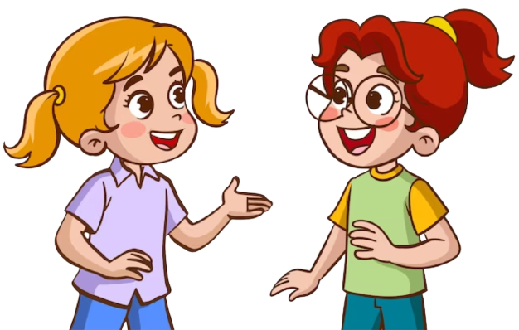
ASK AND ANSWER
pencils / beside / book
erasers / under / desk
pictures / above / window
pens / in front of / clock

Slide 28
ASK AND ANSWER
pencils / beside / book
erasers / under / desk
pictures / above / window
pens / in front of / clock

Slide 30
04
Let’s talk.

Slide 31


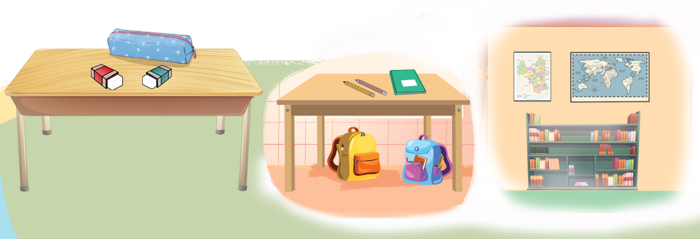
LOOK AND SAY.

Slide 32
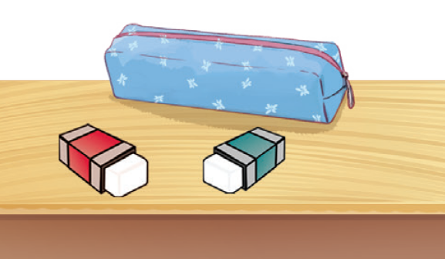
ASK AND ANSWER.
Where are
the erasers?
They’re beside the pencil case.

Slide 33
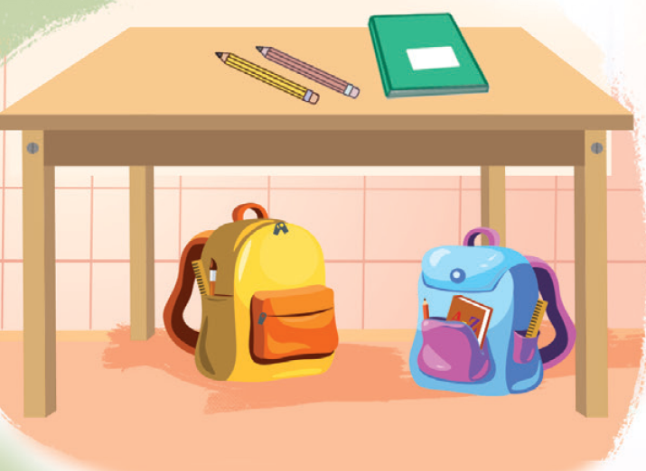

ASK AND ANSWER.
Where are the bags?
They’re under the desk.

Slide 34
ASK AND ANSWER.
Where are the pencils?
They’re beside the notebook.

Slide 35
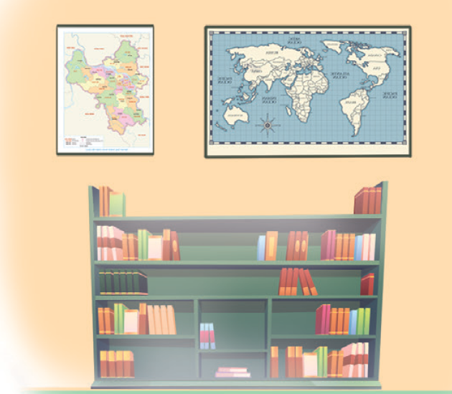
ASK AND ANSWER.
Where are the maps?
They’re above the bookcase.

Slide 36


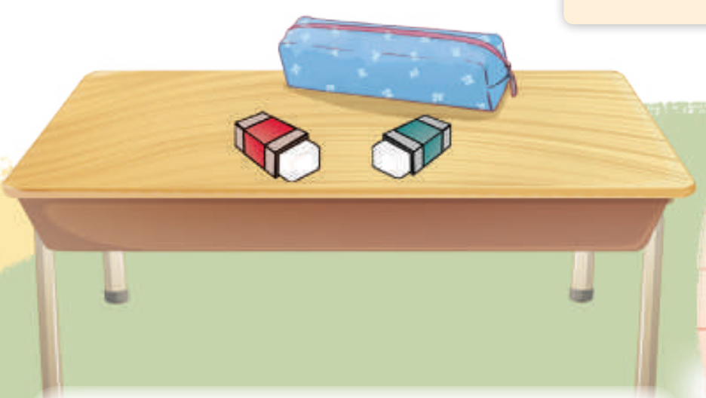
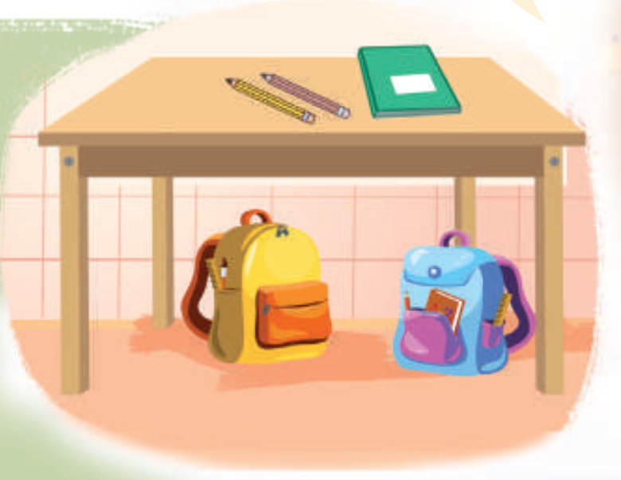
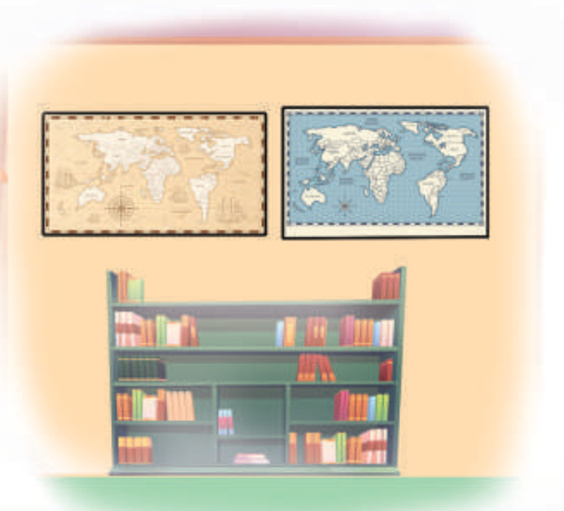
WORK in PAIRS
Ask and answer.

Slide 38
05
Fun corner & Wrap-up

Slide 39
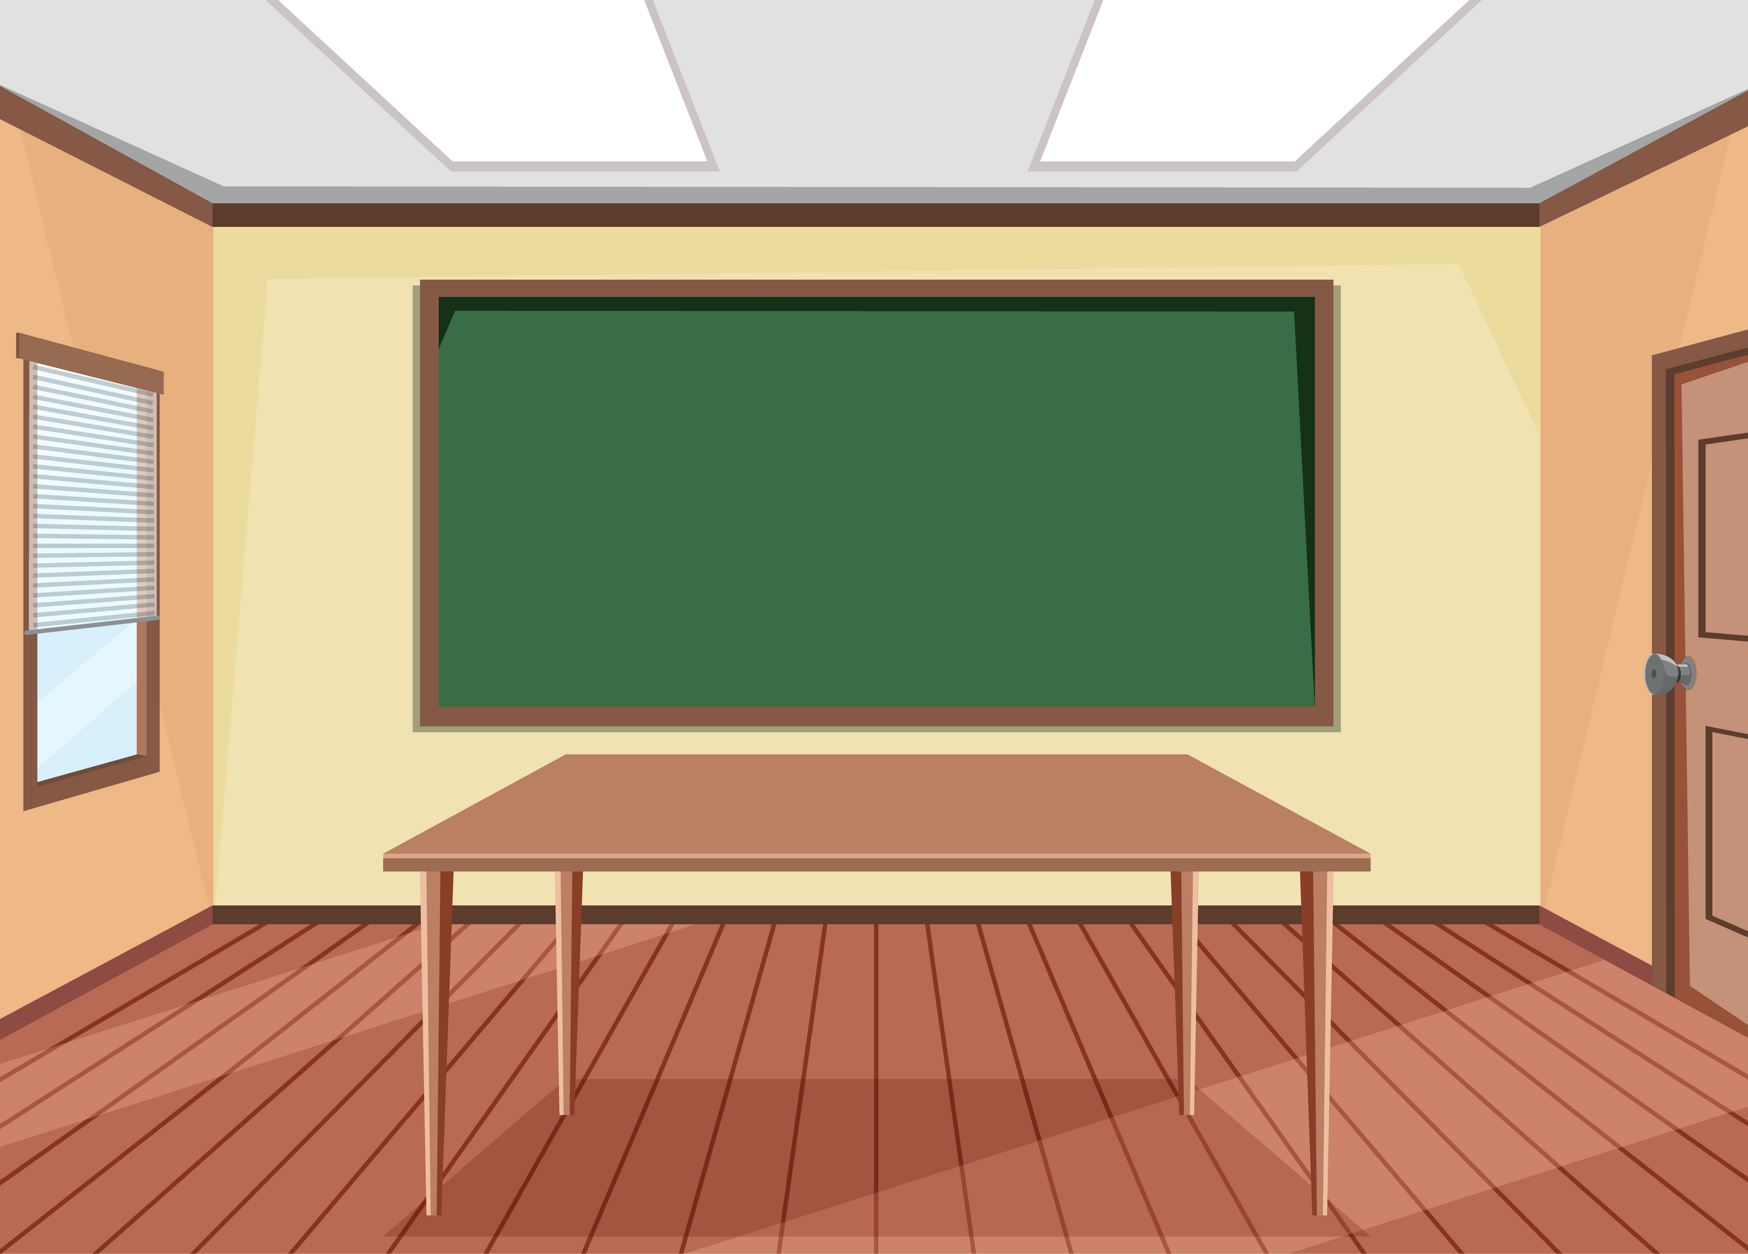

PREPOSITIONS
Memory Quiz Game
PLAY

Slide 40




Slide 41

Where are the three books?
They’re beside the board.
A
They’re beside the bag.
B
C
They’re under the desk.

Slide 42


The three books are beside the bag.
B

Slide 43
Where are the pictures?
They’re on the bookcase.
A
They’re above the board.
B
C
They’re beside the board.

Slide 44
The pictures are beside the board.
C

Slide 45

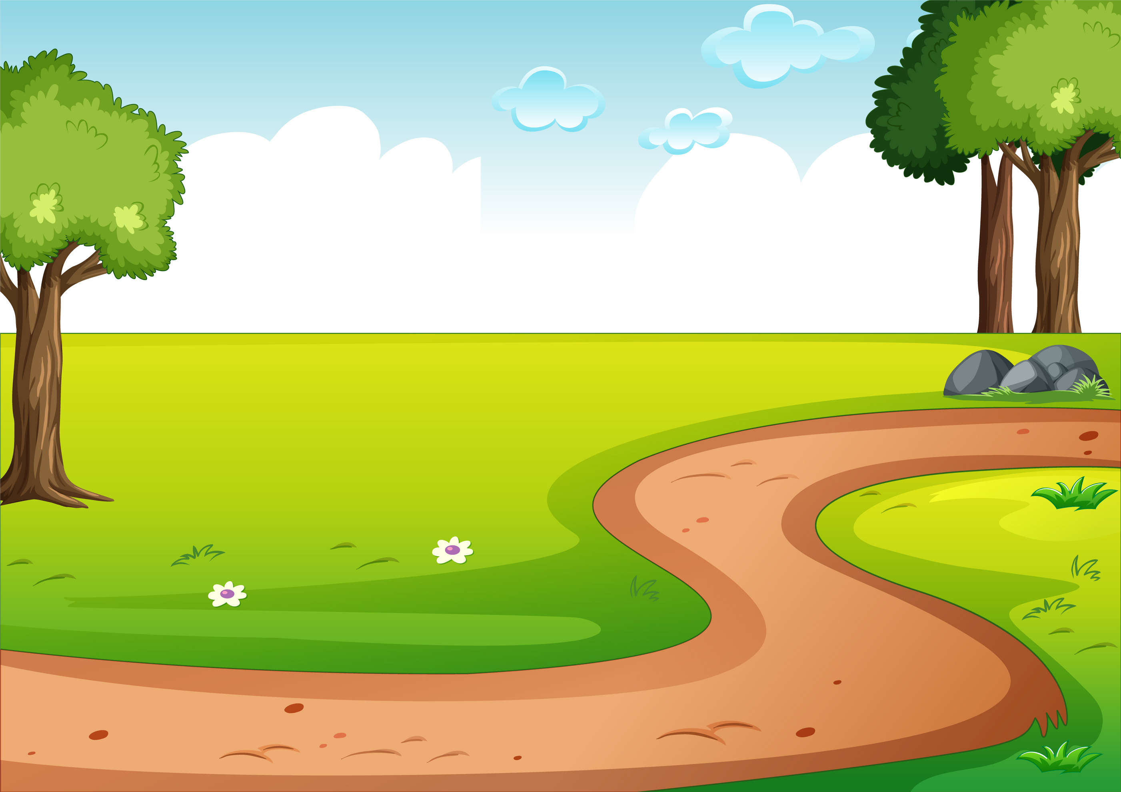

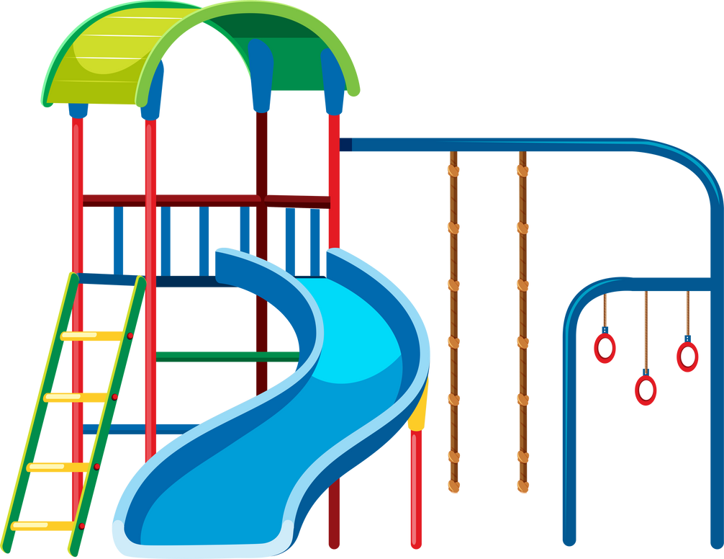
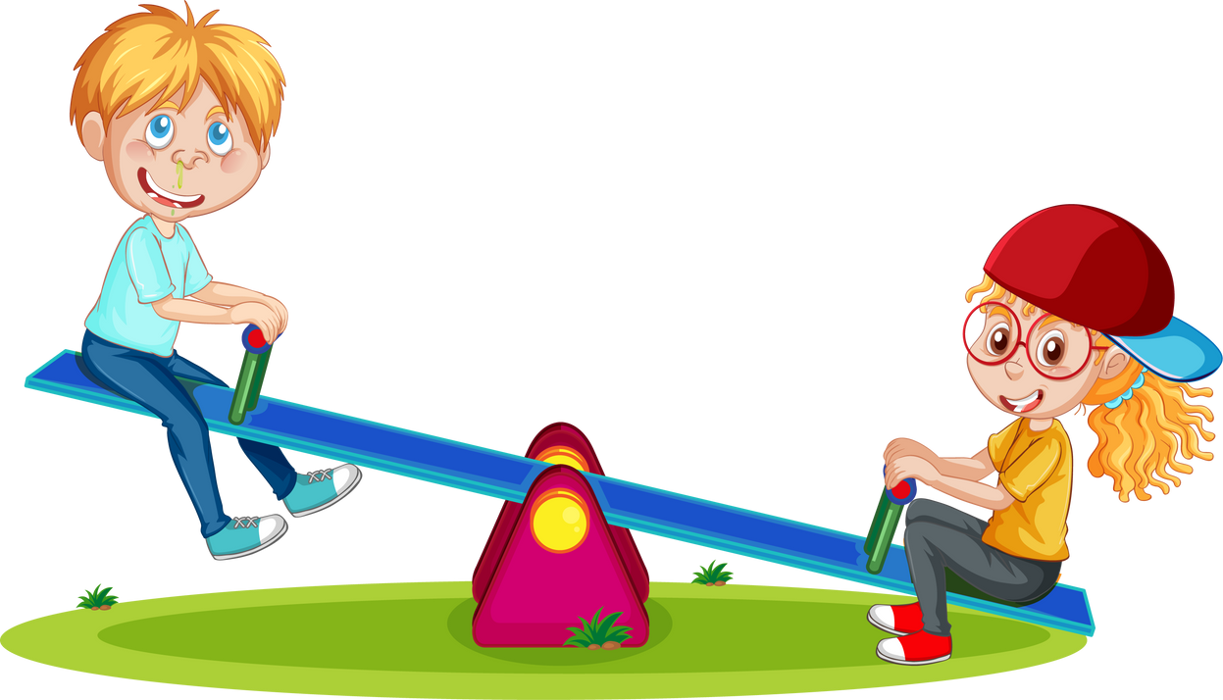

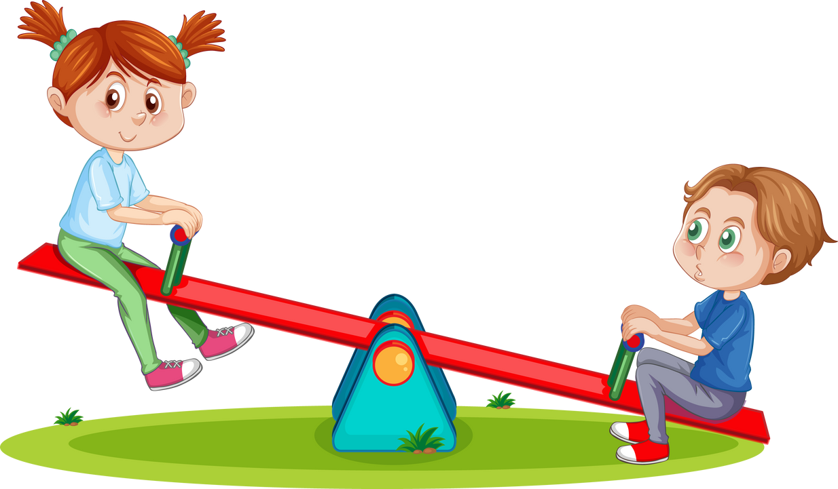
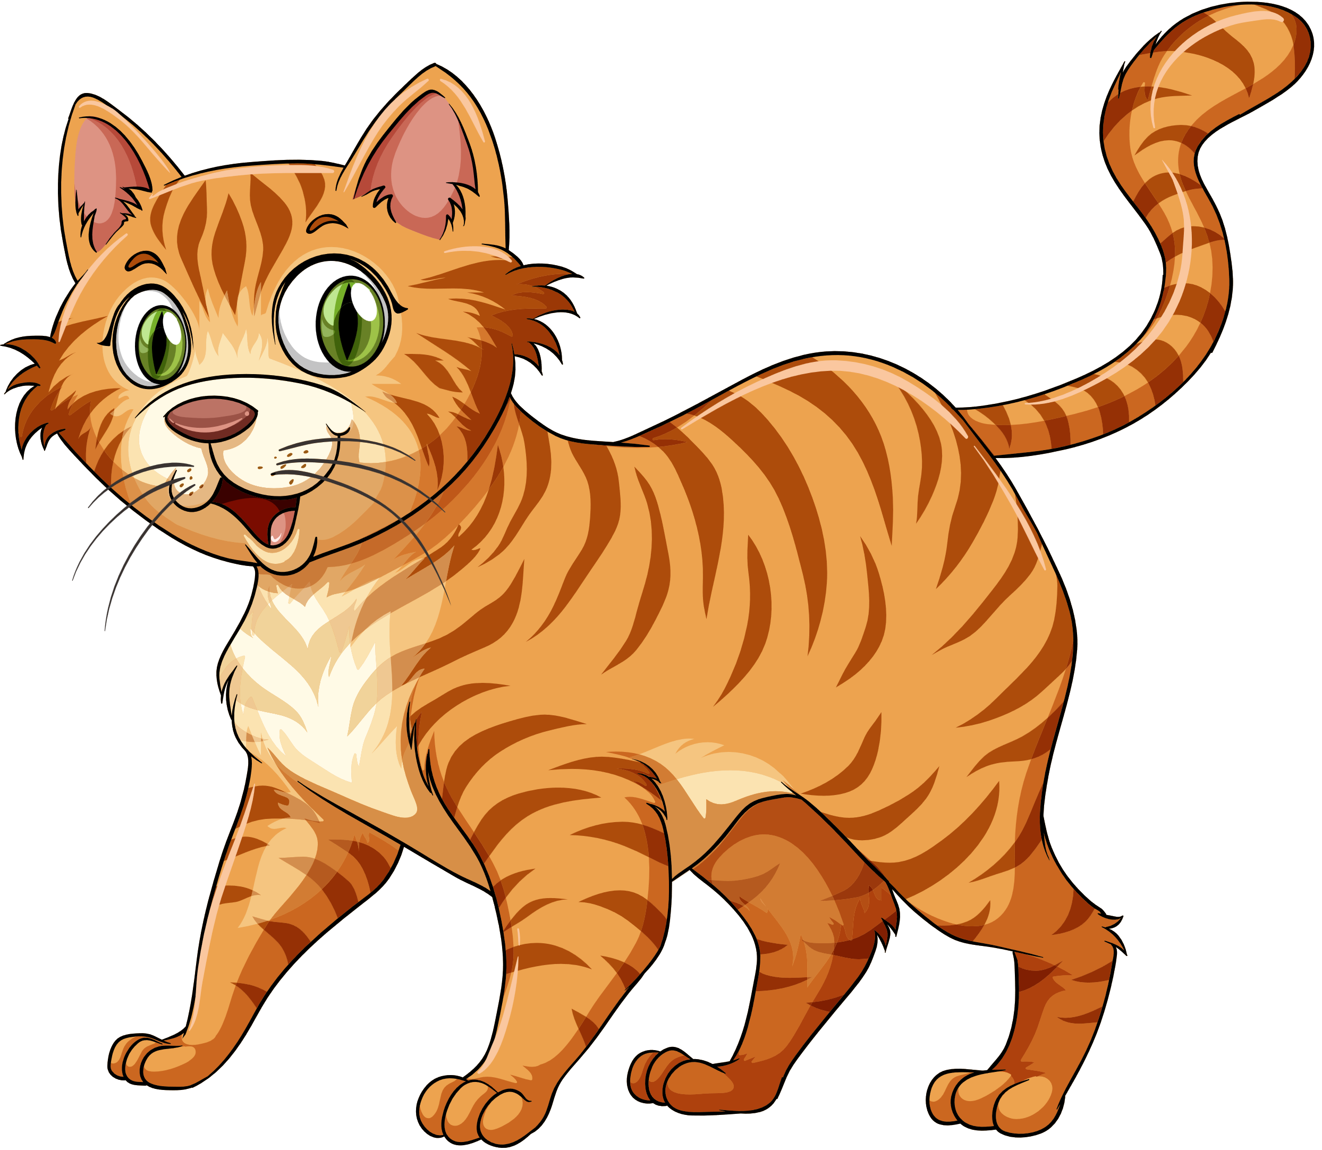
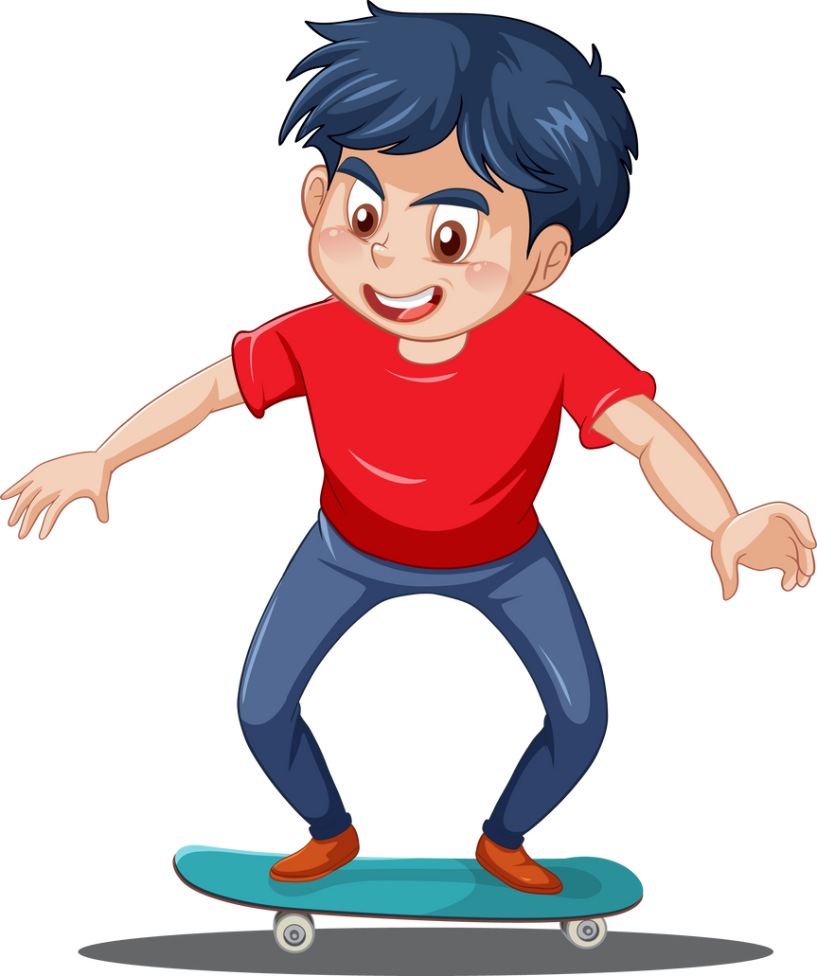



Slide 46
Where are the rabbits?
They’re next to the dog.
A
They’re under the tree.
B
They’re behind the cat.
C

Slide 47
The rabbits are under the tree.
B

Slide 48
Where are the birds?
They’re above the slide.
A
They’re under the tree.
B
They’re beside the cat.
C

Slide 49
The birds are above the slide.
A

Slide 50
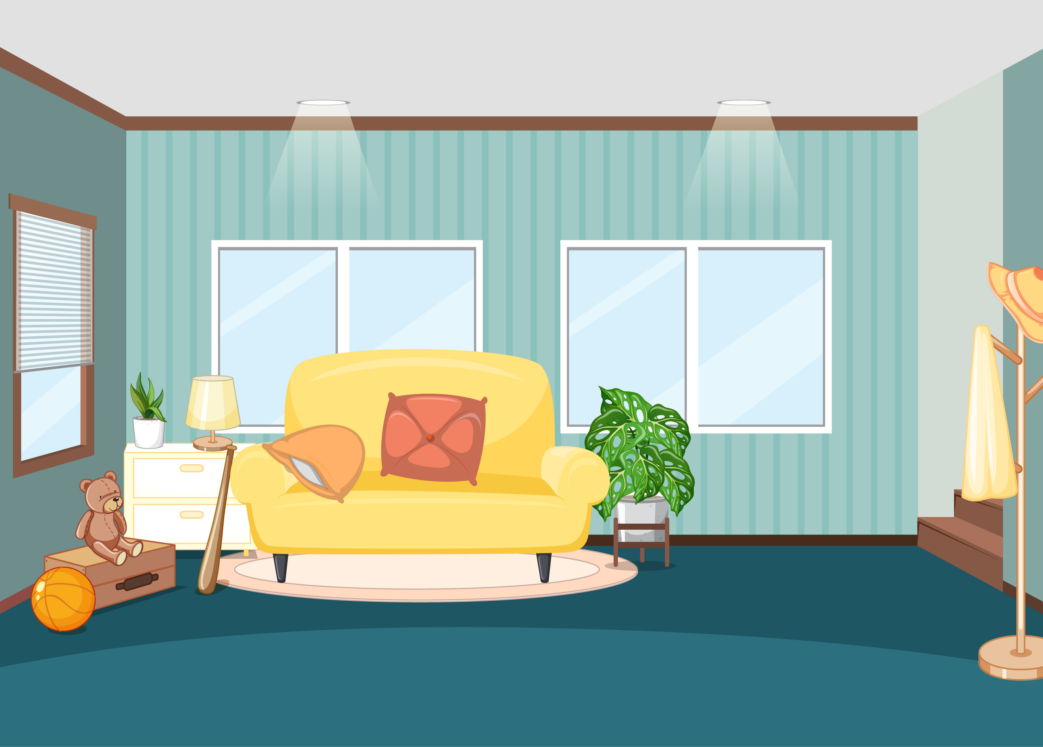
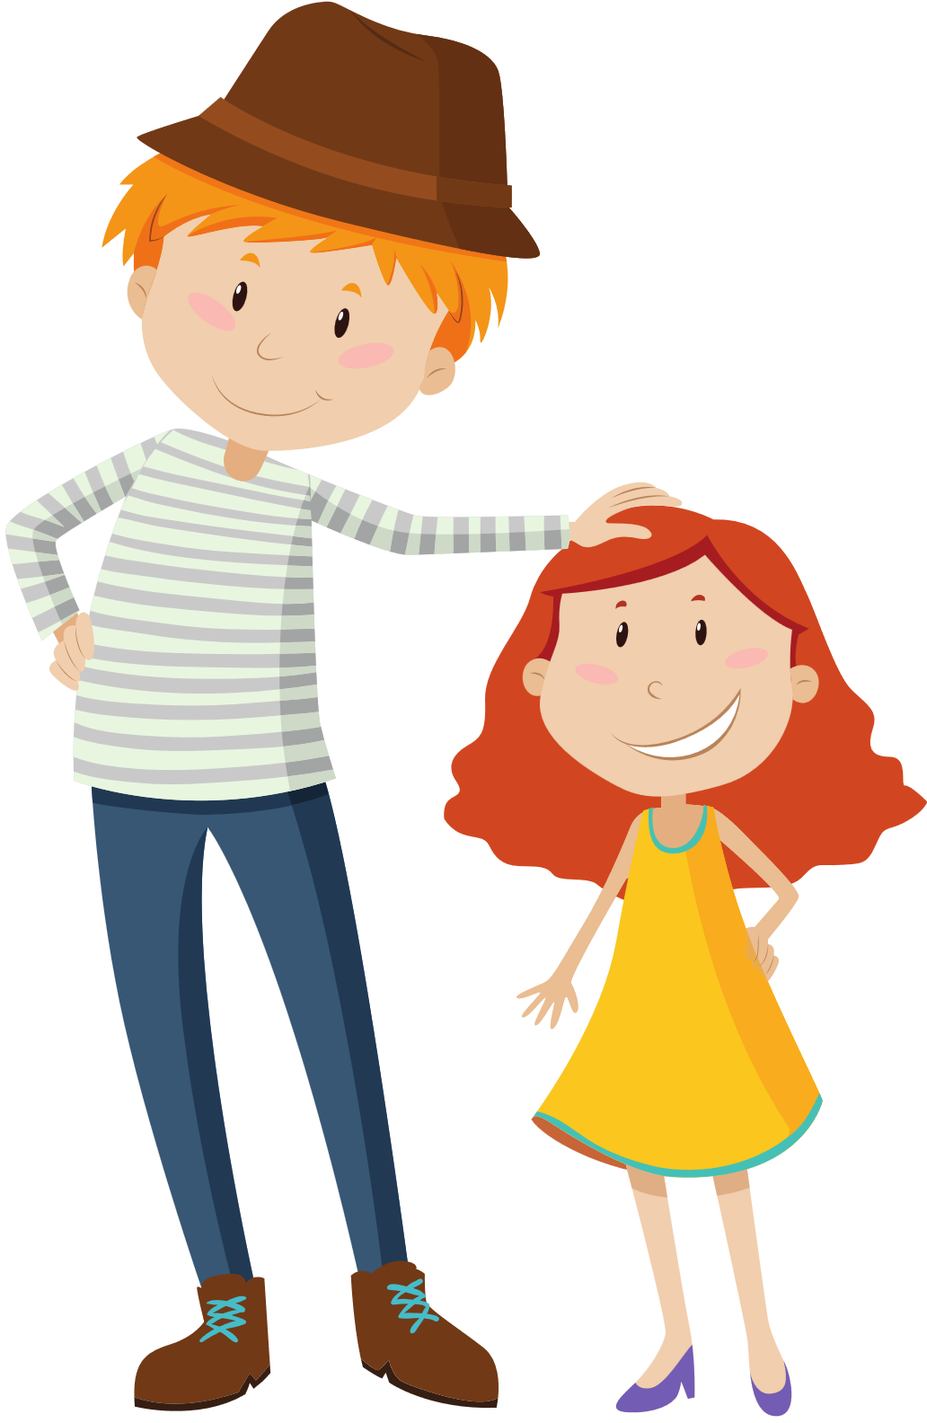
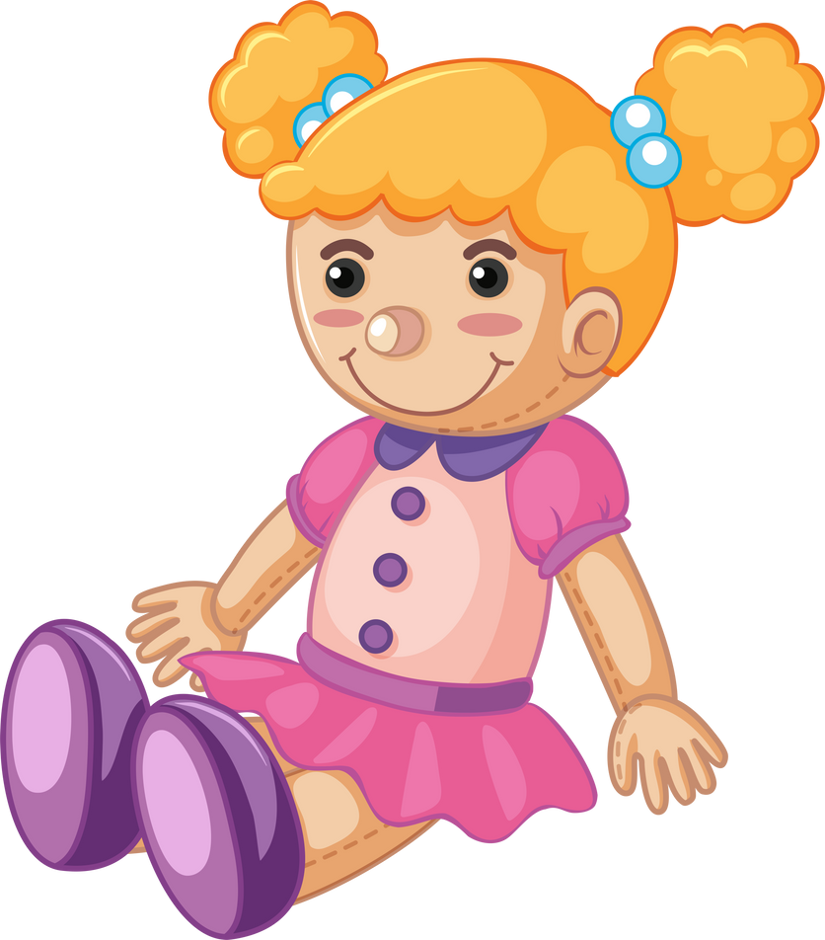




Slide 51
Where are the dolls?
They’re on the sofa.
A
They’re next to the doll.
B
They’re beside the box.
C

Slide 52
The dolls are on the sofa.
A

Slide 53
Where are the boats?
They’re behind the sofa.
A
They’re in front of the sofa.
B
They’re on the sofa.
C

Slide 54
The boats are in front of the sofa.
B

Slide 55
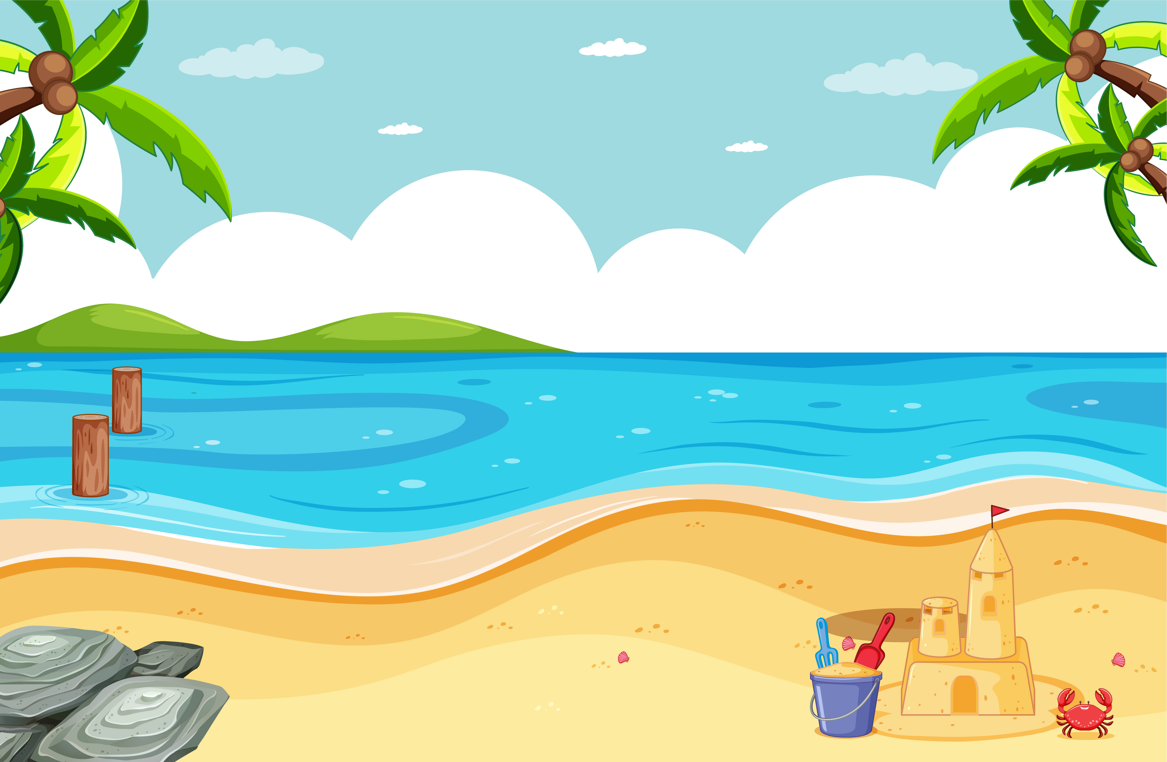




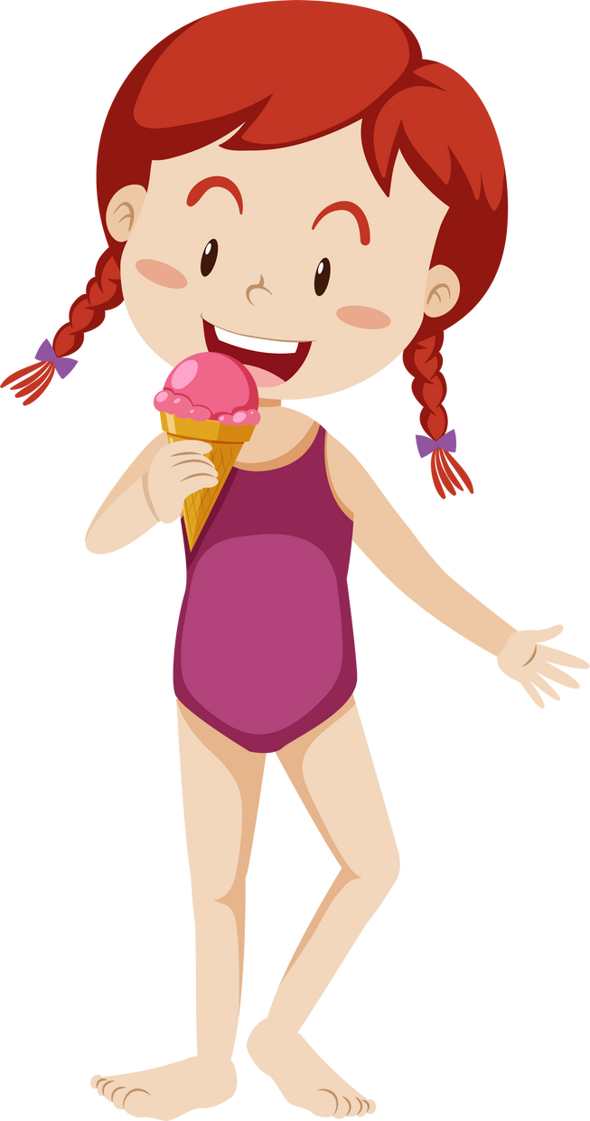




Slide 56
Where are the crabs?
A
They’re on the umbrella.
B
They’re beside the sandcastle.
C
They’re in the water.

Slide 57
The crabs are beside the sandcastle.
B

Slide 58
Where are the birds?
They’re on the umbrella.
A
They’re on the chairs.
B
C
They’re above the boy.

Slide 59

The birds are above the boy.
C

Slide 60
GAME OVER
Thank you for playing!
QUIT

Slide 62





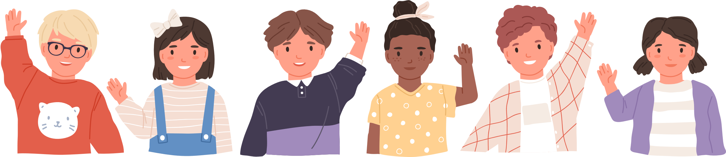
See you
next time!

Slide 63
Website: hoclieu.vn
Fanpage: https://www.facebook.com/tienganhglobalsuccess.vn/

