Slide 1
Unit 13: MY HOUSE
LESSON 3.2

Slide 2
Table of contents
Warm up
01
02
Review
Reading
03
04
Activity
You can describe the topic of the section here
You can describe the topic of the section here
You can describe the topic of the section here
You can describe the topic of the section here

Slide 3
Warm up!

Slide 5
Review game

Slide 6
Find the monster

Slide 7
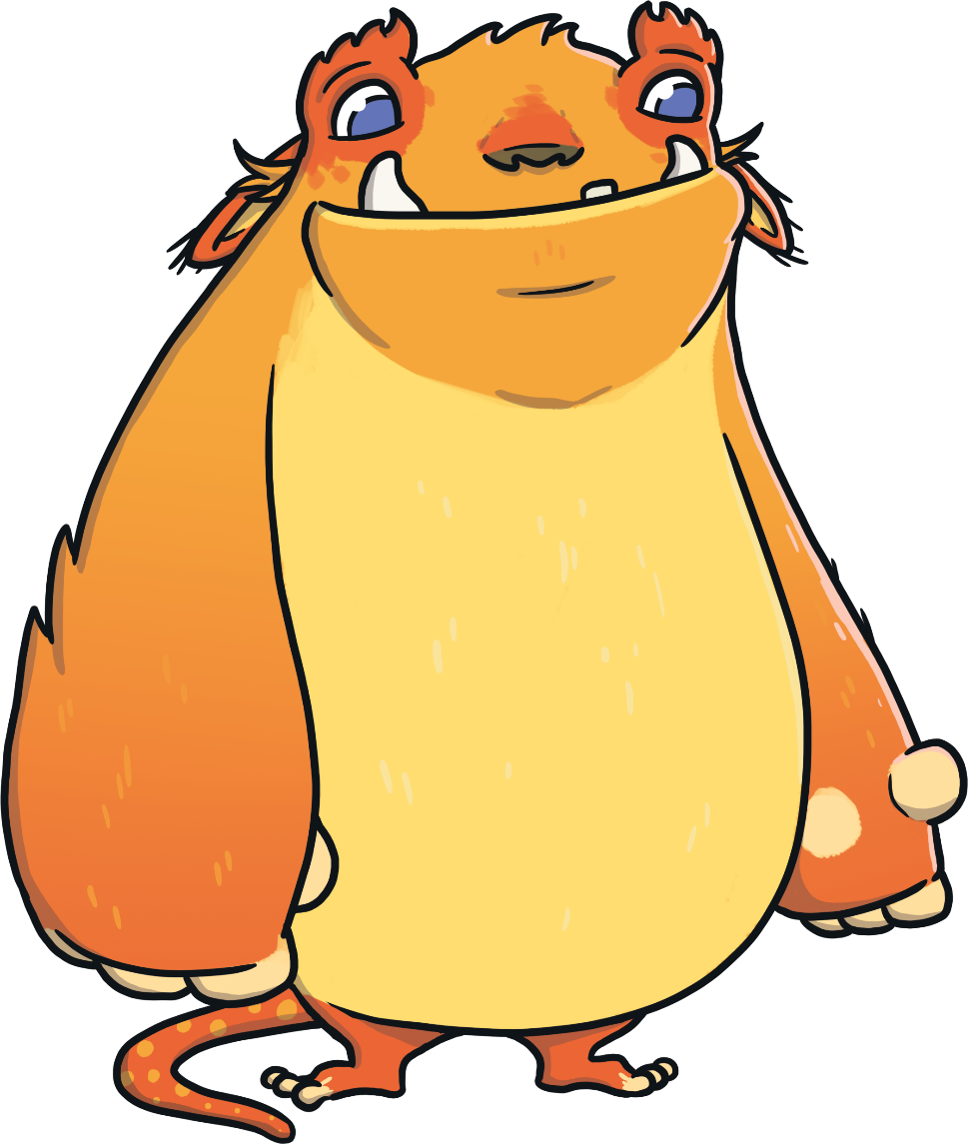
Can you find me?
Can you help me choose the correct answer?

Slide 8
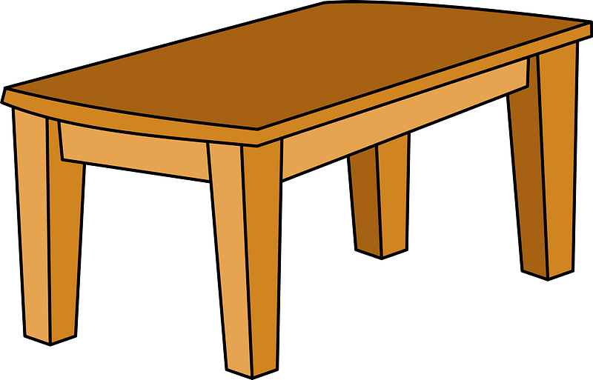
Choose the right word
Next
table
chair
house

Slide 9
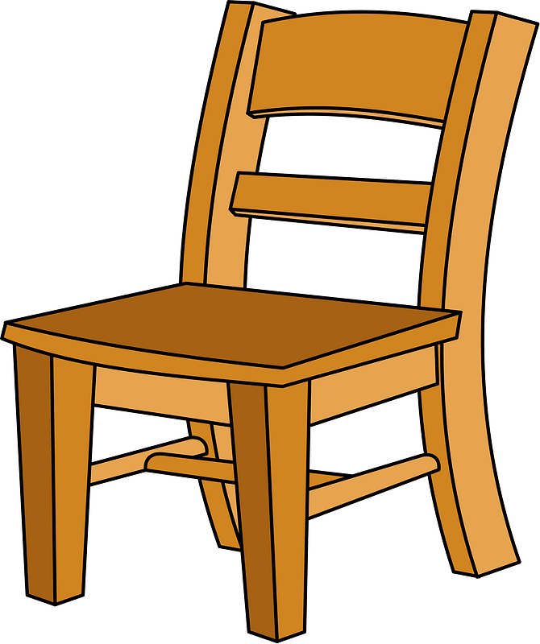
Choose the right word
Next
table
chair
house

Slide 10
Find the missing letter
h….se
Next
ow
ou
oo

Slide 11
REORDER
E-H-R-E
Next
REHE
HEER
HERE

Slide 12
The cat is ..... the box.
Next
here
on
in

Slide 13
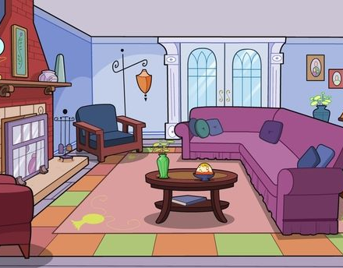
What’s this ?
Next
living room
lamp
kitchen

Slide 14
REORDER
Next
the-Where-lamps?-are
Where the lamps are?
The lamps where are?
Where are the lamps?

Slide 15
It’s there .
Next
Where's the kitchen?
Where are they?
How old are you?

Slide 16
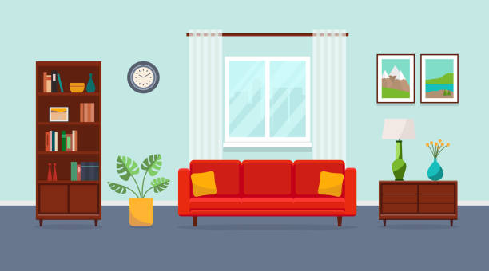
Next
It's you
It's here
It's there

Slide 17
……are the books ?
They're in the box.
Next
Who
Where
What

Slide 18
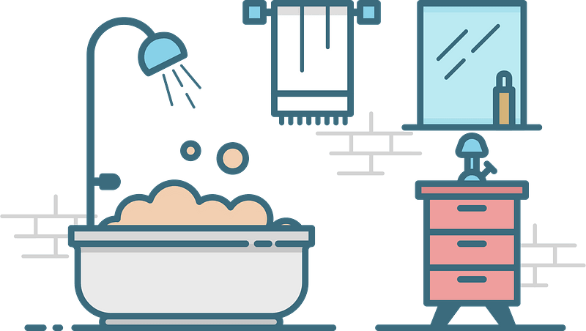
Listen and choose
Next

Slide 20
Reading

Slide 21
the bedroom
the kitchen
the kitchen
the table

Slide 22
Activity

Slide 23
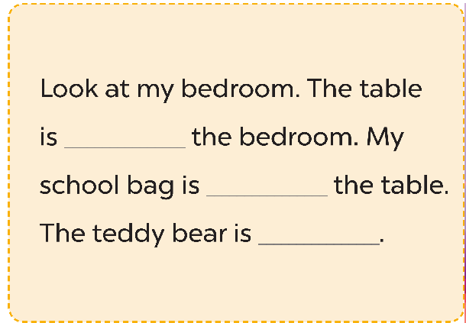
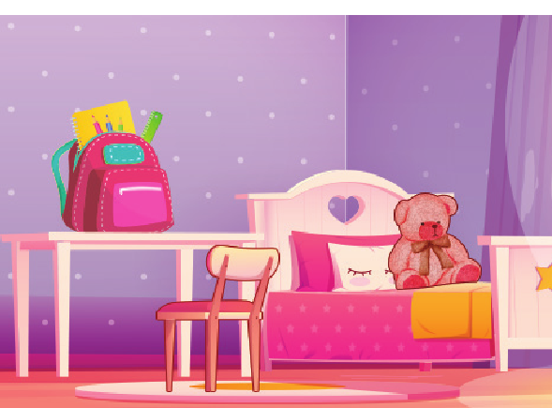

Slide 24
