Slide 1
Unit 13 MY HOUSE
LESSON 2.2

Slide 2
01
WARM UP

Slide 4
02
REVIEW

Slide 5
AGENT

Slide 6
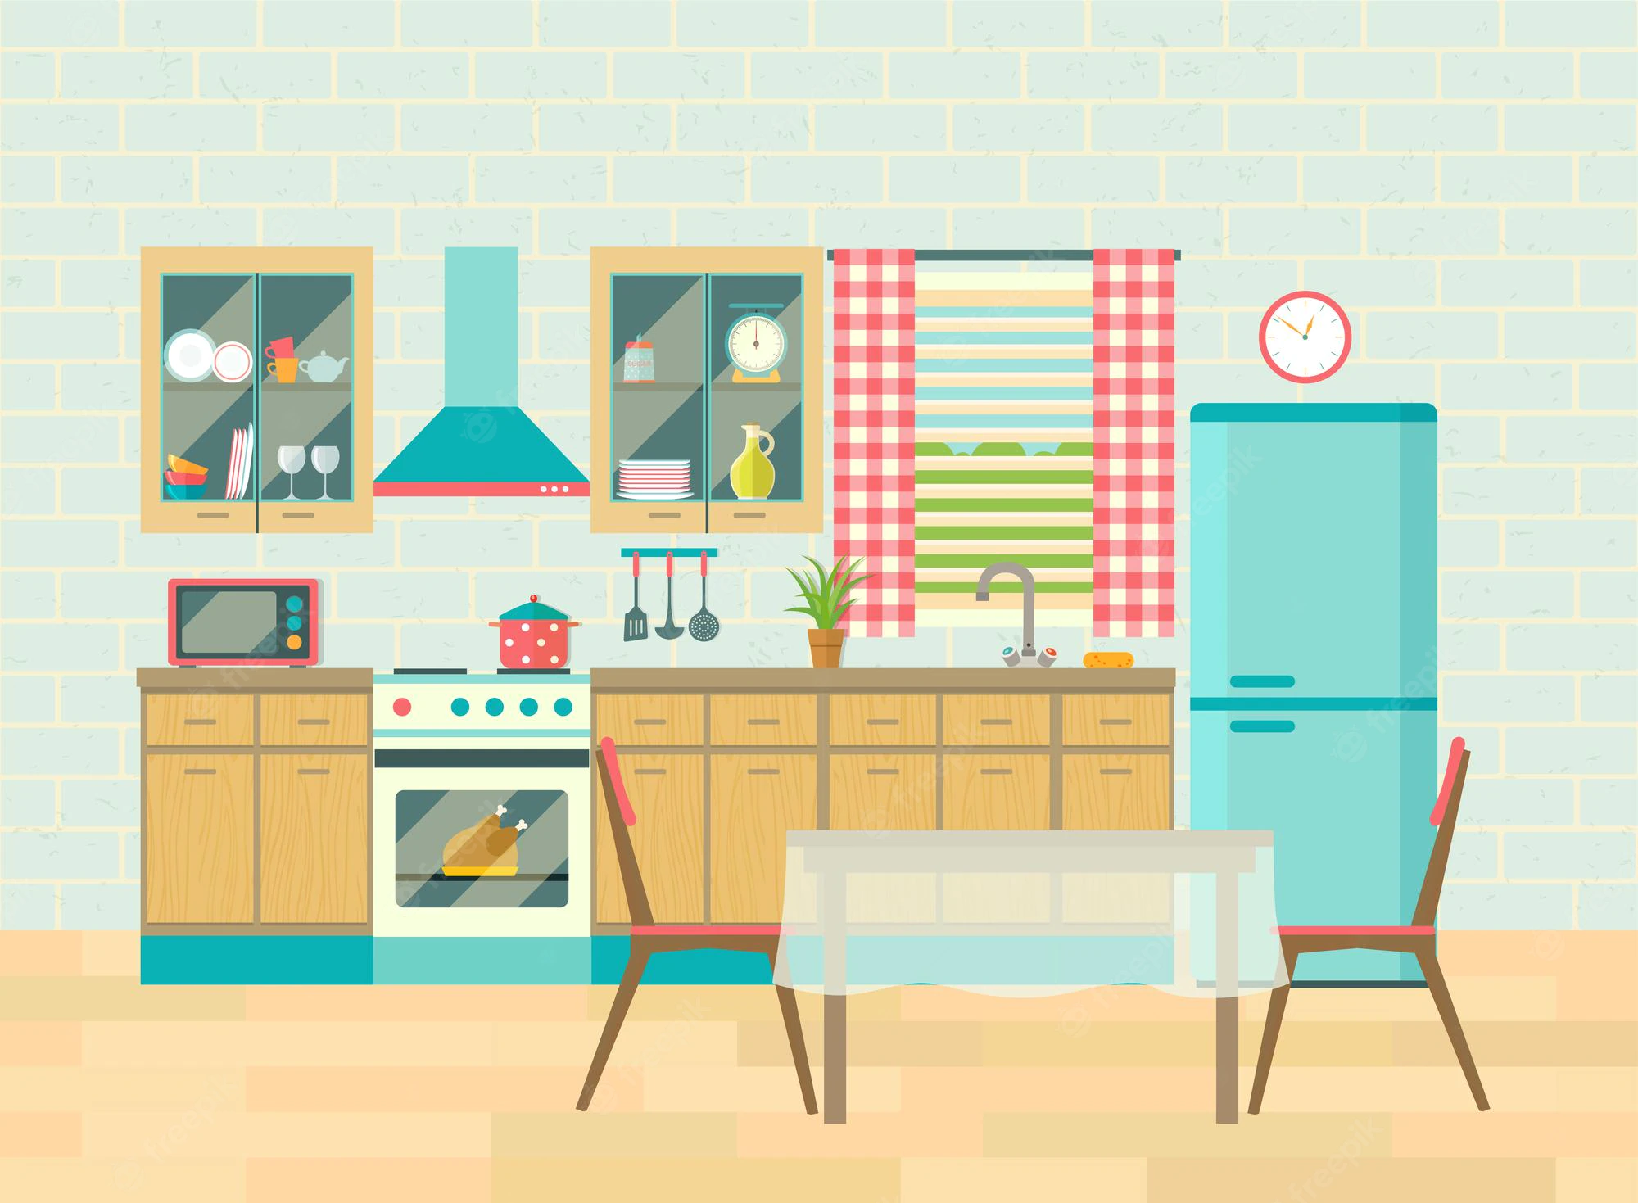
Look and choose.
bathroom
bedroom
GOOD JOB!
kitchen
living room

Slide 7
I can sleep in this room.
GOOD JOB!
bedroom
bathroom
kitchen
living room

Slide 8
Where's is.....?
GOOD JOB!
kitchen
bathroom
house
here

Slide 9
unscramble H-C-I-R-A
GOOD JOB!
chair
chrai
chari
chira

Slide 10
Q:?
A:It's there.
GOOD JOB!
How are you?
What is it?
Where's the bedroom?

Slide 11
Listen and choose.
GOOD JOB!

Slide 12
My mom can cook here.
GOOD JOB!
there
kitchen
kitten
chicken

Slide 13
Where's my bathroom?
GOOD JOB!

Slide 14
They ________ got some beautiful books.
They love reading.
have
GOOD JOB!
have
haven’t
has
hasn’t

Slide 16
03
LISTEN & READ

Slide 17
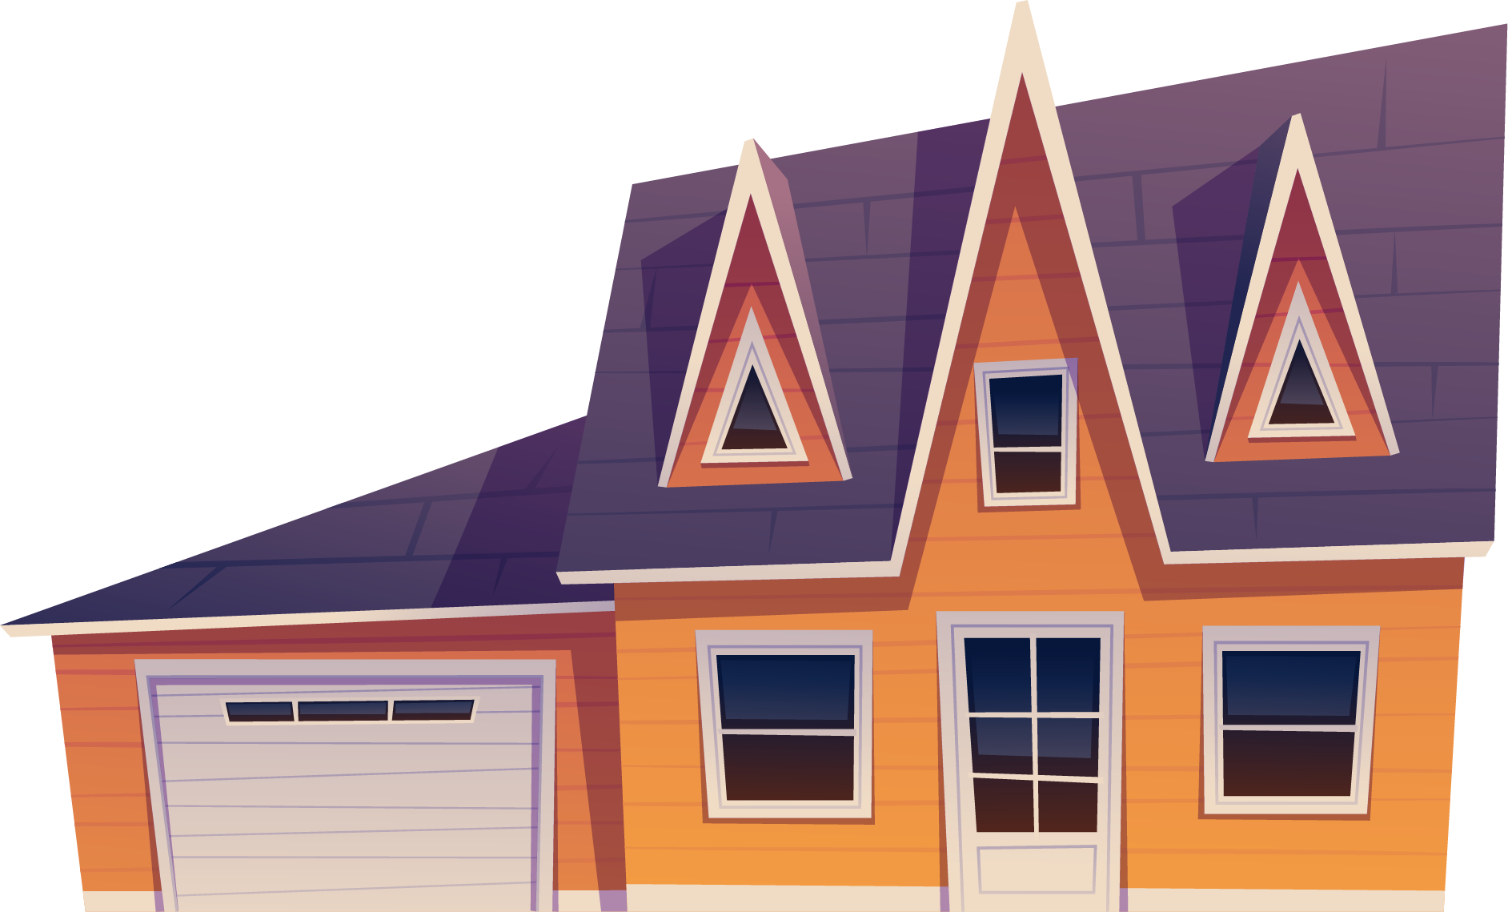
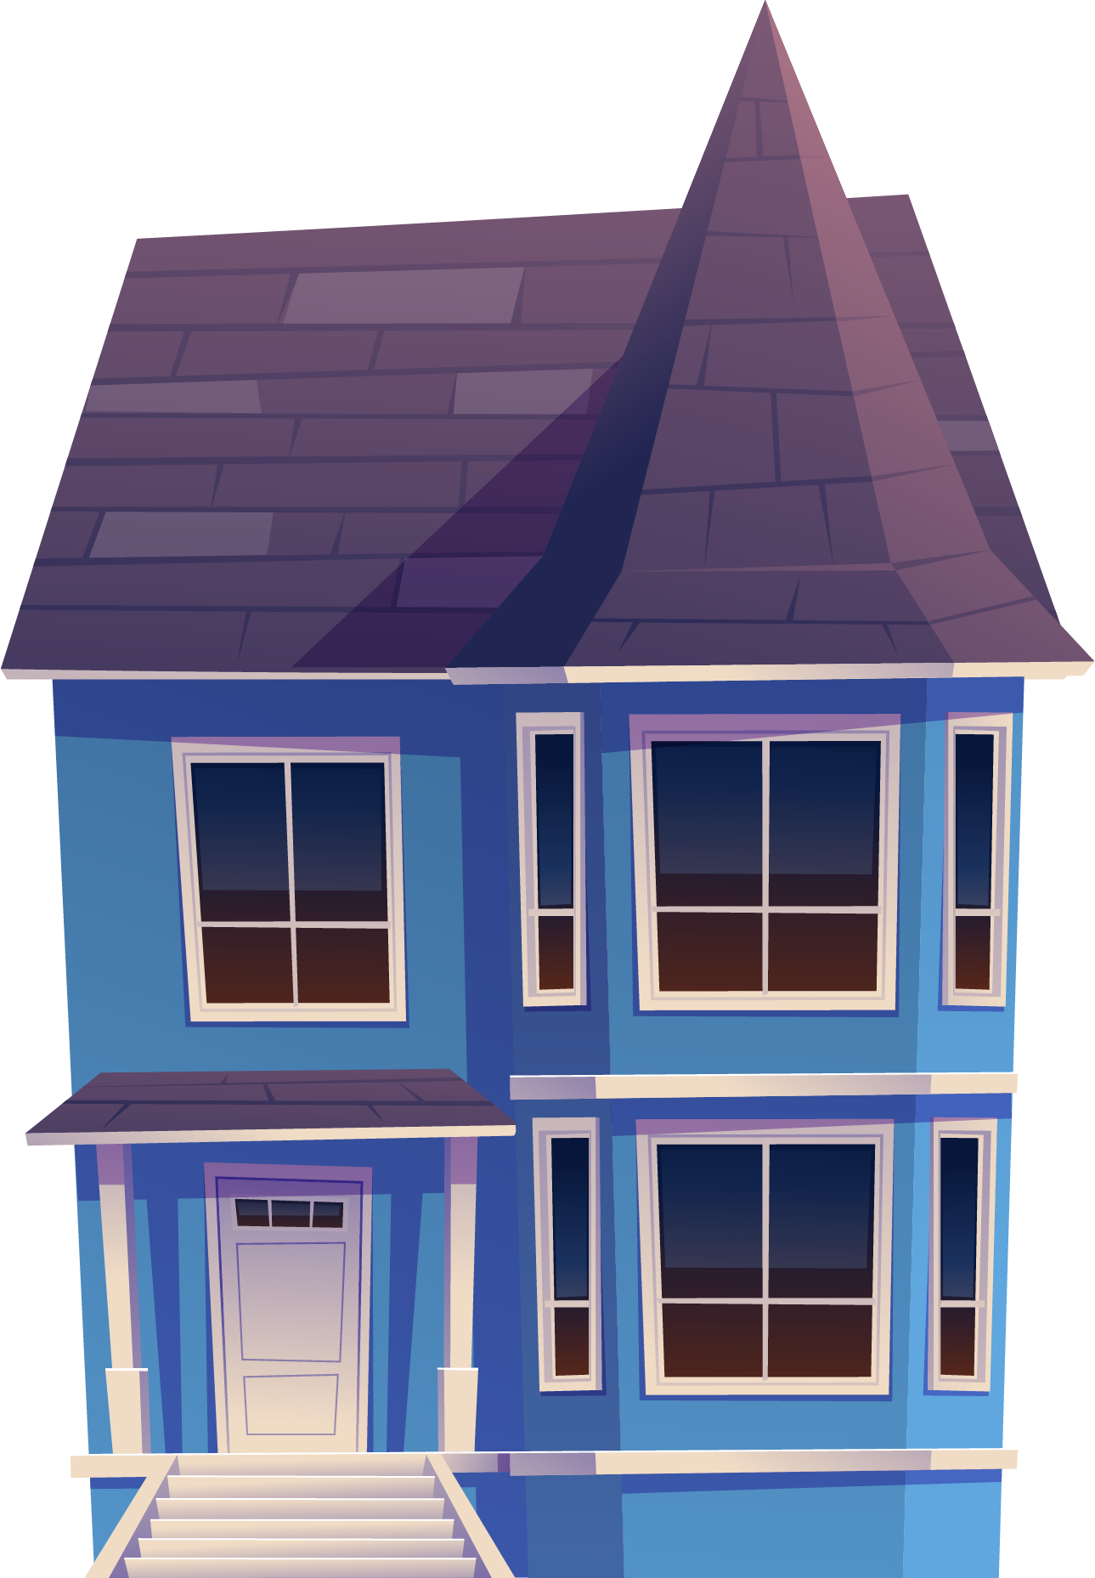
3
1
4
2

Slide 20
04
PRACTICE

Slide 21
