Slide 1
Unit 12:
Jobs
Lesson 3 .2

Slide 2
Content
01
03
WARM UP
WRITING
02
04
PROJECT
READING

Slide 3

Warm Up

Slide 4





Slide 5

yes, she is
Is she a nurse?
Yes, she is
Yes, he is
no, she isn’t
No, he isn’t

Slide 6


Listen and choose:
My father is a …………
teacher
nurse
driver
teacher
farmer

Slide 7
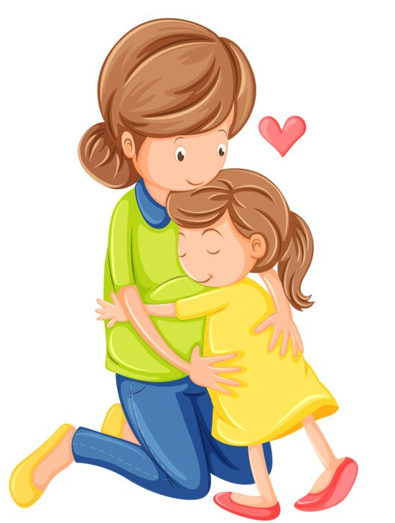
My mother __________ cook
is a
is an
a
is
is a

Slide 8

This is my brother.________is a worker.
His job
My job
Her job
His job
Their job

Slide 9
Is your mother a singer?
-------------------
Yes, she is
No, she isn’t
No,she isn’t
She’s a singer
she’s a nurse

Slide 10
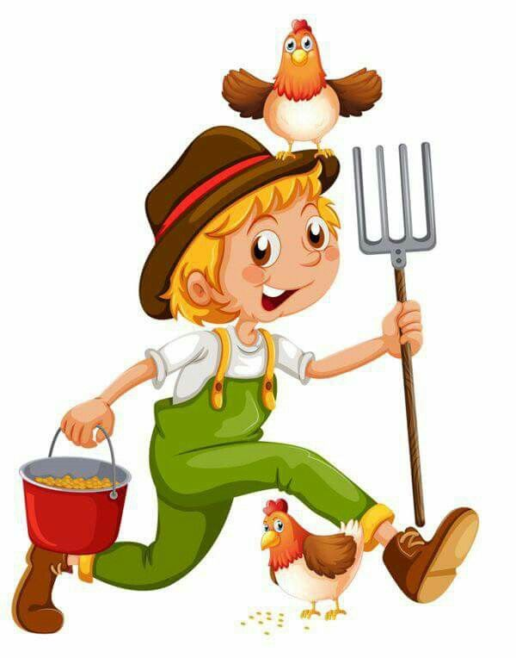
Is he a farmer?
Yes, he is
yes, she is
No, he isn’t
yes, he is
no, she isn’t

Slide 11

My mother is a__________
nurse
doctor
cook
singer
nurse

Slide 12

a/ worker/ my/ is/ sister
My sister is a worker
my is sister a worker
My sister a is sister
my sister is a worker
my sister a worker is

Slide 13

She’s __________
a doctor
doctor
the doctor
an doctor
a doctor

Slide 14

Is he a teacher?
No, he isn’t
No, he isn’t
No, she isn’t
Yes, she is
Yes, he is

Slide 15

Class activities

Slide 16



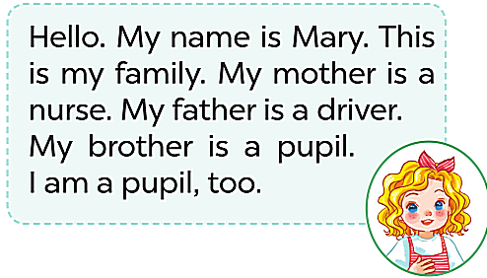
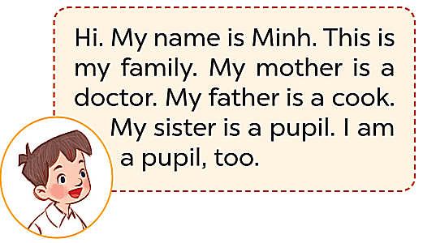
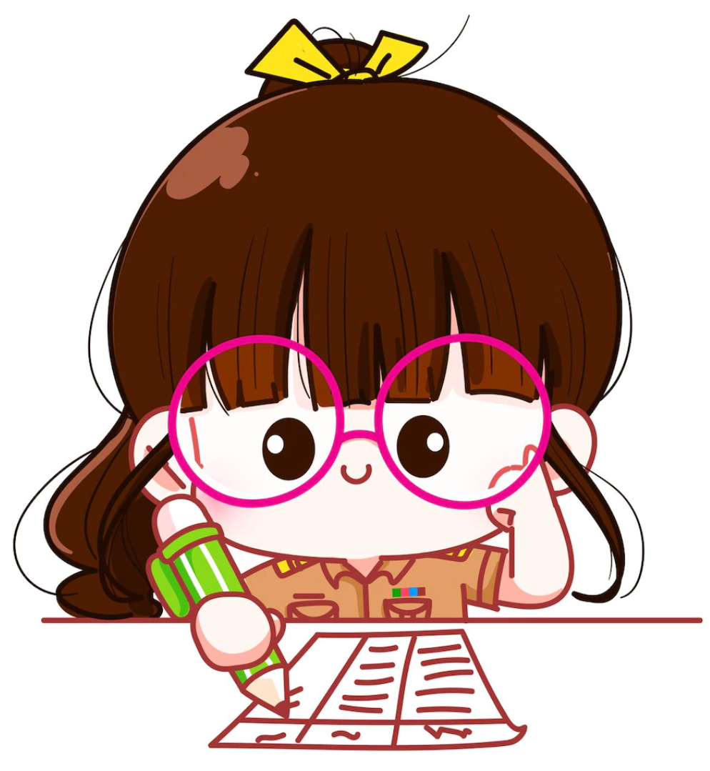
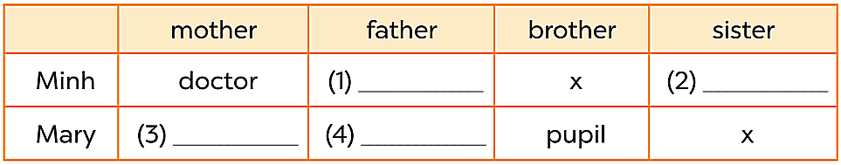


cook
pupil
nurse
driver

Slide 17

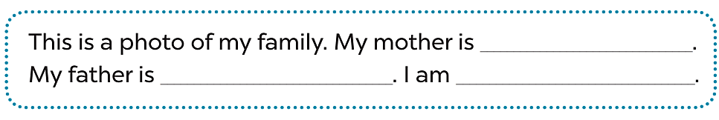
……..
……..
……..

Slide 18

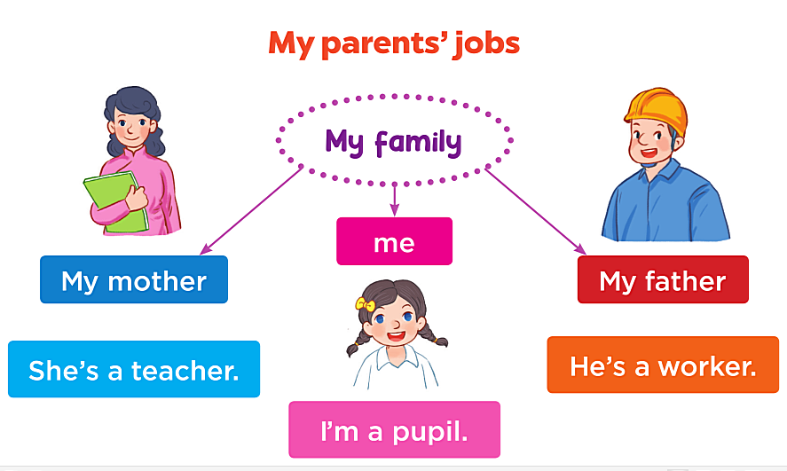

Slide 19

See you soon

