Slide 1
Unit 12: Jobs
Lesson 2 .1

Slide 2
Content
REVIEW
01
REVIEW GAME
03
VOCABULARY
02
SENTENCE
04
REVIEW GAME
05

Slide 3
Review

Slide 4
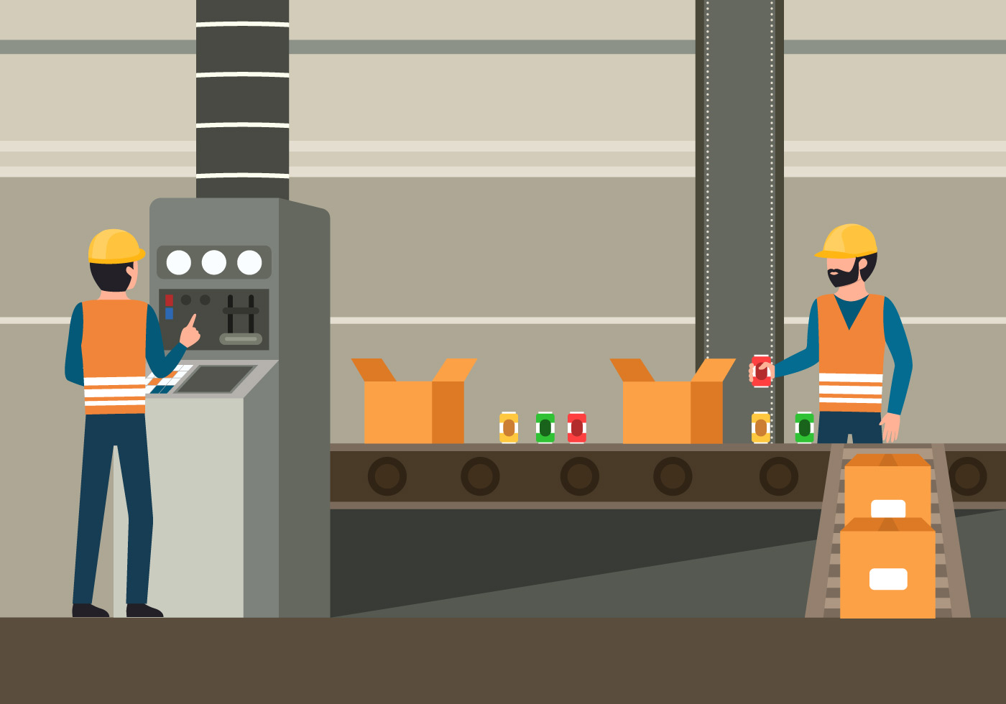
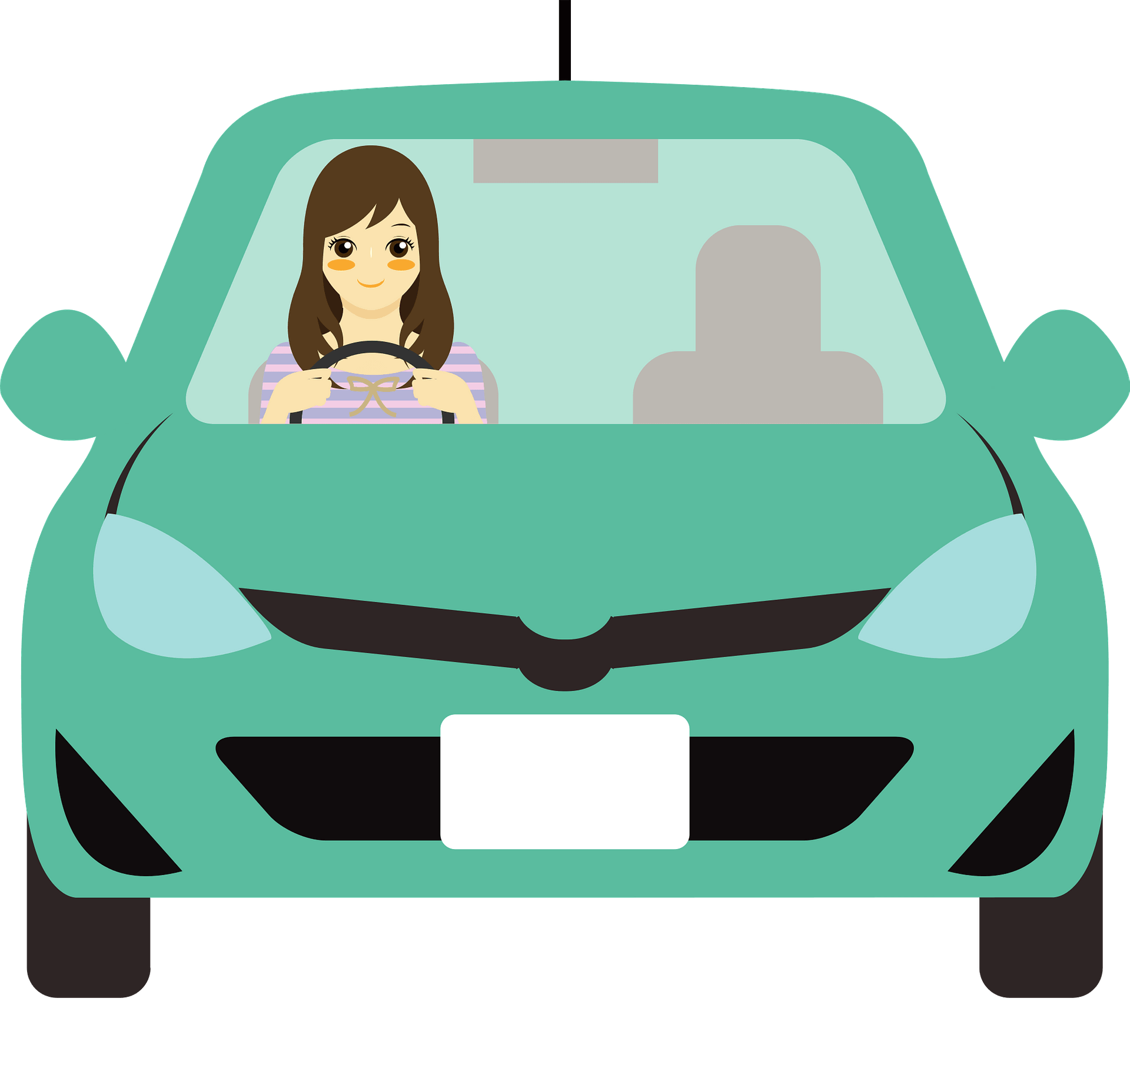
What’s his/her job?
c
He/ she
is a…
a
b
d

Slide 5
Vocabulary

Slide 6
a cook

Slide 7
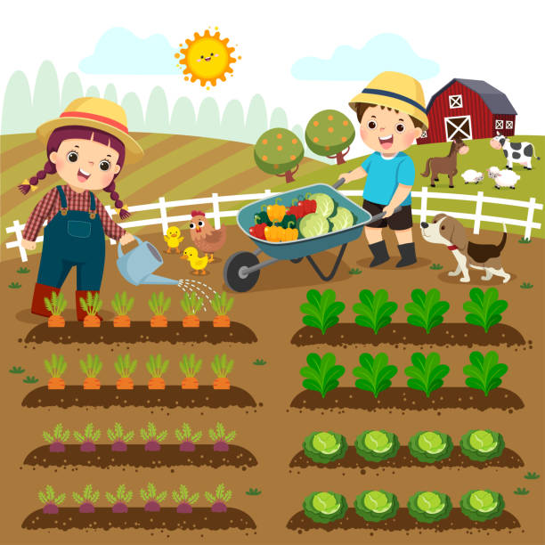
a farmer

Slide 8
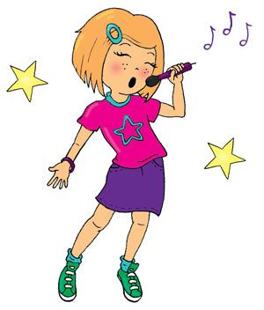
a singer

Slide 9
a nurse

Slide 10
Review Game

Slide 12
I’m a singer
Next

Slide 13
I’m a teacher!
Next

Slide 14
I’m a worker
Next

Slide 15
I’m a nurse!
Next

Slide 16
I’m a farmer!
Next

Slide 17
I’m a doctor!
Next

Slide 18
I’m a driver
Next
Next

Slide 19
I’m a cook!
Next

Slide 21
Sentence

Slide 23
Yes, he is
Is he a….. ?
No, he isn’t
He’s…
Is she a… ?
Yes, she is.
No, she isn’t. She’s...

Slide 24
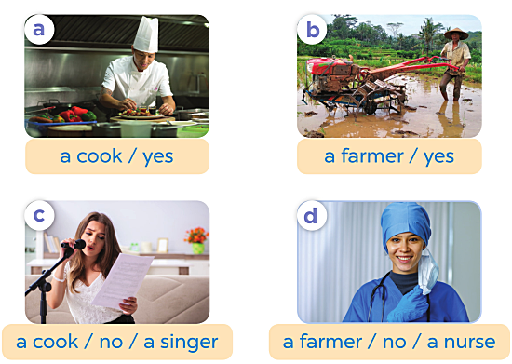
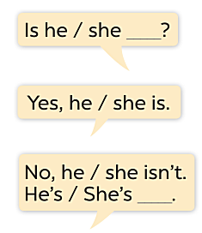

Slide 25
Review Game

Slide 26
1
1
2
2
3
3
4
4
5
5
6
6
7
7
8
8
9
9
10
10

Slide 27
Is she a doctor?
No, she isn’t
A
Yes, he is
B
Yes, she is
C

Slide 28
Is he a worker?
Yes, he is
A
No, she isn’t
B
No, he isn’t
D

Slide 30
What is her job?
She is a nurse
A
She is a driver
B
She is nurse
C

Slide 31
Is she a singer?
Yes, he is
A
No, she isn’t
B
Yes, she is
C

Slide 32
What’s his job?
He a worker
A
B
He is worker
He’s a worker
C

Slide 33
Is she a doctor?
No, she isn’t
A
Yes, she is
B
Yes, he is
C

Slide 34
Is he a farmer?
Yes, he is
A
Yes, she is
B
No, he isn’t.
C

Slide 35
What’s his job?
He’s cook
A
He’s a cook
B
He a cook
C

Slide 37
Speaking

Slide 39
See you soon

