Slide 1
UNIT 11 My Family
LESSON 3 .2

Slide 2
TABLE OF CONTENTS
01
02
Warm up
Reading
03
04
Writing
Project

Slide 3
WARM UP

Slide 4
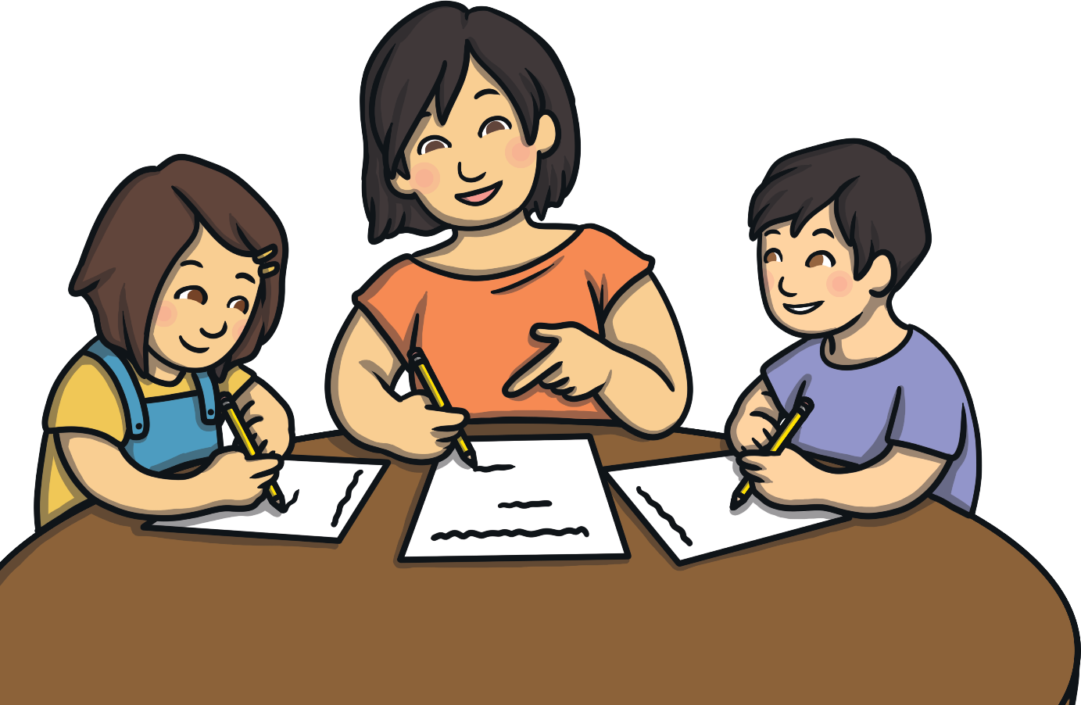
What do we call this person in English?
mother
?

Slide 5
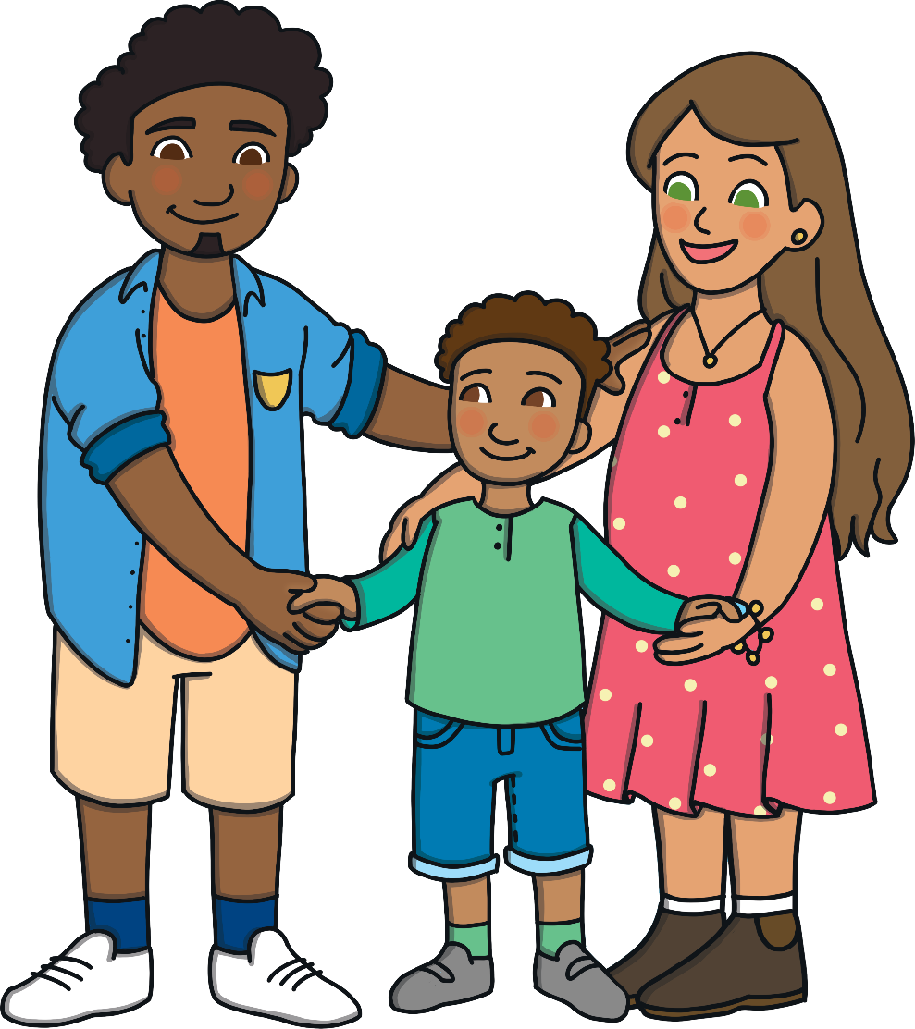
What do we call this person in English?
father
?

Slide 6
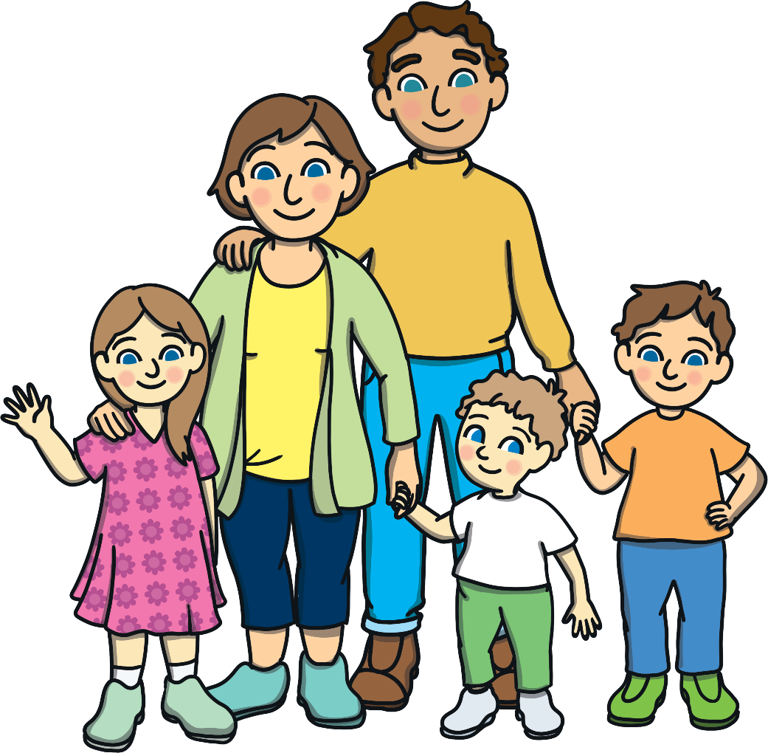
What do we call these people in English?
?
Brother

Slide 7
What do we call this person in English?
?
Sister

Slide 8
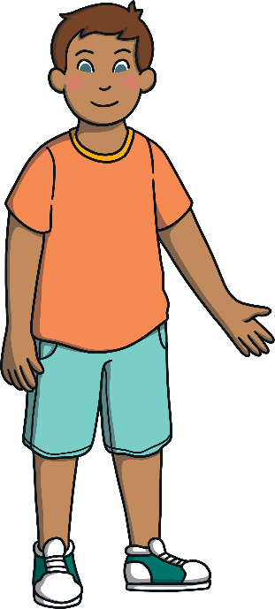
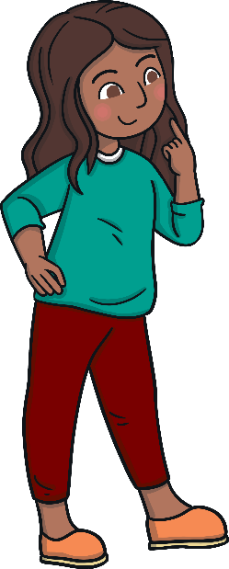
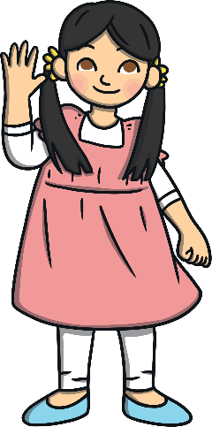
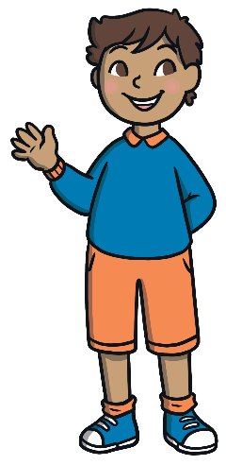
Let’s practice
Can you remember who these people are?
Click below the numbers to check the answer.

Slide 9
Quiz
How old is Nam?
He nineteen years old
He’s nineteen years old
He’s nineteen years old
She’s nineteen years old

Slide 10
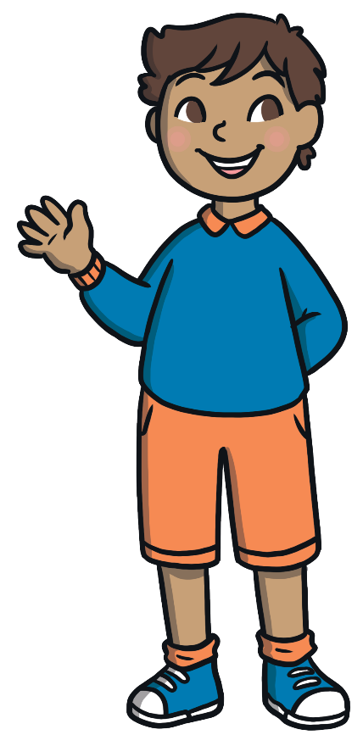
Quiz
Listen and choose
My father is twenty years old.
My brother is twenty years old.
My brother is twenty years old
My sister is twenty years old.

Slide 11
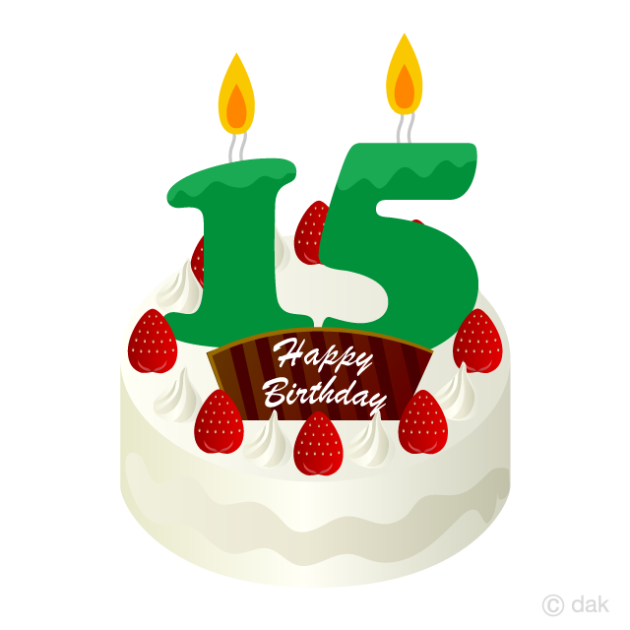
Quiz
Listen and choose: How old is your …………..?
father
brother
sister
sister

Slide 12
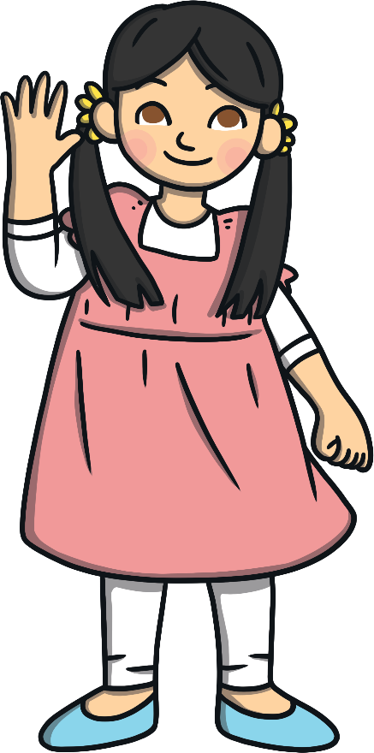
Quiz
old – she – how - is
How old is she?
How old is she?
How she old is?
How old she is?

Slide 13
Quiz
My sister is …………….years old.
thirteen
fifteen
fifteen
sixteen

Slide 14
Quiz
How old is my …………? He’s ………..years old.
Brother - seventeen
Brother - seventeen
Brother - eighteen
Brother - fourteen

Slide 15
NEW LESSON

Slide 16
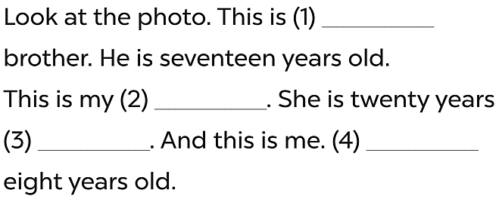
my
sister
old
I’m

Slide 18
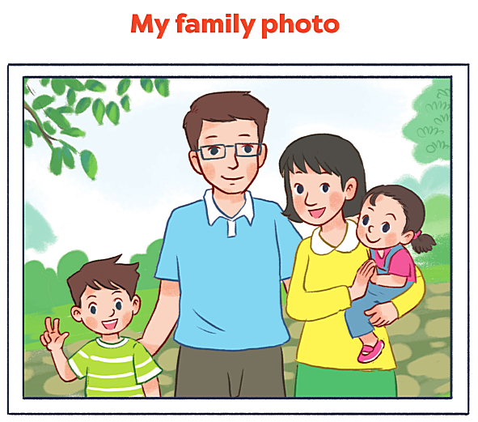

Slide 19
THANK YOU!

