Slide 1
UNIT 11 My Family
LESSON 2 .2

Slide 2
TABLE OF CONTENTS
01
02
Warm up
Listening
03
04
Reading
Let’s play

Slide 3
Warm - up

Slide 4
10
Questions
Subject: Ages

Slide 5
1
2
3
4
5
6
7
8
9
10

Slide 6
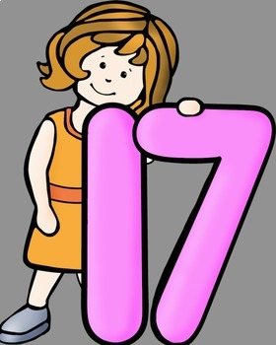
1
How old is your sister?
Reveal Answer
She’s seventeen years old
Back to menu
Next Slide

Slide 7
2
How old is Phong?
Reveal Answer
He’s nineteen years old
Back to menu
Next Slide

Slide 8
3
How old is An?
Reveal Answer
He’s five years old.
Back to menu
Next Slide

Slide 9
4
How old is your sister?
Reveal Answer
She’s three years old.
Back to menu
Next Slide

Slide 10
5
How old is Mai?
Reveal Answer
She’s sixteen years old.
Back to menu
Next Slide

Slide 11
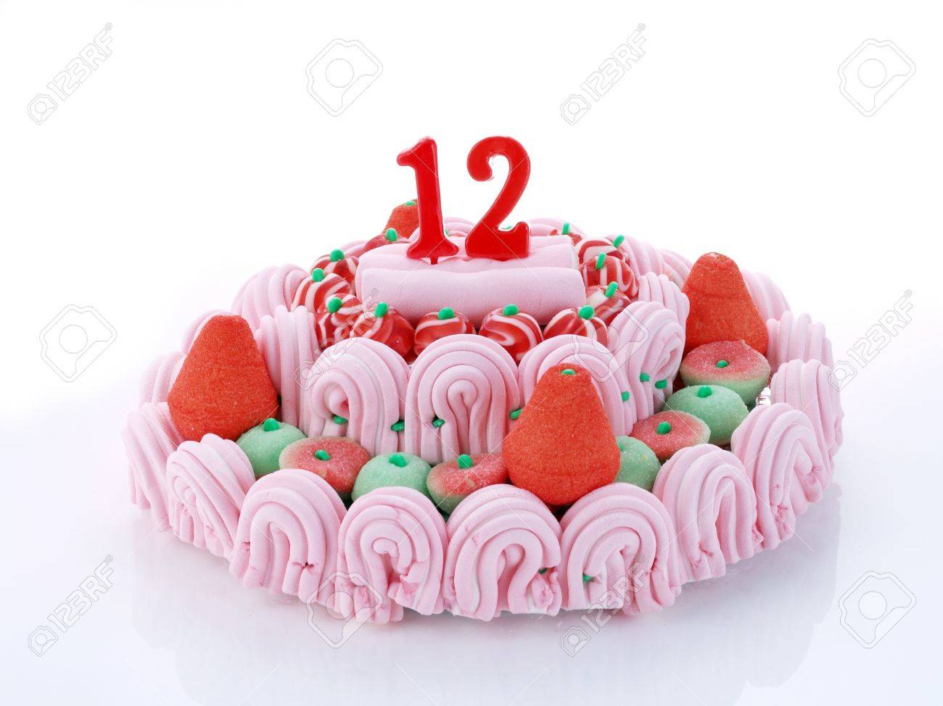
6
How old is Quan?
Reveal Answer
He’s twelve years old.
Back to menu
Next Slide

Slide 12
7
How old is Nam?
Reveal Answer
He’s thirteen years old
Back to menu
Next Slide

Slide 13
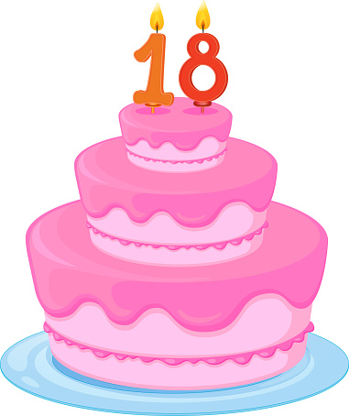
8
How old is Linda?
Reveal Answer
She’s eighteen years old.
Back to menu
Next Slide

Slide 14
9
How old is Mary?
Reveal Answer
She’s fifteen years old.
Back to menu
Next Slide

Slide 15
10
How old is Na?
Reveal Answer
She’s twenty years old.
Back to menu
Next Slide

Slide 16
Listening

Slide 17
3 A: How old is your sister?
B: She’s eighteen
2 A: How old is your brother?
B: He’s twenty
1
3
4
2
1A: How old is she?
B: She’s thirteen
4 A: How old is he?
B: he’s fourteen

Slide 18
Reading

Slide 19
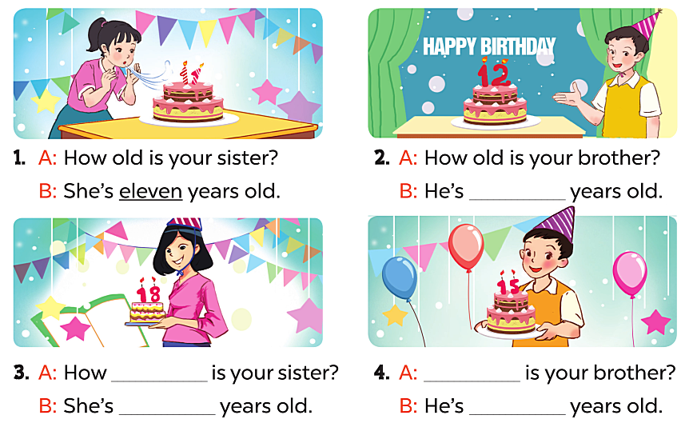
twelve
old
How old
fifteen
eighteen

Slide 20
Let’s play

Slide 21
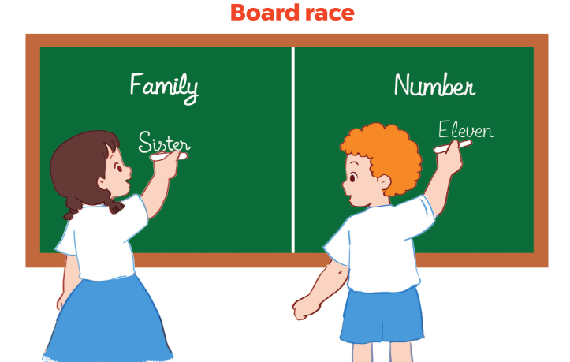

Slide 22
THANK YOU!

