Slide 1
UNIT 11 My Family
Lesson 1 – Part 4,5,6

Slide 2
TABLE OF CONTENTS
01
02
Warm up
Listening
03
04
Reading
Singing

Slide 3
Warm up !

Slide 4
Picking
Apples

Slide 5
father
A
mother
B
brother
Listen and choose
C

Slide 6
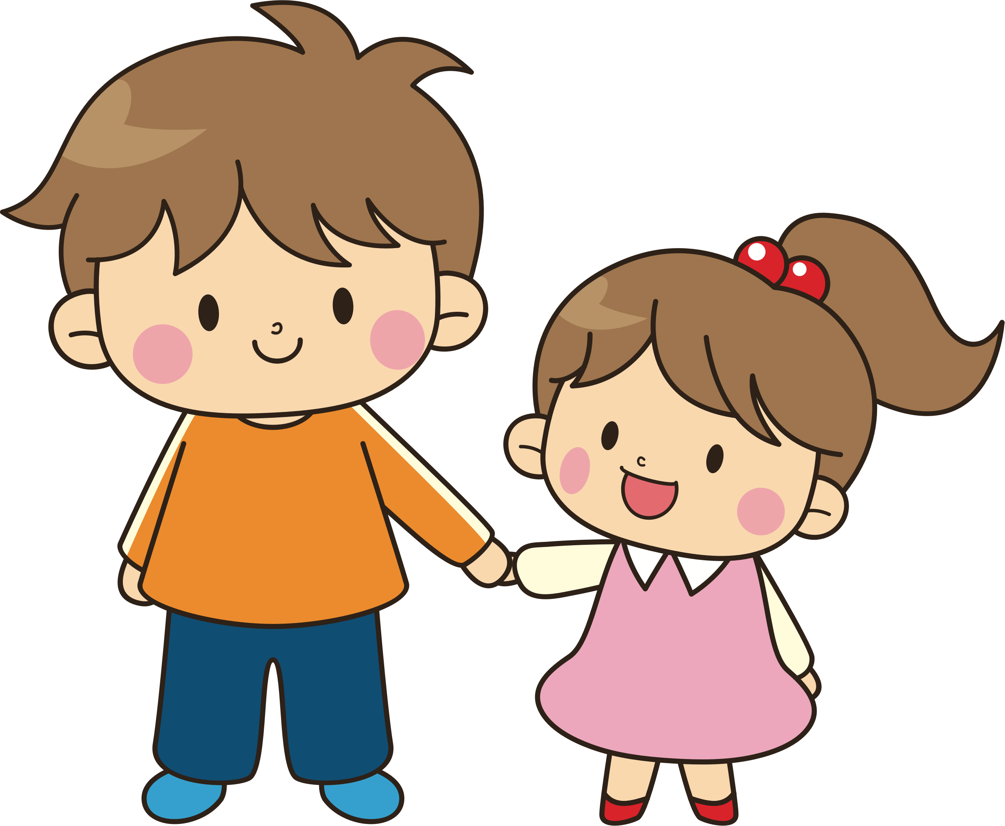
Who’s this?
A
Who’s that?
B
Who are you?
It’s my brother.
C

Slide 7
Where
A
Which
B
……… this?
Who’s
C

Slide 8
It’s my mother.
A
It’s my father
B
It’s my sister.
Listen and choose
C

Slide 9
those
A
that
B
Who’s ___?
this
C

Slide 10
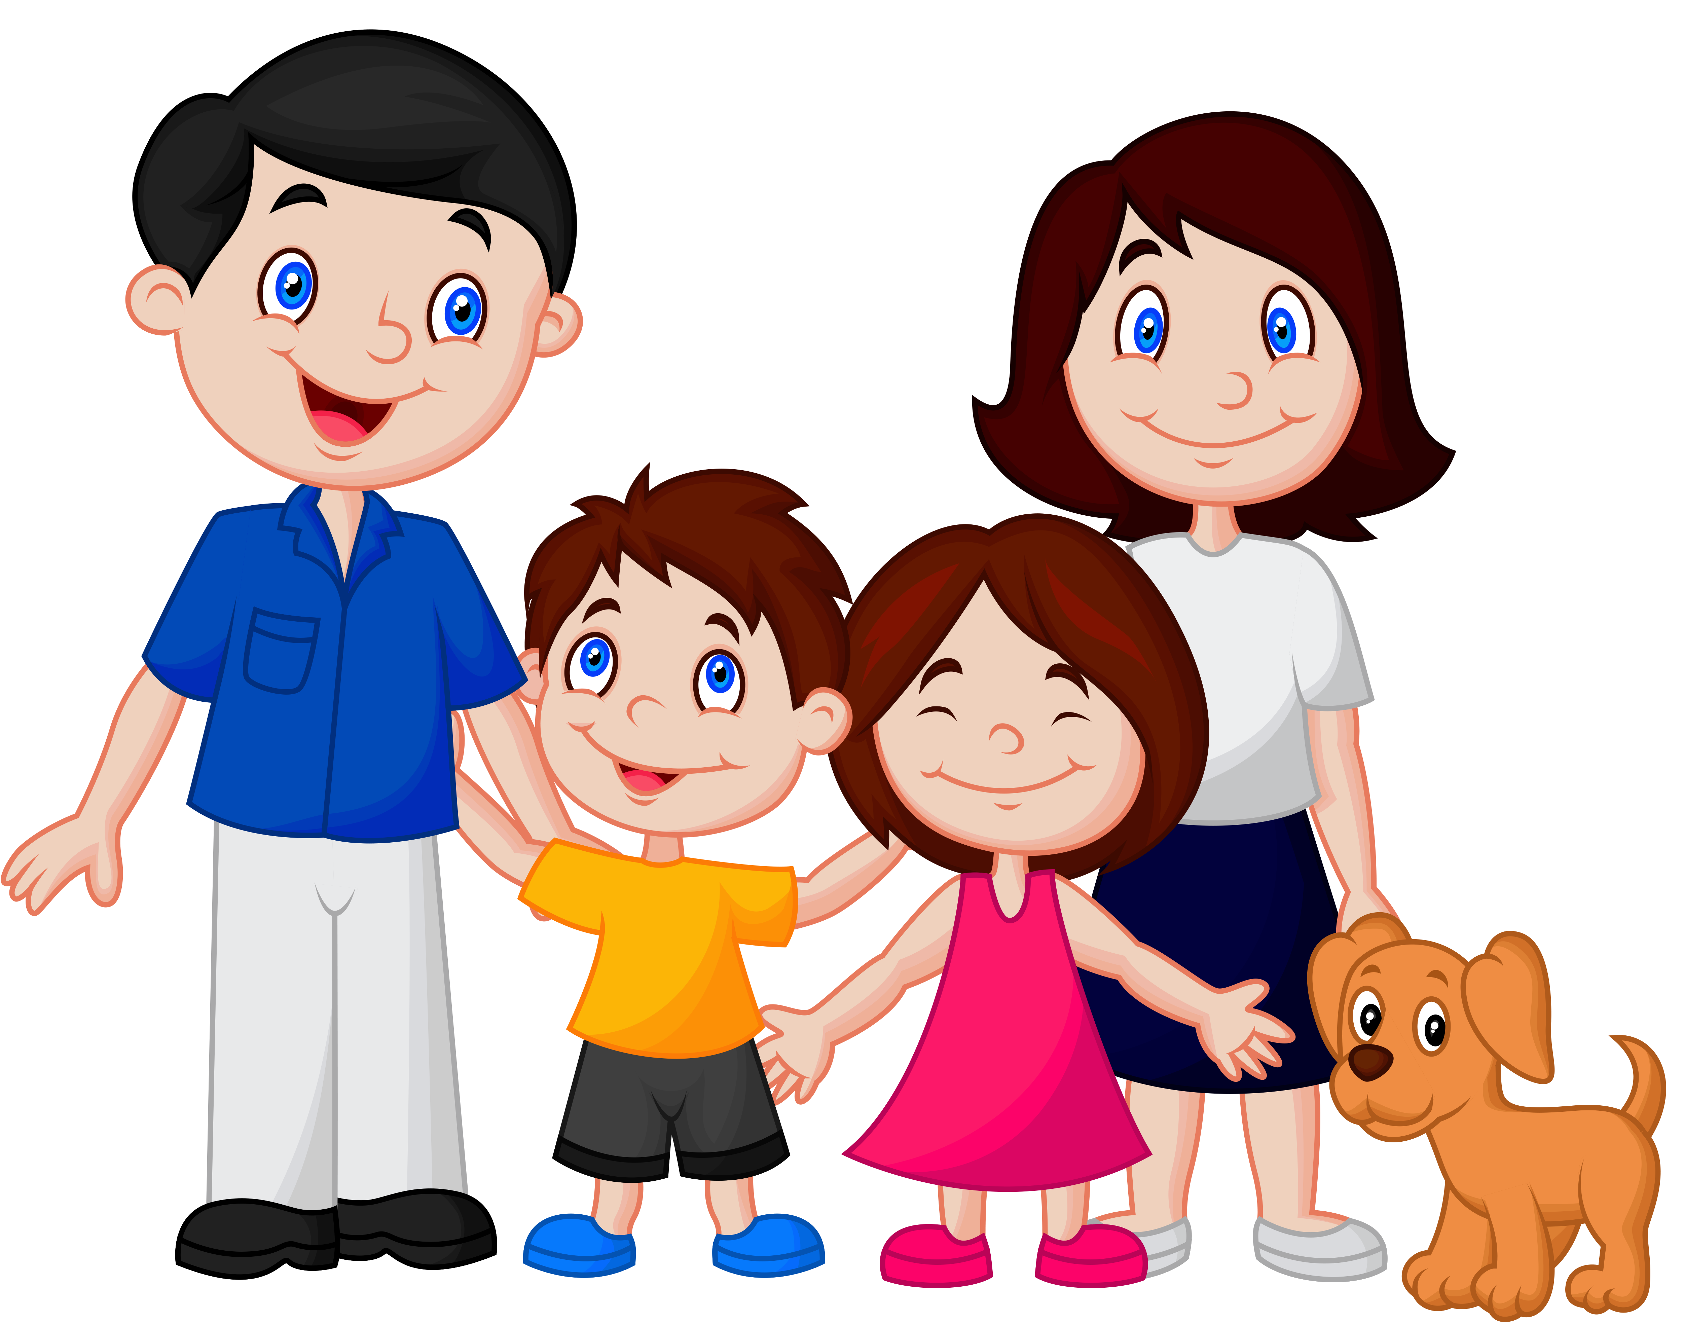
family
A
famyli
B
It’s my __________
famly
C

Slide 11
He’s
A
It’s
B
Who’s that?
sister
______ my sister.
C

Slide 12
It my is brother
A
Reorder the words
brother/ is/ my / it
It is brother my
B
It is my brother
C

Slide 13
is
A
Find a redundant word
Who’s
Who’s is that?
B
that
C

Slide 14
02
Listening

Slide 15
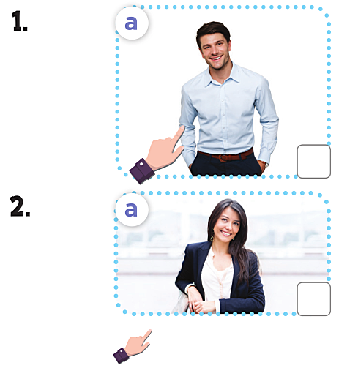
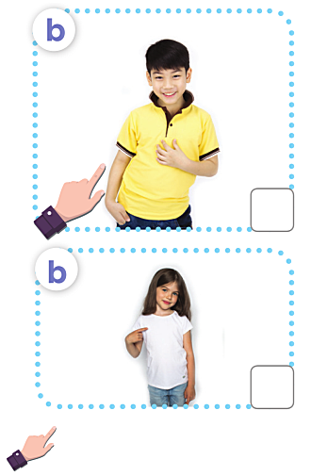
1, A: Who’s this?
B : It’s my father
2, A: Who’s that?
B : It’s my sister

Slide 16
Reading

Slide 17
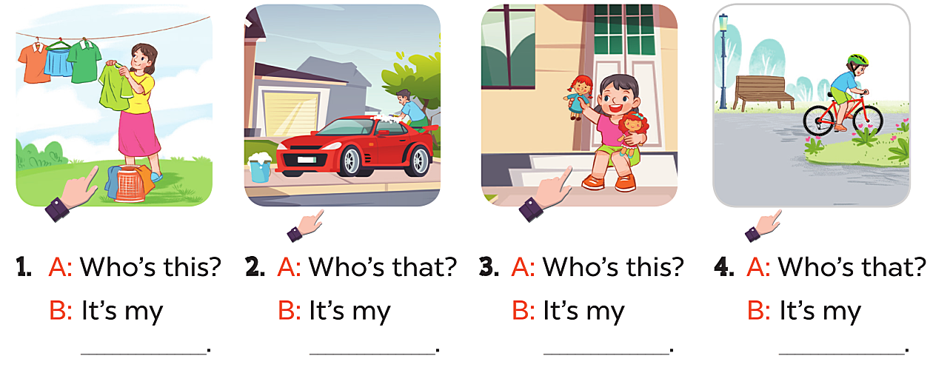
mother
father
sister
brother

Slide 18
Singing

Slide 19
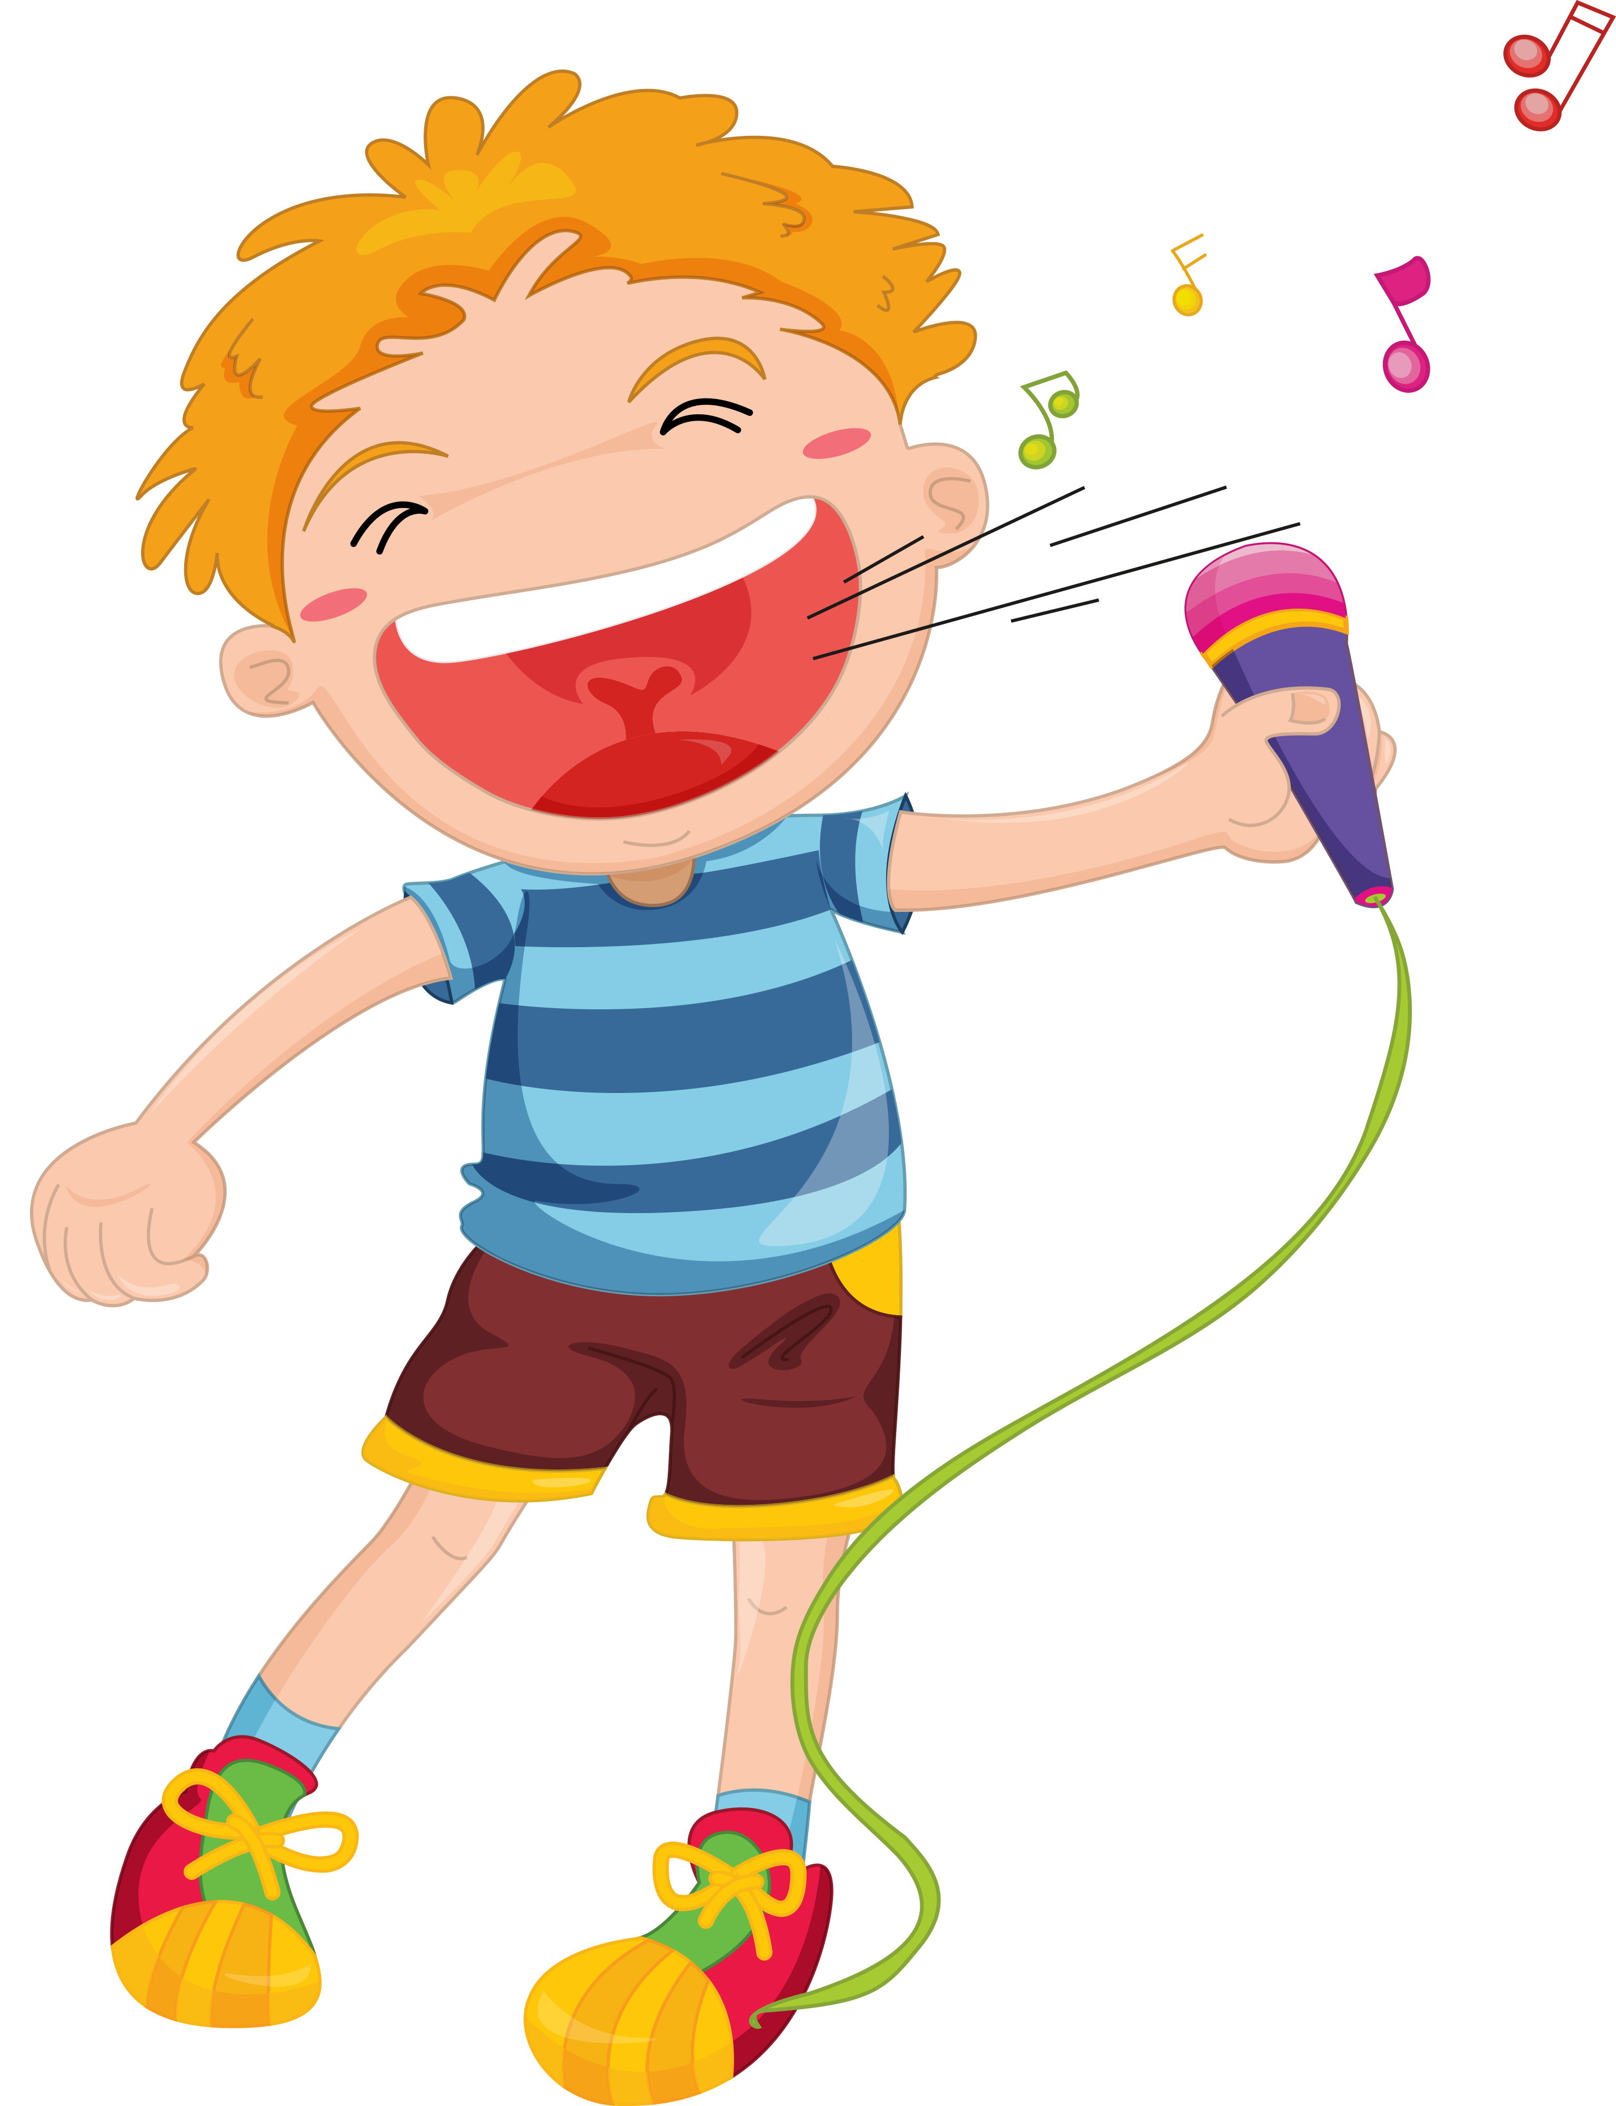

Slide 20
THANK YOU!

